Slide 1
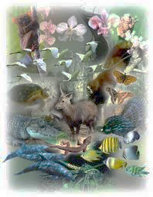
Unit A Biological Diversity

Slide 2


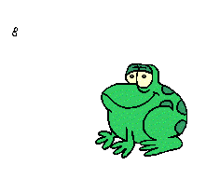
Focusing Questions for this Unit
What is biological diversity?
How are characteristics passed on to future generations?
What impact does human activity have on biological diversity?

Slide 3
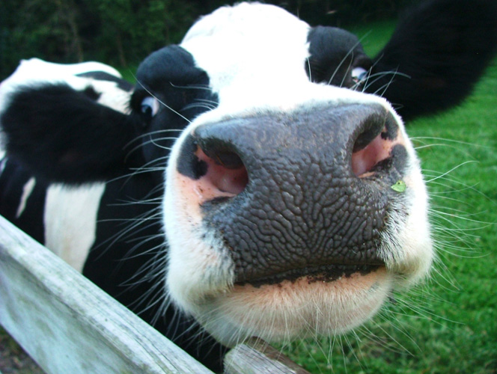
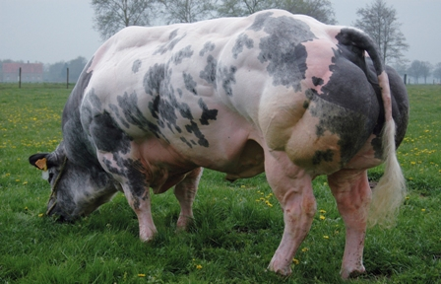
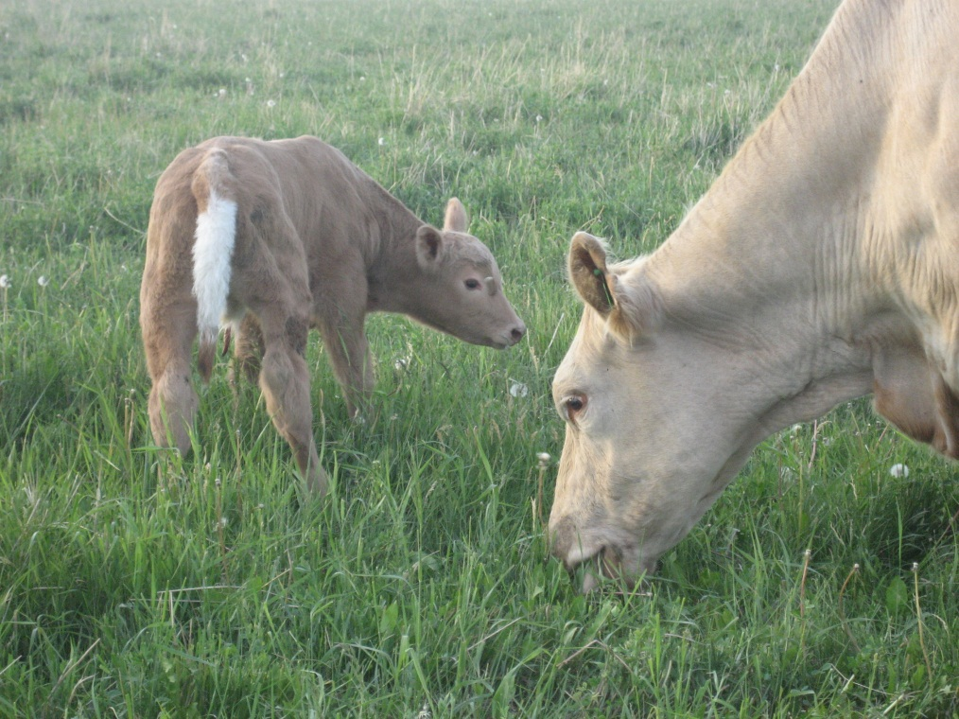
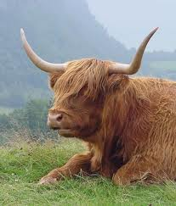
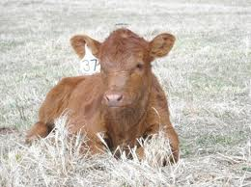
Variety is the Spice of Life

Slide 4
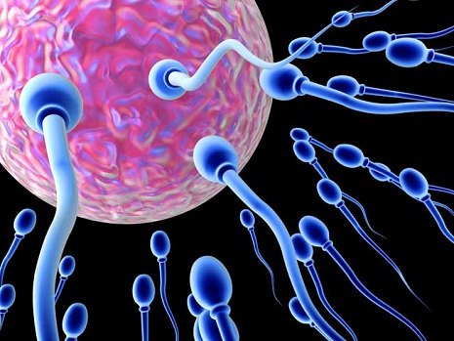
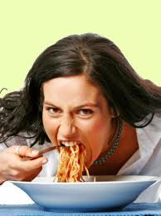
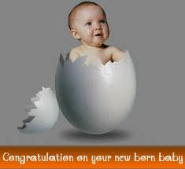
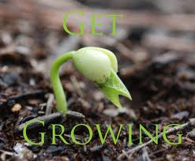

Characteristics of All Living Things
All living things:
Made up of cells
need energy
3) grow and develop
4) Reproduce
5) have adaptations which suit them to the
specific habitat in which they live.

Slide 5
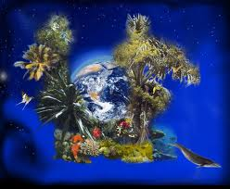
Biological Diversity
Biological Diversity is a measure of the relative diversity among organisms present in different ecosystems.
Diversity in this definition includes diversity within species and within ecosystems, and comparative diversity between ecosystems.

Slide 6
Terms
Ecosystem: biotic organisms interacting with other living organisms and abiotic things in a shared environment.
Biotic: Living
Abiotic: Non-living
Manipulated Variable: is the variable which you deliberately alter the value of (also called the independent variable)
Responding variable: is the variable which you have to measure to get your results (also called the dependent variable)
Controlled Variable: quantities that a scientist wants to remain constant
Interdependence: Organisms in a biological community live and interact with other organisms. They are dependent on one another and their environment.
Eukaryotic: Animals/ Plants
Prokaryotic: Bacteria

Slide 7
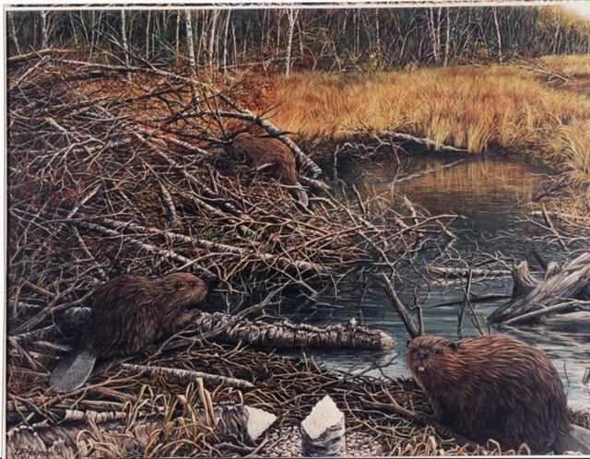
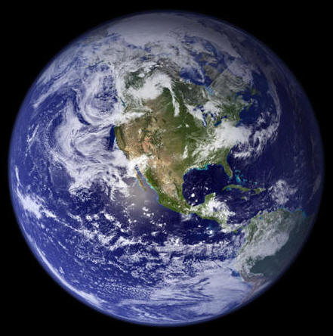
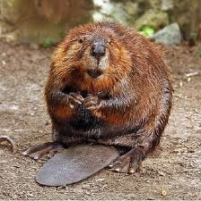
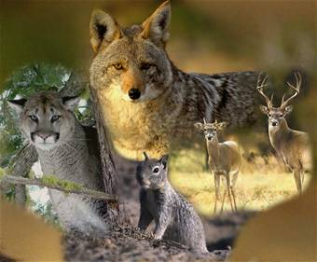
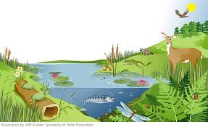
The Bigger Picture…
Populations
Biosphere
Species
Ecosystem
Communities

Slide 8
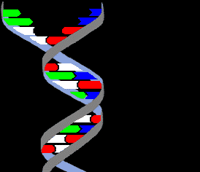
Three Levels of Biodiversity
Genetic Diversity: Genetic diversity is
the variety present at the level of genes.
  This level of diversity can differ by
  alleles by entire genes or by units larger
  than genes such as chromosomal structure.
  genetic diversity often increases with
  environmental variability. Different genes
  will have an advantage at different times or
  places.
  If there are many species, the genetic diversity at that level will be larger than when there are fewer species.
  Genetic diversity within each species can decrease if the large number of species leads to high levels of competition where each species must be extremely specialized

Slide 9
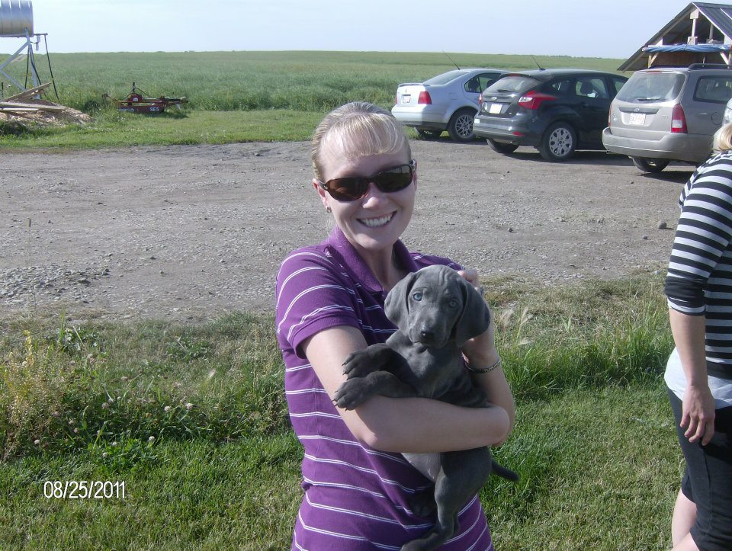
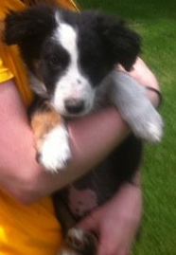
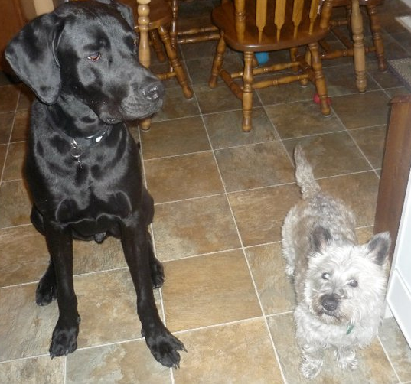
Three Levels of Biodiversity
2. Species Diversity: Species are well known and are distinct units of diversity.
Each species can be considered to have a particular "role" in the ecosystem, so the addition or loss of single species may have consequences for the system as a whole.

Slide 10
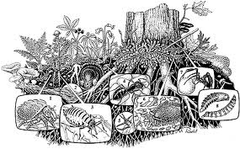
Three Levels of Biodiversity
3. Ecosystem Biodiversity: Deals with species distributions and community patterns, the role and function of key species, and combines species functions and interactions.
Abiotic
Biotic
  Populations and communities can vary within the ecosystem (eg. Clumped populations)

Slide 11
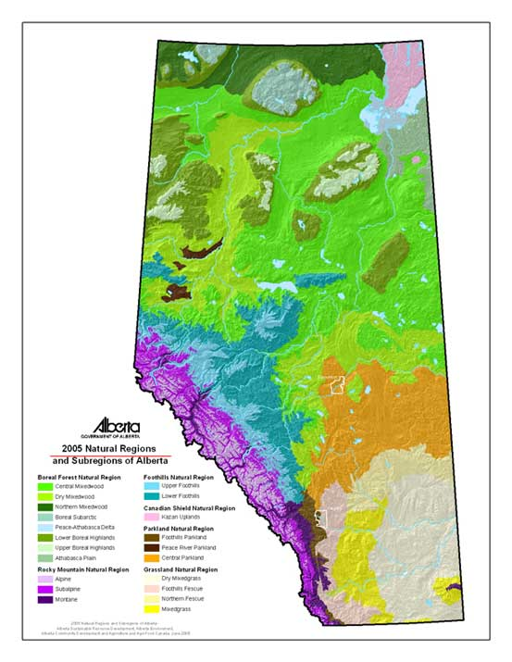
Natural Regions
Boreal Forest
Rocky Mtn
Foothills
Cdn Shield
Parkland
Grassland
http://fetcher.fw-notify.net/00000000011657162336/nsr2005_final_letter.pdf

Slide 12
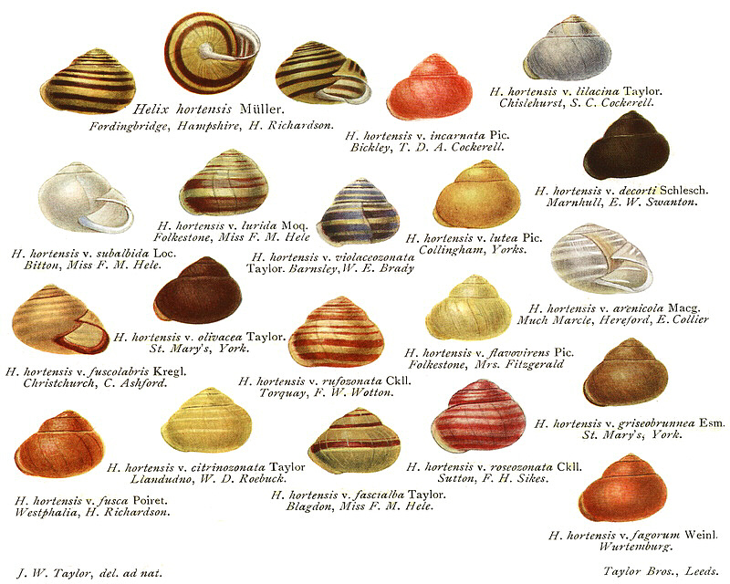
Species
is a group of organisms
that can interbreed in
nature to produce a fertile
offspring.
species is the basic
unit of biodiversity.
a species is assigned a
two-part name in Latin
(italicized or underlined).
ex. humans belong to the genus Homo, and are in the species Homo sapiens.
Remember this as we will be revisiting it in the near future
Notes:
jackelope, zedonk, mule

Slide 13
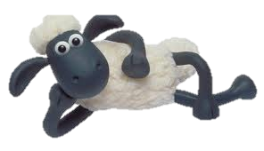
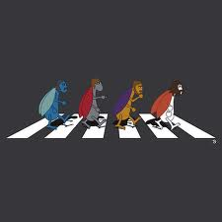
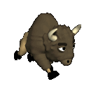
Currently Identified Species
There are currently between 1.5 to 1.8 million named species in the world, about half of which are insects.
The largest group of insects is the beetles (the order Coleoptera), with 300 000 species.
In contrast, there are only 4 500 species of
mammals.
An estimated 140 000 species live in Canada, only
half of which have been identified.

Slide 14
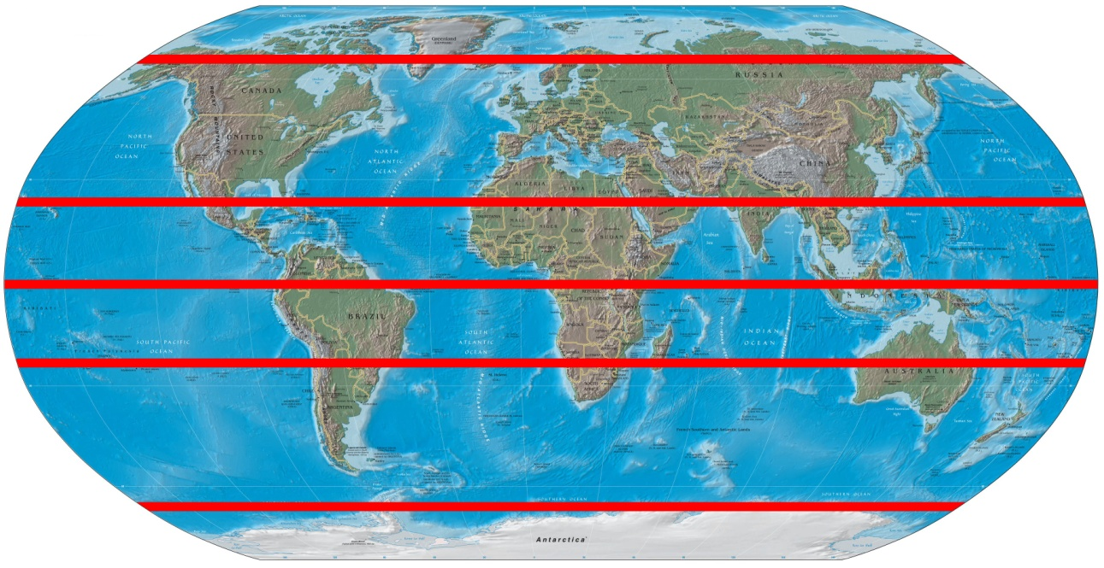
Species Distribution
High Levels of Diversity
Species are not evenly distributed globally.
In general there are more species variety as latitude decreases.
Areas around the tropics have the greatest number of plant and animal species.

Slide 15
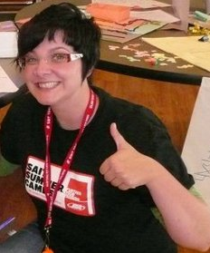
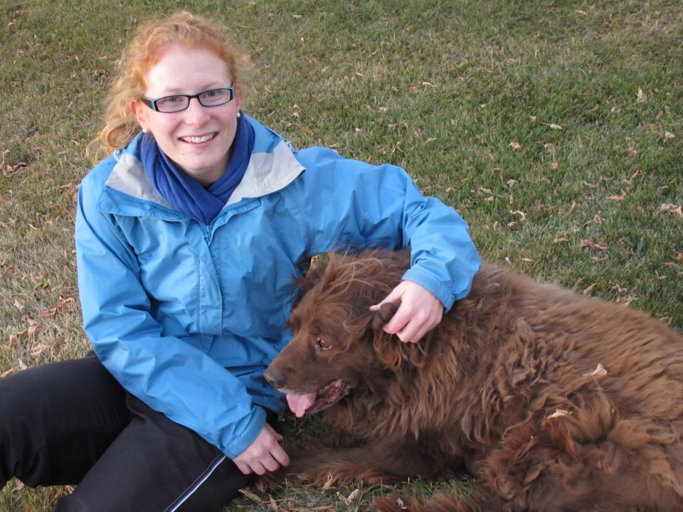
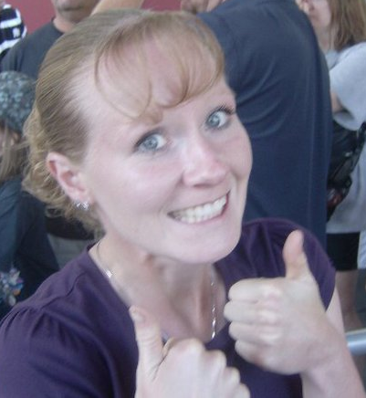
Why So Many?
One question that comes up when dealing with biodiversity is why there are so many species in the first place. Why doesn't a single species outcompete and eliminate the rest?
Which one will outcompete the others?
These two just look like winners
Though awesome this redhead will slowly be pushed to extinction

Slide 16
Variations for Survival
Every organism needs to adapt in order to survive in its environment.
There are two types of adaptations.
Structural Adaptations: Physical
  A change in the structure or function of a species that makes the species better able to reproduce and survive
    Example: Giraffes with long necks
2. Behavioral Adaptations: Actions/behavior
  Changing behaviors include mating, migration, sleep patterns
Note that adaptations do not “just happen” they occur over long periods of time and are a reaction to the organisms environment.

Slide 17
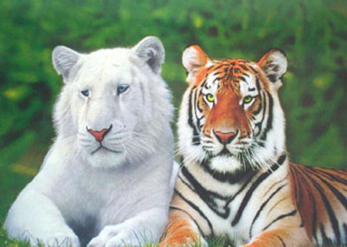
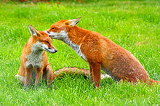
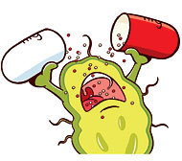
Keeping Your Options Open
Variation within a population, of a single species,
is called variability.
Variability is important if the environment, in which the species lives, changes (suddenly or drastically).
When a species has a great deal of variation,
then, some of the individuals within that species
will likely survive when there is change.
Examples of variability include:
Red fox (color of coat)
Antibiotic resistance (bacteria)
Banded snail (color of shell)
Hair Color in Humans

Slide 18
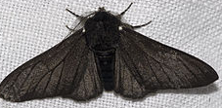
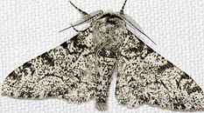
The Mystery of the Peppered Moth

Slide 19
Pre-Industrial Revolution
I own you
I am not worthy

Slide 20
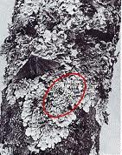


Slide 21
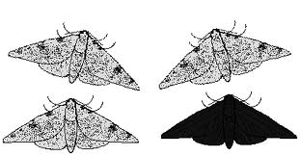
Though outnumbered and at constant risk the black peppered moth persevered

Slide 22
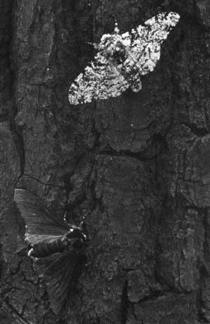
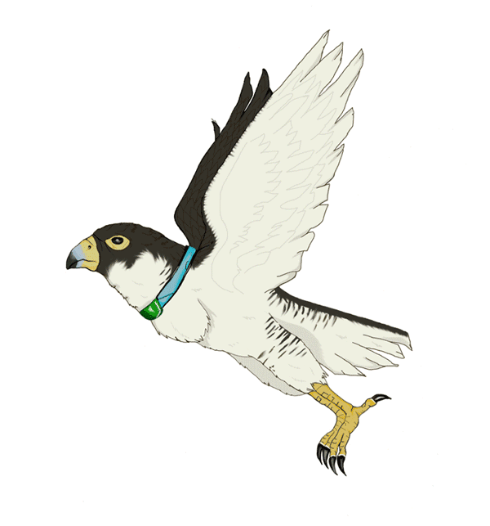
Post Industrial Revolution

Slide 23
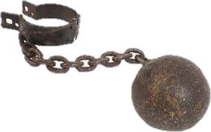

Slide 24
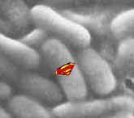
Super Bugs
Why take all of your medicine when you feel better already? (p 21)
Skill Practice p 21 Variability Activity

Slide 25
Your Task
Create a personal ad for an animal with strange adaptations or features looking for love
Complete Questions

Slide 26
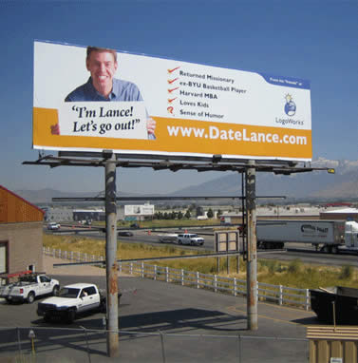

Slide 27
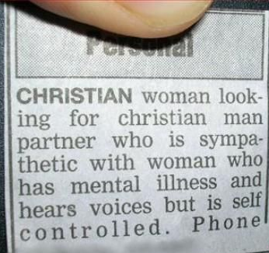

Slide 28
"Young farmer with 100 acres would be pleased to hear from young lady with tractor. Please send photograph of tractor." - Advertisement in Evesham Admag, 1977.

Slide 29
Quiz April 24, 2012
List three of the five characteristics of all living things
Manipulated variable is also known as➔
Responding variable is also known as➔
In the following example identify the manipulated variable, responding variable and controlled variable.
  You are performing a lab to measure the amount of dissolved oxygen in various temperatures of water, to see the impact of hydroelectric dams on local aquatic life.
  5) Define species
  6)Give an example of a structural and behavioral adaptation
  7) Why is variation important. Use an example to help explain your points.

Slide 30
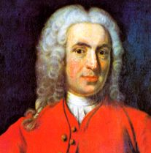
Taxonomy
Because your life wasn’t confusing enough…
Carl Linnaeus (1707-1778)
  “Father of Taxonomy”
  developed a system for naming and
  classifying organisms (binomial system).
  This allowed for worldwide consistency to
  the naming of species
  Two names: Genus and species
    No two species can have the same name
    Closely related species can have same genus name
      Example:
        Red Wolf: Canis rufus
        Timber Wolf: Canis lupus
        Dog: Canis familiaris
  Latin used to provide consistency(common language of the time)
http://www.goorulearning.org/gooru/index.g#/resource/search/Animal Classifications subject:20001 course:20003 unit:20043 topic:20058

Slide 31
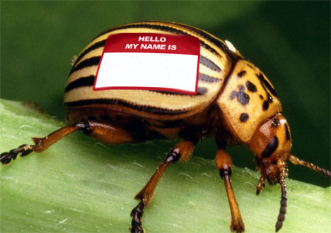
Linnaeus arranged species into groups based on their physical structure rather than on their habitat.
Today we can go beyond basic physical appearances and use genotyping to classify animals (look at genetic similarities)
http://www.treehugger.com/natural-sciences/for-sale-naming-rights-to-newly-discovered-species.html

Slide 32
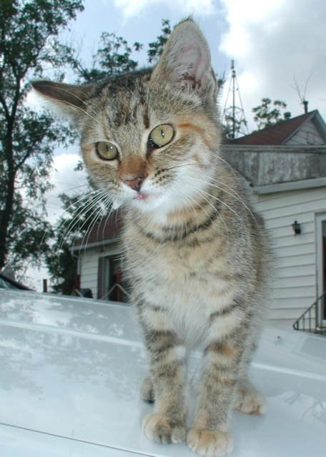
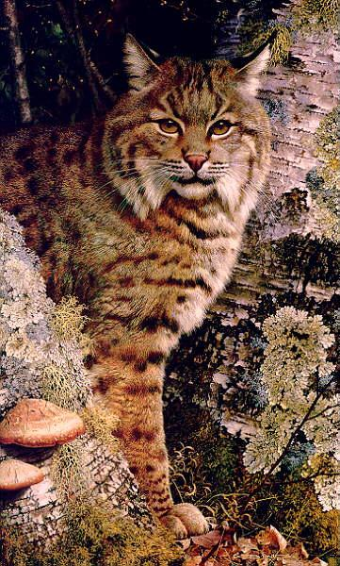
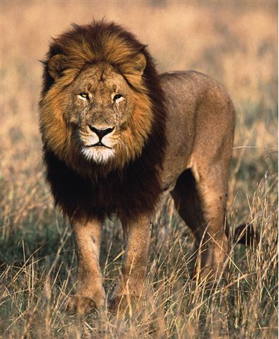
Classification
Kingdom
Phylum - subphylum
Class
Order
Family
Genus
Species
http://faculty.weber.edu/bdattilo//fossils/notes/classification.html
What you will be most concerned with

Slide 33
Classification Answer
Cat Bobcat Lion
K - Animalia Animalia Animalia
P - Chordata Chordata Chordata
C - Mammalia Mammalia Mammalia
O - Carnivora Carnivora Carnivora
F - Felidae Felidae Felidae
G - Felis Lynx Panthera
S - domesticus rufus leo

Slide 34
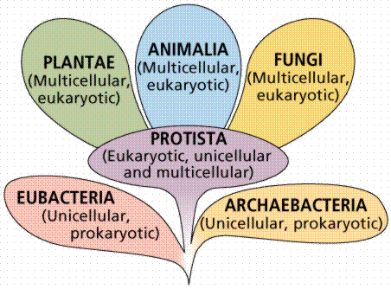
Five (or six) Kingdoms Scientists earlier had developed a system which classifies all organisms, based on their structural differences, into 5 Kingdoms
Plantae
Animalia
Fungi
Protista
Monera
  Archaebacteria
  Eubacteria

Slide 35



Plantae - Plants

Slide 36






Animalia - Animals

Slide 37


Fungi - “fun guys” _{lol ☺}
eg. mushrooms
athlete’s foot

Slide 38



Protista – eukaryotes
eg. paramecium
Link

Slide 39



Monera – prokaryotes
divided into: Archaebacteria & Eubacteria
See infoBit p 12
Bacteria song

Slide 40


Check and Reflect
Read p 4 – 5, & 8 - 15
pg 15 #1-3 & 5-7
Exploring Wolf Population
Trends p 6
  Create bar graph
  Answer bulleted ?s

Slide 41



What do all of these images have to do with Biological Diversity?
Everything!!!!

Slide 42


Slide 43

Natural Selection
Natural selection happens
when factors in the environment
determines, or 'selects' which
individuals, within a species,
will be able to survive.
If they are able to live long
enough to reproduce, then those
individuals with their 'survival
adaptations (characteristics)
will have offspring with similar
survival characteristics
And of course there are those who we have no idea how they have survived this long…
http://www.facebook.com/media/set/?set=a.406350561171.183244.514901171&type=3#!/photo.php?v=1248320281427&set=t.130600720&type=2&theater

Slide 44

The Theory of Natural Selection
The diversity of life in the Galapagos Islands helped Darwin explain his theory of natural selection. It can be summed up in four statements:
All organisms produce more offspring than can possibly survive.
2. There is incredible variation within each species.
3. Some of the variations increase the chances of an organism surviving to reproduce.
4. Over time, variations passed on through offspring lead to changes in the genetic characteristics of a species.

Slide 45

Natural Selection
differential survival of organisms results in changes in the frequency of traits
Far Side – Gary Larson

Slide 46

Natural Selection
generally these populations will return to variability if the limiting factors are removed
Far Side – Gary Larson

Slide 47

Measuring Biological Diversity
To determine the biological diversity of an area, biologists use a measurement called a diversity index.
This compares the diversity of species in a certain area with the total number of organisms in that same area, or ecosystem. It is primarily used to check on the health of an ecosystem – a healthy ecosystem has a high diversity index.

Slide 48


Attack of the Pine Beetle

Slide 49
Explain how this Graph relates to Biodiversity and the Pine Beetle

Slide 50


Population
a group of the same species in the same place at the same time

Slide 51



a number of different
populations in the same place
at the same time

Slide 52

Interdependence
No living thing can exist without interaction with other living things
➔ You don’t live in a bubble
Shark & Remora

Slide 53



Predator-Prey Interdependence

Slide 54

Feeding Relationships
Food Chain & Food webs
Food Chain ➔ single pathway
Food Web➔ Illustrates the interactions between multiple food chains
Eating is complex
  → “is eaten by”
  herbivores, carnivores, omnivores, decomposers
  predator/prey interdependence➔ How can this be???
Create a food chain for a grassland ecosystem
This seems like a really stable relationship

Slide 55

Symbiotic Relations
Symbiosis (together/life) – organisms
that live in close association with each other are
symbiotic

Slide 56


Symbiotic Relations
Commensalism – a symbiotic relationship where one organism benefits and the other is unaffected.
  Example: Clown fish/anemone

Slide 57


Symbiotic
Relations
Mutualism – a symbiotic relationship in which both organisms benefit.
  Example: Shark and
  Remora

Slide 58


Symbiotic Relations
What might be some problems with this type of relationship??
Parasitism – a symbiotic relationship in which one organism benefits and the other is harmed.
  Example: Lamprey,
  Tapeworms
http://animal.discovery.com/videos/monsters-inside-me-meter-long-tapeworm.html
http://www.ebaumsworld.com/video/watch/24078/

Slide 59
Natural Selection
http://www.youtube.com/watch?v=mTTwcCVajAc&feature=youtu.be

Slide 60
Quiz
Provide the order of classification from organisms from most broad to most narrow
2) Define the following and give an example for each
  A) Variability
  B) Biodiversity
  C)Species
  D) Population
3) Name and provide a brief description of the three symbiotic relationships
4) Give an example of interdependence

Slide 61

Interspecies Competition
Happens when two or more species need the same resource
Limits the size of the populations of the competing species

Slide 62

Intraspecific Competition
Members of the same species
compete for the same resources
Example: Infanticide

Slide 63

Niche
The role of an organism in the ecosystem – what it eats and the resources it requires to survive
An organism's niche includes:
  What it eats
  Its habitat
  Nesting site, range and
  habits
  What effect it has on the
  other populations
  What effect it has on the
  environment
A niche, for a particular organism, can change, depending on the environment in which it is located and the organisms with which it inter-relates.

Slide 64

Broad Niche
Organisms living in diverse ecosystem have a broad niche with adaptations that enable them to survive the extreme changes occurring there.
These species are considered to be generalists – able to spread over large areas.

Slide 65

Narrow Niche
Specialists survive in their environment, because they have relatively narrow niches with adaptations directed toward competing for one dependable food source, type of soil or level of light.
This specialization allows many different species to coexist in the same area, preventing one species from becoming dominant. The result of this is high diversity with low populations.
A specialist is well adapted to
survive in one particular
environment. This is considered to
be the ‘trap of specialization’,
because, it is not able to adapt
to extreme change and may not
survive when this occurs.

Slide 66

To Be or Not To Be? That is the Question
To be a specialist or a generalist, that is the question

Slide 67

Competitive Exclusion Principle
No two species can occupy the same niche
(1859, European rabbit → Australia for sport)

Slide 68

Resource Partitioning
allows organisms which require
similar resources to survive in the
same ecosystem.

Slide 69

Video & Reference
“The Trials of Life – Living Together”
Read p 16 – 19
Check & Reflect p 19 # 1-4

Slide 70
Reference
Read p 20 - 24
Check & Reflect p 24 # 1,2 & 5
Section Review p 25 # 1 – 8
Quiz 1 Section 1.0
http://www.youtube.com/watch?v=nUqq3DhEeZQ

Slide 71


Reproduction
2.0 As species reproduce, characteristics are passed from parents to offspring.➔ Variability is key

Slide 72

Reproduction
For life to continue all
species within the animal
and other kingdoms must
reproduce.
Reproduction involves molecules of DNA (deoxyribonucleic acid) and RNA (ribonucleic acid) being transferred to their offspring

Slide 73



Characteristics
Heritable – passed from generation
to generation (Hereditary ➔ Genetic)
Non-heritable – acquired during
lifetime (Painting nails, dying your hair)

Slide 74


Let’s Compare
Phenotype: Specific visible trait
Genotype: the genetic makeup of an organisms

Slide 75



Variation
Discrete – either/or
  Single trait or phenotype
  Can be one or the other not in between
  Most of our knowledge of genetics is focused on
  “discrete” characteristics because they are easier to
  understand and test
  Example: Tongue roller or a non-tongue roller
Continuous – a range of expressions
  Example: Height of individuals, hair color,
  skin color

Slide 76
Give it a Try
Go to page 27 and do Give it a Try
  In groups of 4 to 5 create a data table that will record your results
  Use the 3 criteria from the textbook and use the addition of tongue rolling
  Create a bar graph that best illustrates your results
  One table and graph per group should be handed in, so be sure that
    All names are on the paper
    The graph is appropriately designed to be easily interpreted

Slide 77



Reference
Read p 26 – 29
Check & Reflect p 29 # 1 - 5

Slide 78



2.2 Asexual and Sexual Reproduction

Slide 79


Asexual Reproduction
involves only one parent
Results from cell division known
as mitosis
offspring are identical to parent

Slide 80

Types of Asexual Reproduction
1. Binary Fission
  The splitting of a parent cell into two equal parts
  Monera & Protista➔ One celled organisms
  Steps:
    Contents of the cell are duplicated (Nucleus and Organelles)
    The cell then divides in two with each new cell getting half of the parent cell
    We call these new cells “Daughter” cells
    Each Daughter cell is identical to the parent

Slide 81

Types of Asexual Reproduction
2) Budding
Some animals, like sea sponges or hydras, reproduce asexually by budding
A cell, usually near the base, produces a new group of cells called a bud
The bud will continue to grow until it develops completely, then it will detach
Yeast (a single-celled organism) also reproduces by budding

Slide 82


Forms of Asexual Reproduction
3) Spore Production
similar to seeds but produced by only one parent➔ all genetic information from one individual (clone)
Many spores are produced to ensure that offspring survive
  Example: fungi, algae, molds, ferns

Slide 83

Types of Asexual Reproduction
4. Vegetative Reproduction
Plants continue to grow throughout their life
Root and Stem tips contain areas of rapidly reproducing cells, called meristems
These meristematic cells than specialize into cells that make up leaves, stems and roots
This allows plants to repair damage and also allows for growing plants from cuttings
  Meristematic cells are similar to stem cells in humans
Growing a plant from a cutting results in a clone of the parent
  runners, tubers, suckers and roots grown from part of the plant
  Example: spirogyra, strawberry plants

Slide 84

Types of Asexual Reproduction
5. Parthenogenesis (“virgin birth”)
  unfertilized eggs develop into mature individuals
  Example: drones

Slide 85

Types of Asexual Reproduction
Cloning: parent cell is cultured into a new cell
More to come

Slide 86


Sexual Reproduction

Slide 87

Sexual Reproduction
usually involves two individuals
results in genetic variability➔ genetic
material from each parent
This means that the offspring are not identical to their parents but rather a combination of characteristics from both parents
This produces a new combination of traits in each new offspring, which does not occur in sexual reproduction

Slide 88

Sexual Reproduction
offspring result from the union of two gametes (fertilization)
♂ - sperm & ♀ - ovum
  Gametes are delicate
    Life spans are short, so timing is critical
    A liquid environment is required for sperm to swim through
zygote ➔ cleavage ➔ embryo
Cell division
First cell of a new individual
Multicellular life

Slide 89

Zygote➔ Stage 1
The Zygote requires specific conditions in order to develop
1. Nutrients
  2. Moisture
  3. Warmth and protection

Slide 90

Cleavage Furrows

Slide 91



Embryo

Slide 92



Sexual Reproduction
Animals
  all animals reproduce by sexual reproduction

Slide 93

Sexual Reproduction
Plants
  male and female gamete unite to form zygote
  ♂ - stamen produces pollen which contains the male gametes
  ♀ - pistil produces ovules the female gametes

Slide 94
Sexual Reproduction- Plants
Angiosperms and Gymnosperms reproduce by producing seeds
Remember:
  Angiosperms produce flowers
  Gymnosperms produce cones
    Example: Pine, spruce and fir

Slide 95



Pollination
Self pollination
pollen from the anther -> stigma
sperm cell moves down pistil -> ovary
embryo develops into a seed
Cross pollination occurs when the pollen of one plant is carried to the stigma of another plant
Cross fertilization occurs when a gamete from a pollen grain and a gamete from an ovule join to form a zygote ➔ embryo will show characteristics of both parents
cf. Fig. 2.11 p 33

Slide 96


Advantages
Sexual Reproduction
  Advantage – genetic variability
  (increased fitness)
    Helps species survive environmental changes
Asexual Reproduction
  Advantage –
    high number of offspring produced with low energy output
    No need to find a mate
    No need for specialized cells

Slide 97

Disadvantages
  Sexual
  Disadvantage
    high energy cost
    mate required
    Produces limited number of offspring
      Production of offspring focuses on variability over numbers
Asexual
  Disadvantage
    no variability
      If conditions become unfavorable, entire population may be wiped out

Slide 98



Hermaphrodites
Can produce either sperm or ova
may self- fertilize
eg. slugs, worms, snails, some fish

Slide 99
The Best of Both Worlds
Many organisms are capable of producing both sexually and asexually
  Examples:
    Rhizopus is a mold that produces asexual pores that can be black, blue, yellow, red, etc.
    Rhizopus also reproduces sexually by producing zygospores which contain genetic information from two different sources
    Many plants can reproduce sexually, but also sexually but also asexually (using bulbs are runners)
    Aphids also reproduce sexually and asexually

Slide 100

Bacterial Conjunction
http://www.hhmi.org/biointeractive/animations/conjugation/conj_frames.htm
Bacteria are able to transfer genetic information
from one cell to another
A primitive form of asexual reproduction
Benefit: a new combination of inherited
characteristics may result
  Note: No offspring are produced by this means,
  but later these cells will undergo binary fission

Slide 101
Can’t Decide…
Why might it be a good/bad thing to be able to reproduce both asexually and sexually?

Slide 102


Internal Fertilization
Insects, Mammals, Birds, Reptiles and some fish
Internal environments increase the success rate of fertilization
Warm and moist
Not a harsh climate
No predators

Slide 103


Slide 104

Reference
Read p 30 – 36
Check & Reflect p 36 # 1-7
Section Review p 37 # 1-6 & 10

Slide 105





Genetics prepare to have your mind blown

Slide 106

Its all in your Genes
Genetics is the study of heredity.
Genetic traits are carried in strands of DNA located in chromosomes
Remember that the nucleus is the
control center of the cell and contains
the genetic material.

Slide 107

DNA – Transmitter of Genetic Code
DNA – deoxyribonucleic acid
  Johann Meischer collected DNA
  From a cell in 1868➔ couldn’t explain how he did it
All living organisms have DNA in the nuclei of all their cells ➔ Blueprint
This DNA controls how the cell works and how traits are expressed

Slide 108

History of DNA Discovery
First identified in 1868 it was not confirmed as the method of passing on characteristics until 1944 (Oswald Avery➔ Canadian).
James Watson & Francis Crick identified the double helix structure in 1953

Slide 109

DNA Function
Control all the structures and
functions of the cell
Explain variation within and
between species
Reproduce itself
Transmitted from parent to
offspring

Slide 110

DNA Structure
DNA is a double helix structure with contained nitrogenous bases (GCAT)
A gene is composed of a specific order of these bases.
The sides are made up of alternating subunits called sugars and phosphates

Slide 111
DNA Breakdown
The strands of DNA have
four nitrogen bases:
  1) Cytosine
  2) Adenine
  3) Guanine
  4) Thymine
All the bases are paired up
and coiled together to form a
double helix
A➔ T
G➔C
Nitrogen Bases
Only combinations!!!

Slide 112

So Basically…

Slide 113

The Genetic Code
The sequence of nitrogen bases (A,T, G, C) in DNA forms a code.
This code is like a blue print that controls the production of proteins in a cell
Protein molecules make up the structure of the cells, which in
turn makes up the tissues of the animals and plants
Genetic

Slide 114
The Genetic Code
Various proteins control how a cell is formed or functions
A section of DNA that codes for a specific protein is a gene

Slide 115


Slide 116


Slide 117

Chromosomes
Chromosomes are composed of strands of DNA which are tightly bound
Different organisms have different numbers of chromosomes
A human has 46 chromosomes ➔ 23 come from the male parent and 23 come from the female parent
It is important that each cell in the body has a complete set of chromosomes

Slide 118

Karyotyping

Slide 119


Slide 120

Trisomy 18

Slide 121


Slide 122



Slide 123

Genes
Traits are inherited from our parents; the means by which this occurs is through the genes passed on to us
A gene is a part of a chromosome containing a specific order of nitrogenous base pairs (GCAT)
Genes carry the code for a particular trait
Genes come in pairs
Genes account for the genetic variation that occurs during sexual reproduction
Each gene is responsible for one phenotype

Slide 124


Alleles
Different forms of the same gene➔ Variation

Slide 125

Mutations
Environmental factors contribute to a
change in the DNA➔ Mutations
Mutations: natural or accidental
genetic changes
  Example: Down’s Syndrome (24 chromosomes), Cancer
Mutagens: factors that cause mutations
  Examples: UV rays, X-rays

Slide 126





Disorders

Slide 127

Human Genome Project

Slide 128

Nature vs. Nurture
Not all characteristics are inherited. Some depend entirely on the environment. Non-inherited characteristics are acquired and not necessarily passed on from generation to generation.
  Examples include: change in the pigmentation of skin color throughout the seasons due to the sun, height and weight can be influenced by diet.
  The interactions between a person’s genetics and the environment are very complex and are constantly being debated.
  One way that scientists study the relationship between genetics and the environment is to observe the similarities and differences between identical twins that have been separated at birth and raised in different environments.

Slide 129


Your Task
Read p 38 – 45
Check & Reflect p 45 # 1 – 4 & 7

Slide 130

Grade 9’s Shine at

Slide 131
How many parent cells are needed for asexual reproduction?
How many parent cells are needed for sexual reproduction?
What are the special sex cells called?
In which sort of reproduction is the child different to the parent?
What is the name given to a cell reproducing by splitting in two?
In sexual reproduction how much DNA does a gamete have?
What are the male and female gametes in plants called?
What is the name given to the joining of two gametes?
After fertilization how much DNA does the child cell have?

Slide 132

Cell Division
http://www.youtube.com/watch?v=khBmRuFc_P4&feature=related

Slide 133

Oh How Times Have Changed…

Slide 134
Two Types of Reproduction
Organisms can reproduce their cells in two ways: by sexual reproduction and by asexual reproduction.
Many organisms use both types of reproduction to create more cells in their bodies and to make children.
Differences between sexual and asexual reproduction
Sexual Reproduction | Asexual Reproduction
needs two organisms of the same species | only needs one organism
child is different to the parents | child is an exact copy of the parent
special cells called gametes are created | no special cells involved

Slide 135


When an organism reproduces,
there are two possible outcomes:
  The offspring are genetically
  identical to the parent
  (asexual reproduction)
              The offspring are genetically different from the parent (sexual reproduction)

Slide 136


The cells of our bodies continually divide for growth, repair and replacement
Stomatic cells are the cells of our bodies and they can be many different types of cells
  Brain, heart, skin, liver, red blood cells and
  many others
Estimates of the total number of cells in
our bodies go from 60,000,000,000,000 to
100,000,000,000,000

Slide 137

Some cells last a lifetime, other only a few days
Before a cell divides it makes a copy of each chromosome
Mitosis is the process by which these chromosomes divide
When the cell divides it produces two cells that are identical to each other and the original

Slide 138

Cell Division and Asexual Reproduction (Mitosis)
When a unicellular organism splits to
form two organisms during binary fission,
each daughter cell receives the contents
and divide equally
  Organelles and DNA must duplicate
  before the contents are divided
  If not, each cell would only receive
  half the DNA it needs
  For a very short time, the parent will
  have twice the DNA (therefore
  twice the chromosomes) it requires
http://www.cellsalive.com/mitosis.htm

Slide 139

Mitosis
Multicellular organisms must also replicate new cells to repair, replace or to grow
  To do this, multicellular organisms must duplicate their components before dividing into two cells
  This is known as Mitosis or Normal Cell Division

Slide 140

Mitosis
PMAT
Maintains the diploid number of chromosomes in the daughter cells ➔ cell division produces the same number of chromosomes as the parent
Complete exact copy of DNA
responsible for growth and replacement of dead cells

Slide 141

Mitosis
Mitosis is divided into four phases:
  Prophase
  Metaphase
  Anaphase
  Telophase
Mitosis video
P
M
A
T

Slide 142

http://www.youtube.com/watch?v=Wi1Ss4Oatc4&feature=related

Slide 143

Sexual Cell Division (Meiosis)

Slide 144

Meiosis
Sex cells or gametes only have 23
chromosomes (half of somatic cells)
When a sperm joins an egg the resulting
zygote has
  46 chromosomes (23 + 23 =46)
produces gametes which have ½ the number of chromosomes of the parents cells (haploid)
involves replication of each chromosome then 2 divisions to result in a haploid chromosome number
Fig. 3.11 cf. mitosis & meiosis
http://www.youtube.com/watch?v=iCL6d0OwKt8&feature=related

Slide 145

Meiosis
The first step in meiosis is the same as mitosis, chromosomes double and then the cell divides
The difference is that the cell divides again
Randomly dividing 23 pairs of chromosomes can lead to 8.4 million possibilities
This is why sexual reproduction results in increased variation

Slide 146
Grade 9’s Shine at

Slide 147
Compare Interspecies and Intraspecies competition
Explain Predator-Prey Interdependence
All organisms can be classified using a naming system. List the 7 levels of organization
Organisms who have a broad niche are said to be what?
What are the two types of variation?
Give 3 examples of asexual reproduction
Angiosperms reproduce using what?
Who came up with the double helix structure of DNA?
How many chromosomes would you expect to find in a normal human gamete?
Draw and explain Meiosis

Slide 148

http://www.cellsalive.com/meiosis.htm

Slide 149



Why Sexual Reproduction
Sexual reproduction requires more energy, so it costs the organism a higher price
So the increase in variation that results must be valuable

Slide 150


Aging
Cells can only divide a finite number of times
As cells stop dividing animals experience the symptoms of aging
Read reSEARCH
HeLa cells & telomeres
(p 47)
http://www.youtube.com/watch?v=0gF8bCE4wqA&feature=related
HeLa cells Wikipedia

Slide 151


Technology and Our Genes
Scientists have learned how to move pieces of DNA around in the genetic code or cell to cell
This is called genetic engineering
Genes from one organism can be moved
to another

Slide 152



Medicine
Human genes have been added to bacteria to produce proteins such as insulin
Genes have also been placed into animals for other proteins, these animals are known as transgenic animals
http://www.en.uni-muenchen.de/news/sciencecasts/pigs-and-people/index.html
http://www.rt.com/news/transgenic-farming-genetically-modified-drugs/

Slide 153




Food
Genes into animals
  Disease resistance
  Grow bigger faster
Genes into plants
  Herbicide resistance
  Longer lasting fruits and vegetables
http://www.youtube.com/watch?v=J1ptDnmxdqk&feature=related

Slide 154

The Dilemma
The Biotechnology
brings up the questions:
  Are we tampering with
  nature?
  Are there harmful effects possible?
http://video.nationalgeographic.com/video/national-geographic-channel/all-videos/av-5042-5242/ngc-transgenic-animal-creations/
http://www.youtube.com/watch?v=tYeu2fG87T4
http://www.youtube.com/watch?v=7QQ7SiCgORQ&feature=relmfu
http://www.youtube.com/watch?v=UFkHcs7WmuA&feature=relmfu

Slide 155
Reference
Read p 46 – 48
Do - “Give it a TRY” - p 48
Check & Reflect p 48 # 1 – 5
Read - Career Profile p 49
http://www.youtube.com/watch?v=ZEwddr9ho-4&feature=related

Slide 156
Try This!
Organism | Chromosomes in Body Cell | Chromosomes in Gamete | Chromosomes in Zygote
Felis catus | 38
Canis lupus |  |  | 78
(Corn) Zea mays |  | 10

Slide 157


Our Genetic Journey
http://www.youtube.com/watch?v=0GqEwBESShA&feature=related

Slide 158

Brain Break

Slide 159
A Little Review
Plant and animal breeders
were conducting controlled
breeding experiments long
before chromosomes and genes
were discovered
However, mating champion
females with champion males does not always produce champion offspring
  Breeders have kept records of their successes and failures
  There is a pattern in these outcomes that scientists now explain in terms of alleles

Slide 160

Some Terms…
Allele: a possible form of a gene

Slide 161



Patterns of Inheritance
Genetics is the study of how heritable characteristics (traits) are passed through generations.

Slide 162



Dominant Trait (T)
Capital Letter
A genetic trait that is expressed regardless of the nature of the other half of the alleles
If we breed a purebred black coat with a purebred white coat, we don’t see all the possibilities.
Black, white, grey, white and black
  We see that all the coats are black➔ dominant
Hybrid:
Crossbred from two different purebreds
The look exactly like the dominant trait parent on the outside but their genes are different

Slide 163



Recessive Traits (t)
Lower Case
A genetic trait that will only find expression if BOTH halves of an allele pair
Hybrid parents???

Slide 164


Purebred (true breeding)
an organism that has ancestors with all the same form of a trait

Slide 165



Purebred Breeding
If we want to produce a cow with a white coat, the best way is to choose parents that have ancestors that only have white coats
  This is known as a purebred or true breeding lineage

Slide 166

Hybrid
comes about by crossing two different true breeding lines
The hybrid color is determined by which trait is dominant or recessive
Hybrids look the same as the dominant trait parent on the outside but their genes are different

Slide 167


Slide 168


How Does Mendelian Genetics Work?
Punnitt Square

Slide 169


Slide 170


Dominant/Recessive Traits
a dominant trait will “over-ride” a recessive trait to be expressed if it is present
Example: purebred white x purebred red yields all red progeny
RR
rr
A copy of each
Rr
Rr
Rr

Slide 171
Hybrid Cross
When we cross hybrids, the parents are both the dominant color but we may see the recessive color expressed
  Both hybrid parents have an allele for both genes
  Each parent only passes on only one of their two alleles
crossing two reds from the last cross will result in ¾ red and ¼ white 3:1 ratio➔ This happens every single time
X ➔
“Give it a TRY” p 52
Odd one out

Slide 172
Hybrid Cross Example
When we cross two hybrid parents(black and white) we end up with 4 possibilities:
One black coat allele from both mother and father➔ The offspring is black
One black coat allele from the father and one white coat allele from the mother. Black is dominant: The offspring is black
One white coat allele from the father and one black coat allele from the mother. Black is dominant➔ The offspring is black
One white coat allele from the father and one white coat allele from the mother. The alleles agree➔ The offspring is white

Slide 173

Example 1
Black sheep of the family
In sheep white is a dominant gene (W) & black (w) is a recessive allele. A white ewe mated to a white ram produces a black lamb.
  If they produce another offspring, could it be white? If so, what are the chances of its being white?
  List the genotypes of all the animals mentioned in this problem.

Slide 174

Example 2
In humans, the allele that will produce brown eyes is dominant over the allele that will produce blue eyes. If a brown eyed man and a brown eyed woman have a blue eyed daughter, show the genotypes of all individuals and explain what must have happened in order for this child to be blue eyed.
Try #10 p 55

Slide 175

Example 3
A true-breeding tall pea plant was crossed with a true-breeding short pea plant. If 100 plants came from this cross how many would you expect to be tall?
If two of the progeny were crossed and 100 plants resulted how many would be short?

Slide 176

Incomplete Dominance
neither trait is dominant
a cross of two different traits will result in a blending of the two traits
X ➔
x
➔

Slide 177


Codominance
both traits express
like incomplete dominance but both discrete characteristics are expressed

Slide 178



Inheritance of Complex Traits
inheritance is often not as simple as one gene affecting a trait – many traits are now thought to be affected by a combination of genes

Slide 179

Environmental Factors
The expression of traits is not purely dependent on genetics
Some traits are affected by environmental factors
  Example: asthma, cancer, markings
Thalidomide Babies

Slide 180


During times of famine more girls are born

Slide 181
Reference
Read p 50 – 54
Check & Reflect p 54 # 1 – 7
Section Review p 55 # 1 -10

Slide 182


Slide 183




Humans & Diversity
4.0 Human activity affects biological diversity.

Slide 184





Reduction of Biological Diversity

Slide 185
Reduction of Biological Diversity
Species and ecosystems on Earth and ecological processes of which they are a part of are being threatened
  Urbanization and agriculture removes habitat
    The Amazon Rainforest is being cut down to provide farmland
    As cities expand, think of Calgary, natural spaces may be filled with houses

Slide 186

Reduction of Biological Diversity
  Human industries and activities produce pollution that harms organisms and habitat
    The ozone layer has been damaged by CFCs, which may threaten many species
    Industry and agriculture release
    chemicals which drastically alter
    ecosystems

Slide 187

Reduction of Biodiversity
  Human interactions with nature can result in threats to some species
    Trains and cars versus Grizzly Bears in the Rocky Mountain Parks
    Farmers dealing with animals they consider pests (think of wolves or elephants)
    Hunting and poaching

Slide 188

Reduction of Biodiversity
  This leads to a decline of
    Ecosystem diversity
    Species diversity
    Genetic diversity
  This decline in diversity
  harms other organisms
  (and humans) because
  of the interdependence
  of all organisms

Slide 189


Extinction
Extinction is the disappearance of every individual of a species from the entire planet
Extinction is a natural part of the Earth’s history
  Scientist estimate that 99% of all species that have ever existed are now extinct
Example: Dodo birds, Dinosaurs

Slide 190

Extinction
Mass Extinctions
  The most evident mass extinction that you should be aware of is the extinction of dinosaurs
  Other mass extinctions have occurred throughout the history of the Earth.
  Although most are not well understood, possible causes could include catastrophic events such as:
    Impact events
    Massive volcanic eruptions
    Severe flooding or droughts
    Severe climate change

Slide 191


Extinction
Non-mass extinctions
  Most extinctions are not mass extinctions
  They take place over a longer period of time
    Species are always becoming extinct, usually due to an inability to adapt to changes
  Today, it is thought that the rate of extinctions are increasing
    Species are going extinct at a faster rate than any time since the dinosaur extinction

Slide 192

Natural Causes of Extinction
Recall that variation is important as it allows species to survive changes to its environment
Extinction occurs because changes occur too quickly for the species to adapt
Usual causes of extinction include
  Catastrophic events (floods, volcanoes, fire, etc.)
  Lack of food (overpopulation)
  Disease

Slide 193



Canadian Extinctions
Great Auk
Blue Walleye
Passenger Pigeon

Slide 194



Extirpation
local extinction or the disappearance
Of a species from a particular area
  Example: Brown snake,
  Florida panther, Grizzly bear

Slide 195

The Grizzly Bear
Less than 150 years ago, it is estimated that there were up to 100,000 grizzly bears
They occupied an area from Alaska to Mexico and as far east as Manitoba and Minnesota
Today that territory has shrunk greatly
As European settlers moved into the west, the grizzly has disappeared from those areas
This is an example of extirpation

Slide 196

Overspecialization
some organisms become so highly adapted to one environment that they cannot survive if that habitat is destroyed or diminished
Overspecialization makes species more vulnerable and extinct

Slide 197


Habitat Destruction
Humans change the Earth more than any other species

Slide 198

Habitat Destruction
There are many examples of humans changing habitats
  Construction of housing and urbanization
  Logging or clear cutting land for agriculture
  Dam building
For example, only about 20% of native prairie grassland still exists
  Most was cleared for
  agriculture
  This would affect the
  native prairie species

Slide 199

Habitat Destruction
Pollution also destroys natural habitats
  Pesticides, herbicides and fertilizers are washed into water systems and cause the death of species far away
  Chemicals may cause birth defects in animals

Slide 200

Non-native Species
Also known as invasive species
When these species arrive in a new area
they will compete with native species
for the same resources
Examples:
Cattle vs. Buffalo in North America
Starling - central park
Purple Loosestrife
Fearsome Frogs - link

Slide 201



Over-Hunting/Fishing
Species like the bison and passenger pigeons have been hunted to a point that they became extinct or very endangered

Slide 202

Assignment
Read p 56 – 65
Check & Reflect p 65 # 2-4, 6 & 7

Slide 203




Selecting Desirable Traits

Slide 204

100% Natural…
The Theory of Natural Selection
  Developed by Charles Darwin
Four Statements:
  All organisms produce more offspring than can possibly survive
  There is incredible variation within each species
  Some of these variations increase the chances of an organism surviving to reproduce
  Overtime, variations that are passed on lead to changes in the genetic characteristics of a species

Slide 205

Artificial Selection
selecting organisms with desirable traits and allowing them to breed

Slide 206

Artificial Selection
By breeding to produce the traits that we
want, humans are using artificial selection.
  Some examples:
    Dairy cows to produce more milk
    Beef cattle to produce more/better
    meat
    Sheep to produce better wool or meat
    Chickens to lay more eggs
This is also referred to as selective breeding:
  Breeding to organisms with desirable traits to bring the beneficial traits together in one organism

Slide 207


Artificial Insemination
sperm cells artificially inserted into many female organisms to produce many more offspring than could occur naturally
Advantages:
  More offspring
  Small vials are easier to move than a bull

Slide 208


In Vitro Fertilization
“in glass” fertilization
sperm cells and ova are harvested with fertilization occurring in a petri plate then implanted

Slide 209

Biotechnology
Genetic technology has developed to the point where plant and animal genetic composition can be altered to produce desired characteristics

Slide 210


Plant & Animal Clones
Venus Flytrap (2001)
Copy Cat
(2002)
http://www.gizmag.com/attempt-to-clone-mammoth/17658/

Slide 211


Genetic Engineering
Alters the DNA of an organism
Transgenic insertion of genes
GM foods

Slide 212


Hello Dolly & ANDi
Dolly the sheep (1996)
ANDi the Rhesus monkey (2001)
http://news.bbc.co.uk/1/hi/sci/tech/1112171.stm

Slide 213

Plant Risks
genetically engineered rice with vitamin A has been produced by Swiss scientists
What risks could be associated with genetic manipulation of plants??

Slide 214
Biotechnology and Society
technologies that involve the use of living organisms or products from living organisms in order to benefit humans
usually for medical, agricultural and industrial application
Risks and benefits
Video 1

Slide 215


Designer Babies???

Slide 216

Assignment
Read p 66 – 71
Check & Reflect # 1 – 7 p 71

Slide 217

4.3 Reducing Our Impact on Biological Diversity

Slide 218

Strategies for Conservation
United Nations Convention on Biological
Diversity
  Earth Summit, Rio de Janeiro (1992)
  Earth Day
Goals:
  conserve biodiversity
  sustainability of use
  sharing benefits of genetic resources

Slide 219
Canadian Biodiversity Strategy
focuses on:
  In-situ Conservation
  Ex-situ Conservation
plus
  sustainable use of resources
  ecological management of human activities

Slide 220

Canadian Biodiversity Strategy
In-situ Conservation
  development of parks and preserves to allow species to live in their natural habitat

Slide 221

Restoration (Ecosystems/Species)
threatened species can not recover if they do not have adequate undamaged habitat in which to live
What is your “Ecological Footprint”
Do you;
  litter?
  damage?
  disrespect?

Slide 222

Restoration
Species that have been extirpated from an area can be reintroduced
This can be done through reintroduction from a healthy population in another area
  Example: Wolves were reintroduced to Yellowstone from Canada
If there are not populations in nature, then captive breeding programs can be used to build up a captive population which can be reintroduced

Slide 223


Reintroduction
Updated April 28, 2006—At 10 a.m. local time today a four-year-old panda in China became the first captive-bred giant panda released into the wild.

Slide 224


Reintroduction
Swift Fox
  extirpated Canadian Prairie 1928
  reintroduced 1983
Grey Wolf
  extirpated Yellowstone Natl Park 1920s
  reintroduced 1995

Slide 225




Policies
Laws protect threatened species and strive to control non-indigenous species

Slide 226


Control of Exotic Species
Eurasian Milfoil
Dutch Elm Disease

Slide 227


Canadian Biodiversity Strategy
Ex-situ Conservation
  conservation efforts o/s of the natural habitat
eg. zoos, seed banks …
http://www.enmax.com/Energy/Res/Greenmax/Osprey+Camera/OspreyLiveCamera.htm

Slide 228

Seed Banks
Several countries are making efforts to bank crop seeds and wild seeds thus preserving genetic diversity

Slide 229

Zoos and Biodiversity
The role of zoos in preserving Biodiversity
  Education
  Protecting and preserving endangered animals
    Genetic diversity
  Attempts to maintain biodiversity
Reading p 81

Slide 230

Saving the Whooping Crane
currently 320 in the world
3 breeding populations in captivity (2 in the U.S. & 1 at the Calgary Zoo)
It is illegal to disturb whooping cranes or their nests in Alberta.
Report sightings of whooping cranes to the Canadian Wildlife Service 24-hour hotline at 306-975-5595.

Slide 231

Maintaining Local Biodiversity
Reading p 82

Slide 232
A Global Effort
Preservation of biodiversity depends on both local efforts and global cooperation
Global treaties have been drawn up to protect endangered plants and animals.
  1975 Convention of International Trade of Endangered Species
    Makes it illegal to buy or sell endangered animals and plants or parts of these animals or plants
    500 species are identified
    180 countries agreed to set up protected areas for threatened and endangered species

Slide 233
Unit Review pg 84 – 86
  #1 (define)
Key Concept Review 1.0
  2- 8
Key Concept Review 2.0
  11-18
Key Concept Review 3.0
  20-25
Key Concept Review 4.0
  26-33
Unit EXAM!

Slide 234
Gregor Mendel, an Austrian monk, experimented with pea plants. He observed
that when a plant that produced round seeds was mated with a plant that
produced wrinkled seeds, the resulting offspring produced only round seeds.
A conclusion that can be drawn from Mendel’s experiment is that the wrinkled-seed
trait is
A. dominant and no longer part of the offspring’s DNA
B. recessive and no longer part of the offspring’s DNA
C. dominant and still part of the offspring’s DNA
D. recessive and still part of the offspring’s DNA

Slide 235
Examples of Variation in Alberta
I Unlike most other owl species, which prefer to nest in trees,
burrowing owls nest underground.
II A bull trout and a brook trout look quite similar, but a bull trout
lacks black markings on its fins.
III Some lodgepole pine trees grow branches near the top; some grow
branches along the whole length of the tree.
IV Grizzly bears can be distinguished from black bears by their broad,
round faces and the large humps of muscle on their shoulders.
Variation within a species is demonstrated by example
A. I
B. II
C. III
D. IV

Slide 236
Use the following information to answer the next question.
• Wolves prey on elk.
• Elk consume willow shrubs.
• Willow shrubs along stream banks provide shade.
• Bull trout require cool water temperatures.
Which of the following changes is most likely to occur as a result of a decreased wolf population?
A. A decreased number of elk
B. A decreased number of bull trout
C. An increased number of willow shrubs
D. An increased number of predators of wolves

Slide 237
Which of the following human traits is influenced by environmental factors?
A. Mass
B. Blood type
C. Colour-blindness
D. Ability to roll tongue

Slide 238
A man and a woman who both have brown hair have three children. Two of the children have brown hair and one child has blonde hair.
The gene that codes for brown hair (B) is dominant to the gene that codes for blonde hair (b).
The gene pair combinations of the man and the woman are most likely
A. bb and bb
B. Bb and Bb
C. BB and Bb
D. BB and BB

Slide 239


Slide 240


Slide 241


