Slide 1

Electrical Principles and Technologies
Science 9 Unit D

Slide 2
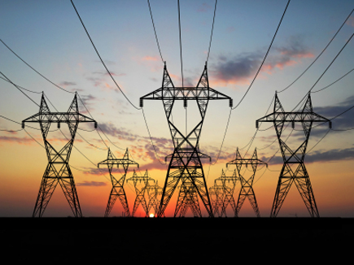
Electrical Energy can be Transferred & Stored
Electrical Charges can be described as ‘Unbalanced charges’ because there is a build up and than it is discharged

Slide 3
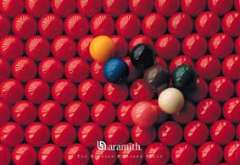
Static Electricity
To understand electricity we must start with the atom.
All matter is composed of atoms.

Slide 4
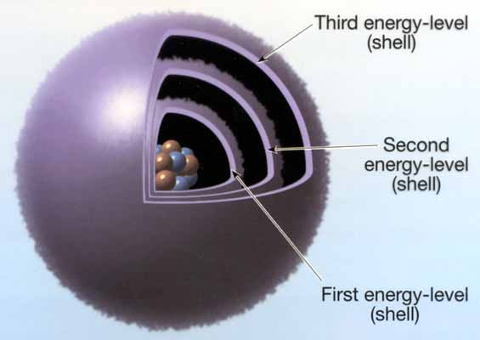
The Atom
The atom consists of three particles:
  Electrons have a negative charge
  Neutrons carry no charge
  Protons have a positive charge
  These charges cause either an attractive or repulsive force between particles

Slide 5

Sub Atomic Particles
Protons and Neutrons are found in the nucleus of the atom
Electrons orbit the nucleus and are free to be removed

Slide 6
Electrical Charge
1. Neutral or Uncharged:
  Most matter exists in this state
  The number of protons (+) and electrons (-) are equal (balanced) so there is not a charge
2. Positively Charged
  There are more protons (+) than electrons (-) so the charge is unbalanced and positive
  Electrons have left
3. Negatively Charged
  There are more electrons (-) than protons (+) so the charge is unbalanced and negative
  Electrons have been added

Slide 7
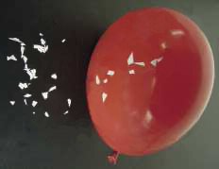
Static Electricity
Most objects are neutral – equal positive and negative charge
Charged objects have more
or less electrons than neutral
objects

Slide 8

Static Electricity
Forces of attraction
  Opposite charges attract
  Like charges repel
A charge separation occurs when a charged object is brought near to a neutral object

Slide 9

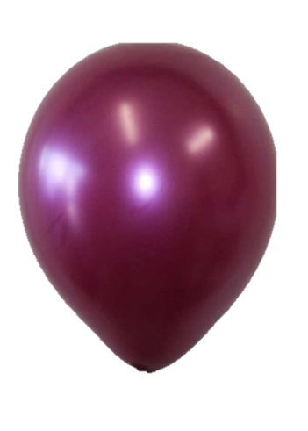
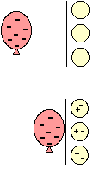
Charge Separation
When a charged object is brought near a neutral object, the law of charges will determine what will happen
Example: A negatively charged balloon approaching a wall
  Electrons in the wall will be repelled by the negative balloon
  An area of positive charge will be created
  The balloon and wall will be attracted

Slide 10
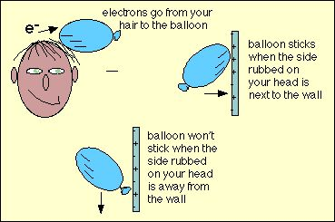

Slide 11
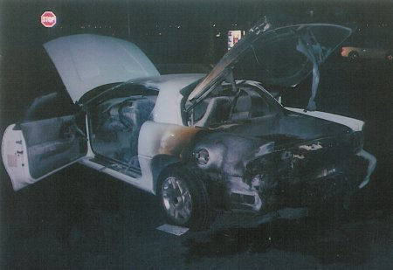
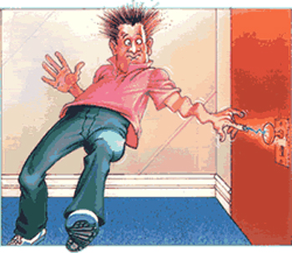
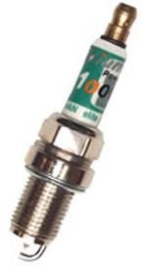
Static Electricity
Electrical discharge (release) can occur when a charge experiences a force great enough to “jump” across a gap

Slide 12
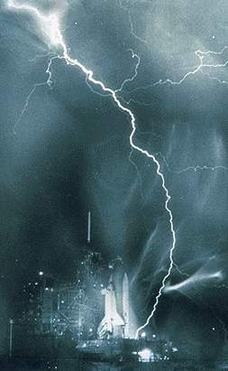
Lightning – static electricity in the air discharges to the Earth’s surface
http://www.youtube.com/watch?v=OLh3q94n8iw
http://www.youtube.com/watch?v=7lfzZY3TH6s ➔ Tesla
Notes:
Nova Video – Lightning
[Lightning H/O]

Slide 13
The Laws of Electrical Charge
These laws describe what happens when two charged particles or objects are brought close together.
1. Opposite charges attract each other
2. Like charges repel each other
3. Charged objects attract uncharged (neutral) charges

Slide 14
Neutralizing Unbalanced Charges
Neutralizing is the balancing of a charge
This can be seen as electrical discharge
  A shock or spark that results in a gaining or loss of electrons to become balanced or neutral
Grounding is another way to balance charges
  A wire is attracted to a large object (many times the Earth) as an easy way to neutralize a charged object

Slide 15
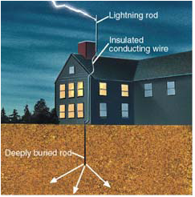

Slide 16

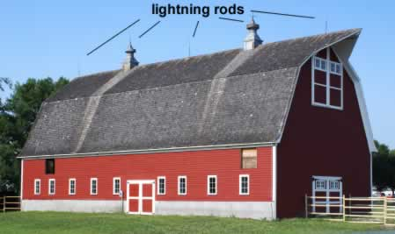

Slide 17
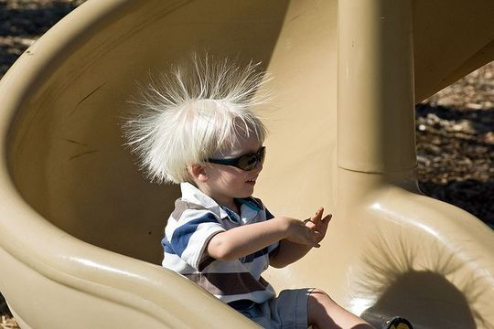
Your Task
Check & Reflect p 278 # 1 - 9

Slide 18
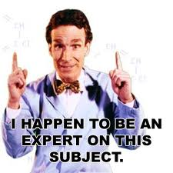
If You Are Having Difficulties…
http://www.youtube.com/watch?v=rg-XFXdtZnQ
http://www.youtube.com/watch?v=gyk4X-ik-zU&feature=related
http://www.youtube.com/watch?v=_EZDh4l4S7k
http://www.youtube.com/watch?v=hP1r7sRVgas&feature=fvwrel
http://www.youtube.com/watch?v=sHvCdnnceTY
http://www.youtube.com/watch?v=HlHgu8Gpq_o

Slide 19
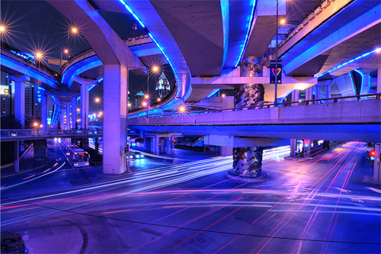
Current Electricity
Electricity in motion

Slide 20
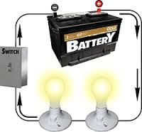
So What Does It All Mean?
Current Electricity: is a continuous flow of electrons from an energy source
Circuit: Uninterrupted flow of
electrons in a complete path

Slide 21
Introduction to Circuits
Circuits generally consist of four main components:
Power Supply
Conductor
Load
Switch
*Note that all circuits DO NOT have to have ALL of these components

Slide 22
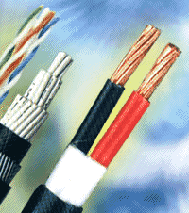
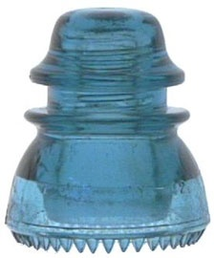
Current Electricity
Conductor – a material that will let electrons flow
  Most metals are conductors
Insulator – a material that resists the flow of electrons
        Most non-metals are insulators

Slide 23
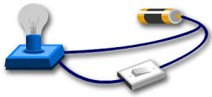
Current Electricity
Electricity can flow when it has a complete circuit and an energy source

Slide 24
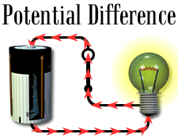
Current Electricity
Measuring Current
Ampere (A) – measure of the number of electrons passing a point each second

Slide 25
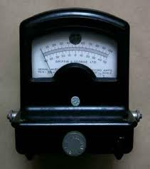
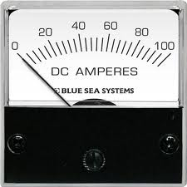
An instrument used to measure very weak electric current is called a galvanometer.
Larger currents are measured with an ammeter.

Slide 26
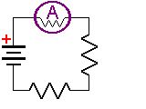
Ammeter
An ammeter is connected in series (all current must flow through the device)

Slide 27
Current Electricity
Electrical energy is measured in volts (V)
  aka potential difference
Voltage is a measure of how much electrical energy each charged particle carries.

Slide 28
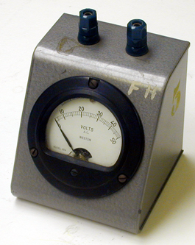
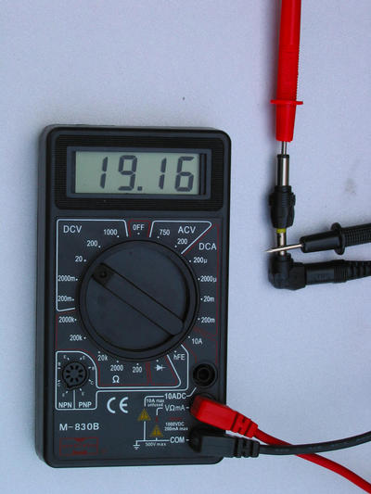
Current Electricity
Voltmeter – a device to measure potential difference (voltage)

Slide 29
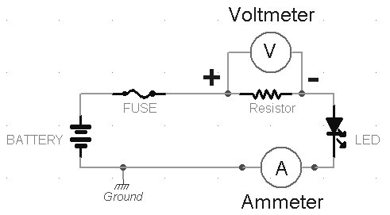
Voltmeter
A voltmeter is connected in parallel (to either side of a load to measure potential difference drop)

Slide 30

Did You Know?
A current with an amperage as little as 0.1A is felt as a shock but a current of 1.0A is deadly.
➔ Voltage jolts, but amperage kills

Slide 31
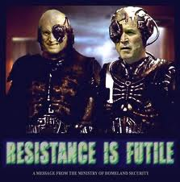
Resistance
Resistance:
  Limits the flow of electricity
  Expressed in Ohms
( Ω )

Slide 32
  Affected by voltage and amperage
    High voltage means high resistance
    voltage = resistance
    Direct Relationship
    High amperage means low resistance
    amperage (I) = resistance
    Indirect Relationship
    High temperature means more resistance
    Temperature= resistance
    Direct Relationship

Slide 33

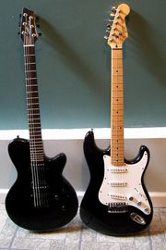
Your Task
Check & Reflect p 283 # 1 - 9

Slide 34

Electrical Safety
PROTECT YOURSELF!

Slide 35
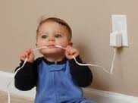
Voltage and amperage both play a role in whether electricity can kill
A significant electric shock, that is not fatal, can still cause serious and long term damage or injury to your body and nervous system

Slide 36
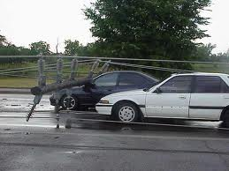
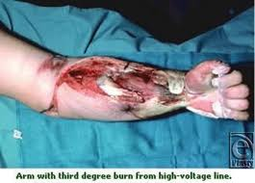
Electrical Safety
Short Circuit: Current bypasses normal circuit and takes the shortest route
  Downed power lines will allow the electricity to move outside the circuit

Slide 37
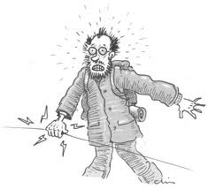
Insulators vs. Conductors
Rubber soled shoes or car tires may provide some protection from a shock
Other substances may come into play, wet or damp soil will conduct better than dry soil
  Example if you touch an electric
  fence on a dry day, the shock
  will be less than the same fence
  on a damp day with muddy ground
Notes:
Current flow (A) is what makes electricity dangerous

Slide 38
Protect Yourself
Never handle electrical devices when you are wet or around water
Don’t use any power cord that is frayed
Always unplug before tampering
Don’t stick items in power outlets
Don’t overload circuits
Stay away from power lines
Don’t bypass safety features
Pull on the plug not the cord
Never remove the third prong

Slide 39
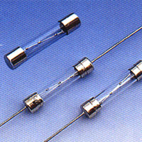
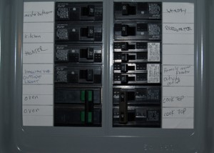
Electrical Safety
Fuses & Breakers – devices that will break a circuit if it becomes overloaded (ie. too much current flowing)
[Read p 286]

Slide 40
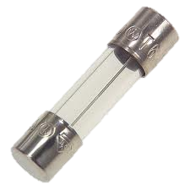
Fuses
A device with a metal strip having a lower melting point than the wire it is connected to
The metal strip melts before the wire overheats
This causes a break in the flow of electricity
A fuse cannot be reused

Slide 41
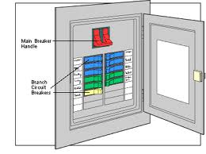
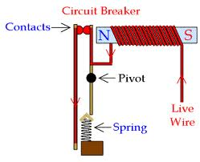
Circuit Breaker
Have a special metal that triggers a spring if too much electricity passes through
The surge produces heat that causes the strip to bend (Flips the breaker and breaks the circuit)

Slide 42
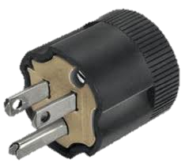
3 Prong Plugs
3-prong plugs provide an alternative way for the electricity if there is a short
  3rd prong is a ground wire ➔ carries an overload of current away from the circuit
Ground Wire

Slide 43
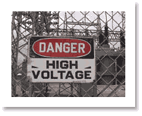
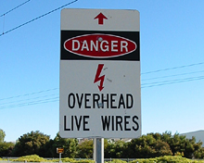
Your Task
Check & Reflect p 287 # 1 - 10

Slide 44
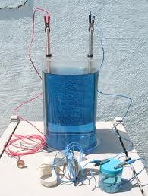
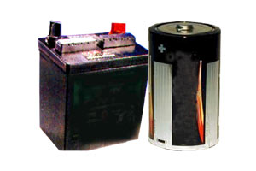
Cells & Batteries
Wet Cells & Dry Cells

Slide 45
Cells and Batteries
Cells or Electrochemical cells are made up of several chemicals to produce a steady supply of electricity
A battery is made when one or more cells are connected together
A cell or battery converts chemical energy into electrical energy
IMPORTANT: One is ALWAYS a CELL. A BATTERY is made up of TWO or MORE CELLS

Slide 46
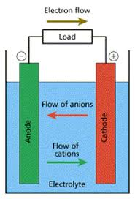
Electrochemical Cells
Two metal electrodes
(2 different metals) are surrounded by an electrolyte (paste or liquid)
Notes:
Anode/Cathode

Slide 47
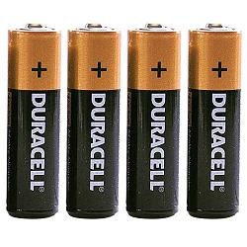
Cells & Batteries
Dry Cells – chemicals in a paste transfer electrons from the negative terminal through the conductor and load then back to the positive terminal

Slide 48
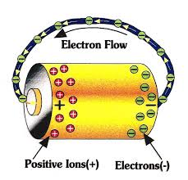
Cells & Batteries
Remember that electrons leave from the negative electrode and return to the positive electrode

Slide 49
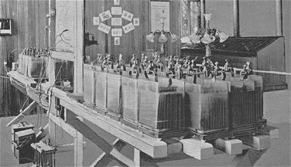
Cells & Batteries
Wet Cells – use a liquid electrolyte (acid) to allow transfer of electrons between the positive and negative electrodes

Slide 50
Primary Cell – a non-rechargeable battery

Slide 51
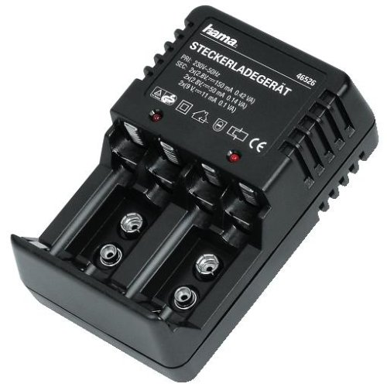
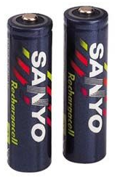
Cells & Batteries
http://www.youtube.com/watch?v=gNnJ9t3HDQs
Rechargeable cells (secondary cells) – electrical energy is used to push electrons back to the source electrode
http://www.youtube.com/watch?v=SMXBR_YFocs

Slide 52
Cells & Batteries
A cell is a single set of electrodes and an electrolyte while a battery is a series of cells connected together
[Note: What we call batteries are not all batteries]
http://www.youtube.com/watch?v=UEPJXSXw7HA
http://www.youtube.com/watch?v=_EZDh4l4S7k&feature=related

Slide 53
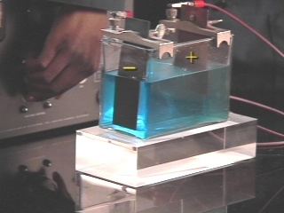

Cells & Batteries
Electroplating
Using a thin coating of a desired metal to coat less expensive metals

Slide 54

Your Task
Check & Reflect p 294 # 1-10
Section Review p 295 # 1 – 10

Slide 55




Technologies to Control the Flow
Read Key Concepts p 296
Read p 296

Slide 56

Unique Circuits and Conductivity
A characteristic of a non-metal is that they do not conduct electricity
  Neon signs are a glass tube filled with a noble gas
  The atoms are excited by
  the current and this causes
  the electrons to become free.
  As these excited electrons
  move back into orbit, energy
  is released as light

Slide 57
Controlling the Flow
Conductors – electrons are not tightly bound and thus can flow easily when voltage is applied
  Example: copper wire or other metals
Insulators – electrons are tightly bound to the nucleus and resist movement when voltage is applied
  Example: Plastic, rubber or glass
  Note Fig 2.2 p 298

Slide 58

Electron Flow Though a Conductor
As soon as electrons are “pushed” into one end of a conductor the electrons already in the conductor begin to move

Slide 59

Quiz Time!!!!!

Slide 60
What are the three subatomic particle? Include their charge, symbol and where they are located.
2. Like charges while opposite charges
3. Explain what happens when a charged balloon is brought to a wall. You may use a diagram to help you explain.
4. What are the 4 parts of a circuit?
Draw an ammeter in a circuit
6. What are the three parts of a cell?
7. What is the difference between a wet and dry cell?

Slide 61

Resistance
No conductor is a perfect conductor – there is always some resistance to electron flow that results in a loss of energy (heat, light)
Notes:
When electrons meet resistance to flow energy is dissipated by the emission of light or heat
Resistors heat up
Draw a lightbulb

Slide 62


Models of Resistance & Current
Read p 305
A long thin pipe (wire) will have more resistance than a large or short pipe (wire)
Current slows as resistance increases

Slide 63
Modeling Current and Resistance
If the pipe is large, the resistance to flow in the pipe is low
  The flow of water is greater
  This models great current
If the pipe is small, the resistance to flow in the pipe is high
  This models less current
For any constant voltage, increasing resistance will decrease current. We call this an inverse relationship

Slide 64
Factors that affect the resistance of a wire include…
1) Length:
  As length increases, resistance increases
  2) Diameter:
  -As diameter increases, resistance decreases
  3) Temperature:
  - As temperature increases, resistance increases
  4) Material:
  -A wire that is a better conductor would have less resistance

Slide 65


Controlling the Flow
Resistors – limit the amount of current
Resistance – a measure of the difficulty electrons have passing through a resistor
[Units = ohms (Ω) ]

Slide 66

Controlling the Flow
Solutions can provide resistance to electric current – depends upon the amount of charged particles they contain
Low resistance =
high conductivity
High resistance =
low conductivity
Notes:
Make sure that the solution is ionic

Slide 67

Polygraph
Lie detector – measures skin resistance, bp and respiration rate.
Sweat is a salt solution thus is a conductor
Resistance of the skin will be less since more sweat (contains salts which are ionic) is produced under stress

Slide 68

Controlling the Flow
Variable Resistors or Rheostats
Switches
  control the flow by “breaking “ the circuit

Slide 69

Controlling the Flow
Rheostat – a variable resistor
Turning the rheostat dial changes how much of the resistor the current must flow through
As the resistance is increased, less current flows
As the resistance is decreased, more current flows

Slide 70

Your Task
Check & Reflect # 1 - 8 p 303

Slide 71

Georg Simon Ohm
Found a relationship between potential difference, current and resistance (Ohm’s Law)
MATH
V = I x R

Slide 72


Ohm’s Law
Written mathematically is:
V= I x R
Where:
V = voltage (potential difference) (V)
I = current (A)
R = resistance (Ω)
[rearranging equations]

Slide 73
Ohm’s Law Example
What is the resistance of a light bulb if the batteries supply 3.0V and the current that runs through it is 0.4A?

Slide 74
Example Problems:
A nine volt battery supplies power to a cordless curling iron with a resistance of 18 ohms. How much current is flowing through the curling iron?

Slide 75
Example
A CD player with a resistance of 40 ohms has a current of 0.1 amps flowing through it. Sketch the circuit diagram and calculate how many volts supply the CD player?
Notes:
[V = 4 V]

Slide 76
Practice
Ohm’s Law practice:
  p 307 “Skill Practice” # 1 – 3
  [click for - interactive circuit]
Notes:
Answers:
1. 2.0 A
2. 160 V
3. 192 Ω

Slide 77

Measuring Electricity
Check & Reflect p 310 # 1 - 10

Slide 78

Electrical Circuits
Circuit Diagrams (aka schematic)
Schematics have four basic parts:
  Source: where electrical energy comes from
  Conductor: wire through which the current flows
  Control/Switch: device that
  can turn the device on or off
  Load(s): items along the
  circuit that convert electricity
  into other forms
Notes:
Note: symbols pg 312 & p 509

Slide 79

Circuits can be:
  Closed:
  -Charges (electrons) can flow without interruption
  2) Open:
  - The electron flow has been interrupted by a break in the circuit
  -The circuit is not complete

Slide 80
Steps to Drawing a Circuit
Draw with a pencil and ruler on graph paper or unlined paper
Place components in a square or rectangular arrangement
Make conductors straight lines with square corners
Arrange diagram so conductors do not cross

Slide 81

Types of Circuits
Series
    All charges move through the same pathway
    Current passes through each load in order
    If load is interrupted circuit is broken

Slide 82

Types of Circuits
Parallel
    Separate current path for each load
    Resistance decreases as loads are added (more paths added)
    Advantage: Can turn off one branch of the circuit without affecting the other branches

Slide 83
Practice Problems
1) Draw a circuit with a 2-cell battery and a light bulb.
2) Draw a circuit with a 4 – cell battery, 2 light bulbs, and an open switch that runs the light bulb
3) Draw a circuit with a 1.5 V cell, light bulb, and a closed switch that only runs a motor
4) Draw a circuit consisting of a four cell battery connected to two lamps in parallel (each controlled by separate switches) to an ammeter

Slide 84

End of Section Practice
Read p 311 - 316
Check & Reflect # 1 – 9 & 11 p 316
Section Review # 1 – 5, 7, 8, & 9 p 317
Circuit Diagram Worksheets

Slide 85
Question 1
Draw a circuit with a 1.5 V cell, light bulb, and a closed switch that only runs a motor

Slide 86
Question 2
Draw a circuit consisting of a four cell battery connected to two lamps in parallel (each controlled by separate switches) and an ammeter

Slide 87
Question 3
Draw a diagram of a series circuit that has a four-cell battery, five bulbs and a motor. Add a resistor that impacts two bulbs and the motor.

Slide 88
Question 4
Draw a diagram of a parallel circuit that has a two-cell battery, two bulbs and a motor. Add a switch or switches that allow you to turn off all three items at once. The switch or switches must also allow you to turn the motor off while the light bulbs remain on. Be sure to indicate the current flow

Slide 89
Question 5
Draw a parallel circuit with a 1.7V cell powering 2 light bulbs and a motor. Include a switch(es) that can turn off 1 light and the motor but leave the rest of the circuit running. As well as a voltmeter.

Slide 90
Question 6
Draw a series circuit with a battery, four light bulbs, a resistor and a switch that controls the whole circuit.

Slide 91
Question 7
Draw a parallel circuit with a motor, resistor, one light bulb, and a switch that controls one of the loads. All powered by a 6V battery.

Slide 92
Question 8
Draw a schematic parallel circuit with a 3 cell battery hooked up to 5 lights, 1 motor and a resistor. With an open switch controlling three of the lights only. And an ammeter.

Slide 93

Electrical Devices
Energy is ‘the ability to do work’

Slide 94


The four most common forms of energy are:
1) Chemical - potential or stored energy stored in chemicals, released when the chemicals react.
2) Electrical - energy of charged
particles, transferred when they
travel from place to place.

Slide 95


3) Mechanical - energy possessed by an object because of its motion or its potential to move.
Thermal - kinetic energy of a substance

Slide 96
Energy can be converted to various forms of energy
Batteries convert chemical energy into electrical energy
Generators convert mechanical energy into electrical energy
Electric motors convert electrical energy into mechanical energy

Slide 97

Chemical Energy
Chemical energy is the energy found
in chemicals, including food.
Glucose molecules are used in your body cells to produce thermal energy and mechanical energy.

Slide 98

Chemical Energy
Chemical energy can also be converted into mechanical and sound energy (a CD player).
Chemical energy can also be
transformed into mechanical
energy, with heat and
light (dynamite).

Slide 99

Electricity and Motion
  Electric energy can be converted into moving energy
    Examples: remote control cars, electric motors
  Motion can also be converted into Electrical Energy
  Most electricity comes from
  the conversion of mechanical
  energy into electrical energy

Slide 100

Electricity and Light
Electric energy can be converted into
light energy
  Example: Incandescent light bulbs
    Has a filament of highly resistant metal
    (tungsten) which glows brightly when current
    passes through it.

Slide 101



Electric Motors – convert electricity flowing through an electric field into mechanical energy.

Slide 102

Electric Motor
Basic Parts:
Armature: rotating shaft with the coil
wrapped around it.
2) Brushes: usually bars of carbon pushed against the metal commutator springs. Make electrical contact with the moving commutator
3) Commuter: split ring that breaks the flow of electricity and then reverses the connection of the coil
4) Magnet
http://www.youtube.com/watch?v=Q2mShGuG4RY

Slide 103



Direct and Alternative Current
AC/DC:
  Alternating Current –
  flows forward then backward
  (60 Hz)
Direct Current – flows in one direction

Slide 104


Transformers
AC transformers
  Change voltage
  Can step-up( increases voltage)
  or
  step-down (decreases voltage)
Read page 329

Slide 105
Motors vs. Generators
A motor converts electrical energy into mechanical energy
A generator converts mechanical energy into electrical energy

Slide 106

Your Task
Check & Reflect
p 331 # 1-8

Slide 107
Quiz
What are the parts of a motor, in alphabetical order?
What is the function of the commutator
Motors convert energy into energy.
Generators convert energy into energy
What are the 4 types of energy
Compare Parallel and Series Circuits

Slide 108

Measuring Energy
Power
  Rate at which energy is used measured in Watts (W)
P = E/t or P = I V
Sample Problems
p 332 & 333
Notes:
Time has to be in seconds

Slide 109

Power Example
A hair dryer has a power rating of 1000W. It is plugged into a 120-V outlet. What is the current flowing through the hair dryer?

Slide 110

Power Example 2
A curling iron is plugged into a 110-V outlet. It uses 8.33-A of current. What is the power rating of the iron?

Slide 111
Power is also defined as the energy per unit time
  Describes the amount of electrical energy converted to light, heat, sound and other forms
  Power= energy ÷ time
  P = E ÷ t
1 Watt = 1 Joule / 1 second

Slide 112

Example
A microwave oven has a power rating of 800 W. If you cook a roast in this oven for 30 minutes at high, how many joules of electrical energy are converted to heat by the microwave?

Slide 113

Example
What is the wattage of a frying pan that uses 300,000 joules of energy to cook bacon for ten minutes?

Slide 114
Inefficiency of Energy Transformation
Law of Conservation of Energy – energy cannot be created or destroyed only converted to other forms
Input E is always greater than output energy
Energy is most commonly lost as:
  Heat
  Sound
  Light

Slide 115


Efficiency
Efficiency refers to the ratio of the useful energy output to the total energy input
Energy efficiency saves money and reduces environmental harm
% Eff = useful output E x 100%
input E
OR

Slide 116

Efficiency Example
An incandescent light bulb uses 780 J of energy to produce 31 J of light. What is the efficiency of the light bulb?

Slide 117
Efficiency Example
Calculate the efficiency of an 1000W kettle that takes 4 min to boil water. To heat the water to boiling point, it takes 196,000 J of energy. What is the efficiency of the kettle?
Skill Practice p 336
C&R p 338 # 4,6 - 9

Slide 118


Energy Wasted by Devices
Energy costs money
Using less energy and reducing waste helps save money and is ecologically responsible.

Slide 119


Energuide
Provide useful comparative information when shopping for appliances

Slide 120

Energy “Loss”
Thermal energy is the most common form of energy loss – wasted energy
Results from friction which is expelled by exhaust gases and to cooling systems

Slide 121



Reducing Friction
Lubricants and well designed bearings can increase the efficiency of a motor.
Section Review p 343 # 1 - 8

Slide 122
Quiz Time!!!!!

Slide 123
1) jolt kills
2) Draw an electrochemical cell. Label all parts
3) The positive electrode is called the and the negative electrode is called the
4) Explain electroplating
5) Draw a diagram explaining how protons and electrons interact in an insulator and in a conductor
6) A variable resistor is also known as a
7) A 12V battery supplies power to 3 light bulbs and a motor in parallel, with a resistor with a rating of 18 ohms. Draw a schematic for this as well as calculate how much current is flowing through the circuit.

Slide 124


Electrical Energy
& Society
p 344 - 359

Slide 125

Sources & Alternatives
Electrical energy can be generated using a turbine and a generator
Various methods can be used to turn turbines:
  steam
  wind
  tides…

Slide 126

Sources & Alternatives
Turbines can be turned directly by mechanical energy or indirectly by converting the energy source to heat which then converts water to steam which turns the turbine.

Slide 127

Steam Generation
Any fuel that can boil water can be used to provide the mechanical energy of steam to turn a electrical turbine.
(Nuclear, fossil fuel, biomass, geothermal …)
[see Fig 4.1]

Slide 128

Sources of Energy
http://www.youtube.com/watch?v=cJ-J91SwP8w
Fossil Fuels: Include coal, oil and natural gas.
  They provide heat energy necessary to change water into steam which then turns a turbine. The turbine shaft rotates to produce electricity.
  These fossil fuels are non-renewable
  Coal and natural gas generated power contributes to air
  pollution
Byproducts of Burning Fossil Fuels
  High carbon dioxide emissions contribute to global
  warming while sulfur dioxide emissions produce acid rain.

Slide 129

Hydroelectric: electricity is generated in areas where large volumes of water are collected behind dams.
The collected water has high potential energy (gravitational energy), which when released spins the turbine and generator to produce electricity
  The initial cost of constructing a hydroelectric power plant is high but once
  in operation the cost of producing
  electricity is lower
  Water is a renewable
  resource
http://www.youtube.com/watch?v=Jh_wUV1ZOCQ&feature=related

Slide 130

Wind Generators: this energy is harnessed by large propeller-type blades, which turn a shaft - connected to a generator.
Renewable resource

Slide 131

Nuclear Steam Generation
Nuclear reactors use uranium to produce heat energy
  Chernobyl

Slide 132

Geothermal: molten rock beneath Earth’s surface heats the ground water creating steam which is transported through pipes to drive turbines
Except for the sulfur smell, geothermal energy does not pollute the environment
http://www.youtube.com/watch?v=vSZ1dIBdOIs&feature=related
Notes:
Iceland has been geothermal energy for years

Slide 133

Biomass: refers to organic materials present in garbage
  Organic materials decompose to produce methane gas which is collected and used as fuel
  You can also burn it.
http://www.youtube.com/watch?v=cqrAWYtd6RI&feature=related
http://www.youtube.com/watch?v=sJpaGCZBAeo&feature=related

Slide 134

Solar Power: Solar cells (made from silicon) enable the energy from the sun to be transformed (photoelectric effect) into electricity.
The initial cost is high but the energy produced is inexpensive and pollution free

Slide 135

Alternate Sources
Renewable energy sources include:
  Tides
  Wind
  Solar
  Batteries (chemical)
  Biomass

Slide 136
Electricity and the Environment
Strip mining techniques removes all plants and animals from large areas of land resulting in habitat and species destruction.
Oil and Gas wells can often give off poisonous gases.
Steam turbines often release warm water into nearby lakes and rivers. The increase in water temperature can affect the local marine ecology and can kill fish.
Mines and refineries that produce nuclear fuel can also cause damage to the environment, because of the radioactive waste.
Dams, wind farms and solar cell arrays can decimate large areas of ecological habitat.
Tidal power plants can disrupt the habitat of fish and other marine life.

Slide 137

Your Task
Check and Reflect p 350 # 1-3, 6-8 & 10

Slide 138

4.2 Environmental Concerns p 351 - 353
Read 351 – 353
Check & Reflect p 353 # 4, 8, 9

Slide 139

4.3 Technology & Society p 354 - 359
Read p 354 – 358
Check & Reflect p 358 # 1 – 4
Section Review p 359 # 2, 5, 7 & 9

Slide 140

End of Unit
Read Unit Summary p 360
Read Three Gorges Dam p 361 (no research reqd.)
Unit Review p 363 – 365
  1 (define), 4,5,7,9,10,12, 14-16,18-20,25,29

