Slide 1
Math 7 Review

Slide 2
Chapter 1

Slide 3
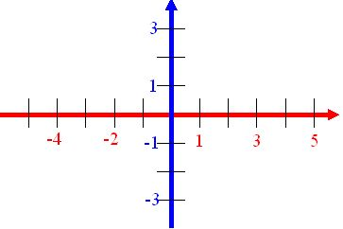
Cartesian Plane
Student Outcome: Identify and plot points in the 4 quadrants of the Cartesian plan using ordered pairs
The Cartesian Plane (or coordinate grid) is made up of two number lines that intersect perpendicularly at their respective zero points.
ORIGIN
The point where the x-axis and the y-axis cross
(0,0)

Slide 4
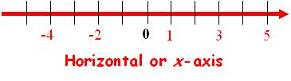
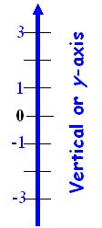
Parts of a Cartesian Plane
Student Outcome: Identify and plot points in the 4 quadrants of the Cartesian plan using ordered pairs
The horizontal axis is called the x-axis.
The vertical axis is called the y-axis.

Slide 5
Quadrants
Student Outcome: Identify and plot points in the 4 quadrants of the Cartesian plan using ordered pairs
The Coordinate Grid is made up of 4 Quadrants.
QUADRANT II
QUADRANT I
QUADRANT III
QUADRANT IV

Slide 6
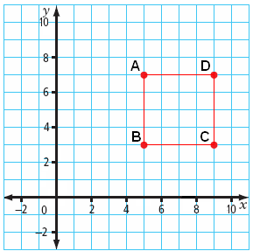
1.1 The Cartesian Plane
Student Outcome: Identify and plot points in the 4 quadrants of the Cartesian plan using ordered pairs
Identify Points on a Coordinate Grid
A: (x, y)
B: (x, y)
C: (x, y)
D: (x, y)
HINT: To find the
X coordinate count how
many units to the right
if positive,
or how many units to the
left if negative.

Slide 7
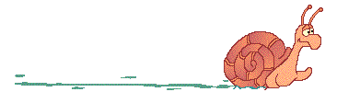
Translation
Translations are SLIDES!!!
Let's examine some translations related to coordinate geometry.

Slide 8
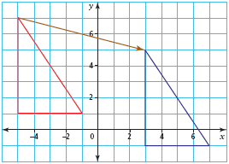
1.3 Transformations
Student Outcome: I can perform and describe transformations of a 2-D shape in all 4 quadrants of a Cartesian plane.
Translation:
  A slide along a straight line
  Count the number of horizontal units and vertical units represented by the translation arrow.
  The horizontal distance is 8 units to the right, and the vertical distance is 2 units down
  (+8 -2)
Notes:
Label the vertices A, B, C
Label the new translation A’, B’, C’

Slide 9
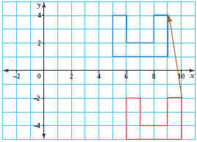
1.3 Transformations
Student Outcome: I can perform and describe transformations of a 2-D shape in all 4 quadrants of a Cartesian plane.
Translation:
  Count the number of horizontal units the image has shifted.
  Count the number of vertical units the image has shifted.
We would say the
Transformation is:
1 unit left,6 units up
or
(-1+,6)

Slide 10

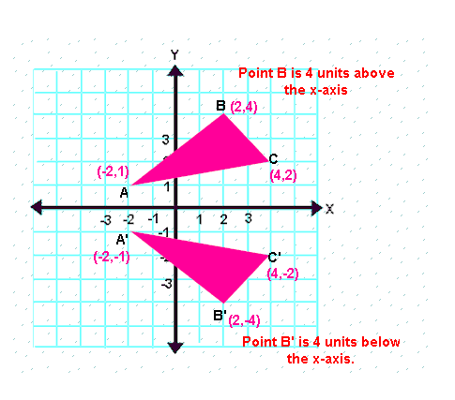
A reflection is often called a flip.
Under a reflection, the figure does not change size.
It is simply flipped over the line of reflection.
Reflecting over the x-axis:
When you reflect a point across the x-axis, the x-coordinate remains the same, but the y-coordinate is transformed into its opposite.

Slide 11
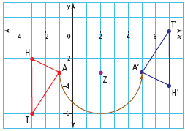
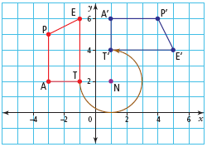
1.3 Transformations
Student Outcome: I can perform and describe transformations of a 2-D shape in all 4 quadrants of a Cartesian plane.
Rotation:
  A turn about a fixed point called “the center of rotation”
  The rotation can be clockwise or counterclockwise.

Slide 12
Chapter 2

Slide 13
Place Value
The place value chart below shows 1247.63
Thousands | Hundreds | Tens | Ones | Decimal Point | Tenths | Hundredths
1 | 2 | 4 | 7 | . | 6 | 3
The number 1248.63 is one more than 1247.63
The number 1147.63 is one hundred less than 1247.63
The number 1247.83 is two tenths more than 1247.63

Slide 14
Review – Adding and Subtracting Decimals
What do you need to do?
Line up the decimals
Add zeros into place values that are empty (if you wish)
Ex: 12.3 + 2. 4 = 12.3 12.3
              + 2.4 + 02.4
                14.7 14.7

Slide 15
2.1 Add and Subtract Decimals
Student Outcome: I can use different strategies to estimate decimals.
Pg 44 Vocabulary:
  Estimate:
    to approximate an answer
  Overestimate:
    Estimate that is larger than the actual answer
  Underestimate:
    Estimate that is smaller than the actual answer

Slide 16
Multiplying Decimals
Student Outcome: I can estimate by +,-,x,÷ decimals.
Use front-end estimation and relative size to estimate:
  2.65 x 3.72
    Front-End Estimation:
    Relative Size: (are there easier #’s to use)
    Compensation:

Slide 17
Dividing Decimal Numbers
Student Outcome: I can estimate by +,-,x,÷ decimals.
Example 1:
  A) 15.4 ÷ 3.6 = 4.27778
Front-End Estimation:
  Things I know: 15 ÷ 3 = 5
    The answer closest to 5 is 4.27778

Slide 18
Use Estimation to Place the Decimal Point.
Student Outcome: I can problem solve using decimals.
Example #2:
Four friends buy 1.36L of pure orange juice and divide it equally.
  A) Estimate each person’s share.
  B) Calculate each person’s share.

Slide 19
Use Estimation to Place the Decimal Point.
Solution:
  A) To estimate, round 1.36L to a number that is easier to work with.
    Try 1.2
      1.2 ÷ 4 = 0.3 Underestimate
    Try 1.
      1.6 ÷ 4 = 0.4 Overestimate
                Things I know
12 ÷ 4 = 3 So
1.2 ÷ 4 = 0.3
16 ÷ 4 = 4 So
1.6 ÷ 4 = 0.4

Slide 20

BEDMAS
Student Outcome: I can solve problems using order of operations.
Remember the order by the phrase
B - BRACKETS
E - EXPONENTS
D/M – DIVIDE OR MULTIPLY
A/S – ADD OR SUBTRACT

Slide 21
The “B” and “E”
Student Outcome: I can solve problems using order of operations.
The “B” stands for items in brackets
Do all items in the brackets first
(2 + 3)
The “E” stands for Exponents
Do anything that has a exponent (power)
8²

Slide 22

The “DM”
Student Outcome: I can solve problems using order of operations.
Represents divide and multiply
Do which ever one of these comes first in the problem
Work these two operations
from left to right

Slide 23
The “AS”
Student Outcome: I can solve problems using order of operations..
Represents Add and Subtract
Do which ever one of these comes first
Work left to right
You can only work with 2 numbers at a time.
8 + 7 - 5 + 2

Slide 24
Chapter 3

Slide 25
What You Will Learn
To draw a line segment parallel to another line segment
To draw a line segment perpendicular to another line segment
To draw a line that divides a line segment in half and is perpendicular to it
To divide an angle in half
To develop and use formulas to calculate the area of triangles and parallelograms.
CHALLENGE
Try to draw what you think the first 5 bullets may look like.

Slide 26

What Are Line Segments?
Parallel Line Segments
  Describes lines in the same plane that never cross, or intersect
  They are marked using arrows
  The perpendicular distance between
  line segments must be the same at
  each end of the segment.
  To create, use a ruler and a right triangle, or paper folding

Slide 27
Student Outcome: I will be able to describe different shapes
Parallel: two lines or two sides that are the same distance apart and never meet.
Arrows: show parallel sides
Vertex: the point where sides meet or intersect
Learn Alberta
http://www.learnalberta.ca/content/memg/index.html?term=Division02/Parallel/index.html

Slide 28

What Are Line Segments?
Perpendicular Line Segments
  Describes lines that intersect at right angles (90°)
  They are marked using a small square
  To create use a ruler and a protractor,
  or paper folding.

Slide 29
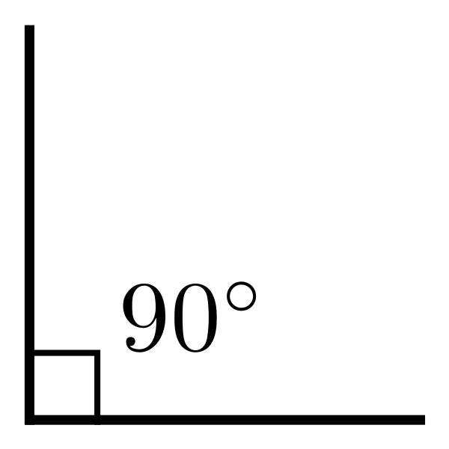
Student Outcome: I will be able to describe different shapes
Perpendicular: where a horizontal edge and vertical edge intersect to form a right angle
OR
when two sides of any shape intersect to make a right angle
Right Angle: 90’ symbol is a box in the corner
Vertical
Perpendicular side
Vertical side
Perpendicular side
Horizontal
Learn Alberta - Perpendicular
http://www.learnalberta.ca/content/memg/index.html?term=Division02/Perpendicular/index.html

Slide 30
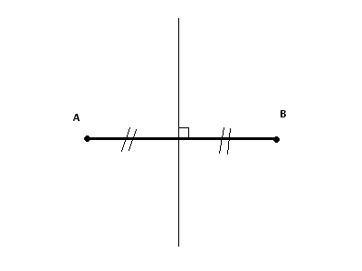
Student Outcome: I will understand and be able to draw a perpendicular bisector.
A Perpendicular Bisector:
  cuts a line segment in half and is at right angles (90°) to the line segment.
  If line segment AB is 2
  20cm long where
  is the perpendicular
  bisector?

Slide 31

Student Outcome: I will understand and be able to draw an angle bisector.
An angle bisector is a line that divides the angle evenly in terms of degrees.
<ABD = 45’
What is
<DAC =
D
45’

Slide 32


Student Outcome: I will understand and be able to draw an angle bisector.
To draw a line that divides a line segment in half and is perpendicular to it
To divide an angle in half

Slide 33
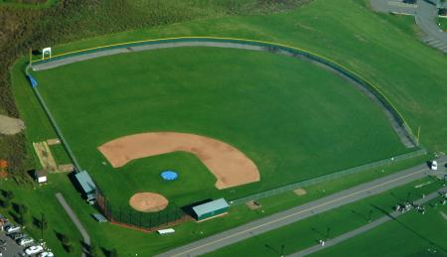
Review
Student Outcome: I will be able to understand perimeter.
Perimeter: the distance around a shape
or
the sum of all the sides

Slide 34
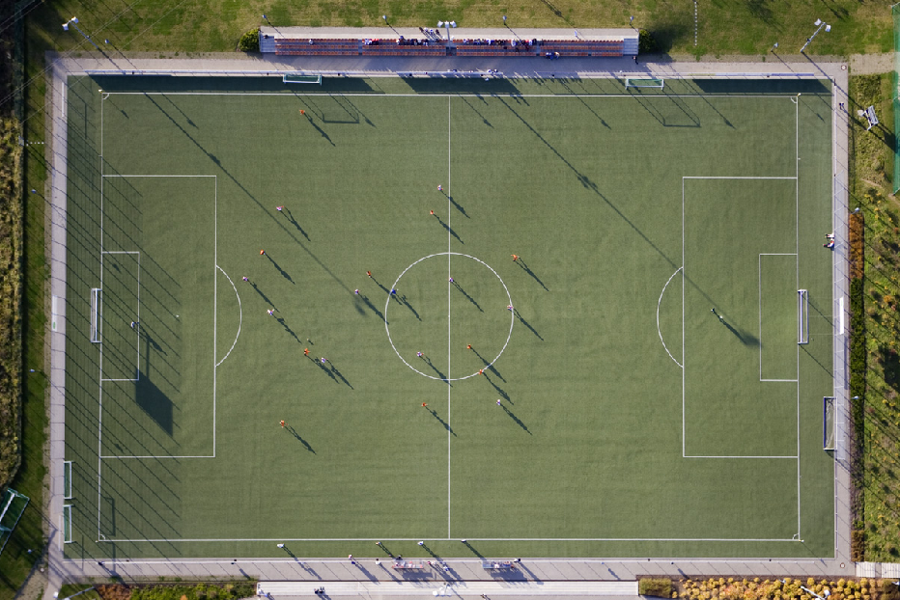
Review
Student Outcome I will be able to understand area.
Area: the amount of surface a shape covers
: it is 2-dimensional - length (l) and width (w)
: measured in square units (cm ²) or (m²)

Slide 35


Area of a rectangle or square
Area = length x width
A = l x w
Area of a parallelogram
Area = base x height
A = b x h

Slide 36

Practical Quiz #3
On a piece of paper
Draw a parallelogram with a height of 3cm and a base of 8cm. Solve the area.(on the front)
Draw a triangle with a base of 6cm and a height of 5cm. Solve the area.(on the back)

Slide 37
Chapter 4

Slide 38
Student Objective:
After this lesson, I will be able to…
  Estimate percents as fractions or as decimals
  Compare and order fractions decimals, and percents
  Estimate and solve problems involving percent

Slide 39
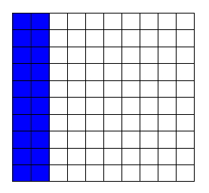
Percent
Student Objective: I will be able to problem solve using percents from 1%-100%
What does it mean??
  “out of 100”
  Ex: 20 out of 100 or 20% or 20 or 0.20
100
“of” means x

Slide 40
Percent
Student Objective: I will be able to problem solve using percents from 1%-100%
  Ex: 64% = 64 = 0.64
  100
Ex: 91% = =
Ex: 37% = =
Bonus
Ex: 107% = =

Slide 41
“Friendly” Percents
  Discuss with your partner
  What are FRIENDLY percent numbers “percentages” to work with? and why?

Slide 42
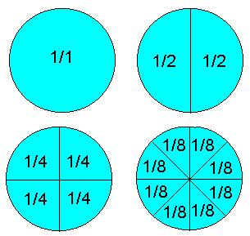
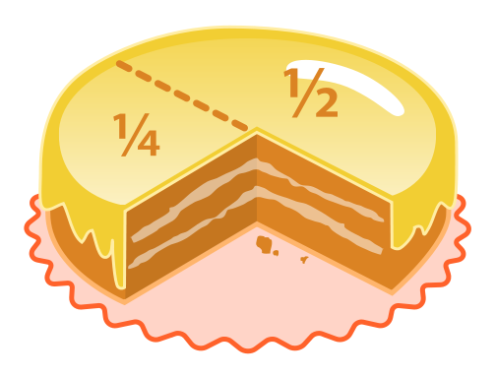
“Friendly” Percents
  25% 50% 75% 100%

Slide 43
Friendly Percent Numbers
Student Objective: I will be able to problem solve using percents from 1%-100%
What is 25% of $10.00? =
What is 50% of $10.00? =
What is 75% of $10.00? =
What is 100% of $10.00? =
What strategy did you use to solve this problem?
Notes:
November 24

Slide 44
“UnFriendly” Percents
  17%, 93%, 77%, 33%, 54%.......
  So how do you work with these percents?
  You must convert the percent to a decimal then multiple

Slide 45
Show What You Know…
Student Outcome: I will be able convert %’s, decimals and fractions
A) 56%, 0.48, ½ (place in ascending order)
B) 35%, 39/100, 0.36 (place in descending order)

Slide 46
Using Your Table
Goalies can be rated on “save percentages.” This statistic is the ratio of saves to shots on goal.
  Save Percentage = Number of Saves
  Shots on Goal

Slide 47
Extending Your Thinking!!
Using our chart, decide which goalie is having the best season.
Is it better to have a higher or lower save percentage?
How are the decimal and fraction forms of the save percentage related?
Which form is more useful? Why?

Slide 48
Convert Fractions to Decimals and Percents
Team | Wins | Losses | Winning % (Decimal) | Winning %
Miami | 59 | 23
New Jersey | 42 | 40
Los Angeles | 34 | 48
Team Percentage = Number of wins
Total game played

Slide 49
4.2 Estimate Percents
Student Outcome: I will be able to make estimations using %’s
Ex: Paige has answered 94 questions correctly out of 140 questions.
Estimate her mark as a percent.

Slide 50
Solution
Student Outcome: I will be able to make estimations using %’s
Think: What is 50% of 140?
  Half of 140 is 70
Think: what is 10% of 140?
  140 ÷ 10 = 14
50% + 10% = 60% of 140
  70 + 14 = 84
50% + 10% + 10% = 70% of 140
  70 + 14 + 14 = 98
The answer is between 60% and 70%, but closer to 70%
TOO LOW
TOO HIGH

Slide 51
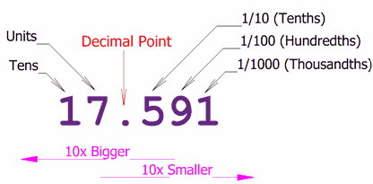

Slide 52
Key Ideas
To change a fraction to a decimal number, divide the numerator by the denominator.
  Ex: 3/8 = 3 ÷ 8 = 0.375
Repeating decimal numbers can be written using a bar notion
  Ex: 1/3 = 0.333… = 0.3
To express a terminating decimal number as a fraction, use place value to determine the denominator
  0.9 = 9/10 0.59 = 59/100 1.463 = 1463/1000

Slide 53
Chapter 5

Slide 54
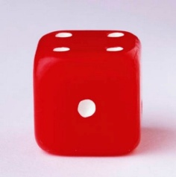
Probability
Student Outcome: I will be able to write probabilities as ratios, fractions and percents.
Probability: is the likelihood or chance of an event occurring.
Outcome: any possible result of a probability event.
Favourable Outcome: a successful result in a probability event.
(ex: rolling the #1 on a die)
Possible Outcome: all the results that could occur during a probability
    event (ex: rolling a die - - #1, #2, #3, #4, #5, #6)
P = Favourable Outcomes
Possible Outcomes
What is the probability of rolling the number 2 on a dice?
What is the favourable outcome?
How many possible outcomes?

Slide 55

How to express probability
Student Outcome: I will be able to write probabilities as ratios, fractions and percents.
Probability can be written in 3 ways...
As a fraction = 1/6
As a decimal = 0.16
As a percent
0.16 x 100% = 17%
How often will the
number 2 show up
when rolled?

Slide 56
Determine the probability
Student Outcome: I will be able to write probabilities as ratios, fractions and percents.
First you must find the possible outcomes (all possibilities)
and then the favourable outcomes (what you’re looking for).
Then place them into the probability equation.
Rolling an even number on a die?
Pulling a red card out from a deck of cards?
Using a four colored spinner to find green?
Selecting a girl from your class?
P = Favourable Outcomes
Possible Outcomes

Slide 57
Determine the probability
Student Outcome: I will be able to write probabilities as ratios, fractions and percents.
A cookie jar contains 3 chocolate chip, 5 raisin, 11 Oreos,
and 6 almond cookies. Find the probability if you were to
reach inside the cookie jar for each of the cookies above.
Type of Cookie | Chocolate Chip | Raisin | Oreo | Almond
Fraction
Decimal
Percent
Ratio

Slide 58

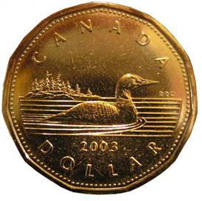
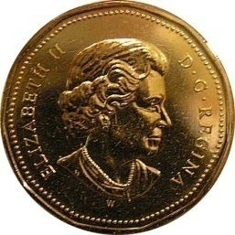
Organized Outcomes
Student Outcome: I will be able to create a sample space involving 2 independent events.
Independent Events:
The outcome of one event has no effect on the outcome of another event
Example:
ROCK
PAPER
SCISSOR
Tails Head

Slide 59
Organized Outcomes
Student Outcome: I will be able to create a sample space involving 2 independent events.
You can find the sample space of two independent
events in many ways.
Chart
Tree Diagram
Spider Diagram
Your choice, but showing one of the above
illustrates that you can find the favourable and
possible outcomes for probability.

Slide 60
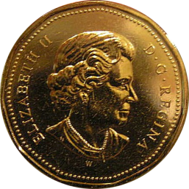
Chart
Student Outcome: I will be able to create a sample space involving 2 independent events.
Sample Space:
All possible outcomes of an event/experiment
(all the combinations)
      coin
hand
What is the probability of Paper/Head?
What is the probability of tails showing up?
Sample Space | Head | Tail
Rock
Paper
Scissor

Slide 61

“Tree Diagram” to represent Outcomes
Student Outcome: I will be able to create a sample space involving 2 independent events.
Coin Flip
H T
R P S R P S
Rock, Paper, Scissor
H, Rock T, Rock
H, Paper T, Paper
H, Scissor T, Scissor
Outcomes

Slide 62
“Spider Diagram” to represent Outcomes
Student Outcome: I will be able to create a sample space involving 2 independent events.
Rock
Rock
Paper
Paper
Scissor
Scissor

Slide 63
Probabilities of Simple Independent Events
Student Outcome: I will learn about theoretical probability.
Random:
an event in which every outcome has an equal chance of
occurring.
Problem:
A school gym has three doors on the stage and two back
doors. During a school play, each character enters through
one of the five doors. The next character to enter can be
either a boy or a girl. Use a “Tree Diagram” to determine
to show the sample space. Then answer the questions on
the next slide!

Slide 64
Using a Table to DETERMINE Probabilities
Student Outcome: I will learn about theoretical probability.
How to determine probabilities:
Probability (P) = favourable outcomes
possible outcomes
= decimal x 100%
Use your results from the “tree diagram” of the gym doors
and place them into a chart. Then determine the
probabilities for the chart.

Slide 65

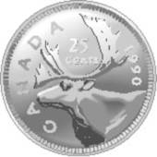
Practical Quiz #2
On the front of the paper:
Draw a sample space using a chart for the following events.
On the back of the paper:
Draw a sample space using a tree diagram for the following events.
Rolling a 4 sided die and flipping a quarter.

Slide 66
Chapter 6

Slide 67
Patterns in Multiplication and Division
Factors: numbers you multiply to get a product.
Example: 6 x 4 = 24
Factors Product
Product: the result of multiplication (answer).

Slide 68
Patterns in Multiplication and Division
Opposites: using multiplication to solve division
42 ÷ 7 = 6
Dividend Divisor Quotient
What multiplication equations can I create from above
1.
quotient: is the result of a division.

Slide 69
Introduction to Fraction Operations
Student Outcome: I will learn why a number is divisible by 2, 3, 4, 5, 6, 8, 9, 10 and NOT 0
Divisibility: how can you determine if a number is divisible by
2,3,4,5,6,7,8,9 or 10?
With a partner….
Complete the chart on the next slides and circle all the numbers divisible by 2,3,4,5,6,7,8,9, and 10.
Then find a pattern with the numbers to figure out divisibility rules.
Reflect on your findings with your class.

Slide 70
Student Outcome: Use Divisibility Rules to SORT Numbers
Carroll Diagram
Venn Diagram
 | Divisibility by 9 | Not Divisible by 9
Divisibility by 6 | 162 3996 | 30 31 974
Not Divisible by 6 | 23 517 | 79
Divisible
by 6 6
Divisible
by 9 6
162
39966
30
31 9746
23 5176
79
Shows how numbers are the
same and different!
Shows relationships between
groups of numbers.
Discuss with you partner why each number belongs where is does.

Slide 71
Student Outcome: Use Divisibility Rules to SORT Numbers
Fill in the Venn diagram with 7 other numbers. There must be a minimum 2 numbers in each section.
Venn Diagram
Divisible
by 2 6
Divisible
By 5 6
Share your number with the group beside you. Do their numbers work?

Slide 72
Student Outcome: I will be able to use Divisibility Rules to Determine Factors
Common Factors: a number that two or more numbers are divisible by
OR
numbers you multiply together to get a product
Example: 4 is a common factor of 8 & 12 HOW?
1 x 8 = 8 1 x 12 = 12
2 x 4 = 8 2 x 6 = 12
          3 x 4 = 12
What is the greatest common factor (GCF) for 8 and 12?
How would you describe in your own words (GCF)? Then discuss with your partner

Slide 73
Student Outcome: I will be able to use Divisibility Rules to place fractions in lowest terms.
Lowest Terms:
when the numerator and denominator of the fraction have no common factors than 1.
Ask Yourself?
What are things you know that will help with the factoring?
What number can I factor out of the numerator and denominator?
Can I use other numbers to make factoring quicker?
Example: 12 = 6
42 21
÷ 2
÷ 2

Slide 74
Student Outcome: I will learn how to add fractions with Like denominators
Name the fractions above…
What if I were to ADD the same fraction to the one above…how many parts would need to be colored in?
What is the name of our new fraction?
Using other pattern blocks can it be reduced to simplest form?
___ + ___ = ____ + ____ =

Slide 75
Chapter 7

Slide 76
Common Denominators
Student Outcome: I will learn about multiples and how it relates to common denominators
What is a common denominator?
Definition | Fraction | Fraction
a common multiple of the fractions denominators Or Making equivalent fractions with the same denominator (common) | 1/3 | 1/2
 | Multiples of 3 | Multiples of 2

Slide 77
Determine the “Equivalent Fraction”
Student Outcome: I will be able to model and explain equivalent fractions
Which of the models below are examples of common denominators?

Slide 78
Adding Fractions of Different Denominators
Student Outcome: I will understand adding fractions with different (unlike) denominators.
You will be able to model and understand how to add fractions of different denominators
1 + 1
2 3
How can you add the two fractions together if they are NOT equal
sections (denominators)? Hint…find the lowest common multiple!
New Addition Fraction Statement
+ 2
6 6

Slide 79
Mixed Numbers
Student Outcome: I will learn the relationship between mixed numbers and improper fractions.
What is a mixed number?
: contains a whole number with a fraction.
: is the cousin of the improper fraction.
1
3
6
9
6
=
How?
Use pattern blocks to try and prove!!! How did you show this?

Slide 80


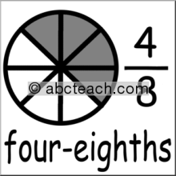
Add Mixed Numbers
Student Outcome: I will be able to add mixed numbers.
1 + 1
Steps:
Add the whole #’s
Find Lowest Common Denominators
Add the numerators
Place the fraction into lowest terms
3
8
4
8

Slide 81
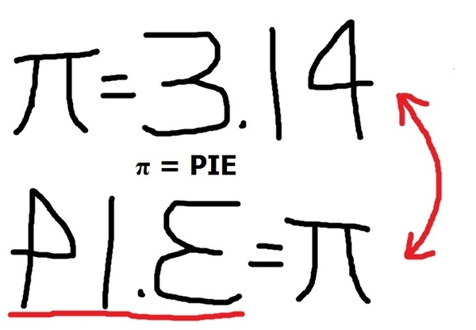
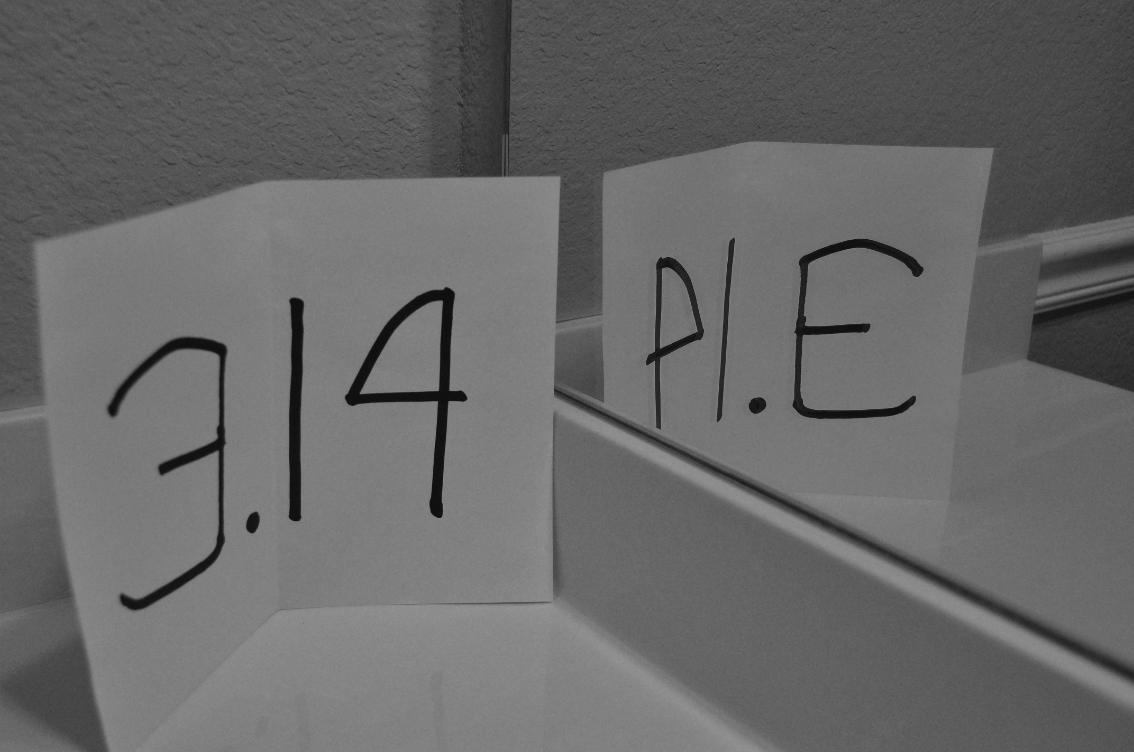
Circles (Unit 8)

Slide 82
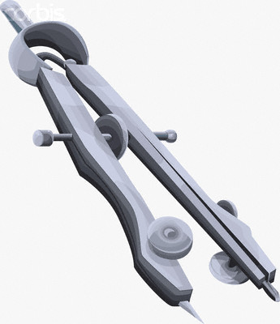
Construct Circles (Unit 8)
Student outcome: I will be able to describe the relationship of radius, diameter and circumference
Use your compass to draw a circle…Use a ruler to find your radius first!
Radius
Distance from the centre of the circle to the outside edge…represented by “r”
Diameter
Distance across a circle through its centre…represented by “d”

Slide 83
Circumference of a Circle
Student outcome: I will understand radius, diameter, circumference relationships.
Circumference: is the distance (perimeter) around a circle.
What is the relationship between the diameter and circumference of a circle?
∏ is very close to 3 (friendly number)
C = 3 x d (estimated)
C = ∏ x d (actual)
The “∏” is known as pi and is known as 3.14
http://www.learnalberta.ca/content/memg/index.html?term=Division03/Circumference/index.html

Slide 84
Circumference of a Circle
Student outcome: I will understand radius, diameter, circumference relationships
Circumference: is the distance (perimeter) around a circle.
The “∏” is known as pi and is known as 3.14
Diameter | Estimated Circumference C= 3 x d | Actual Circumference C= ∏ x d
5
12
7

Slide 85
Area of a Circle
Student outcome: I will be able to solve the area of a circle.
Radius | Estimate Area A = 3 x r x r or A = 3r² | Actual Area A = ∏r² or A = ∏ x r x r
6 cm
8 cm
14 cm

Slide 86
What is a “Circle Graph”
Student outcome: I will be able to read a circle graph.
Circle Graph:
a graph that
represents data using
sections of a circle
Sector:
a section of a circle
formed by two radii
and the arc of the
edge of a circle, which
connect the radii
http://www.learnalberta.ca/content/memg/index.html?term=Division03/Circle_Graph/index.html

Slide 87
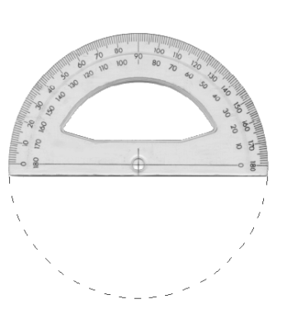
Create Circle Graphs
Student outcome: I will be able to build a circle graph.
You will need…
Ruler Protractor Compass Pencil Crayons
Construct a circle graph with a radius of 8 cm.
Create the circle
Questions:
a) What is the diameter?
b) How many degrees are in the top ½ of the circle?
c) How many degrees are in the bottom ½ of the circle?
d) What is the sum of the central angles of a circle?
8 cm

Slide 88
Create Circle Graphs
Student outcome: I will be able to build a circle graph.
How do we find the “degrees” of something?
% of 360° decimal x 360°
Example: 45% x 360°
0.45 x 360° = 162°

Slide 89
Let’s Review Integers (Unit 9)
http://www.learnalberta.ca/content/mesg/html/math6web/index.html?page=lessons&lesson=m6lessonshell06.swf
Learn Alberta

Slide 90
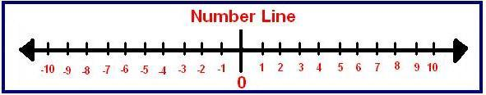
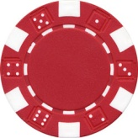
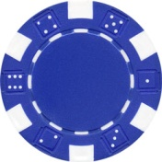
Add & Subtract Integers (Unit 9)
Red Chips = +1 Blue Chips = -1
1. Combine 2 red chips and 2 blue chips…what is their sum?
2. Make the above into an addition statement …use brackets.

Slide 91
Zero Pairs
Student Outcome: I learn about zero pairs.
Zero Pair: combining (+1) with (-1) (+1) + (-1) = 0
We can combine numerous zero pairs to solve problems:
For example:
(+1) + (-1) =
(-3) + (+3) =
(+11) + (-11) =

Slide 92


Adding Integers
Student Outcome: I will be able to add integers using integer chips.
Grouping: combining “positives with positives” “positives with negatives” or “negatives with negatives” to allow us to solve
Addition Statements:
(+1) + (+2) = ______ (+5) + (- 4) = ______
Your turn…apply “integer addition”
Draw the model for (-3) + (+ 4)
2. Draw the model for (+11) + (-3)

Slide 93
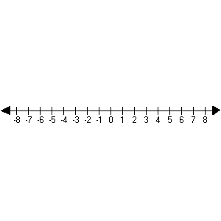
What is the “addition statement?”
Student Outcome: I will be able to add integers using a number line.
The addition statement below is…
(+4) + (+3)
What do the colors of the arrows represent?
What do the length of the arrows represent?
What is the total?

Slide 94

Explore Integer Subtraction
Student Outcome: I will be able to subtract integers using integer chips.
Subtract integers using integer chips…
What is the subtraction expression for the model above?
Take away 4 red chips from the original 6 red chips…what do you have left?

Slide 95

Model it… Subtraction
Student Outcome: I will be able to subtract integers using integer chips.
Model the equations below…
(-5) – (-2) (+8) – (+3)
What do you notice about each equation?

Slide 96
Model it… Subtraction
Student Outcome: I will learn different strategies to use addition to subtract integers..
STRATEGY #1
“Move in – Move out”

Slide 97


What if the Integer #’s are different?
Student Outcome: I will learn different strategies to use addition to subtract integers..
(+ 2) – (+5)
Step 1 Step 2
Step 3
Step 4
Steps to follow:
Model the first integer
Move in enough to model the second integer
3. Remove the chips asked in the subtraction statement
4. What is left

Slide 98
Model it… Subtraction
Student Outcome: I will learn different strategies to use addition to subtract integers..
STRATEGY #2
“Zero Pairs”

Slide 99
What if the Integer #’s are different?
Student Outcome: I will learn different strategies to use addition to subtract integers..
(+ 2) – (- 4)
Step 1 Step 2
Step 3
Step 4
Steps to follow:
Model what the question is asking
ZERO PAIRS: 2nd integer reversing the (+) or (-) of number…
3. Remove the chips asked in the subtraction statement
4. Then group the chips left over!

Slide 100
Model it… Subtraction
Student Outcome: I will learn different strategies to use addition to subtract integers..
STRATEGY #3
“Sub to Add”

Slide 101
Subtracting Integers
Use integer chips to find the answer to the subtraction statement below…
(+4) – (+ 2)
What happens when we change the subtraction statement to an addition statement?
(+4) + (- 2)
The answers are ____________________.
Which of the two methods above are easier?
Zero Pair | Remove | Group
Zero Pair | Remove | Group
NOT needed! | NOT needed!

Slide 102
Applying Integer Operations
Student Outcome: I will decide when to add and subtract integers.
Use the “Wind Chill Chart” on page 337 to answer the question below.
If the air temperature is – 20ºC and the wind speed is
10 km/h…then what is the “wind chill” temperature?
If the air temperature is - 25ºC…and the wind speed is
50 km/h…then what is the “wind chill” temperature?
3. What are the differences between the air temperature and the “wind chill” temperatures above? (Hint…colder!)

Slide 103
(Unit 10) Review
Expressions/Equations/Variables
Learn Alberta - video
http://www.learnalberta.ca/content/mesg/html/math6web/index.html?page=lessons&lesson=m6lessonshell08.swf

Slide 104

Describe Patterns (Unit 10)
Student Outcome: Describe patterns using words, tables and diagrams.
Patterns can be made of shapes, colours, number, letters,
words and more. Some patterns are quite easy to
describe. Others can be more difficult.
Find the Pattern
How many cubes are in the 4th and 7th shape?
How will you do this?

Slide 105
Describe a Number Pattern…
Student Outcome: Describe patterns with repeating decimals.
Find the pattern of “ninths” changed to decimals.
Example: 1/9 = 0.111111111 repeated
__
This can be changed to 0.1 called a repeating decimal
Change the ninths below to repeating decimals!
2/9 = 5/9 = 8/9 = 3/9 =

Slide 106
Exploring Variables & Expressions…
Student Outcome: I can write an expression to represent a pattern.
Write the “expression” to represent the pattern…
Use your data to find expressions for patterns…
Picture # | 1 | 2 | 3 | 4 | 5 | 9
White Tiles | 4 | 8 | 12
Red Tiles | 2 | 4 | 6
Red Tiles = W ÷ 2 or W/2
White Tiles =

Slide 107
Describing patterns using EXPRESSIONS
Student Outcome: Identify constant, numerical coefficient and variable.
Variable: a letter that represents an unknown number (x, a, b, etc…)
Expression: a number or variable combined with an operation (+, -, x…)
Value: a known or calculated amount
Equation: a mathematical statement with 2 expressions ( = )
Constant: a number that does NOT change. It increases or decreases the value.
Numerical Coefficient: a number that multiplies the variable.
Label the “terms” above to the arrows in the example below…
Learn Alberta
http://www.learnalberta.ca/content/memg/index.html?term=Division02/Variable/index.html
3c x 4 = 36

Slide 108
Describing patterns using EXPRESSIONS
Student Outcome: I can write an expression to represent a pattern.
Find the pattern(s)…put into words
Create a T-chart
Find an expression for the diagrams and number of toothpicks.
Predict the number of toothpicks for diagrams 10, 22 and 35.
Do you see another pattern? HINT “use the base” Can we create an expression based on the base and total number of toothpicks?

Slide 109
Describing patterns using EXPRESSIONS
Student Outcome: I can write an expression to represent a pattern.
Complete #4 on page 361 (squares made from toothpicks)…you
may work with a partner and discuss.
Find the pattern(s)…put into words
Create a T-chart
Find the expressions comparing the “base” and the “total number of toothpicks”
Predict the total number of toothpicks (perimeter) if the base is 10, 22 and 35?
Predict the # of toothpicks on the base if the perimeter is
40, 60, and 120?

Slide 110
Evaluate Expressions…
Student Outcome: I will be able to model an expression.
Model an expression: draw a picture for an expression
Let “c” represent the unknown number of pennies in the cup(s)…then add 4 more pennies. If you where to Place 6 pennies in the cup. Write the expression, draw a model for the expression, what is the value of “c” and find the value of the expression?

Slide 111

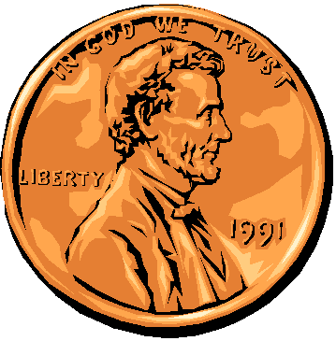
Evaluate Expressions…
Student Outcome: I will be able to model an expression.
Student Outcome I can make and solve equations with adding and subtracting
Let “c” represent the unknown number of pennies in the cup(s)…then add 4 more pennies. If you place 6 more pennies in the cup. Write the expression, what is the value of “c” and find the value of the expression?
Expression | Value of “c” | Value of Expression
c + 4 | c = 6 | 10
+

Slide 112
Evaluate Expressions…
Student Outcome: I will be able to model an expression.
Student Outcome I can make and solve equations with adding and subtracting
Let “c” represent the unknown number of pennies in the cup…then add 4 more pennies. Place 6 more pennies in the cup. Write the expression, what is the value of “c” and find the value of the expression?
Expression | Value of “c” | Value of Expression
c + 4 | c = 6 | 10
+

Slide 113
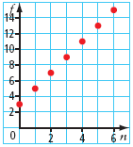
Graph Linear Relations …
Student Outcome: I will be able to graph a linear relation.
Linear Relation:
a pattern made by two sets of numbers that results in points
along a straight line (pattern) on a coordinate grid.
What can we do to make the data on the grid make more sense?
What is the pattern?
What is the “expression?”

Slide 114
Plot Points From a Given Data…
Number of Pups, “p” | Number of Fish, “f” | Ordered Pair (p, f)
1 | 3 | (1, 3)
2 | 6 | (2, 6)
3 | 9 | (3, 9)
7 | 21 | (7, 21)
10 | 30 | (10, 30)
What is the pattern?
What is the expression to find “p”
What is the expression to find “f”

