Slide 1

Unit 2: Matter and Chemical Change
Science 9
Mrs. Sample

Slide 2
Sections
Safety/WHMIS
Topic 1
Topic 2
Topic 3
Topic 4
Topic 5
Topic 6
Topic 7
Topic 8

Slide 3


WHMIS Symbols
Compressed Gas
Flammable

Slide 4


WHMIS Symbols
Oxidizing Material
Corrosive

Slide 5


WHMIS Symbols
Poisonous
Toxic

Slide 6


WHMIS Symbols
Biohazardous
Reactive

Slide 7
Classifying Matter
Chemistry includes facts and observations about matter, laws that summarize patterns of behaviour in matter, and theories that explain the patterns of behaviour.

Slide 8
The Particle Model of Matter
All matter is made up of extremely tiny particles
Each pure substance has its own kind of particle, different from the particles of other pure substances
Particles attract each other
Particles are always moving
Particles at a higher temperature move faster on average than particles at a lower temperature

Slide 9
Mixtures
You have already learned that matter can be classified according to its state as a gas, a liquid, or a solid. Matter can be further classified according to its composition as a mixture or a pure substance.
Each pure substance contains its own unique kind of particle. Mixtures contain at least two kinds of particles.

Slide 10
Mixtures
Mixtures can be classified by their properties.
  If the particles are uniformly scattered, the mixture is homogeneous.
  If the particles are not uniformly scattered, the mixture is heterogeneous.

Slide 11
Mixtures of Matter
Most matter is found in the form of homogeneous or heterogeneous mixtures.
  Homogeneous mixtures (solutions) are usually clear if they are liquids and cannot be filtered to separate the particle.
    The scattering of light cannot be seen when you shine a flashlight in a solution.

Slide 12
Mixtures of Matter
Most matter is found in the form of homogeneous or heterogeneous mixtures.
  Heterogeneous mixtures (mechanical mixtures) can be further classified based on the size of particles.
    In ordinary mechanical mixtures, the different parts are big enough to see, and they stay mixed.
  Example: granite is an ordinary mechanical mixture because you can see the particles of quartz, feldspar, and mica.

Slide 13
Mixtures of Matter
A suspension is a heterogeneous mixture made of large particles that are uniformly mixed but will settle if left undisturbed.
  Example: flour, charcoal, or powdered chalk mixed in water.
Suspensions can be separated by filtering and will scatter light.

Slide 14
Mixtures of Matter
Colloids are heterogeneous mixtures composed of fine particles evenly distributed throughout a second substance.
  Examples: hair gel, clouds
Whether a mixture forms a solution, colloid, or suspension depends on the size of the particles, solubility, and mixing ability (miscibility)

Slide 15
Mixtures of Matter
Emulsions are types of colloids in which liquids are dispersed in liquids.
  Examples: mayonnaise, milk, jelly, and salad dressing.
Many emulsions quickly separate to form layers of the original liquids.

Slide 16
Emulsifying Agents
The addition of an emulsifying agent may keep a liquid dispersed in another liquid.
If a suitable emulsifying agent is added to oil and vinegar salad dressing, the oil droplets cannot clump together to form a separate layer.

Slide 17
Changes in Matter
Science 9

Slide 18
Chemical and Physical Changes
Chemists classify changes in matter into two categories – physical changes and chemical changes.

Slide 19
Physical Change
During a physical change a substance changes in form but not in chemical composition. No new substances are formed.
Examples:
  Ice melting
  Ice freezing
  The taste of chlorinated water

Slide 20
Chemical Change
A chemical change causes one or more new substances to be formed. A chemical change may be difficult or impossible to reverse.
Examples:
  Burning paper (or just about anything else)
  Heating mercury oxide
  Rusting
  Digestion

Slide 21
Evidence of Chemical Change
Chemical changes or reactions have probably taken place if 2 or more of the following happen:
Heat is produced or absorbed
The starting material is used up
There is a change in colour
A material with new properties forms
Gas bubbles form in a liquid
A precipitate forms in a liquid
The change is difficult to reverse

Slide 22
Physical Properties
Any property that can be observed or measured without forming a new substance is a physical property.
  Example: Density (the amount of matter that occupies a certain space)
Physical properties are often further classified as either qualitative or quantitative.

Slide 23
Physical Properties
Qualitative
Examples
A qualitative physical property is a characteristic of a substance that can be described but might not be measured (a quality)
Colour
Texture
Taste
Smell
State
Crystal shape
Malleability
Ductility

Slide 24
Physical Properties
Quantitative
Examples
A quantitative physical property is a characteristic of a substance that can be measured numerically (a quantity)
Melting temperature
Boiling temperature
Density
Viscosity
Solubility
Electrical conductivity
Heat conductivity

Slide 25
Chemical Properties
Any property that describes how a substance reacts with another substance when forming a new substance is a chemical property
  Examples:
Reacts with water
Reacts with air
Reacts with pure oxygen
Reacts with acids
Reacts with other pure substances
Toxicity
Combustibility
Stability

Slide 26
What are elements?
Science 9

Slide 27
What are Elements?
Ancient Greek philosophers views of the elements:
  Thought that matter was made out of fire, water, earth and air.
  These four substances were called “elements”.
  Combinations of the elements had varying properties of hotness, dryness, coldness and wetness

Slide 28
What are Elements?
Alchemists view of the elements:
  Performed investigations to try and turn worthless metals into gold.
  Developed many useful procedures such as distillation and described the properties of many materials.

Slide 29
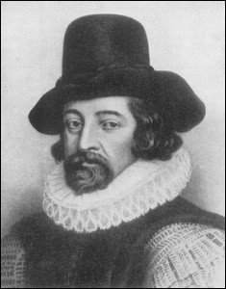
What are Elements?
The current view of the elements:
  Sir Francis Bacon (1561-1626):
    Published a book stating that science should be built on experimental evidence rather than on thought

Slide 30
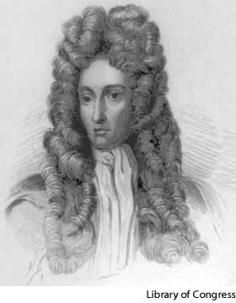
What are Elements?
Robert Boyle (1627-1691):
  Recognized that elements could combine to form compounds.
  The ideas of Bacon and Boyle led to the search for elements

Slide 31
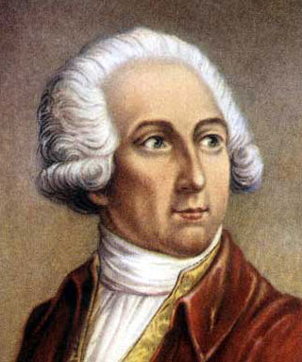
Taking Matter Apart
Antoine Lavoisier (1743-1794):
  Devout Catholic
  Widely considered the “Father of Modern Chemistry”
  Was guillotined during the French Revolution

Slide 32
Taking Matter Apart
Antoine Lavoisier (1743-1794):
  He defined elements as pure substances that cannot be decomposed into simpler substances by means of a chemical change
  He identified 23 pure substances

Slide 33
Law of Conservation of Mass
Lavoisier also discovered the Law of Conservation of Mass:
  In a chemical change, the total mass of the new substance is always the same as the total mass of the original substance.

Slide 34
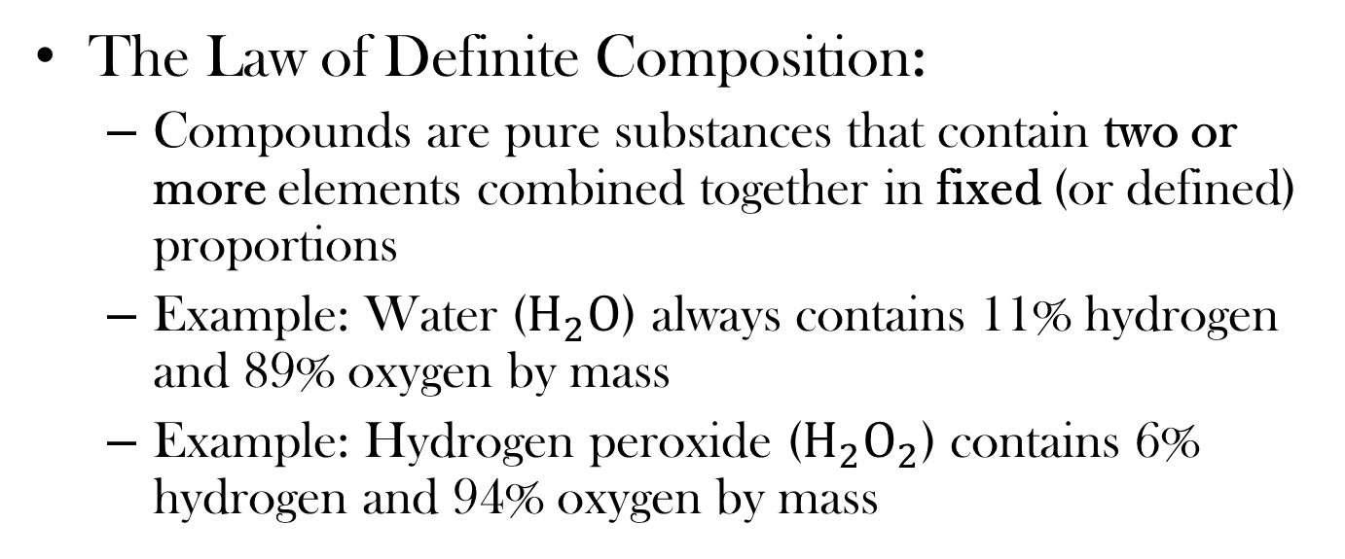
Law of Definite Composition
The Law of Definite Composition:
  Compounds are pure substances that contain two or more elements combined together in fixed (or defined) proportions
  Example: Water ($H_{2}O$) always contains 11% hydrogen and 89% oxygen by mass
  Example: Hydrogen peroxide ($H_{2}O_{2}$) contains 6% hydrogen and 94% oxygen by mass

Slide 35
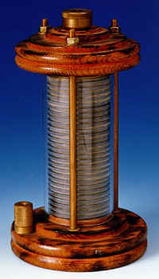
New Discoveries
The Voltaic Pile (The Battery):
  By the 19th century, scientists discovered electricity
  Scientists found that they could use electricity to convert water into hydrogen gas and oxygen gas
  This process is called electrolysis

Slide 36
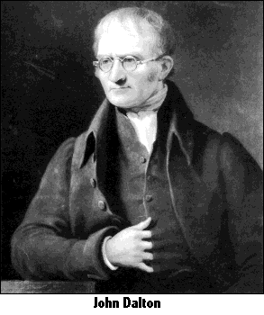
Dalton’s Atomic Theory
John Dalton (1766-1844):
  All matter is made up of small particles called atoms
  Atoms cannot be created, destroyed, or divided into smaller particles
  All atoms of the same element are identical in mass and size
  Atoms of one element are different in mass and size from the atoms of other elements
  Compounds are created when atoms of different elements link together in definite proportions

Slide 37
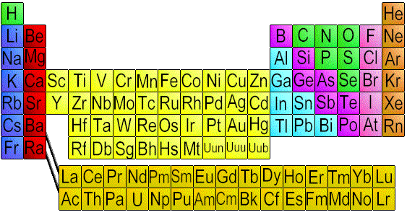
Elements
A pure substance made up of one type of particle (atom)
Each element has its own distinct properties and cannot be broken down into simpler substances by means of a chemical change

Slide 38
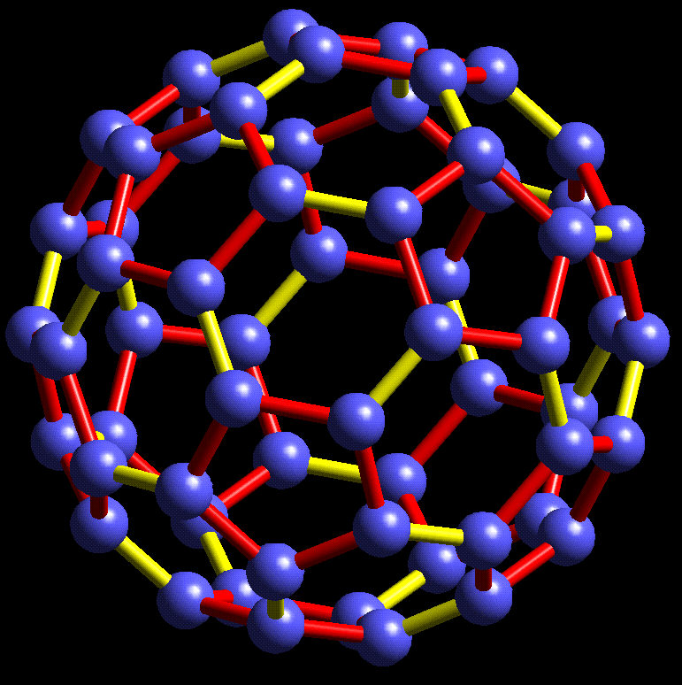
Compounds
Pure substances that are made up of two or more elements chemically combined together
Compounds can be broken down into elements again by chemical means

Slide 39
Laws, Theories, Models and Observations
Laws:
Simply describe and summarize what happens
Theories:
Imaginative ways to explain why something happens

Slide 40
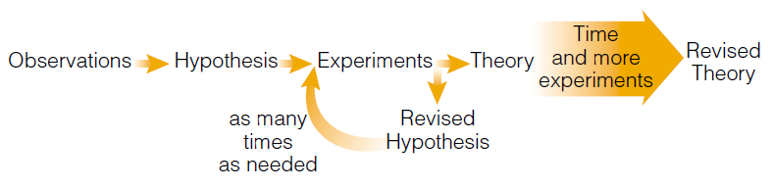
Laws, Theories, Models and Observations

Slide 41
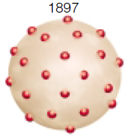
The Plum Pudding Model
Thomson studied particles in gas discharge tubes, and discovered streams of negatively charged particles (electrons)
Since atoms do not normally have a charge, he reasoned that there must also be positively charged particles in the atom
He envisioned negatively charged electrons stuck in the positively charged mass

Slide 42
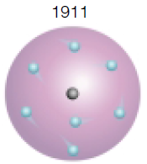
The Planetary Model
Rutherford hypothesized that almost all of the mass of the atom was in the centre, which he called the nucleus
The rest of the atom was mostly empty space occupied by tiny electrons
He called the positively charged particles in the nucleus protons
Neutrons, the uncharged particles in the nucleus, were discovered years later

Slide 43
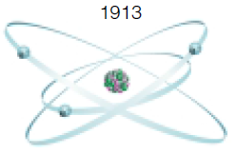
Bohr’s Atomic Model
Both Bohr and Rutherford pictured the atom like a miniature solar system
Electrons rotated around the nucleus like planets around the sun
Bohr suggested that electrons move around the nucleus in fixed pathways called electron shells
Exact path and position of electrons could not be determined precisely, but their energy level could be determined.

Slide 44
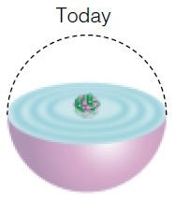
The Electron Cloud Model
Quantum model
Louis de Broglie, Erwin Schrödinger, and others
Agreed with Bohr’s theory of electron levels
Suggested that there was an area around the nucleus where electrons were most likely to be found, called the “electron cloud”

Slide 45
Classifying elements
Science 9

Slide 46
Element Symbols
Elements:
  Substances that cannot be broken down into other substances

Slide 47
Element Symbols
Chemists use one, two or three letters to represent elements.
The first letter is a capital, and those that follower are lower case.
Examples:
  The symbol for zinc is Zn
  The symbol for phosphorus is P

Slide 48
Element Classification
One method used to classify elements is that they are put into one of the following three categories:
  Metals
  Non-metals
  Metalloids

Slide 49
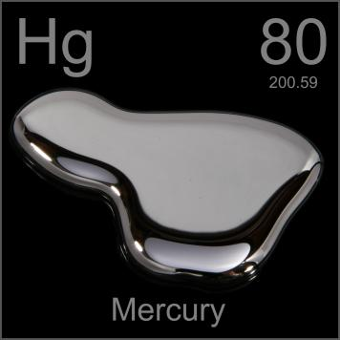
Metals
Solids (except Mercury, which is liquid)
Shiny/luster
Good conductors of heat and electricity
Malleable - can be flattened into sheets without crumbling
Ductile – can be stretched into long wires
Found on the left side of the staircase line on the periodic table.

Slide 50
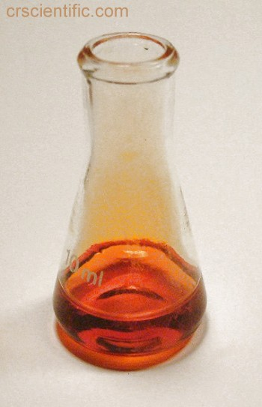
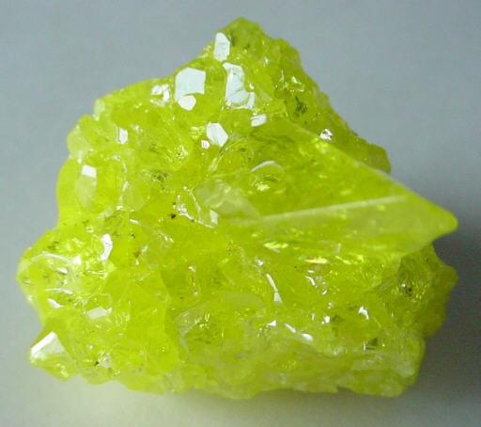
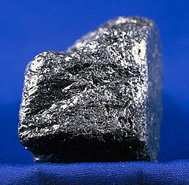
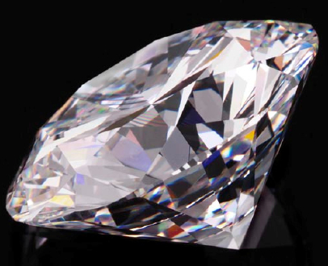
Non-Metals
Some gases and some solids
  Bromine is the only liquid
Not very shiny
Poor conductors of heat and electricity
Brittle, not ductile
Found on the right side of the staircase line on the periodic table.

Slide 51
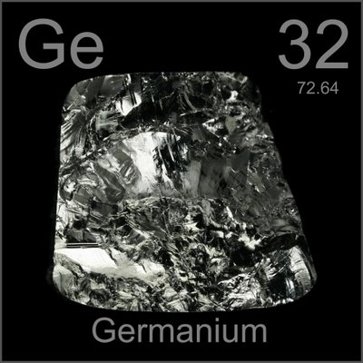
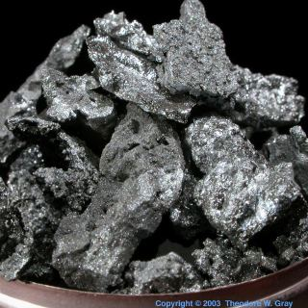
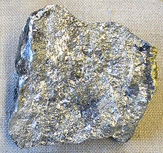
Metalloids / Semi-Metals
Solids
Some are shiny, and some are dull
Some conduct electricity, somewhat poor conductors of heat
Brittle not ductile
Found along the staircase line on the periodic table.

Slide 52
Element Classification
Another way elements are classified is that they are placed into chemical families.
  Chemical families are a group of elements that have similar properties.
On the periodic table, chemical families are also called groups and are organized in vertical columns.

Slide 53
The periodic table
Science 9

Slide 54
The Periodic Table
Was developed as a way to systematically organize all of the elements
Elements – a pure substance that cannot be further decomposed chemically, it is composed only of one type of atom
Many different models to organize the elements were proposed

Slide 55
Dmitri Mendeleev
Dmitri Mendeleev came up with the periodic table that we use today which lists the elements in order of atomic mass
  At the time Mendeleev contained some blank spaces where the known elements did not appear to fit, suggesting that there were elements still to be discovered that fit there (which was true)

Slide 56
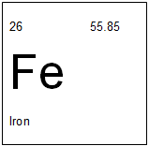
The Periodic Table
Every element is in sequence
  With the shape is makes it difficult to print on a page and so it is often rearranged
Each block contains the same parts:

Slide 57
The Periodic Table
The periodic table is organized into groups/families and periods
Groups (Families) - Vertical columns
  18 Groups on the Periodic Table
  Elements in each group have similar chemical properties
Periods - Horizontal rows
  Properties gradually change from metallic to non-metallic

Slide 58
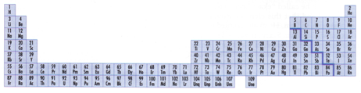
The Periodic Table

Slide 59
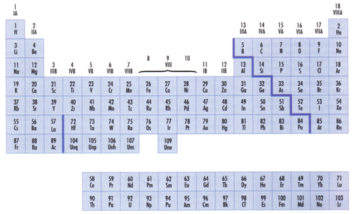
The Periodic Table

Slide 60
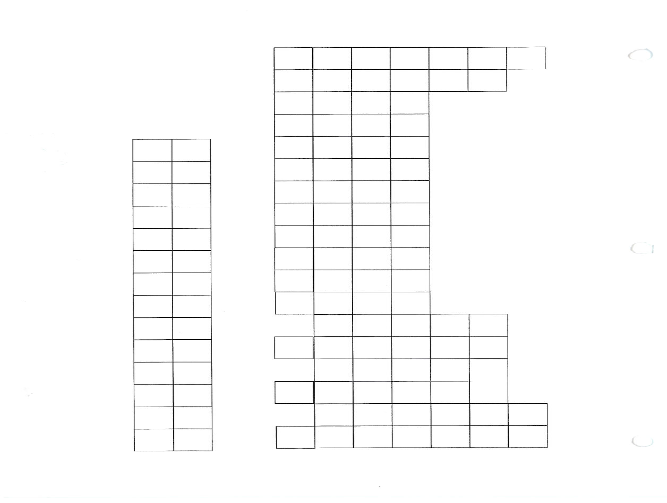
The Periodic Table

Slide 61
Alkali Metals
Most metals are reactive, but alkali metals are so reactive that many of them require special storage.
Cesium in Water

Slide 62
Alkaline Earth Metals
The name “Alkaline Earth” originates with early chemists who thought anything that was insoluble in water and unchanged by heat was one of the “earth” elements.
Alkaline earth elements react fairly vigorously with some substances, but are not as reactive as the alkali metals.

Slide 63
Noble Gases
Chemists find the noble gases interesting because they are so unreactive.
Numerous laboratory experiments have confirmed that all noble gases are chemically “stable”, and therefore are highly unlikely to take part in a chemical change

Slide 64
Halogens
Halogens are naturally found in the form of compounds because halogen atoms react vigorously with almost every other element
Like alkali metal, they have an unpaired electron
  Halogens tend to gain an available electron when they form compounds

Slide 65
Non-Metals
Note:
  All elements above #93 are synthetic
    Can only be formed in a lab for a very short amount of time

Slide 66
Subatomic particle | Relative charge | Symbol | Mass (kg) | Relative mass | Radius (m)
proton | 1+ | p⁺ | 1.67×10^{–27} | 1 | 10^{–15}
neutron | 0 | n⁰ | 1.67×10^{–27} | 1 | 10^{–15}
Electron | 1– | e– | 9.02×10^{–31} | _1_ 1850 | smaller than 10^{–18}

Slide 67
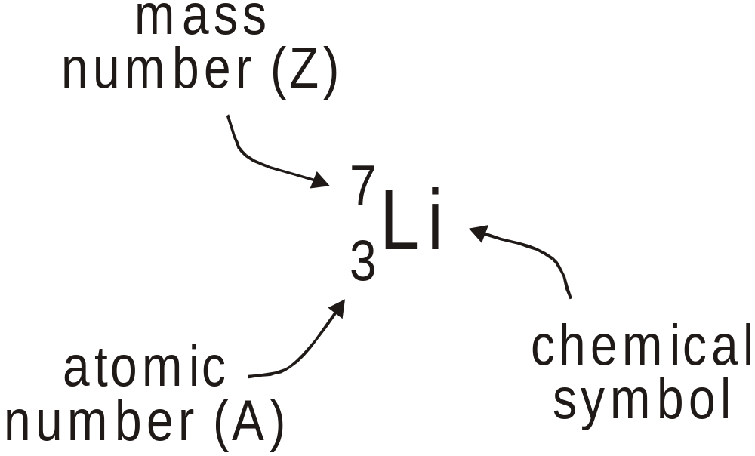
Nuclear Notation

Slide 68
Example
Write the standard notation for:
  Magnesium (has 12 neutrons)
  Iron (has 30 neutrons)
  Hydrogen (mass number of 1)

Slide 69
Atomic number (A)
Each element has a unique atomic number
The atomic number tells us how many protons there are in the nucleus
The atom as a whole must be neutral so to balance the positive charges of the protons the atom must have an equal number of negative charges (electrons).
Atomic number (A) = # of protons = # of electrons

Slide 70
Mass Number (Z)
total # of protons and neutrons in the nucleus
Mass Number (Z) = # of protons + # of neutrons

Slide 71
Example: Use your periodic table to complete the chart below.
boron | nitrogen | phosphorous
A = Z = protons = electrons = neutrons = 6 | A = Z = 14 protons = electrons = neutrons = | A = Z = protons = electrons = neutrons = 16

Slide 72
Chemical compounds
Science 9

Slide 73
Chemical Compounds
There are over 112 elements. These elements can combine in groups of two, three or more to form compounds.
Elements are held together by chemical bonds. Chemical bonds are formed when elements gain, lose, or share electrons
If atoms transfer electrons to other atoms, an ionic compound is formed.
If atoms share electrons, a molecular compound is formed.

Slide 74
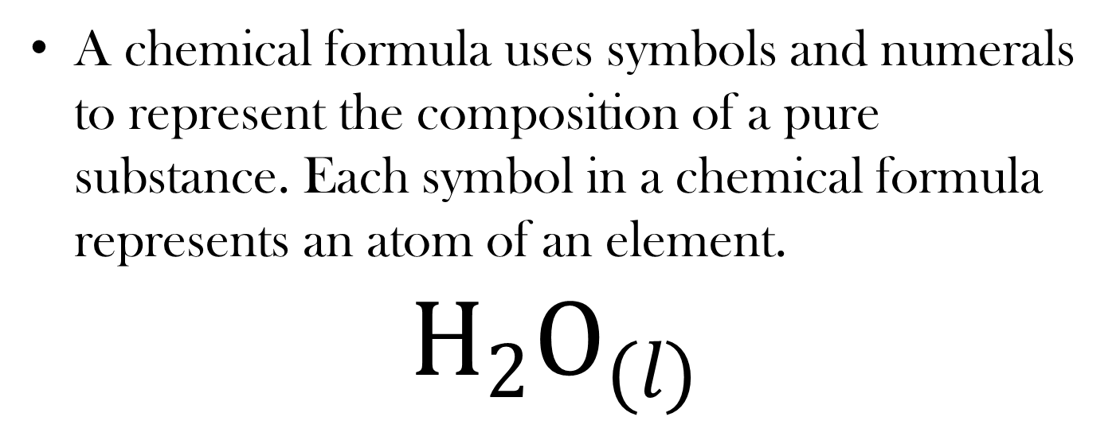
Formulas for Compounds
A chemical formula uses symbols and numerals to represent the composition of a pure substance. Each symbol in a chemical formula represents an atom of an element.
$$H_{2}O_{(l)}$$

Slide 75
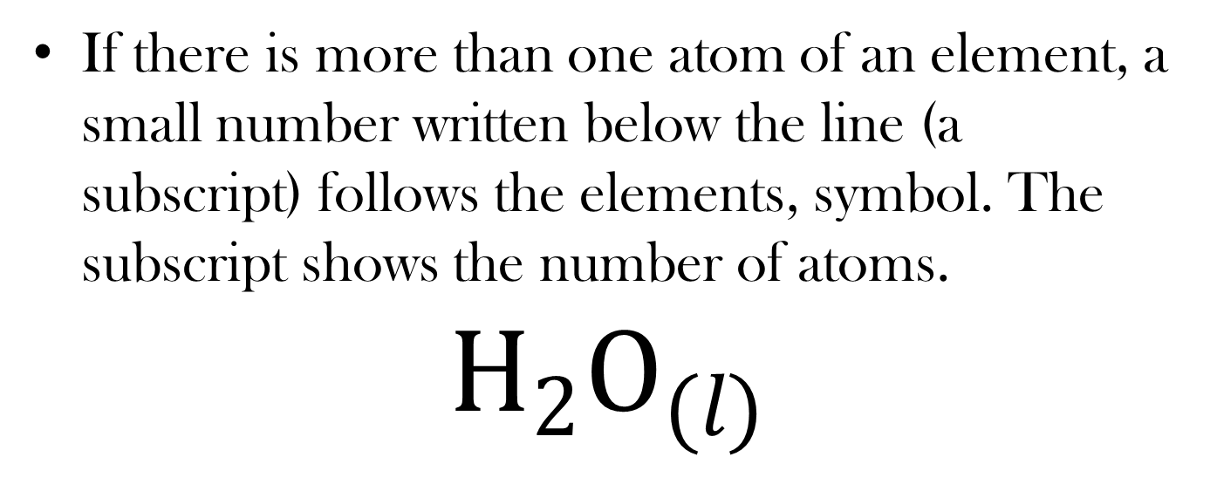
Formulas for Compounds
If there is more than one atom of an element, a small number written below the line (a subscript) follows the elements, symbol. The subscript shows the number of atoms.
$$H_{2}O_{(l)}$$

Slide 76
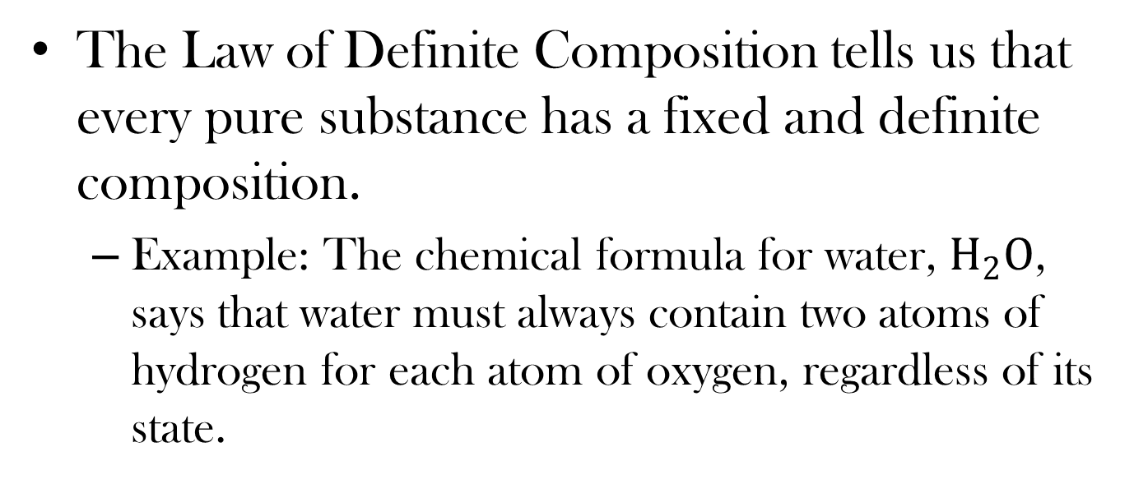
Formulas for Compounds
The Law of Definite Composition tells us that every pure substance has a fixed and definite composition.
  Example: The chemical formula for water, $H_{2}O$, says that water must always contain two atoms of hydrogen for each atom of oxygen, regardless of its state.

Slide 77
Subscripts
Subscripts also indicate the state of the substance:
s – solid
l - liquid
g – gas
aq – aqueous (in solution)

Slide 78
Molecular Compounds
A molecule is the smallest independent unit of a pure substance and is generally a cluster of atoms joined together. These atoms stay linked together regardless of how many times the substance is melted, boiled, or frozen.
Most molecular compounds do not form large structures. Although the bonding between atoms is strong, the attraction between molecules is weak.

Slide 79
Molecular Compounds
When you melt or vaporize a molecular compound, you must apply enough energy to overcome the attraction between the molecules.
Because this attraction is weak, most molecular compounds have low melting and boiling points.
Because molecular compounds have no free electrons, they are poor electrical conductors, even when in a liquid state.

Slide 80
Diatomic Molecular Compounds
Diatomic molecules are molecules made of two atoms of the same element. Oxygen, nitrogen, and hydrogen are examples of diatomic molecules.
To write the formula, use the chemical symbol with a subscript 2.
To name the compound, write the element’s name.

Slide 81
Binary Molecular Compounds
Binary molecular compounds are composed of two different elements.
Steps for naming binary molecular compounds:
  Write the name of the first element
  Change the ending on the name of the second element to -ide
  Use a prefix to indicate the number of each type of atom in the formula

Slide 82
Ionic Compounds
These are compounds composed of a metal and a non-metal
Ionic compounds are held together by ionic bonds. This type of bonding involves a complete transfer of electrons from metallic atoms to nonmetallic atoms.
An ion is a particle or group of particles with a positive or negative charge. This charge is due to a loss or gain of electron(s)
Anion: an anion is an ion with a negative charge
Cation: a cation is an ion with a positive charge

Slide 83
Naming Ionic Compounds
The rules for naming binary ionic compounds are similar to those for binary molecular compounds. A key difference is the name of the compound does not indicate the number of ions in each element.

Slide 84
Rules for Naming Ionic Compounds
The name includes both elements in the compound, with the name of the metallic element first.
The non-metallic element is second. Its ending is changed to -ide.
Subscripts indicate the ratio of ions in the compound. For example, in CaCl₂ the ratio of calcium to chloride ions is 1:2.

Slide 85
Chemical reactions
Science 9

Slide 86
Chemical Reactions
A chemical reaction occurs when one or more substances change
The substances that go into a chemical reaction are the reactants
The substances produced by a chemical reaction are the products

Slide 87
Evidence of a Chemical Reaction
Formation of a gas
Formation of a solid (precipitate)
Odour change
Colour change
Energy change: temperature change, emission of light, emission of sound, electrical energy

Slide 88
Energy Changes in Chemical Reactions
  Reactions that release energy are classified as exothermic. This is caused by chemical bonds forming.
  Reactions that absorb energy are classified as endothermic. This is caused by chemical bonds breaking.

Slide 89
Law of Conservation of Energy
Energy can be converted from one form to another, but the total energy in the universe remains constant.
  Breaking chemical bonds takes in energy.
  Forming chemical bonds releases energy.

Slide 90
Chemical Equations
One way to describe a chemical reaction is with a word equation that describes the reactants and products.
reactants: the substance(s) that go into a chemical reaction
products: the substance(s) produced by a chemical reaction

Slide 91
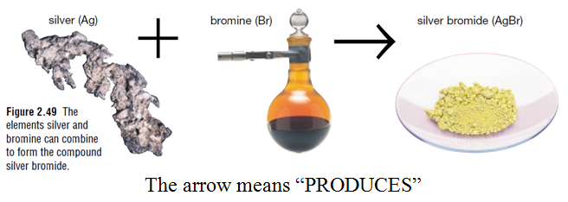
You can convert a word equation into a chemical equation by substituting the chemical formulas for the chemical names.

Slide 92
Examples
iron + oxygen → iron (II) oxide
4 Fe + 3 O₂ → 2 Fe₂O₃
carbon dioxide + water + light energy → oxygen + glucose
6 CO₂ + 6 H₂O + energy → 6 O₂ + C₆H₁₂O₆
iron + oxygen → iron (II) oxide
Fe + O₂ → Fe₂O₃
carbon dioxide + water + light energy → oxygen + glucose
CO₂ + H₂O + energy → O₂ + C₆H₁₂O₆

Slide 93
Balancing Chemical Equations
You need the same number of each atom on each side.
You can only change the number in front (the coefficient)
ex. 2 Cu + O₂ → 2 CuO
This is balanced.

Slide 94
Balancing Tips
if there is a base (OH) change the water to HOH first
pick an element (usually not H or O) on one side, then balance other side
move on to another and do the same
double check, sometimes you will have to go back and change numbers
if can only have evens, double the number

Slide 95
Examples
C₂H₄ + O₂ → CO₂ + H₂O
Cr₂O₃ → Cr + O₂
H₂ + Fe₂O₃ → Fe + H₂O
Cl₂ + NaBr → Br₂ + NaCl

Slide 96
Reaction rate
Science 9

Slide 97
Reaction Rates
The reaction rate is a measure of how fast a reaction occurs
To find the rate of reaction, you can measure either how quickly one of the reactants is disappearing or how quickly one of the products in disappearing

Slide 98
Reaction Rates
The rate of a chemical reaction can be sped up or slowed down by changing the temperature.
  At higher temperatures the rate of most chemical reactions increases.
Other ways of changing the rate of reaction are:
  Stirring
  Changing the size of the reactants
  Changing the concentration of the reactants

Slide 99
Catalysts
Another way to change the rate of a reaction is to add or remove a substance called a catalyst
A catalyst is a substance that speeds up the rate of a reaction without being changed itself.
  A catalyst does not affect the amount of product produced in a chemical reaction. It only affects the speed of the reaction.
  Example: the production of vegetable shortening, synthetic rubber, and high-octane gasoline are all chemical processes that succeed with the help of catalysts.

Slide 100
Enzymes
An enzyme is a natural catalyst made by living things.
Almost all reactions that take place in the body are catalyzed by enzymes.
Example: when you get a foreign particle in your eye, an enzyme in your tears attacks the cell walls of bacteria, preventing them from infecting the eye.

Slide 101
Inhibitors
Inhibitors are substances that slow down chemical reactions.
Example: some plants have natural inhibitors in their seeds to prevent germination until conditions are just right.
Example: an inhibitor is added to bottles of hydrogen peroxide to prevent its molecules from decomposing too quickly.

Slide 102
Corrosion
Corrosion is the oxidation of metals or rocks in the presence of air and moisture
A common example of corrosion is rust
  Rust is iron oxide, a product of the chemical reaction of iron, oxygen, and moisture.
  Note that while water is needed for rusting, it is not a part of the chemical equation.

Slide 103
Preventing Corrosion
Corroded materials lose their strength. Once the top layer of metal has corroded, more surface area is exposed. Oxygen from the air can then reach the inner layers
One way to protect a metal from corrosion is to apply a thin coating of paint.

Slide 104
Preventing Corrosion
Galvanization: the process of coating metals with a thin layer of zinc.
Other metals, including chromium, are also used to prevent corrosion or rusting.

Slide 105
Combustion
Combustion is the highly exothermic reaction between a substance and oxygen.
The equation for the combustion of propane is:
C₃H_{8(g)} + 5 O_{2(g)} → 3 CO_{2(g)} + 4 H₂O_{(g)} + energy (heat)
From the equation, we can see that the reactants are always oxygen and a fuel, and the products are always water and carbon dioxide.

Slide 106
Combustion
The products of combustion are not always beneficial.
  Burning wood or coal produces smoke and ash as well as heat.
  Soot, carbon monoxide, carbon dioxide, and oxides of sulfur and nitrogen can be created by the combustion of fuels

