Slide 1
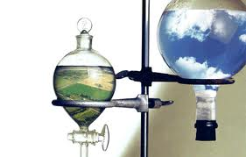
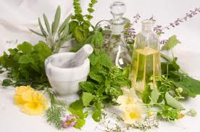
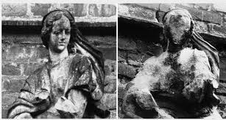
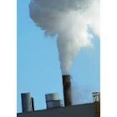
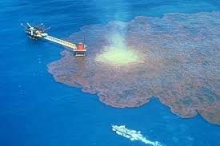
Environmental Chemistry

Slide 2

Chemicals in the Environment
The environment is made up of chemicals that can support or harm living things:
  Essential Chemicals:
      Water
      Air
Human activities can also cause chemical changes in the environment
http://www.youtube.com/watch?v=oJAbATJCugs

Slide 3
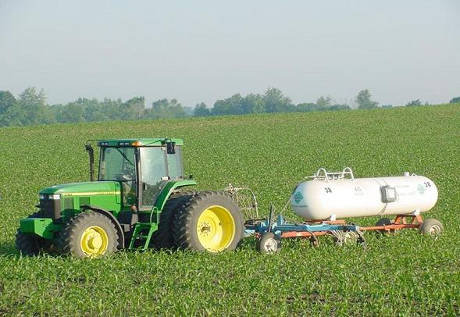
Chemicals in the Environment
Recall that elements are pure substances which can not be broken down
Chemicals are necessary for life but can also be harmful to the environment

Slide 4
Chemicals in the Environment
To constantly replenish the energy in an ecosystem, chemicals must be cycled through living organisms and their environment.
Nitrogen, carbon and water are the most important elements recycled through organisms and their environment

Slide 5
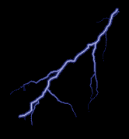
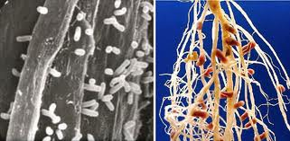
The Nitrogen Cycle
Free nitrogen is converted (fixed) to form nitrogen compounds which are then available to plants➔ Nitrogen Fixation
Lightning, bacteria and decomposers supply nitrogen to plants which are then eaten by animals.
Bacteria live in symbiosis with legumes.

Slide 6
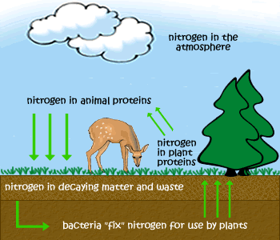

Slide 7
Farmers and Nitrogen

Slide 8
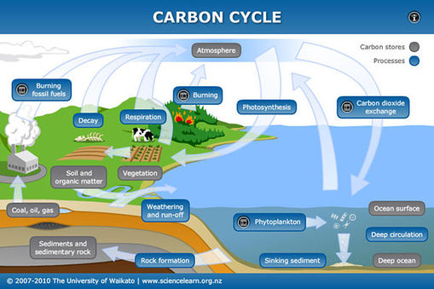
Carbon Cycle
In the carbon cycle, carbon passes from the environment into living things and back to the environment

Slide 9
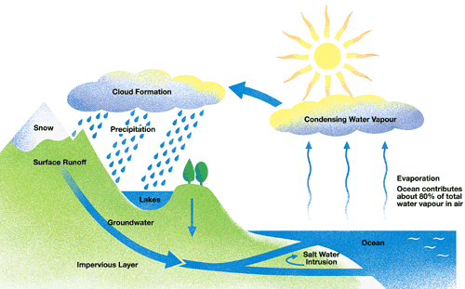
The Water Cycle

Slide 10
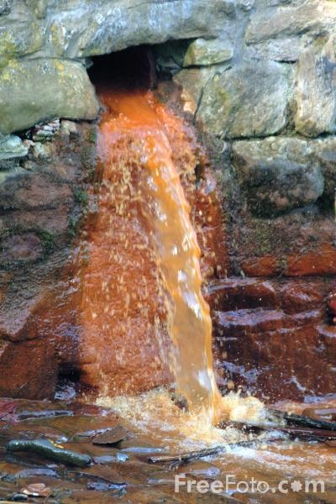
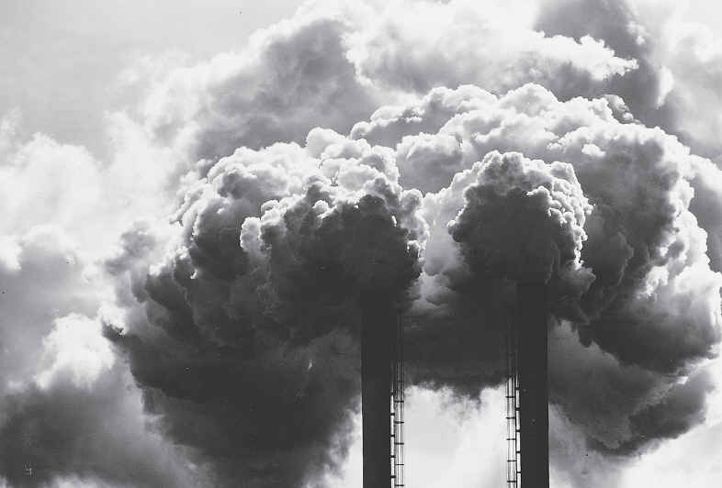
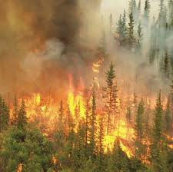
Pollution
Any change in the environment that is harmful to living things
Can be caused by natural or human processes.

Slide 11
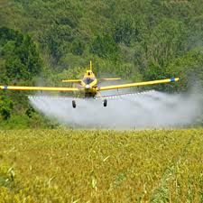
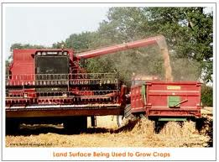

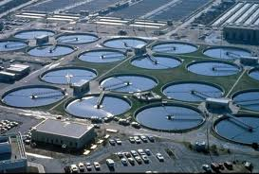
What’s The Big Deal?

Slide 12
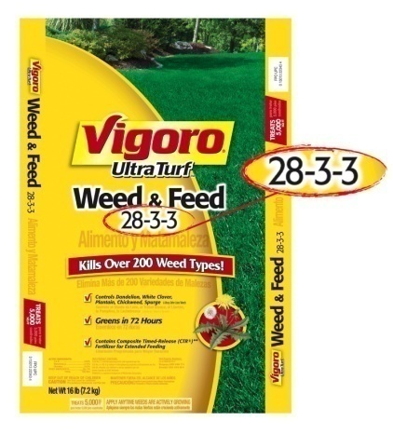
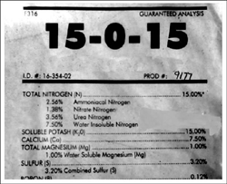
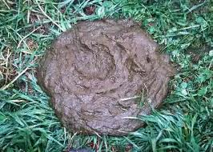
Fertilizers
Natural or synthetic chemicals used in soils for plants to grow
Numbers mean % of nitrogen, phosphorous, potassium (sulfur)
Over-application can lead to environmental problems (crop damage, algal blooms etc)

Slide 13
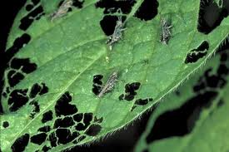

Pesticides
Pest = organism which harms people, crops or structures
Herbicides, insecticides, fungicides
Improper use of pesticides can be harmful to living things & the environment

Slide 14
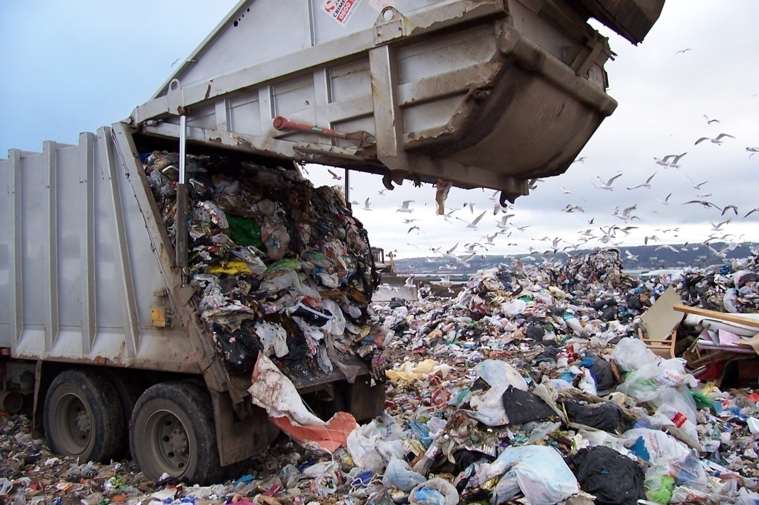
Solid Wastes
Landfill and incinerators are used to deal with the wastes humans produce.

Slide 15
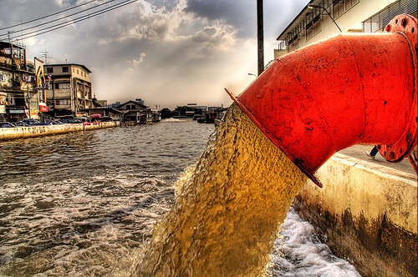
Wastewater
Sewage moves to a treatment plant (or septic tank) it is treated and the effluent is released.
Street drains go directly to rivers/lakes therefore any oils, salts, detergents go directly into the ecosystem.

Slide 16
Wastewater
Wastewater left untreated becomes a breeding ground for harmful bacteria
The treatment process involves three stages: physical, biological and chemical
Physical: larger material filtered out by a screen
Biological: organic sewage material is decomposed by the action of bacteria
Chemical: chemicals are added to remove inorganic phosphates and nitrates

Slide 17
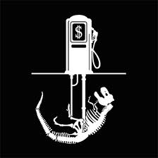
Fossil Fuels
Coal, oil and natural gas are called fossil fuels because they are formed from dead plants and animals.
Hydrocarbons are
very important in our
lives
Burning fossil fuels is
part of the water cycle
and part of the C-O
cycle

Slide 18
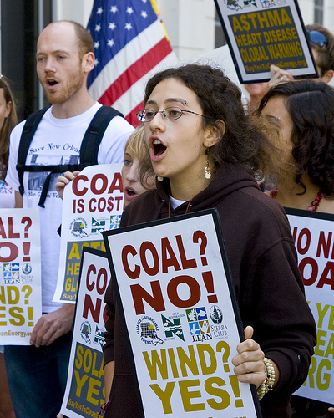
Electrical Energy
Most of our electricity comes from coal fired generators

Slide 19
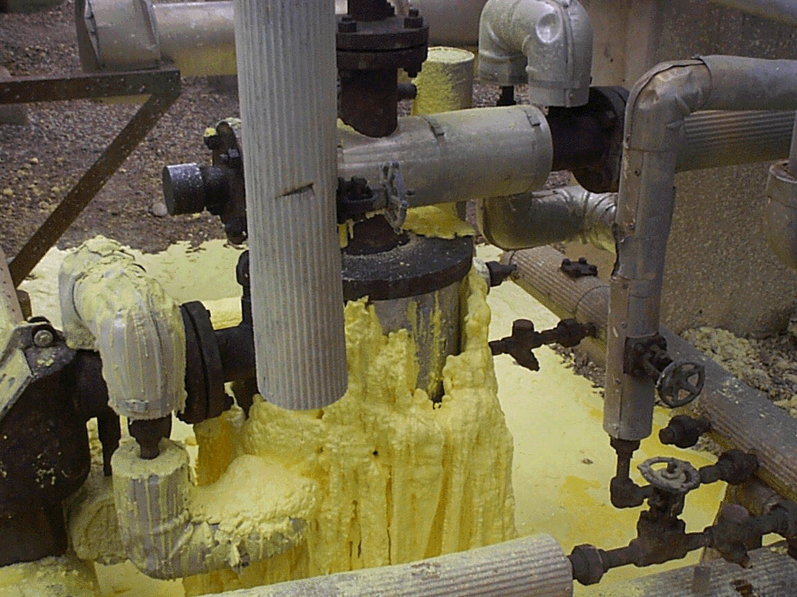
Dirty Fuels
Fossil fuels can have many other compounds mixed in with them including sulfur, mercury and lead.
Sour gas is natural gas that has a high hydrogen sulfide content so the sulfur must be removed
Sweet gas has no H₂S _{(g)}

Slide 20
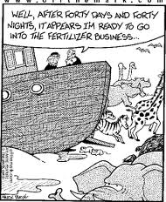
Your Task
Read pages 180-190 and take relevant notes
Do Check and Reflect page 190
  Questions: 1-9, 11
It is very important
that you put some
thought into question 11
as this will be the focus
of our next class

Slide 21
Thought of the Day
Chemistry may seem to be an intimidating subject. Although there is so much to learn, everyone must start somewhere. THE LONGEST JOURNEY BEGINS WITH A SINGLE STEP.
http://www.chem.iastate.edu/group/Greenbowe/sections/projectfolder/animations/aceticeq.html

Slide 22

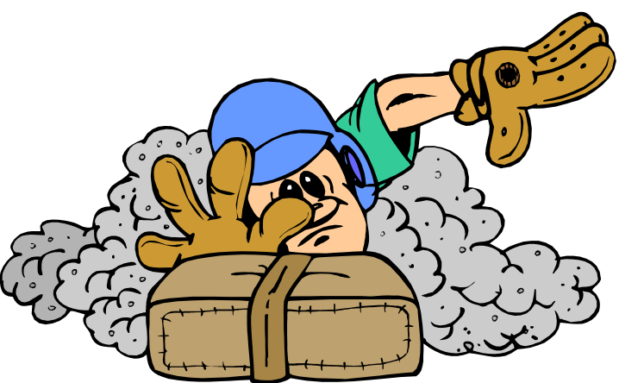
Acids
and
Bases

Slide 23
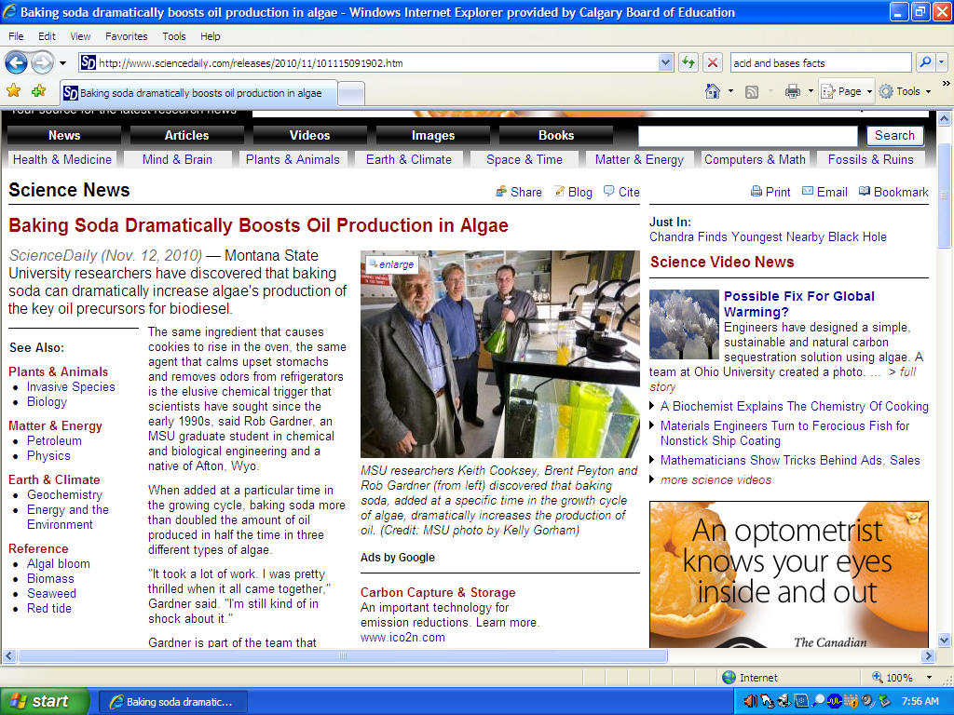

Slide 24

Properties of Acids and Bases
empirical properties
observable properties
are of a substance
acids, bases and neutral substances have some properties that distinguish them and some that
are the same
We will now investigate the empirical properties of Acids, Bases and Neutral Substances

Slide 25
Acids
Bases
Neutral Substances
sour
taste
bitter
taste
electrolytes
electrolytes
electrolytes, non-electrolytes
neutralize
bases
neutralize
acids
react with
indicators
react with
indicators
do not
affect indicators the same way
litmus -
red
litmus -
blue
bromothymol blue -
yellow
bromothymol blue -
blue
phenolphthalein -
colourless
phenolphthalein -
pink
react with to produce
metals
H_{2(g)}
pH
greater than 7
pH
pH
of 7
less than 7
eg)
HCl(aq), H₂SO₄(aq)
eg)
Ba(OH)₂(aq) NH₃(aq)
eg)
NaCl(aq), Pb(NO₃)₂(aq)

Slide 26
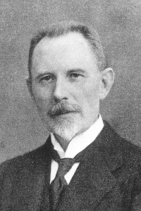
The pH Scale
in 1909, Soren Sorenson devised the
pH scale
at 25°C (standard conditions), most solutions have a pH that falls between
0.0 and
14.0
it is possible to have a pH and a pH
negative
above 14
it is a based on whole numbers that are powers of 10
logarithmic scale
http://dwb4.unl.edu/ChemAnime/PH1D/PH1D.html

Slide 27
there is a for every change in on the pH scale
10-fold change in [H₃O⁺(aq)]
1
eg)
a solution with a pH of 11 is times more basic than a solution with a pH of 9
10 × 10 = 100
pH Scale
more acidic
more basic
0
7
14
neutral
http://www.mhhe.com/physsci/chemistry/chang7/esp/folder_structure/ac/m1/s2/assets/real/acm1s2_1.rm

Slide 28
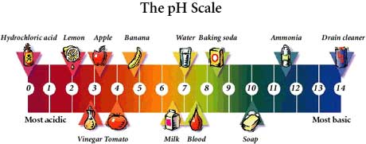
pH Scale
pH scale – 10 x increase for each numeric increase
Acid pH < 7
Neutral pH = 7
Base pH > 7

Slide 29
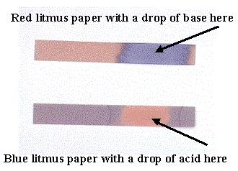
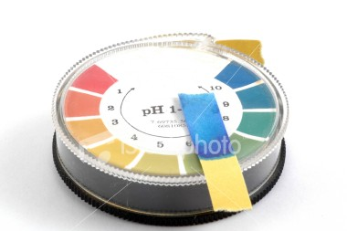
Measuring pH
pH can be measured using :
1. acid-base indicators
2. pH meter
Indicators
an is any chemical that in an acidic or basic solution
acid-base indicator
changes colour
they can be
dried onto strips of paper
eg) litmus paper, pH paper
  Red/Blue
    blue -> red = acid
    red -> blue = base

Slide 30
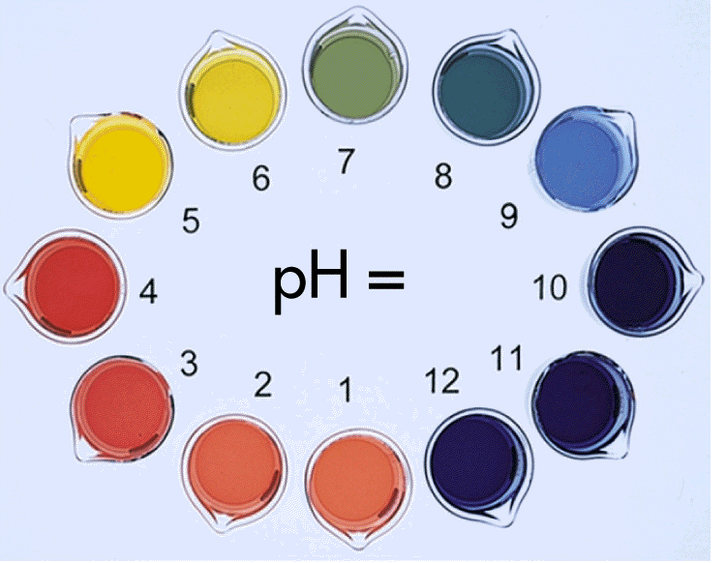
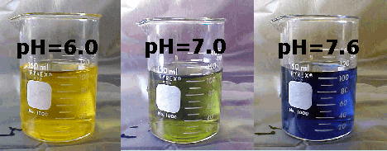

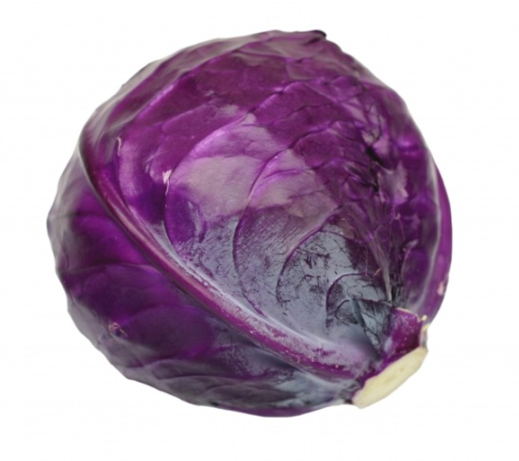
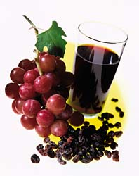
they can be
solutions
eg) bromothymol blue, universal indicator, indigo carmine etc
they can be made from
natural substances
eg) tea, red cabbage juice, grape juice

Slide 31
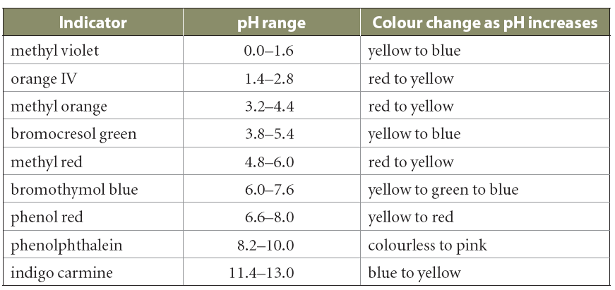
each indicator has a where it will
specific pH range
change colour
you can use to approximate the
two or more indicators
pH of a solution

Slide 32
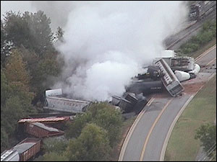
Acids -Bases and You
there are many uses for both acids and bases in our households and in industry
due to their, special care must be used when they are being
reactivity and corrosiveness
produced and transported
If there is a spill we must be prepared to deal with it to minimize the effects on the environment and avoid contact with humans and animals. One of the process to do this
NEUTRALIZATION

Slide 33
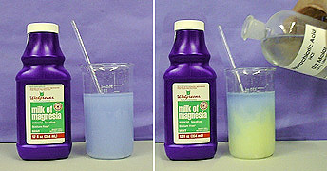
Neutralization Reaction
A reaction between an acid and a base that produces water and a salt.
You Tube clip

Slide 34
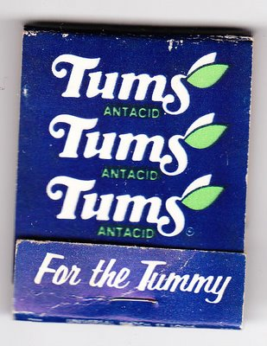
Assignment
Read p 191-193
Check & Reflect p 195 # 1,2,4 – 6

Slide 35
Quiz for November 8, 2011
1)Give an example of an indicator other than litmus paper
2) If your blue litmus paper stays blue what type of substance do you have?
3) What are the two products you get from a neutralization reaction?
4) Drain Cleaner is a strong base what would you predict its pH to be?
5) What tells you that a chemical change has occurred?
6) Give an example of a suspension

Slide 36
Quiz Answers
1)Answers will vary
2) Basic
3)Salt and water
4) Around 14
5) A new substance is formed
6) Answers will vary

Slide 37

Thought of the Day…
Intellectuals solve problems; geniuses prevent them.

Slide 38
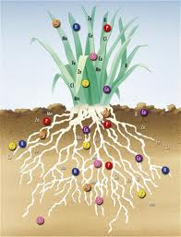
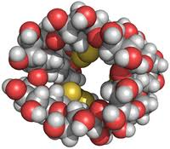
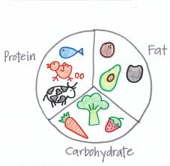
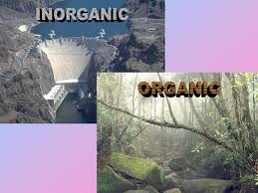
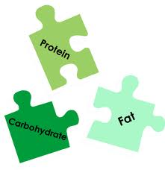
Essentials For Life
http://www.teachersdomain.org/asset/nsn11_vid_lifeorigins/

Slide 39
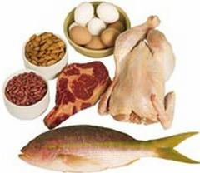
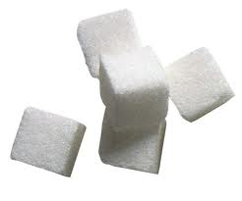
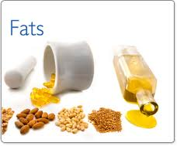
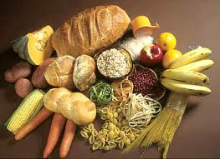
Substances Essential For Life
Our bodies need about 25 elements for normal growth
The most common chemical compounds of living things are:
  Carbon
  Oxygen
  Hydrogen
Together they make up the complex molecules that form:
  Sugar
  Starch
  Fat
  Oil
  Wax
  Proteins

Slide 40

Nutrients
The elements required for life can be divided into two groups:
  Macronutrients – C, Mg, H, O, P, K, N, S, Ca
    These 9 elements are essential for the normal growth of plants
    Macro➔ large amounts
  Micronutrients – minor or trace
  amounts
Nutrients must be available within optimal limits (ie. Not too much nor too little)
Notes:
C the Mganager of the HOPKNS Ca Fe Mn Zn Mo Bo Cu

Slide 41






Slide 42

Organic compounds
  Contain carbon & hydrogen
  Very large and complex
  Far more organic compounds than inorganic compounds
Inorganic Compounds
  Do NOT contain carbon

Slide 43

Organic Molecules
Four types of organic molecules make up living things:
  1) Carbohydrates – organic molecules made up of atoms of carbon, hydrogen and oxygen.
      Examples: sugars & starches
  2) Lipids – compounds composed of many carbon, hydrogen and oxygen atoms
    Examples: fats & oils

Slide 44


Organic Molecules
  3) Proteins and Amino Acids– used by organisms for growth, repair and as a source of energy.
    They are also the main component of enzymes.
    A protein is made up of units called amino acids
      Examples: hormones & enzymes

Slide 45


Slide 46

Organic Molecules
  4) Nucleic acids – the largest and most complex molecules found in all living things.
    All cells contain 2 important nucleic acids:
      1. DNA= deoxyribonucleic acid
      2. RNA= ribonucleic acid
      DNA & RNA are made up of : ribose, phosphates & nitrogen

Slide 47
Practice
Read pages 196-211
  Take additional meaningful notes
  Copy chart on page 197 if not already done
  Mark labs together
Check & Reflect page 211 # 8ab, 9ab, 11

Slide 48




Uptake of Materials and Nutrients

Slide 49



Lets Investigate Plants!!!!!!!!

Slide 50


Intake of Substances
Nutrients can enter plants by
  Diffusion
  Osmosis
  Active transport

Slide 51


Passive or Active?
Passive Transport: does not require the plant to use energy.
  Happens through diffusion and osmosis

Slide 52

Diffusion
Diffusion: is the movement of molecules from an area of high concentration to an area of low concentration
An evening out or balancing of the concentration of a substance in a solution
➔ Equilibrium

Slide 53

Osmosis
Osmosis: water is drawn into the cell because the concentration of water inside the cell is great than it is outside the wall.
Water moves through a
semi permeable membrane.

Slide 54
Lets Compare…
http://highered.mcgraw-hill.com/sites/0072495855/student_view0/chapter2/animation__how_osmosis_works.html

Slide 55

Passive or Active?
Active Transport: Requires the plant to use energy to move molecules of nutrients in the direction opposite to diffusion

Slide 56


Humans & Animals
obtain nutrients from food by
  Ingestion – food is taken into the body
  Digestion – chemical bonds are broken (hydrolysis)
    Mechanical ➔ Chewing Food
    Chemical➔ Enzymes
  Absorption - nutrients are moved into the body
  Egestion - indigestible material removed from the body

Slide 57
Hydrolysis
Hydrolysis is the breakdown or digestion of large organic molecules
  Hydro= Water
  Lysis= breakdown
Let’s breakdown Hydrolysis

Slide 58


Where did it go? And how did it get there?
label mechanical and chemical breakdown
http://www.youtube.com/watch?v=A7jKCfx-0Mo

Slide 59


Substrate
A substrate is the material on which an organisms moves or lives

Slide 60
Lets Review…
- Abiotic factors - water temperature, rate of flow (turbulence), obstacles in the water, wind, amount of photosynthesis by water plants
➔ Non-living
- Biotic factors - number of organisms using oxygen
➔ Living

Slide 61

Keep on Reviewing
Toxicity: describes how poisonous a substance is

Slide 62
Monitoring Quantity of Chemicals in the Environment

Slide 63

Monitoring Chemicals

Slide 64


Monitoring Water Quality

Slide 65



Water Quality
Water quality is determined according to what the water is used for.
Both Provincial and Federal Government guidelines for water quality in five categories of water use:
  1) Human drinking water
  2) Recreation
  3) Livestock drinking water
  4) Irrigation
  5) protection of aquatic life

Slide 66


How Do We Test Water Quality?
Scientists and technicians make sure that these guidelines are being met by monitoring water quality.
They use biological and chemical indicators

Slide 67




Biological Indicators
Scientists use organisms that live in water to help determine water quality.
These indicators include fish, plants, worms, insects, plankton, protozoa, bacteria and viruses

Slide 68


Microbiological Indicators
http://vimeo.com/18382889
Microscopic organisms such as bacteria can cause serious health problems
Water samples are taken to determine the numbers and types of microscopic organisms
Examples: Escherichia coli
http://video.ca.msn.com/watch/video/tragic-memories/16ai6310n?cpkey=7ec5262f-e411-4cb1-b3e2-6887ff318be6%7c%7c%7c%7c

Slide 69



Aquatic Invertebrates
Some biological indicators of water quality show the effects of pollution, which may indicate unsafe water
Example: Aquatic Invertebrates
http://www.youtube.com/watch?v=wBX9LpZKV-A

Slide 70

Aquatic Environments
If the pH of the water in an aquatic ecosystem is below 5(acidic) you will not find many fish or insects there
The diversity of all organisms decreases as acidity increases and dissolved oxygen decreases.

Slide 71
Chemical Factors That Affect Organisms
Water in the environment is never completely pure
It contains many different organic and inorganic compounds.
The concentration of these compounds affects water quality
The following are the most commonly monitored as indicators of water quality:
  A) dissolved oxygen B) Acidity
  C) Heavy Metals D) Pesticides
  E) Nitrogen F) Phosphorous
  G) Sodium Chloride H) Magnesium sulfate

Slide 72
Measuring Chemicals in the Environment
The concentration of chemicals in the environment is usually measured in parts per million (ppm) or milligrams per liter(mg/L)
1) Calculate the salt concentration (in ppm) when you have dissolved 10 mg of salt into 250 g of water (250 mL of water has a mass of 250 g).

Slide 73
Dissolved Oxygen
Dissolved oxygen is essential for the health of aquatic life
An acceptable level of dissolved oxygen for aquatic life is between 5 and 8 ppm
The level of dissolved oxygen in water depends on:
  Temperature
  Turbulence due to wind or speed of moving water
  Amount of photosynthesis by plants and algae in the water
  The number of organisms using up the oxygen

Slide 74
Dissolved Oxygen
Five milligrams per liter (equals 5ppm) of dissolved oxygen will support most organisms that live in lakes and streams
Dissolved Oxygen (ppm or mg/L) | Invertebrates
Poor Quality (0-4 ppm) | Midge larvae , Leech, Mosquito wriggler
Moderate Quality (5-8 ppm) | Freshwater clam, Dragonfly nymph, Fairy shrimp ,Mayflies, Stoneflies
Good Quality (9-10 ppm) | Caddisfy larvae, Stonefly larvae, Mayfly larvae and some worms

Slide 75
Try This
Estimate the oxygen levels in each sample by looking at the number of freshwater invertebrates in the following samples.
(i) Site A sample: 3 midges, 3 caddis flies, 1 damsel fly, 1 leech
(ii) Site B sample: 4 crane flies, 5 dragonflies, 1 stonefly, 3 blackflies
(iii) Site C sample: 1 gilled snail, 5 mayflies, 2 crane flies, 1 crayfish
(iv) Site D sample: 3 midges, 4 leeches, 1 worm, 1 dragonfly

Slide 76
Phosphorous and Nitrogen Content
One factor that can affect dissolved oxygen is an increase in phosphorous and nitrogen in the water➔ Optimal limits
Fertilizer runoff➔ increased phosphorus and nitrogen in water➔ increased growth of algae ➔ grow/die➔ dead organic matter➔ bacteria eat➔ bacteria increase➔ use up dissolved oxygen➔oxygen content decreases ➔ aquatic life dies

Slide 77

Acidity
Precipitation with a pH lower than 5.6 is considered acid rain or snow
When acid precipitation falls on aquatic ecosystems the acidity in the water increases and the diversity of living things decreases
Spring Acid Shock!!!!

Slide 78


Heavy Metals

Slide 79

Pesticides
Can remain in environment for long periods of time
Pesticide resistant pest may develop
Mixed pesticides in environment may be toxic

Slide 80

Salt Content
Salinity increases can be harmful to fresh water habitats.
Salt content can increase due to
  geology
  surface runoff
  evaporation

Slide 81

Measuring Toxicity
Toxins are substances that produce serious health problems or death when introduced into an organism
When we compare toxins we use a measurement called LD50
    LD➔ Lethal Dose
    50 ➔ 50%
LD50 is the amount of a substance that causes 50% of a group of test animals to die if they are given a specified dose of the substance all at once

Slide 82

Measuring Toxicity
(Note: lower LD50 = more toxic)

Slide 83
Try These
Which of the following statements best defines the term LD50?
A. LD50 is the proportion of the first 50 organisms in a test population that dies when exposed to a particular substance.
B. LD50 is the proportion of the first 50 organisms in a test population that becomes sick when exposed to a particular substance.
C. LD50 is the concentration of a substance administered to a test population that kills half the organisms in the test population.
D. LD50 is the concentration of a substance administered to a test population that makes half the organisms in the test population sick.

Slide 84
Your Task
Read 204-223
  Make sure that you go over the section on Lethal Dose!!!!!
  ppm!!!!!
Check & Reflect page 209
  Questions #1-7
Check and Reflect page 224
  Questions: 1-8, 11

Slide 85




Monitoring Air Quality

Slide 86

Air Composition
Air is made up of:
  Nitrogen (78%)
  Oxygen (21%)
  Argon (< 1%)
  Carbon Dioxide (0.03%)
  Trace gases – H₂ & Ne

Slide 87


Measuring Air Quality
http://www.youtube.com/watch?v=BlPsCPAx1Os
Air quality can be determined in two ways:
  Measuring levels of pollutants
  Estimating emissions from pollution sources

Slide 88
Sulfur Dioxide – SO₂
SO₂ pollution comes from
  Industrial processes
  Burning fossil fuels
Produces acid rain when mixed with H₂O in atmosphere
SO₂ removed using scrubbers in stacks which react limestone to produce gypsum

Slide 89

Nitrogen Oxides - NO_{x}
Formed mainly by vehicle exhaust but also from industrial processes
Forms brownish gas
Also contributes to acid rain

Slide 90

http://www.youtube.com/watch?v=HE6Y0iEuXMQ

Slide 91

Do skill practice on page 226

Slide 92

Carbon Monoxide
Odorless & colorless (silent killer)
Forms in combustion reactions in which there is not enough O₂
Dangerous gas can cause
  Headaches
  Sleepiness
  Brain damage -> death

Slide 93


Ground-Level Ozone
http://www.youtube.com/watch?v=3s5G-mP4_qg
Ozone found at the Earth’s upper atmosphere as well as on the Earth’s surface
Ozone is an:
  Odorless gas
  Colorless gas
  Composed of 3 oxygen atoms
At ground level it forms from reactions between oxygen, nitrogen oxides and volatile organic compounds (VOCs)
  VOC’s➔ organic chemicals that evaporate easily
    Most VOCs come from human made products such as solvents and gasoline's
Can cause lung damage and affect crops

Slide 94

Your Task
Read 225-227
Check & Reflect p 228 #1-7

Slide 95




Monitoring the Atmosphere

Slide 96




The Greenhouse Effect?

Slide 97

Greenhouse Gases
Greenhouse gases are gases in the atmosphere that absorb and emit radiation
The main greenhouse gases are
  water vapor
  carbon dioxide
  methane
  nitrous oxides
  ozone

Slide 98

Greenhouse Effect

Slide 99

Enhanced Greenhouse Effect
Human caused emissions
Water vapor is the #1 greenhouse gas
CO₂ is NOT a pollutant
The enhanced greenhouse effect results in increased concentration of gases which traps even more heat

Slide 100
Global Warming
This temperature increase worldwide is known as GLOBAL WARMING or CLIMATE CHANGE
Global warming may lead to climate change which could affect all living things. These effects could include:
  - More violent storms
  - Flooding of costal areas from melting ice caps
  - Spread of diseases.

Slide 101

Global Warming?
Some scientists say that human activities -> climate change (the new term for global warming)
There is some controversy regarding these claims and data

Slide 102

Ozone
Ozone (O₃ _{(g)} ) protects us from UV radiation
Ozone depletion was caused by CFCs
Ozone depletion noticed in the 1970s has made some significant recovery since the banning of CFCs

Slide 103

CFCs & Ozone Destruction
CFCs were widely used as a propellant in aerosols and as a coolant in refrigerators
1 molecule of CFC can destroy 100 000 O₃ molecules
http://newsisaconversation.blogspot.com/2007/03/what-happened-to-ozone-hole.html

Slide 104

Practice
Read 229 – 232
Check and Reflect page 233 Q’s: 1,3,6,8
Notes:
Dec 3 1973 & April 9 2001

Slide 105


Section Review p 234
Group Review – Answer # 1 – 11
Notes:
Environmentalism as the “new Religion”

Slide 106
Social and Environmental Context
You need to create an ad campaign (commercial, website, newspaper ad, poster, wiki, blog, imovie) to address one of the topics provided.
You will have one class period to research this and come up with an idea and half a class to pull everything together.

Slide 107



Spread of Harmful Substances

Slide 108



Potentially harmful substances are spread and concentrated in the environment in various ways.

Slide 109

Release at the Source
Source of pollutants may be difficult to identify because many have been dispersed over large areas [even globally]

Slide 110

Transport of Materials Through Air, Soil, and Water
Transport in Air:
  There are three stages of transport of substances in air:
  Release of the chemical at the source
  Dispersion of the chemical in the atmosphere
  Deposition of the chemical in soil or water

Slide 111



Detective Work…
In order to determine the direction and distance that airborne chemicals travel we must consider the following:
  Pollutants properties
  The wind speed
  Direction of prevailing winds
  Precipitation
  Do activity on
  Page 238

Slide 112

Transport in Groundwater
Contaminants can enter the surface water in a number of ways:
  From the air
  From groundwater
  Runoff from industrial sites, agriculture & civic storm-water/waste-water
Potential to damage community drinking water

Slide 113
Transport in Soil
Water landing on soil can do 4 things:
  1) Evaporate
  2) Soak into the soil and is taken up by plants
  3) Some runs onto the streets or streams
  4) Some soaks through the soil and moves downwards. As it moves down the water dissolves substances in the soil and carries them➔ Leachate
    Leachate: Liquid mixture formed as water passes through chemicals in the soil.
  Pore size affects fate of precipitation

Slide 114

Your Task
Read pages 236 – 242
Check and Reflect pg 242 # 1-8

Slide 115
Check It Out
http://www.teachersdomain.org/asset/ess05_vid_rhine/
http://www.teachersdomain.org/asset/envh10_vid_envdallas/
http://www.teachersdomain.org/asset/frnpw10_vid_industry/

Slide 116




Changing Concentrations of Chemicals in the Environment

Slide 117


Changing Concentration
The concentration of chemicals in the environment can be changed using different techniques.
Techniques include:
  Dispersion
  Dilution
  Biodegradation
  Phytoremediation
  Photolysis

Slide 118

Dispersion and Dilution
Spreading the chemical around or reducing its [ ] (concentration)

Slide 119

Biodegradation
Using living things to reduce the [ ] of chemicals
This is a multi-step process in which the large organic molecules are broken down (hydrolyzed) either inside or outside bacteria.
The rate of biodegradation is dependent on:
  1) Temperature
  2) Moisture
  3) Oxygen Supply
  4) Vegetation
  5) pH

Slide 120

Bacteria and Biodegradation
Bacteria can be of two types:
  Aerobic: bacteria that require oxygen
  Anaerobic: bacteria that live “without oxygen”

Slide 121


Phytoremediation
Using plants to remediate (fix) soils
Plants are grown and harvested then burned or composted
This biotic activity reduces the amount of toxins in the soil

Slide 122

Photolysis
Photolysis is the breakdown of chemical substances by sunlight
Using sunlight to breakdown compounds
  NO₂ → NO + O₂
  Photodegradable plastic
http://www.ted.com/talks/capt_charles_moore_on_the_seas_of_plastic.html

Slide 123


Slide 124

Your Task
Read pages 243 - 247
Check and Reflect page 247 # 1 - 8

Slide 125



Hazardous Household Chemicals

Slide 126

Close to Home…
Lynnview Ridge – lead contamination

Slide 127


The Exxon Valdez Disaster: 20 Years Later
YouTube 1 (2:22)
YouTube 2 (9:52)
http://www.youtube.com/watch?v=MbjC9SMKClE
http://www.youtube.com/watch?v=YkzB1ZYcTwM&NR=1

Slide 128

Alberta Spills: Wabamun Lake

Slide 129


Alberta Spills: Wabamun Lake
Lake Wabamun, one of the best-known lakes of Alberta, lies 60 km west of Edmonton. It is a large shallow lake that is 19.2 km long and 6.6 km wide.

Slide 130
Alberta Spills: Wabamun Lake
On August 3, 2005, 43 CN railcars went off the tracks beside Lake Wabamun, spilling Bunker C oil and pole treating oil into the lake.
Alberta Environment closely monitored CN’s clean-up of the spill site, the lake and the shoreline.

Slide 131


Alberta Spills: Glennifer Lake

Slide 132


Mosquito Control

Slide 133

I Want to Suck Your Blood
Every time an insecticide is
used, it introduces chemicals
into the local environment.
Though these chemicals are closely regulated, to limit damage to the environment. These insecticides used to kill mosquitoes may kill other species of insects as well

Slide 134


So What Are We Doing?
Monitoring of mosquitoes takes place from May until September.
A one-kilometre buffer zone around the City is monitored and larvae are counted using a dipper cup in stagnant water.
Areas temporarily subject to higher population due to heavy rains are more likely to be potential problem areas compared to permanent water bodies because permanent areas have established predators.
The Parks Department regularly checks these sites and track larvae counts and stages. When larval dip yields 25, spraying of larvicide commences. The Parks Department only sprays for larvae not adult mosquitoes. The chemical of choice is a biological control called Vectobac. It is a very safe and only harms mosquito larvae. A follow-up evaluation of the area is made within four days

Slide 135

How we control mosquito populations in Calgary
The City’s mosquito control program aims to improve the quality of life of Calgarians by reducing mosquitoes, which are considered both a nuisance and a medical threat, while protecting our natural spaces by using means considered to have the least impact on the environment.
The City carefully monitors the mosquito population in Calgary by monitoring larvae. If it is determined that larvae numbers are above threshold levels, control measures are initiated. "Larvaciding" is the method used by The City and is the most efficient and effective means of controlling mosquitoes through non-toxic means. Treatments within the city involve the direct application of a natural, non-toxic larvacide. This is a controlled and specific application to pools of standing water where mosquitoes lay their eggs. The application kills the mosquito larvae while having little or no impact on other life forms. In the city, products are applied in a granular form which allows for direct application – eliminating any possibility of drifting to other areas of the environment. Aerial applications via helicopters are used for the buffer zone around the city.

Slide 136


Costs and Benefits

Slide 137

West Nile Virus

Slide 138
Hazardous Household Chemicals
Government regulations are designed to protect consumers and reduce the risks associated with transporting, storing, using and disposing hazardous materials.

Slide 139

How Do We Get Rid Of Chemicals?
Never pour hazardous waste down the drain or soil or throw them into the garbage.
Disposing of hazardous household products by pouring them into the soil or putting them in the garbage can contribute to contamination of drinking water, soil and air.

Slide 140

What’s in a Label
If a potentially hazardous chemical is being transported, stored or used it must be labeled to alert workers to the dangers of the product and to provide basic safety precautions

Slide 141
Labels
Use Limitations:
Use on exterior surfaces only
Use only above ground
Keep away from water systems since product is toxic to fish
Directions for Use:
Be sure to have a clean dry surface before you apply this product
Use a brush to apply. Do not spray.
Use full strength. Do not dilute
Precautions:
Avoid breathing vapors
Keep away from open flames or sparks
Avoid skin contact
Wash with soap and water after using this product
First Aid:
If swallowed do not induce vomiting. Call a doctor or poison control center immediately.
If spilled on skin, wash with vegetable oil followed by soap and water
If splashed in eye, flush eyes with water for 15 min.

Slide 142
New Product Regulations
Certain products require government approval before they can be sold.
Companies need to follow a strict testing process and must provide detailed information that includes:
    Intended use, physical, chemical properties and active ingredient(s)
    Instructions for use, safety precautions
    Health effects, environmental effects, toxicity to humans and first aid instructions in case of poisoning.

Slide 143
Your Task
Check and Reflect pg 252 questions 2, ,3ab, 4, 6
Read pg 253 – 258
Note: blue boxed sections
Check & Reflect p 259 Questions # 3, 7 & 8

Slide 144

Section Review
Page 247 Questions1,5
Page 260 Questions 1,2,5

Slide 145

Exam Preparation
Section Review page 260
Unit Summary page 262
Unit Review p 266 # 1,4,7,10,12,13,14,18,21,22,23,26
Unit Test:

