Slide 1
Interactions Within an Ecosystem
Topic 1

Slide 2
Ecology
Ecology is the study of the relationship between living organisms and their environment.
An ecologist is someone who studies those relationships.
They may study what an organism eats, how it reproduces or how they raise their young.

Slide 3
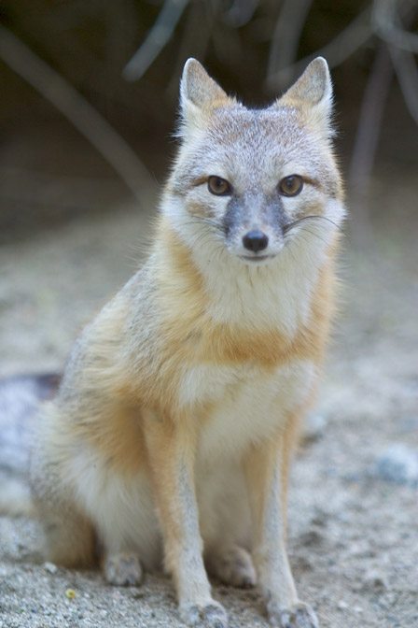
Swift Foxes
Swift foxes almost entirely disappeared from Canada. The last fox in Alberta was seen in 1928. Ecologists determined that swift foxes were accidently killed in the early 1900s when people were using poison to control the wolves and coyotes who preyed on them.
As well most of their habitat was lost due to human developments like cities and farms.
The fox is currently being reintroduced.

Slide 4
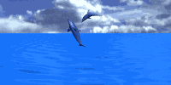
Needs of Living Things
What do you think a species needs to survive?

Slide 5
Four Basic Needs
Food
Water
Suitable Habitat
Exchange of gases
Living things are always interacting with each other and with the non-living things in their environment.

Slide 6
Adaptations
Living things are adapted, so they 'fit' into their surroundings, to ensure survival.
An adaptation is something that can be inherited or learned during the organism's lifetime. It is a characteristic that helps an organism survive and reproduce in its environment.

Slide 7
Types of Adaptations
There are two types of adaptations
  Inherited: you were born with the adaptation. For example: A bear can survive a harsh winter because it hibernates.
  Learned: something you are taught in order to survive.
  For example: You learn how to speak a language in order communicate.

Slide 8
Ecosystems
An ecosystem is the interactions between living and non-living things in a particular environment.
An ecosystem is a place where these interactions occur, such as a rotting log, or a forest.
All organisms and parts within this place are interacting all the time and adjustments must occur if the organism is to survive.

Slide 9
Ecosystems vary in size and complexity. In order to study an entire ecosystem, scientists often study only a small aspect of an ecosystem and then work with other scientists to piece together the overall picture of how the ecosystem functions.

Slide 10
Interactions in Ecosystems
Symbiosis - When two or more species live closely together in a relationship that lasts over time symbiosis occurs.

Slide 11
Types of Symbiosis
There are three types of Symbiosis
  Mutualism
  Parasitism
  Commensalism

Slide 12
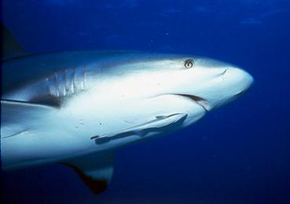
Mutualism
Mutualism occurs when there is a relationship between two different organisms, in which each partner benefits from the relationship.
Examples include: Remora and shark

Slide 13
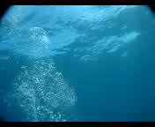

Slide 14
Parasitism
Parasitism occurs when there is a relationship between two different organisms, in which one partner benefits from the relationship, while the other partner is harmed.
The partner that benefits is the parasite, who lives on or in the other organism who is called the host

Slide 15
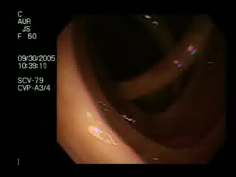

Slide 16
Commensalism
Commensalism occurs when there is a relationship between two different organisms, in which one partner benefits from the relationship, while the other neither benefits, nor is harmed.

Slide 17
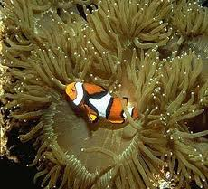
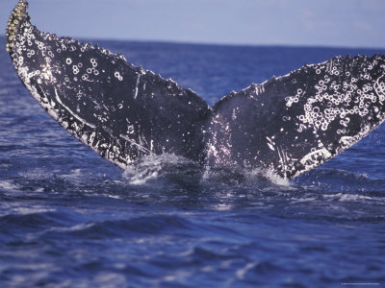

Slide 18
Commensalism Example
An orchid plant will attach itself high up a tree trunk to have a safe, sheltered place to grow and receive water dripping down the tree trunk .
The tree trunk which provides the habitat for the orchid seems to neither be harmed nor benefit from the relationship.

Slide 19
Impacts on Ecosystems
Symbiotic relationships are only a few ways that organisms interact with one another within an ecosystem.

Slide 20
Other interactions may involve the physical changing of the ecosystem by the organisms living in it and interacting with parts of it.
For every action in an ecosystem there is a resulting effect and reaction which will change the make-up of the ecosystem in some way.

Slide 21
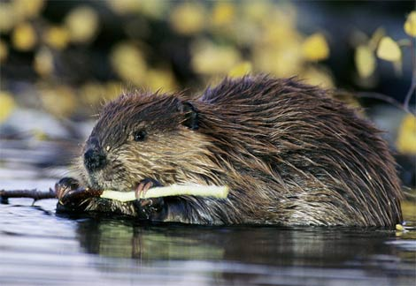
Impact Example
Like when a family of beavers make a dam, the stream below the dam dries up, killing the water organisms that need the water to survive. Above the dam, a pond changes the habitat and limits the kinds of organisms that can survive there.

Slide 22
Human Impacts on Ecosystems
Topic 2

Slide 23
Natural Resources
are the materials and products that are found in nature, that people use to meet their basic needs.
Provide some examples of natural resources.

Slide 24
The impact that people have on the use of resources can be very small, or can be huge, and can lead to positive or negative consequences.
The needs of all living things now have to be met with the available natural resources.
How we are able to satisfy these needs with minimal conflict will determine how resourceful we can be.

Slide 25
People and Nature - A Changing Relationship
The ways people interact with the environment has changed over time. Machines and advanced technologies have caused a higher impact than in the past.
All of the needs people had in the past were satisfied by the natural resources they were able to find in the environment around them.
Today, resources are transported throughout the world, as the demand gets higher. Lifestyle changes over time have increased the pressure on different environments and the ecosystems we live in.

Slide 26
Gathering Food
Head-Smashed-In Buffalo Jump
Buffalo were hunted by driving them to run off a cliff. The carcasses were then dragged to camps where they were processed into meat, hides, tools, and other necessary items. All parts of the buffalo were used, with minimal impact on the environment.

Slide 27
Prairie Settlers
Early settlers kept mixed farms (livestock and crops).
Improvements in technology allowed them to stay in one place (instead of following the food supply around).
This lifestyle had a larger impact on the environment because farmland and ranchland had to be modified, to support the crops and livestock.

Slide 28
Cattle Feedlots
A large area that has been fenced in to feed cattle for food is called a feedlot. Once the beef is slaughtered and processed, the products are transported all over the world.
The impact of this activity is significant, because cattle waste can pollute the water system nearby, and the soil conditions can be negatively affected.

Slide 29
When Is a Need a Want?
Needs are basic to survival, whereas, ' wants ' are things that just make survival more comfortable or enjoyable.
Each time a need or a want is satisfied, natural resources or energy are used up. This impacts the environment we live in.

Slide 30
Transporting food from all around the world, just so we can have the luxury of choice impacts other regions as well, because those regions had to clear land, use fuel (energy) and through the industrial processes caused pollutants to enter the air.

Slide 31
When our 'want' demands conflict with the health of our ecosystems, we need to begin making some more responsible choices.
The needs of wildlife can be negatively impacted by the wants of people. When this happens we need to decide whether our want is more important than their need.

Slide 32
DDT
Knowing what effects you are having on the environment (or will likely have) will help you make decisions.
The use of DDT (a chemical pesticide) was found to have a negative effect on Peregrine Falcons. It wasn't until the species was almost lost completely that something was done. DDT was banned and recovery programs were put in place to restore the numbers of peregrine falcons.

Slide 33
Environmental Choices
Topic 3

Slide 34
Sustainability
Sustainability means that the resources from the environment can be replaced as quickly as they are used.
Are we putting back what we take out, or, are we using up all the resources before they can be replaced?

Slide 35
Your Ecological Footprint
We depend on the environment and we are part of the environment.
To calculate your ecological footprint, you need to determine the total area of land that you use and water needed to supply all of the energy and materials that you use, as well as absorb all of the waste that you produce.

Slide 36
Materials that are included are: food, water, supplies to build shelter and raw materials needed to produce the manufactured products you use.
Energy includes: electricity, natural gas, as well as all the energy needed to produce, and transport all of the manufactured products you use

Slide 37
Ways to reduce ecological footprint include:
Be aware of the products you consume in a typical day
Reduce the energy you use
Reduce the number of products you buy
Reduce the amount of garbage you produce

Slide 38
How Organisms Interact
Topic 4

Slide 39
Biotic & Abiotic
Living organisms make up the biotic components of the ecosystem
Non-living things make up the abiotic parts of the same ecosystem

Slide 40
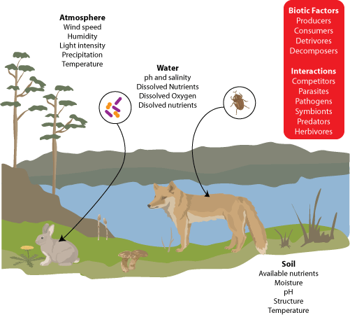

Slide 41
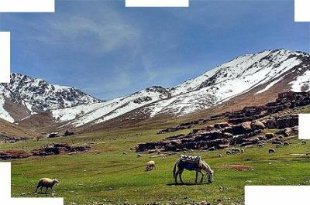
Identify the abiotic and biotic components

Slide 42
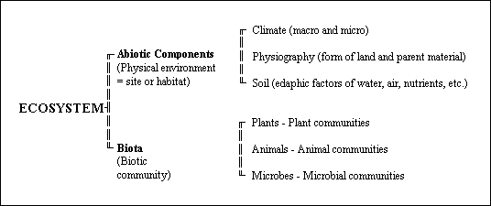

Slide 43
The Roles of Organisms in an Ecosystem
All of the organisms within an ecosystem have different roles. These roles are called niches.
Organisms can have more than one niche and knowing the niches of an organism can help to explain why they act and interact the way they do.
To determine an organism's niche, you need to identify what it eats, where it lives and how it interacts with the other organisms in the same ecosystem.

Slide 44
Niches Include:
Producers - produce food energy for themselves and others
Consumers - consume the food made by the producers
Herbivores - eat producers (plant eating niche)
Carnivores - eat other consumers (meat eating niche)
Omnivores - eat both producers and consumers

Slide 45
Provide an example for the following:
Producer
Consumer
Herbivore
Omnivore
Carnivore

Slide 46
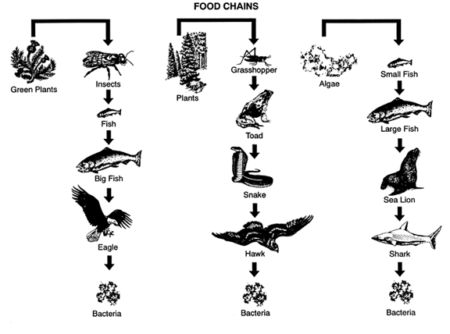
Food Chain
A food chain is a model that shows how energy stored in food passes from organism to organism.

Slide 48
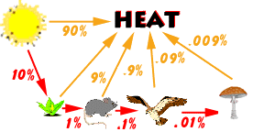
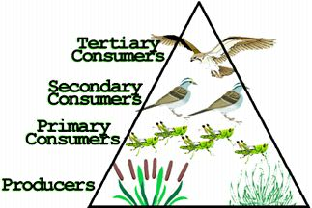
Energy Flow
Energy flow is the movement of energy, starting with the sun, and passing from one organism to another.
As energy flows from one organism to another a food chain is established. Food chains usually involve more than three organisms.

Slide 49
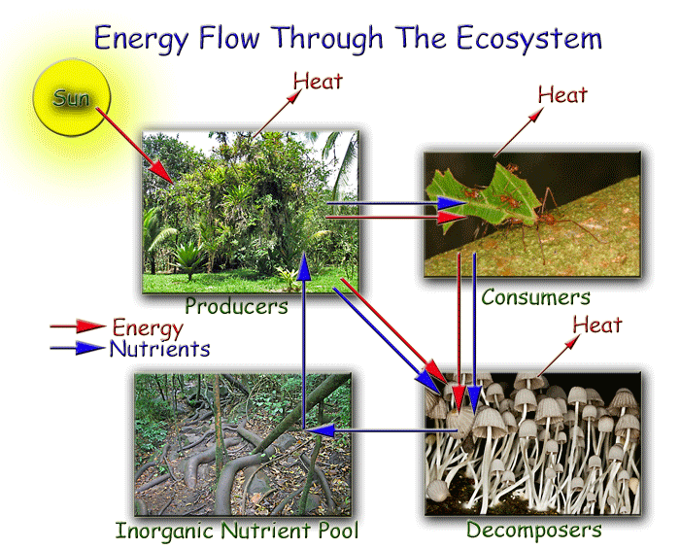

Slide 50
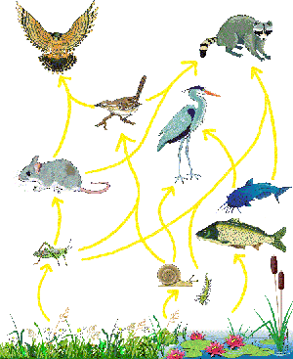
Food Web
A food web is a combination of many different food chains, showing the interrelationships between and among many different producers and consumers in an ecosystem

Slide 51
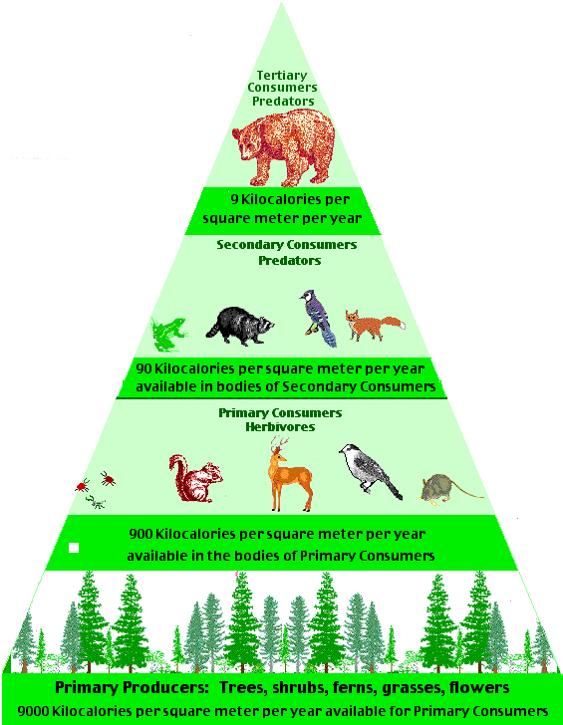
Food Pyramid
A Food Pyramid is a model representing the numbers of organisms consumed at each successive level of the pyramid.
The size of the level indicates the number of organisms at that level.
There are always more animals being eaten than are eating.

Slide 52
Biomass
To find out how much energy is being transferred from one level of the pyramid to the other, Biomass needs to be calculated.
Biomass is the total of all the organisms in the ecosystem.
As you move up the pyramid, there is less biomass. The most biomass is found at the base, where the producers are.

Slide 53
Decomposers and Scavengers
Scavengers are organisms that feed on dead or decaying plant or animal matter.
Decomposers are different from scavengers because they do not actually eat dead material.
They grow on or in the dead or waste matter, absorbing the nutrients directly into their cells, which are then recycled back into the environment.

Slide 54
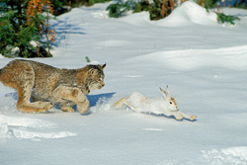
Predator and Prey
Predators hunt prey for a food source.

Slide 55


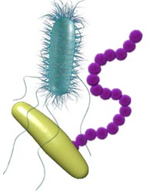


Slide 56
Decomposer and Scavenger Quiz http://www.nhptv.org/natureworks/quiz11.htm
Ecosystem http://www.biology.ualberta.ca/facilities/multimedia/uploads/alberta/Ecosystem.html
Ecological Footprint

Slide 57
Cycles in the Environment
Topic 5

Slide 58
Overview
When organisms breathe, the gases are recycled in the air and used by other organisms.
When organisms die, the nutrients they are composed of are recycled back into the environment and used as well.

Slide 59
Carbon Cycle
Carbon is necessary for all life to exist and is recycled in the environment. Creating the carbon cycle.
Plants use carbon dioxide from the air in order to make food.
Moose, mice and other organisms eat the plants and release the carbon dioxide when they exhale.

Slide 60
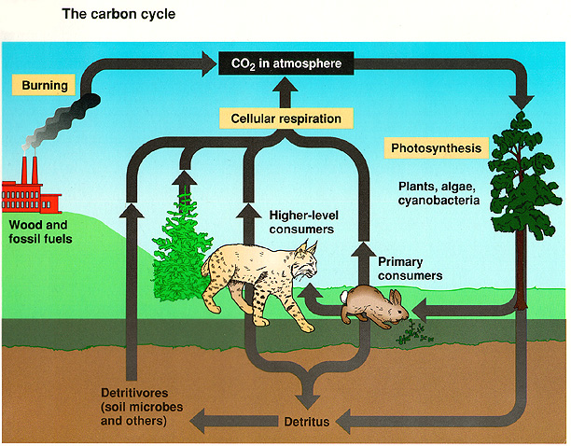

Slide 61
Water Cycle
All living things needs water.
  Apple-84% water
  Human – 60 to 70%
  Carrot – 88%
  Tomato – 94%

Slide 62
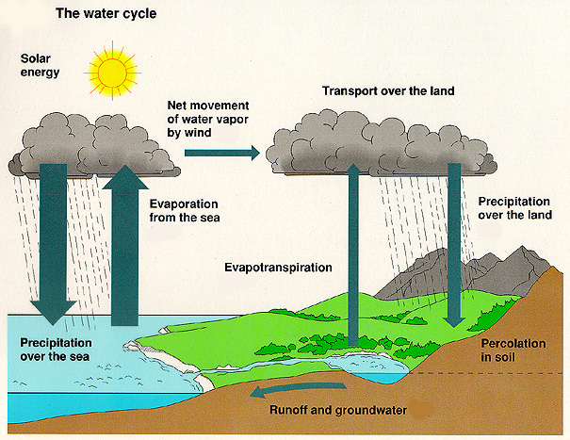

Slide 63
Water Cycle
  The water cycle contains 4 processes:
    Evaporation and transpiration – move water up from the Earth into the atmosphere
    Condensation and precipitation – return water to Earth

Slide 64
Evaporation : process in which a liquid changes into water vapour.
Transpiration: process in which water that is taken in through a plant’s roots evaporates from the plant’s leaves, stem and flowers.
Condensation: process in which water vapour. As air cools, however, it is able to old less and less water. Condensation happens when air becomes so cool that it can no longer hold as much water vapour, and liquid water is released. This creates clouds, fog or dew.
Precipitation: process when liquid water forms from condensation occurring inside clouds, and then falls as rain, sleet, now and hail.
Groundwater: water in the soil. Plant roots can grow down to reach ground water. People can reach it by digging wells.
Run-off: water that runs of the ground into lakes, rivers, or streams.

Slide 65
Pollution in the Environment
Pollution occurs when a substance is added to the environment at such a fast rate that it cannot be broken down, stored or recycled in the air, land, or water in a non-damaging form.
Pollutants are substances that cause pollution.

Slide 66
Type of Pollutant | Acid Rain (high pH) | Carbon Dioxide
Reason they are pollutants | Sulfur and Nitrogen at higher than normal levels in the air, which mix with water to produce acidic precipitation. | Burning of Fossil fuels puts higher than normal levels of CO2 into the atmosphere and the ozone layer (which protects us from radiation is being depleted.

Slide 67
Movement of Pollution
PCBs – substances that are used for paints and packaging materials. Never meant to enter into environment but leaked into air, water and ground through waste-disposal sites.
PCBs break down very slowly and can cause harm to organisms.
Mercury used by industries including gold mining and disposed of as water. Leaked out fro waste-disposal sites and dissolved in water.
Causes mercury poisoning.

Slide 68
Bioaccumulation
Bioaccumulation is the process in which a substance builds up in a living organism from the surrounding air or water, or through the consumption of organisms that already have the substance that is being accumulated.
It will vary for different species and will depend on sources of contamination, as well as water quality and temperature. It provides increasing levels harmful to species higher up the food chain, because of "biomagnification", where substances like mercury will increase in concentration from microorganisms, to fish, to fish eating predators like otters and loons, and to humans.

Slide 69
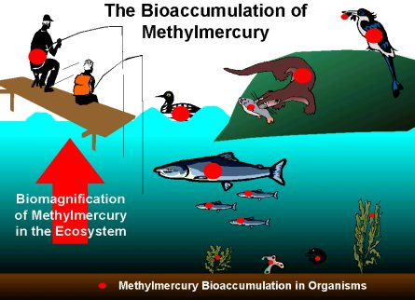

Slide 70
Succession and Change in Ecosystems
Topic 6

Slide 71
Succession
The gradual process by which some species within an ecosystem replaces other species is called succession.
Organisms that are present at one stage alter the environment in some way. This change makes it possible for some other species to move in.

Slide 72
Primary succession is the gradual growth of organisms in an area that was previously bare like a rocky slope.
Organisms to first appear are those that can cling to the rock and grow, such as mosses and lichens. These organisms break down the rock and die. Other organisms use the nutrients to begin to grow.

Slide 73
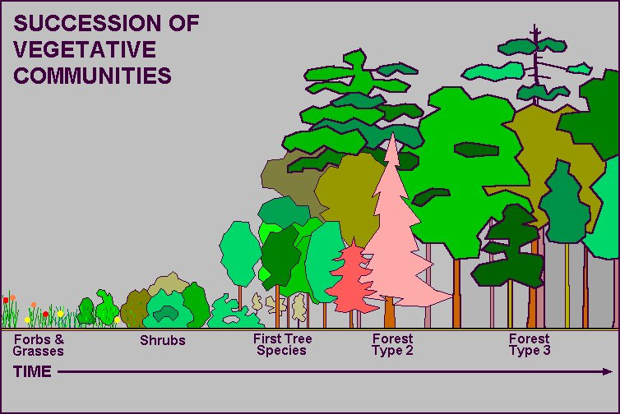

Slide 74
Where Primary Succession Can Occur…
Examples of areas in which a community has never lived before would be:
new lava or rock from a volcano that makes a new island or a new landscape
a sand bar that arises from shifting sands in the ocean
a meteor makes a depression that fills with rainwater or fresh water from underground streams.

Slide 75
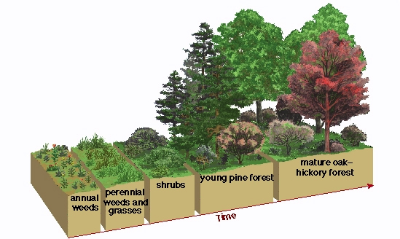
Secondary Succession
The gradual growth of organisms in an area after a disturbance, such as a fire, or when a large tree falls, is known as secondary succession.

Slide 77
Changes Caused by Human Activity
Humans affect the environments around them in many ways, including activities and technologies such as: forestry, industrial processes, transportation, urban development, construction and farming.
When an ecosystem is changed by human activity, there can be unexpected consequences.
Some species thrive when change occurs (eg. Cowbirds), while some species suffer (eg. Warblers )

Slide 78
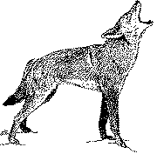
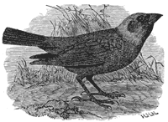
Some Species Adapt Better Than Others
Cowbirds adapt to farmland easily,
while others cannot.
The coyote has been able to adapt to the spread of urban areas, whereas other animals, such as the wolf have not

Slide 79
Pest Control
Pests that can affect human health and crops are a major problem.
Besides controlling the pest population a pesticide can also damage other organisms that are not targeted.
This occurs with a pesticide that is designed to kill lygus bugs (who damage canola crops).
The pesticide will also kill bees. If the pesticide kills the pest predators, then the pest population may actually increase.

Slide 80
Biological Control
Using their own natural enemies is another way to control pests. This method is known as biological control
Example: Leafy spurge is a weed introduced into Canada. It grows faster than naturally occurring pasture grasses. Cattle will not eat leafy spurge so the cow’s food was decreasing.
The blackdot spurge beetle was introduced to Alberta to eat the spurge weed and try and control the species.

Slide 81
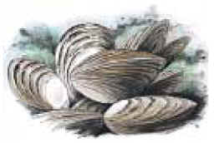
Introduced Species
Biological control can however cause other problems. The species that is introduced may have no natural predators and will overtake the area (using up the food supply) so that other organisms cannot survive.
This happened when zebra mussels were introduced into the Great Lakes. It has become a major problem.

Slide 82
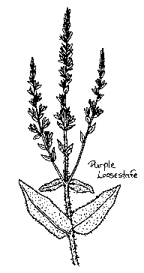
Introduced Species
Purple loosestrife, sometimes called the beautiful killer, was introduced into North America and has taken over valuable wetland habitat, pushing out native species.

Slide 83
Species In Danger
Many species in North America and in Canada specifically are in danger of extinction. If a species becomes extinct, it can no longer be found anywhere in the world. Sometimes the organism is only lost in a large region.
If this occurs, the species is extirpated.
If a particular species is in danger of becoming extinct, or extirpated, it is placed on the endangered species list. There are special protection programs and laws made to protect endangered species.

Slide 84
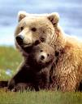
Endangered Species
The loss of an organisms home or habitat is a major reason why species become endangered. Humans cleared land across Canada to build homes, cities, and roads.
This has resulted in the loss of natural habitat for many species.

Slide 85
How Can You Help?
Recovery programs are in place or being developed to assist the species with repopulating an area. Volunteering to help is a great way to get personally involved.

Slide 86
Environmental Monitoring
Topic 7

Slide 87
Ecosystem monitoring
Ecosystem monitoring (also called - environmental monitoring) is a way to check the condition (health) of an ecosystem.
Compares results of investigations done at different times.
Monitoring helps scientists understand impacts of disturbances and changes - sudden and gradual - in order to try to reverse or reduce the impact.
Biotic and abiotic factors are monitored.

Slide 88
Types of Disturbances
Gradual Disturbances occur over time
  Chemical Weathering
  Wind Erosion
  Water Erosion
Sudden Disturbances occur without warning
  Landslide
  Tornado
  Hurricane
  Flash Flood

Slide 89
Ecosystem Monitoring Types
Physical
Chemical
Biological
Environmental

Slide 90
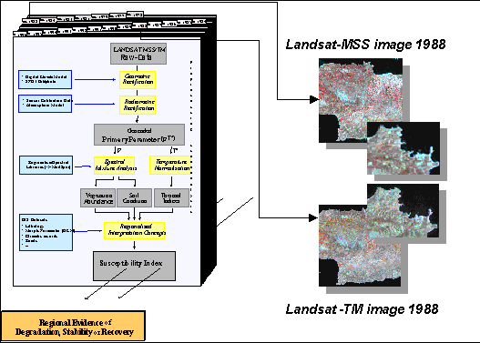
Physical: uses satellites to track changes in the landscape over time

Slide 91
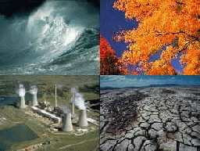
Environmental tracks changes in climate, temperature and weather patterns.

Slide 92
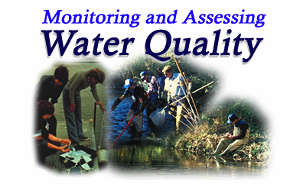
Chemical, assesses the quality of air, soil and water

Slide 93
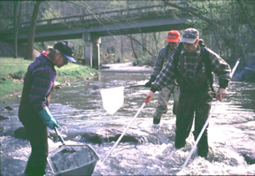
Biological, tracks the changes in organisms or populations of organisms

Slide 94
When do we monitor?
Environmental monitoring usually begins after a disturbance has taken place.
It can also begin before a known disturbance occurs.
A key part of the monitoring program is to provide the evidence on which environmental decisions can be made to maintain the balance between human needs and the needs of other organisms in the environment.
Continuous monitoring gives us the scientific data we need to make informed decisions about how we affect the environment over time.

Slide 95
Long-Term Monitoring Programs
Amphibians are very sensitive to environmental change, which makes them an indicator species. By using this indicator species, scientists all over the word can study the effects of pesticides, acid rain, loss of habitat and introduction of non-native species on these amphibians.
Long term monitoring provides the most evidence to gather information because you are seeing change over time!

Slide 96
Quality vs. Quantity
Monitoring programs may be
qualitative,
quantitative.
Monitoring involves the use of indicators, indicator species or indicator communities.
The presence or absence of the indicator or of an indicator species or indicator community reflects environmental conditions.

Slide 97
Baseline Data
Baseline Data gives scientists a starting point to compare changes in the environment.
Scientists to monitor change use permanent plots, or study areas. The report that provides the data that has been collected - identifying how a certain activity will affect the environment - is called an Environmental Impact Assessment.

Slide 98
Quadrant Sampling is a technique used to study a large are. The quadrant is selected and the species is counted in the quadrant.
The number of quadrants in the area provides the multiplier to estimate the population of the species in the area.
X X x x | x x
X x X xx | Xxx

Slide 99
Using Science in Real Ecosystems
The North River Basins Study (1991) was designed to see what impact the development of natural resources would have on the ecosystems in the region. The analysis of the results indicated that industries were having a negative impact.

