Slide 1


Splash Screen

Slide 2

5-Minute Check 1
Find the sum of 2.19 + 18.35.
A. 19.44
B. 20.44
C. 20.54
D. 21.54

Slide 3
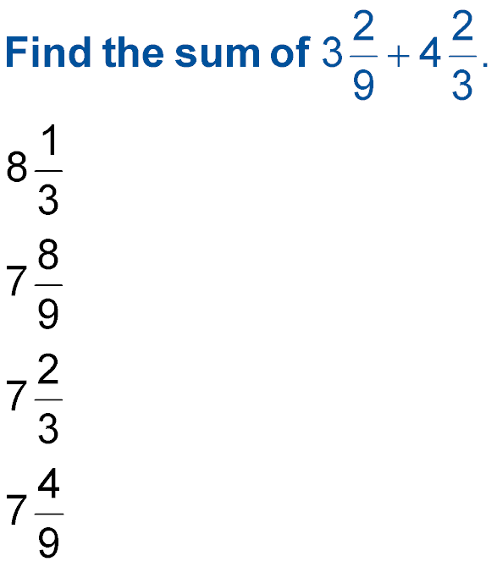

5-Minute Check 2
A.
B.
C.
D.

Slide 4

5-Minute Check 3
Find the quotient of 84 ÷ 6.
A. 16
B. 15.3
C. 15
D. 14

Slide 5
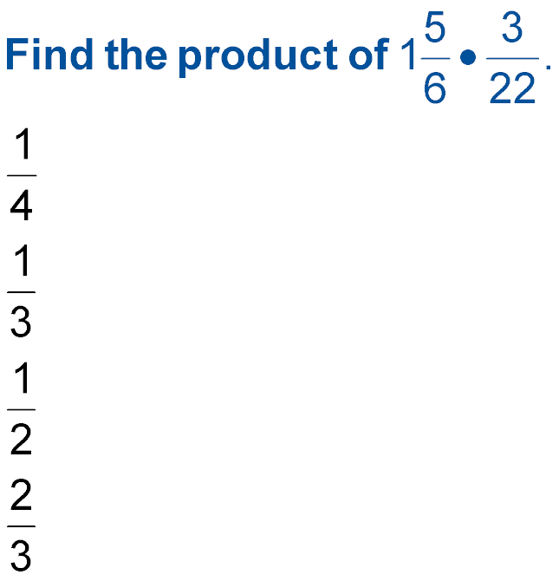

5-Minute Check 4
A.
B.
C.
D.

Slide 6
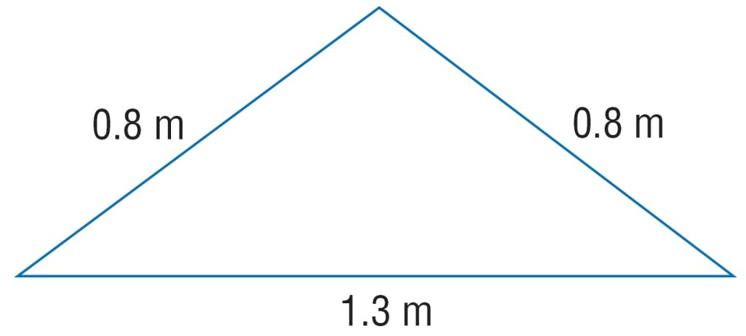

5-Minute Check 5
Find the perimeter of the figure.
A. 2.9 m
B. 2.5 m
C. 1.8 m
D. 1.45 m

Slide 7

5-Minute Check 6
Find the mean of the following set of data.
15, 23, 18, 17, 8, 20, 16, 23, 17, 18, 25, 15, 13, 19, 17
A. 17
B. 17.6
C. 18
D. 20

Slide 8

CCSS
Content Standards
A.SSE.1a Interpret parts of an expression, such as terms, factors, and coefficients.
A.SSE.2 Use the structure of an expression to identify ways to rewrite it.
Mathematical Practices
4 Model with mathematics.

Slide 9


Then/Now
You performed operations on integers.
Write verbal expressions for algebraic expressions.
Write algebraic expressions for verbal expressions.

Slide 10

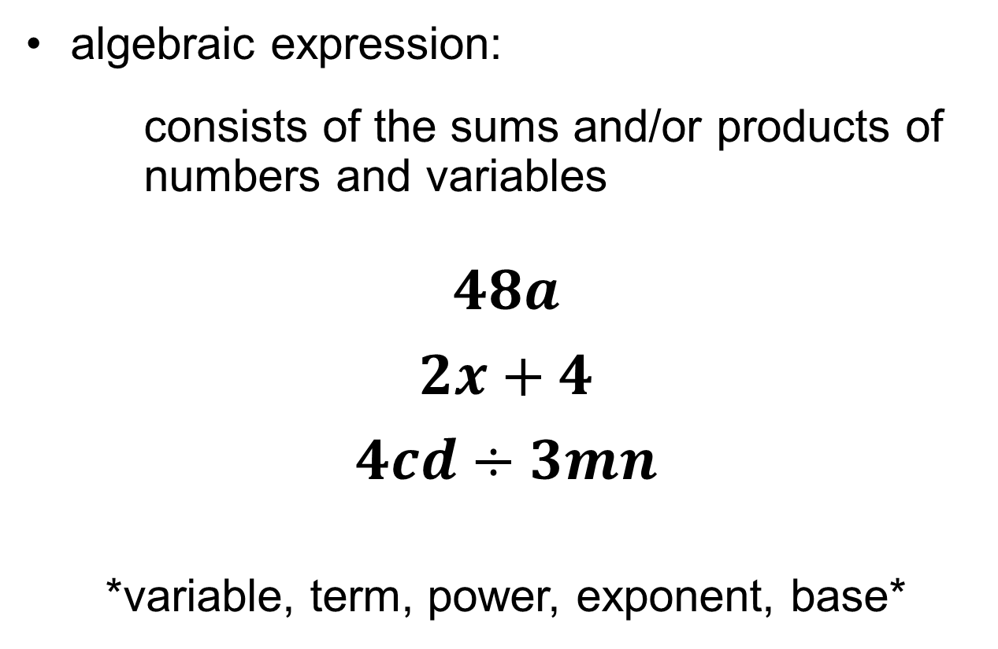
Vocabulary

Slide 11
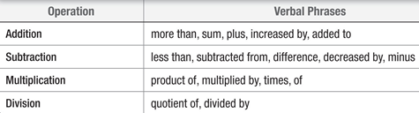
KC
Translating Verbal and Algebraic Expressions

Slide 12
Example 1
Write Verbal Expressions
A. Write a verbal expression for 8x².

Slide 13
Example 1
Write Verbal Expressions
B. Write a verbal expression for y⁵ – 16y.

Slide 14
Example 2
Write Algebraic Expressions
A. Write an algebraic expression for 5 less than a number c.

Slide 15
Example 2
Write Algebraic Expressions
B. Write an algebraic expression for 9 plus the product of 2 and d.

Slide 16
Example 2
Write Algebraic Expressions
C. Write an algebraic expression for two fifths of the area a.

Slide 17
Example 2
Write Algebraic Expressions
D. Write an algebraic expression for the difference of 6 and 4 times a number x.

Slide 18
Example 3
Write an Expression
ENTERTAINMENT Mr. Nehru bought two adult tickets and three student tickets for the planetarium show. Write an algebraic expression that represents the cost of the tickets.

Slide 19
Example 3
Write an Expression
MONEY Lorenzo bought a bag of peanuts that
cost p dollars and he gave the cashier a $20 bill. Write an expression for the amount of change that he will receive.

Slide 20
End of the Lesson

