Slide 1


Splash Screen

Slide 2
Lesson Menu
Five-Minute Check (over Lesson 1–1)
CCSS
Then/Now
New Vocabulary
Example 1: Evaluate Expressions
Key Concept: Order of Operations
Example 2: Use Order of Operations
Example 3: Expressions with Grouping Symbols
Example 4: Evaluate an Algebraic Expression
Example 5: Real-World Example: Write and Evaluate an Expression

Slide 3

5-Minute Check 1
Write an algebraic expression for the difference of 12 and n.
A. 12 + n
B. 12 – n
C. 12 ÷ n
D. 12n

Slide 4

5-Minute Check 2
Write an algebraic expression for four times the square of n.
A. 4n²
B. 4n
C. 4 + n²
D. 4 + 2n

Slide 5

5-Minute Check 3
Write a verbal expression for 6m – 2.
A. six m less than two
B. six times m more than two
C. the difference of six and two
D. two less than six times m

Slide 6

5-Minute Check 4
Write a verbal expression for 2c ² + d.
A. two c plus d
B. two times the square of a number c plus a number d
C. two plus the square of a number c plus a number d
D. the square of a number c plus a number d times two

Slide 7

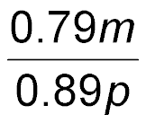
5-Minute Check 5
Mechanical pencils sell or $0.79 each, and pens sell for $0.89 each. Write an expression for the cost of m pencils and p pens.
A.
B. 0.79p + 0.89m
C. 0.79m + 0.89p
D. 0.79 + 0.89mp

Slide 8

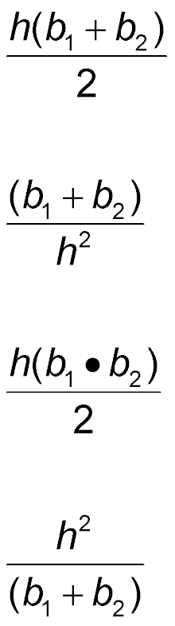
5-Minute Check 6
The area of a trapezoid is one half of the product of the height h and the sum of the bases b₁ and b₂ of the trapezoid. Write an expression that gives the area of a trapezoid.
A.
B.
C.
D.

Slide 9

CCSS
Content Standards
A.SSE.1b Interpret complicated expressions by viewing one or more of their parts as a single entity.
A.SSE.2 Use the structure of an expression to identify ways to rewrite it.
Mathematical Practices
7 Look for and make use of structure.
Common Core State Standards © Copyright 2010. National Governors Association Center for Best Practices and Council of Chief State School Officers. All rights reserved.

Slide 10


Then/Now
You expressed algebraic expressions verbally.
Evaluate numerical expressions by using the order of operations.
Evaluate algebraic expressions by using the order of operations.

Slide 11

Vocabulary
evaluate
order of operations

Slide 12
Example 1
Evaluate Expressions
Evaluate 2⁶.
2⁶ = 2 ● 2 ● 2 ● 2 ● 2 ● 2 Use 2 as a factor
6 times.
= 64 Multiply.
Answer: 64

Slide 13


Example 1
Evaluate 4⁴.
A. 64
B. 128
C. 192
D. 256

Slide 14
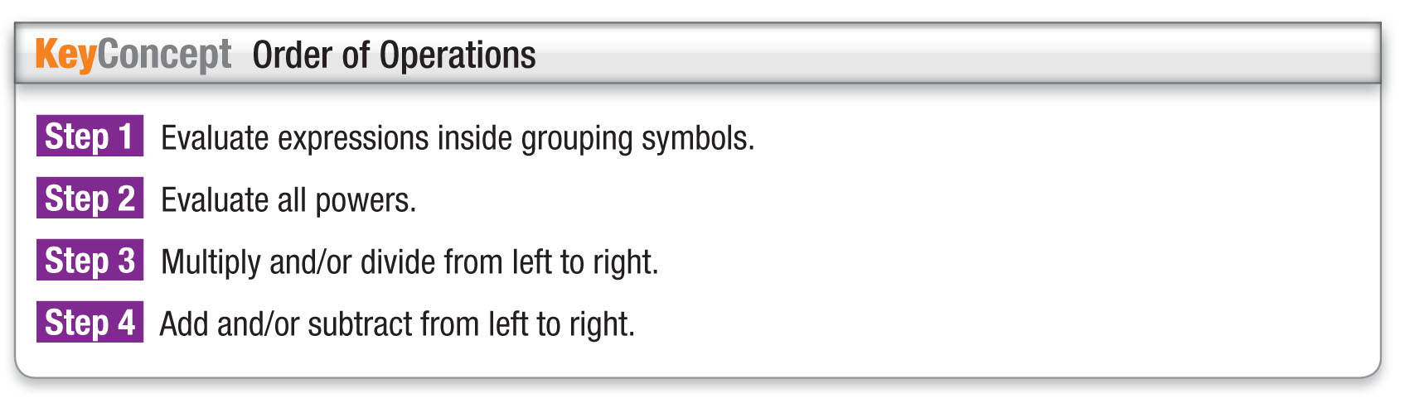
KC

Slide 15
Example 2
Use Order of Operations
Evaluate 48 ÷ 2³ ● 3 + 5.
48 ÷ 2³ ● 3 + 5 = 48 ÷ 8 ● 3 + 5 Evaluate powers.
= 6 ● 3 + 5 Divide 48 by 8.
= 18 + 5 Multiply 6 and 3.
= 23 Add 18 and 5.
Answer: 23

Slide 16
Example 2
Evaluate [(9² – 9) ÷ 12]5.
A. 6
B. 15
C. 30
D. 45

Slide 17
Example 3
Expressions with Grouping Symbols
A. Evaluate (8 – 3) ● 3(3 + 2).
(8 – 3) ● 3(3 + 2) = 5 ● 3(5) Evaluate inside parentheses.
= 5 ● 15 Multiply 3 by 5.
= 75 Multiply 5 by 15.
Answer: 75

Slide 18
Example 3
Expressions with Grouping Symbols
B. Evaluate 4[12 ÷ (6 – 2)]².
4[12 ÷ (6 – 2)]² = 4(12 ÷ 4)² Evaluate innermost expression first.
= 4(3)² Evaluate expression in grouping symbol.
= 4(9) Evaluate power.
= 36 Multiply.
Answer: 36

Slide 19
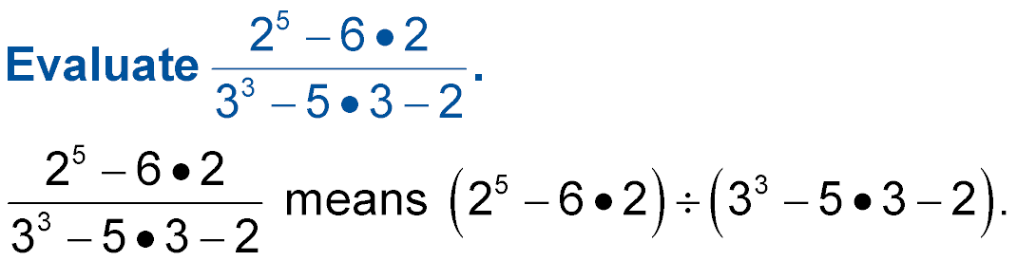
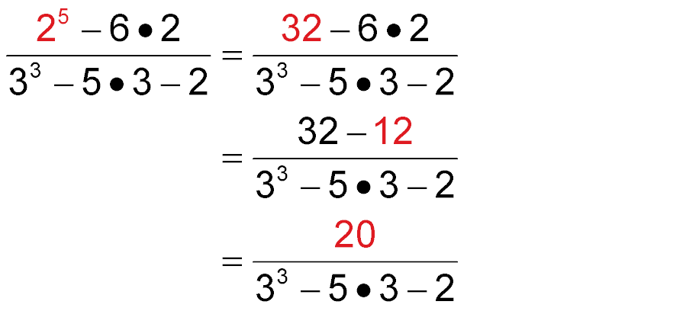
Example 3
Expressions with Grouping Symbols
C.
Evaluate the power in the numerator.
Multiply 6 and 2 in the numerator.
Subtract 32 and 12 in the numerator.

Slide 20
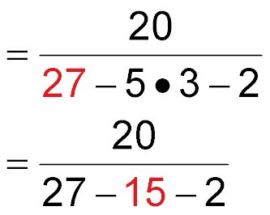
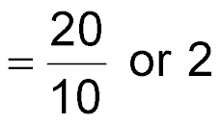
Example 3
Expressions with Grouping Symbols
Evaluate the power in the denominator.
Multiply 5 and 3 in the denominator.
Subtract from left to right in the denominator.
Answer: 2

Slide 21
Example 3
A. Evaluate the expression 2(4 + 7) ● (9 – 5).
A. –60
B. 66
C. 88
D. 68

Slide 22
Example 3
B. Evaluate the expression 3[5 – 2 ● 2]².
A. 9
B. 18
C. 108
D. 3

Slide 23
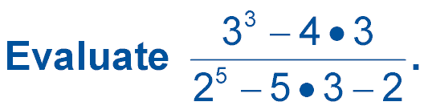

Example 3
C.
A. 1
B.
C. 4
D.

Slide 24
Example 4
Evaluate an Algebraic Expression
Evaluate 2(x² – y) + z² if x = 4, y = 3, and z = 2.
2(x² – y) +z² = 2(4² – 3) + 2² Replace x with 4, y with 3 and z with 2.
= 2(16 – 3) + 2² Evaluate 4².
= 2(13) + 2² Subtract 3 from 16.
= 2(13) + 4 Evaluate 2².
= 26 + 4 Multiply 2 and 13.
= 30 Add.
Answer: 30

Slide 25
Example 4
Evaluate x³ – y² + z, if x = 3, y = 2, and z = 5.
A. 6
B. 28
C. 36
D. 10

Slide 26
Example 5
Write and Evaluate an Expression
ARCHITECTURE Each side of the Great Pyramid at Giza, Egypt, is a triangle. The base of each triangle once measured 230 meters. The height of each triangle once measured 187 meters. The area of a triangle is one-half the product of the base b and its height h.

Slide 27
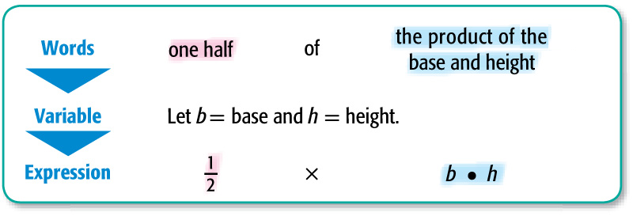
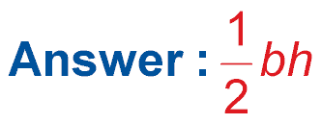
Example 5
Write and Evaluate an Expression
A. Write an expression that represents the area of one side of the Great Pyramid.

Slide 28
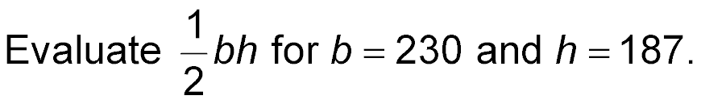
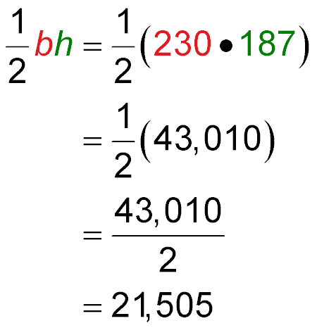
Example 5
Write and Evaluate an Expression
B. Find the area of one side of the Great Pyramid.
Replace b with 230 and h with 187.
Multiply 230 by 187.
Multiply by 43,010.
Answer: The area of one side of the Great Pyramid is 21,505 m².

Slide 29
Example 5
Find the area of a triangle with a base of 123 feet and
a height of 62 feet.
A. 3813 ft²
B. 7626 ft²
C. 15,252 ft²
D. 32 ft²

Slide 30
End of the Lesson

