Slide 1


Splash Screen

Slide 2
Lesson Menu
Five-Minute Check (over Lesson 1–2)
CCSS
Then/Now
New Vocabulary
Key Concept: Properties of Equality
Key Concept: Addition Properties
Key Concept: Multiplication Properties
Example 1: Evaluate Using Properties
Key Concept: Commutative Property
Key Concept: Associative Property
Example 2: Real-World Example: Apply Properties of Numbers
Example 3: Use Multiplication Properties

Slide 3

5-Minute Check 1
Evaluate the expression 20 – 6 • 3.
A. 42
B. 38
C. 11
D. 2

Slide 4

5-Minute Check 2
Evaluate the expression 2(15 + 3) – 11 • 2.
A. 50
B. 25
C. 14
D. 2

Slide 5
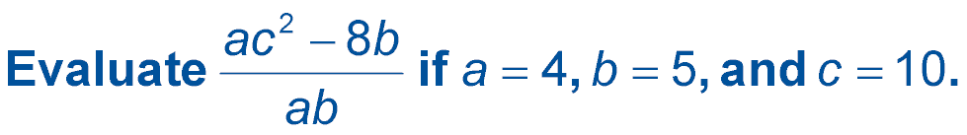

5-Minute Check 3
A. 17
B. 18
C. 20
D. 21

Slide 6

5-Minute Check 4
A. 170
B. 165
C. 160
D. 125

Slide 7
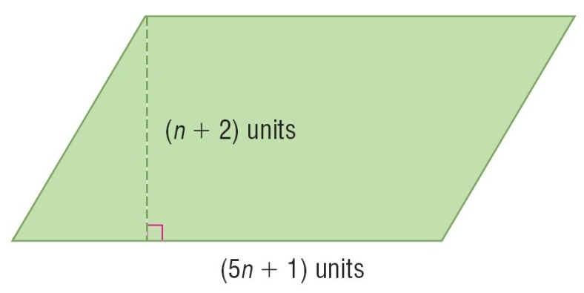

5-Minute Check 5
The area of a parallelogram
is the product of its base
and height. What is the area
of the parallelogram when
n = 3?
A. 16 units²
B. 32 units²
C. 62 units²
D. 80 units²

Slide 8

5-Minute Check 6
Simplify 40 ÷ 5 + 5 • 2(13 – 7).
A. 48
B. 68
C. 72
D. 156

Slide 9

CCSS
Content Standards
A.SSE.1b Interpret complicated expressions by viewing one or more of their parts as a single entity.
A.SSE.2 Use the structure of an expression to identify ways to rewrite it.
Mathematical Practices
2 Reason abstractly and quantitatively.
3 Construct viable arguments and critique the reasoning of others.
Common Core State Standards © Copyright 2010. National Governors Association Center for Best Practices and Council of Chief State School Officers. All rights reserved.

Slide 10


Then/Now
You used the order of operations to simplify expressions.
Recognize the properties of equality and identity.
Recognize the Commutative and Associative Properties.

Slide 11

Vocabulary
equivalent expressions
additive identity
multiplicative identity
multiplicative inverse
reciprocal

Slide 12
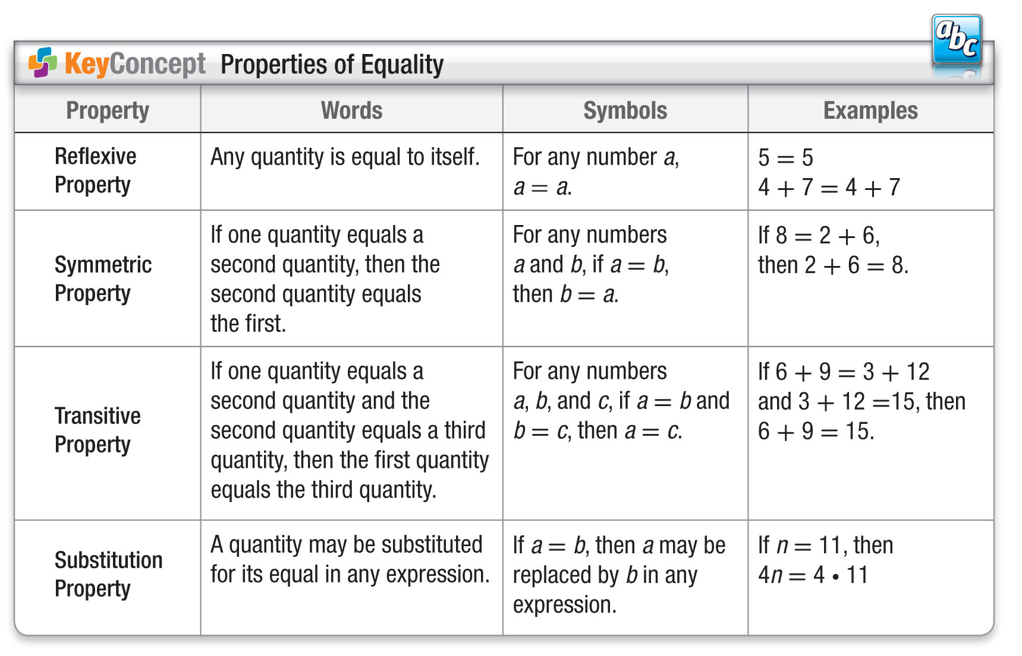
KC 1

Slide 13
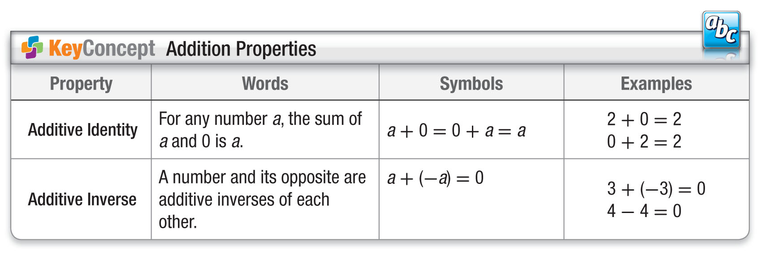
KC 2

Slide 14
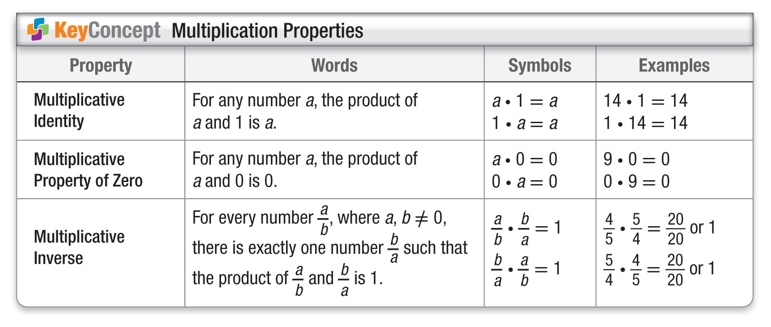
KC 3

Slide 15
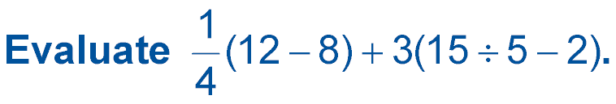
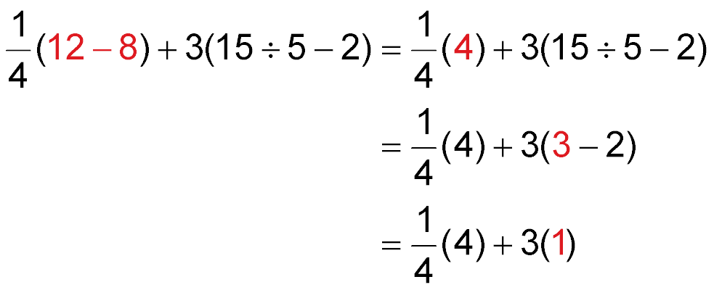
Example 1
Evaluate Using Properties
Name the property used in each step.
Substitution: 12 – 8 = 4
Substitution: 15 ÷ 5 = 3
Substitution: 3 – 2 = 1

Slide 16
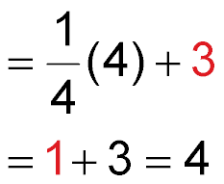
Example 1
Evaluate Using Properties
Multiplicative Identity: 3(1) = 3
Multiplicative Inverse: (4) = 1
= 4 Substitution: 1 + 3 = 4
Answer: 4

Slide 17


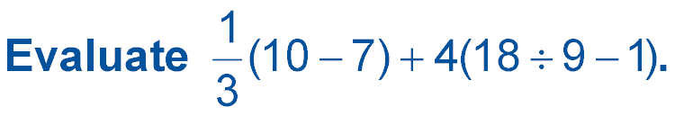
Example 1
A. 4
B. 5
C. 1
D. 0

Slide 18
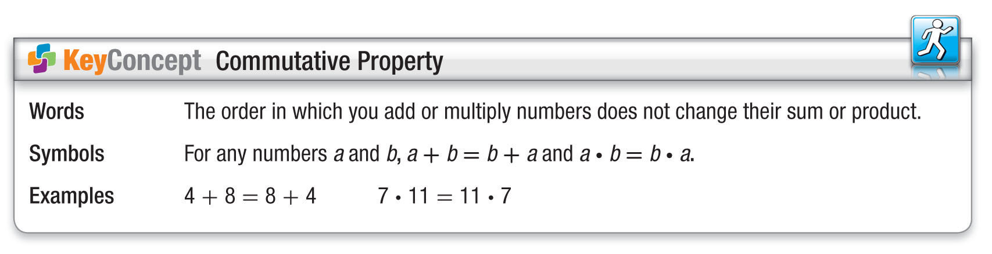
KC 4

Slide 19
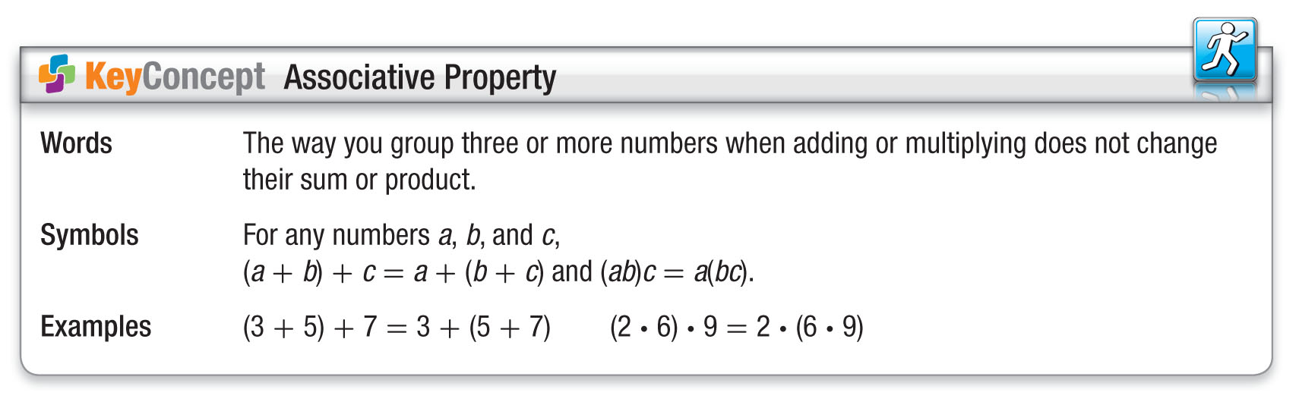
KC 5

Slide 20
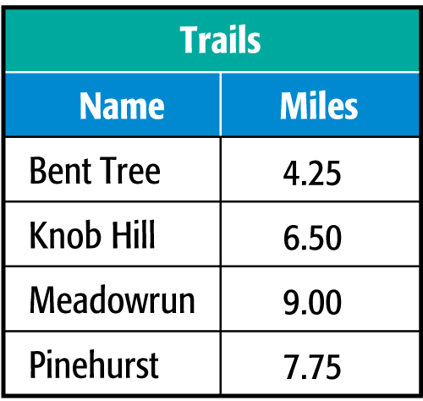
Example 2
Apply Properties of Numbers
HORSEBACK RIDING Migina made a list of trail lengths to find the total miles she rode. Find the total miles Migina rode her horse.
Bent Tree
Knob Hill
Meadowrun
Pinehurst
4.25 + 6.50 + 9.00 + 7.75

Slide 21
Example 2
Apply Properties of Numbers
= 4.25 + 7.75 + 6.50 + 9.00 Commutative (+)
= (4.25 + 7.75) + (6.50 + 9.00) Associative (+)
= 12.00 + 15.50 Substitution
= 27.50 Substitution
Answer: Migina rode 27.5 miles on the trails.

Slide 22
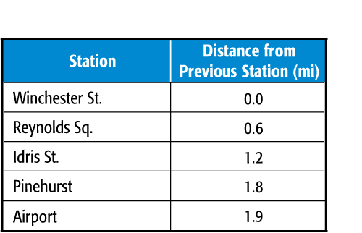
Example 2
TRANSPORTATION Darlene rode the city train from the Winchester Street Station to the airport. How far did she travel on the train?
A. 4.5 mi
B. 5.5 mi
C. 6.0 mi
D. 6.2 mi

Slide 23
Example 3
Use Multiplication Properties
Evaluate 2 ● 8 ● 5 ● 7 using properties of numbers. Name the property used in each step.
You can rearrange and group the factors to make mental calculations easier.
2 ● 8 ● 5 ● 7 = 2 ● 5 ● 8 ● 7 Commutative (×)
= (2 ● 5) ● (8 ● 7) Associative (×)
= 10 ● 56 Substitution
= 560 Substitution
Answer: 560

Slide 24
Example 3
Evaluate 3 ● 5 ● 3 ● 4.
A. 45
B. 36
C. 15
D. 180

Slide 25
End of the Lesson

