Slide 1


Splash Screen

Slide 2
Lesson Menu
Five-Minute Check (over Lesson 1–3)
CCSS
Then/Now
New Vocabulary
Key Concept: Distributive Property
Example 1: Real-World Example: Distribute Over Addition
Example 2: Mental Math
Example 3: Algebraic Expressions
Example 4: Combine Like Terms
Example 5: Write and Simplify Expressions
Concept Summary: Properties of Numbers

Slide 3

5-Minute Check 1
Which property is demonstrated in the equation
8 • 0 = 0?
A. Multiplicative Property of Zero
B. Multiplicative Inverse
C. Commutative Property
D. Identity

Slide 4

5-Minute Check 2
What property is demonstrated in the equation
7 + (11 – 5) = 7 + 6?
A. Associative Property
B. Multiplicative Inverse
C. Commutative Property
D. Substitution

Slide 5
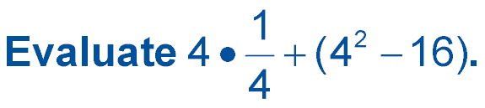

5-Minute Check 3
A. 2
B. 1
C. 0
D. –1

Slide 6

5-Minute Check 4
Name the addition property shown by
(6 + 9) + 8 = 6 + (9 + 8).
A. Commutative Property
B. Identity Property
C. Associative Property
D. Distributive Property

Slide 7

CCSS
Content Standards
A.SSE.1a Interpret parts of an expression, such as terms, factors, and coefficients.
A.SSE.2 Use the structure of an expression to identify ways to rewrite it.
Mathematical Practices
1 Make sense of problems and persevere in solving them.
8 Look for and express regularity in repeated reasoning.
Common Core State Standards © Copyright 2010. National Governors Association Center for Best Practices and Council of Chief State School Officers. All rights reserved.

Slide 8


Then/Now
You explored Associative and Commutative Properties.
Use the Distributive Property to evaluate expressions.
Use the Distributive Property to simplify expressions.

Slide 9

Vocabulary
like terms
simplest form
coefficient

Slide 10
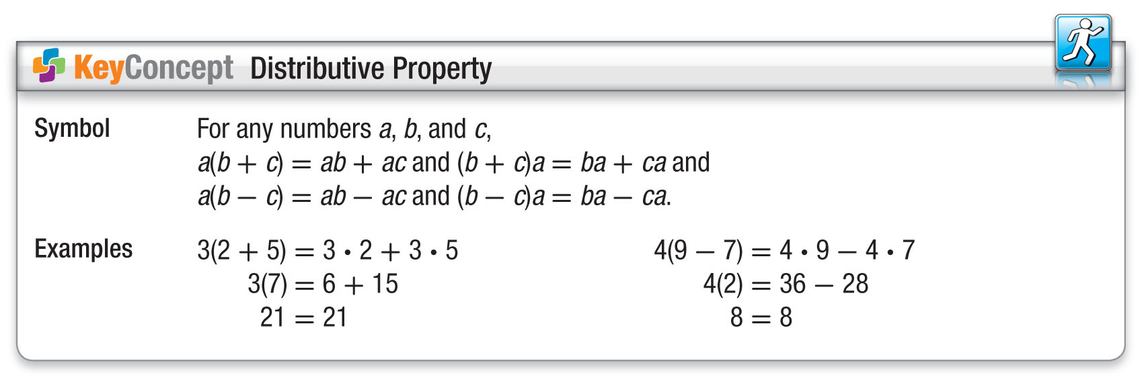
Concept

Slide 11
Example 1
Distribute Over Addition
FITNESS Julio walks 5 days a week. He walks at a fast rate for 7 minutes and cools down for 2 minutes. Use the Distributive Property to write and evaluate an expression that determines the total number of minutes Julio walks.
Understand You need to find the total number of
minutes Julio walks in a week.
Plan Julio walks 5 days for 7 + 2 minutes a day.
Solve Write an expression that shows the
product of the number of days that Julio
walks and the sum of the number of
minutes he walks at each rate.

Slide 12
Example 1
Distribute Over Addition
5(7 + 2) = 5(7) + 5(2) Distributive Property
= 35 + 10 Multiply.
= 45 Add.
Answer: Julio walks 45 minutes a week.
Check: The total number of days he walks is 5 days, and he walks 9 minutes per day. Multiply 5 by 9 to get 45. Therefore, he walks 45 minutes per week.

Slide 13


Example 1
WALKING Susanne walks to school and home from school 5 days each week. She walks to school in
15 minutes and then walks home in 10 minutes. Rewrite 5(15 + 10) using the Distributive Property. Then evaluate to find the total number of minutes Susanne spends walking to and home from school.
A. 15 + 5 ● 10; 65 minutes
B. 5 ● 15 + 10; 85 minutes
C. 5 ● 15 + 5 ● 10; 125 minutes
D. 15 + 10; 25 minutes

Slide 14
Example 2
Mental Math
Use the Distributive Property to rewrite 12 ● 82.
Then evaluate.
12 ● 82 = (10 + 2)82 Think: 12 = 10 + 2
= 10(82) + 2(82) Distributive Property
= 820 + 164 Multiply.
= 984 Add.
Answer: 984

Slide 15
Example 2
Use the Distributive Property to rewrite 6 ● 54.
Then evaluate.
A. 6(50); 300
B. 6(50 ● 4); 1200
C. 6(50 + 4); 324
D. 6(50 + 4); 654

Slide 16
Example 3
Algebraic Expressions
A. Rewrite 12(y + 3) using the Distributive Property.
Then simplify.
12(y + 3) = 12 ● y + 12 ● 3 Distributive Property
= 12y + 36 Multiply.
Answer: 12y + 36

Slide 17
Example 3
Algebraic Expressions
B. Rewrite 4(y² + 8y + 2) using the Distributive Property. Then simplify.
4(y² + 8y + 2) = 4(y²) + 4(8y) + 4(2) Distributive Property
= 4y² + 32y + 8 Multiply.
Answer: 4y² + 32y + 8

Slide 18
Example 3
A. Simplify 6(x – 4).
A. 6x – 4
B. 6x – 24
C. x – 24
D. 6x + 2

Slide 19
Example 3
B. Simplify 3(x³ + 2x² – 5x + 7).
A. 3x³ + 2x² – 5x + 7
B. 4x³ + 5x² – 2x + 10
C. 3x³ + 6x² – 15x + 21
D. x³ + 2x² – 5x + 21

Slide 20
Example 4
Combine Like Terms
A. Simplify 17a + 21a.
17a + 21a = (17 + 21)a Distributive Property
= 38a Substitution
Answer: 38a

Slide 21
Example 4
Combine Like Terms
B. Simplify 12b² – 8b² + 6b.
12b² – 8b² + 6b = (12 – 8)b² + 6b Distributive Property
= 4b² + 6b Substitution
Answer: 4b² + 6b

Slide 22
Example 4
A. Simplify 14x – 9x.
A. 5x²
B. 23x
C. 5
D. 5x

Slide 23
Example 4
B. Simplify 6n² + 7n + 8n.
A. 6n² + 15n
B. 21n²
C. 6n² + 56n
D. 62n²

Slide 24
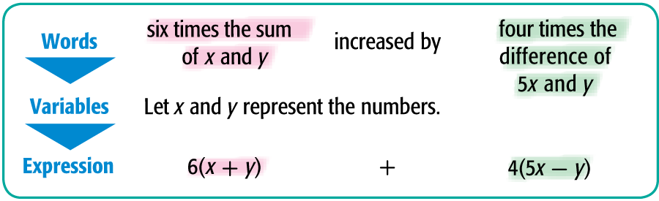
Example 5
Write and Simplify Expressions
Use the expression six times the sum of x and y increased by four times the difference of 5x and y.
A. Write an algebraic expression for the verbal expression.
Answer: 6(x + y) + 4(5x – y)

Slide 25
Example 5
Write and Simplify Expressions
B. Simplify the expression and indicate the properties used.
6(x + y) + 4(5x – y)
= 6(x) + 6(y) + 4(5x) – 4(y) Distributive Property
= 6x + 6y + 20x – 4y Multiply.
= 6x + 20x + 6y – 4y Commutative (+)
= (6 + 20)x + (6 – 4)y Distributive Property
= 26x + 2y Substitution
Answer: 26x + 2y

Slide 26
Example 5
Use the expression three times the difference of 2x and y increased by two times the sum of 4x and y.
A. Write an algebraic expression for the verbal expression.
A. 3(2x + y) + 2(4x – y)
B. 3(2x – y) + 2(4x + y)
C. 2(2x – y) + 3(4x + y)
D. 3(x – 2y) + 2(4x + y)

Slide 27
Example 5
B. Simplify the expression 3(2x – y) + 2(4x + y).
A. 2x + 4y
B. 11x
C. 14x – y
D. 12x + y

Slide 28
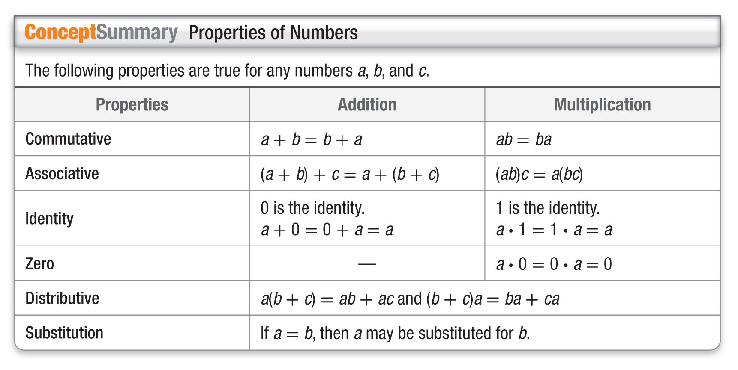
Concept

Slide 29
End of the Lesson

