Slide 1


Splash Screen

Slide 2
Lesson Menu
Five-Minute Check (over Lesson 1–4)
CCSS
Then/Now
New Vocabulary
Example 1: Use a Replacement Set
Example 2: Standardized Test Example
Example 3: Solutions of Equations
Example 4: Identities
Example 5: Equations Involving Two Variables

Slide 3

5-Minute Check 1
Simplify 11(10 – 8).
A. 110 – 88
B. 11 + 10 – 8
C. 198
D. 22

Slide 4

5-Minute Check 2
Simplify 6(4x + 5).
A. 24x + 5
B. 24x + 30
C. 10x + 5
D. 10x + 30

Slide 5

5-Minute Check 3
Simplify (2d + 7)9.
A. 2d + 16
B. 2d + 63
C. 18d + 16
D. 18d + 63

Slide 6

5-Minute Check 4
Simplify 8n + 9 + 3n.
A. 11n + 9
B. 9n + 11
C. 20n
D. 20

Slide 7

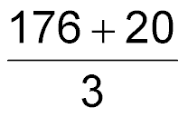
5-Minute Check 5
A theater has 176 seats and standing room for another 20 people. Write an expression to determine the number of people who attended
3 performances if all of the spaces were sold for each performance.
A. 3(176)
B. 3(176) + 20
C. 3(176 + 20)
D.

Slide 8

5-Minute Check 6
Use the Distributive Property to evaluate
5(z – 3) + 4z.
A. 9z – 15
B. 9z – 3
C. 6z
D. z – 3

Slide 9

CCSS
Content Standards
A.CED.1 Create equations and inequalities in one variable and use them to solve problems.
A.REI.3 Solve linear equations and inequalities in one variable, including equations with coefficients represented by letters.
Mathematical Practices
3 Construct viable arguments and critique the reasoning of others.
Common Core State Standards © Copyright 2010. National Governors Association Center for Best Practices and Council of Chief State School Officers. All rights reserved.

Slide 10


Then/Now
You simplified expressions.
Solve equations with one variable.
Solve equations with two variables.

Slide 11

Vocabulary
open sentence
set
element
solution set
identity
equation
solving
solution
replacement set

Slide 12
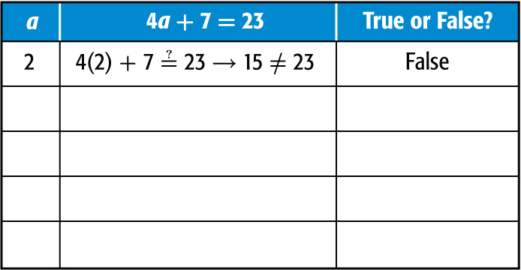
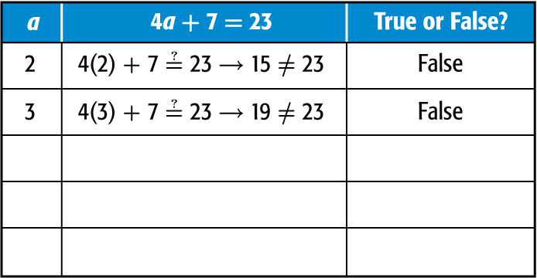
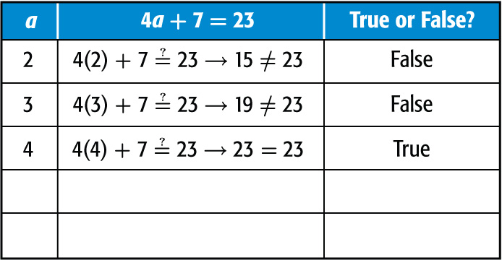
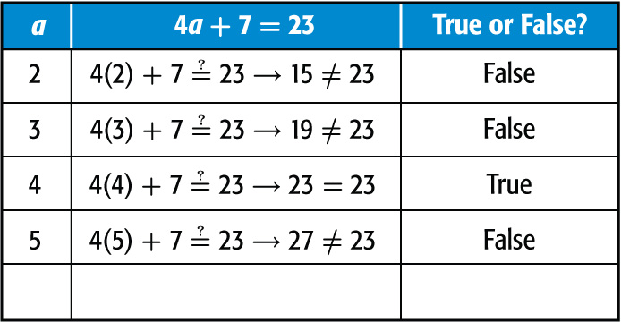
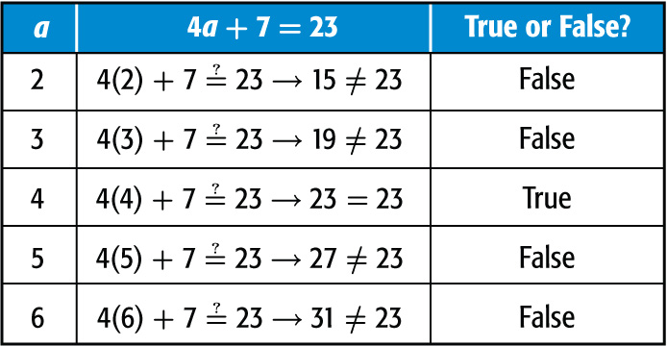
Example 1
Use a Replacement Set
Find the solution set for 4a + 7 = 23 if the replacement set is {2, 3, 4, 5, 6}.
Replace a in 4a + 7 = 23 with each value in the replacement set.
✓
Answer: The solution set is {4}.

Slide 13


Example 1
Find the solution set for 6c – 5 = 7 if the
replacement set is {0, 1, 2, 3, 4}.
A. {0}
B. {2}
C. {1}
D. {4}

Slide 14
Example 2
Solve 3 + 4(2³ – 2) = b.
A 19 B 27 C 33 D 42
Read the Test Item You need to apply the order of
operations to the expression to
solve for b.
Solve the Test Item
3 + 4(2³ – 2) = b Original equation
3 + 4(8 – 2) = b Evaluate powers.
3 + 4(6) = b Subtract 2 from 8.

Slide 15
Example 2
3 + 24 = b Multiply 4 by 6.
27 = b Add.
Answer: The correct answer is B.

Slide 16
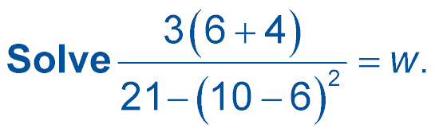

Example 2
A. 1
B.
C.
D. 6

Slide 17
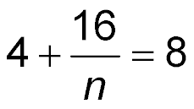
Example 3A
Solutions of Equations
A. Solve 4 + (3² + 7) ÷ n = 8.
4 + (3² + 7) ÷ n = 8 Original equation
4 + (9 + 7) ÷ n = 8 Evaluate powers.
Add 9 and 7.
4n + 16 = 8n Multiply each side by n.
16 = 4n Subtract 4n from each side.
4 = n Divide each side by 4.
Answer: This equation has a unique solution of 4.

Slide 18
Example 3B
Solutions of Equations
B. Solve 4n – (12 + 2) = n(6 – 2) – 9.
4n – (12 + 2) = n(6 – 2) – 9 Original equation
4n – 12 – 2 = 6n – 2n – 9 Distributive Property
4n – 14 = 4n – 9 Simplify.
No matter what value is substituted for n, the left side of the equation will always be 5 less than the right side of the equation. So, the equation will never be true.
Answer: Therefore, there is no solution of this equation.

Slide 19
Example 3A
A. Solve (4² – 6) + f – 9 = 12.
A. f = 1
B. f = 2
C. f = 11
D. f = 12

Slide 20
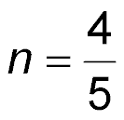
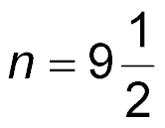
Example 3B
B. Solve 2n + 7² – 29 = (2³ – 3 • 2)n + 29.
A.
B.
C. any real number
D. no solution

Slide 21
Example 4
Identities
Solve (5 + 8 ÷ 4) + 3k = 3(k + 32) – 89.
(5 + 8 ÷ 4) + 3k = 3(k + 32) – 89 Original equation
(5 + 2) + 3k = 3(k + 32) – 89 Divide 8 by 4.
7 + 3k = 3(k + 32) – 89 Add 5 and 2.
7 + 3k = 3k + 96 – 89 Distributive Property
7 + 3k = 3k + 7 Subtract 89 from 96.
No matter what real value is substituted for k, the left side of the equation will always be equal to the right side of the equation. So, the equation will always be true.
Answer: Therefore, the solution of this equation could be any real number.

Slide 22
Example 4
Solve 4³ + 6d – (2 • 8) = (3² – 1 – 2)d + 48.
A. d = 0
B. d = 4
C. any real number
D. no solution

Slide 23
Example 5
Equations Involving Two Variables
GYM MEMBERSHIP Dalila pays $16 per month for a gym membership. In addition, she pays $2 per Pilates class. Write and solve an equation to find the total amount Dalila spent this month if she took 12 Pilates classes.
The cost for the gym membership is a flat rate. The variable is the number of Pilates classes she attends. The total cost is the price per month for the gym membership plus $2 times the number of times she attends a Pilates class. Let c be the total cost and p be the number of Pilates classes.
c = 2p + 16

Slide 24
Example 5
Equations Involving Two Variables
To find the total cost for the month, substitute 12 for p in the equation.
c = 2p + 16 Original equation
c = 2(12) + 16 Substitute 12 for p.
c = 24 + 16 Multiply.
c = 40 Add 24 and 16.
Answer: Dalila’s total cost this month at the gym is $40.

Slide 25
Example 5
SHOPPING An online catalog’s price for a jacket is $42.00. The company also charges $9.25 for shipping per order. Write and solve an equation to find the total cost of an order for 6 jackets.
A. c = 42 + 9.25; $51.25
B. c = 9.25j + 42; $97.50
C. c = (42 – 9.25)j; $196.50
D. c = 42j + 9.25; $261.25

Slide 26
End of the Lesson

