Slide 1


Splash Screen

Slide 2
Lesson Menu
Five-Minute Check (over Lesson 1–6)
CCSS
Then/Now
New Vocabulary
Key Concept: Function
Example 1: Identify Functions
Example 2: Draw Graphs
Example 3: Equations as Functions
Concept Summary: Representations of a Function
Example 4: Function Values
Example 5: Nonlinear Function Values

Slide 3

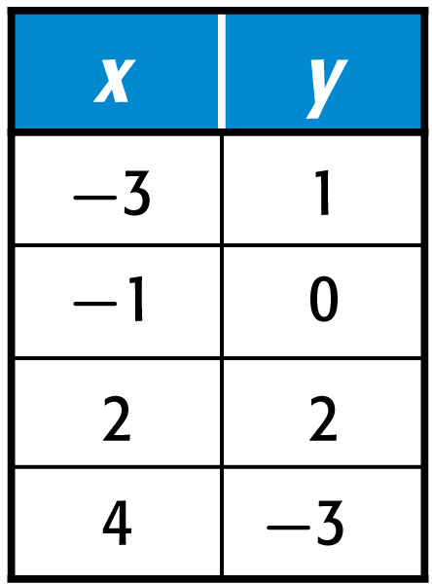
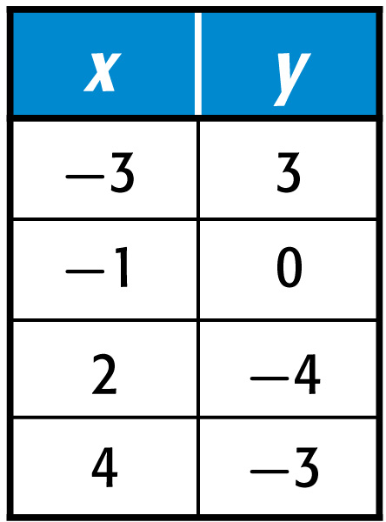
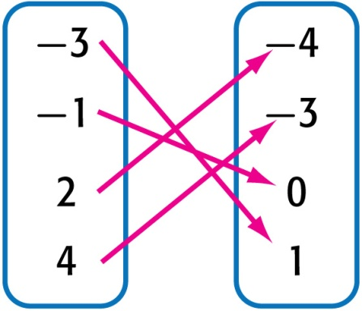
5-Minute Check 1
Which expresses the relation {(–1, 0), (2, –4),
(–3, 1), (4, –3)} correctly?
A. B.
C.

Slide 4

5-Minute Check 3
Jason, a waiter, expressed his customers’ bills and the tips they left him as the relation
{(10, 2), (8, 1.5), (4, 1.25)}. Which table correctly expresses the relation?
A. B. C.
bills | tips
$10 | $1.25
$8 | $1.50
$4 | $2
bills | tips
$10 | $2
$8 | $1.50
$4 | $1.25
bills | tips
$10 | $4
$8 | $2
$4 | $1

Slide 5

5-Minute Check 3
A student earns $8 for every lawn he mows. Which equation shows the relationship between the number of lawns mowed ℓ and the wages earned d?
A. ℓ = d + 8
B. 8 – ℓ = d
C. ℓ = 8d
D. 8ℓ = d

Slide 6

CCSS
Content Standards
F.IF.1 Understand that a function from one set (called the domain) to another set (called the range) assigns to each element of the domain exactly one element of the range. If f is a function and x is an element of its domain, then f(x) denotes the output of f corresponding to the input x. The graph of f is the graph of the equation y = f(x).
F.IF.2 Use function notation, evaluate functions for inputs in their domains, and interpret statements that use function notation in terms of a context.
Mathematical Practices
3 Construct viable arguments and critique the reasoning of others.
Common Core State Standards © Copyright 2010. National Governors Association Center for Best Practices and Council of Chief State School Officers. All rights reserved.

Slide 7


Then/Now
You solved equation with elements from a replacement set.
Determine whether a relation is a function.
Find function values.

Slide 8

Vocabulary
function
discrete function
continuous function
vertical line test
function notation
nonlinear function

Slide 9
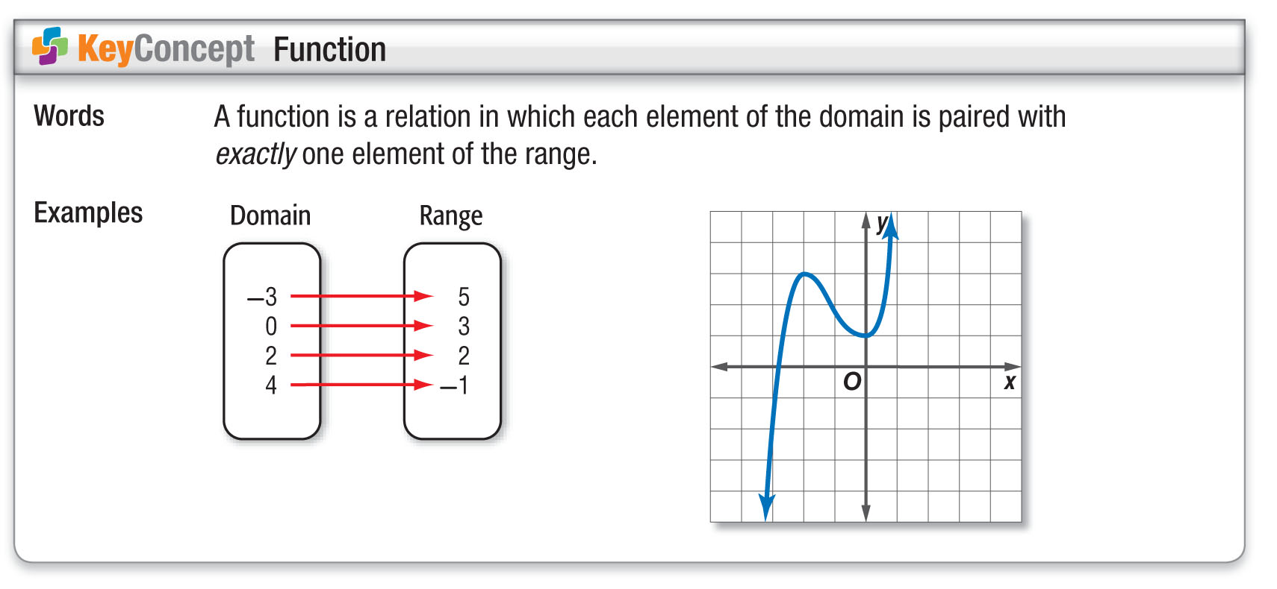
Concept 1

Slide 10
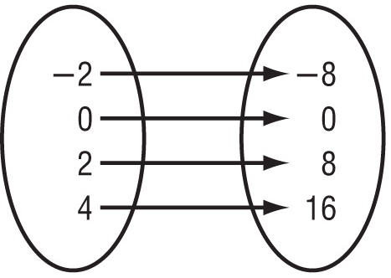
Example 1
Identify Functions
A. Determine whether the relation is a function. Explain.
Domain
Range
Answer: This is a function because the mapping shows each element of the domain paired with exactly one member of the range.

Slide 11
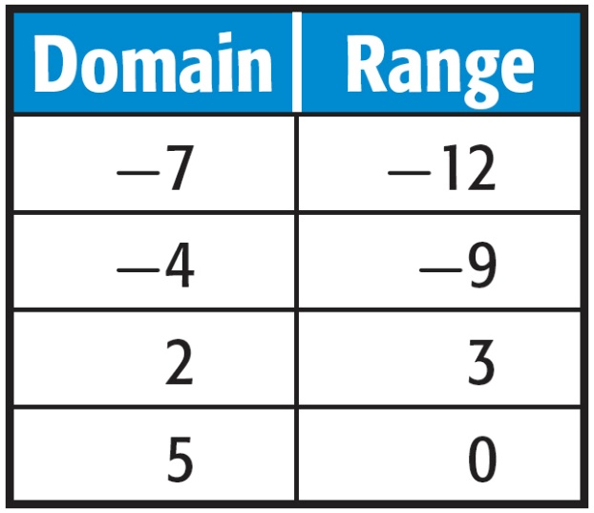
Example 1
Identify Functions
B. Determine whether the relation is a function. Explain.
Answer: This table represents a function because the table shows each element of the domain paired with exactly one element of the range.

Slide 12


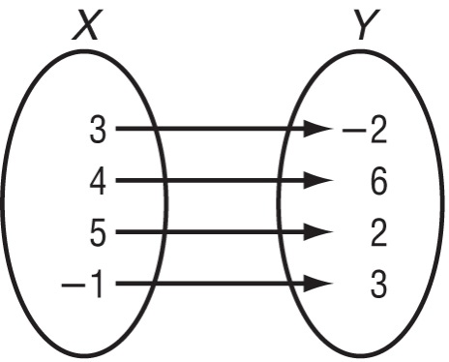
Example 1
A. Is this relation a function? Explain.
Yes; for each element of the domain, there is only one corresponding
element in the range.
Yes; it can be represented by a mapping.
No; it has negative
x-values.
No; both –2 and 2 are in
the range.

Slide 13
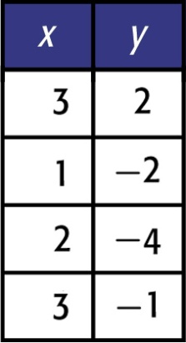
Example 1
B. Is this relation a function? Explain.
No; the element 3 in the domain is paired with both 2 and –1 in the range.
No; there are negative values in the range.
Yes; it is a line when graphed.
Yes; it can be represented in a chart.

Slide 14
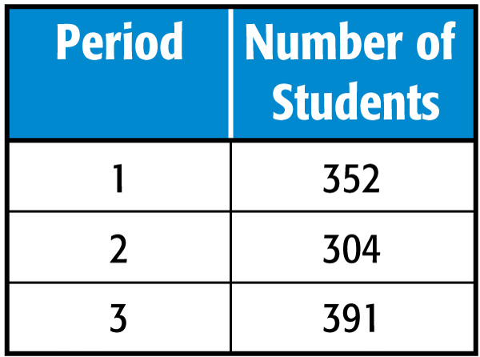
Example 2
Draw Graphs
A. SCHOOL CAFETERIA There are three lunch periods at a school. During the first period, 352 students eat. During the second period, 304 students eat. During the third period, 391 students eat. Make a table showing the number of students for each of the three lunch periods.
Answer:

Slide 15
Example 2
Draw Graphs
B. Determine the domain and range of the function.
Answer: D: {1, 2, 3}; R: {352, 304, 391}

Slide 16
Example 2
Draw Graphs
C. Write the data as a set of ordered pairs. Then draw the graph.
The ordered pairs can be determined from the table.
The period is the independent variable and the number
of students is the dependent variable.
Answer: The ordered pairs are {1, 352}, {2, 304}, and {3, 391}.

Slide 17
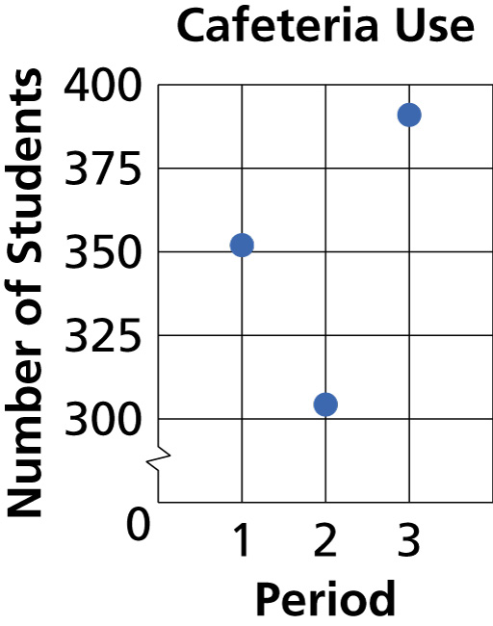
Example 2
Draw Graphs
Answer:

Slide 18
Example 2
Draw Graphs
D. State whether the function is discrete or continuous. Explain your reasoning.
Answer: Because the points are not connected, the function is discrete.

Slide 19
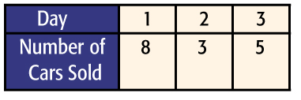
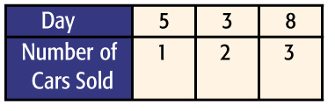


Example 2
At a car dealership, a salesman worked for three days. On the first day, he sold 5 cars. On the second day he sold 3 cars. On the third, he sold 8 cars. Make a table showing the number of cars sold for
each day.
A.
B.
C.
D.

Slide 20
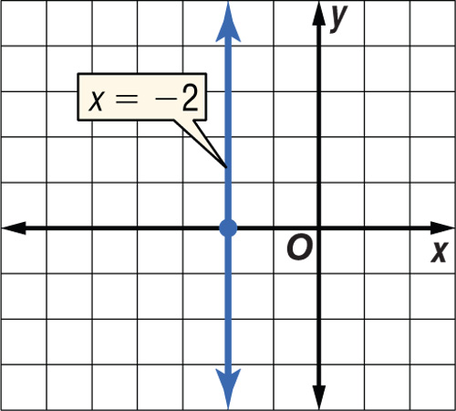
Example 3
Equations as Functions
Determine whether x = –2 is a function.
Graph the equation. Since the graph is in the form Ax + By = C, the graph of the equation will be a line. Place your pencil at the left of the graph to represent a vertical line. Slowly move the pencil to the right across the graph. At x = –2 this vertical line passes through more than one point on the graph.
Answer: The graph does not pass the vertical line test. Thus, the line does not represent a function.

Slide 21
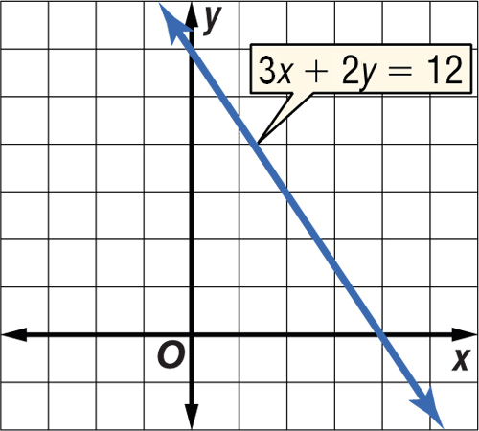
Example 3
Determine whether 3x + 2y = 12 is a function.
yes
no
not enough information

Slide 22
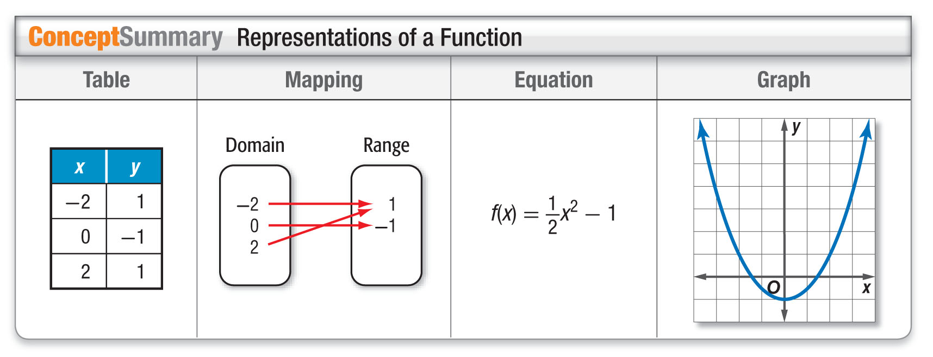
Concept 2

Slide 23
Example 4
Function Values
A. If f(x) = 3x – 4, find f(4).
f(4) = 3(4) – 4 Replace x with 4.
= 12 – 4 Multiply.
= 8 Subtract.
Answer: f(4) = 8

Slide 24
Example 4
Function Values
B. If f(x) = 3x – 4, find f(–5).
f(–5) = 3(–5) – 4 Replace x with –5.
= –15 – 4 Multiply.
= –19 Subtract.
Answer: f(–5) = –19

Slide 25
Example 4
A. If f(x) = 2x + 5, find f(3).
A. 8
B. 7
C. 6
D. 11

Slide 26
Example 4
B. If f(x) = 2x + 5, find f(–8).
A. –3
B. –11
C. 21
D. –16

Slide 27
Example 5
Nonlinear Function Values
A. If h(t) = 1248 – 160t + 16t², find h(3).
h(3) = 1248 – 160(3) + 16(3)² Replace t with 3.
= 1248 – 480 + 144 Multiply.
= 912 Simplify.
Answer: h(3) = 912

Slide 28
Example 5
Nonlinear Function Values
B. If h(t) = 1248 – 160t + 16t², find h(2z).
h(2z) = 1248 – 160(2z) + 16(2z)² Replace t with 2z.
= 1248 – 320z + 64z² Multiply.
Answer: h(2z) = 1248 – 320z + 64z²

Slide 29
Example 5
The function h(t) = 180 – 16t² represents the height of a ball thrown from a cliff that is 180 feet above the ground.
A. Find h(2).
A. 164 ft
B. 116 ft
C. 180 ft
D. 16 ft

Slide 30
Example 5
The function h(t) = 180 – 16t² represents the height of a ball thrown from a cliff that is 180 feet above the ground.
B. Find h(3z).
A. 180 – 16z² ft
B. 180 ft
C. 36 ft
D. 180 – 144z² ft

Slide 31
End of the Lesson

