Slide 1


Splash Screen

Slide 2
Lesson Menu
Five-Minute Check (over Lesson 1–7)
CCSS
Then/Now
New Vocabulary
Example 1: Real-World Example: Interpret Intercepts
Example 2: Real-World Example: Interpret Symmetry
Key Concepts: Positive, Negative, Increasing, Decreasing, Extrema, and End Behavior
Example 3: Real-World Example: Interpret Extrema and End Behavior

Slide 3

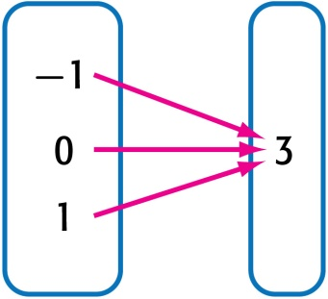
5-Minute Check 1
Is the relation a function?
A. yes
B. no

Slide 4

5-Minute Check 2
Is the relation a function?
x | y
16 | –8
12 | –6
0 | 0
–4 | 2
–10 | 5
A. yes
B. no

Slide 5

5-Minute Check 3
Is the relation {(7, 0), (0, 7), (–7, 0), (0, –7)}
a function?
A. yes
B. no

Slide 6

5-Minute Check 4
Is the relation y = 6 a function?
A. yes
B. no

Slide 7

5-Minute Check 5
If f(x) = 3x + 7, find f(10).
A. 20
B. 23
C. 32
D. 37

Slide 8

5-Minute Check 6
If g(x) = –2x – 2, find g(–2x).
A. g(–2x) = 4x – 2
B. g(–2x) = 4x² + 4
C. g(–2x) = 4x²
g(–2x) = 4x² – 2

Slide 9

5-Minute Check 7
What is the range shown in this function table?
x | 4x + 5 | y
–2 | 4(–2) + 5 | –3
0 | 4(0) + 5 | 5
1 | 4(1) + 5 | 9
A. {–3, 5, 9}
B. {–8, 0, 4}
C. {3, 5, 6}
D. {–2, 0, 1}

Slide 10

CCSS
Content Standards
F.IF.4 For a function that models a relationship between two quantities, interpret key features of graphs and tables in terms of the quantities, and sketch graphs showing key features given a verbal description of the relationship.
Mathematical Practices
1 Make sense of problems and persevere in solving them.
Common Core State Standards © Copyright 2010. National Governors Association Center for Best Practices and Council of Chief State School Officers. All rights reserved.

Slide 11


Then/Now
You identified functions and found function values.
Interpret intercepts, and symmetry of graphs of functions.
Interpret positive, negative, increasing, and decreasing behavior, extrema, and end behavior of graphs of functions.

Slide 12

Vocabulary
intercept
increasing
decreasing
extrema
relative maximum
relative minimum
end behavior
x-intercept
y-intercept
line symmetry
positive
negative

Slide 13
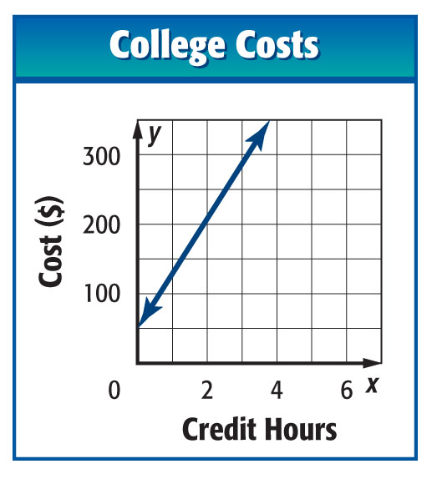
Example 1
Interpret Intercepts
COLLEGE The graph shows the cost at a community college y as a function of the number of credit hours taken x. Identify the function as linear or nonlinear. Then estimate and interpret the intercepts of the graph of the function.

Slide 14
Example 1
Interpret Intercepts
Answer: Linear or Nonlinear: Since the graph is a straight line, the graph is linear.
y-Intercept: The graph intersects the y-axis at about (0, 55), so the y-intercept of the graph is about 50. This means that the there is an additional fee of $50 added to the cost charged per credit hour.
x-Intercept(s): The graph does not intersect the x-axis. This means that no amount of credit hours will cost $0.

Slide 15


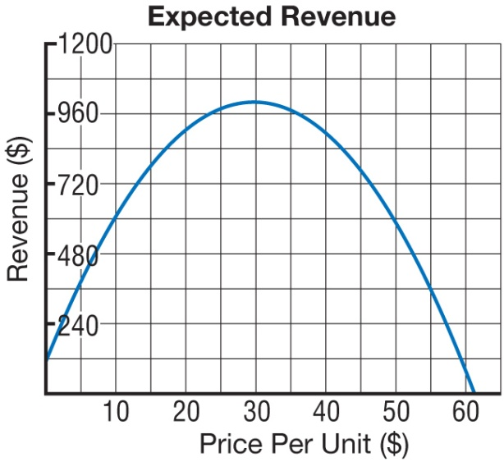
Example 1
SALES The graph shows the expected revenue y as a function of the price per unit x. Identify the function as linear or nonlinear. Then estimate and interpret the intercepts of the graph of the function.
A. nonlinear; (0, 100): Zero revenue at a price of $100; (62, 0): $62 expected revenue at a cost of $0.
B. nonlinear; (100, 0): Zero revenue at a price of $100; (0, 62): $62 expected revenue at a cost of $0.
C. nonlinear; (100, 0): revenue at a price of $0; (0, 62): No expected revenue at a price of $62 per unit.
D. nonlinear; (0, 100): revenue at a price of $0; (62, 0): No expected revenue at a price of $62 per unit.

Slide 16
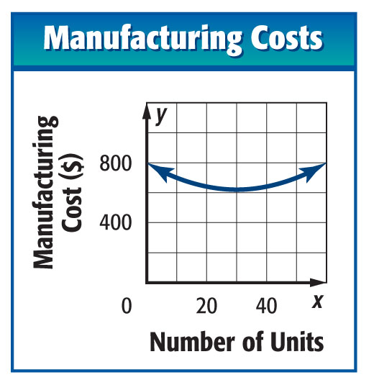
Example 2
Interpret Symmetry
MANUFACTURING The graph shows the cost y to manufacture x units of a product. Describe and interpret any symmetry.
Answer: The right half of the graph is the mirror image of the left half in approximately the line x = 30. The symmetry of the graph tells you that the cost to produce n more or n less than 30 units will be the same.

Slide 17
Example 2
SALES The graph shows the expected revenue y as a function of the price per unit x. Describe and interpret any symmetry.
A. The right half of the graph is the mirror
image of the left half in approximately the
line x = 30. The expected revenue at a
price of n more or n less than 30 dollars
per unit will be the same.
B. The right half of the graph is the mirror image of the left half in approximately the line x = 3. The expected revenue at a price of n more or n less than 3 dollars per unit will be the same.
C. There is no symmetry.
D. The right half of the graph is the mirror image of the left half in approximately the line y = 1000. The expected price at a revenue of n more or n less than 1000 dollars per unit will be the same.

Slide 18
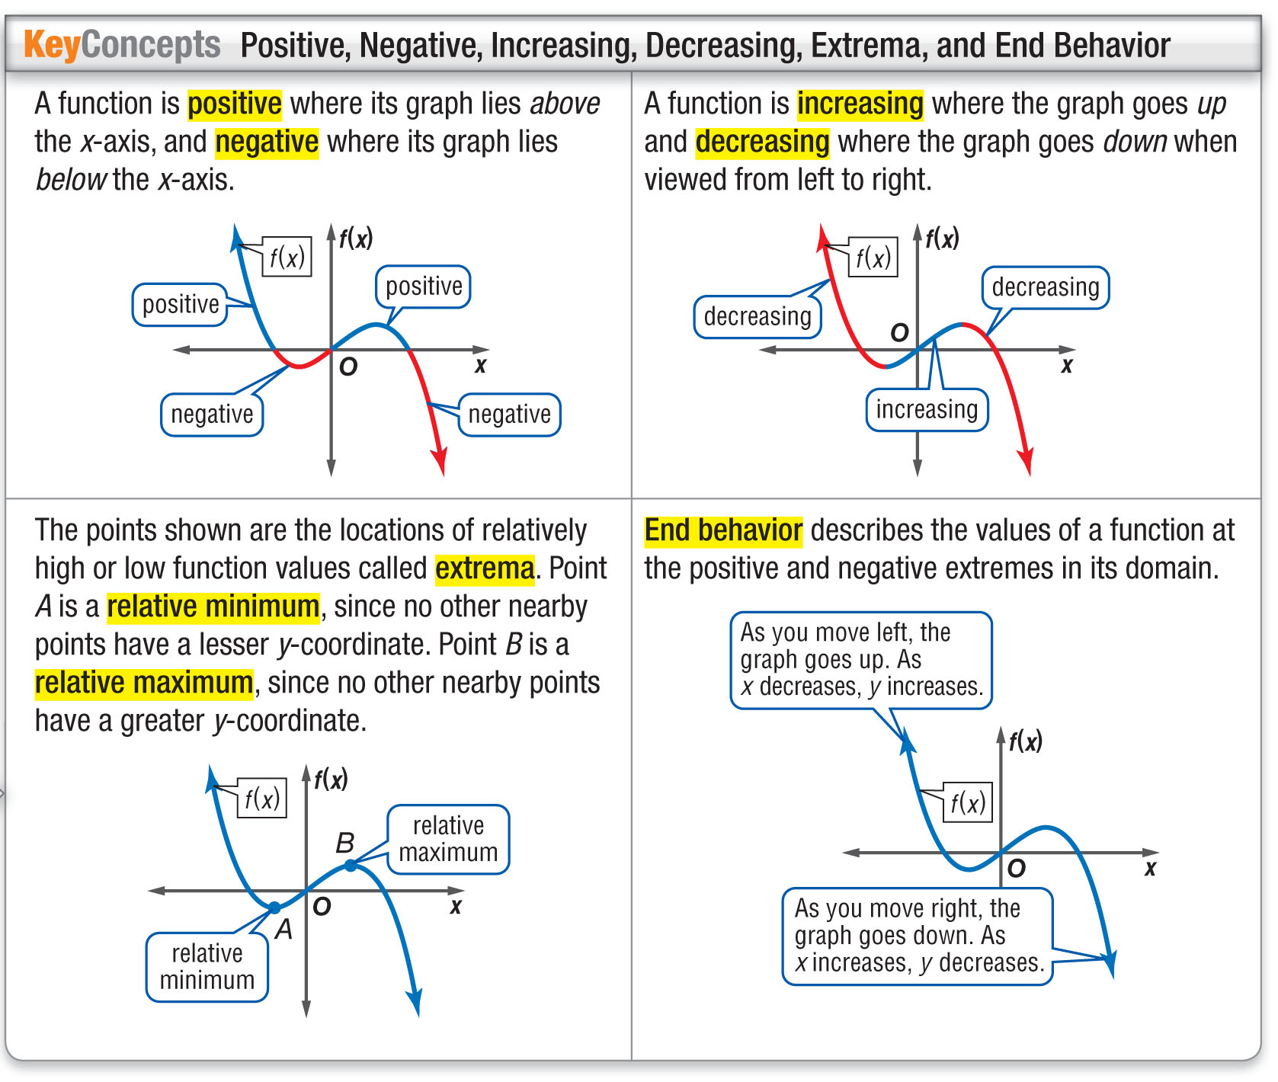
Key Concept

Slide 19
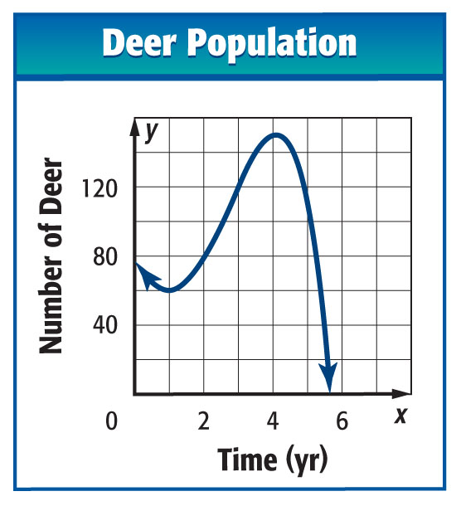
Example 3
Interpret Extrema and End Behavior
DEER The graph shows the population y of deer x years after the animals are introduced on an island. Estimate and interpret where the function is positive, negative, increasing, and decreasing, the x-coordinates of any relative extrema, and the end behavior of the graph.

Slide 20
Example 3
Interpret Extrema and End Behavior
Answer:
Positive: between x = 0 and about x = 7.5
Negative: for about x > 7.5
This means that there were some deer on the island for almost 8 years after they were introduced to the island.
Increasing: for between about x = 1 and x = 4
Decreasing: for x < 1 and x > 4
This means that the deer population decreased for the first year, increased for the next three years, then decreased after year 4.
Relative Maximum: at about x = 4
Relative Minimum: at about x = 1
The extrema of the graph indicate that the population experienced a relative low at year 1 and a relative high at year 4. The population then decreased to 0 after year 4.

Slide 21
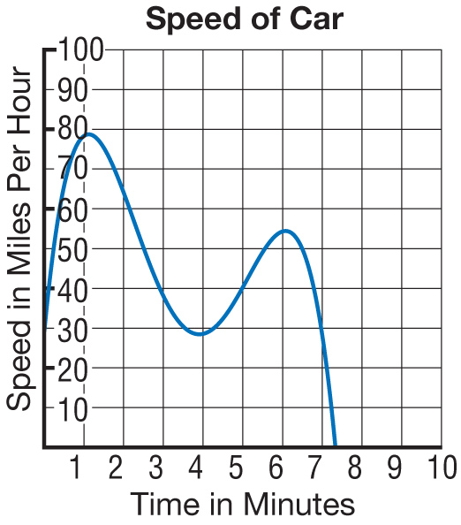
Example 3
SPEED The graph shows the speed of a car after x minutes. Estimate and interpret where the function is positive, negative, increasing, and decreasing, the x-coordinates of any relative extrema, and the end behavior of the graph.

Slide 22
Example 3
A. positive: 0 < t < 7.2, negative: t > 7.2 minutes; decreasing: t < 1, 4 < t < 6 , increasing: 1 < t < 4, t > 6, max: t = 4, min: t = 1 and t = 6
B. positive: 0 < t < 7.2, negative: t > 7.2 minutes; increasing: t < 1, 4 < t < 6 , decreasing: 1 < t < 4,
t > 6, max: t = 4, min: t = 1 and t = 6
C. positive: 0 < t < 7.2, negative: t > 7.2 minutes; increasing: t < 30, 90 < t < 120 , decreasing:
30 < t < 90, t > 120, max: t = 1, min: t = 4
D. positive: 0 < t < 7.2, negative: t > 7.2 minutes; increasing: t < 1, 4 < t < 6 , decreasing: 1 < t < 4,
t > 6, max: t = 1 and t = 6, min: t = 4

Slide 23
End of the Lesson

