Slide 1


Splash Screen

Slide 2
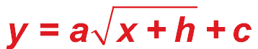
Lesson Menu
Five-Minute Check (over Chapter 9)
CCSS
Then/Now
New Vocabulary
Key Concept: Square Root Function
Example 1: Dilation of the Square Root Function
Key Concept: Graphing
Example 2: Reflection of the Square Root Function
Example 3: Translation of the Square Root Function
Example 4: Real-World Example: Analyze a Radical Function
Example 5: Transformations of the Square Root Function

Slide 3

5-Minute Check 1
What are the coordinates of the vertex of the graph of –3x² + 5 = 12x? Is the vertex a maximum or a minimum?
A. (4, 17); maximum
B. (2, 7); minimum
C. (–2, 4); minimum
D. (–2, 17); maximum

Slide 4

5-Minute Check 2
Solve x² + 4x = 21.
A. –9, 4
B. –7, 3
C. 4, 6
D. 7, 4

Slide 5

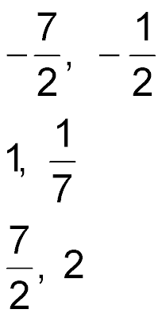
5-Minute Check 3
Solve 4x² + 16x + 7 = 0.
A.
B. –3, 2
C.
D.

Slide 6
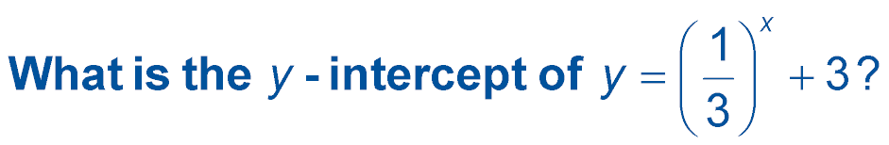

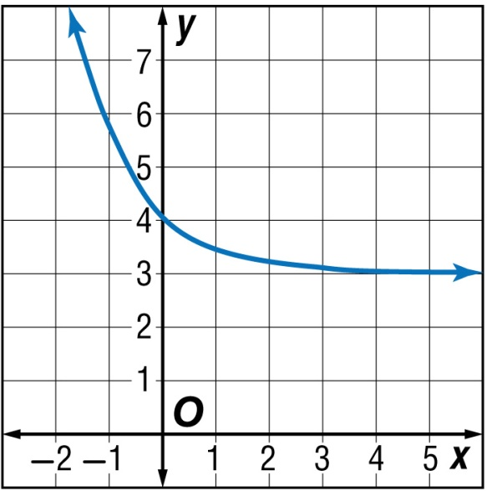
5-Minute Check 4
A. 6
B. 5
C. 4
D. 3

Slide 7

5-Minute Check 5
A work of art purchased for $1200 increases in value 5% each year for 5 years. What is its value after 5 years?
A. $826.13
B. $954.72
C. $1260.36
D. $1531.54

Slide 8

5-Minute Check 6
Write the function rule and find the sixth term of a sequence with a first term of 10 and common ratio of –0.5.
A. A(n) = 10n ● (–0.5); –30
B. A(n) = 10 ● (–0.5)^{n}; –0.15625
C. A(n) = 10 ● (–0.5)^{n – 1}; –0.3125
D. A(n) = 10[n + (–0.5)]; 55

Slide 9

CCSS
Content Standards
F.IF.4 For a function that models a relationship between two quantities, interpret key features of graphs and tables in terms of the quantities, and sketch graphs showing key features given a verbal description of the relationship.
F.IF.7b Graph square root, cube root, and piecewise-defined functions, including step functions and absolute value functions.
Mathematical Practices
6 Attend to precision.
Common Core State Standards © Copyright 2010. National Governors Association Center for Best Practices and Council of Chief State School Officers. All rights reserved.

Slide 10


Then/Now
You graphed and analyzed linear, exponential, and quadratic functions.
Graph and analyze dilations of radical functions.
Graph and analyze reflections and translations of radical functions.

Slide 11

Vocabulary
square root function
radical function
radicand

Slide 12
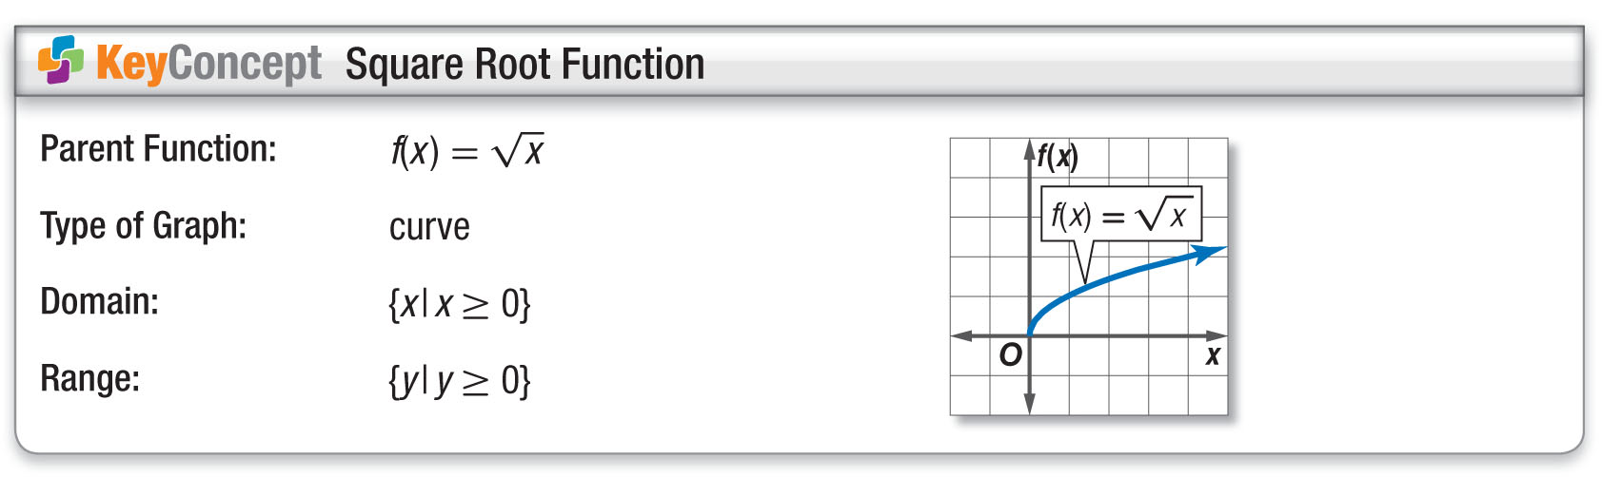
Concept 1

Slide 13

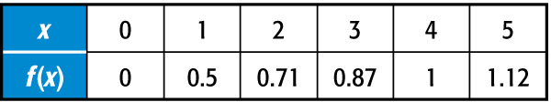
Example 1
Dilation of the Square Root Function
Step 1 Make a table.

Slide 14
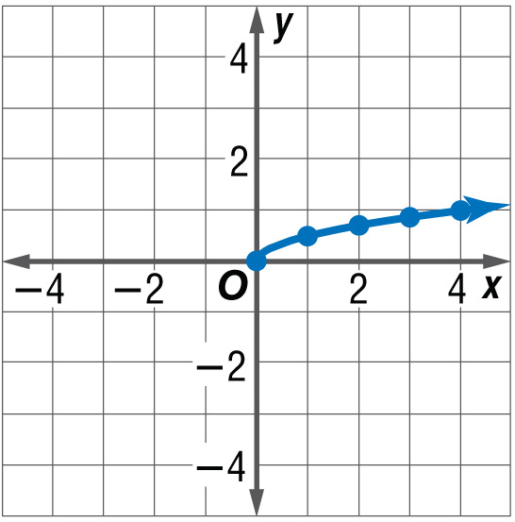
Example 1
Dilation of the Square Root Function
Step 2 Plot the points. Draw a smooth curve.
Answer: The domain is {x│x ≥ 0}, and the range
is {y│y ≥ 0}.

Slide 15



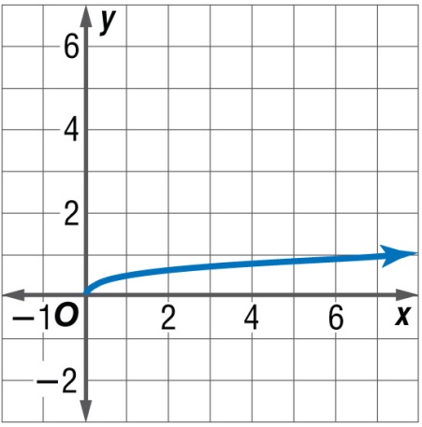
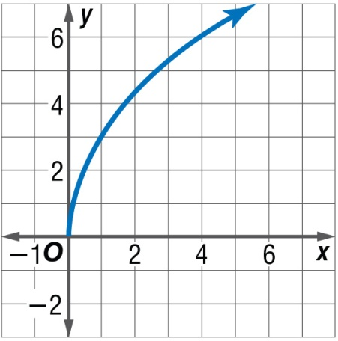
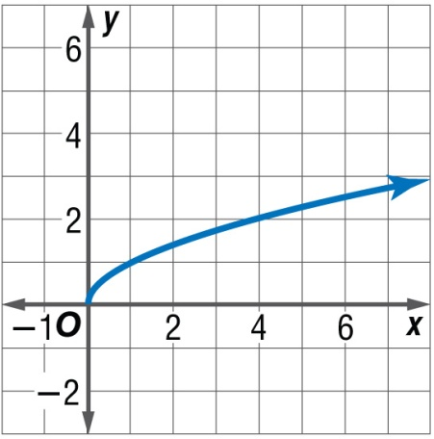
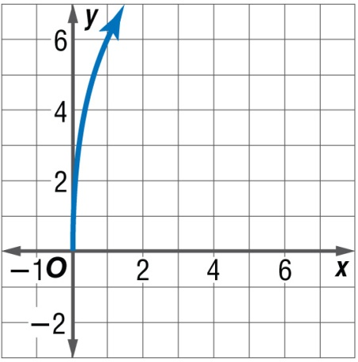
Example 1
A. B.
C. D.

Slide 16
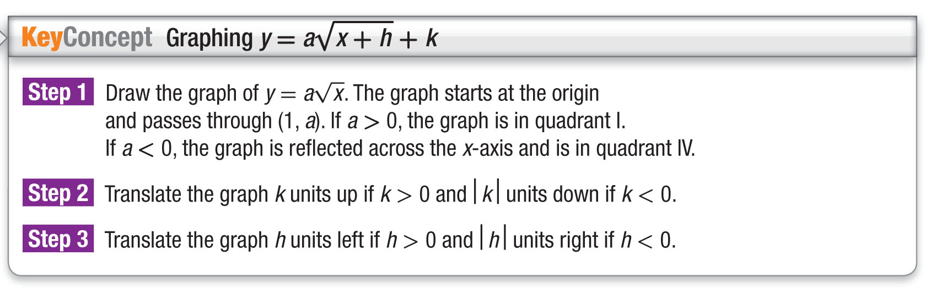
Concept 2

Slide 17

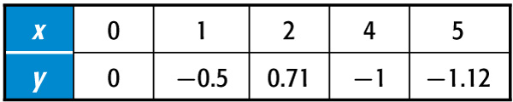
Example 2
Reflection of the Square Root Function
Compare it to the parent graph. State the domain and range.
Make a table of values. Then plot the points on a coordinate system and draw a smooth curve that connects them.

Slide 18
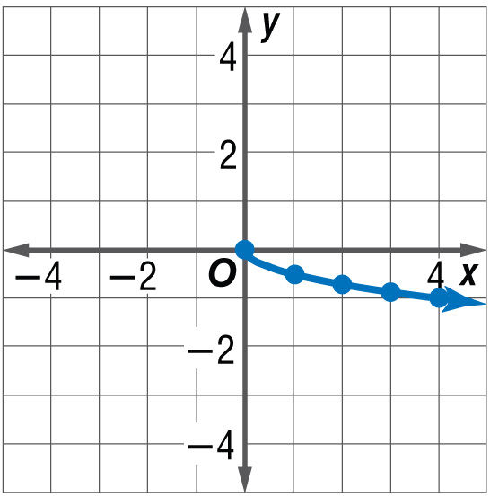

Example 2
Reflection of the Square Root Function
Answer: Notice that the graph is in the 4th quadrant.
It is a vertical compression of the graph of that has been reflected across the
x-axis. The domain is {x│x ≥ 0}, and the range is {y│y ≤ 0}.

Slide 19

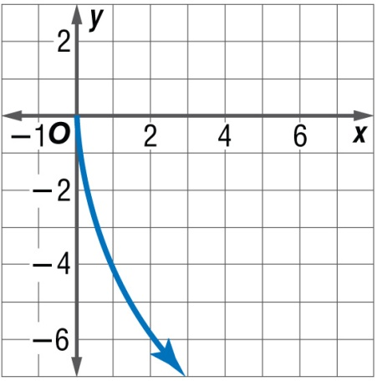

Example 2
A. It is a vertical stretch of that has been reflected over the x-axis.
B. It is a translation of that has been reflected over the x-axis.
C. It is a vertical stretch of that has been reflected over the y-axis.
D. It is a translation of that has been reflected over the y-axis.
A
B
C
D

Slide 20

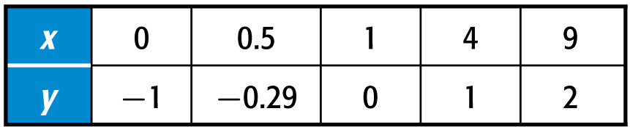
Example 3A
Translation of the Square Root Function

Slide 21
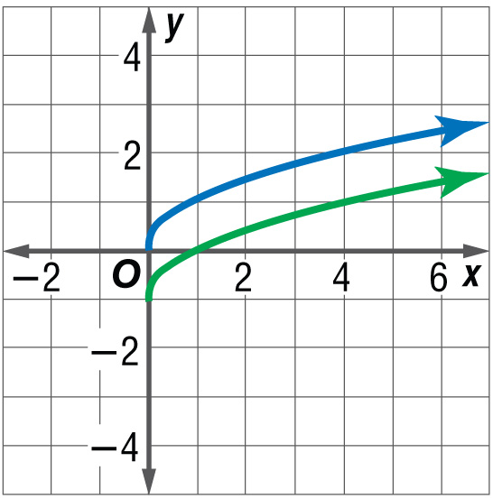

Example 3A
Translation of the Square Root Function
f(x)
g(x)
Notice that the values of g(x) are 1 less than those of
Answer: This is a vertical translation 1 unit down from the parent function. The domain is {x│x ≥ 0}, and the range is {g(x)│g(x) ≥ –1}.

Slide 22

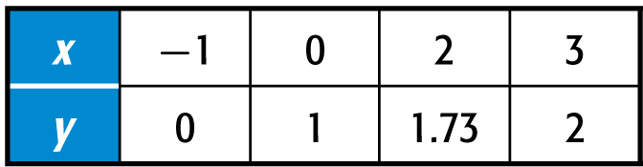
Example 3B
Translation of the Square Root Function

Slide 23
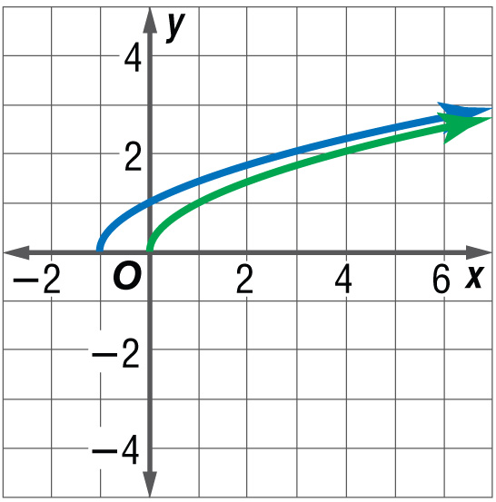
Example 3B
Translation of the Square Root Function
h(x)
f(x)
Answer: This is a horizontal translation 1 unit to the left of the parent function. The domain is {x│x ≥ –1}, and the range is {y│y ≥ 0}.

Slide 24
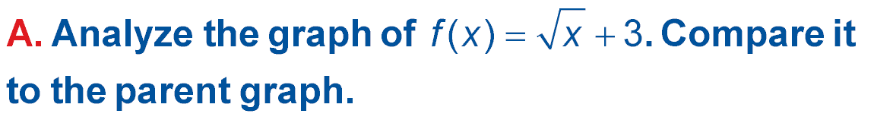
Example 3A
A. It is a horizontal translation of that has been shifted 3 units right.
B. It is a vertical translation of that has been shifted 3 units down.
C. It is a horizontal translation of that has been shifted 3 units left.
D. It is a vertical translation of that has been shifted 3 units up.

Slide 25
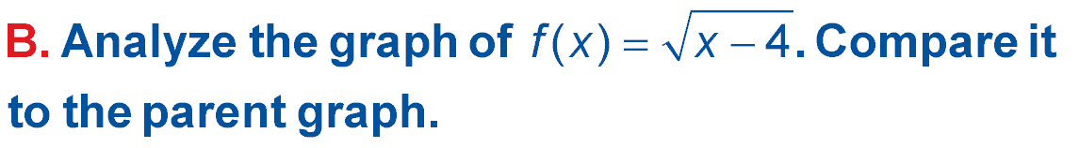
Example 3B
A. It is a horizontal translation of that has been shifted 4 units right.
B. It is a horizontal translation of that has been shifted 4 units left.
C. It is a vertical translation of
that has been shifted 4 units up.
D. It is a vertical translation of
that has been shifted 4 units down.

Slide 26

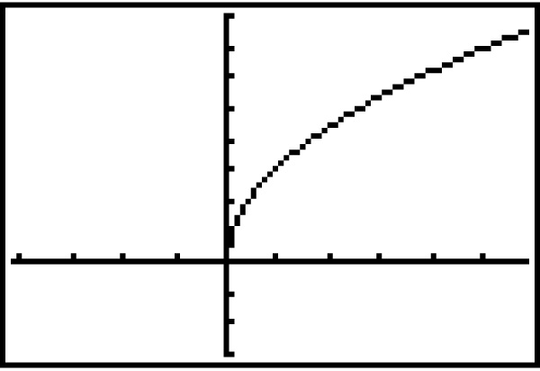
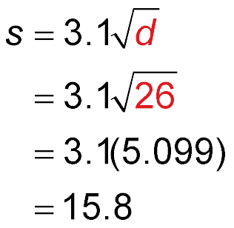
Example 4
Analyze a Radical Function
TSUNAMIS The speed s of a tsunami, in meters per second, is given by the function
where d is the depth of the ocean water in meters. Graph the function. If a tsunami is traveling in water 26 meters deep, what is its speed?
Use a graphing calculator to graph the function. To find the speed of the wave, substitute 26 meters for d.
Original function
d = 26

Slide 27
Example 4
Analyze a Radical Function
≈ 3.1(5.099)
Use a calculator.
≈ 15.8
Simplify.
Answer: The speed of the wave is about 15.8 meters per second at an ocean depth of 26 meters.

Slide 28

Example 4
When Reina drops her key down to her friend from the apartment window, the velocity v it is traveling is given by where g is the constant,
9.8 meters per second squared, and h is the height from which it falls. Graph the function. If the key is dropped from 17 meters, what is its velocity when it hits the ground?
A. about 333 m/s
B. about 18.3 m/s
C. about 33.2 m/s
D. about 22.5 m/s

Slide 29

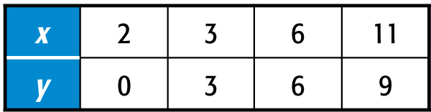
Example 5
Transformations of the Square Root Function

Slide 30
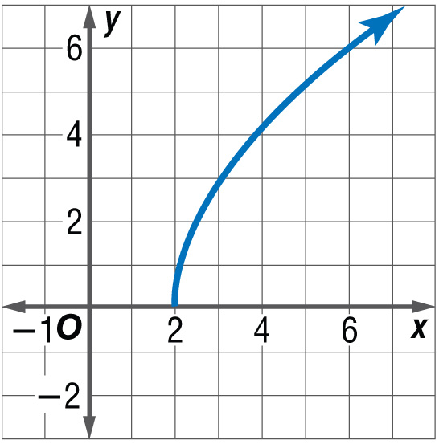
Example 5
Transformations of the Square Root Function
Answer: This graph is a vertical stretch of the graph of that has been translated 2 units right. The domain is {x│x ≥ 2}, and the range is {y│y ≥ 0}.

Slide 31
Example 5
A. The domain is {x│x ≥ 4}, and the range is {y│y ≥ –1}.
B. The domain is {x│x ≥ 3}, and the range is {y│y ≥ 0}.
C. The domain is {x│x ≥ 0}, and the range is {y│y ≥ 0}.
D. The domain is {x│x ≥ –4}, and the range is {y│y ≥ –1}.

Slide 32
End of the Lesson

