Slide 1


Splash Screen

Slide 2
Lesson Menu
Five-Minute Check (over Lesson 10–1)
CCSS
Then/Now
New Vocabulary
Key Concept: Product Property of Square Roots
Example 1: Simplify Square Roots
Example 2: Multiply Square Roots
Example 3: Simplify a Square Root with Variables
Key Concept: Quotient Property of Square Roots
Example 4: Standardized Test Example
Example 5: Use Conjugates to Rationalize a Denominator

Slide 3

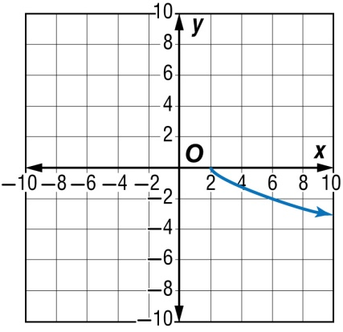
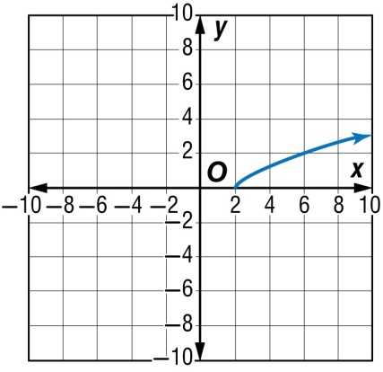
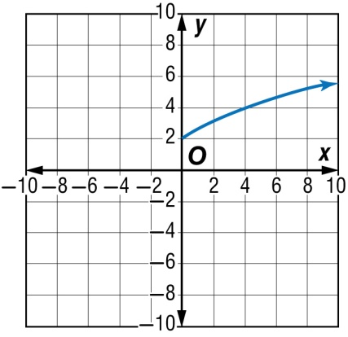
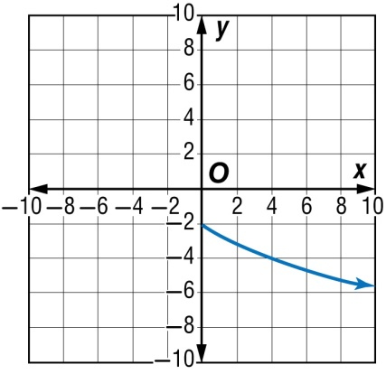
5-Minute Check 1
A. D = {x | x ≥ 2} B. D = {x | x ≥ 2}
C. D = {x | x ≥ 0} D. D = {x | x ≥ 0}

Slide 4

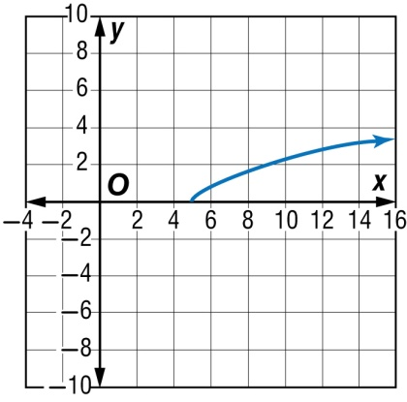
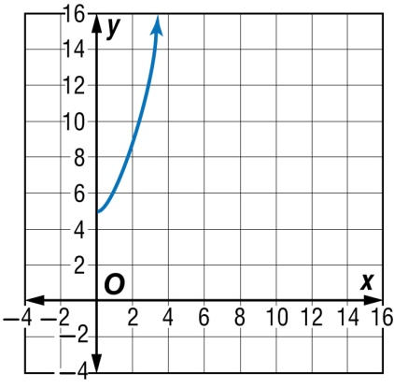
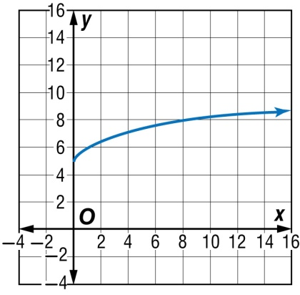
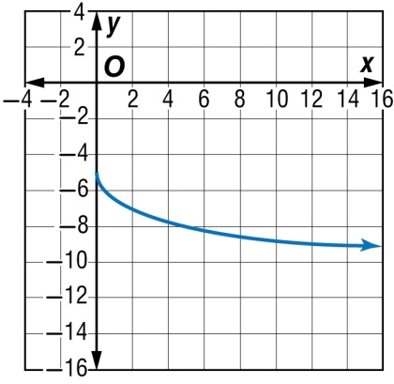
5-Minute Check 2
A. R = { y | y ≥ 0} B. R = { y | y ≥ 5}
C. R = { y | y ≥ 5} D. R = { y | y ≥ –5}

Slide 5

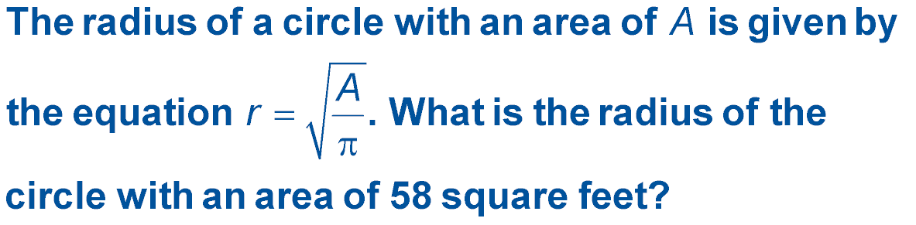
5-Minute Check 3
A. about 5.2 ft
B. about 4.3 ft
C. about 3.8 ft
D. about 3.2 ft

Slide 6

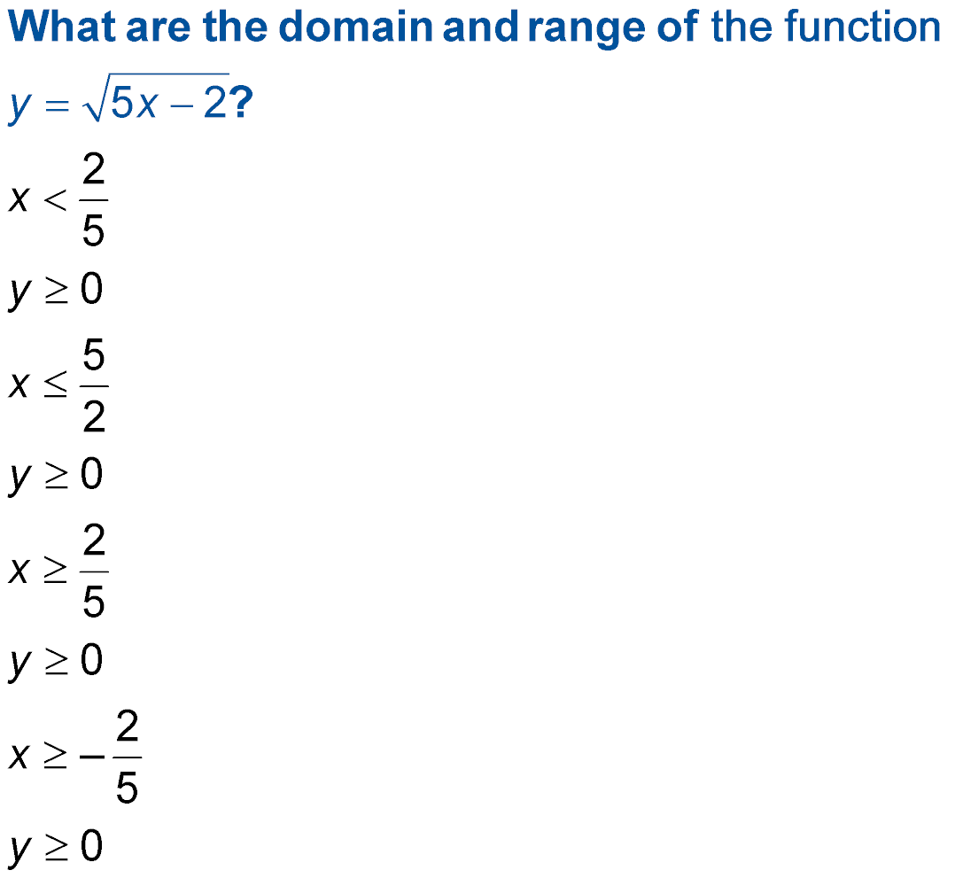
5-Minute Check 4
;
A.
B.
C.
D.
;
;
;

Slide 7

CCSS
Content Standards
A.REI.4a Use the method of completing the square to transform any quadratic equation in x into an equation of the form (x – p)² = q that has the same solutions. Derive the quadratic formula from this form.
Mathematical Practices
7 Look for and make use of structure.
8 Look for and express regularity in repeated reasoning.
Common Core State Standards © Copyright 2010. National Governors Association Center for Best Practices and Council of Chief State School Officers. All rights reserved.

Slide 8


Then/Now
You simplified radicals.
Simplify radical expressions by using the Product Property of Square Roots.
Simplify radical expressions by using the Quotient Property of Square Roots.

Slide 9

Vocabulary
radical expression
rationalizing the denominator
conjugate

Slide 10
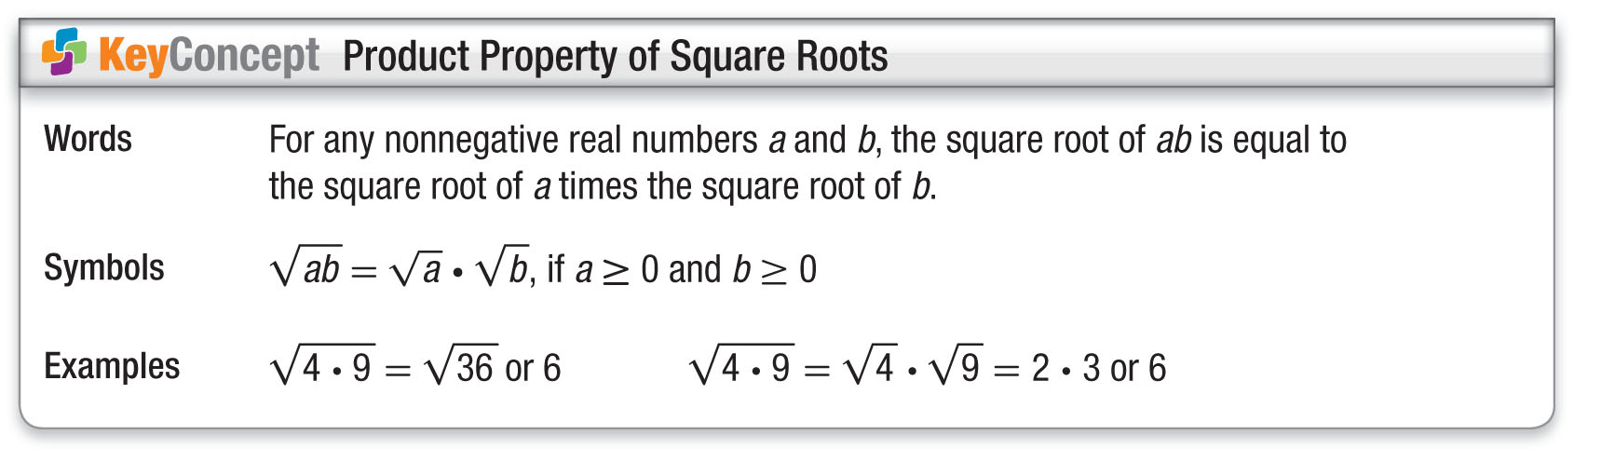
Concept 1

Slide 11
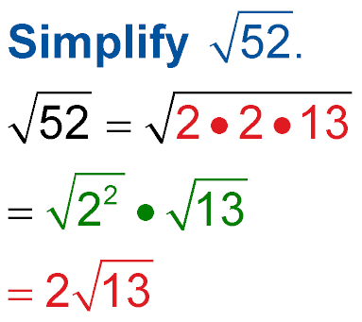
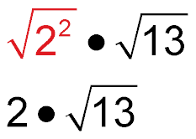
Example 1
Simplify Square Roots
Prime factorization of 52
Product Property of Square Roots
= 2 ● Simplify.
Answer:

Slide 12


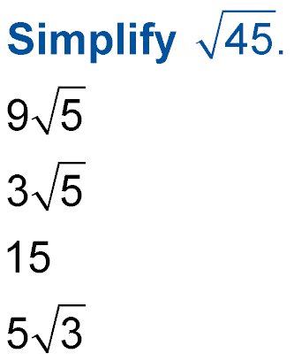
Example 1
A.
B.
C. 15
D.

Slide 13
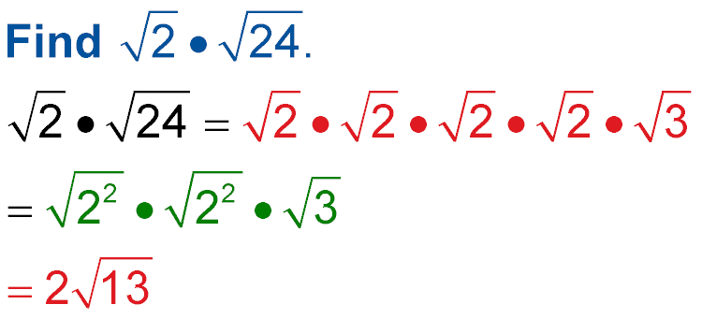
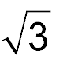
Example 2
Multiply Square Roots
Product Property
Product Property
= 2 ● 2 ● Simplify.
Answer: 4

Slide 14
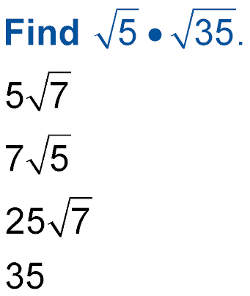
Example 2
A.
B.
C.
D. 35

Slide 15
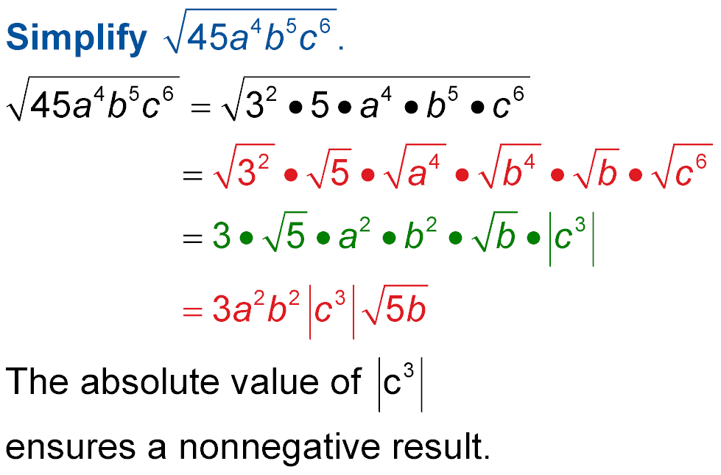

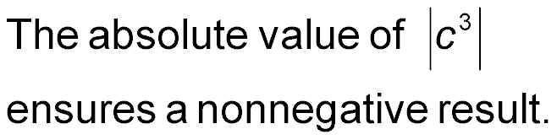

Example 3
Simplify a Square Root with Variables
Prime factorization
Product Property
Simplify.
Answer:

Slide 16

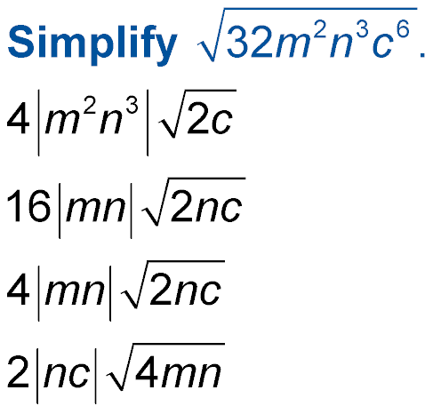
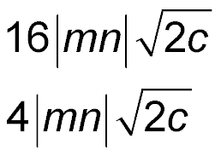
Example 3
A.
B.
C.
D.

Slide 17
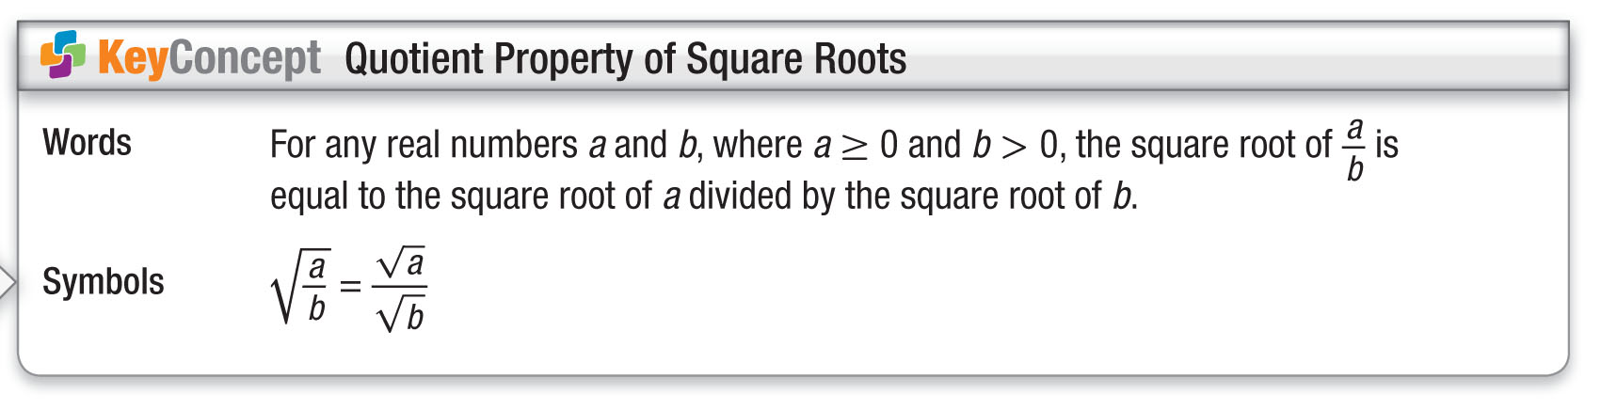
Concept 2

Slide 18
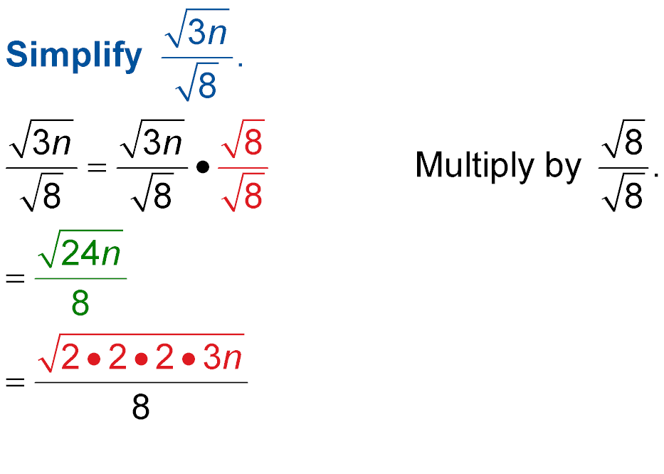
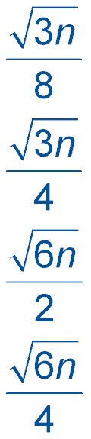
Example 4
Which expression is equivalent to ?
A C
B D
Read the Test Item
The radical expression needs to be simplified.

Slide 19
Example 4
Solve the Test Item
Product Property of Square Roots

Slide 20
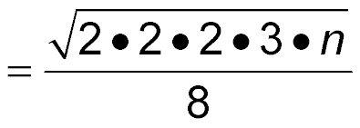
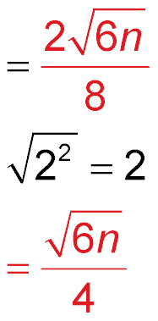
Example 4
Prime factorization
Simplify.
Answer: The correct choice is D.

Slide 21
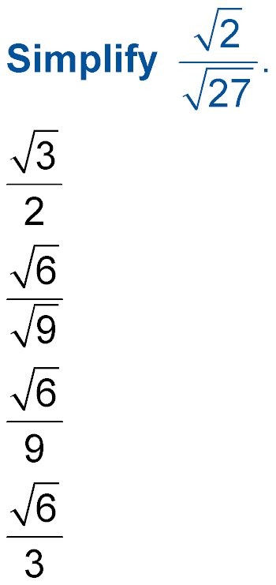
Example 4
A.
B.
C.
D.

Slide 22
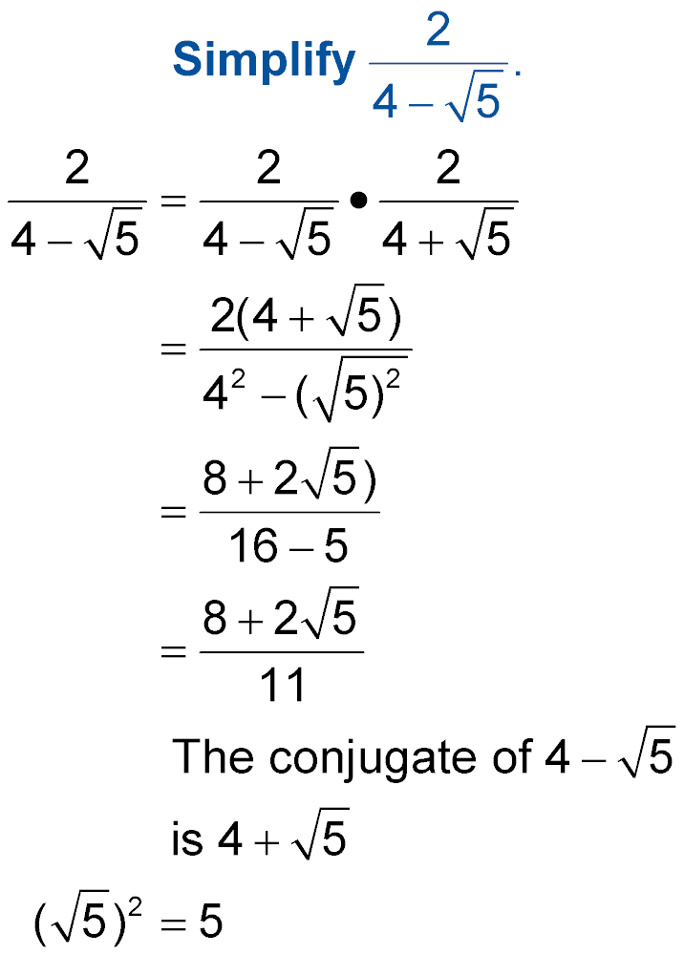
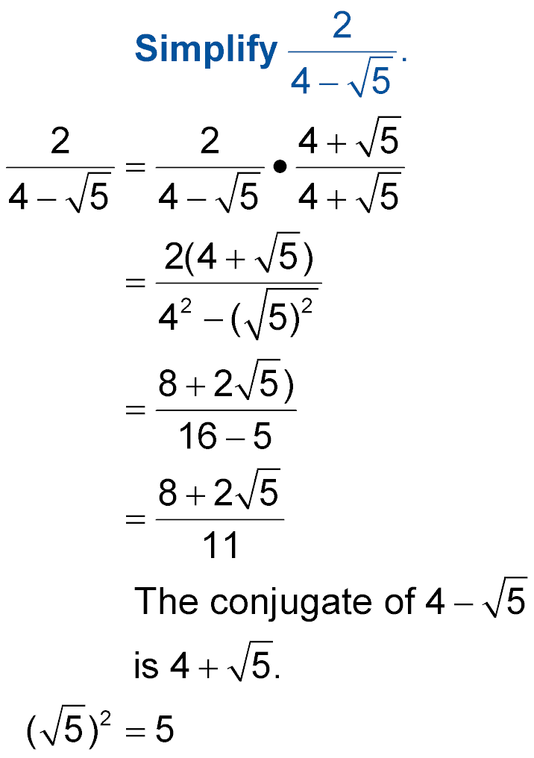
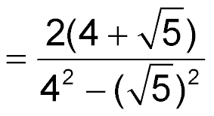
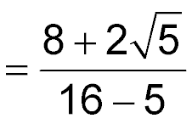
Example 5
Use Conjugates to Rationalize a Denominator
(a – b)(a + b) = a² – b²
Simplify.

Slide 23
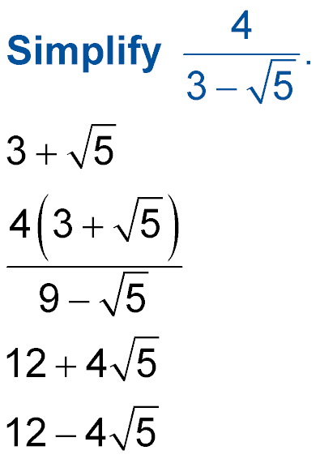
Example 5
A.
B.
C.
D.

Slide 24
End of the Lesson

