Slide 1


Splash Screen

Slide 2
Lesson Menu
Five-Minute Check (over Lesson 10–2)
CCSS
Then/Now
Example 1: Add and Subtract Expressions with Like Radicands
Example 2: Add and Subtract Expressions with Unlike Radicands
Example 3: Multiply Radical Expressions
Example 4: Real-World Example: Multiply Radical Expressions
Concept Summary: Operations with Radical Expressions

Slide 3

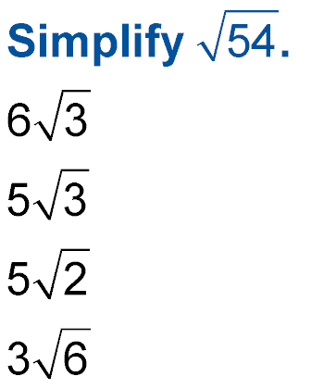
5-Minute Check 1
A.
B.
C.
D.

Slide 4

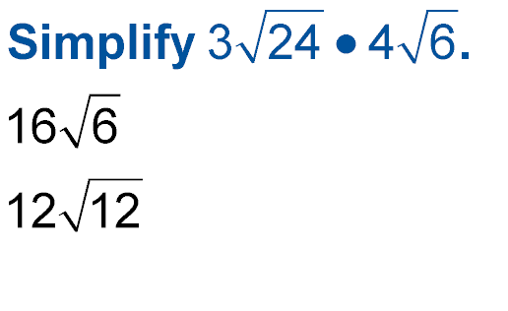
5-Minute Check 2
A. 144
B.
C.
D. 36

Slide 5

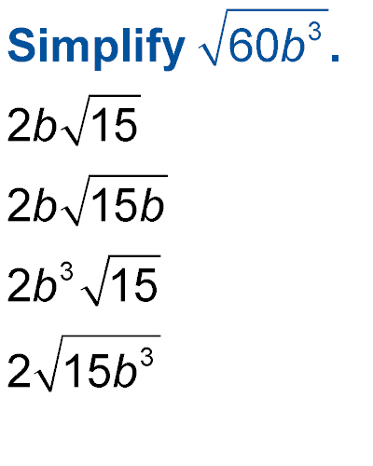
5-Minute Check 3
A.
B.
C.
D.

Slide 6
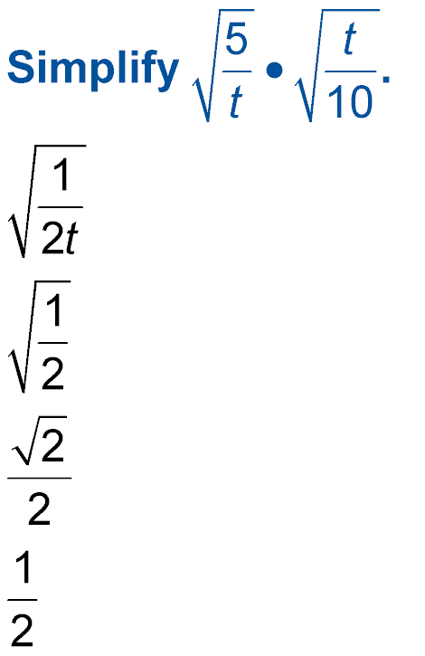

5-Minute Check 4
A.
B.
C.
D.

Slide 7

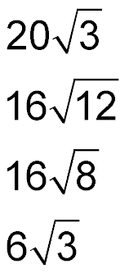
5-Minute Check 5
The formula for the total surface area of a cube with side ℓ is 6ℓ². The surface area of a cube is
648 square feet. What is the length of side ℓ?
A.
B.
C.
D.

Slide 8

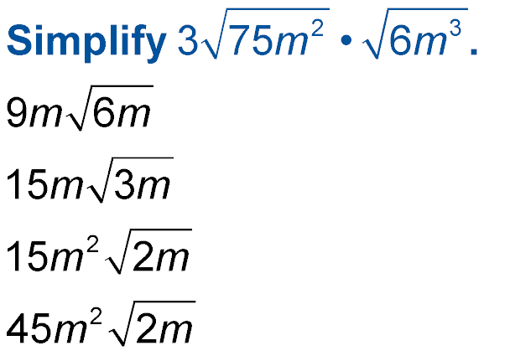
5-Minute Check 6
A.
B.
C.
D.

Slide 9

CCSS
Content Standards
N.RN.2 Rewrite expressions involving radicals and rational exponents using the properties of exponents.
Mathematical Practices
2 Reason abstractly and quantitatively.
Common Core State Standards © Copyright 2010. National Governors Association Center for Best Practices and Council of Chief State School Officers. All rights reserved.

Slide 10


Then/Now
You simplified radical expressions.
Add and subtract radical expressions.
Multiply radical expressions.

Slide 11
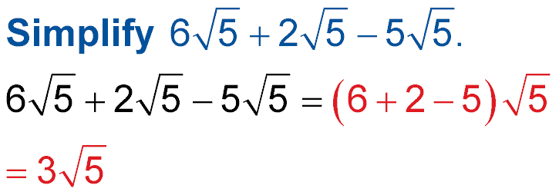
Example 1A
Add and Subtract Expressions with Like Radicands
A.
Distributive Property
Simplify.
Answer:

Slide 12
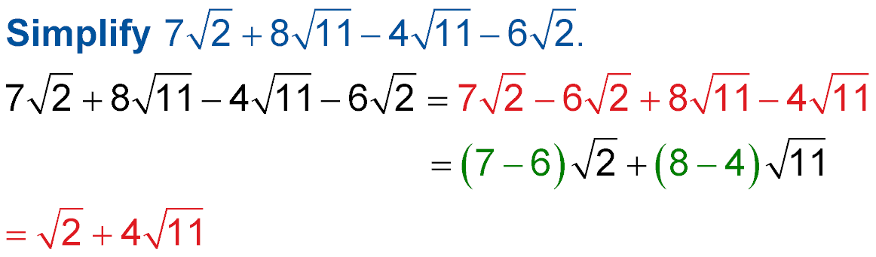
Example 1B
Add and Subtract Expressions with Like Radicands
B.
Commutative Property
Distributive Property
Simplify.
Answer:

Slide 13


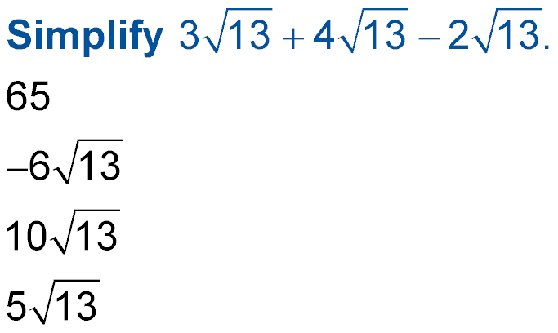
Example 1A
A.
A. 65
B.
C.
D.

Slide 14
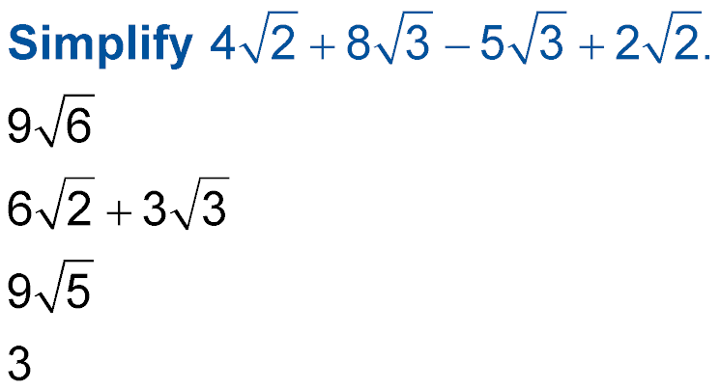
Example 1B
B.
A.
B.
C.
D. 3

Slide 15
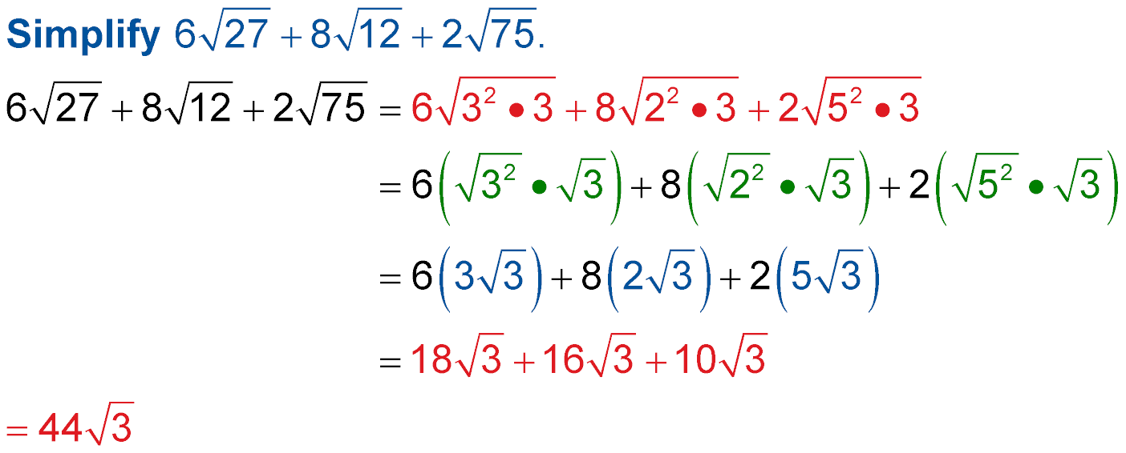
Example 2
Add and Subtract Expressions with Unlike Radicands
Product Property
Simplify.
Multiply.
Simplify.
Answer:

Slide 16
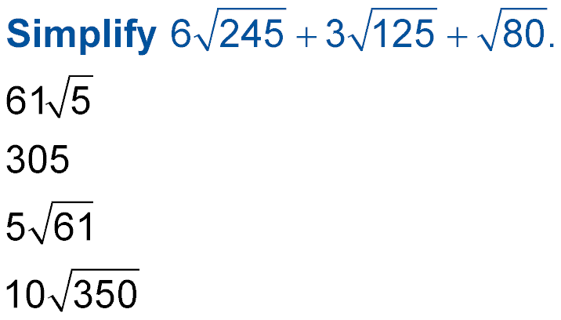
Example 2
A.
B. 305
C.
D.

Slide 17
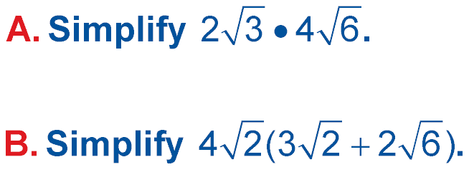
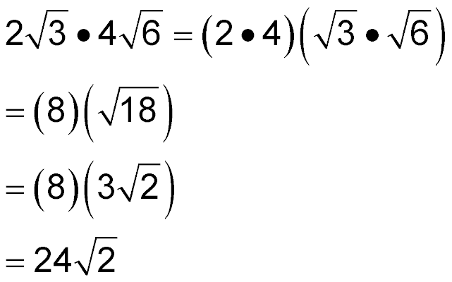
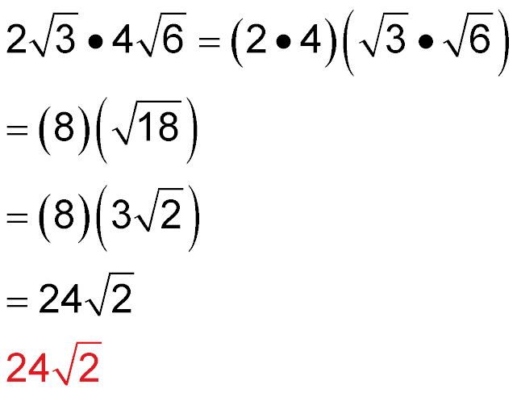
Example 3A
Multiply Radical Expressions
Associative Property
Multiply.
Simplify.
Multiply.
Answer:

Slide 18
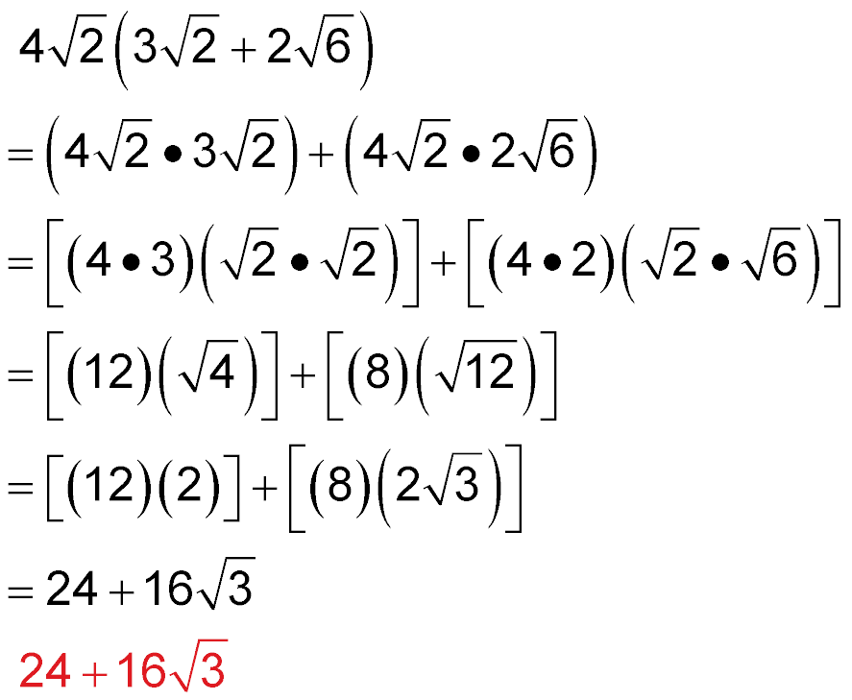
Example 3B
Multiply Radical Expressions
Distributive Property
Associative Property
Multiply.
Simplify.
Multiply.
Answer:

Slide 19
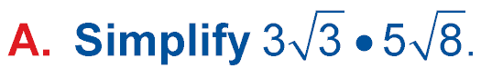
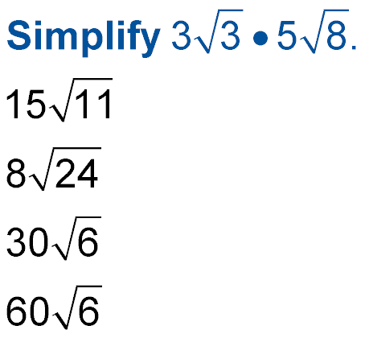
Example 3A
A.
B.
C.
D.

Slide 20
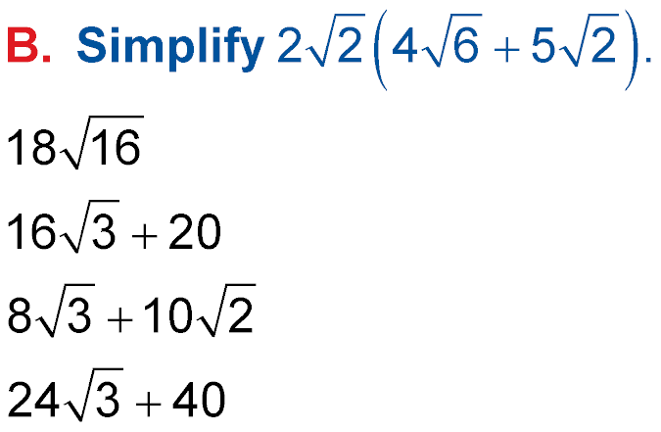
Example 3B
A.
B.
C.
D.

Slide 21
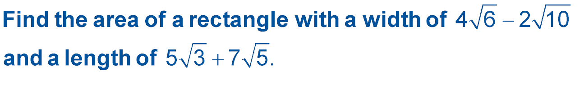
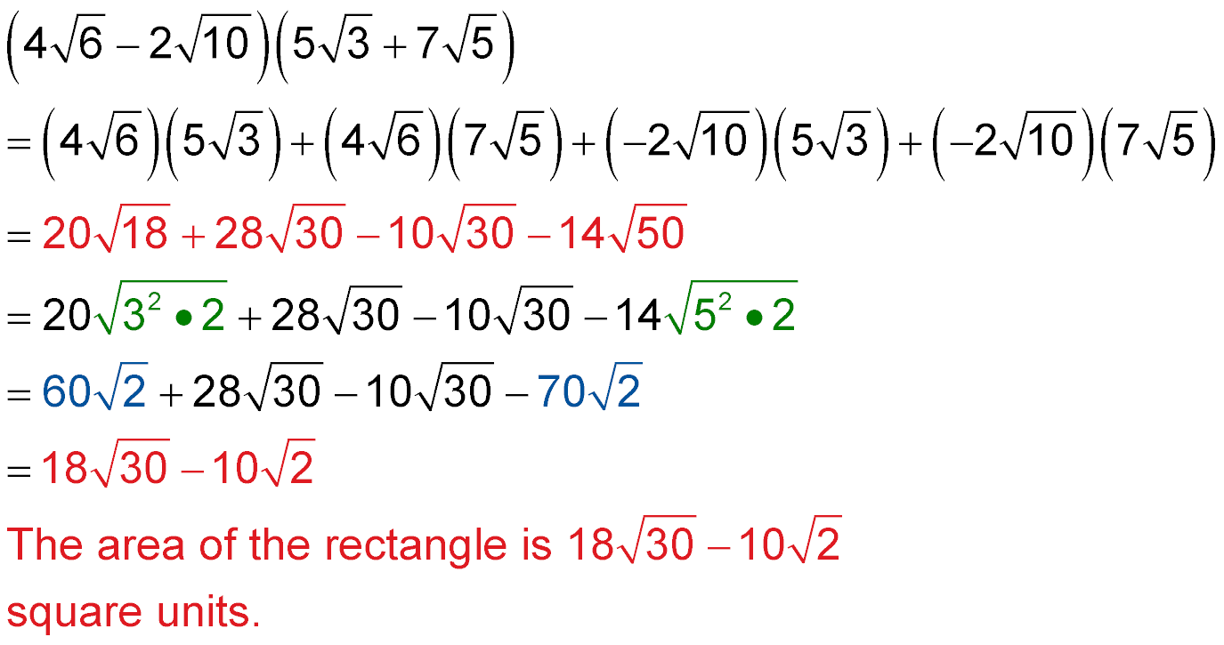
Example 4
Multiply Radical Expressions
GEOMETRY Find the area of a rectangle in
simplest form with a width of and a
length of
A = A = ℓ ● w
First terms
Outer terms
Inner terms
Last terms
Multiply.

Slide 22
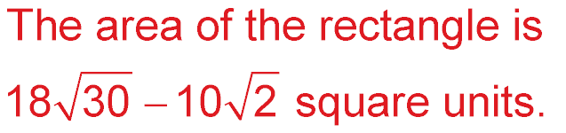
Example 4
Multiply Radical Expressions
Prime factorization
Simplify.
Combine like terms.
Answer:

Slide 23
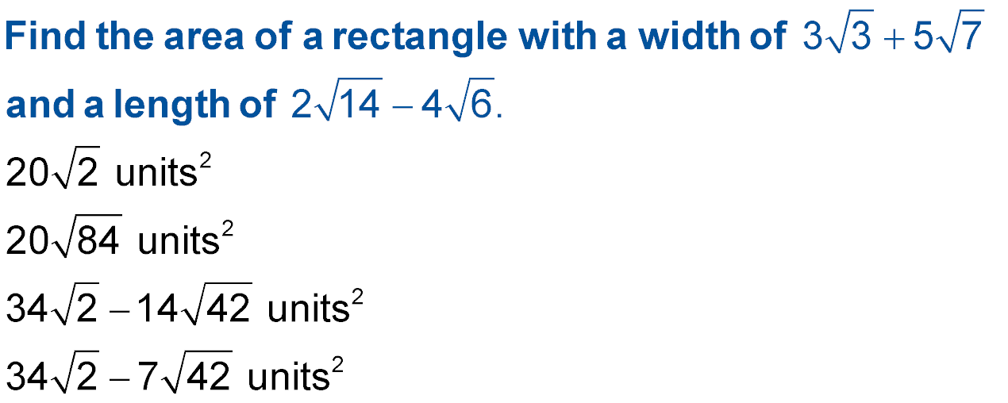
Example 4
A.
B.
C.
D.

Slide 24
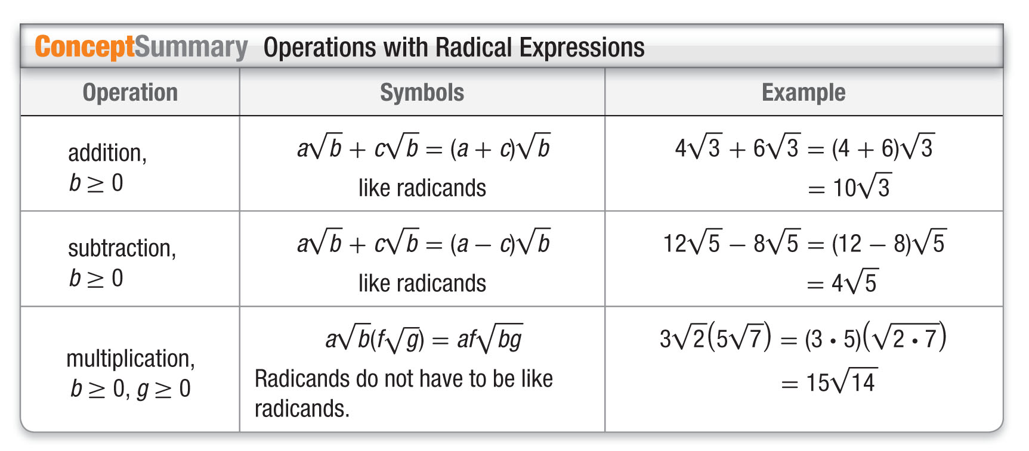
Concept

Slide 25
End of the Lesson

