Slide 1


Splash Screen

Slide 2
Lesson Menu
Five-Minute Check (over Lesson 10–3)
CCSS
Then/Now
New Vocabulary
Key Concept: Power Property of Equality
Example 1: Real-World Example: Variable as a Radicand
Example 2: Expression as a Radicand
Example 3: Variable on Each Side

Slide 3

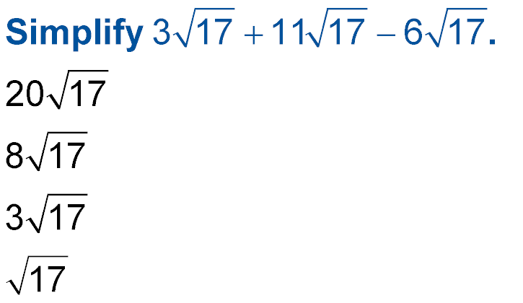
5-Minute Check 1
A.
B.
C.
D.

Slide 4

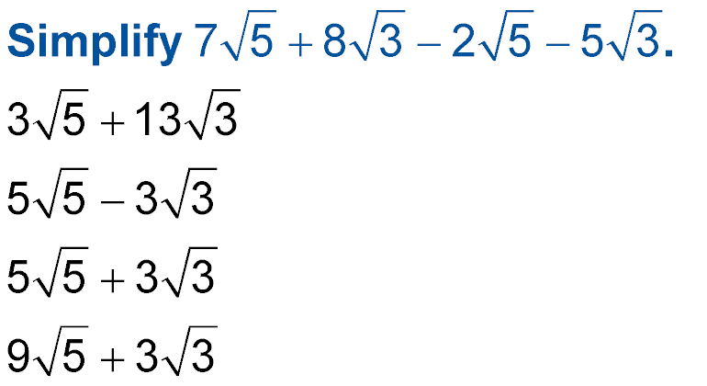
5-Minute Check 2
A.
B.
C.
D.

Slide 5

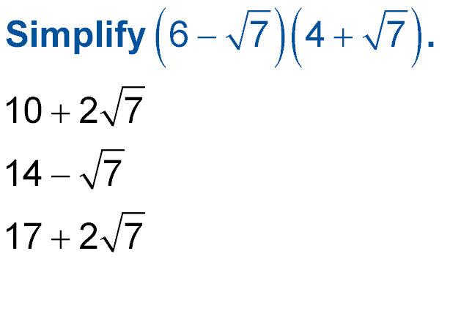
5-Minute Check 3
A. 10
B.
C.
D.

Slide 6

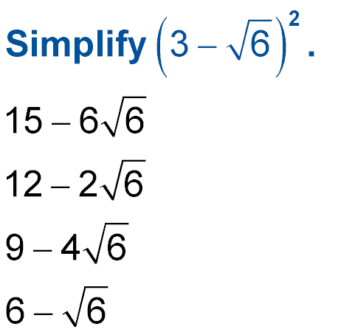
5-Minute Check 4
A.
B.
C.
D.

Slide 7

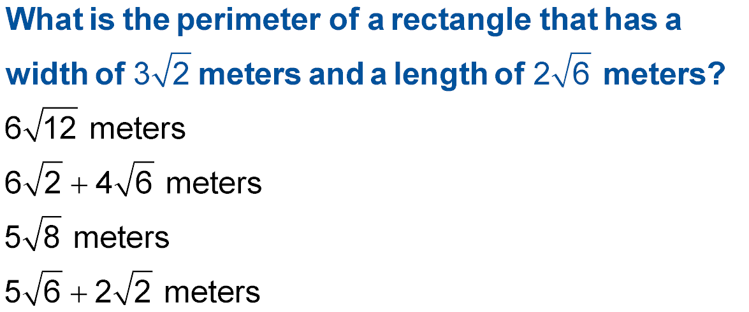
5-Minute Check 5
A.
B.
C.
D.

Slide 8

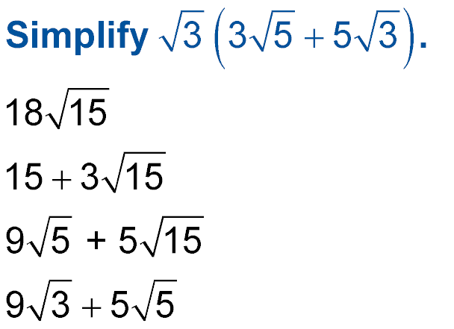
5-Minute Check 6
A.
B.
C.
D.

Slide 9

CCSS
Content Standards
N.RN.2 Rewrite expressions involving radicals and rational exponents using the properties of exponents.
A.CED.2 Create equations in two or more variables to represent relationships between quantities; graph equations on coordinate axes with labels and scales.
Mathematical Practices
3 Construct viable arguments and critique the reasoning of others.
4 Model with mathematics.
Common Core State Standards © Copyright 2010. National Governors Association Center for Best Practices and Council of Chief State School Officers. All rights reserved.

Slide 10


Then/Now
You added, subtracted, and multiplied radical expressions.
Solve radical equations.
Solve radical equations with extraneous solutions.

Slide 11

Vocabulary
radical equations
extraneous solutions

Slide 12
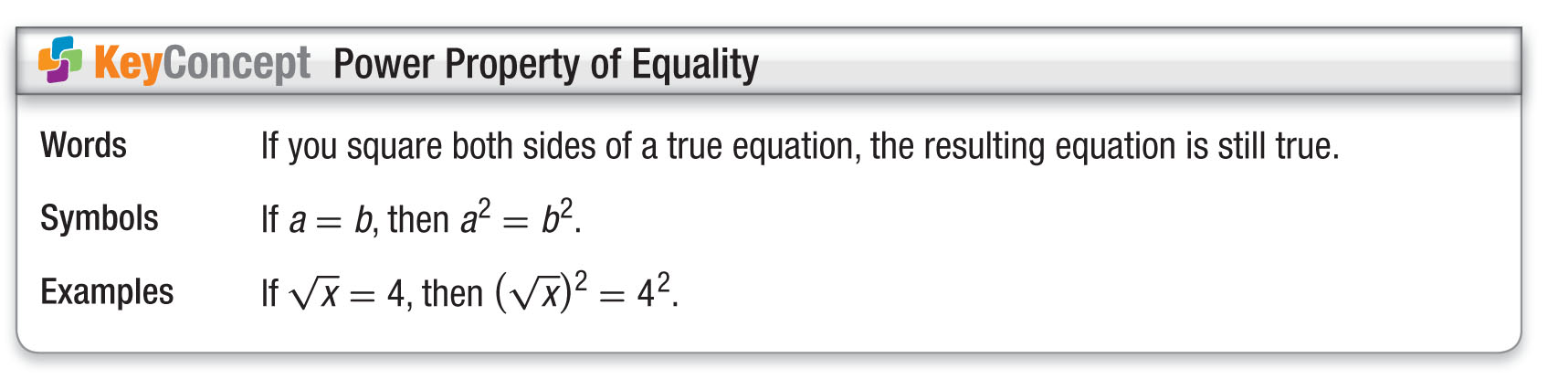
Concept

Slide 13
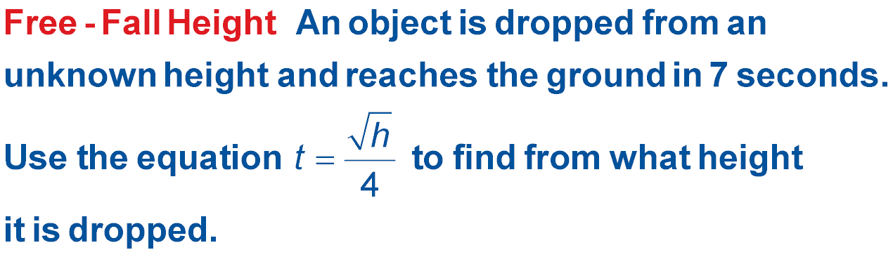
Example 1
Variable as a Radicand
FREE-FALL HEIGHT An object is dropped from
an unknown height and reaches the ground in
5 seconds. Use the equation , where t is time
in seconds and h is height in feet, to find the height
from which the object was dropped.
Understand You know the time it takes for the object to hit the ground. You need to find the height.

Slide 14
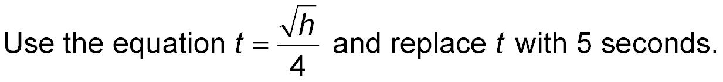
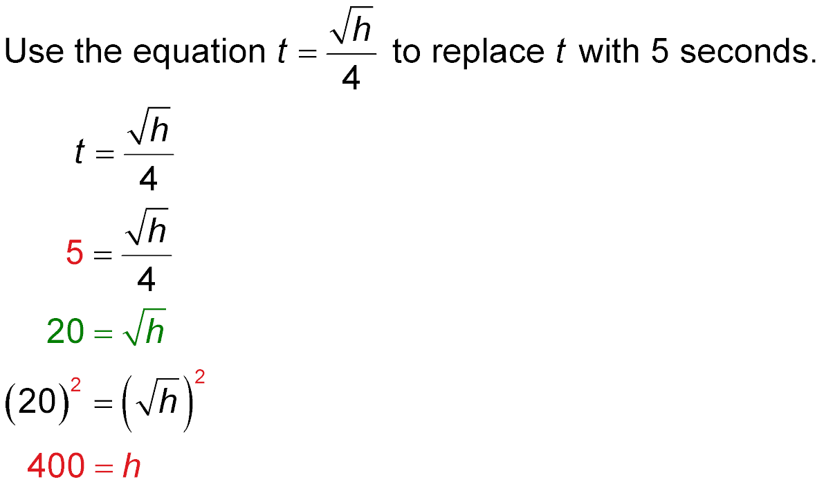
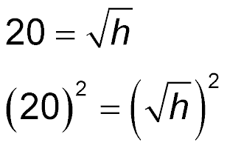
Example 1
Variable as a Radicand
Plan
Solve
Original equation
Replace t with 5.
Multiply each side by 4.

Slide 15
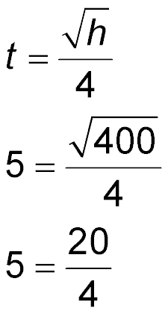
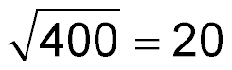
Example 1
Variable as a Radicand
Square each side.
400 = h Simplify.
Answer: The object was dropped from a height of 400 feet.
Check by substituting 400 for h in the original equation.
Original equation
?
t = 5 and h = 400
?
5 = 5  Divide.

Slide 16



Example 1
A. 28 ft
B. 11 ft
C. 49 ft
D. 784 ft

Slide 17
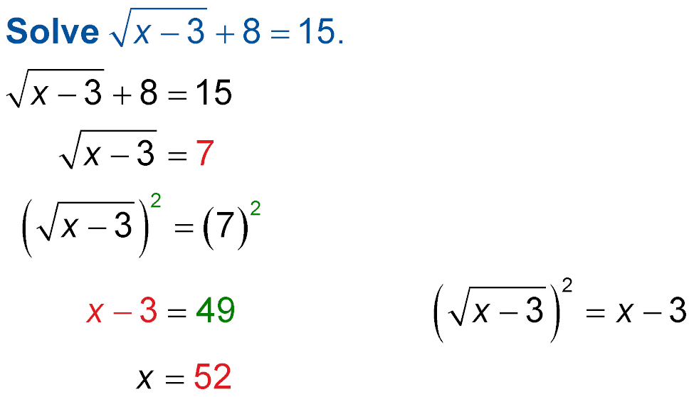
Example 2
Expression as a Radicand
Original equation
Subtract 8 from each side.
Square each side.
x = 52 Add 3 to each side.
Answer: The solution is 52.

Slide 18
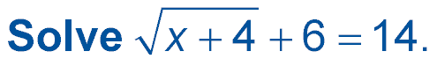
Example 2
A. 64
B. 60
C. 4
D. 196

Slide 19
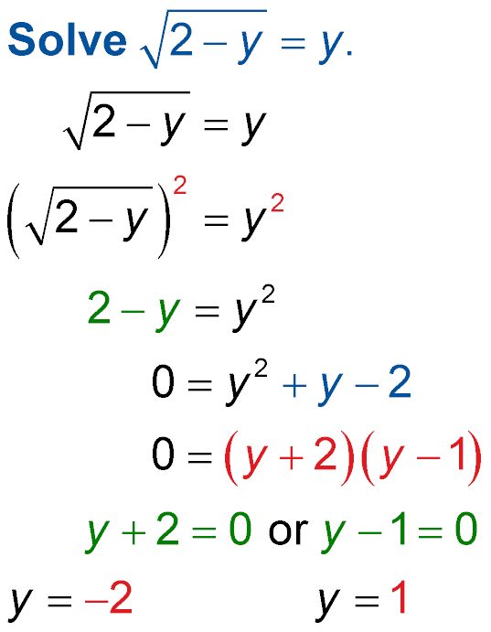
Example 3
Variable on Each Side
Check your solution.
Original equation
Square each side.
2 – y = y² Simplify.
0 = y² + y – 2 Subtract 2 and add y to
each side.
0 = (y + 2)(y – 1) Factor.
y + 2 = 0 or y – 1 = 0 Zero Product Property
y = –2 y = 1 Solve.

Slide 20
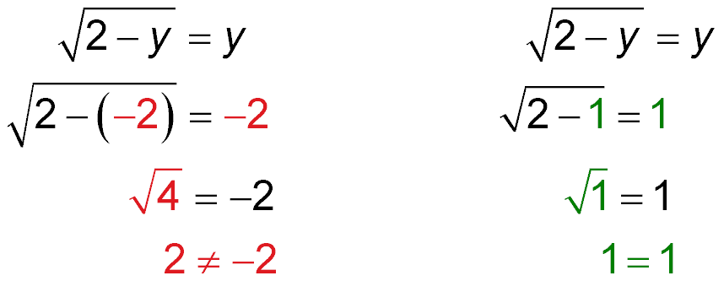

Example 3
Variable on Each Side
Check
?
?
?
?
X
✓
Answer: Since –2 does not satisfy the original equation, 1 is the only solution.

Slide 21
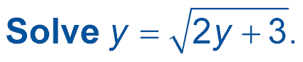
Example 3
A. 3
B. –1
C. –1, 3
D. –3

Slide 22
End of the Lesson

