Slide 1


Splash Screen

Slide 2
Lesson Menu
Five-Minute Check (over Lesson 10–4)
CCSS
Then/Now
New Vocabulary
Key Concept: The Pythagorean Theorem
Example 1: Find the Length of a Side
Example 2: Real-World Example: Find the Length of a Side
Key Concept: Converse of the Pythagorean Theorem
Example 3: Check for Right Triangles

Slide 3

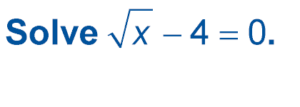
5-Minute Check 1
A. 16
B. 60
C. 64
D. no solution

Slide 4

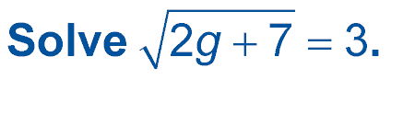
5-Minute Check 2
A. 3
B. 2
C. 1
D. no solution

Slide 5

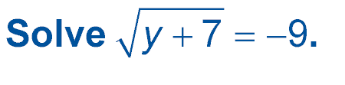
5-Minute Check 3
A. –42
B. –12
C. 15
D. no solution

Slide 6

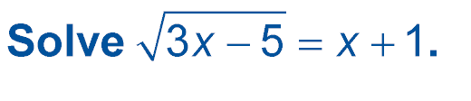
5-Minute Check 4
A. 4
B. 3
C. 2
D. no solution

Slide 7

5-Minute Check 5
A circular pond has an area of 69.3 square meters. What is the radius of the pond? Round to the nearest tenth of a meter.
A. 5.2 m
B. 4.7 m
C. 4.2 m
D. 3.7 m

Slide 8

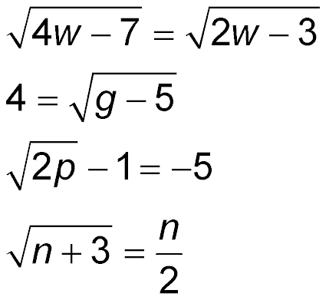
5-Minute Check 6
Which radical equation has no solution?
A.
B.
C.
D.

Slide 9

CCSS
Mathematical Practices
1 Make sense of problems and persevere in solving them.
Common Core State Standards © Copyright 2010. National Governors Association Center for Best Practices and Council of Chief State School Officers. All rights reserved.

Slide 10


Then/Now
You solved quadratic equations by using the Square Root Property.
Solve problems by using the Pythagorean Theorem.
Determine whether a triangle is a right triangle.

Slide 11

Vocabulary
hypotenuse
legs
converse
Pythagorean triple

Slide 12
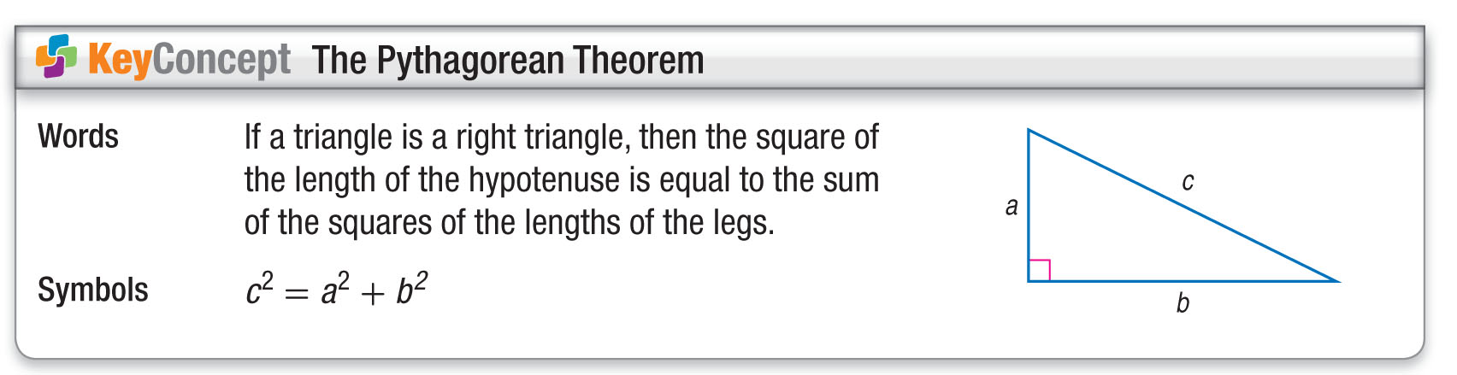
Concept 1

Slide 13
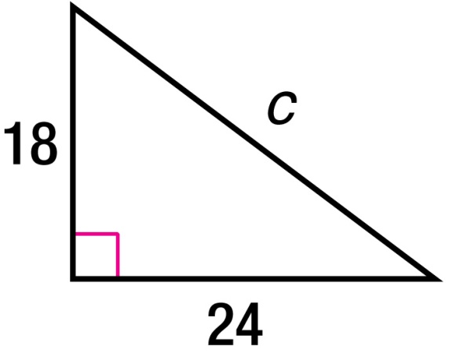
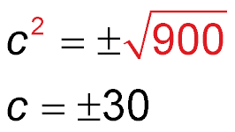
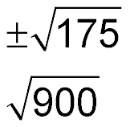
Example 1A
Find the Length of a Side
A. Find the length of the missing
side. If necessary, round to the
nearest hundredth.
c² = a² + b² Pythagorean Theorem
c² = 18² + 24² a = 18 and b = 24
c² = 324 + 576 Evaluate squares.
c² = 900 Simplify.
c Take the square root of each side.
Use the positive value.
Answer: 30 units

Slide 14
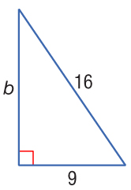
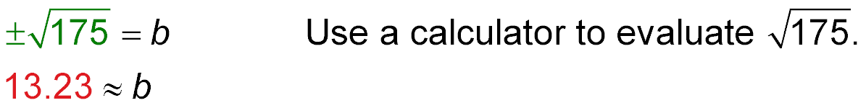
Example 1B
Find the Length of a Side
B. Find the length of the missing side.
If necessary, round to the nearest hundredth.
c² = a² + b² Pythagorean Theorem
16² = 9² + b² a = 9 and c = 16
256 = 81 + b² Evaluate squares.
175 = b² Subtract 81 from each side.
Take the square root of each side.
13.23 ≈ b
Answer: about 13.23 units

Slide 15


Example 1A
A. Find the length of the hypotenuse of a right triangle if a = 25 and b = 60.
A. 45 units
B. 85 units
C. 65 units
D. 925 units

Slide 16
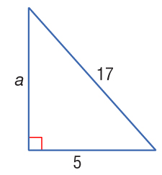
Example 1B
B. Find the length of the missing side.
A. about 12 units
B. about 22 units
C. about 16.25 units
D. about 5 units

Slide 17
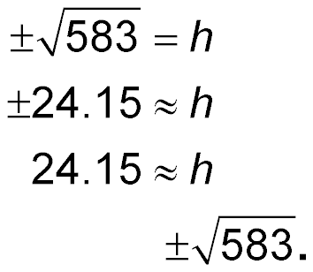
Example 2
Find the Length of a Side
TELEVISION The diagonal of a television screen is 32 inches. The width of the screen is 21 inches. Find the height of the screen.
32² = h² + 21² Pythagorean Theorem
1024 = h² + 441 Evaluate squares.
583 = h² Subtract 441 from each side.
Take the square root of each side.
Use the positive value.
Answer: The screen is approximately 24.15 inches high.

Slide 18
Example 2
HIKING Amarita is hiking out directly east from her camp on the plains. She walks for 6 miles before turning right and walking 7 more miles towards the south. After her hiking, how far does she need to walk for the shortest route straight back to camp?
A. about 10.7 miles
B. 13 miles
C. about 11.6 miles
D. about 9.22 miles

Slide 19
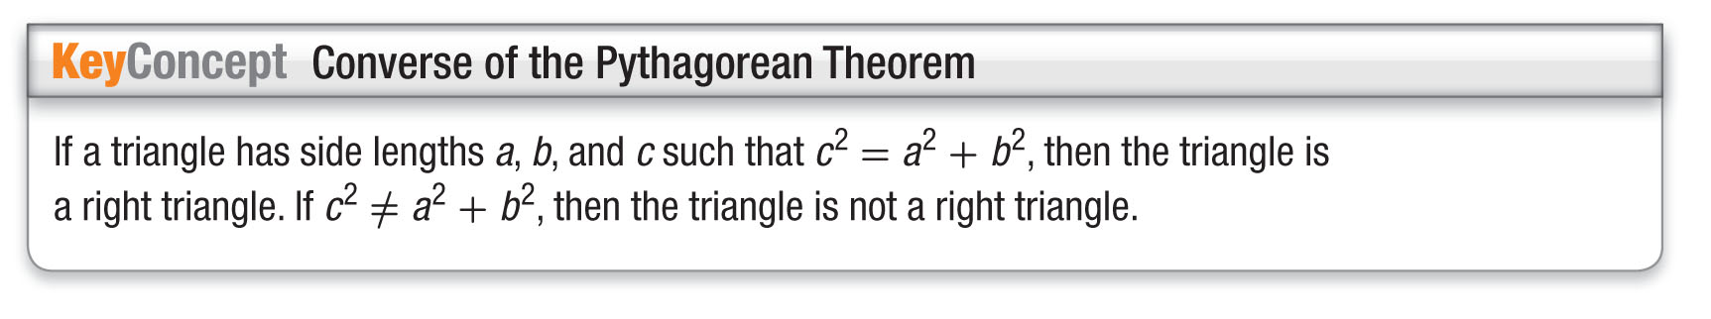
Concept 2

Slide 20
Example 3
Check for Right Triangles
Determine whether 7, 12, and 15 can be the lengths of the sides of a right triangle.
Since the measure of the longest side is 15, let c = 15,
a = 7, and b = 12. Then determine whether c² = a² + b².
c² = a² + b² Pythagorean Theorem
?
15² = 7² + 12² a = 7, b = 12, and c = 15
?
225 = 49 + 144 Evaluate squares.
225 ≠ 193 Add.
Answer: Since c² ≠ a² + b², the triangle is not a right triangle.

Slide 21
Example 3
Determine whether 33, 44, and 55 can be the lengths of the sides of a right triangle.
A. right triangle
B. not a right triangle
C. cannot be determined

Slide 22
End of the Lesson

