Slide 1


Splash Screen

Slide 2
Lesson Menu
Five-Minute Check (over Lesson 10–5)
CCSS
Then/Now
New Vocabulary
Key Concept: Trigonometric Ratios
Example 1: Find Sine, Cosine, and Tangent Ratios
Example 2: Use a Calculator to Evaluate Expressions
Example 3: Solve a Triangle
Example 4: Real-World Example: Find a Missing Side Length
Key Concept: Inverse Trigonometric Functions
Example 5: Find a Missing Angle Measure

Slide 3
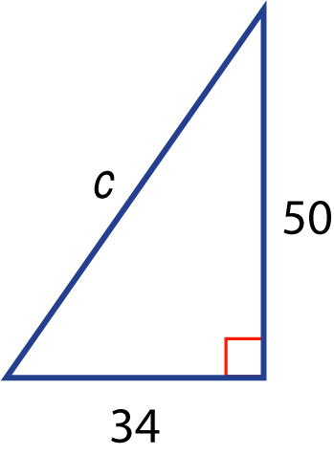

5-Minute Check 1
Find the missing length. If necessary,
round to the nearest hundredth.
A. 72.34
B. 60.46
C. 59.82
D. 55.36

Slide 4

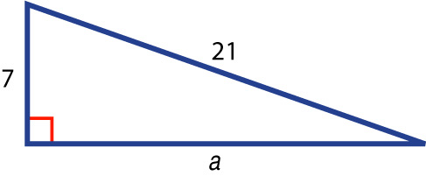
5-Minute Check 2
Find the missing length.
If necessary, round to the
nearest hundredth.
A. 19.80
B. 18.72
C. 16.55
D. 14.41

Slide 5

5-Minute Check 3
If c is the measure of the hypotenuse of a right triangle, find the missing measure. If necessary, round to the nearest hundredth.
a = 5, b = 9, c = ____
?
A. 14.87
B. 11.56
C. 10.30
D. 8.44

Slide 6


5-Minute Check 3
If c is the measure of the hypotenuse of a right triangle, find the missing measure b. If necessary, round to the nearest hundredth.
a = 6,
A. 15.3
B. 13.7
C. 9.11
D. 6.3

Slide 7

5-Minute Check 4
The length of the hypotenuse of a right triangle is 26 yards long. The short leg is 10 yards long. What is the length of the longer leg?
A. 10 yd
B. 12 yd
C. 16 yd
D. 24 yd

Slide 8

CCSS
Mathematical Practices
5 Use appropriate tools strategically.
Common Core State Standards © Copyright 2010. National Governors Association Center for Best Practices and Council of Chief State School Officers. All rights reserved.

Slide 9


Then/Now
You used the Pythagorean Theorem.
Find trigonometric ratios of angles.
Use trigonometry to solve triangles.

Slide 10

Vocabulary
trigonometry
trigonometric ratio
sine
cosine
tangent
solving the triangle
inverse sine
inverse cosine
inverse tangent

Slide 11
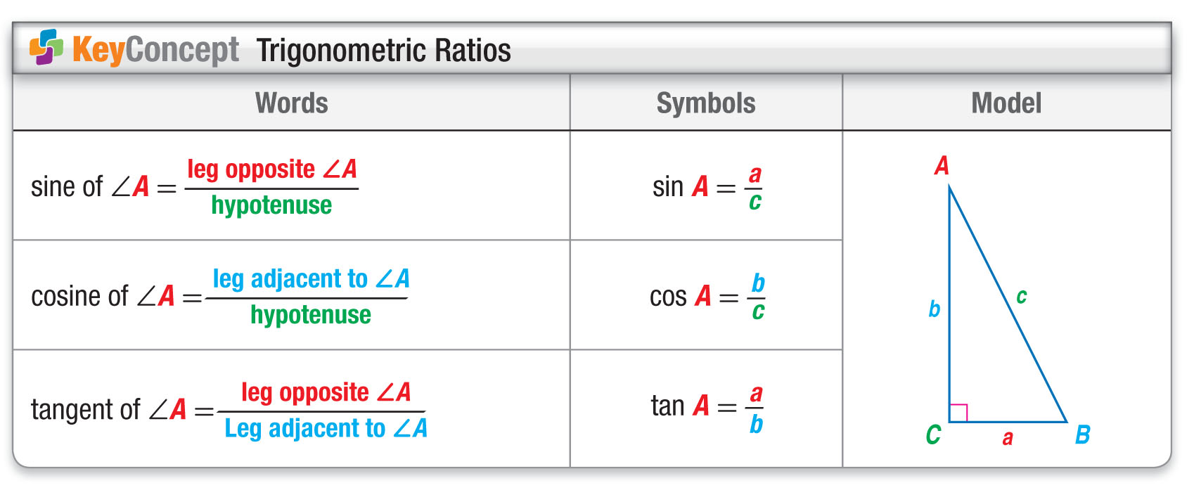
Concept

Slide 12
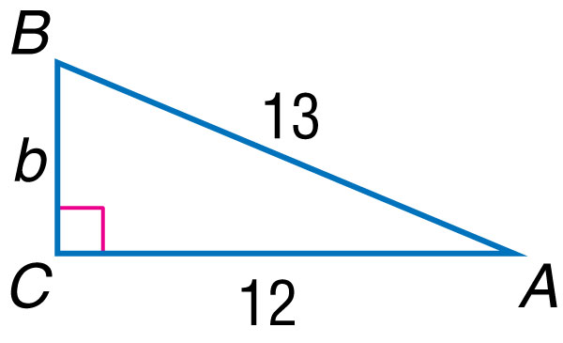
Example 1
Find Sine, Cosine, and Tangent Ratios
Find the values of the three trigonometric ratios for angle B.

Slide 13
Example 1
Find Sine, Cosine, and Tangent Ratios
Step 1 Use the Pythagorean Theorem to find BC.
a² + b² = c² Pythagorean Theorem
12² + b² = 13² a = 12 and c = 13
144 + b² = 169 Simplify.
b² = 25 Subtract 144 from each side.
b = 5 Take the square root of each side.

Slide 14
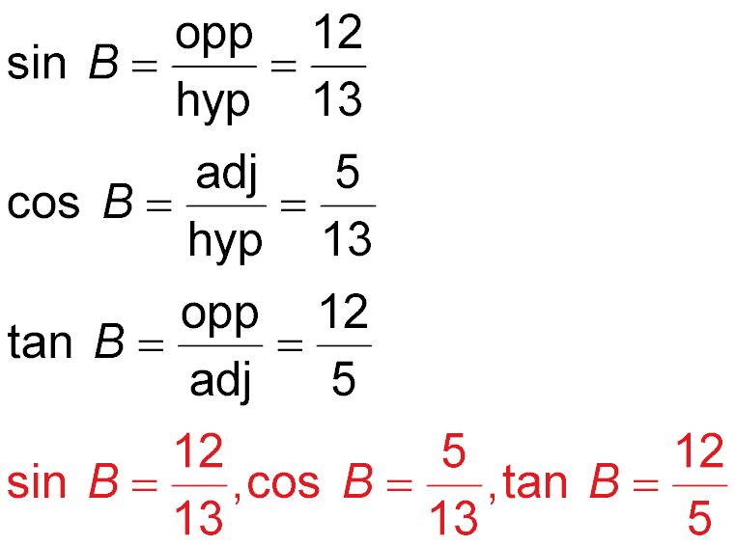
Example 1
Find Sine, Cosine, and Tangent Ratios
Step 2 Use the side lengths to write the trigonometric ratios.
Answer:

Slide 15


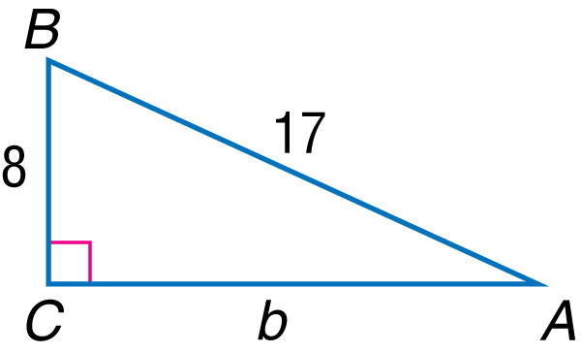
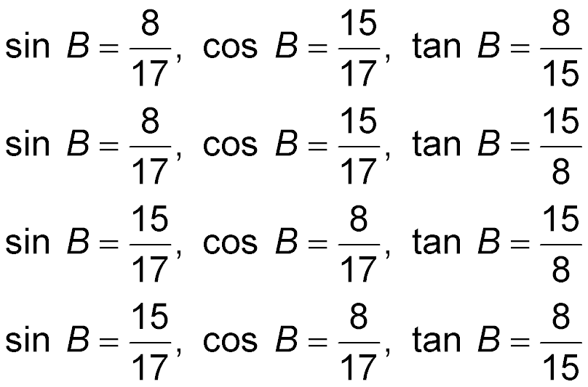
Example 1
Find the values of the three trigonometric ratios for angle B.
A.
B.
C.
D.

Slide 16
Example 2
Use a Calculator to Evaluate Expressions
Use a calculator to find tan 52° to the nearest
ten-thousandth.
TAN
)
ENTER
Keystrokes: 52
Answer: Rounded to the nearest ten-thousandth,
tan 52° ≈ 1.2799.

Slide 17
Example 2
Use a calculator to find sin 84° to the nearest
ten-thousandth.
A. 0.9945
B. 0.1045
C. 9.5144
D. 0.7431

Slide 18
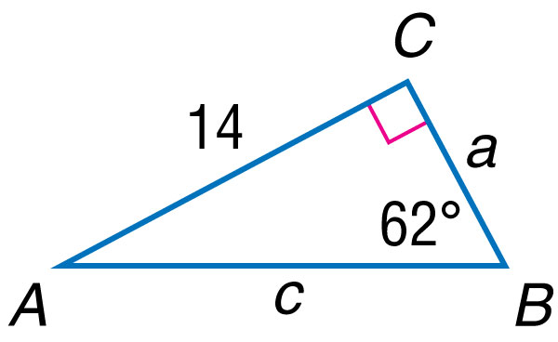
Example 3
Solve a Triangle
Solve the right triangle. Round each side to the nearest tenth.

Slide 19
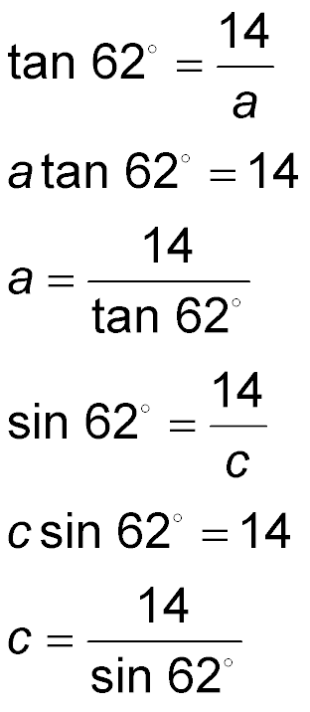
Example 3
Solve a Triangle
Step 1 Find the measure of ∠A.
180° – (90° + 62°) = 28°
The measure of ∠A = 28°.
Step 2 Find a. Since you are given the measure of the side opposite ∠B and are finding the measure of the side adjacent to ∠B, use the tangent ratio.
Definition of tangent
Multiply each side by a.

Slide 20
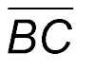
Example 3
Solve a Triangle
Divide each side by tan 62°
a ≈ 7.4 Use a calculator.
So, the measure of a or is about 7.4.
Step 3 Find c. Since you are given the measure of the side opposite ∠B and are finding the measure of the hypotenuse, use the sine ratio.
Definition of sine
Multiply each side by c.

Slide 21
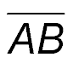
Example 3
Solve a Triangle
Divide each side by sin 62°
c ≈ 15.9 Use a calculator.
So, the measure of c or is about 15.9.
Answer: m∠A = 28°, a ≈ 7.4, c ≈ 15.9

Slide 22
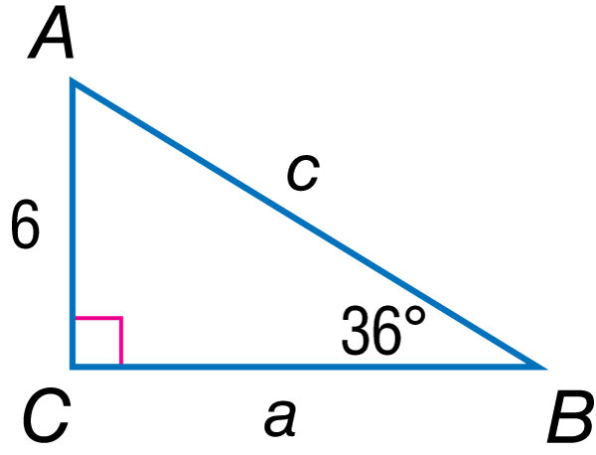
Example 3
Solve the right triangle. Round each side length to the nearest tenth.
A. m∠A = 54°, a ≈ 8.3, c ≈ 10.2
B. m∠A = 54°, a ≈ 7.4, c ≈ 4.4
C. m∠A = 54°, a ≈ 3.5, c ≈ 10.2
D. m∠A = 126°, a ≈ 8.3, c ≈ 12.0

Slide 23
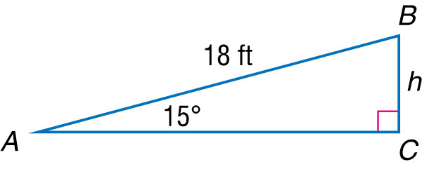
Example 4
Find a Missing Side Length
CONVEYOR BELTS A conveyor belt moves recycled materials from Station A to Station B. The angle the conveyor belt makes with the floor of the first station is 15°. The conveyor belt is 18 feet long. What is the approximate height of the floor of Station B relative to Station A?

Slide 24
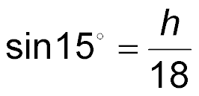
Example 4
Find a Missing Side Length
Definition of sine
18 • sin 15° = h Multiply each side by 18.
4.7 ≈ h Use a calculator.
Answer: The height of the floor is approximately
4.7 feet.

Slide 25
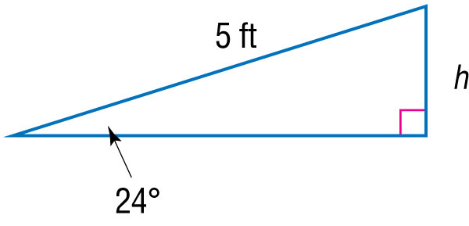
Example 4
BICYCLES A bicycle ramp is 5 feet long. The angle the ramp makes with the ground is 24°. What is the approximate height of the ramp?
A. 2.0 ft
B. 3.8 ft
C. 4.6 ft
D. 12.3 ft

Slide 26
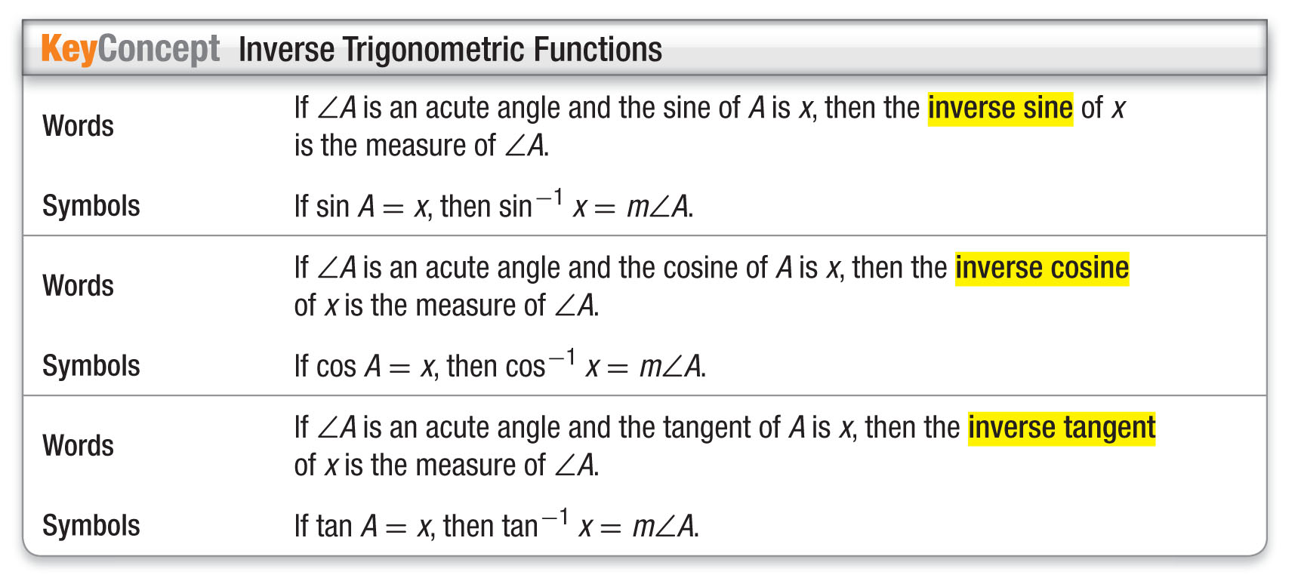
Concept 2

Slide 27
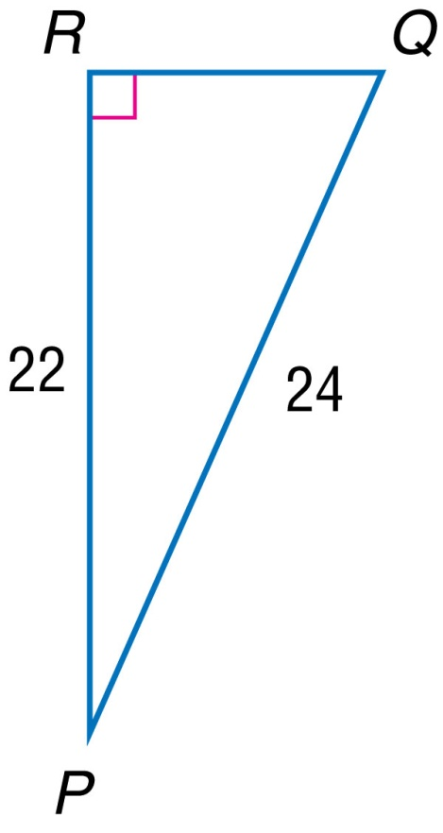
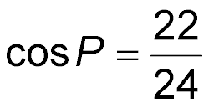
Example 5
Find a Missing Angle Measure
Find m∠P to the nearest degree.
You know the measure of the side adjacent to ∠P and the measure of the hypotenuse. Use the cosine ratio.
Definition of cosine
Use a calculator and the [cos^{–1}] function to find the measure of the angle.

Slide 28
Example 5
Find a Missing Angle Measure
Keystrokes: [cos^{–1}] 22 24 23.55646431
2nd
÷
)
ENTER
Answer: So, m∠P ≈ 24°.

Slide 29
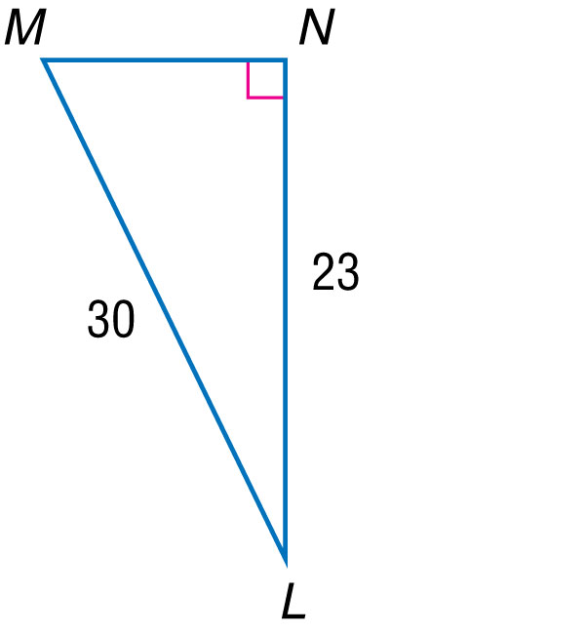
Example 5
Find m∠L to the nearest degree.
A. 28°
B. 31°
C. 36°
D. 40°

Slide 30
End of the Lesson

