Slide 1


Splash Screen

Slide 2
Lesson Menu
Five-Minute Check (over Chapter 10)
CCSS
Then/Now
New Vocabulary
Key Concept: Inverse Variation
Example 1: Identify Inverse and Direct Variations
Example 2: Write an Inverse Variation
Key Concept: Product Rule for Inverse Variations
Example 3: Solve for x or y
Example 4: Real-World Example: Use Inverse Variations
Example 5: Graph an Inverse Variation
Concept Summary: Direct and Inverse Variations

Slide 3

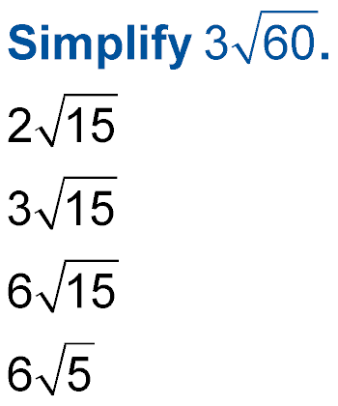
5-Minute Check 1
A.
B.
C.
D.

Slide 4
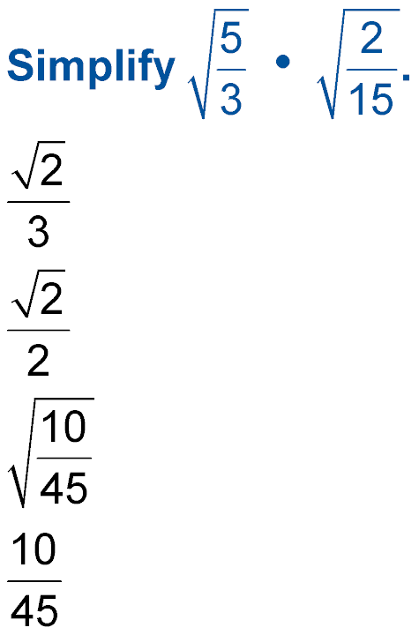

5-Minute Check 2
A.
B.
C.
D.

Slide 5

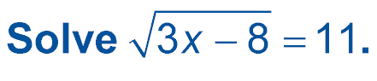
5-Minute Check 3
A. 52
B. 43
C. 37
D. 33

Slide 6

5-Minute Check 4
If c is the measure of the hypotenuse of a right triangle, find the missing measure b when a = 5 and c = 9.
A. 11.14
B. 9.21
C. 7.48
D. 5.62

Slide 7

5-Minute Check 5
A triangle has sides of 10 centimeters,
48 centimeters, and 50 centimeters. Is the triangle
a right triangle?
A. yes
B. no

Slide 8

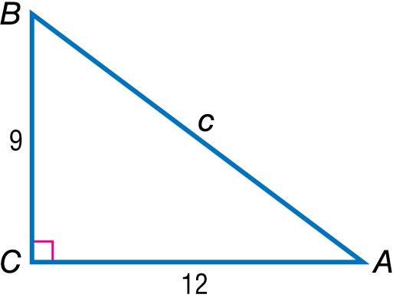

5-Minute Check 6
What is cos A?
A.
B.
C.
D.

Slide 9

CCSS
Mathematical Practices
1 Make sense of problems and persevere in solving them.
Common Core State Standards © Copyright 2010. National Governors Association Center for Best Practices and Council of Chief State School Officers. All rights reserved.

Slide 10


Then/Now
You solved problems involving direct variation.
Identify and use inverse variations.
Graph inverse variations.

Slide 11

Vocabulary
inverse variation
product rule

Slide 12
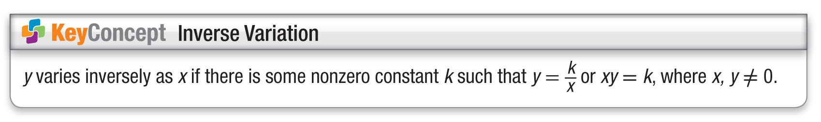
Concept 1

Slide 13
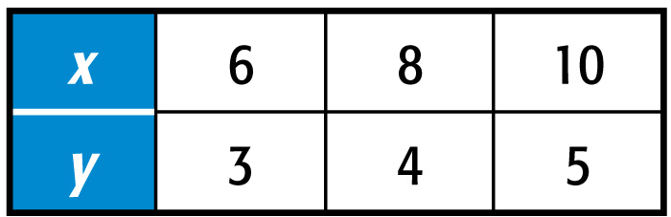
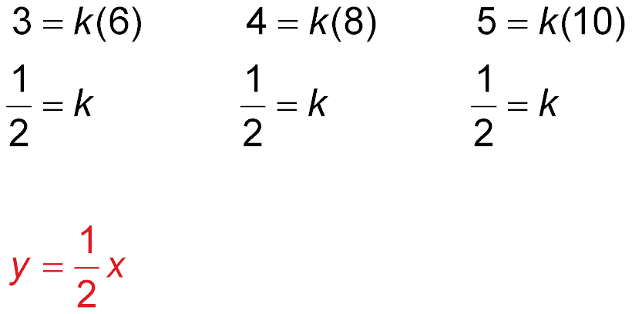
Example 1A
Identify Inverse and Direct Variations
A. Determine whether the table represents an inverse or a direct variation. Explain.
Notice that xy is not constant. So, the table does not represent an indirect variation.

Slide 14
Example 1A
Identify Inverse and Direct Variations
Answer: The table of values represents the direct variation .

Slide 15
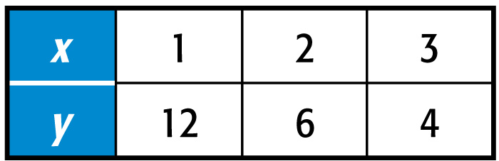
Example 1B
Identify Inverse and Direct Variations
B. Determine whether the table represents an inverse or a direct variation. Explain.
In an inverse variation, xy equals a constant k. Find xy for each ordered pair in the table.
1 ● 12 = 12
2 ● 6 = 12
3 ● 4 = 12
Answer: The product is constant, so the table represents an inverse variation.

Slide 16
Example 1C
Identify Inverse and Direct Variations
C. Determine whether –2xy = 20 represents an inverse or a direct variation. Explain.
–2xy = 20 Write the equation.
xy = –10 Divide each side by –2.
Answer: Since xy is constant, the equation represents an inverse variation.

Slide 17
Example 1D
Identify Inverse and Direct Variations
D. Determine whether x = 0.5y represents an inverse or a direct variation. Explain.
The equation can be written as y = 2x.
Answer: Since the equation can be written in the form y = kx, it is a direct variation.

Slide 18


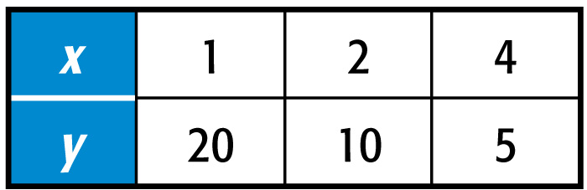
Example 1A
A. Determine whether the table represents an inverse or a direct variation.
A. direct variation
B. inverse variation

Slide 19
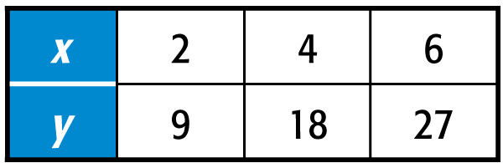
Example 1B
B. Determine whether the table represents an inverse or a direct variation.
A. direct variation
B. inverse variation

Slide 20
Example 1C
C. Determine whether 2x = 4y represents an inverse or a direct variation.
A. direct variation
B. inverse variation

Slide 21
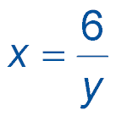
Example 1D
D. Determine whether represents an inverse or a direct variation.
A. direct variation
B. inverse variation

Slide 22
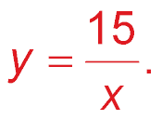
Example 2
Write an Inverse Variation
Assume that y varies inversely as x. If y = 5 when
x = 3, write an inverse variation equation that relates x and y.
xy = k Inverse variation equation
3(5) = k x = 3 and y = 5
15 = k Simplify.
The constant of variation is 15.
Answer: So, an equation that relates x and y is
xy = 15 or

Slide 23
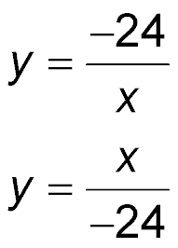
Example 2
Assume that y varies inversely as x. If y = –3 when x = 8, determine a correct inverse variation equation that relates x and y.
A. –3y = 8x
B. xy = 24
C.
D.

Slide 24
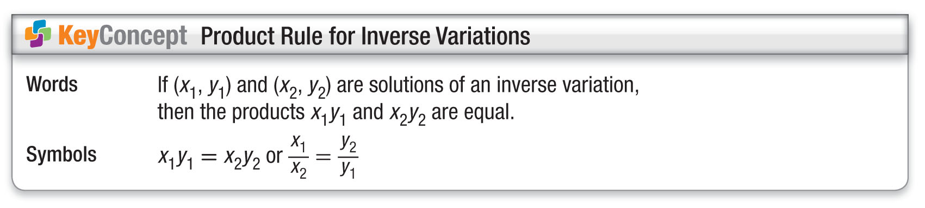
Concept

Slide 25
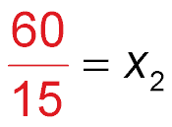
Example 3
Solve for x or y
Assume that y varies inversely as x. If y = 5 when
x = 12, find x when y = 15.
Let x₁ = 12, y₁ = 5, and y₂ = 15. Solve for x₂.
x₁y₁ = x₂y₂
Product rule for inverse variations
12 ● 5 = x₂ ● 15
x₁ = 12, y₁ = 5, and y₂ = 15
60 = x₂ ● 15
Simplify.
Divide each side by 15.
4 = x₂
Simplify.
Answer: 4

Slide 26
Example 3
If y varies inversely as x and y = 6 when x = 40, find x when y = 30.
A. 5
B. 20
C. 8
D. 6

Slide 27
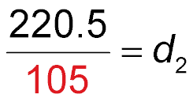
Example 4
Use Inverse Variations
PHYSICAL SCIENCE When two people are balanced on a seesaw, their distances from the center of the seesaw are inversely proportional to their weights. How far should a 105-pound person sit from the center of the seesaw to balance a 63-pound person sitting 3.5 feet from the center?
Let w₁ = 63, d₁ = 3.5, and w₂ = 105. Solve for d₂.
w₁d₁ = w₂d₂
Product rule for inverse variations
63 ● 3.5 = 105d₂
Substitution
Divide each side by 105.
2.1 = d₂
Simplify.

Slide 28
Example 4
Use Inverse Variations
Answer: To balance the seesaw, the 105-pound person should sit 2.1 feet from the center.

Slide 29
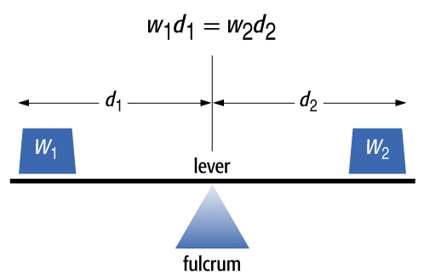
Example 4
PHYSICAL SCIENCE When two objects are balanced on a lever, their distances from the fulcrum are inversely proportional to their weights. How far should a 2-kilogram weight be from the fulcrum
if a 6-kilogram weight is
3.2 meters from the fulcrum?
A. 2 m B. 3 m
C. 4 m D. 9.6 m

Slide 30
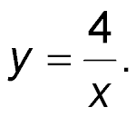
Example 5
Graph an Inverse Variation
Graph an inverse variation in which y = 1 when
x = 4.
Solve for k.
Write an inverse variation equation.
xy = k
Inverse variation equation
(4)(1) = k
x = 4, y = 1
4 = k
The constant of variation is 4.
The inverse variation equation is xy = 4 or

Slide 31
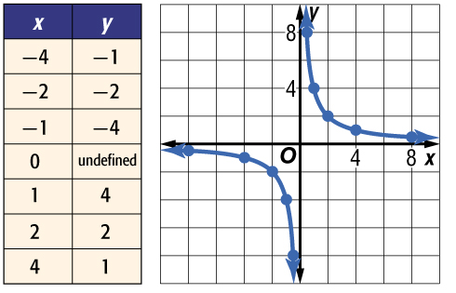
Example 5
Graph an Inverse Variation
Choose values for x and y whose product is 4.
Answer:

Slide 32
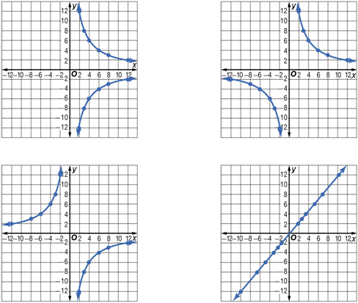
Example 5
Graph an inverse variation in which y = 8 when
x = 3.
A. B.
C. D.

Slide 33
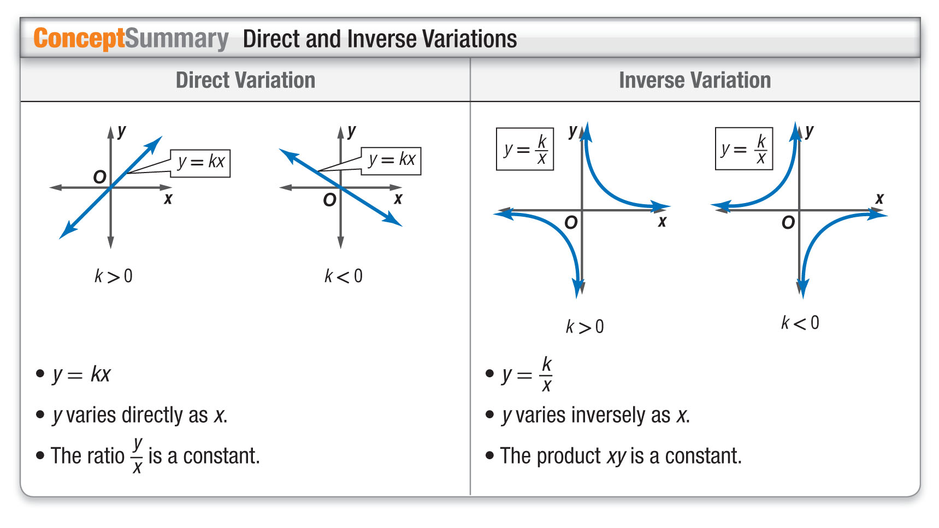
Concept

Slide 34
End of the Lesson

