Slide 1


Splash Screen

Slide 2
Lesson Menu
Five-Minute Check (over Lesson 11–1)
CCSS
Then/Now
New Vocabulary
Key Concept: Arithmetic Sequence
Example 1: Find Excluded Values
Example 2: Real-World Example: Graph Real-Life Rational Functions
Key Concept: Asymptotes
Example 3: Identify and Use Asymptotes to Graph Functions
Concept Summary: Families of Functions

Slide 3

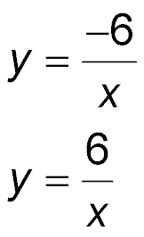
5-Minute Check 1
Write an inverse variation equation that relates
x and y if y = 3 when x = –2.
A. y = –6x
B.
C. y = x – 6
D.

Slide 4

5-Minute Check 2
Assume that y varies inversely as x.
If y = –4 when x = 6, find x when y = 1.5.
A. –4
B. 4
C. –16
D. 16

Slide 5

5-Minute Check 3
Assume that y varies inversely as x.
If y = 7.2 when x = 3, find x when y = 2.
A. 1.8
B. 10.8
C. 12
D. 12.4

Slide 6

5-Minute Check 4
Electrical current I varies inversely with resistance R. If the current in a wire is
1.5 amperes at 4 ohms resistance, what is
the current at 1.2 ohms resistance?
A. 7 amperes
B. 6 amperes
C. 5 amperes
D. 4 amperes

Slide 7

5-Minute Check 5
The points (18, 4.5) and (x, 3) are on the graph of an inverse variation. What is the missing value?
A. 27
B. 29
C. 25
D. 19

Slide 8

CCSS
Content Standards
A.CED.2 Create equations in two or more variables to represent relationships between quantities; graph equations on coordinate axes with labels and scales.
Mathematical Practices
3 Construct viable arguments and critique the reasoning of others.
7 Look for and make use of structure.
Common Core State Standards © Copyright 2010. National Governors Association Center for Best Practices and Council of Chief State School Officers. All rights reserved.

Slide 9


Then/Now
You wrote inverse variation equations.
Identify excluded values.
Identify and use asymptotes to graph rational functions.

Slide 10

Vocabulary
rational function
excluded value
asymptote

Slide 11
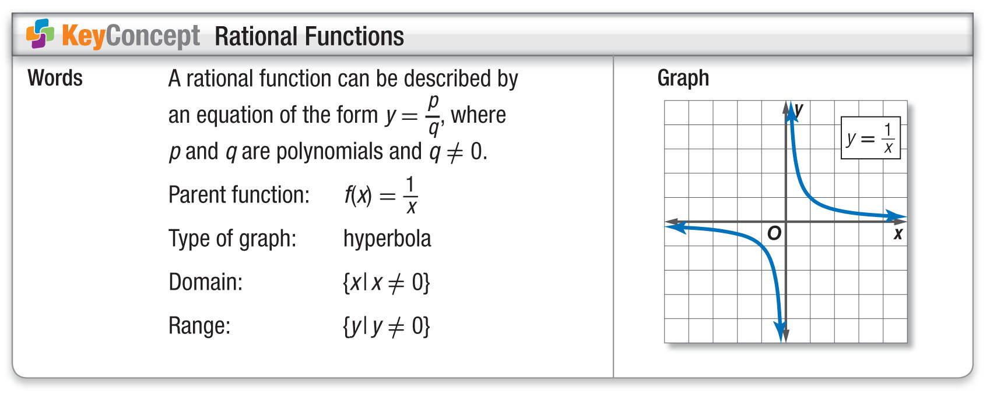
Concept 1

Slide 12
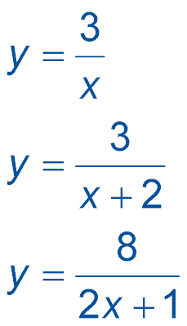
Example 1A
Find Excluded Values
A. State the excluded value for the function
.
Answer: The denominator cannot equal 0. So, the excluded value is x = 0.

Slide 13
Example 1B
Find Excluded Values
B. State the excluded value for the function
.
x + 2 = 0 Set the denominator equal
to 0.
x = –2 Subtract 2 from each side.
Answer: The excluded value is x = –2.

Slide 14
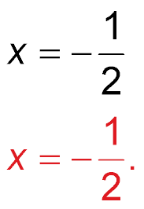
Example 1C
Find Excluded Values
C. State the excluded value for the function
.
2x + 1 = 0 Set the denominator equal
to 0.
2x = –1 Subtract 1 from each side.
Divide each side by 2.
Answer: The excluded value is

Slide 15


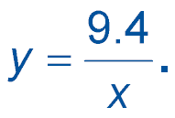
Example 1A
A. State the excluded value for the function
A. 9.4
B. 1
C. 0
D. –9.4

Slide 16
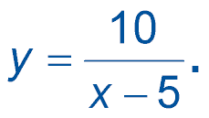
Example 1B
B. State the excluded value for the function.
A. –5
B. 1
C. 0
D. 5

Slide 17
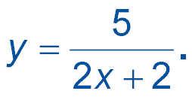

Example 1C
C. State the excluded value for the function.
A.
B. –1
C. 0
D. –2

Slide 18
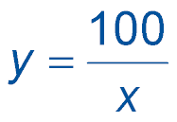
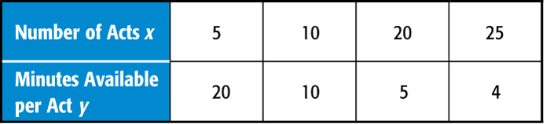
Example 2
Graph Real-Life Rational Functions
TALENT SHOW If x students will compete in a talent show lasting 100 minutes, the function
represents the number of minutes available for each act. Graph this function.
Since the number of acts cannot be zero, it is reasonable to exclude negative values and only use positive values for x.

Slide 19
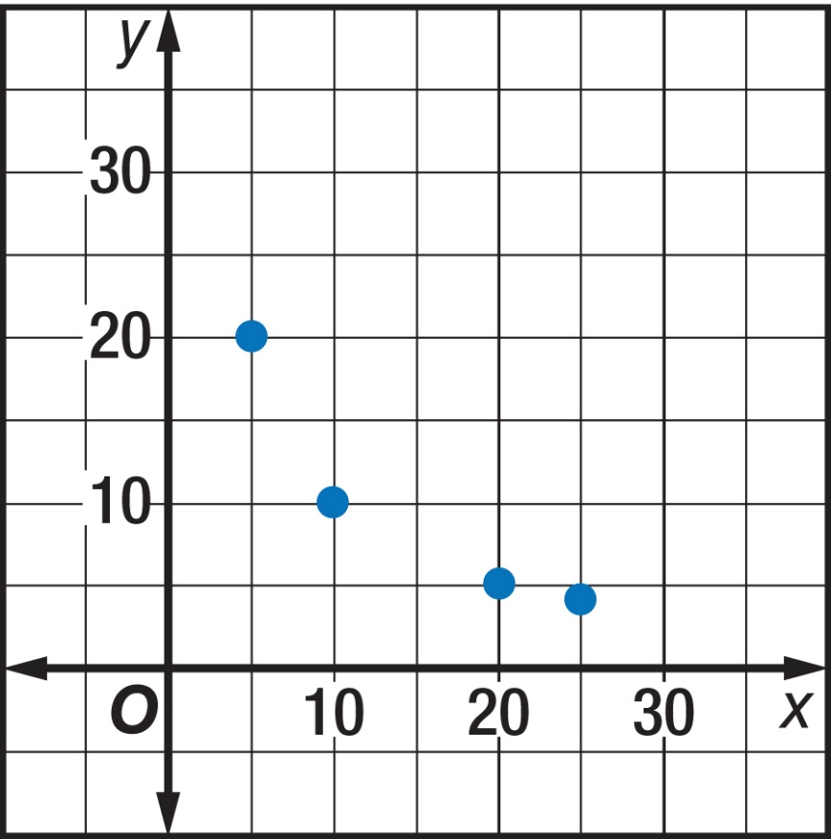
Example 2
Graph Real-Life Rational Functions
Answer:

Slide 20
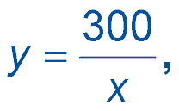
Example 2
Dante and some friends are organizing a lawn service to earn some money for the summer. They have contracted many houses in the neighborhood and are on track to earn $300. The average share of profits y, represented by the function
decreases as the number of friends x Dante works with. Choose the graph that represents this function.

Slide 21
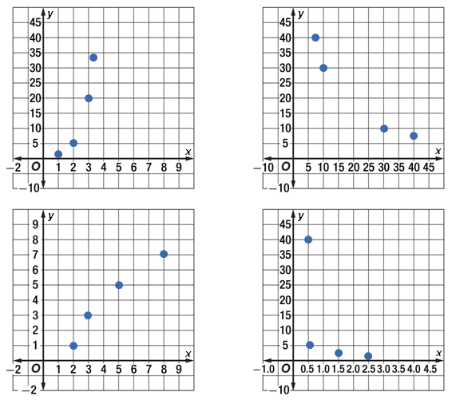
Example 2
A. B.
C. D.

Slide 22
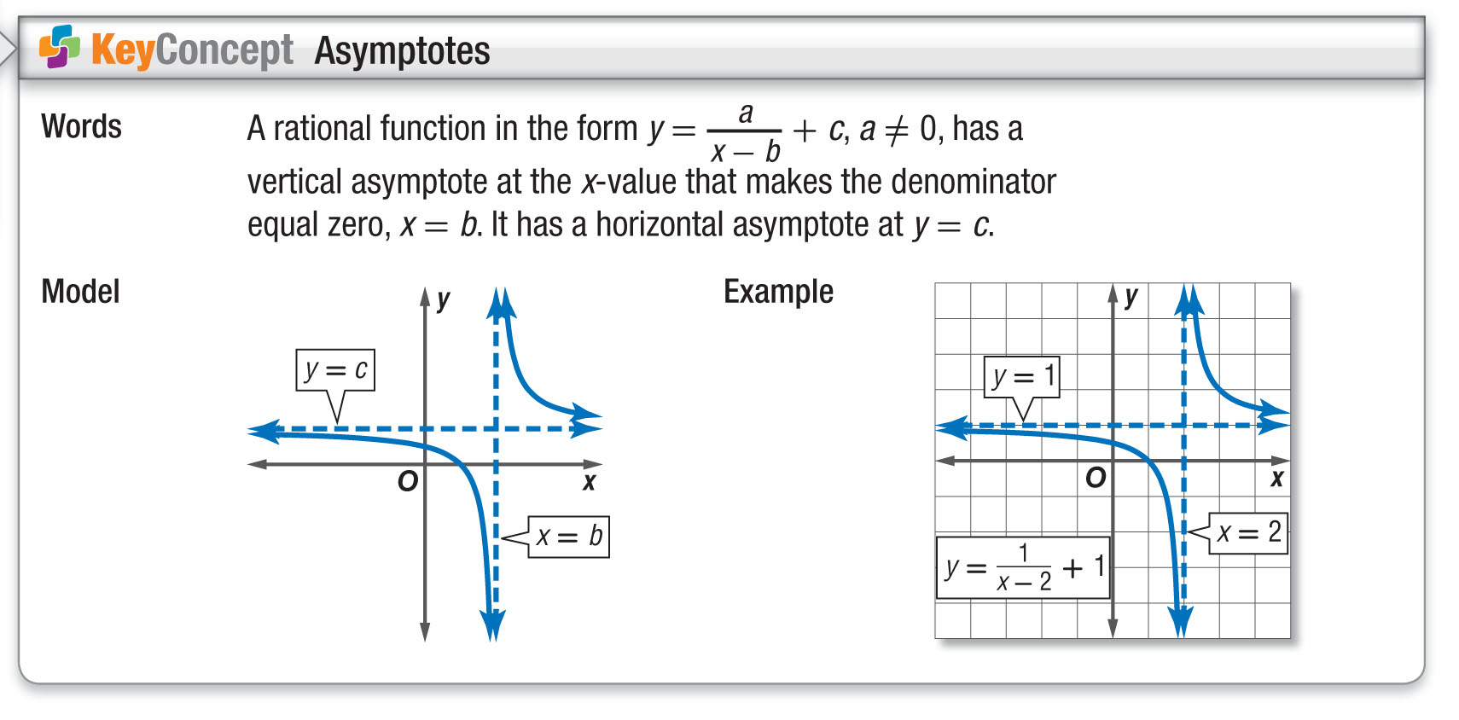
Concept 2

Slide 23
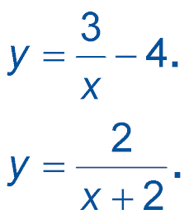
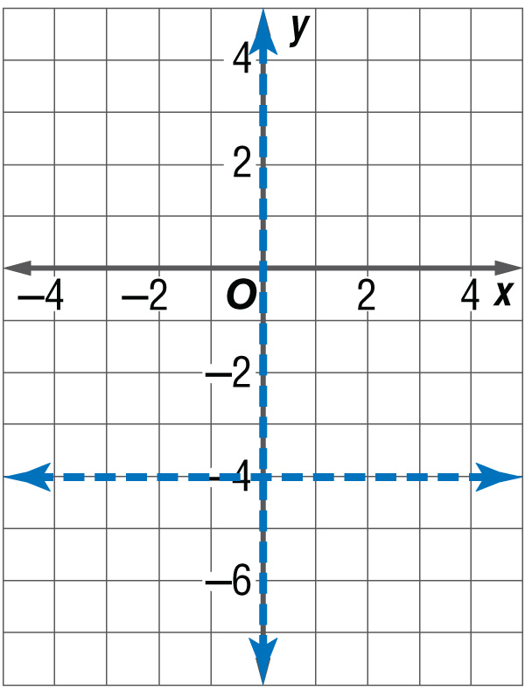
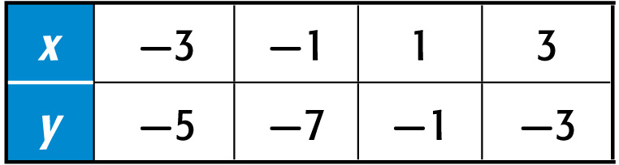
Example 3A
Identify and Use Asymptotes to Graph Functions
A. Identify the asymptotes for
Then graph the function.
Step 1 Identify and graph the asymptotes using
dashed lines.
vertical asymptote: x = 0
horizontal asymptote: y = –4
Step 2 Make a table of values and plot the points.
Then connect
them.

Slide 24
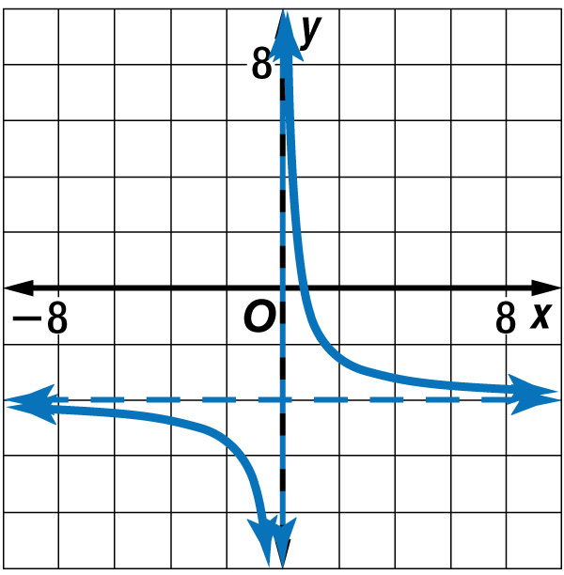
Example 3A
Identify and Use Asymptotes to Graph Functions
Answer: x = 0; y = –4

Slide 25
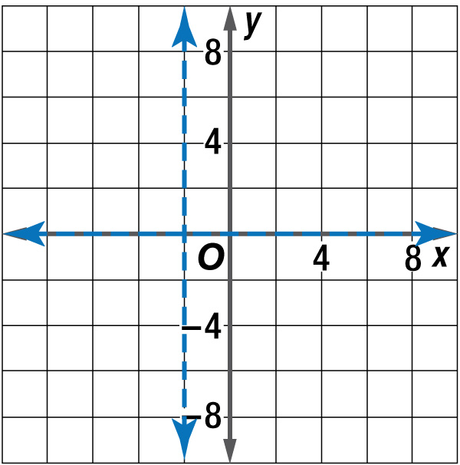
Example 3B
Identify and Use Asymptotes to Graph Functions
B. Identify the asymptotes for
Then graph the function.
Step 1 Identify and graph the asymptotes using dashed lines.
vertical asymptote: x = –2
horizontal asymptote: y = 0

Slide 26
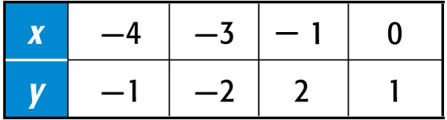
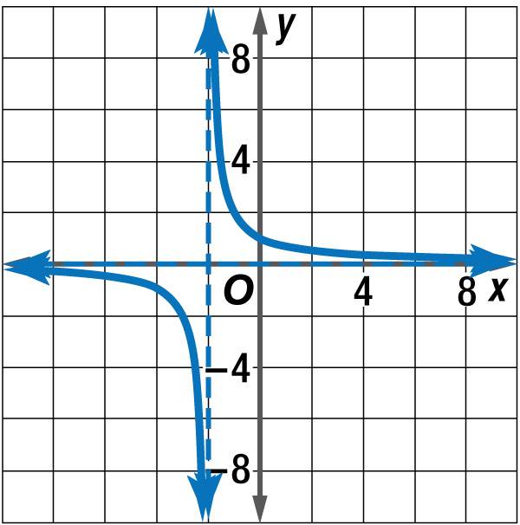
Example 3B
Identify and Use Asymptotes to Graph Functions
Step 2 Make a table of values and plot the points. Then connect them.
Answer: x = –2; y = 0

Slide 27
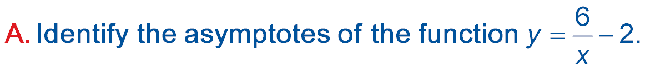
Example 3A
A. x = 0, y = –2
B. x = –2, y = 2
C. x = –2, y = 0
D. x = 6, y = –2

Slide 28
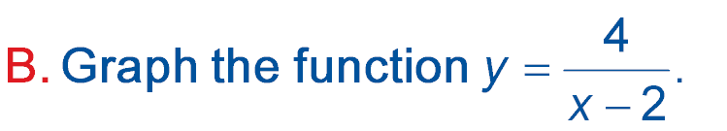
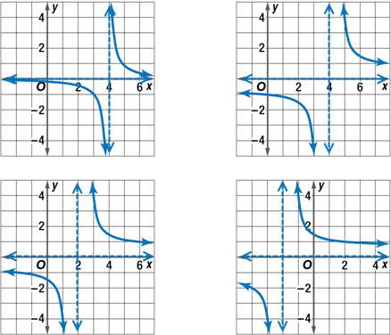
Example 3B
A. B.
C. D.

Slide 29
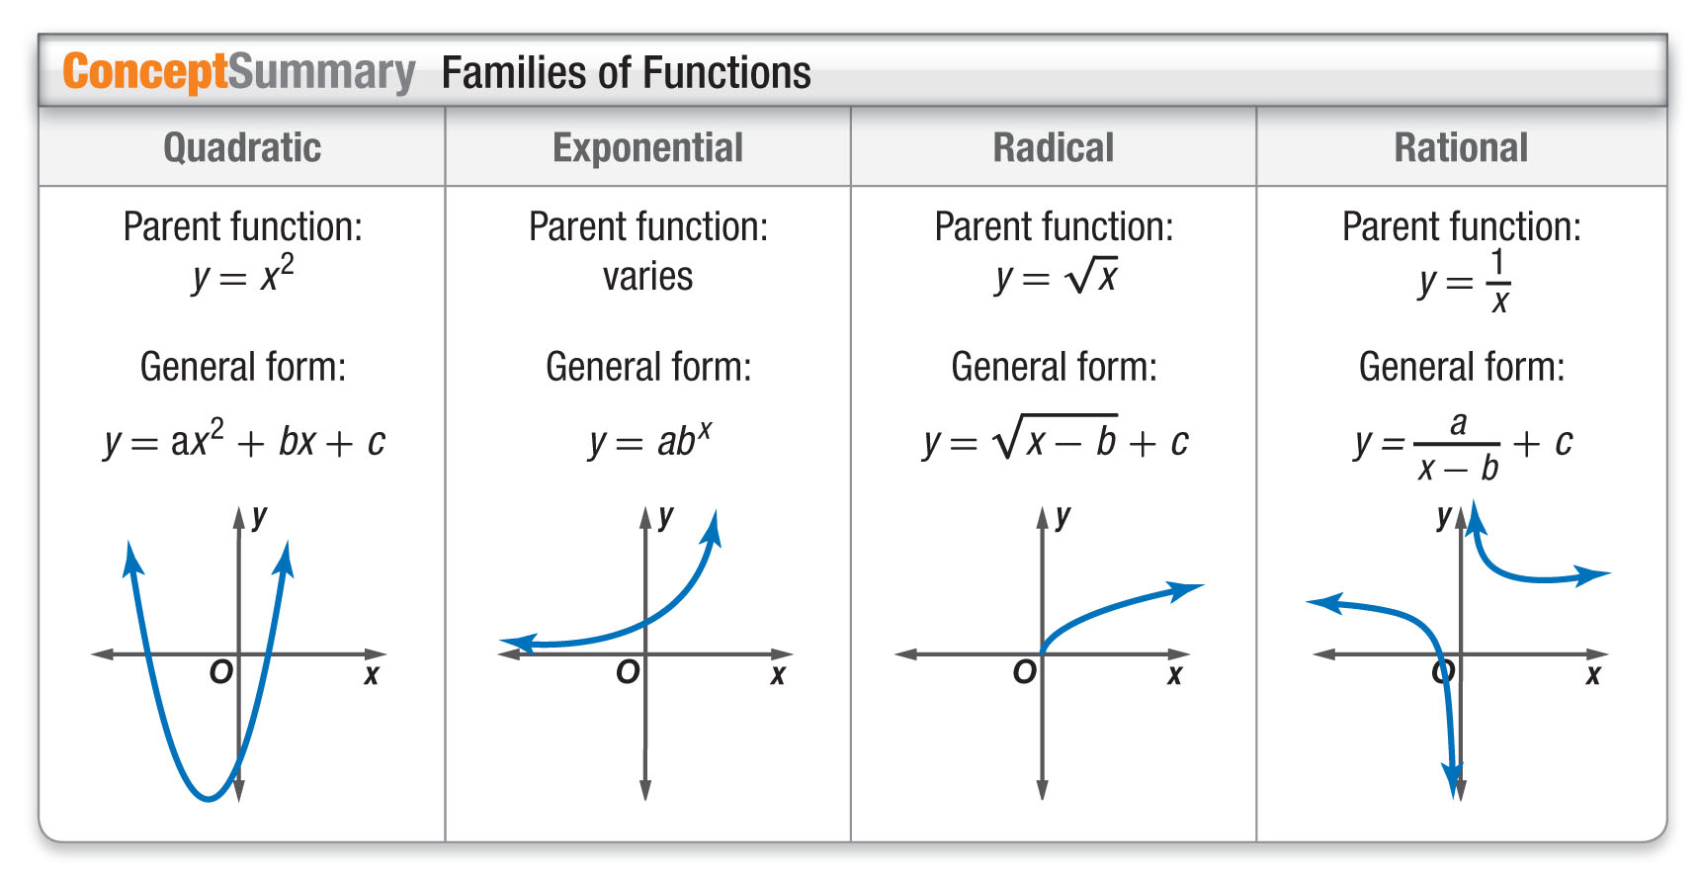
Concept 3

Slide 30
End of the Lesson

