Slide 1


Splash Screen

Slide 2
Lesson Menu
Five-Minute Check (over Lesson 11–2)
CCSS
Then/Now
New Vocabulary
Example 1: Find Excluded Values
Example 2: Real-World Example: Use Rational Expressions
Key Concept: Simplifying Rational Expressions
Example 3: Standardized Test Example
Example 4: Simplify Rational Expressions
Example 5: Recognize Opposites
Example 6: Rational Functions

Slide 3

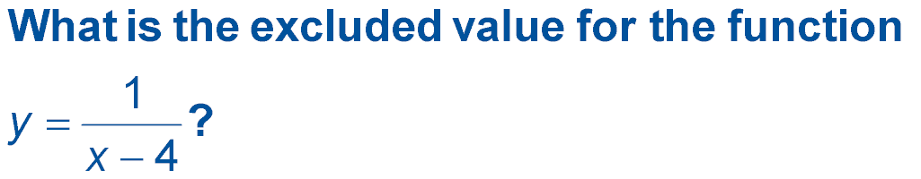
5-Minute Check 1
A. 0
B. 1
C. 2
D. 4

Slide 4

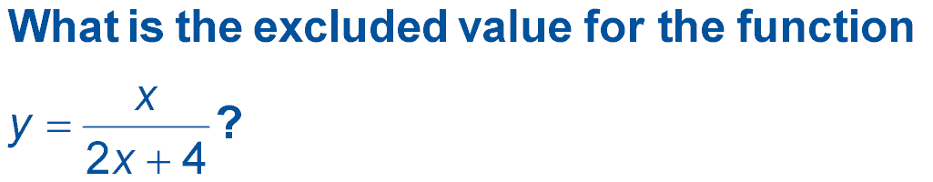
5-Minute Check 2
A. –4
B. –2
C. 2
D. 4

Slide 5



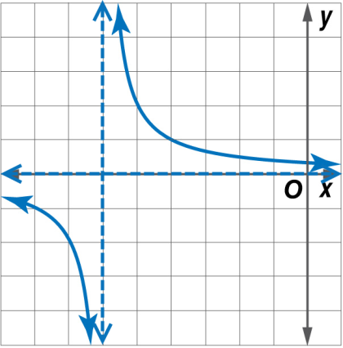
5-Minute Check 3
A. x = –6, y = 2
B. x = –7, y = –6
C. x = –6, y = 0
D. x = 8, y = 0

Slide 6

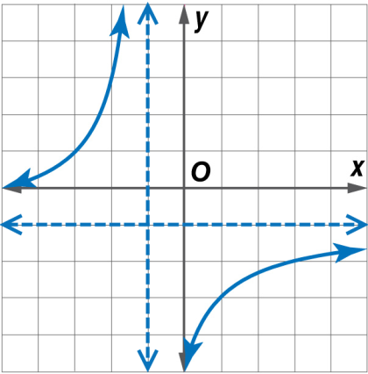
5-Minute Check 4
A. x = –1, y = –1
B. x = –2, y = 1
C. x = –1.5, y = 2
D. x = 2, y = 3

Slide 7

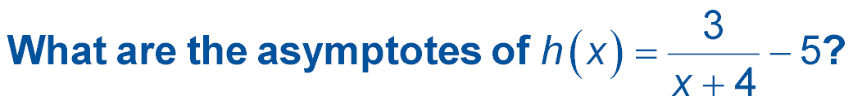
5-Minute Check 5
A. x = 4; y = 5
B. x = –4; y = 3
C. x = –4; y = –5
D. x = 3; y = –5

Slide 8

CCSS
Mathematical Practice
7 Look for and make use of structure.
Common Core State Standards © Copyright 2010. National Governors Association Center for Best Practices and Council of Chief State School Officers. All rights reserved.

Slide 9


Then/Now
You simplified expressions involving the quotient of monomials.
Identify values excluded from the domain of a rational expression.
Simplify rational expressions.

Slide 10

Vocabulary
rational expression

Slide 11
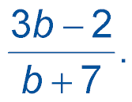
Example 1A
Find Excluded Values
A. State the excluded value of
Exclude the values for which b + 7 = 0, because the denominator cannot equal 0.
b + 7 = 0
b = –7
Subtract 7 from each side.
Answer: b cannot equal –7.

Slide 12
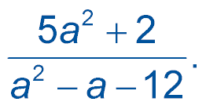
Example 1B
Find Excluded Values
B. State the excluded values of
Exclude the values for which a² – a – 12 = 0.
a² – a – 12 = 0
The denominator cannot equal zero.
(a + 3)(a – 4) = 0
Factor.
a + 3 = 0 or
a – 4 = 0
Zero Product Property
a = –3
a = 4
Answer: a cannot equal –3 or 4.

Slide 13
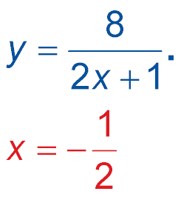
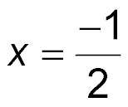
Example 1C
Find Excluded Values
C. State the excluded values of
Exclude the values for which 2x + 1 = 0.
2x + 1 = 0
The denominator cannot be zero.
2x = –1
Subtract 1 from each side.
Divide each side by 2.
Answer: x cannot equal .

Slide 14


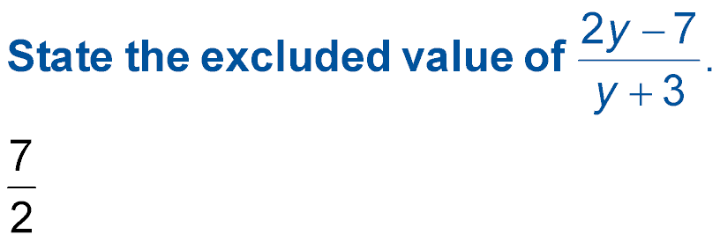
Example 1A
A. State the excluded values of
A.
B. –3
C. 0
D. y is all real numbers.

Slide 15
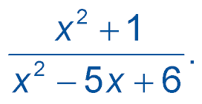
Example 1B
B. State the excluded values of
A. 0, 2
B. 0, 2, 3
C. 2, 3
D. x is all real numbers.

Slide 16
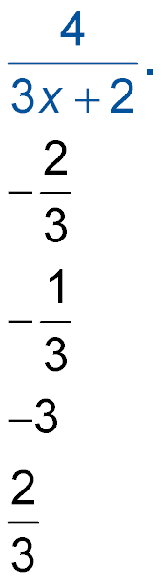
Example 1C
C. State the excluded values of
A.
B.
C.
D.

Slide 17

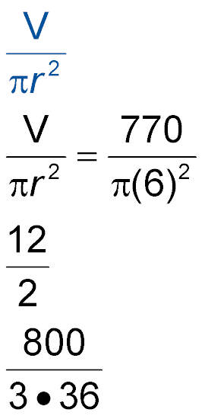
Example 2
Use Rational Expressions
The height of a cylinder with volume V and a radius r is given by . Find the height of a cylinder that has a volume of 770 cubic inches and a diameter of 12 inches. Round to the nearest tenth.
Understand You have a rational expression with unknown variables, V and r.
Plan Substitute 770 for V and or 6 for r.

Slide 18
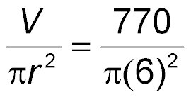
Example 2
Use Rational Expressions
Solve
Replace V with 770 and r with 6.
≈ 6.8
Answer: The height of the cylinder is approximately
6.8 inches.
Check Use estimation to determine whether the answer is reasonable.
≈ 7  The solution is reasonable.

Slide 19
Example 2
Find the height of a cylinder that has a volume of 680 cubic inches and a radius of 8 inches. Round to the nearest tenth.
A. 3.3 in.
B. 3.4 in.
C. 4.1 in.
D. 4.7 in.

Slide 20
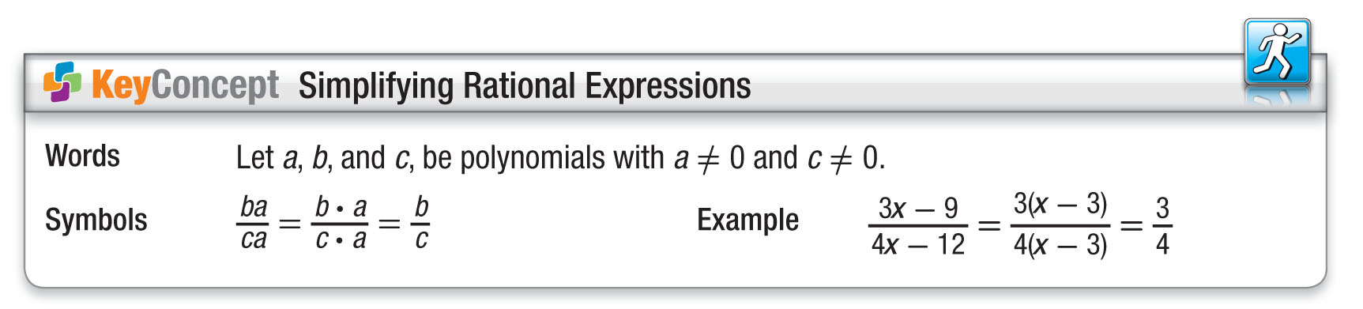
Concept

Slide 21
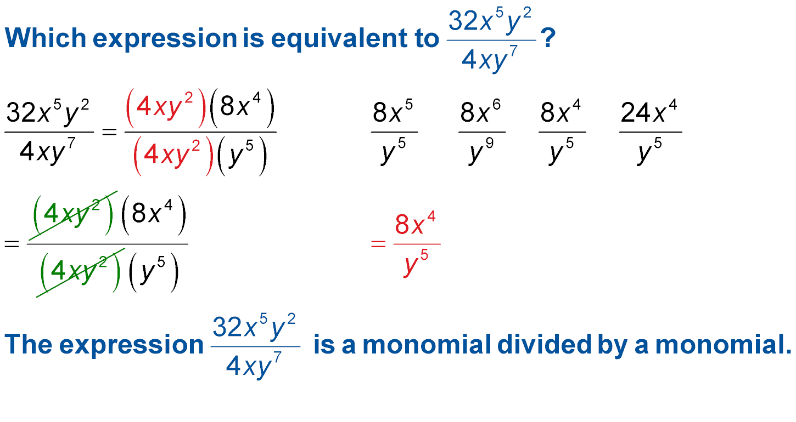
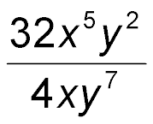
Example 3
Which expression is equivalent to
A C
B D
Read the Test Item
The expression is a monomial divided by a monomial.

Slide 22
Example 3
Solve the Test Item
Step 1 Factor the numerator and denominator, using their GCF.
Step 2 Simplify.
Answer: The correct answer is B.

Slide 23
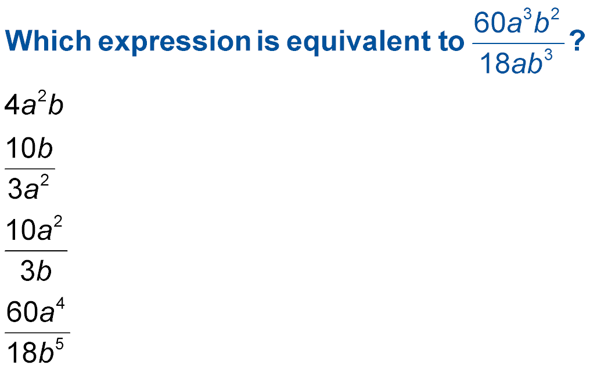
Example 3
Which expression is equivalent to
A.
B.
C.
D.

Slide 24
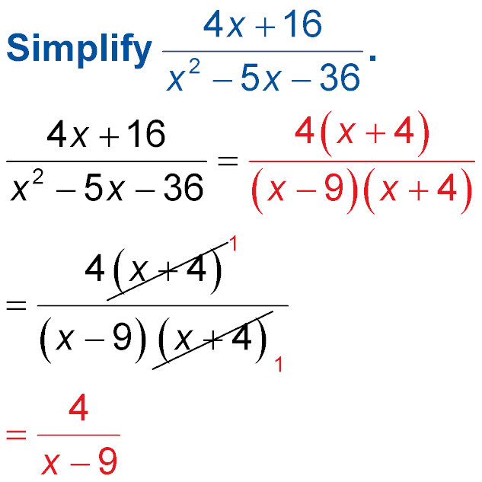
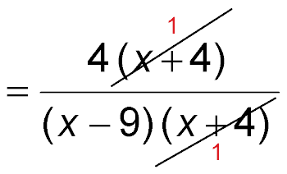
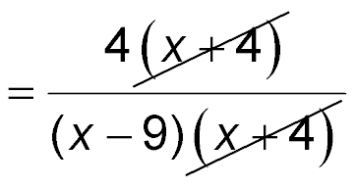
Example 4
Simplify Rational Expressions
Simplify State the excluded values of x.
Factor.
Divide the numerator and denominator by the GCF, x + 4.
Simplify.

Slide 25
Example 4
Simplify Rational Expressions
Exclude the values for which x² – 5x – 36 equals 0.
x² – 5x – 36 = 0
The denominator cannot equal zero.
(x – 9)(x + 4) = 0
Factor.
x = 9 or x = –4
Zero Product Property
Answer: ; x ≠ –4 and x ≠ 9

Slide 26
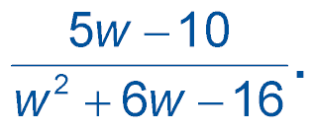
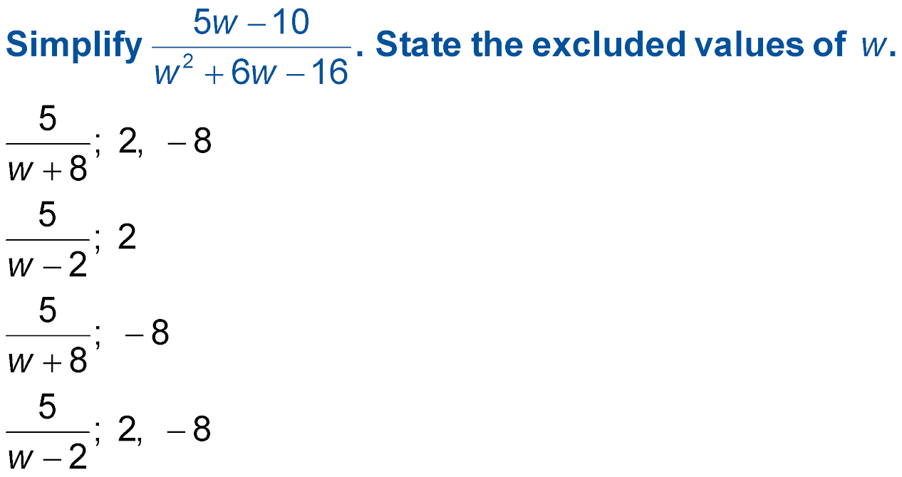
Example 4
Simplify State the excluded values of w.
A.
B.
C.
D.

Slide 27
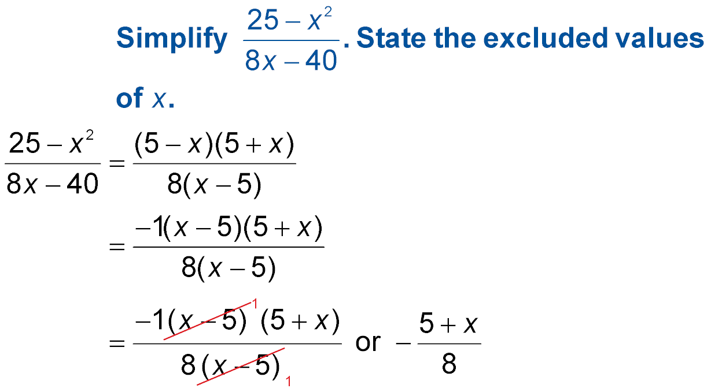
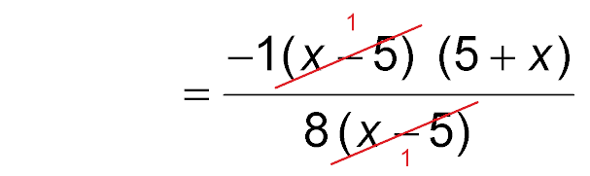
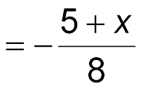
Example 5
Recognize Opposites
Factor.
Rewrite 5 – x as
–1(x – 5).
Divide out the common factor, x – 5.
Simplify.

Slide 28
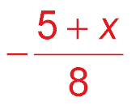
Example 5
Recognize Opposites
Exclude the values for which 8x – 40 equals 0.
8x – 40 = 0 The denominator cannot equal
zero.
8x = 40 Add 40 to each side.
x = 5 Zero Product Property
Answer: ; x ≠ 5

Slide 29
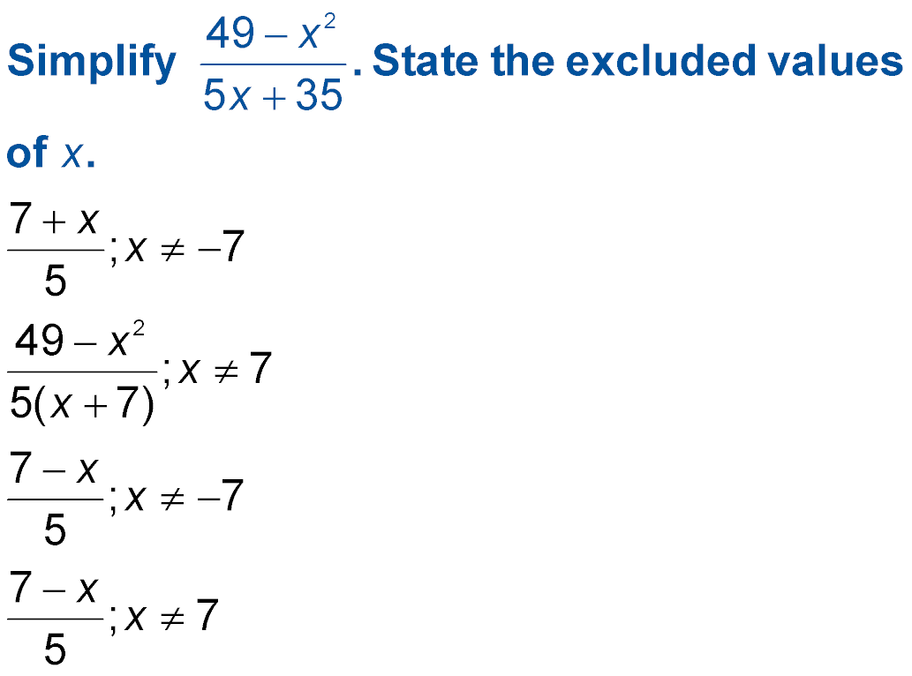
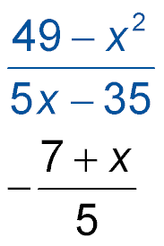
Example 5
A.
B.
C.
D.

Slide 30
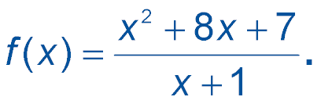
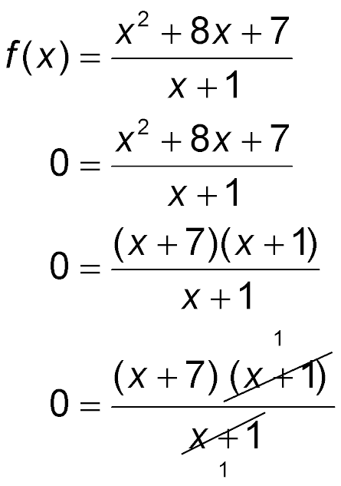
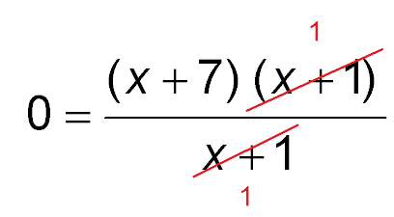
Example 6
Rational Functions
Find the zeros of f(x) =
Original function
f(x) = 0
Factor.
Divide out common factors.
0 = x + 7 Simplify.

Slide 31
Example 6
Rational Functions
When x = –7, the numerator becomes 0, so f(x) = 0.
Answer: Therefore, the zero of the function is –7.

Slide 32
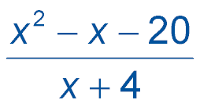
Example 6
Find the zeros of f(x) = .
A. 0
B. 4
C. –4
D. 5

Slide 33
End of the Lesson

