Slide 1


Splash Screen

Slide 2
Lesson Menu
Five-Minute Check (over Lesson 11–3)
CCSS
Then/Now
Key Concept: Multiplying Rational Expressions
Example 1: Multiply Expressions Involving Monomials
Example 2: Real-World Example: Dimensional Analysis
Key Concept: Dividing Rational Expressions
Example 3: Divide by a Polynomial
Example 4: Divide by Rational Expressions and Polynomials
Example 5: Expression Involving Polynomials

Slide 3
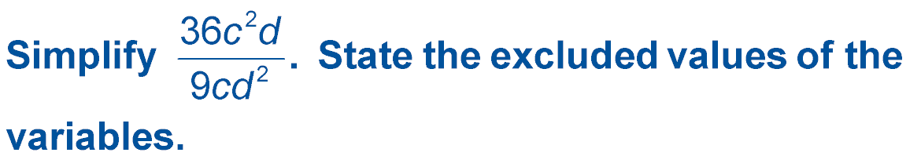

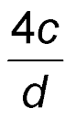
5-Minute Check 1
; c ≠ 0, d ≠ 0
A.
B. 4c²d; c ≠ 0, d ≠ 0
C. 27cd; c ≠ 1, d ≠ 1
D. 36cd; c ≠ 1, d ≠ 0

Slide 4
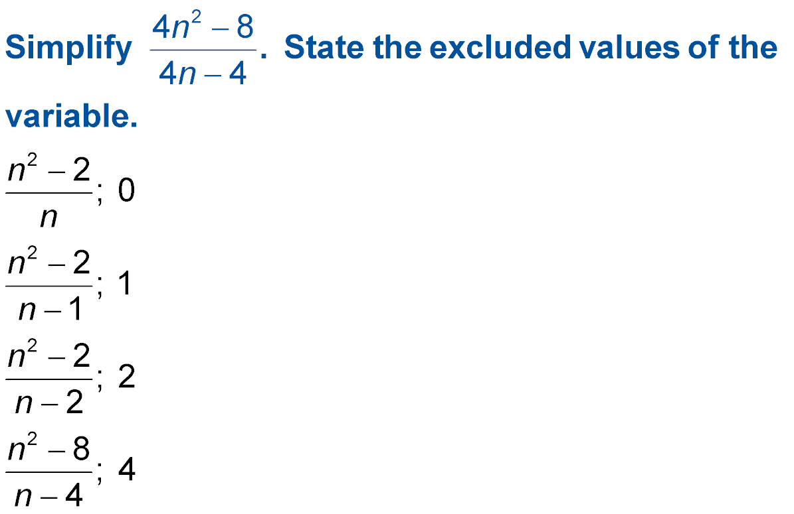

5-Minute Check 2
A.
B.
C.
D.

Slide 5
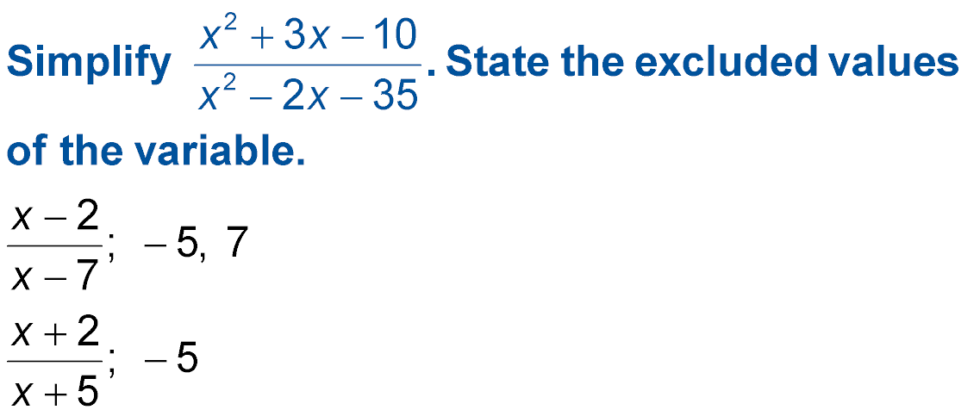

5-Minute Check 3
A. x + 5; –5
B. x – 10; 10
C.
D.

Slide 6

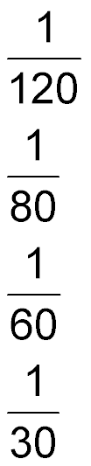
5-Minute Check 4
When 50 pounds of a compound are produced, the manufacturing cost is described by x – 2 and the selling price is described by x² + 8x – 20. What is the ratio of the cost to the selling price when
x = 50?
A.
B.
C.
D.

Slide 7
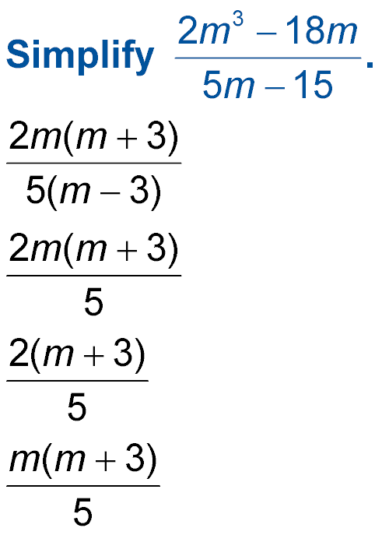

5-Minute Check 5
A.
B.
C.
D.

Slide 8

CCSS
Mathematical Practices
1 Make sense of problems and persevere in solving them.
Common Core State Standards © Copyright 2010. National Governors Association Center for Best Practices and Council of Chief State School Officers. All rights reserved.

Slide 9


Then/Now
You multiplied and divided polynomials.
Multiply rational expressions.
Divide rational expressions.

Slide 10
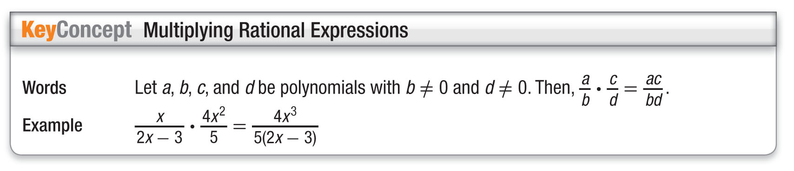
Concept 1

Slide 11
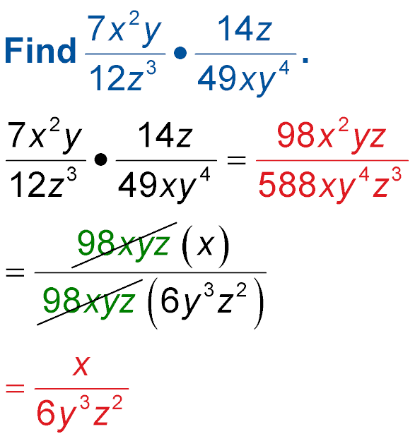
Example 1A
Multiply Expressions Involving Monomials
A. Find
Method 1 Divide by the greatest common factor after multiplying.
Multiply the numerators.
Multiply the denominators.
1
The GCF is 98xyz.
1
Simplify.

Slide 12
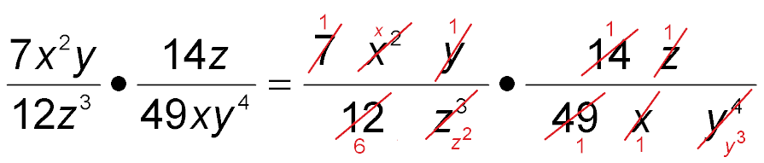
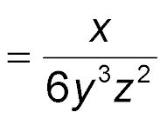
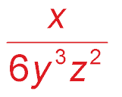
Example 1A
Multiply Expressions Involving Monomials
Method 2 Divide by the common factors before multiplying.
Divide by common factors 2, 7²,
x, y, and z.
Multiply.
Answer:

Slide 13
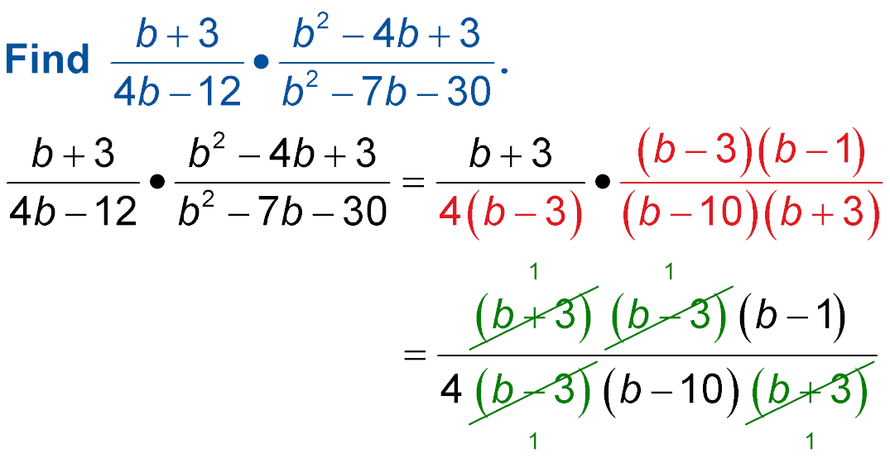
Example 1B
Multiply Expressions Involving Monomials
B. Find
Factor.
The GCF is (b + 3)
(b – 3).

Slide 14
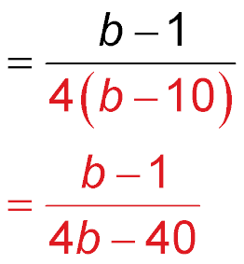
Example 1B
Multiply Expressions Involving Monomials
Multiply.
Simplify.
Answer:

Slide 15


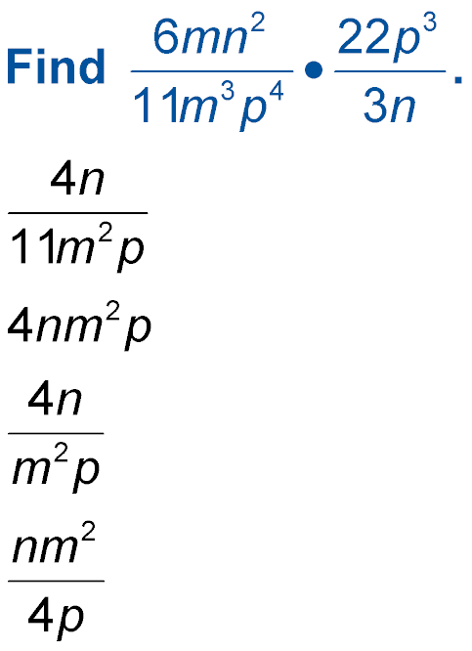
Example 1A
A. Find
A.
B.
C.
D.

Slide 16
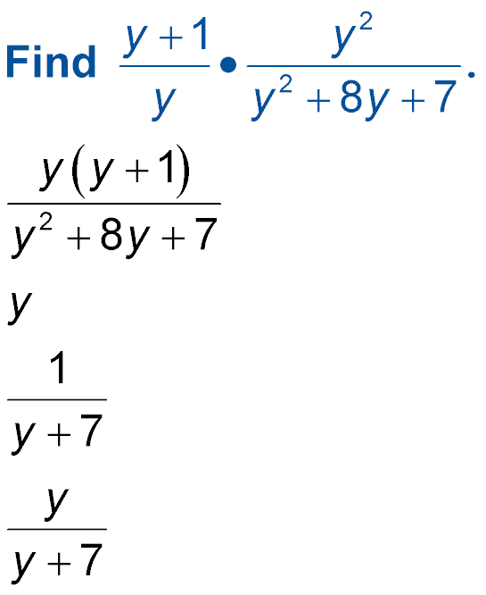
Example 1B
B. Find
A.
B.
C.
D.

Slide 17
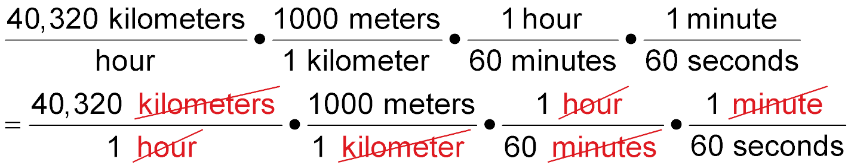
Example 2
Dimensional Analysis
SPACE The velocity that a spacecraft must have in order to escape Earth’s gravitational pull is called the escape velocity. The escape velocity for a spacecraft leaving Earth is about 40,320 kilometers per hour. What is this speed in meters per second?

Slide 18
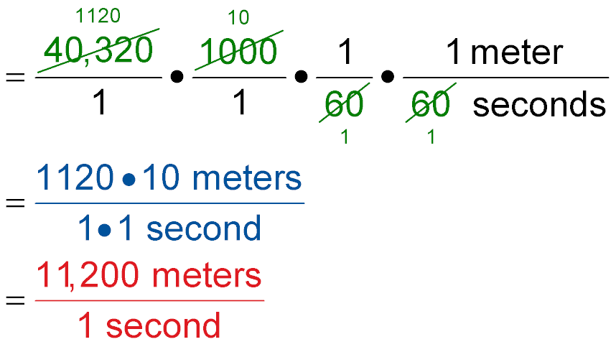
Example 2
Dimensional Analysis
Simplify.
Multiply.
Answer: The escape velocity is 11,200 meters per second.

Slide 19
Example 2
AVIATION The speed of sound, or Mach 1, is approximately 330 meters per second at sea level. What is the speed of sound in kilometers per hour?
A. 330 kilometers per hour
B. 1188 kilometers per hour
C. 3300 kilometers per hour
D. 500 kilometers per hour

Slide 20
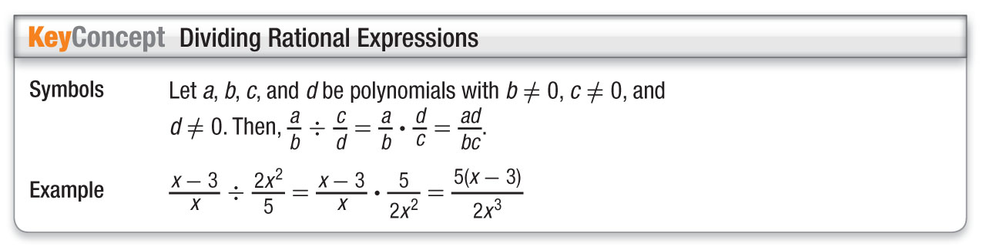
Concept 2

Slide 21
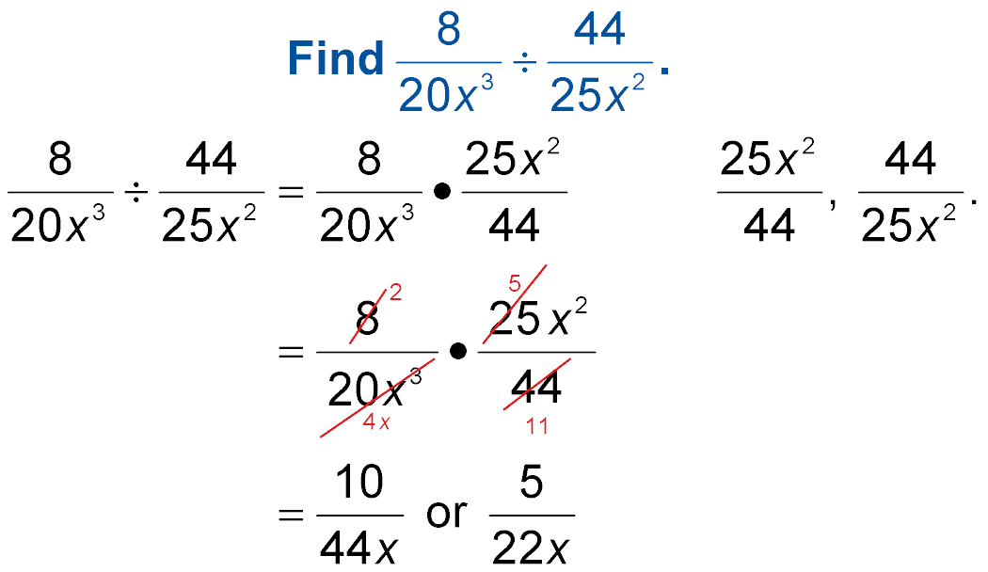
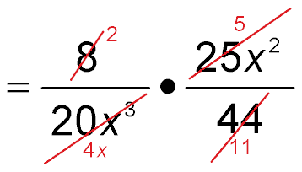
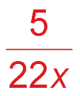
Example 3
Divide by a Polynomial
Multiply by the reciprocal of
Divide by common factors 4, 5, and x.
Simplify.
Answer:

Slide 22
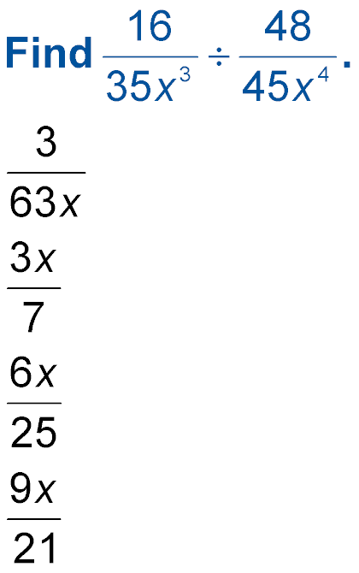
Example 3
A.
B.
C.
D.

Slide 23
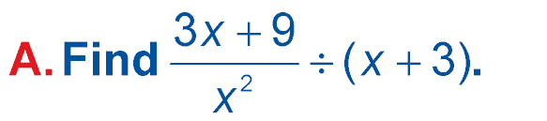
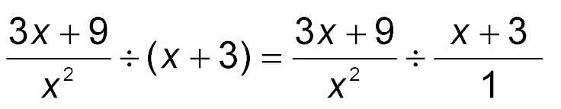
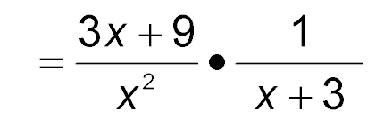
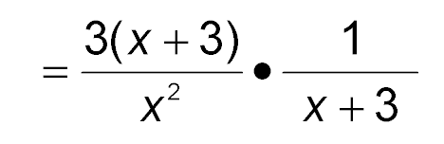
Example 4A
Divide by Rational Expressions and Polynomials
Write the binomial as a fraction.
Multiply by the reciprocal of x + 3.
Factor 3x + 9.

Slide 24
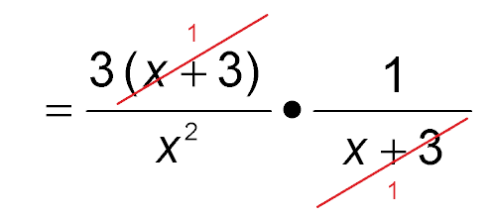
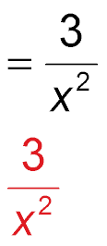
Example 4A
Divide by Rational Expressions and Polynomials
The GCF is x + 3.
Simplify.
Answer:

Slide 25
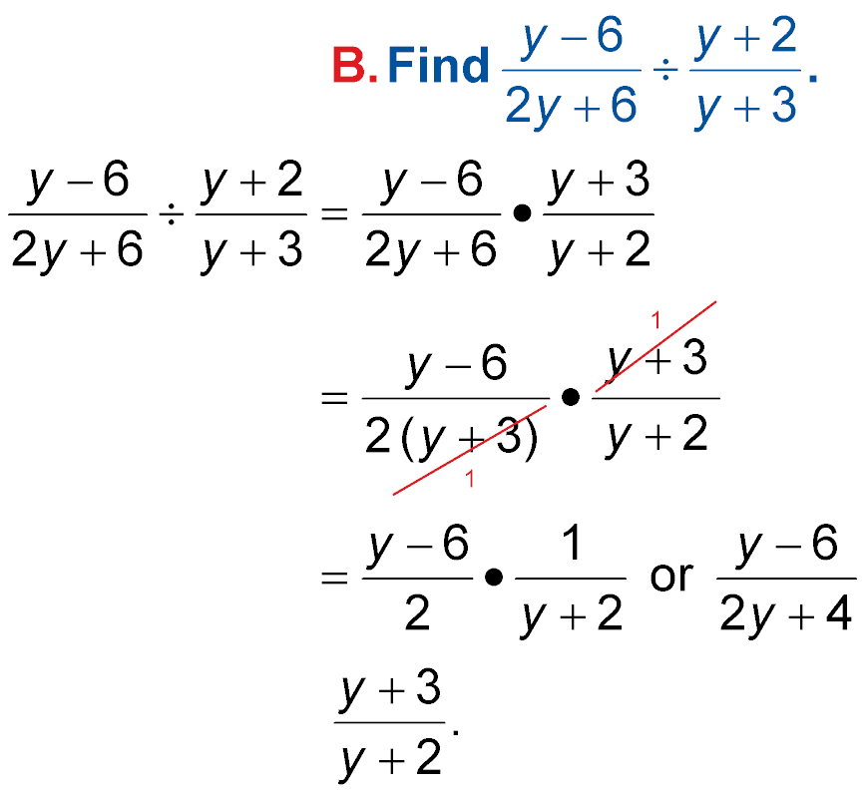
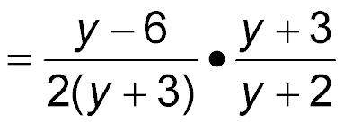
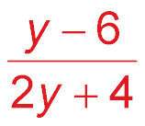
Example 4B
Divide by Rational Expressions and Polynomials
Multiply by the reciprocal,
Factor 2y + 6.
The GCF is
y + 3. Simplify.
Answer:

Slide 26
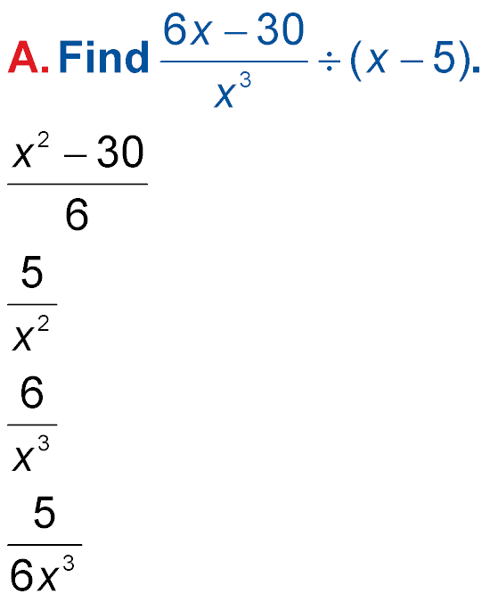
Example 4
A.
B.
C.
D.

Slide 27
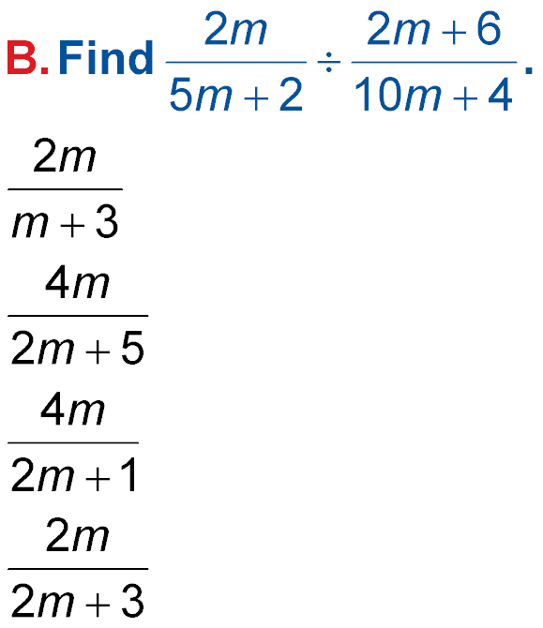
Example 4
A.
B.
C.
D.

Slide 28
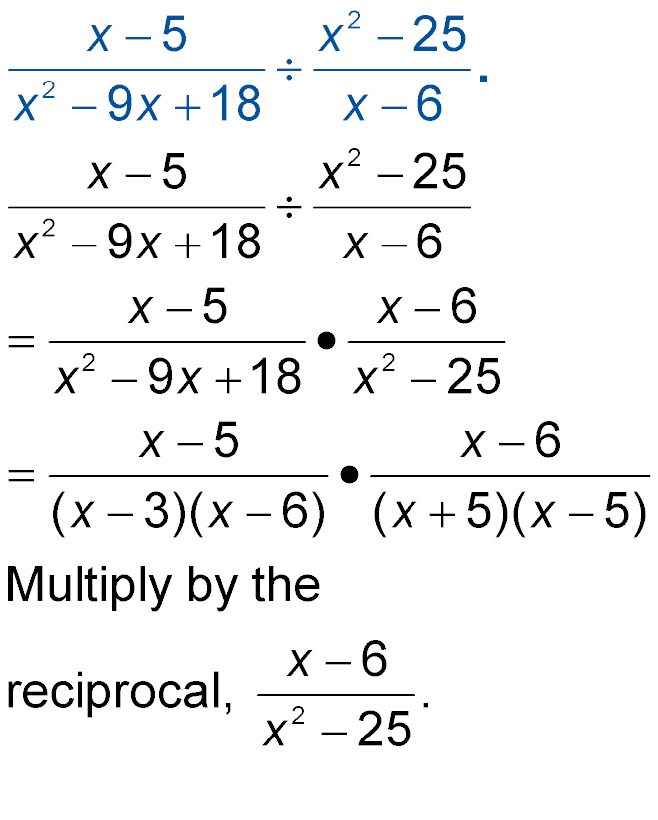
Example 5
Expression Involving Polynomials
Find
Factor.

Slide 29
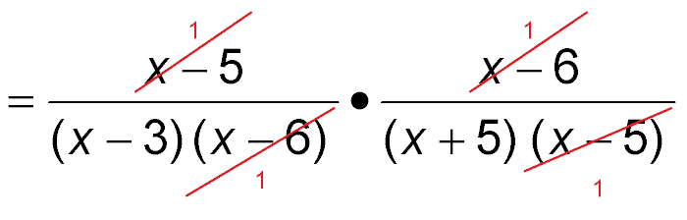
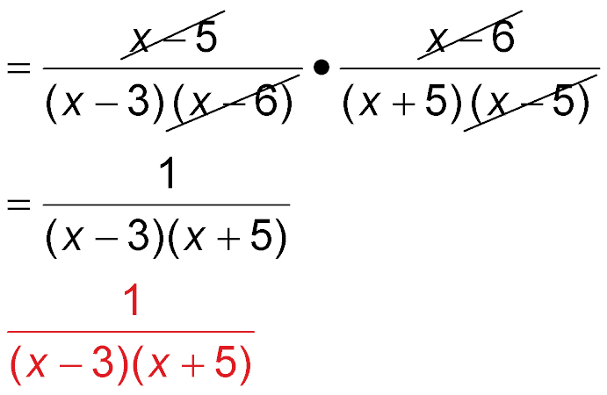
Example 5
Expression Involving Polynomials
The GCF is
(x – 6)(x – 5).
Simplify.
Answer:

Slide 30
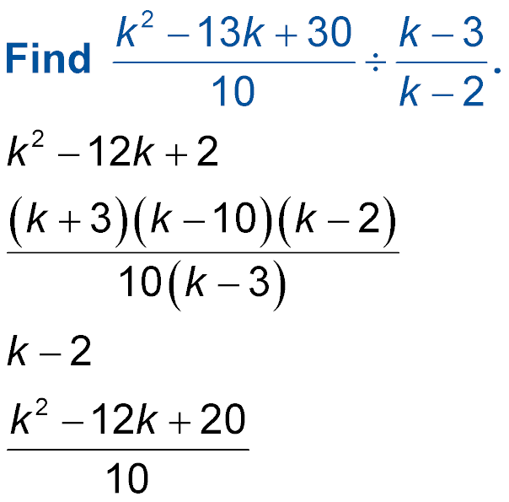
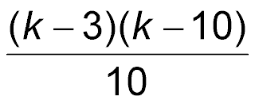
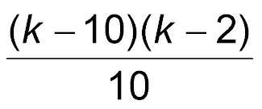
Example 5
Find
A.
B.
C. k – 2
D.

Slide 31
End of the Lesson

