Slide 1


Splash Screen

Slide 2
Lesson Menu
Five-Minute Check (over Lesson 11–4)
CCSS
Then/Now
Example 1: Divide Polynomials by Monomials
Example 2: Divide a Polynomial by a Binomial
Example 3: Use Long Division
Example 4: Real-World Example: Divide Polynomials to Solve a Problem
Example 5: Insert Missing Terms

Slide 3
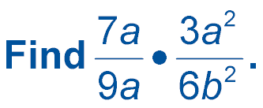

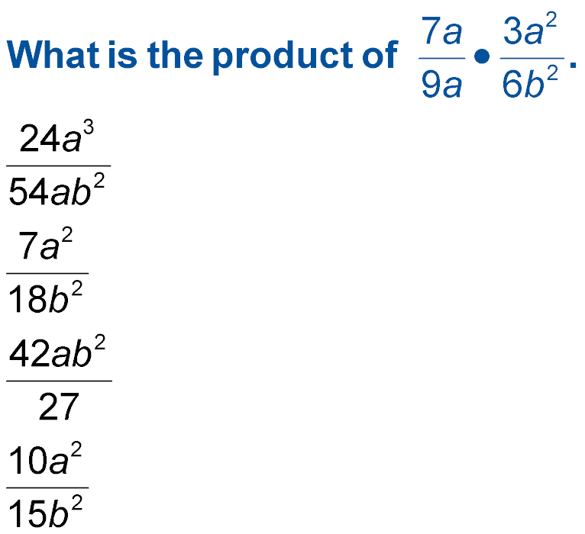
5-Minute Check 1
A.
B.
C.
D.

Slide 4
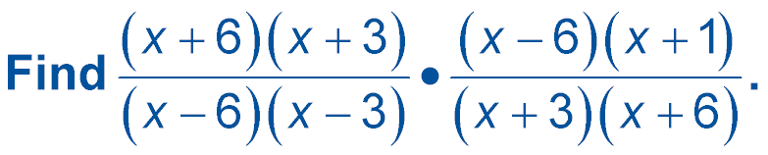

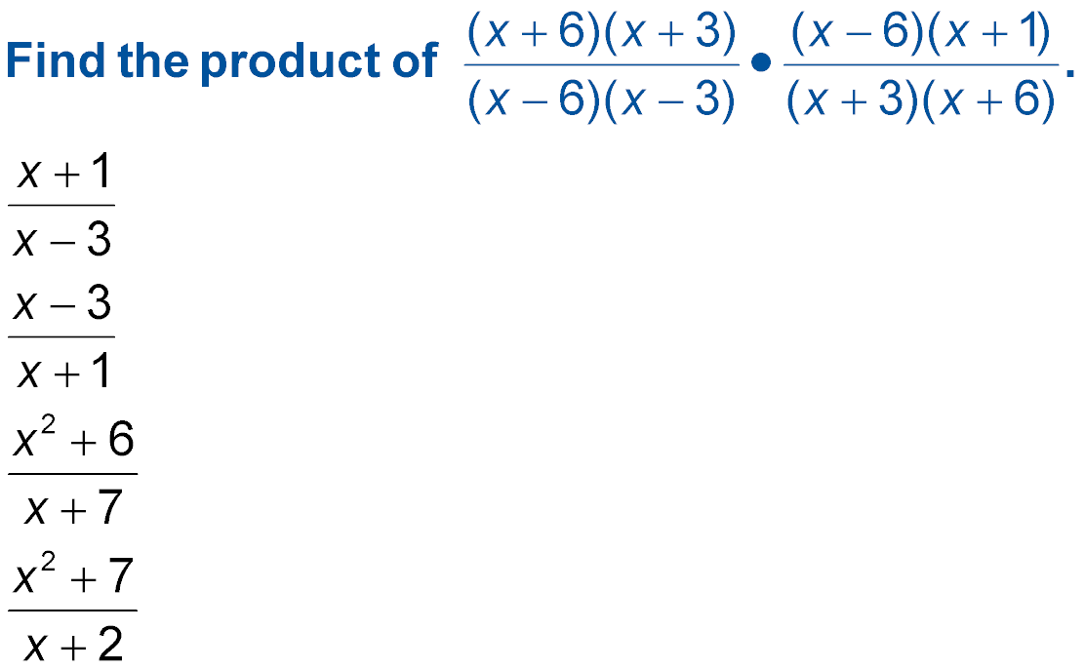
5-Minute Check 2
A.
B.
C.
D.

Slide 5
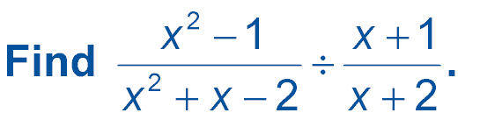

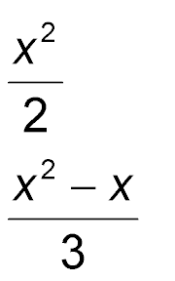
5-Minute Check 3
A.
B.
C. 1
D. x + 2

Slide 6
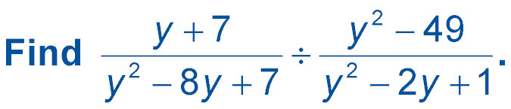

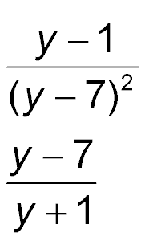
5-Minute Check 4
A.
B.
C. y² + 7
D. 1

Slide 7

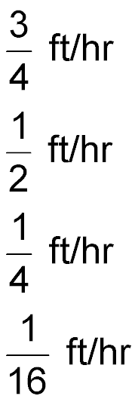
5-Minute Check 5
During the summer months, the glaciers of Mount Rainier move about 18 inches per day. How many feet per hour do they move?
A.
B.
C.
D.

Slide 8
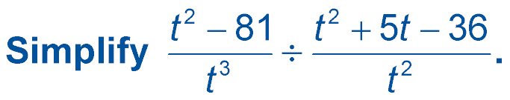

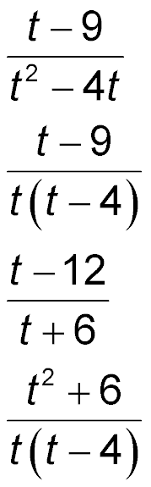
5-Minute Check 6
A.
B.
C.
D.

Slide 9

CCSS
Mathematical Practices
8 Look for and express regularity in repeated reasoning.
Common Core State Standards © Copyright 2010. National Governors Association Center for Best Practices and Council of Chief State School Officers. All rights reserved.

Slide 10


Then/Now
You divided rational expressions.
Divide a polynomial by a monomial.
Divide a polynomial by a binomial.

Slide 11
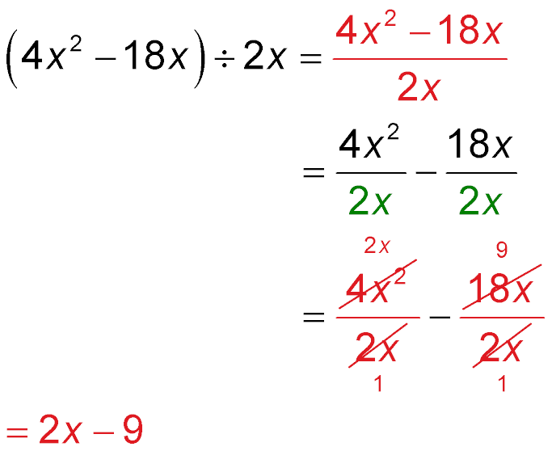
Example 1A
Divide Polynomials by Monomials
A. Find (4x² – 18x) ÷ 2x.
Write as a rational expression.
Divide each term by 2x.
Divide out common factors.
= 2x – 9
Simplify.
Answer: 2x – 9

Slide 12
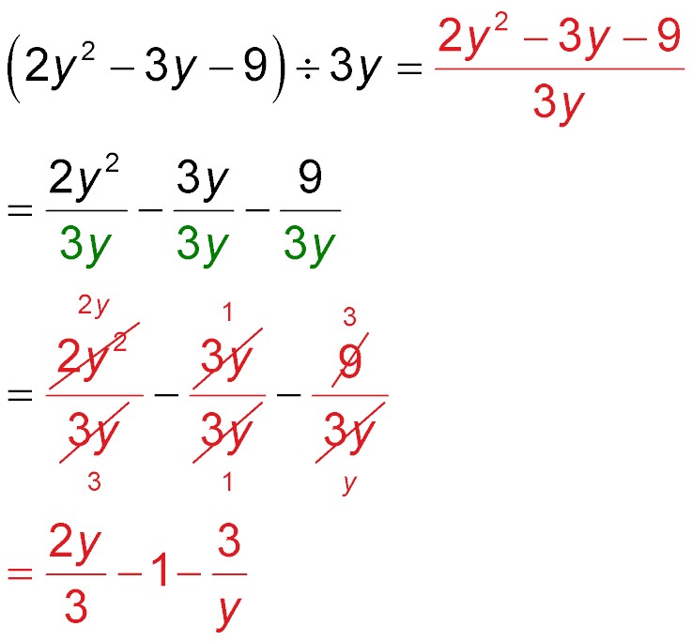
Example 1B
Divide Polynomials by Monomials
B. Find (2y² – 3y – 9) ÷ 3y.
Write as a rational expression.
Divide each term
by 3y.
Divide out
common factors.
Simplify.

Slide 13
Example 1B
Divide Polynomials by Monomials
Answer:

Slide 14


Example 1A
A. Find (48z² + 18z) ÷ 6z.
A. 8z + 18z
B. 8z + 18
C. 8z + 3
D. 42z + 12

Slide 15
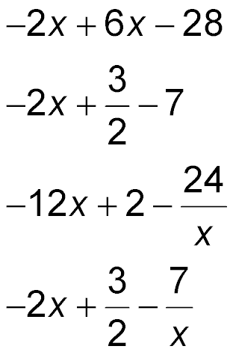
Example 1B
B. Find (–8x² + 6x – 28) ÷ 4x.
A.
B.
C.
D.

Slide 16
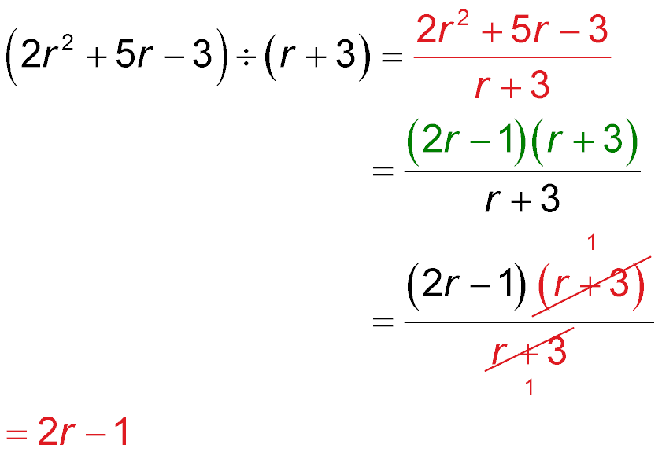
Example 2
Divide a Polynomial by a Binomial
Find (2r² + 5r – 3) ÷ (r + 3).
Write as a rational expression.
Factor the numerator.
Divide out
common factors.
= 2r – 1
Simplify.
Answer: 2r – 1

Slide 17
Example 2
Find (2c² – 3c – 9) ÷ (c – 3).
A. 2c + 3
B. c + 3
C. c – 3
D. 2c² – 3c – 9

Slide 18
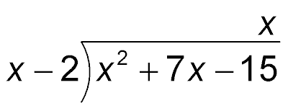
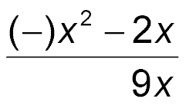

Example 3
Use Long Division
Find (x² + 7x – 15) ÷ (x – 2) by using long division.
Step 1 Divide the first term of the dividend, x², by the first term of the divisor, x.
x² ÷ x = x
Multiply x and x – 2.
Subtract and bring down –15.

Slide 19

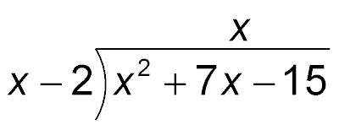

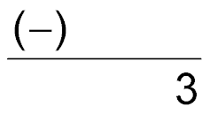

Example 3
Use Long Division
Step 2 Divide the first term of the partial dividend,
9x – 15, by the first term of the divisor, x.
9x ÷ x = 9
Subtract and bring down –15.
Multiply 9 and x – 2.
Subtract.

Slide 20
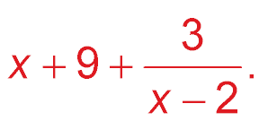
Example 3
Use Long Division
Answer: So, (x² + 7x – 15) ÷ (x – 2) is x + 9 with a
remainder of 3, which can be written as

Slide 21
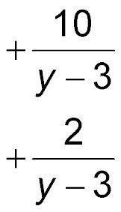
Example 3
Find (y² – 4y + 5) ÷ (y – 3) by using long division.
A. y – 2
B. y – 1
C. y + 5
D. y – 1

Slide 22
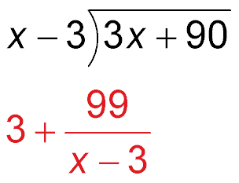
Example 4
Divide Polynomials to Solve a Problem
GEOMETRY The area of a rectangle is represented by 3x + 90. Its length is (x – 3).
Find (3x + 90) ÷ (x – 3) to determine the width of the rectangle.
3
(–)
3x – 9
99
Answer: So, represents the width of the rectangle.

Slide 23
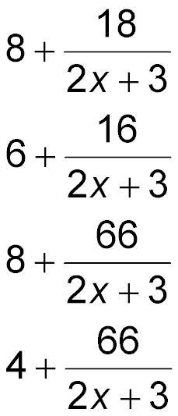
Example 4
GEOMETRY The area of a triangle is represented by 8x + 21. The height is 2x + 3. Find 2(8x + 21) ÷ (2x + 3) to find the base of the triangle.
A.
B.
C.
D.

Slide 24
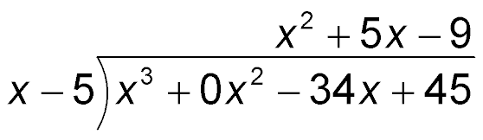
Example 5
Insert Missing Terms
Find (x³ – 34x + 45) ÷ (x – 5).
Insert an x²-term that has a coefficient of 0.
(–)
x³ – 5x²
Multiply x² and x – 5.
5x² – 34x
Subtract and bring down 34x.
(–)
5x² – 25x
Multiply 5x and x – 5.
–9x + 45
Subtract and bring down 45.
(–)
–9x + 45
Multiply –9 and x – 5.
0
Subtract.
Answer: The quotient is x² + 5x – 9.

Slide 25
Example 5
Find (b³ – 6b² + 32) ÷ (b – 4).
A. b² – 2b – 8
B. b – 8
C. b² – 8
D. b²

Slide 26
End of the Lesson

