Slide 1


Splash Screen

Slide 2
Lesson Menu
Five-Minute Check (over Lesson 11–5)
CCSS
Then/Now
New Vocabulary
Key Concept: Add or Subtract Rational Expressions with Like Denominators
Example 1: Add Rational Expressions with Like Denominators
Example 2: Subtract Rational Expressions with Like Denominators
Example 3: Inverse Denominators
Example 4: LCMs of Polynomials
Key Concept: Add or Subtract Rational Expressions with Unlike Denominators
Example 5: Add Rational Expressions with Unlike Denominators
Example 6: Real-World Example: Add Rational Expressions
Example 7: Subtract Rational Expressions with Unlike Denominators

Slide 3

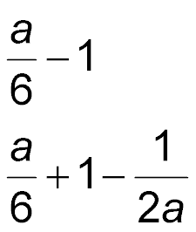
5-Minute Check 1
Find (a² + 6a – 3) ÷ 6a.
A.
B.
C. 6a – 2
D. 6

Slide 4


5-Minute Check 2
A. 2x + y – 6
B. 2x – y + 4
C. 4x² – y
D. 4x + y – 6

Slide 5

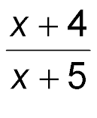
5-Minute Check 3
Find (x² + 9x + 20) ÷ (x + 5).
A. x + 4
B. x – 4
C.
D. 1

Slide 6

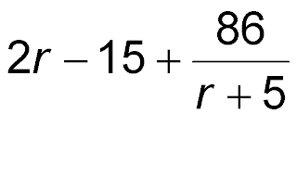
5-Minute Check 4
Find (2r² – 5r + 11) ÷ (r + 5).
A. 2r
B. 2r + 25
C. 2r + 55
D.

Slide 7

5-Minute Check 5
Which value of k is c + 7 a factor of c² – 2c + k?
A. –84
B. –72
C. –63
D. –54

Slide 8

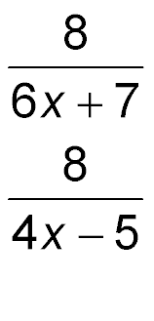
5-Minute Check 6
Which of the following expressions equals
(24x² – 2x – 27) ÷ (4x – 5)?
A. 6x + 8
B. 6x + 8 +
C. 6x + 7 +
D. 6x + 7 –

Slide 9

CCSS
Mathematical Practices
6 Attend to precision.
Common Core State Standards © Copyright 2010. National Governors Association Center for Best Practices and Council of Chief State School Officers. All rights reserved.

Slide 10


Then/Now
You added and subtracted polynomials.
Add and subtract rational expressions with like denominators.
Add and subtract rational expressions with unlike denominators.

Slide 11

Vocabulary
least common multiple (LCM)
least common denominator (LCD)

Slide 12
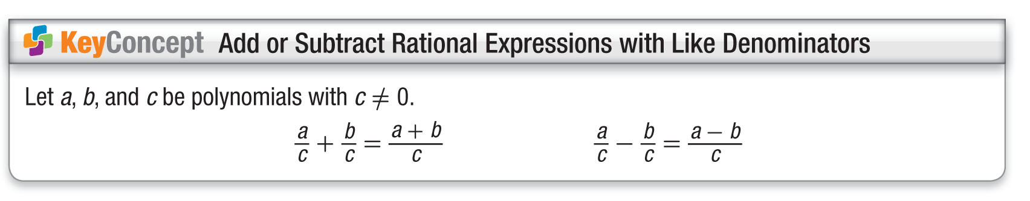
Concept 1

Slide 13
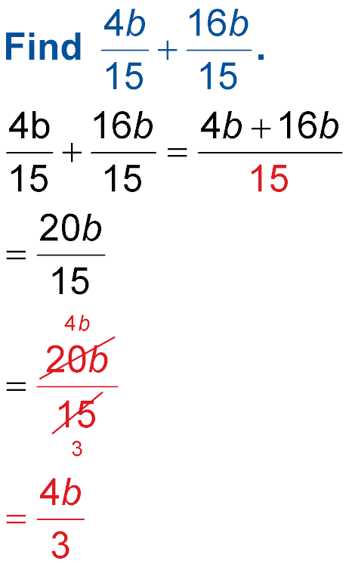
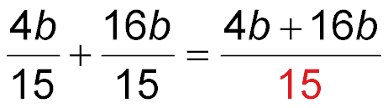
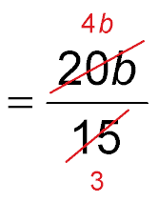
Example 1
Add Rational Expressions with Like Denominators
Find
The common denominator is 15.
Add the numerators.
Divide by the common factor, 5.

Slide 14
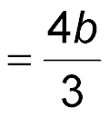
Example 1
Add Rational Expressions with Like Denominators
Simplify.
Answer:

Slide 15


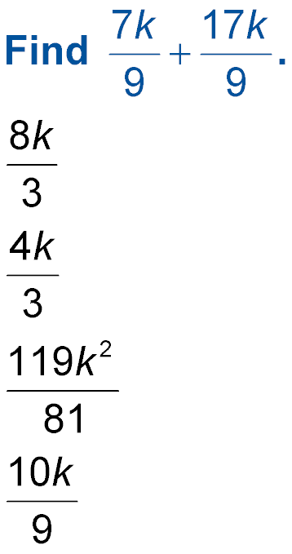
Example 1
Find
A.
B.
C.
D.

Slide 16
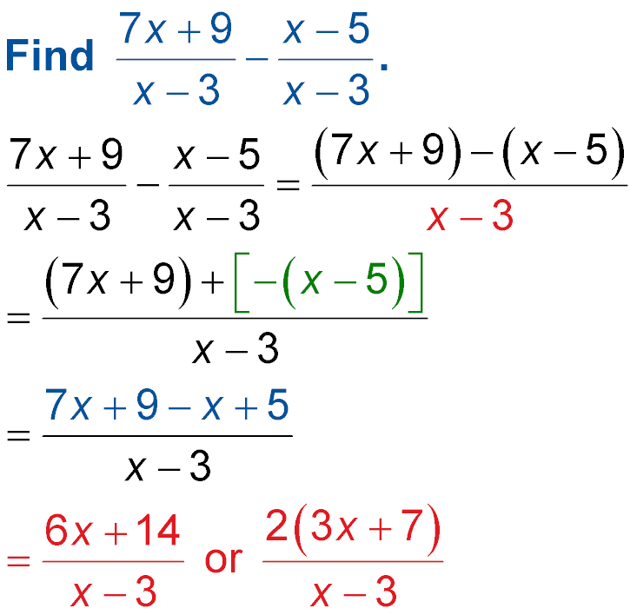
Example 2
Subtract Rational Expressions with Like Denominators
Find
The common denominator is
x – 3.
The additive inverse of (x – 5) is –(x – 5).
Distributive Property
Simplify.

Slide 17
Example 2
Subtract Rational Expressions with Like Denominators
Answer:

Slide 18
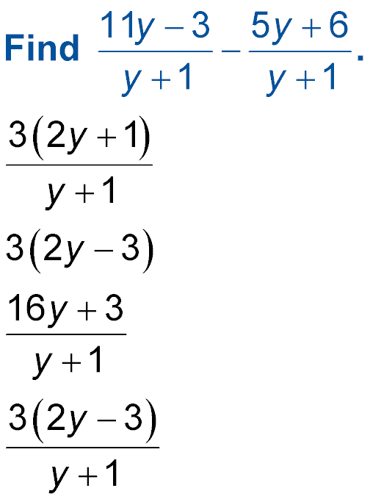
Example 2
Find
A.
B. 3(2y – 3)
C.
D.

Slide 19
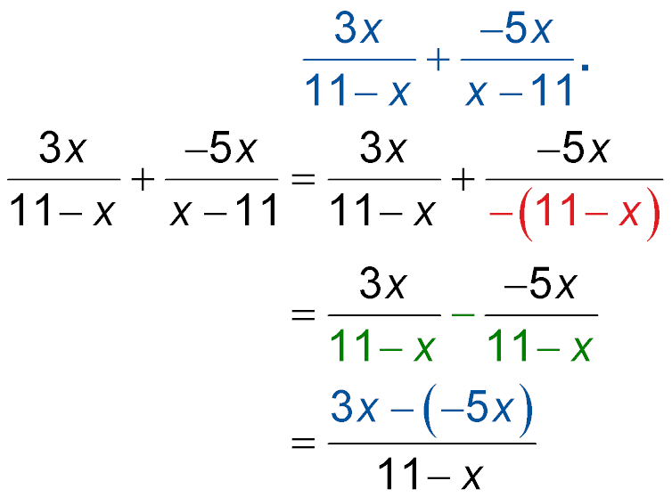
Example 3
Inverse Denominators
Find
Rewrite x – 11 as
–(11 – x).
Rewrite so the common denominators are the same.
Subtract the numerators.

Slide 20
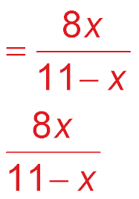
Example 3
Inverse Denominators
Simplify.
Answer:

Slide 21
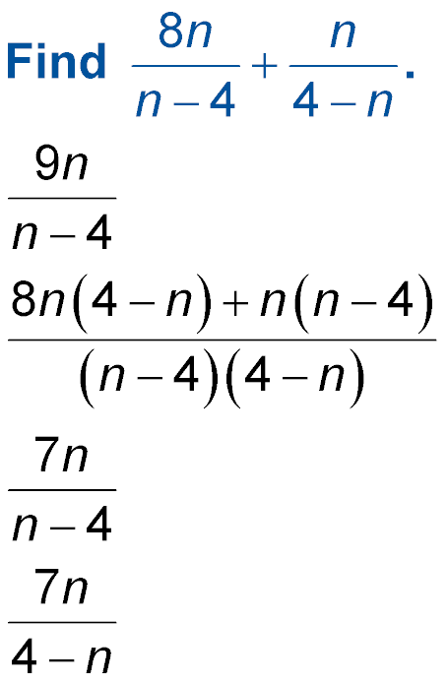
Example 3
Find
A.
B.
C.
D.

Slide 22
Example 4A
LCMs of Polynomials
A. Find the LCM of 12b⁴c⁵ and 32bc².
Find the prime factors of each coefficient and
variable expression.
Use each prime factor the greatest number of times it appears in any of the factorizations.
12b⁴c⁵ = 2 ● 2 ● 3 ● b ● b ● b ● b ● c ● c ● c ● c ● c
32bc² = 2 ● 2 ● 2 ● 2 ● 2 ● b ● c ● c
Answer: LCM = 2 ● 2 ● 2 ● 2 ● 2 ● 3 ● b ● b ● b ●
b ● c ● c ● c ● c ● c or 96b⁴c⁵

Slide 23
Example 4B
LCMs of Polynomials
B. Find the LCM of x² – 3x – 28 and x² – 8x + 7.
Express each polynomial in factored form.
x² – 3x – 28 = (x – 7)(x + 4)
x² – 8x + 7 = (x – 7)(x – 1)
Use each factor the greatest number of times it appears.
Answer: LCM = (x + 4)(x – 7)(x – 1)

Slide 24
Example 4A
A. Find the LCM of 21a²b⁴ and 35a³b².
A. 35a³b²
B. 7a²b²
C. 14ab²
D. 105a³b⁴

Slide 25
Example 4B
B. Find the LCM of y² + 12y + 36 and y² + 2y – 24.
A. (y + 6)²(y – 4)
B. (y + 6) (y – 4)
C. (y – 4)
D. (y + 6) (y – 4)²

Slide 26
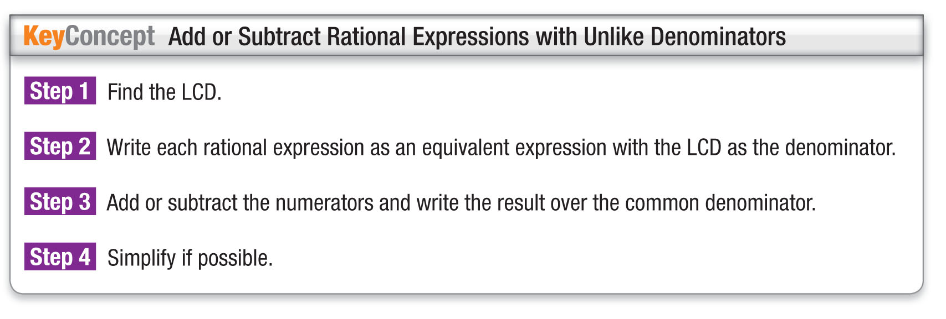
Concept 2

Slide 27
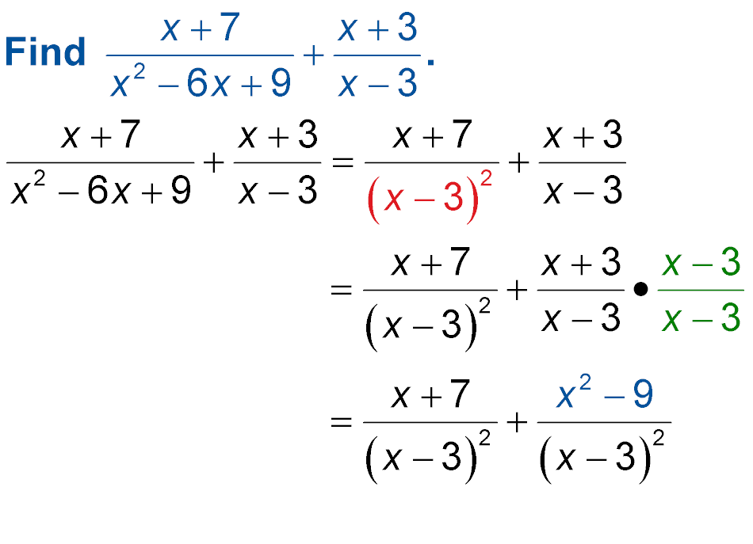
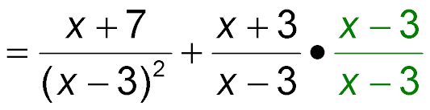
Example 5
Add Rational Expressions with Unlike Denominators
Find
Factor the denominators.
The LCD
is (x – 3)².
(x + 3)(x – 3)
= x² – 9

Slide 28
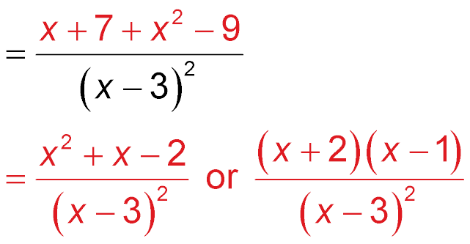
Example 5
Add Rational Expressions with Unlike Denominators
Add the numerators.
Simplify.
Answer:

Slide 29
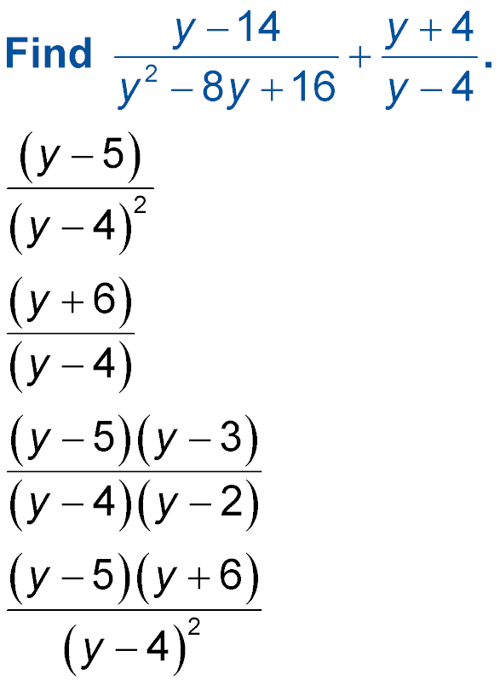
Example 5
Find
A.
B.
C.
D.

Slide 30
Example 6A
Add Rational Expressions
A. BIKING For the first 15 miles, a biker travels at x miles per hour. Then, due to a downhill slope, the biker travels 2 miles at a speed that is 2 times as fast.
Write an expression to represent how much time the biker is bicycling.
Understand For the first 15 miles the biker’s speed
is x. For the last 2 miles, the biker’s
speed is 2x.

Slide 31
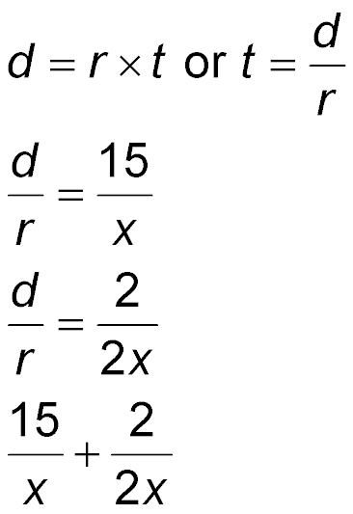
Example 6A
Add Rational Expressions
Plan Use the formula to
represent the time t of each section of
the biker’s trip, with rate r and distance d.
Solve Time to ride 15 miles:
d = 15 mi,
r = x
Time to ride 2 miles:
d = 2 mi,
r = 2x

Slide 32
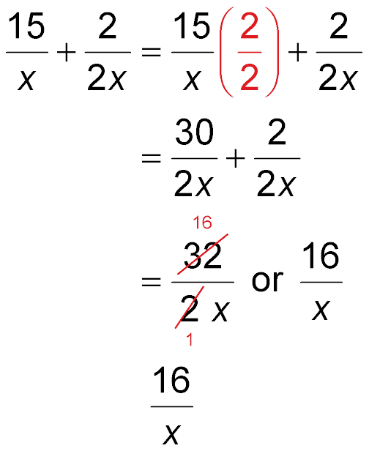
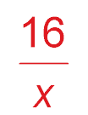
Example 6A
Add Rational Expressions
Total riding time:
The LCD is 2x.
Multiply.
Simplify.
Answer:

Slide 33
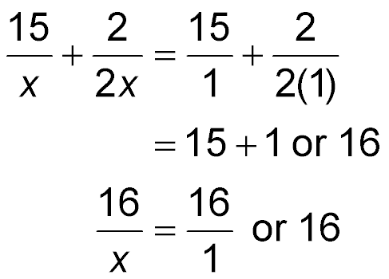
Example 6A
Add Rational Expressions
Check Let x = 1 in the
original expression.
Simplify.
Let x = 1 in the answer expression.
Since the expressions have the same value
for x = 1, they are equivalent. So, the answer
is reasonable.

Slide 34
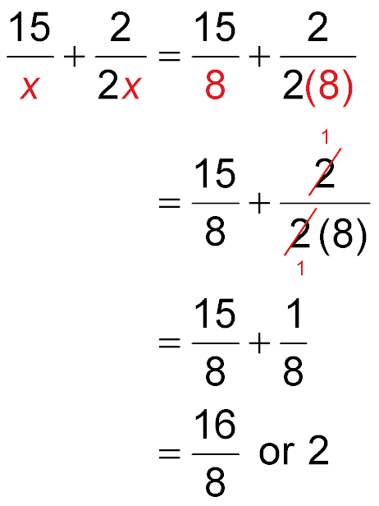
Example 6B
Add Rational Expressions
B. BIKING For the first 15 miles, a biker travels at x miles per hour. Then, due to a downhill slope, the biker travels 2 miles at a speed that is 2 times as fast. If the biker is bicycling at a rate of 8 miles per hour for the first 15 miles, find the total amount of time the biker is bicycling.
Substitute 8 for x in the expression.
Divide out the common factor 2.

Slide 35
Example 6B
Add Rational Expressions
Multiply.
Simplify.
Answer: So, the biker is bicycling for 2 hours.

Slide 36

Example 6A
A. EQUESTRIAN A rider is on a horse for 3 miles traveling at x miles per hour. Then for the last half mile of the ride, the horse doubles its speed when it sees the barn on the horizon. Write an expression to represent how much time the horse is galloping.
A.
B.
C.
D.

Slide 37
Example 6B
B. EQUESTRIAN A rider is on a horse for 3 miles traveling at x miles per hour. Then for the last half mile of the ride, the horse doubles its speed when it sees the barn on the horizon. If the horse is galloping at a rate of 15 miles per hour for the first 3 miles, find the total amount of time the horse was galloping.
A. 0.22 hour
B. 0.56 hour
C. 1.02 hours
D. 0.15 hour

Slide 38
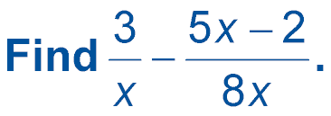

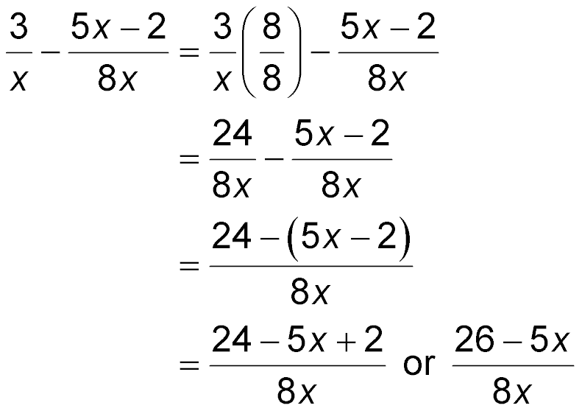
Example 7
Subtract Rational Expressions with Unlike Denominators
Write using the LCD, 8x.
Simplify.

Slide 39
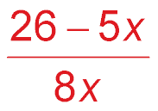
Example 7
Subtract Rational Expressions with Unlike Denominators
Subtract the numerators.
Simplify.
Answer:

Slide 40
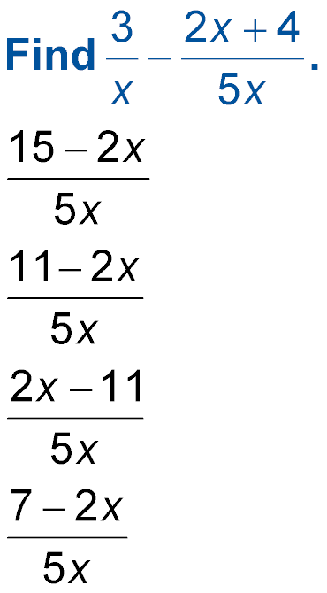
Example 7
A.
B.
C.
D.

Slide 41
End of the Lesson

