Slide 1


Splash Screen

Slide 2
Lesson Menu
Five-Minute Check (over Lesson 11–6)
CCSS
Then/Now
New Vocabulary
Example 1: Change Mixed Expression to Rational Expression
Example 2: Real-World Example: Use Complex Fractions to Solve Problems
Example 3: Complex Fractions Involving Monomials
Example 4: Complex Fractions Involving Polynomials

Slide 3

5-Minute Check 1
Find the LCM of 4x³y and 2xy².
A. 2x³y²
B. 2x²y
C. 4x³y²
D. 4x²y

Slide 4
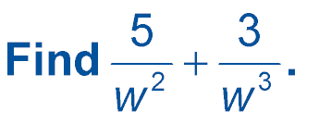

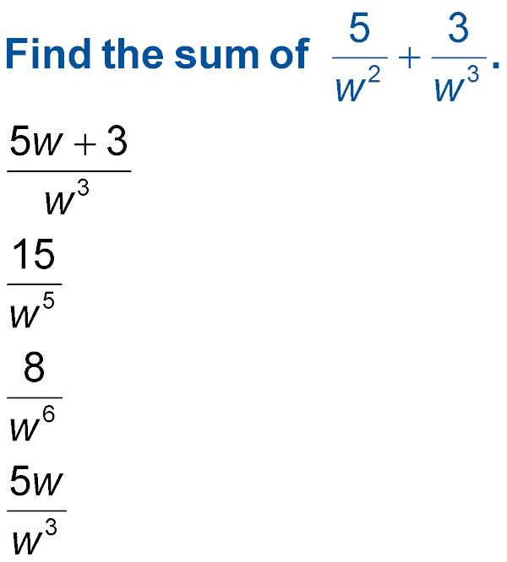
5-Minute Check 2
A.
B.
C.
D.

Slide 5
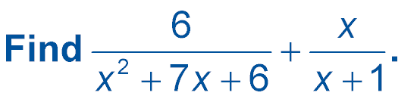

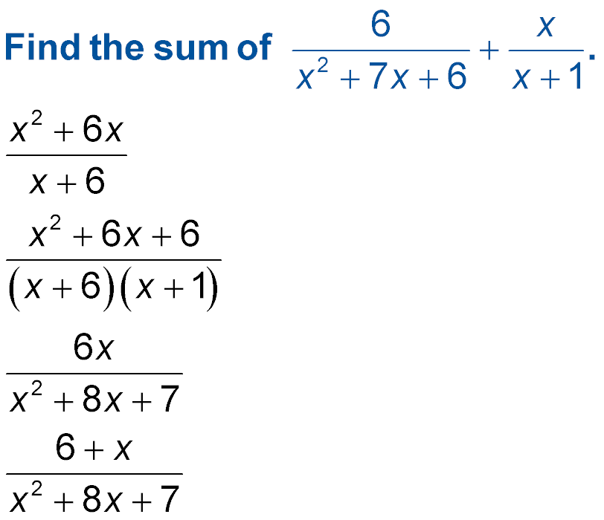
5-Minute Check 3
A.
B.
C.
D.

Slide 6
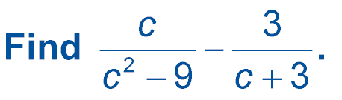

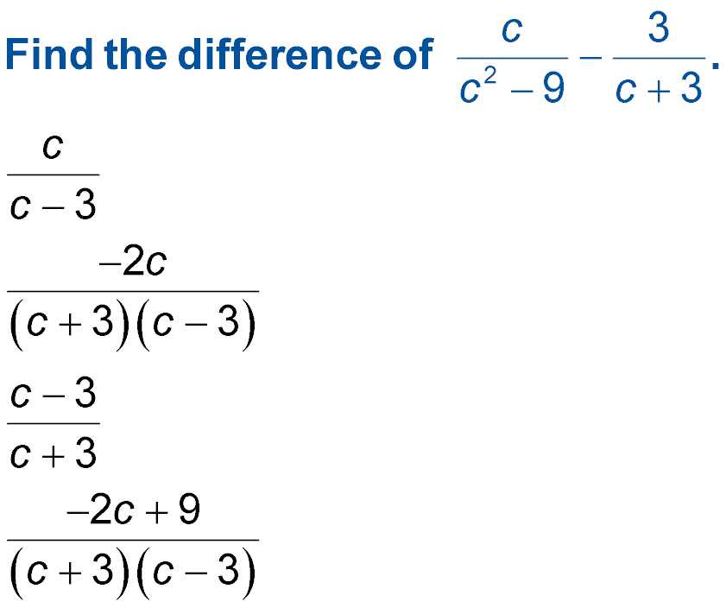
5-Minute Check 4
A.
B.
C.
D.

Slide 7

5-Minute Check 5
On May 1, a groundskeeper cuts and fertilizes the lawn. Then he cuts the lawn every 2 weeks and fertilizes every 3 weeks. How many times will he do both things again on the same day over the next 15 weeks?
A. 5 times
B. 3 times
C. 2 times
D. 4 times

Slide 8
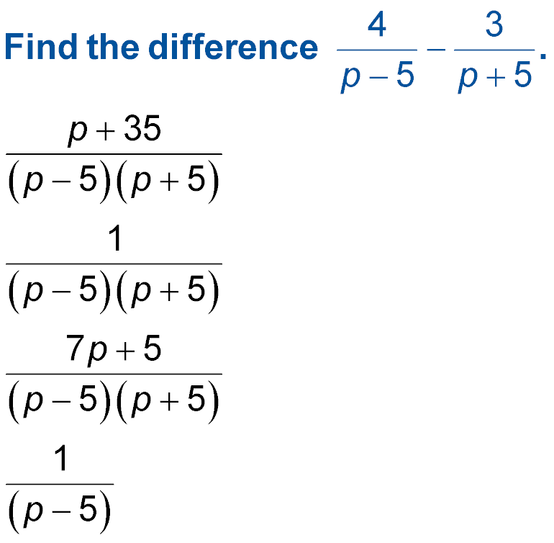

5-Minute Check 6
A.
B.
C.
D.

Slide 9

CCSS
Mathematical Practices
4 Model with mathematics.
Common Core State Standards © Copyright 2010. National Governors Association Center for Best Practices and Council of Chief State School Officers. All rights reserved.

Slide 10


Then/Now
You simplified rational expressions.
Simplify mixed expressions.
Simplify complex fractions.

Slide 11

Vocabulary
mixed expression
complex fraction

Slide 12
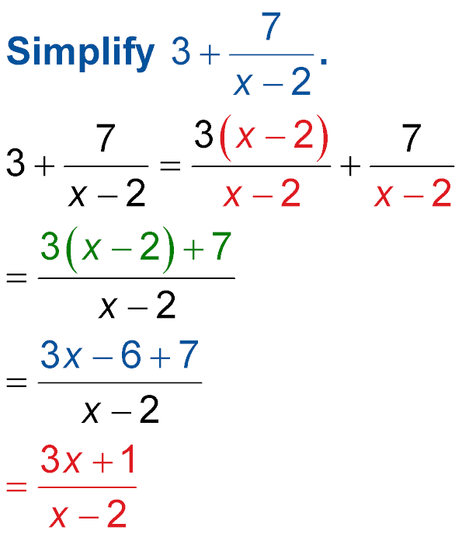
Example 1
Change Mixed Expression to Rational Expressions
Write as a rational expression.
The LCD is x – 2.
Add the numerators.
Distributive Property

Slide 13
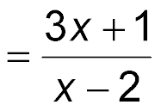
Example 1
Change Mixed Expression to Rational Expressions
Simplify.
Answer:

Slide 14


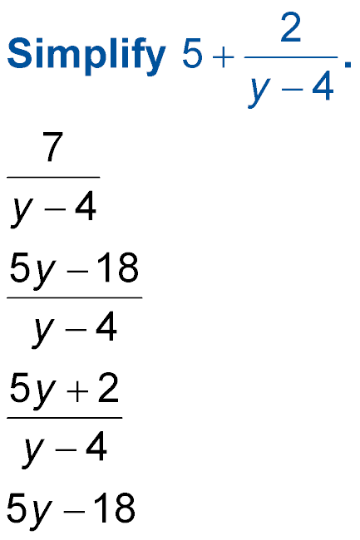
Example 1
Write as a rational expression.
A.
B.
C.
D. 5y – 18

Slide 15

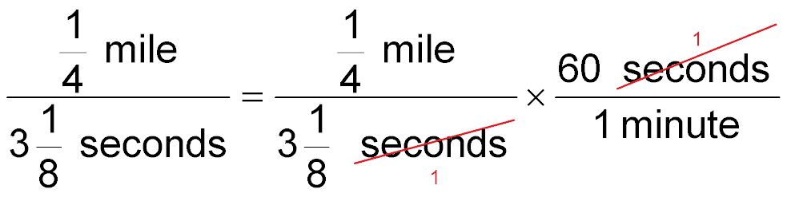
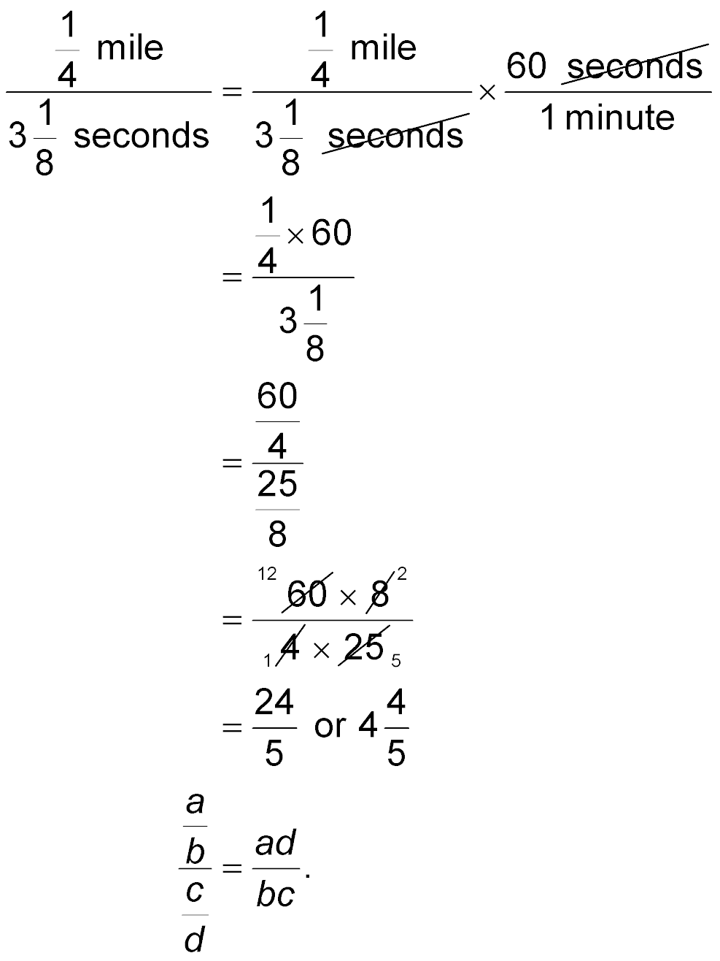
Example 2
Use Complex Fractions to Solve Problems
If a Top Fuel dragster can cover mile in seconds, what is its average speed in miles per minute?
Convert seconds to
minutes.
Simplify.

Slide 16
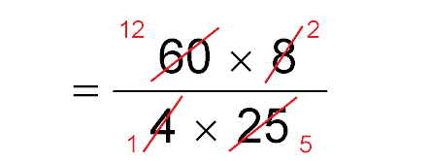

Example 2
Use Complex Fractions to Solve Problems
Express each term as an improper fraction.
Use the rule
Simplify.
Answer: The average speed of the Top Fuel dragster
is miles per minute.

Slide 17
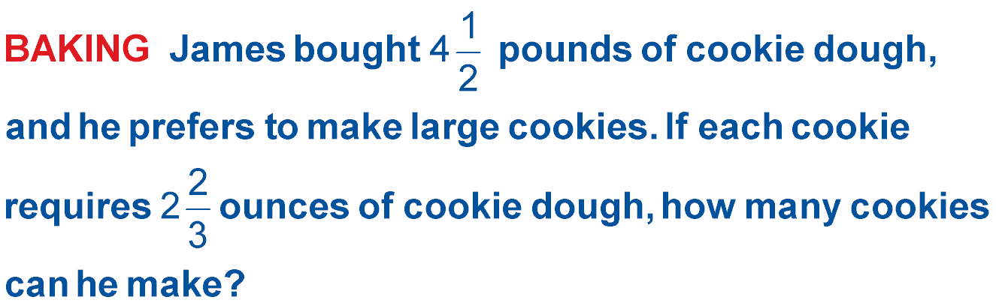
Example 2
A. 27 cookies
B. 30 cookies
C. 25 cookies
D. 20 cookies

Slide 18
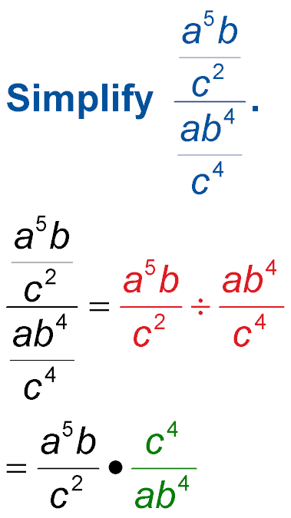
Example 3
Complex Fractions Involving Monomials
Simplify
Rewrite as a division sentence.
To divide, multiply by the reciprocal.

Slide 19
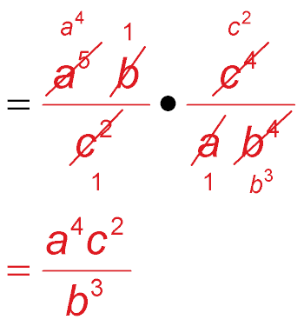
Example 3
Complex Fractions Involving Monomials
Divide by common factors
a, b, and c².
Simplify.
Answer:

Slide 20
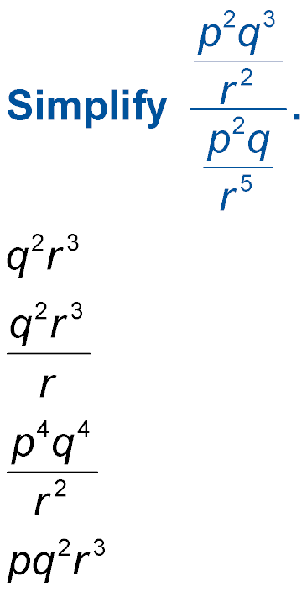
Example 3
Simplify
A. q²r³
B.
C.
D. pq²r³

Slide 21
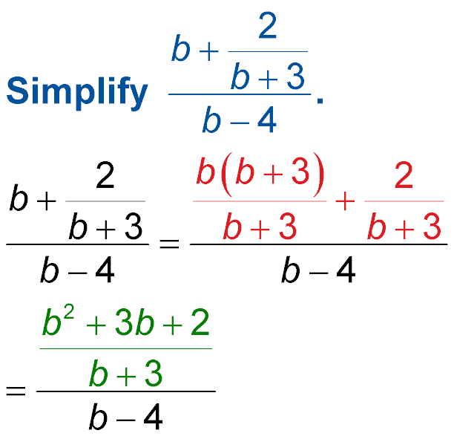
Example 4A
Complex Fractions Involving Polynomials
A. Simplify
The numerator contains a mixed expression. Rewrite it as a rational expression first.
The LCD of the fractions in the numerator is
b + 3.
Simplify the numerator.

Slide 22
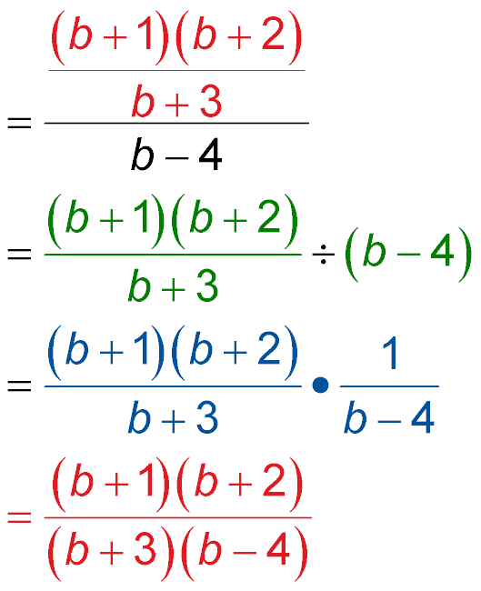
Example 4A
Complex Fractions Involving Polynomials
Factor.
Rewrite as a division sentence.
Multiply by the reciprocal of b – 4.
Simplify.
Answer:

Slide 23
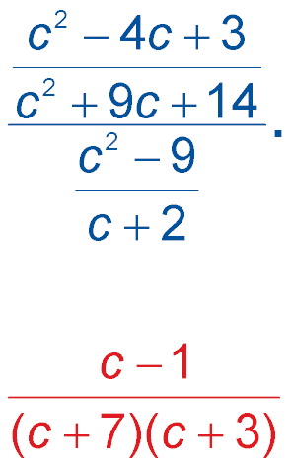
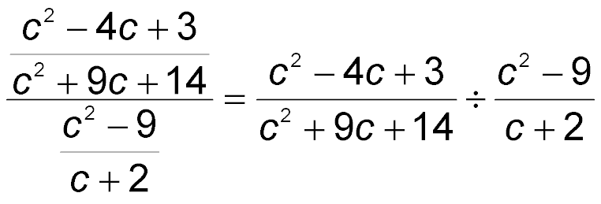
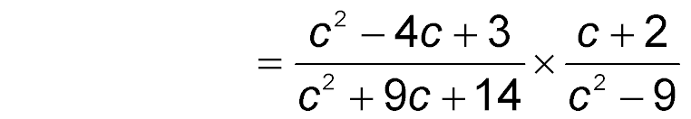
Example 4B
Complex Fractions Involving Polynomials
B. Simplify
Write as a division sentence.
To divide, multiply by the reciprocal.

Slide 24
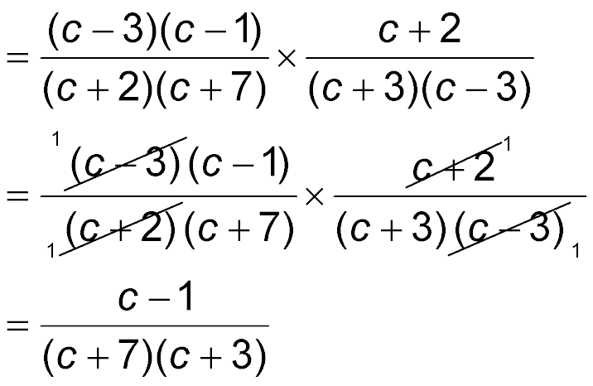
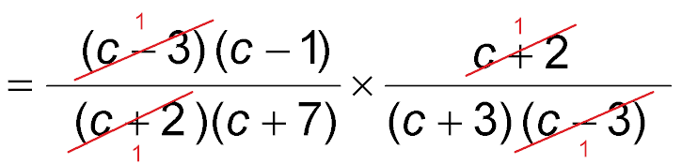
Example 4B
Complex Fractions Involving Polynomials
Factor the polynomials.
Divide out common factors.
Simplify.
Answer:

Slide 25
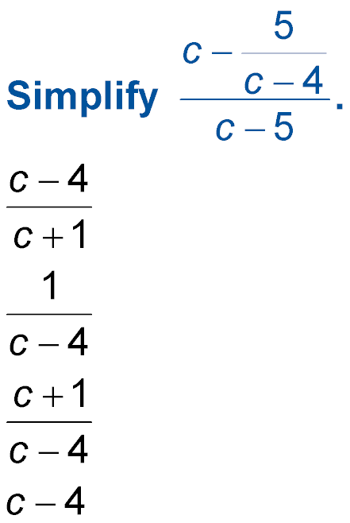
Example 4A
A. Simplify
A.
B.
C.
D. c – 4

Slide 26
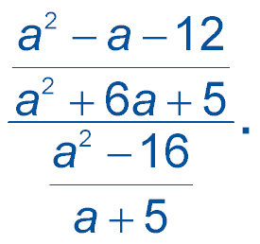
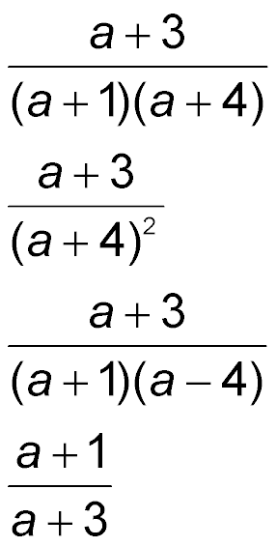
Example 4B
B. Simplify
A.
B.
C.
D.

Slide 27
End of the Lesson

