Slide 1


Splash Screen

Slide 2
Lesson Menu
Five-Minute Check (over Lesson 11–7)
CCSS
Then/Now
New Vocabulary
Example 1: Real-World Example: Use Cross Products to Solve Equations
Example 2: Use the LCD to Solve Rational Equations
Example 3: Extraneous Solutions
Example 4: Real-World Example: Work Problem
Example 5: Real-World Problem: Rate Problem

Slide 3
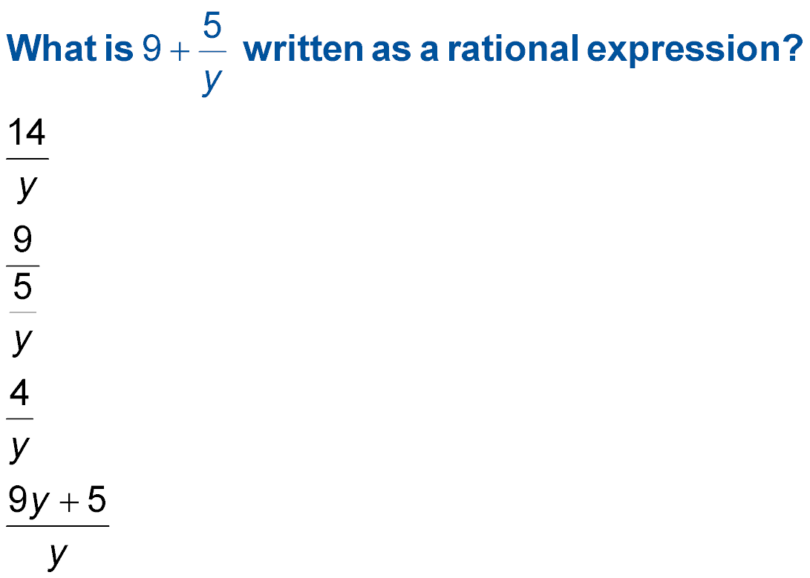

5-Minute Check 1
A.
B.
C.
D.

Slide 4
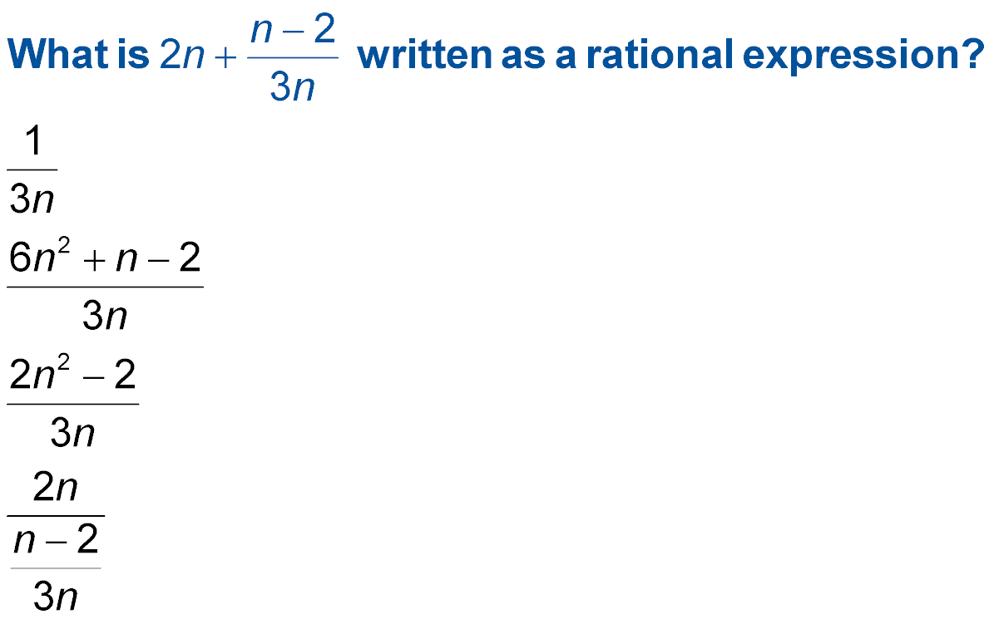

5-Minute Check 2
A.
B.
C.
D.

Slide 5
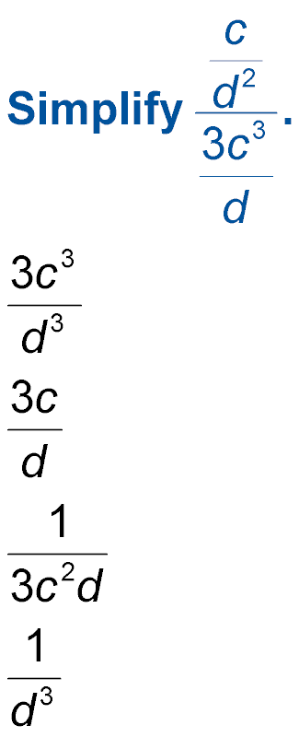

5-Minute Check 3
A.
B.
C.
D.

Slide 6
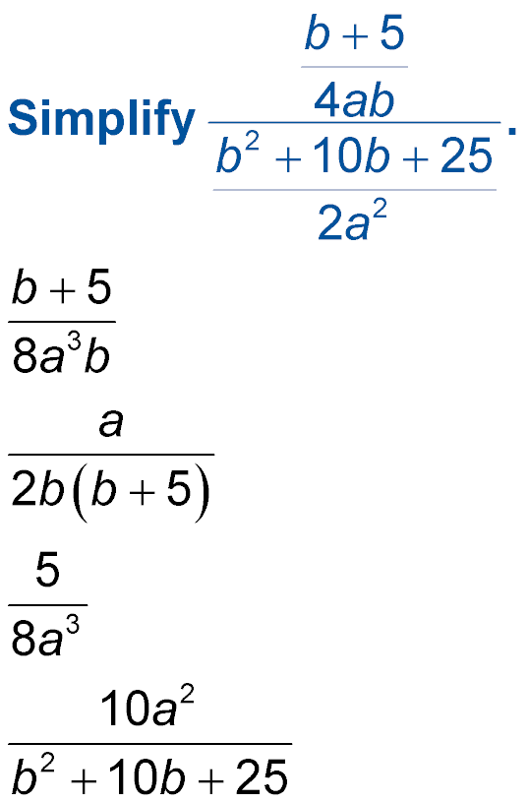

5-Minute Check 4
A.
B.
C.
D.

Slide 7
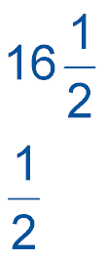

5-Minute Check 5
A chef prepares quarts of soup. How many
-pint servings are there in a batch of soup?
A. 66 half-pint servings
B. 42 half-pint servings
C. 33 half-pint servings
D. 24 half-pint servings

Slide 8
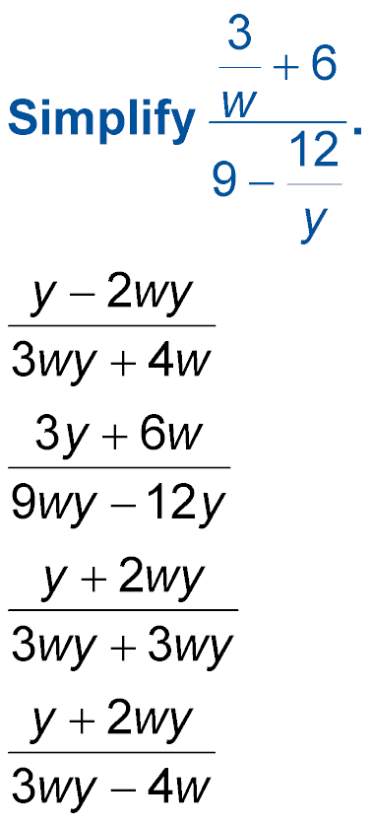

5-Minute Check 6
A.
B.
C.
D.

Slide 9

CCSS
Content Standards
A.CED.2 Create equations in two or more variables to represent relationships between quantities; graph equations on coordinate axes with labels and scales.
Mathematical Practices
2 Reason abstractly and quantitatively.
4 Model with mathematics.
Common Core State Standards © Copyright 2010. National Governors Association Center for Best Practices and Council of Chief State School Officers. All rights reserved.

Slide 10


Then/Now
You solved proportions.
Solve rational equations.
Use rational equations to solve problems.

Slide 11

Vocabulary
rational equation
extraneous solution
work problem
rate problem

Slide 12
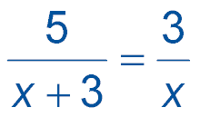
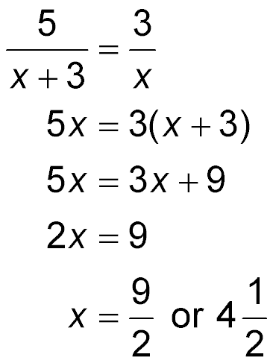
Example 1
Use Cross Products to Solve Equations
FRIENDS Cabrini can run 3 miles an hour faster than Michael. Cabrini can run 5 miles in the same time it takes Michael to run 3 miles. Solve
to find how fast Michael can run. Check the solution.
Original equation
Find the cross products.

Slide 13
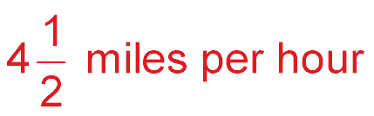
Example 1
Use Cross Products to Solve Equations
Distributive Property
Subtract 3x from each side.
Divide each side by 2.
Answer: Michael can run .

Slide 14
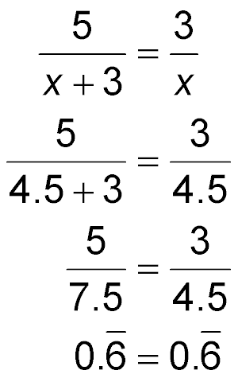
Example 1
Use Cross Products to Solve Equations
Check:
Original equation
Replace x with 4.5.
Simplify.
✓
Divide.

Slide 15


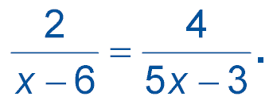
Example 1
Solve
A. 3
B. 0
C. –3
D. 6

Slide 16
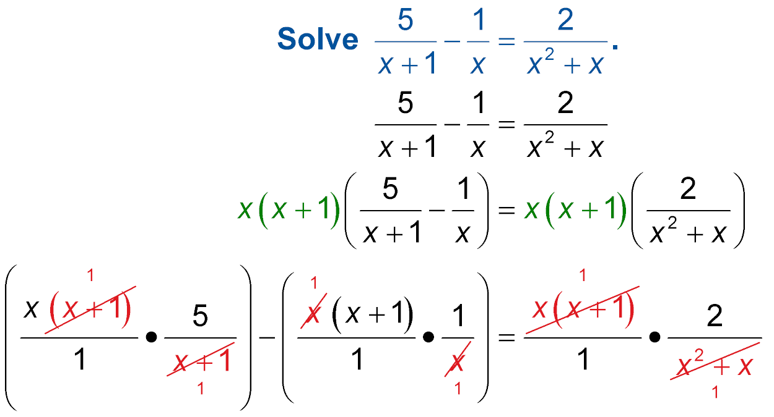
Example 2
Use the LCD to Solve Rational Equations
Solve
The LCD of x and x + 1 is x(x + 1).
Original equation
Multiply by the LCD.

Slide 17
Example 2
Use the LCD to Solve Rational Equations
Distributive Property
5x – (x + 1) = 2
Simplify.
4x – 1 = 2
Subtract.
4x = 3
Add 1 to each side.

Slide 18
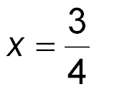
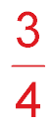
Example 2
Use the LCD to Solve Rational Equations
Divide each side by 4.
Answer:

Slide 19
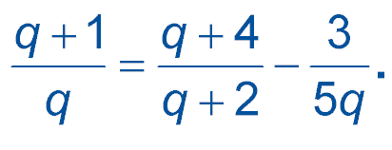
Example 2
Solve
A. 1
B. –2
C. 4
D. 8

Slide 20
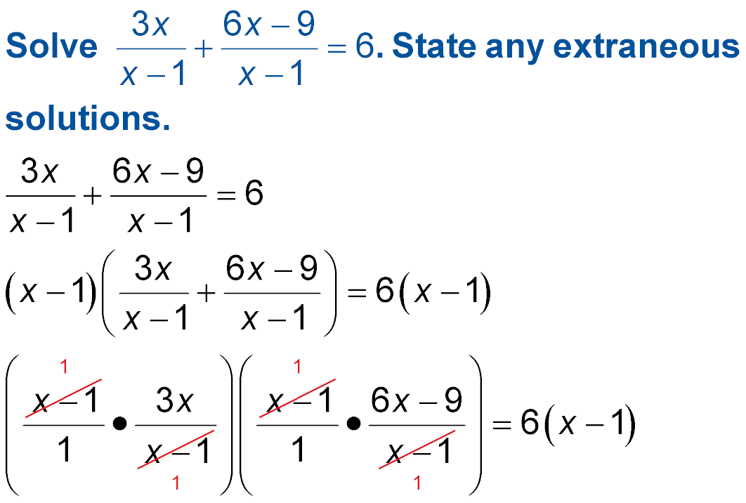
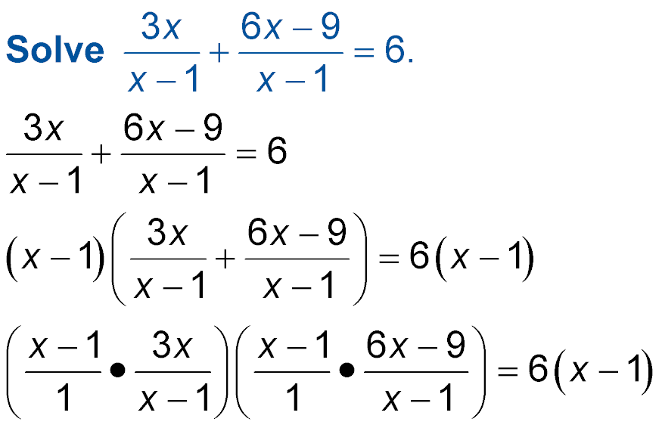
Example 3
Extraneous Solutions
Original equation
Multiply each side by the LCD,
x – 1.

Slide 21
Example 3
Extraneous Solutions
Distributive Property
3x + 6x – 9 = 6x – 6
Simplify.
9x – 9 = 6x – 6
Add like terms.

Slide 22
Example 3
Extraneous Solutions
9x – 6x – 9 = 6x – 6x – 6
Subtract 6x from each side.
3x – 9 + 9 = –6 + 9
Add 9 to each side.
x = 1
Divide by 3.
Since x = 1 results in a zero in the denominator of the original equation, it is an extraneous solution.
Answer: So, the equation has no solution and the extraneous solution is 1.

Slide 23
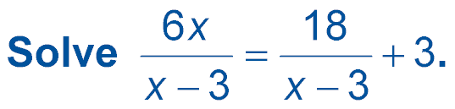
Example 3
A. x = 3
B. x = 9
C. x = 12
D. no solution

Slide 24
Example 4
Work Problem
TV INSTALLATION On Saturdays, Lee helps her father install satellite TV systems. The jobs normally take Lee’s father about 2 hours. But when Lee helps, the jobs only take them 1 hours. If Lee were installing a satellite system herself, how long would the job take?
1
__
2
1
__
2

Slide 25
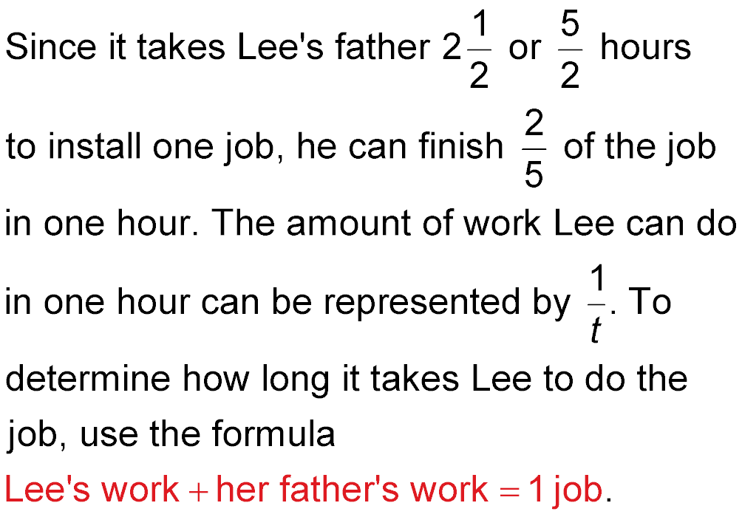
Example 4
Work Problem
Understand
.

Slide 26
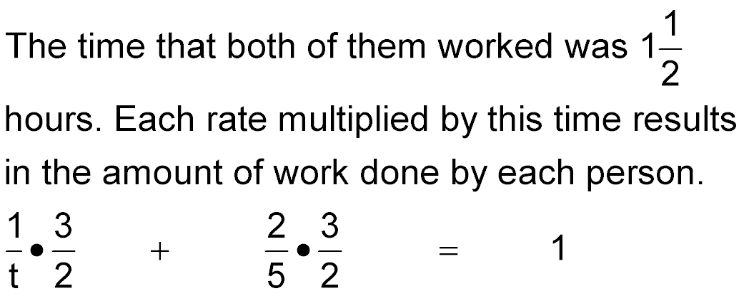

Example 4
Work Problem
Plan
Solve Lee’s her father’s total
work plus work equals work.

Slide 27
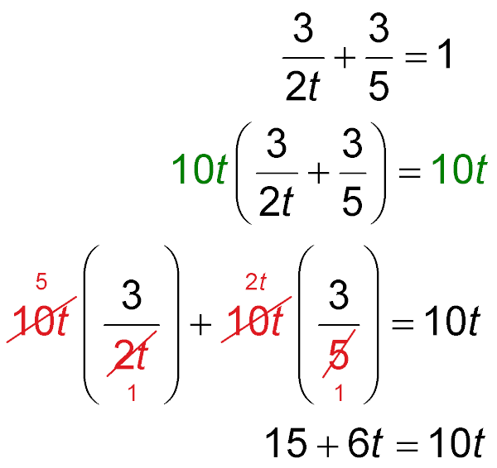
Example 4
Work Problem
Multiply.
The LCD is 10t.
Distributive Property
Simplify.

Slide 28
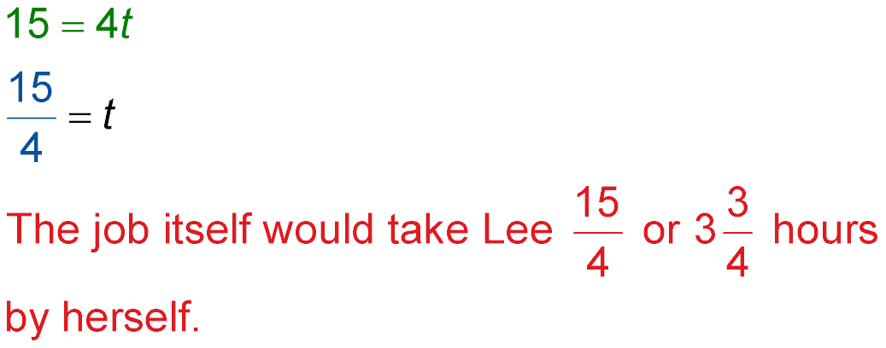
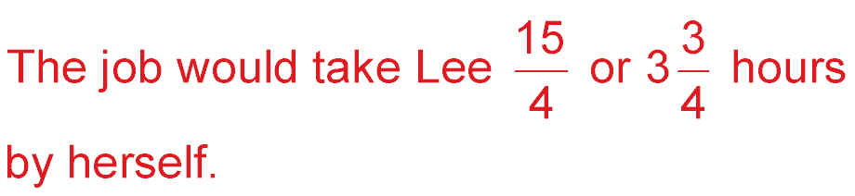
Example 4
Work Problem
Add –6t to each side.
Divide each side by 4.
Answer:

Slide 29
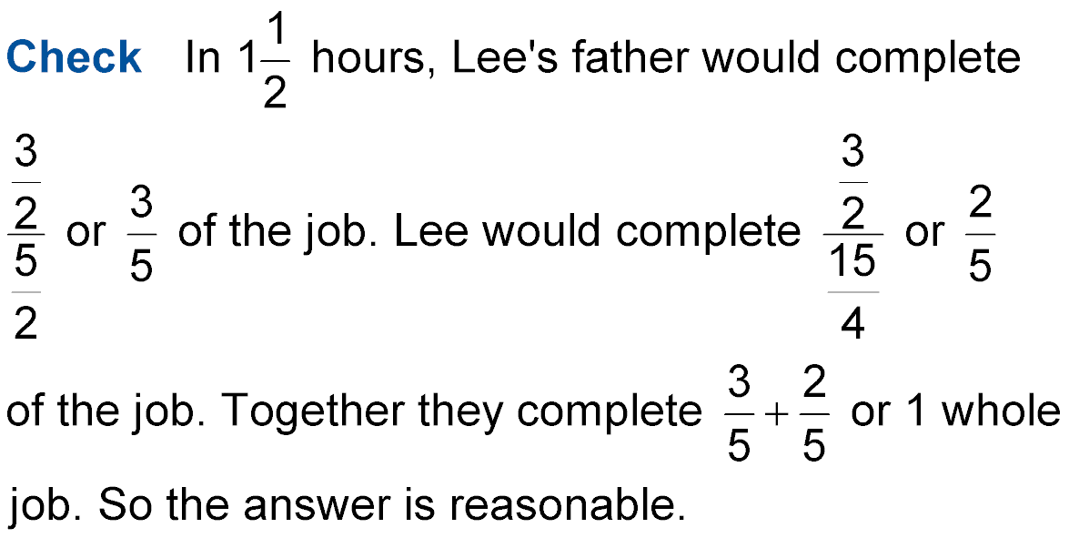
Example 4
Work Problem

Slide 30
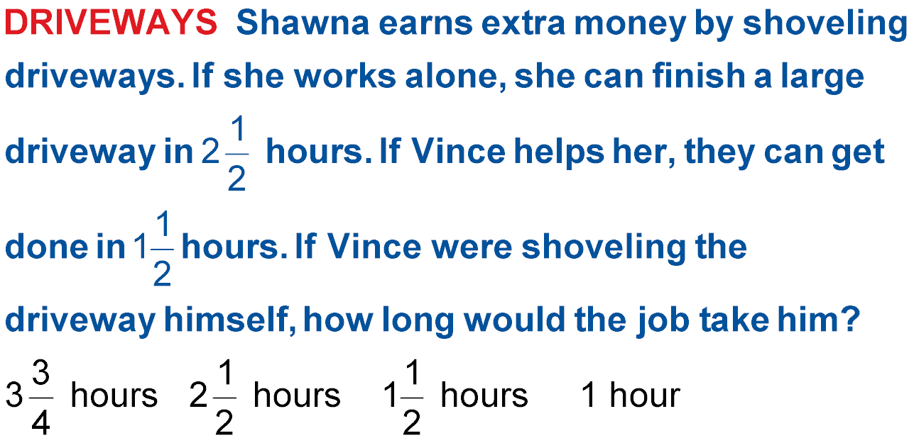
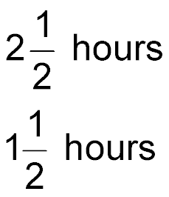
Example 4
A. B.
C. D. 1 hour

Slide 31
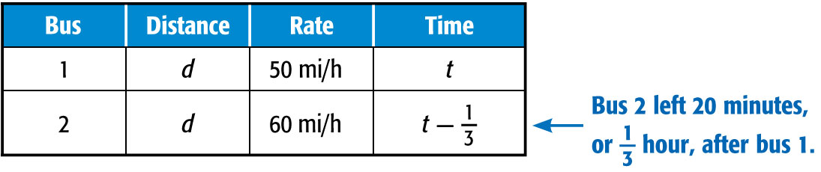
Example 5
Rate Problem
BUS A bus leaves a station and travels an average of 50 miles per hour towards a city. Another bus leaves the same station 20 minutes later and travels to the same city traveling 60 miles per hour. How long will it take the second bus to pass the first bus?
Record the information you know in a table.

Slide 32
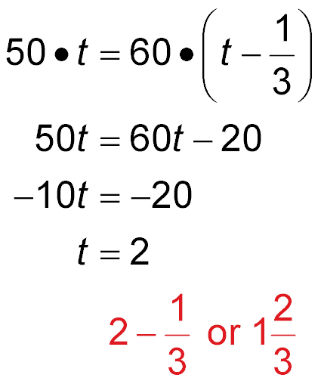
Example 5
Rate Problem
Since both buses will have traveled the same distance when bus 2 passes bus 1, you can write the following equation.
distance = rate ● time
Distributive Property
Subtract 60t from each side.
Divide each side by –10.

Slide 33
Example 5
Rate Problem
Answer: The time it will take the second bus to
pass the first bus is hours after the second bus leaves.

Slide 34
Example 5
TRANSPORTATION Two cyclists are riding on a
5-mile circular bike trail. They both leave the bike trail entrance at 3:00 P.M. traveling in opposite directions. It usually takes the first cyclist one hour to complete the trail and it takes the second cyclist 50 minutes. At what time will they pass each other?
A. 3:27 P.M.
B. 3:30 P.M.
C. 3:50 P.M.
D. 4:00 P.M.

Slide 35
End of the Lesson

