Slide 1


Splash Screen

Slide 2
Lesson Menu
Five-Minute Check (over Chapter 11)
Then/Now
New Vocabulary
Example 1: Real-World Example: Classify a Random Sample
Example 2: Biased and Unbiased Samples
Key Concept: Study Types
Example 3: Classify Study Techniques
Example 4: Biased and Unbiased Survey Questions
Example 5: Real-World Example: Biased and Unbiased Experimental Designs

Slide 3

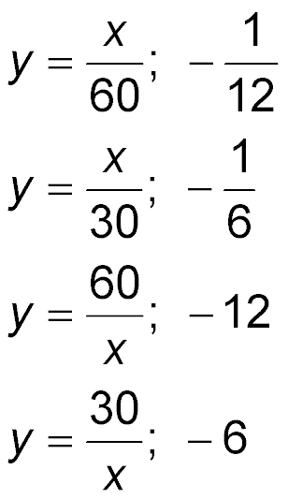
5-Minute Check 1
Write an inverse variation equation that relates
x and y. Assume that y varies inversely as x, and
y = 30 when x = 2. Find y when x = –5.
A.
B.
C.
D.

Slide 4
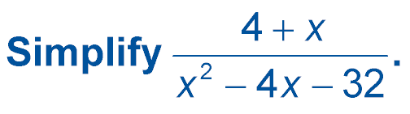

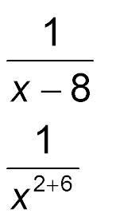
5-Minute Check 2
A.
B.
C. x – 8
D. x + 6

Slide 5
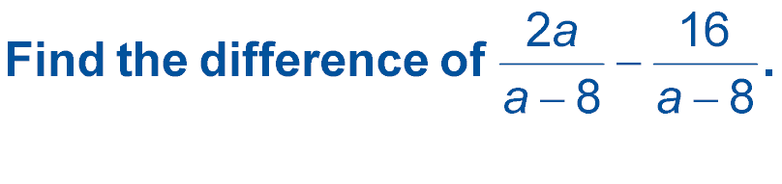

5-Minute Check 3
A. 2a
B. a
C. 2
D. 8

Slide 6

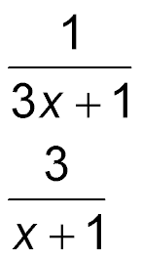
5-Minute Check 4
Find (3x² – 26x – 9) ÷ (x – 9).
A.
B.
C. 3x² – 1
D. 3x + 1

Slide 7

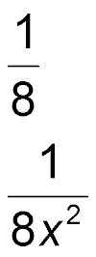
5-Minute Check 5
A container has an amount of water in it described by 16x³. If an amount of dye described by 2x is added to the water, what is the ratio of the dye to the water?
A.
B.
C. 8x
D. 8x²

Slide 8

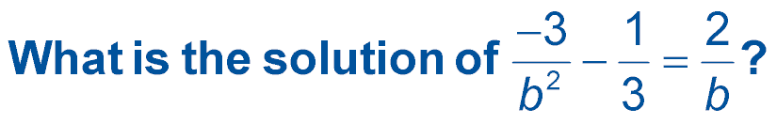
5-Minute Check 6
A. –3
B. –2
C. 3
D. 6

Slide 9


Then/Now
You displayed results from studies.
Classify and analyze samples.
Classify and analyze studies.

Slide 10

Vocabulary
population
sample
simple random sample
systematic sample
self-selected sample
convenience sample
stratified sample
bias
survey
observational study
experiment

Slide 11
Example 1
Classify a Random Sample
A. MOVIES Every fifth person walking out of a movie theater is asked to name their favorite type of movie.
Identify the sample, and suggest a population from which it is selected.
Answer: Sample: every fifth person leaving the theater; population: all moviegoers

Slide 12
Example 1
Classify a Random Sample
B. MOVIES Every fifth person walking out of a movie theater is asked to name their favorite type of movie.
Classify the sample as simple, systematic, self-selected, convenience, or stratified. Explain your reasoning.
Answer: Systematic; members are selected according to a specified interval.

Slide 13


Example 1
WEBSITES Visitors to a Web site are asked to complete a questionnaire about their favorites aspects of the site and what could be done to improve it. Identify the sample, and suggest a population from which it is selected. Classify the sample as simple, systematic, self-selected, convenience, or stratified. Explain your reasoning.
A. Sample: people who complete the questionnaire; Population: people who surf the Web; Self-selected: volunteered to be included
B. Sample: people who complete the questionnaire; Population: people who visit the Web site; Convenience: volunteered to be included
C. Sample: people who complete the questionnaire; Population: people who visit the Web site; Self-selected: volunteered to be included
D. Sample: people who complete the questionnaire; Population: people who surf the Web; Convenience: volunteered to be included

Slide 14
Example 2
Biased and Unbiased Samples
A. STUDENT COUNCIL The student council surveys the students in one classroom to decide the theme for the spring dance.
Identify the sample as biased or unbiased. Explain
your reasoning.
Answer: The sample is biased because the participants are not randomly selected. The sample is selected in one classroom.

Slide 15
Example 2
Biased and Unbiased Samples
B. SCHOOL The Parent Association surveys the parents of every fifth student on the school roster to decide whether to hold a fundraiser.
Identify the sample as biased or unbiased.
Explain your reasoning.
Answer: Unbiased; the parents are picked randomly, and all have an equal chance of being picked.

Slide 16
Example 2
ELECTRONICS An electronics company uses a randomly selected group its employees’ children to test a new product. Identify the sample as biased or unbiased. Explain your reasoning.
A. The sample is unbiased because it represents the population.
B. Biased: everyone in the sample is related to one of the employees of the company and underrepresenting the population.
C. The sample is biased because the company is using children to test the product.
D. The sample is unbiased because it underrepresents the population.

Slide 17
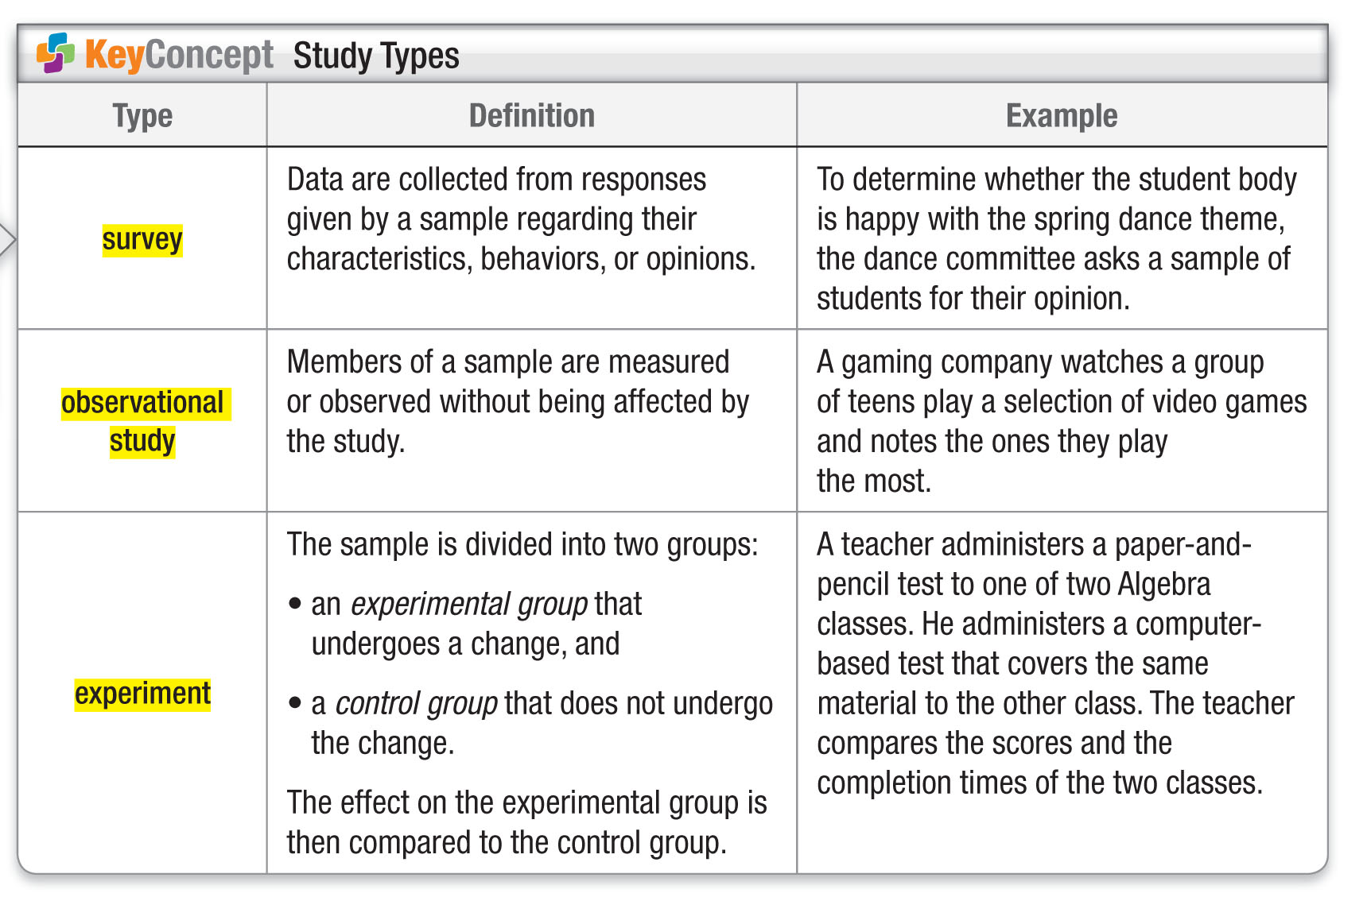
Concept

Slide 18
Example 3
Classify Study Techniques
A. RETAIL A retailer wants to evaluate their performance in customer service. They contact 1000 random customers asking if they would complete an evaluation form. Determine whether this situation describes a survey, an observational study, or an experiment. Explain your reasoning.
Answer: Survey; the data are gathered from responses given by members of the sample.

Slide 19
Example 3
Classify Study Techniques
B. VITAMINS Researchers analyze the reactions of rats to a vitamin. Determine whether this situation describes a survey, an observational study, or an experiment. Explain your reasoning.
Answer: Experiment; rats that did not get the vitamin are the control group and rats that got the vitamin are the experimental group.

Slide 20
Example 3
TELEVISION Researchers analyze the reactions of people to a new type of television screen. Is this a survey, an observational study, or an experiment? Explain your reasoning.
A. Observational Study: The members of the sample are measured or observed without being affected by the study.
B. Experiment: The members of the sample are measured or observed without being affected by the study.
C. Observational Study: The members of the sample are affected by the study.
D. Experiment: The members of the sample are affected by the study.

Slide 21
Example 4
Biased and Unbiased Survey Questions
A. Identify each survey question as biased or unbiased. If biased, explain your reasoning.
How often do you exercise?
Answer: This question is unbiased. It does not encourage participants to answer a certain way, and it is clearly stated.

Slide 22
Example 4
Biased and Unbiased Survey Questions
B. Identify each survey question as biased or unbiased. If biased, explain your reasoning.
Do you like basketball? If so, do you prefer watching high school, college, or professional?
Answer: Biased; the question addresses more than one issue.

Slide 23
Example 4
Identify the survey question as biased or unbiased. If biased, explain your reasoning.
Should the school district offer college courses to qualified high school students for free?
A. biased; the question encourages the members of the sample to answer a certain way
B. biased; the question is confusing
C. biased; the question causes a strong reaction
D. unbiased

Slide 24
Example 5
Biased and Unbiased Experimental Designs
BASEBALL A baseball bat manufacturer wants to test a new grip on their bats. They select 75 high school baseball players to try out the bat with the new grips and 75 other players to try out the old grips. Identify the experiment as biased or unbiased. If biased, explain your reasoning.
Answer: Biased; members of the control group and the experimental group are not randomly selected.

Slide 25
Example 5
DRUGS A research team wants to test a new anti-balding drug. They select 50 randomly chosen men to try the drug and give 50 other randomly chosen balding men a placebo. Identify the experiment as biased or unbiased.
A. unbiased
B. biased; the men are not randomly chosen
C. biased; the drug is not the only difference between the groups
D. biased; the men in the sample should already be bald

Slide 26
End of the Lesson

