Slide 1


Splash Screen

Slide 2
Lesson Menu
Five-Minute Check (over Lesson 12–1)
CCSS
Then/Now
New Vocabulary
Example 1: Statistics and Parameters
Key Concept: Mean Absolute Deviation
Example 2: Mean Absolute Deviation
Key Concept: Standard Deviation
Example 3: Variance and Standard Deviation
Example 4: Compare Two Sets of Data

Slide 3

5-Minute Check 1
HEALTH CLUBS At a heath club, a random sample of members are asked some questions about dieting. Classify the sample as simple, systematic, self-selected, convenience, or stratified.
A. simple
B. systematic
C. self-selected
D. convenience

Slide 4

5-Minute Check 2
ELECTIONS At a shopping mall, every 10th shopper is asked some questions about the upcoming election. Classify the sample as simple, systematic, self-selected, convenience, or stratified.
A. simple
B. systematic
C. self-selected
D. convenience

Slide 5

5-Minute Check 3
MUSIC At a rock concert, a random sample of people is asked the type of music they prefer. Is the sample biased or unbiased? Explain your reasoning.
A. biased; The participants are randomly selected
B. biased; The participants are selected at a rock concert, which will influence their answers.
C. unbiased; The participants are randomly selected.
D. unbiased; The participants are selected at a rock concert, so their answers will not be influenced.

Slide 6

5-Minute Check 4
GOLF Every fifth person leaving a golf course is asked his of her favorite summertime activity. Is the sample biased or unbiased? Explain your reasoning.
A. biased; The participants are selected at a golf course, which will influence their answers.
B. biased; The participants are randomly selected.
C. unbiased; Every fifth person is selected.
D. unbiased; The participants are randomly selected.

Slide 7

5-Minute Check 5
TELEVISION The management of a detention center alters the colors of their walls then compares the behaviors of their kids with the kids where the colors were not changed. Determine whether the situation describes a survey, an observational study, or an experiment. Explain your reasoning.
A. observational study; the kids are unaffected by the study
B. observational study; the kids are affected by the study
C. experiment; the kids are divided into two groups where one group is affected by the study
D. experiment; the kids are divided into two groups but neither group is affected by the study

Slide 8

CCSS
Content Standards
S.ID.2 Use statistics appropriate to the shape of the data distribution to compare center (median, mean) and spread (interquartile range, standard deviation) of two or more different data sets.
Mathematical Practices
2 Reason abstractly and quantitatively.
6 Attend to precision.
Common Core State Standards © Copyright 2010. National Governors Association Center for Best Practices and Council of Chief State School Officers. All rights reserved.

Slide 9


Then/Now
You analyzed data collection techniques.
Identify sample statistics and population parameters.
Analyze data sets using statistics.

Slide 10

Vocabulary
statistical inference
statistic
parameter
mean absolute deviation (MAD)
standard deviation
variance

Slide 11
Example 1
Statistics and Parameters
A. Identify the sample and the population for each situation. Then describe the sample statistic and the population parameter.
A movie rental business selects a random sample of 50 orders in one day. The median number of rentals per order is calculated.
Answer: sample: 50 movie orders; population: all movie orders for the day of the sample; sample statistic: mean number of rentals per order in the sample; population parameter: mean number of rentals per order for all rentals the day of the sample

Slide 12
Example 1
Statistics and Parameters
B. Identify the sample and the population for each situation. Then describe the sample statistic and the population parameter.
A stratified random sample of 2 trees of each species is selected from all trees at a nursery. The mean height of trees in the sample is calculated.
Answer: sample: 2 trees of each species found at the nursery; population: all trees at the nursery; sample statistic: mean height of trees in the sample; population parameter: mean height of all trees at the nursery

Slide 13


Example 1
A company’s human resources department surveyed the employees about working conditions. Identify the sample and the population. Then describe the sample statistic and the population parameter.
A. sample: employees who responded; population: all employees; statistic: mean satisfaction of sample; parameter: mean satisfaction of all employees
B. sample: employees who responded; population: all employees; statistic: mean satisfaction of all employees; parameter: mean satisfaction of sample
C. sample: all employees; population: employees who responded; statistic: mean satisfaction of sample; parameter: mean satisfaction of all employees
D. sample: all employees; population: employees who responded; statistic: mean satisfaction of all employees; parameter: mean satisfaction of sample

Slide 14
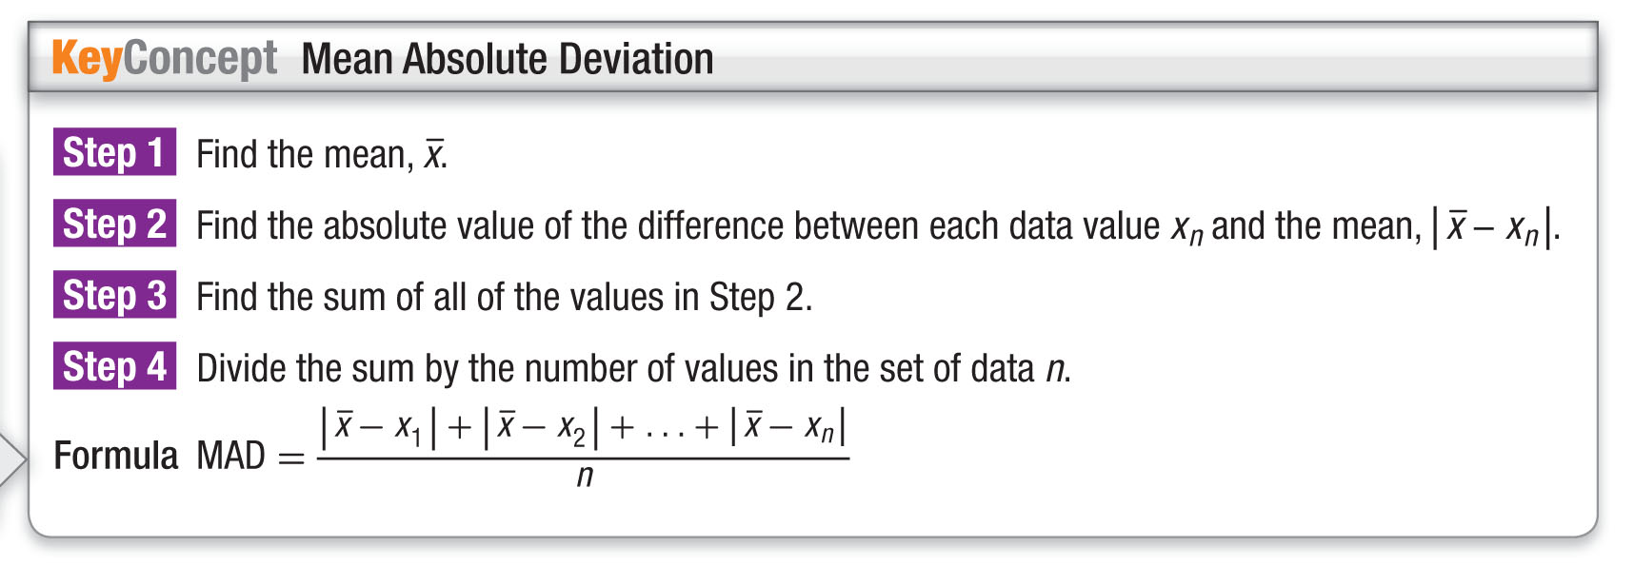
Concept

Slide 15
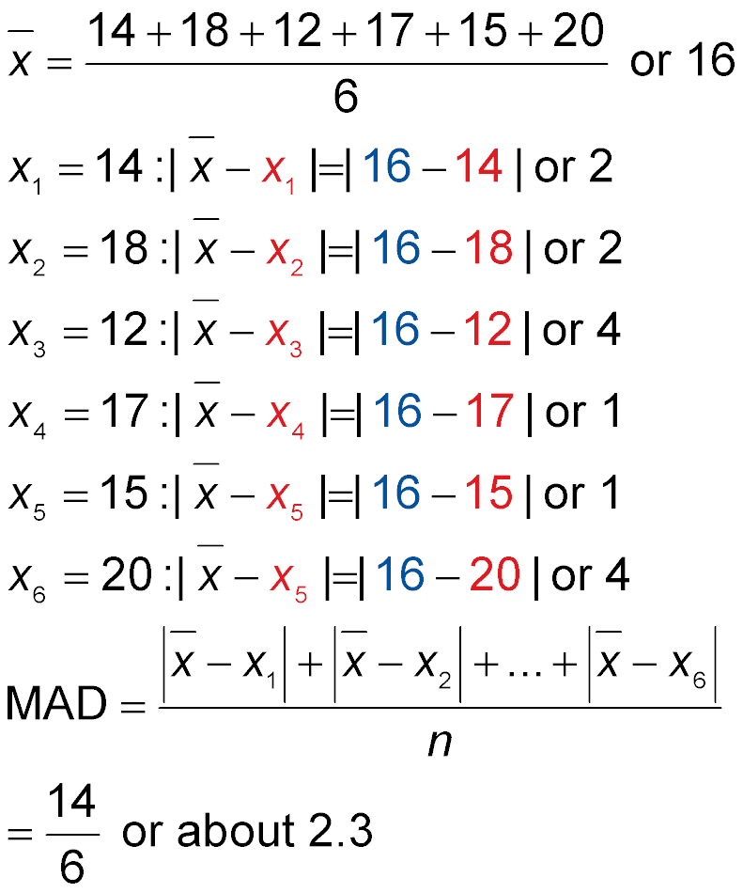
Example 2
Mean Absolute Deviation
PETS A rescue agency records the number of pets adopted each month: {14, 18, 12, 17, 15, 20}. Find and interpret the mean absolute deviation.
Step 1
Find the mean.
Step 2
Find the absolute values of the differences.

Slide 16
Example 2
Mean Absolute Deviation
Step 2
Find the absolute values of the differences.

Slide 17
Example 2
Mean Absolute Deviation
Step 3
Find the sum.
2 + 2 + 4 + 1 + 1 + 4 = 14
Step 4
Find the mean absolute deviation.
Formula for Mean Absolute Deviation
The sum is 14 and
n = 6.

Slide 18
Example 2
Mean Absolute Deviation
Answer: A mean absolute deviation of 2.3 indicates that, on average, the monthly number of pets adopted each month is about 2.3 pets from the mean of 16 pets.

Slide 19
Example 2
FOOTBALL A statistician reviewed the number of points his high school team gave up at their home games this season: {14, 0, 20, 24, 17, 30}. Find and interpret the mean absolute deviation.
A. The team gave up an average of 7.2 points per game.
B. On average, the number of points given up was about 7.2 away from the mean of 17.5 points. This is affected by the outliers 24 and 30.
C. On average, the number of points given up was about 7.2 away from the mean of 17.5 points.
D. On average, the team gave up 17.5 points per game.

Slide 20
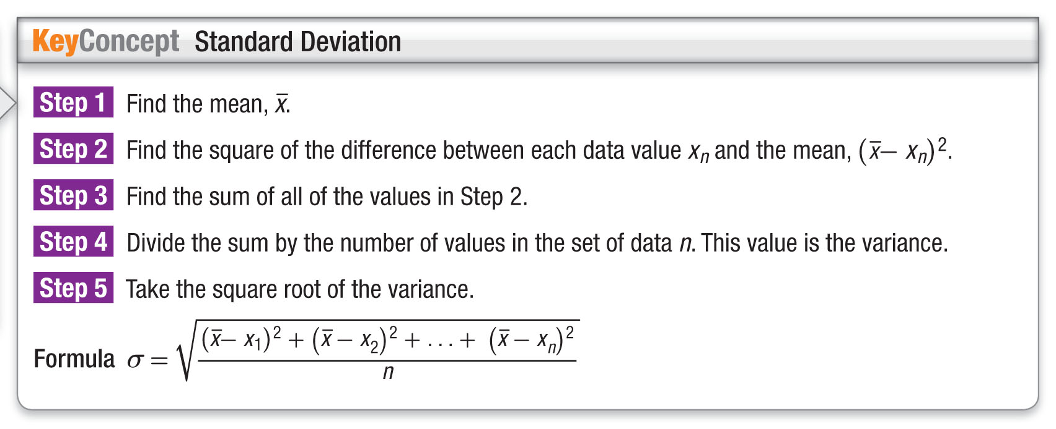
Concept

Slide 21
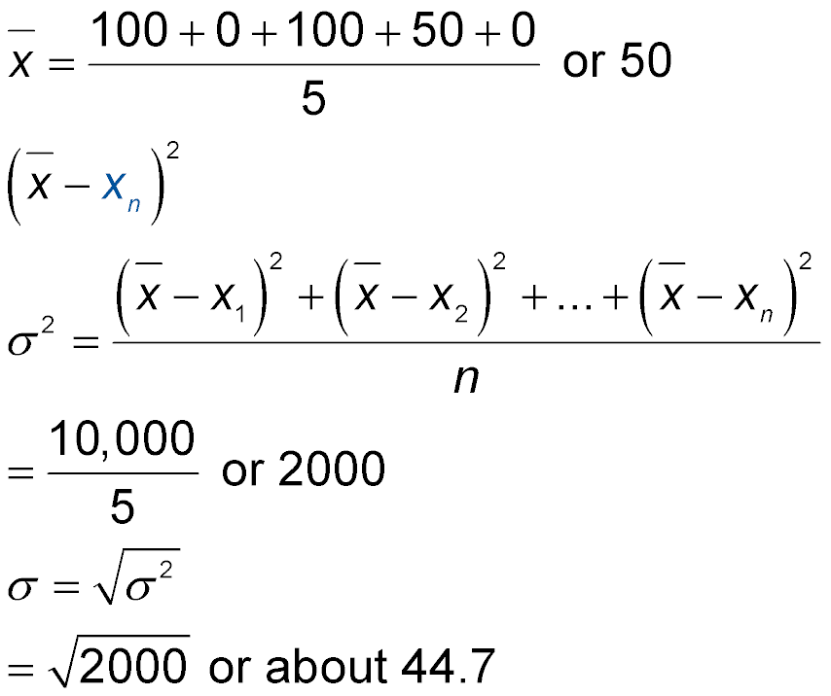
Example 3
Variance and Standard Deviation
SCORES Leo tracked his homework scores for the past week: {100, 0, 100, 50, 0}. Find and interpret the standard deviation of the data set.
Step 1
Find the mean.

Slide 22
Example 3
Variance and Standard Deviation
Step 2
Find the square of the differences, .
(100 – 50)² = 2500
(0 – 50)² = 2500
(100 – 50)² = 2500
(50 – 50)² = 0
(0 – 50)² = 2500
Step 3
Find the sum.
2500 + 2500 + 2500 + 0 + 2500 = 10,000

Slide 23
Example 3
Variance and Standard Deviation
Step 4
Find the variance.
Formula for Variance
The sum is 10,000 and
n = 5.

Slide 24
Example 3
Variance and Standard Deviation
Step 5
Find the standard deviation.
Square Root of the Variance
Answer: A standard deviation very close to the mean suggests that the data deviate quite a bit. Most of Leo’s scores are far away from the mean of 50.

Slide 25
Example 3
FIGURE SKATING The scores that Jenny received from the judges: {6.0, 5.5, 5.5, 6.0, 5.0, 5.5, 5.5, 6.0}. Find and interpret the standard deviation of the data set.
A. A standard deviation of 0.33 which is very close to the mean suggests that most of Jenny’s scores are close to the mean of 5.625.
B. A standard deviation of 0.33 which is far from the mean suggests that most of Jenny’s scores are far away from the mean of 5.625.
C. A standard deviation of 0.33 which is not close to the mean suggests that most of Jenny’s scores are close to the mean of 5.625.
D. A standard deviation of 0.33 which is very close to the mean suggests that most of Jenny’s scores are far away from the mean of 5.625.

Slide 26
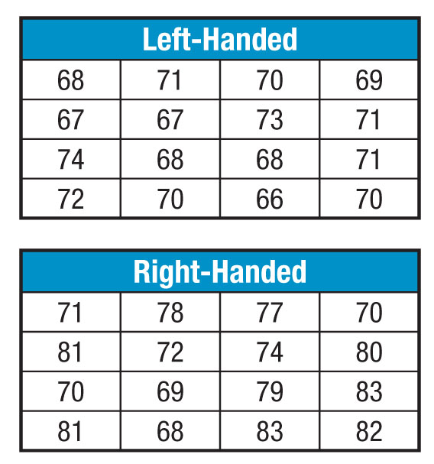
Example 4
Compare Two Sets of Data
BASEBALL Kyle can throw a baseball left-handed or right-handed. Below are the speeds in miles per hour of 16 throws from each hand. Compare the means and standard deviations.

Slide 27



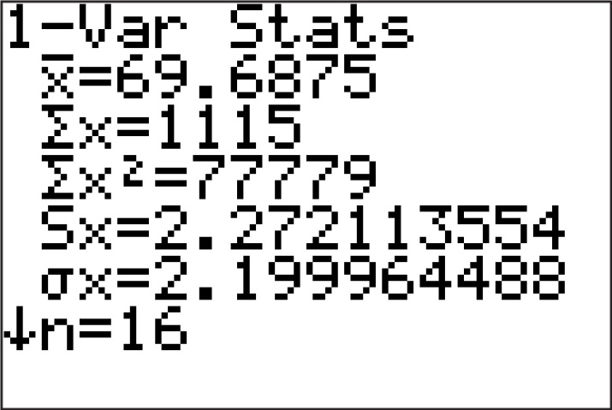
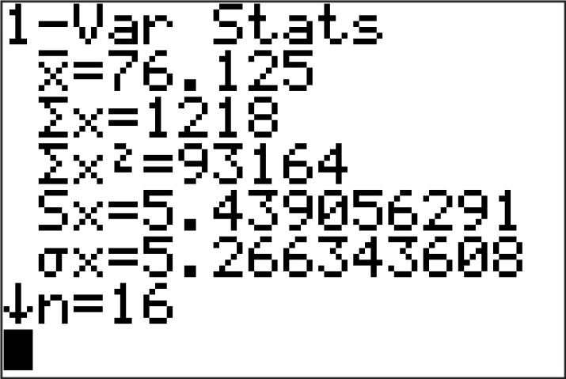
Example 4
Compare Two Sets of Data
Use a graphing calculator to find the mean and standard deviation. Clear all lists. Then press STAT ENTER, and enter each data value into L1. To view the statistics, press STAT 1 ENTER .
Left-Handed
Right-Handed

Slide 28
Example 4
Compare Two Sets of Data
Sample Answer: The left-handed throws had a mean of about 69.7 miles per hour with a standard deviation of about 2.2. The right-handed throws had a mean of about 76.1 miles per hour with a standard deviation of about 5.3. While the right-handed throws had a higher average speed, there was also greater variability in the speeds of the throws.

Slide 29
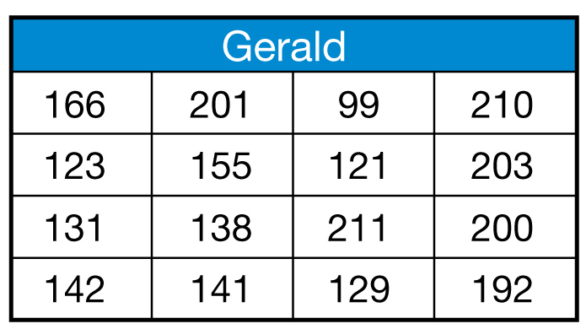
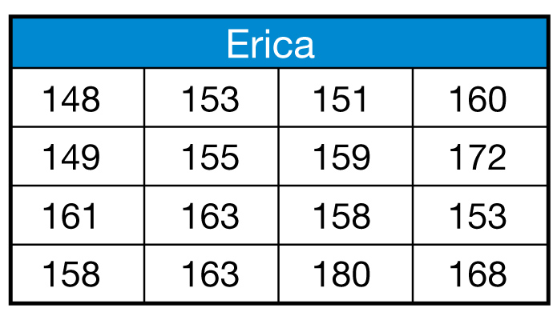
Example 4
BOWLING Gerald and Erica compared their bowling scores. Compare the means and standard deviations.
A. Gerald: 160.1, 36.1; Erica: 159.4, 8.3; Their averages were almost identical, but Gerald was more consistent.
B. Gerald: 160.1, 36.1; Erica: 159.4, 8.3; Their averages were almost identical, but Erica was more consistent.
C. Gerald: 160.1, 36.1; Erica: 159.4, 8.3; Gerald had a much higher average, but Erica was more consistent.
D. Gerald: 160.1, 36.1; Erica: 159.4, 8.3; Gerald had a much higher average and was more consistent.

Slide 30
End of the Lesson

