Slide 1


Splash Screen

Slide 2
Lesson Menu
Five-Minute Check (over Lesson 12–2)
CCSS
Then/Now
New Vocabulary
Key Concept: Symmetric and Skewed Distributions
Example 1: Distribution Using a Histogram
Key Concept: Symmetric and Skewed Box-and-Whisker Plots
Example 2: Distribution Using a Box-and-Whisker Plot
Example 3: Choose Appropriate Statistics
Example 4: Real-World Example: Choose Appropriate Statistics

Slide 3

5-Minute Check 1
BICYCLING A random sample of 100 bicyclists is surveyed about their average miles traveled per bike ride. Identify the sample and the population for each situation. Then describe the sample statistic and the population parameter.
A. sample: all bicyclists; population: 100 bicyclists; sample statistic: the average miles per ride traveled by all bicyclists; population parameter: the average miles per ride traveled by the sample
B. sample: 100 bicyclists; population: all bicyclists; sample statistic: the average miles per ride traveled by the sample; population parameter: the average miles per ride traveled by all bicyclists
C. sample: 100 bicyclists; population: all bicyclists; sample statistic: the total miles traveled by all bicyclists; population parameter: the total miles traveled by the sample
D. sample: all bicyclists; population: 100 bicyclists; sample statistic: the total miles traveled by the sample; population parameter: the total miles traveled by all bicyclists

Slide 4

5-Minute Check 2
COMMUTING A random sample of 200 commuters is asked for the average amount of time it takes them to commute to work. Identify the sample and the population for each situation. Then describe the sample statistic and the population parameter.
A. sample: 200 commuters; population: all commuters; sample statistic: the average time to commute to work for the sample; population parameter: the average time to commute to work for all commuters
B. sample: all commuters; population: 200 commuters; sample statistic: the average time to commute to work for all commuters; population parameter: the average time to commute to work for the sample
C. sample: the average time to commute to work for the sample; population: the average time to commute to work for all commuters; sample statistic: 200 commuters; population parameter: all commuters
D. sample: the average time to commute to work for all commuters; population: the average time to commute to work for the sample; sample statistic: all commuters; population parameter: 200 commuters

Slide 5

5-Minute Check 3
EDUCATION A stratified random sample of 550 adults is asked how they plan on voting on the upcoming school levy. Identify the sample and the population for each situation. Then describe the sample statistic and the population parameter.
A. sample: number of votes for “yes” for all of the adults in the district; population: number of votes for “yes” from the sample; sample statistic: all adults within the school district; population parameter: 550 adults
B. sample: number of votes for “yes” from the sample; population: number of votes for “yes” for all of the adults in the district; sample statistic: 550 adults; population parameter: all adults within the school district
C. sample: all adults within the school district; population: 550 adults; sample statistic: number of votes for “yes” for all of the adults in the district; population parameter: number of votes for “yes” from the sample
D. sample: 550 adults; population: all adults within the school district; sample statistic: number of votes for “yes” from the sample; population parameter: number of votes for “yes” for all of the adults in the district

Slide 6

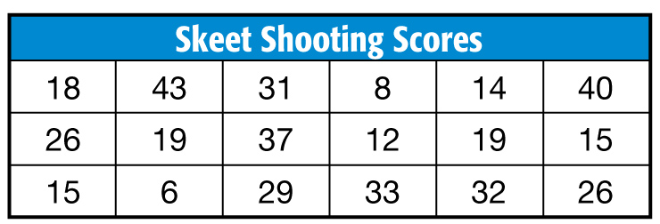
5-Minute Check 4
SKEET SHOOTING A skeet shooting coach tracked the scores of her students at the first practice. Find and interpret the mean absolute deviation.
A. 11.1; On average, each student’s score is 11.1 away from the mean of 23.5.
B. 10.8; On average, each student’s score is 10.8 away from the mean of 23.5.
C. 9.5; On average, each student’s score is 9.5 away from the mean of 23.5.
D. 23.5; On average, each student’s score is 23.5 away from the mean of 18.

Slide 7

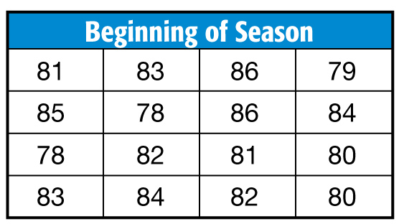
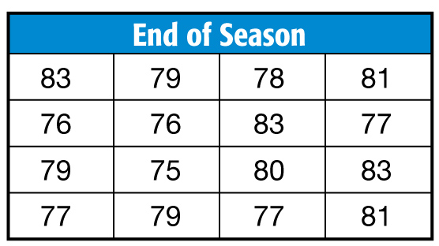
5-Minute Check 5
GOLF The golf coach wants to compare the students’ scores at the end of the season with their scores at the beginning of the season. Compare the means and standard deviations of each set of data.
A. The students performed the same at the beginning and end of the season.
B. The students had higher scores at the end of the season.
C. The students had lower scores and were more consistent at the end of the season.
D. The students had lower scores and had the same consistency at the end of the season

Slide 8

CCSS
Content Standards
S.ID.2 Use statistics appropriate to the shape of the data distribution to compare center (median, mean) and spread (interquartile range, standard deviation) of two or more different data sets.
S.ID.3 Interpret differences in shape, center, and spread in the context of the data sets, accounting for possible effects of extreme data points (outliers).
Mathematical Practices
5 Use appropriate tools strategically.
Common Core State Standards © Copyright 2010. National Governors Association Center for Best Practices and Council of Chief State School Officers. All rights reserved.

Slide 9


Then/Now
You calculated measures of central tendency and variation.
Describe the shape of a distribution.
Use the shapes of distributions to select appropriate statistics.

Slide 10

Vocabulary
distribution
negatively skewed
distribution
symmetric distribution
positively skewed
distribution

Slide 11
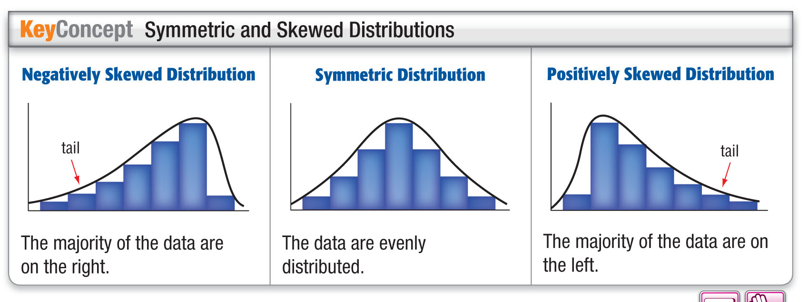
Concept

Slide 12



Example 1
Distribution Using a Histogram
Use a graphing calculator to construct a histogram for the data, and use it to describe the shape of the distribution.
9, 18, 22, 12, 24, 25, 19, 25, 2
5, 28, 12, 22, 19, 28, 15, 23, 6
8, 27, 17, 14, 22, 21, 13, 24, 21
9, 25, 16, 24, 16, 25, 27, 21, 10
First, press and enter each data value. Then, press [STAT PLOT]
and choose „. Finally, adjust the window to the dimensions shown.

Slide 13
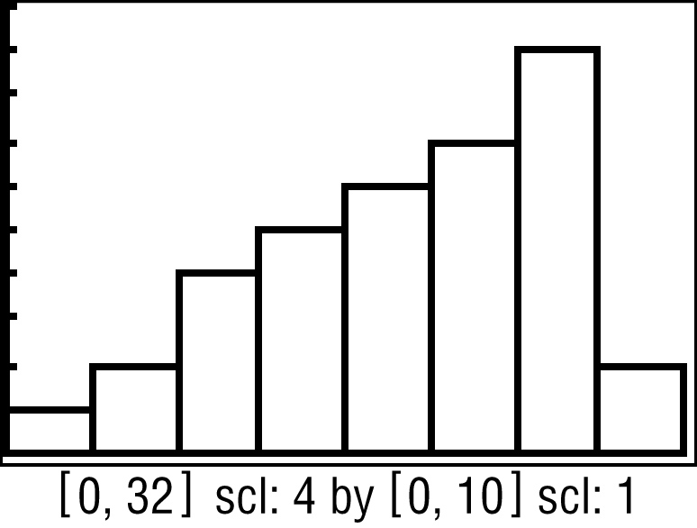
Example 1
Distribution Using a Histogram
Answer: The distribution is negatively skewed.

Slide 14


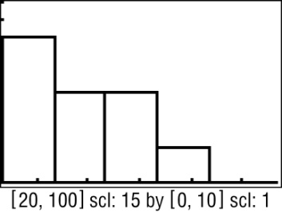
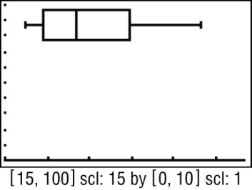
Example 1
Use a graphing calculator to construct a histogram for the data, and use it to describe the shape of the distribution.
22, 25, 35, 38, 42, 23, 46, 49, 56, 57, 26, 28, 32, 31, 30, 62, 69, 78, 85, 62
A. The distribution is
negatively skewed.
B. The distribution is
positively skewed.
C. The distribution is
symmetric.
D. The distribution is
negatively skewed.

Slide 15
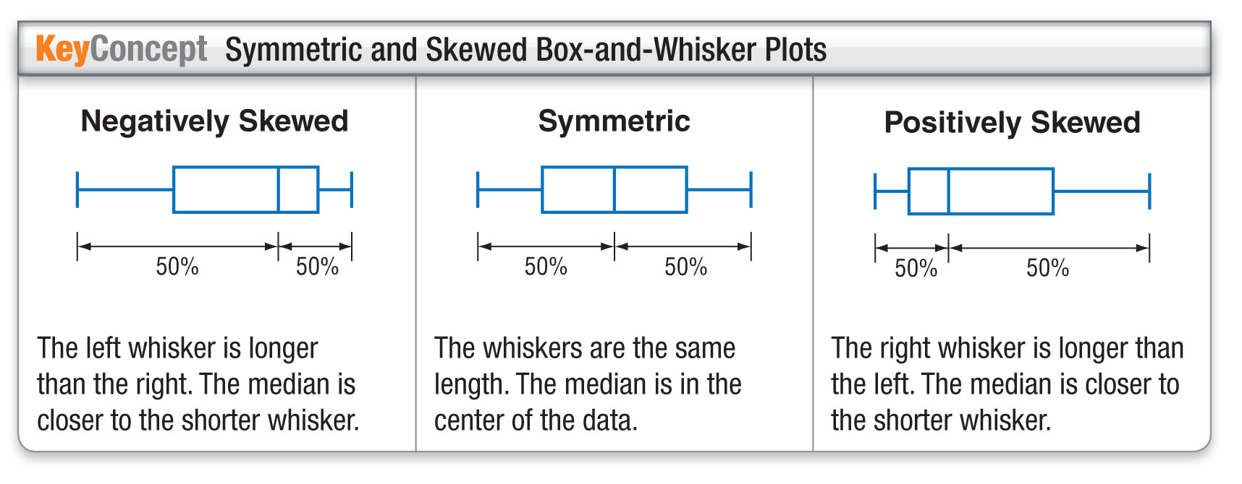
Concept

Slide 16
Example 2
Distribution Using a Box-and-Whisker Plot
Use a graphing calculator to construct a box-and-whisker plot for the data, and use it to determine the shape of the distribution.
9, 18, 22, 12, 24, 25, 19, 25, 2
5, 28, 12, 22, 19, 28, 15, 23, 6
8, 27, 17, 14, 22, 21, 13, 24, 21
9, 25, 16, 24, 16, 25, 27, 21, 10
Enter the data as L1. Press [STAT PLOT] ENTER ENTER and choose ﬂ. Adjust the window to the dimensions shown.

Slide 17
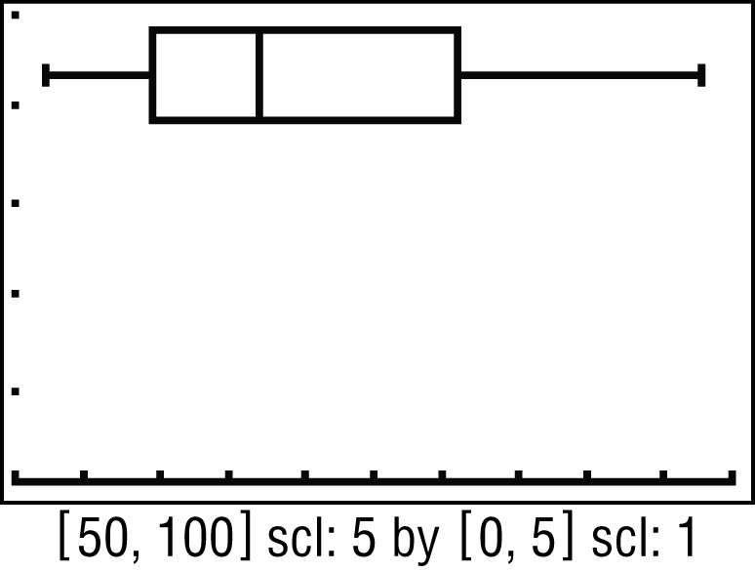
Example 2
Distribution Using a Box-and-Whisker Plot
Answer: The right whisker is longer than the left, and the median is to the left of the plot. This indicates that the data are distributed more to the left of the median. Thus, the distribution is positively skewed.

Slide 18
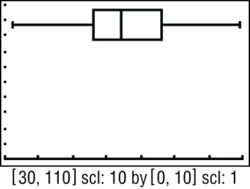
Example 2
Use a graphing calculator to construct a box-and-whisker plot for the data, and use it to determine the shape of the distribution.
65, 65, 66, 57, 53, 43, 56, 56, 78, 81, 68, 64, 86, 79, 74, 41, 32, 99, 62, 63
A. symmetric
B. positively skewed
C. negatively skewed
D. clustered

Slide 19
Example 3
Choose Appropriate Statistics
Describe the center and spread of the data using either the mean and standard deviation or the five-number summary. Justify your choice by constructing a histogram for the data.
78, 68, 72, 71, 79, 67, 71, 78, 70
80, 76, 82, 82, 70, 84, 72, 71, 85
67, 86, 74, 86, 73, 72, 77, 87, 70
66, 88, 75, 72, 76, 71, 90, 69, 94
Use a graphing calculator to create a histogram. The graph is high on the left and low on the right. Therefore, the distribution is skewed. Use the five-number summary. The range is 94 – 66 or 28. The median is 74.5, and half of the data are between 71 and 82.

Slide 20
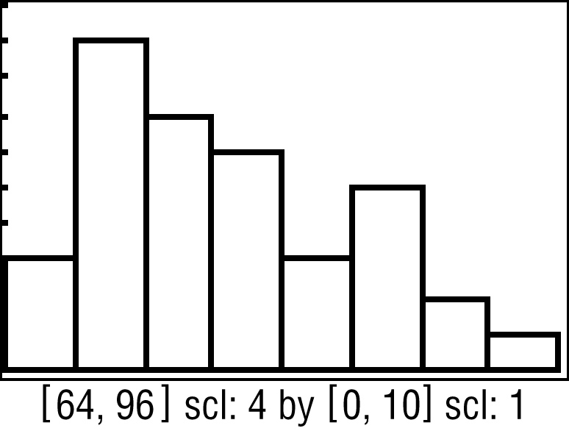
Example 3
Choose Appropriate Statistics
Answer: The range is 94 – 66 or 28. The median is 74.5, and half of the data are between 71 and 82.

Slide 21
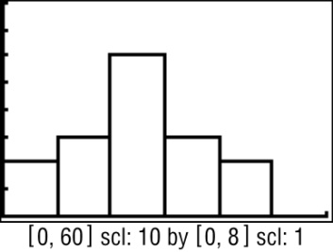
Example 3
Describe the center and spread of the data using either the mean and standard deviation or the five-number summary. Justify your choice by constructing a histogram for the data.
24, 24, 36, 44, 25, 27, 8, 18, 17, 33, 25, 26, 35, 47, 18, 9
A. The range is 47 – 8 or 39. The median is 25, and half of the data are between 18 and 34.
B. The mean is 26 with a standard deviation of about 10.7.
C. The mean is about 10.7 with a
standard deviation of about 26.
D. The range is 16. The median is
26, and half of the data are
between 8 and 47.

Slide 22
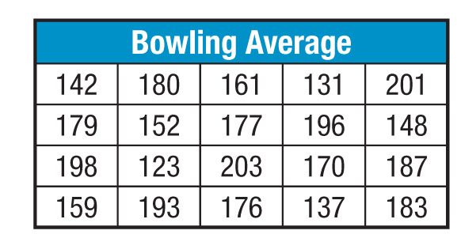
Example 4
Choose Appropriate Statistics
BOWLING The averages for the bowlers on five teams are shown below. Describe the center and spread of the data using either the mean and standard deviation or the five-number summary. Justify your choice by constructing a box-and-whisker plot for the data.

Slide 23
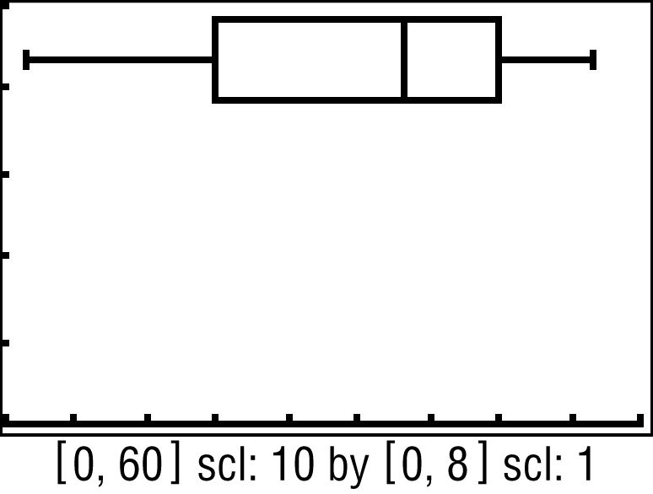
Example 4
Choose Appropriate Statistics
Use a graphing calculator to create a box-and-whisker plot. The right whisker is longer than the left and the median is closer to the left whisker. Therefore, the distribution is positively skewed.
[120, 210] scl: 10 by [0, 5] scl: 1

Slide 24
Example 4
Choose Appropriate Statistics
Answer: The distribution is skewed, so use the
five-number summary. The range is
203 – 123 or 80. The median bowling average is 176.5, and half of the bowlers have an average between 150 and 190.

Slide 25
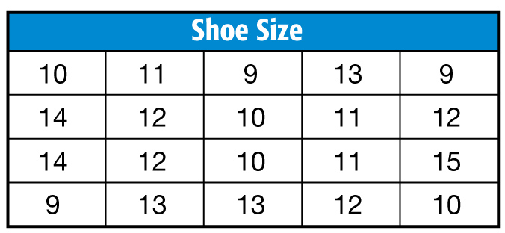
Example 4
SHOES The shoe sizes for a group of men are shown below. Describe the center and spread of the data using either the mean and standard deviation or the five-number summary. Justify your choice by constructing a box-and-whisker plot for the data.

Slide 26
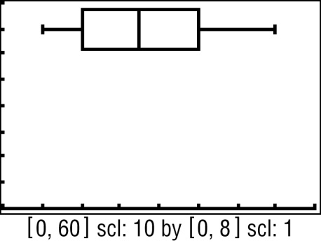
Example 4
A. The range is 6. The median is 11.5, and half of the data are between 10 and 13.
B. The mean is about 1.7 with
a standard deviation of about 11.5.
C. The range is 3. The median
is 11.5, and half of the data are between 9 and 15.
D. The mean is about 11.5 with
a standard deviation of about 1.7.
[8, 16] scl: 1 by [0, 8] scl: 1
[8, 16] scl: 1 by [0, 8] scl: 1
[8, 16] scl: 1 by [0, 8] scl: 1
[8, 16] scl: 1 by [0, 8] scl: 1

Slide 27
End of the Lesson

