Slide 1


Splash Screen

Slide 2
Lesson Menu
Five-Minute Check (over Lesson 12–3)
CCSS
Then/Now
New Vocabulary
Key Concept Transformations Using Addition
Example 1: Transformation Using Addition
Key Concept: Transformation Using Multiplication
Example 2: Transformation Using Multiplication
Example 3: Compare Data Using Histograms
Example 4: Real-World Example: Compare Data Using Box-and-Whisker Plots

Slide 3

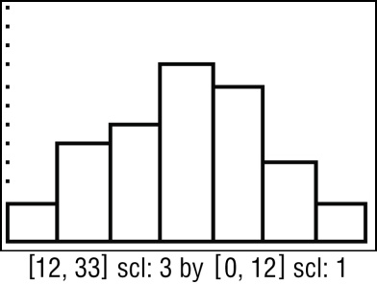
5-Minute Check 1
Use a graphing calculator to construct a histogram for the
data. Then describe the shape of the distribution.
12, 14, 28, 24, 21, 22, 26, 19, 29, 26, 21, 26, 21, 30, 15, 24, 17, 19, 30, 22, 15, 20, 20, 21, 18, 24, 25, 28, 29, 21, 16, 15, 26, 21, 22, 20
A. positively skewed
B. negatively skewed
C. symmetrical
D. clustered

Slide 4

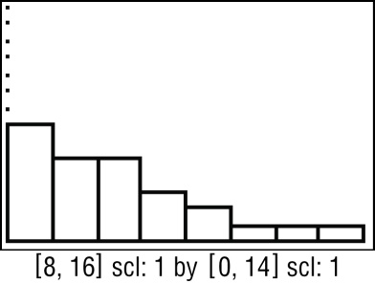
5-Minute Check 2
Use a graphing calculator to construct a histogram for the data. Then describe the shape of the distribution.
8, 8, 14, 15, 8, 8, 9, 9, 9, 10, 10, 11, 10, 10, 11, 11, 12, 10, 12, 13, 8, 9, 9, 8, 8
A. positively skewed
B. negatively skewed
C. symmetrical
D. clustered

Slide 5

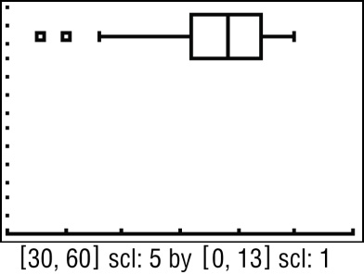
5-Minute Check 3
Use a graphing calculator to construct a box-and-whisker plot for the data. Then describe the shape of the distribution.
45, 45, 46, 46, 48, 48, 47, 49, 48, 50, 52, 52, 51, 55, 54, 54, 55, 51, 40, 48, 47, 35, 33, 35, 38, 48, 49, 55, 53, 53, 52, 55, 51, 50
A. positively skewed
B. negatively skewed
C. symmetrical
D. clustered

Slide 6

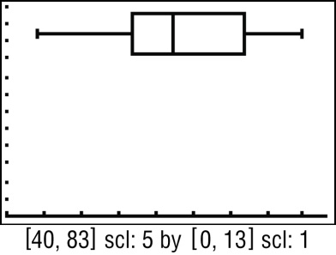
5-Minute Check 4
Use a graphing calculator to construct a box-and-whisker plot for the data. Then describe the shape of the distribution.
53, 53, 44, 45, 78, 79, 78, 80, 48, 52, 62, 50, 61, 62, 63, 72, 73, 73, 74, 72, 73, 62, 61, 56, 57, 58, 57, 58, 57, 59, 65, 66, 66, 67, 68, 67, 68, 69
A. positively skewed
B. negatively skewed
C. symmetrical
D. clustered

Slide 7

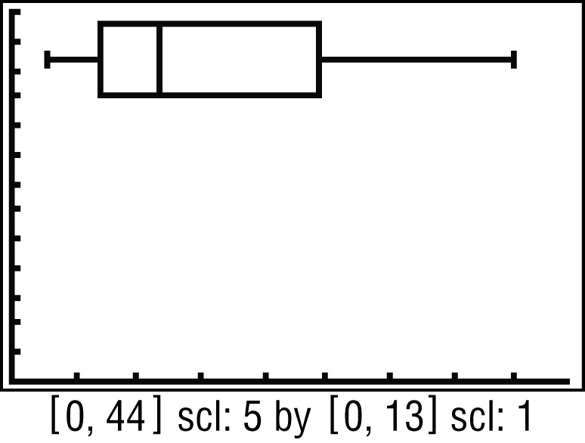
5-Minute Check 5
SOCCER The total number of minutes played in a game by all of the members of an indoor soccer team is shown. Determine the shape of the distribution and describe the center and spread of the data using either the mean and standard deviation or the five-number summary. Use the box-and-whisker plot for the data to justify your choice.
4, 3, 8, 12, 9, 11, 14, 5, 10, 6, 40, 25, 28, 25, 16, 24
A. skewed; five number summary:
3; 7; 11.5; 24.5; 40
B. symmetric; five number
summary: 3; 7; 11.5; 24.5; 40
C. skewed; mean and standard
deviation: 15; 10.2
D. symmetric; mean and standard deviation: 15; 10.2

Slide 8

CCSS
Content Standards
S.ID.2 Use statistics appropriate to the shape of the data distribution to compare center (median, mean) and spread (interquartile range, standard deviation) of two or more different data sets.
S.ID.3 Interpret differences in shape, center, and spread in the context of the data sets, accounting for possible effects of extreme data points (outliers).
Mathematical Practices
1 Make sense of problems and persevere in solving them.
Common Core State Standards © Copyright 2010. National Governors Association Center for Best Practices and Council of Chief State School Officers. All rights reserved.

Slide 9


Then/Now
You calculated measures of central tendency and variation.
Determine the effect that transformations of data have on measures of central tendency and variation.
Compare data using measures of central tendency and variation.

Slide 10

Vocabulary
linear transformation

Slide 11
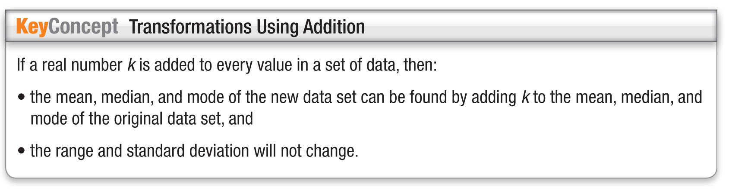
Concept

Slide 12
Example 1
Transformation Using Addition
Find the mean, median, mode, range, and standard deviation of the data set obtained after adding 12 to each value.
73, 78, 61, 54, 88, 90, 63, 78, 80, 61, 86, 78
Method 1
Find the mean, median, mode, range, and standard deviation of the original data set.
Mean 74.2 Mode 8 Median 78
Range 36 Standard Deviation 11.3
Add 12 to the mean, median, and mode. The range and standard deviation are unchanged.
Mean 86.2 Mode 90 Median 90
Range 36 Standard Deviation 11.3

Slide 13
Example 1
Transformation Using Addition
Method 2
Add 12 to each data value.
85, 90, 73, 66, 100, 102, 75, 90, 92, 73, 98, 90
Find the mean, median, mode, range, and standard deviation of the new data set.
Mean 86.2 Mode 90 Median 90
Range 36 Standard Deviation 11.3
Answer: Mean: 86.2
Mode: 90
Median: 90
Range: 36
Standard Deviation: 11.3

Slide 14


Example 1
Find the mean, median, mode, range, and standard deviation of the data set obtained after adding –6 to each value.
26, 17, 19, 20, 23, 24, 19, 15, 20, 27, 19, 15, 14
A. 25.8; 25; 25; 13; 4.0
B. 13.8; 13; 13; 13; 4.0
C. 19.8; 19; 19; 13; 4.0
D. 13; 13.8; 13; 7.5; 4.0

Slide 15
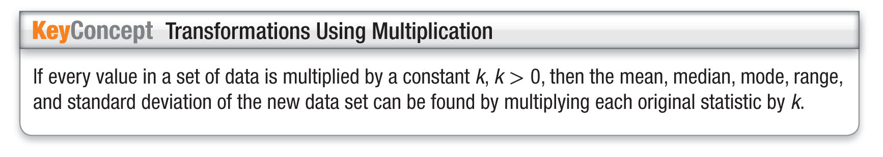
Concept

Slide 16
Example 2
Transformation Using Multiplication
Find the mean, median, mode, range, and standard deviation of the data set obtained after multiplying each value by 2.5.
4, 2, 3, 1, 4, 6, 2, 3, 7, 5, 1, 4
Find the mean, median, mode, range, and standard deviation of the original data set.
Mean 3.5 Mode 4 Median 3.5
Range 6 Standard Deviation 1.8
Multiply the mean, median, mode, range, and standard deviation by 2.5.
Mean 8.75 Mode 10 Median 8.75
Range 15 Standard Deviation 4.5

Slide 17
Example 2
Transformation Using Multiplication
Answer: Mean: 8.75
Mode: 10
Median: 8.75
Range: 15
Standard Deviation: 4.5

Slide 18
Example 2
Find the mean, median, mode, range, and standard deviation of the data set obtained after multiplying each value by 0.6.
28, 24, 22, 25, 28, 22, 16, 28, 32, 36, 18, 24, 28
A. 25.5; 25; 28; 20; 5.2
B. 152.8; 150; 168; 120; 31.3
C. 15.3; 15; 16.8; 12; 3.1
D. 42.4; 41.7; 46.7; 33.3; 8.7

Slide 19
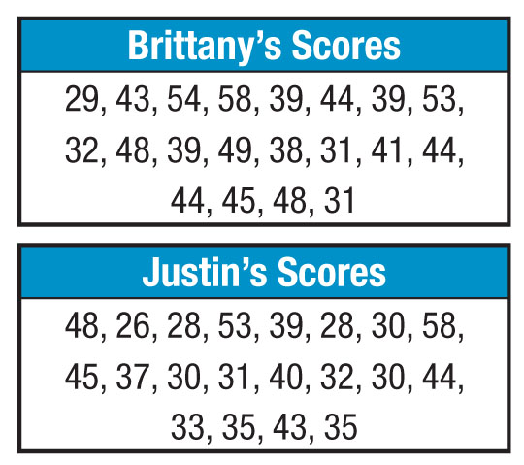
Example 3
Compare Data Using Histograms
A. GAMES Brittany and Justin are playing a computer game. Their high scores for each game are shown below. Use a graphing calculator to create a histogram for
each set of data. Then
describe the shape of
each distribution.

Slide 20
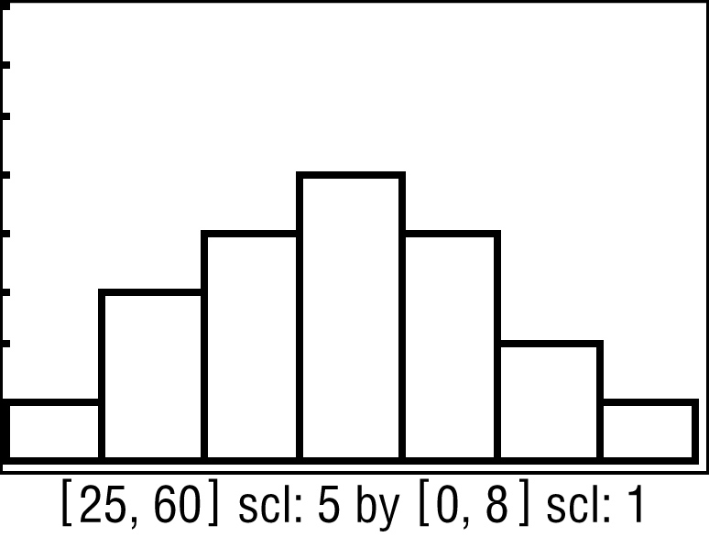
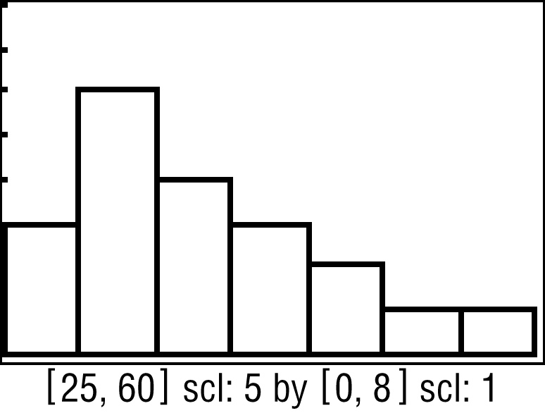
Example 3
Compare Data Using Histograms
Enter Brittany’s scores as L1 and Justin’s scores as L2. Graph both histograms by graphing L1 as Plot1 and L2 as Plot2.
Brittany’s Scores
Justin’s Scores

Slide 21
Example 3
Compare Data Using Histograms
Answer: For Brittany’s scores, the distribution is high in the middle and low on the left and right. The distribution is symmetric. For Justin’s scores, the distribution is high on the left and low on the right. The distribution is positively skewed.

Slide 22
Example 3
Compare Data Using Histograms
B. GAMES Brittany and Justin are playing a computer game. Their high scores for each game are shown below. Compare the distributions using either the means and
standard deviations or
the five-number
summaries. Justify your
choice.

Slide 23
Example 3
Compare Data Using Histograms
Answer: One distribution is symmetric and the other is skewed, so use the five-number summaries. Both distributions have a maximum of 58, but Brittany’s minimum score is 29 compared to Justin’s minimum scores of 26. The median for Brittany’s scores is 43.5 and the upper quartile for Justin’s scores is 43.5. This means that 50% of Brittany’s scores are between 43.5 and 58, while only 25% of Justin’s scores fall within this range. Therefore, we can conclude that overall, Brittany’s scores are higher than Justin’s scores.

Slide 24
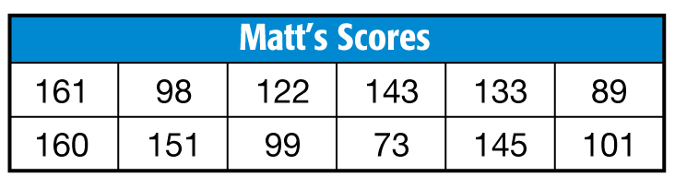
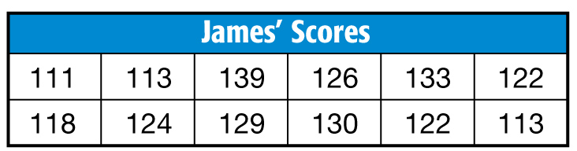
Example 3
FANTASY FOOTBALL Matt and James are in a fantasy football league. Their scores for each week are shown. Compare the distributions using either the means and standard deviations or the five-number summaries. Justify your choice.
A. While the medians are close, James’ scores are more consistent.
B. James’ scores have a higher median and a smaller range.
C. While the means are close, James’ scores are more consistent.
D. While the means are close, James’ scores have a larger standard deviation.

Slide 25
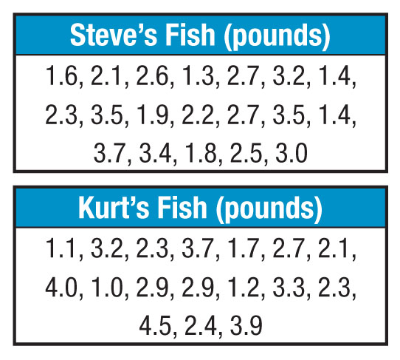
Example 4
Compare Data Using Box-and-Whisker Plots
A. FISHING Steve and Kurt went fishing for the weekend. The weights of the fish they each caught are shown below. Use a graphing calculator to create a box-and-whisker
plot for each data set.
Then describe the shape
of the distribution for
each data set.

Slide 26
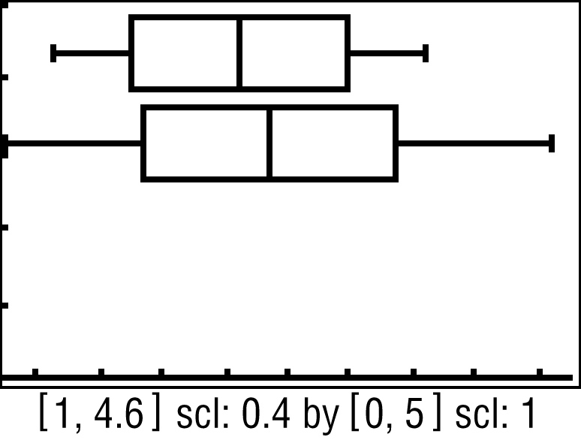
Example 4
Compare Data Using Box-and-Whisker Plots
Enter Steve’s fish as L1 and Kurt’s fish as L2. Graph both box-and-whisker plots on the same screen by graphing L1 as Plot1 and L2 as Plot2.
Answer: For each distribution, the lengths of the whiskers are approximately equal, and the median is in the middle of the data. The distributions are symmetric.

Slide 27
Example 4
Compare Data Using Box-and-Whisker Plots
B. FISHING Steve and Kurt went fishing for the weekend. The weights of the fish they each caught are shown below. Compare the distributions using either the means and
standard deviations or the
five-number summaries.
Justify your choice.

Slide 28
Example 4
Compare Data Using Box-and-Whisker Plots
Answer: The distributions are symmetric, so use the mean and standard deviation to compare the data. The mean weight for Steve’s fish is about 2.5 pounds with standard deviation of about 0.8 pound. The mean weight for Kurt’s fish is about 2.7 pounds with standard deviation of about 1 pound. While the mean weight for Kurt’s fish is greater, the weights of Kurt’s fish also have more variability. This means the weights for Steve’s fish are generally closer to his mean than the weights for Kurt’s fish.

Slide 29
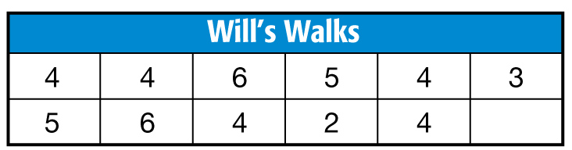
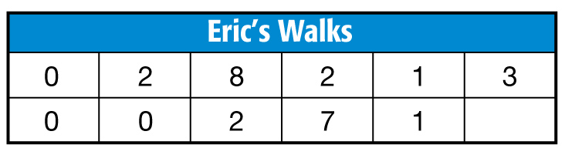
Example 4
BASEBALL Will and Eric pitch for a baseball team. The number of walks they give up each game is shown. Compare the distributions using either the means and standard deviations or the five-number summaries. Justify your choice.
A. The mean number of walks that Will has is lower than Eric’s and Will is also more consistent.
B. The mean number of walks that Will has is higher than Eric’s and Eric is also more consistent.
C. The median number of walks that Will has is higher than Eric’s and Will is also more consistent.
D. The median number of walks that Will has is higher than Eric’s and Eric is also more consistent.

Slide 30
End of the Lesson

