Slide 1


Splash Screen

Slide 2
Lesson Menu
Five-Minute Check (over Lesson 12–4)
CCSS
Then/Now
New Vocabulary
Example 1: Standardized Test Example: Find Experimental Probability
Key Concept: Designing a Simulation
Example 2: Real-World Example: Design a Simulation
Example 3: Conduct and Evaluate a Simulation

Slide 3

5-Minute Check 1
Find the mean, median, mode, range, and standard deviation of each data set that is obtained after adding the given constant to each value.
5, 12, 14, 6, 8, 11, 29, 14, 17, 9, 10, 12, 14; + (–3)
A. 12.4, 12, 14, 24, 5.8
B. 15.4, 15, 17, 24, 5.8
C. 9.4, 9, 11, 21, 2.8
D. 9.4, 9, 11, 24, 5.8

Slide 4

5-Minute Check 2
Find the mean, median, mode, range, and standard deviation of each data set that is obtained after adding the given constant to each value.
19, 15, 18, 13, 13, 15, 20, 22, 21, 9, 11, 16; + 8
A. 16, 15.5, 13 and 15, 13, 3.9
B. 24, 23.5, 21 and 23, 13, 3.9
C. 8, 7.5, 5 and 7, 13, 3.9
D. 24, 23.5, 21 and 23, 21, 11.9

Slide 5

5-Minute Check 3
Find the mean, median, mode, range, and standard deviation of each data set that is obtained after multiplying each value by the given constant.
45, 45, 46, 46, 48, 48, 47, 49, 48, 43, 43, 50; × 2
A. 46.5, 46.5, 48, 7, 4.3
B. 46.5, 46.5, 48, 7, 2.15
C. 93, 93, 96, 14, 4.3
D. 93, 93, 96, 7, 4.3

Slide 6

5-Minute Check 4
Find the mean, median, mode, range, and standard deviation of each data set that is obtained after multiplying each value by the given constant.
8, 12, 10, 7, 9, 9, 11, 11, 12, 10, 10, 10, 6; × 4
A. 9.62, 10, 10, 6, 1.7
B. 13.62, 14, 14, 6, 1.7
C. 38.5, 40, 40, 6, 1.7
D. 38.5, 40, 40, 24, 6.9

Slide 7

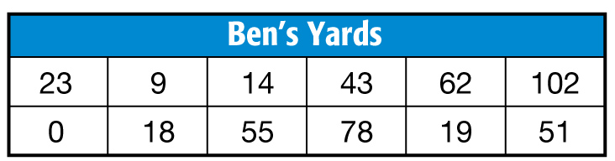
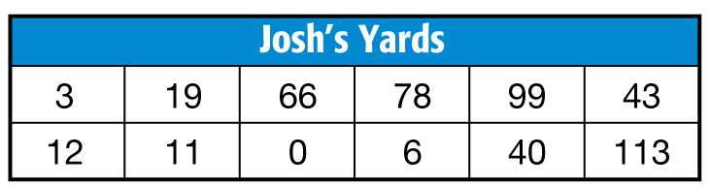
5-Minute Check 5
FOOTBALL Ben and Josh’s yards gained per game are shown. Compare the data sets using either the means and standard deviations or the five-number summaries. Justify your choice.
A. Both distributions are skewed. Ben was slightly more consistent than Josh.
B. Both distributions are skewed. Josh was slightly more consistent than Ben.
C. Both distributions are symmetric. Josh was slightly more consistent than Ben.
D. Both distributions are symmetric. Ben was slightly more consistent than Josh.

Slide 8

CCSS
Mathematical Practices
4 Model with mathematics.
Common Core State Standards © Copyright 2010. National Governors Association Center for Best Practices and Council of Chief State School Officers. All rights reserved.

Slide 9


Then/Now
You calculated simple probability.
Calculate experimental probabilities.
Design simulations and summarize data from simulations.

Slide 10

Vocabulary
theoretical probability
experimental probability
relative frequency
simulation
probability model

Slide 11
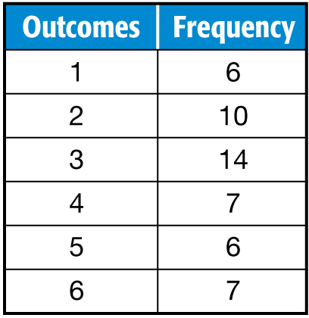
Example 1
Find Experimental Probability
A die is rolled 50 times and the results are recorded. Find the experimental probability of rolling a prime number.
We are asked to find the probability of rolling a prime number. Therefore, we need to consider rolling a 1, 2, 3, or 5.

Slide 12
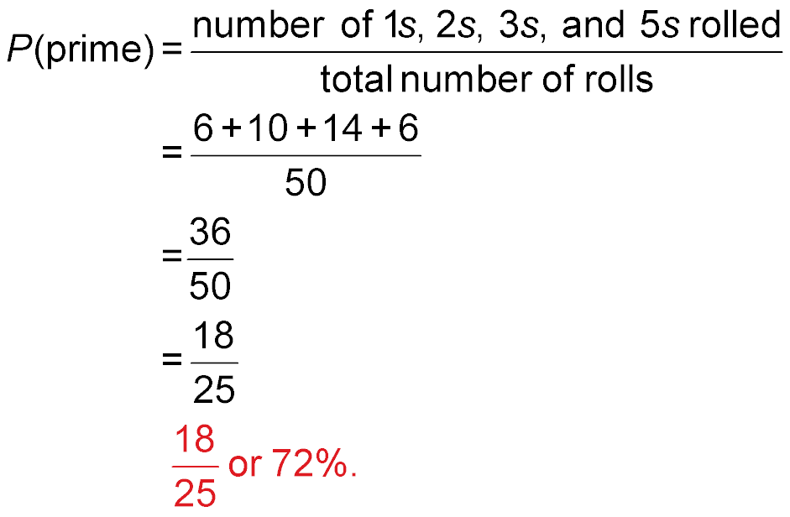
Example 1
Find Experimental Probability
Answer: The experimental probability of rolling a prime number is

Slide 13


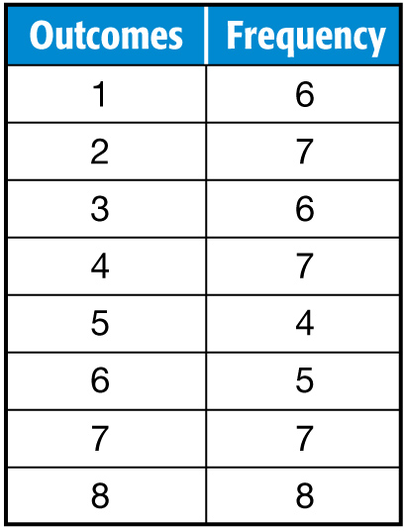

Example 1
A spinner is spun 50 times and the results are recorded. Find the experimental probability of landing on an odd number.
A.
B.
C.
D.

Slide 14
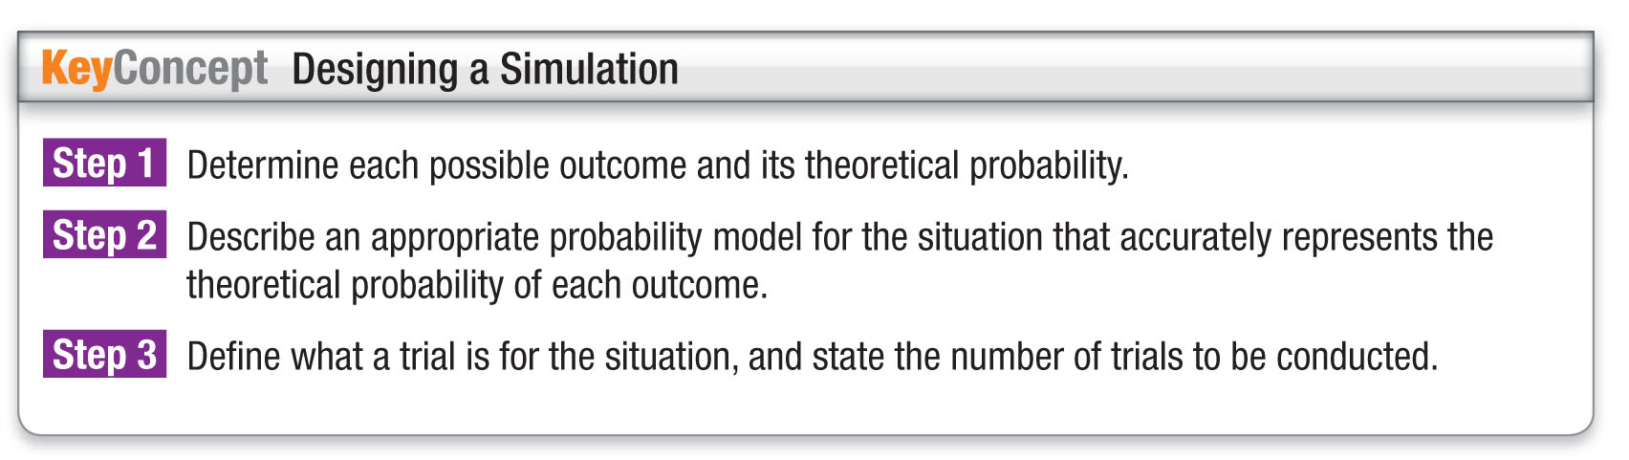
Concept

Slide 15
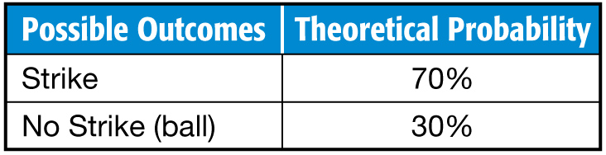
Example 2
Design a Simulation
SOFTBALL Mandy is a pitcher on her high school softball team. Last season, 70% of her pitches were strikes. Design a simulation that can be used to estimate the probability that Mandy’s next pitch is a strike.
Step 1
There are two possible outcomes: strike and no strike (a ball). Use Mandy’s expectation of strikes to calculate the theoretical probability of each outcome.

Slide 16
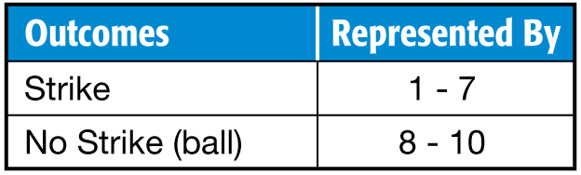
Example 2
Design a Simulation
Step 2
We can use the random number generator on a graphing calculator. Assign the integers 1-10 to accurately represent the probability data.
Step 3
A trial will represent one pitch. The simulation can consist of any number of trials. We will use 50.

Slide 17
Example 2
SCHOOL BUS Larry’s bus is late 60% of the time. Design a simulation that can be used to estimate the probability that his bus is late.
A. Use a random number generator for 50 trials
with integers 1 through 10. 1-6: the bus is late;
7-10: the bus is not late.
B. Use a random number generator for 50 trials with integers 1 through 10. 1-6: the bus is not late;
7-10: the bus is late.
C. Flip a coin for 50 trials. heads: the bus is late; tails: the bus is not late.
D. Roll a die for 50 trials. 1-4: the bus is late;
5-6: the bus is not late.

Slide 18
Example 3
Conduct and Evaluate a Simulation
SOFTBALL Mandy is a pitcher on her high school softball team. Last season, 70% of her pitches were strikes. Conduct the simulation that can be used to estimate the probability that Mandy’s next pitch is a strike.

Slide 19





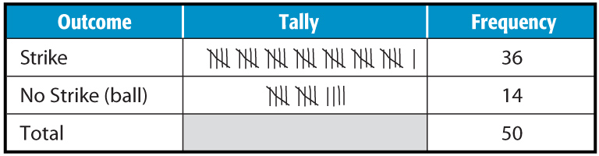
Example 3
Conduct and Evaluate a Simulation
Press and select [randInt (].Then press 1 , 10 , 50 ) ENTER . Use the left and right arrow buttons to view the results. Make a frequency table and record the results.

Slide 20
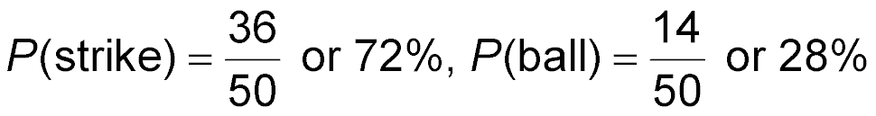
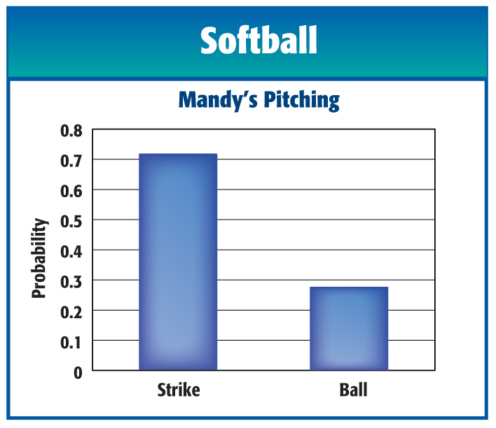
Example 3
Conduct and Evaluate a Simulation
Calculate the experimental probabilities.
Answer:

Slide 21
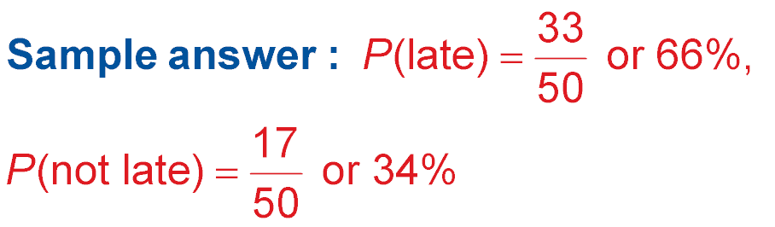
Example 3
SCHOOL BUS Larry’s bus is late 60% of the time. Conduct a simulation that can be used to estimate the probability that his bus is late.

Slide 22
End of the Lesson

