Slide 1


Splash Screen

Slide 2
Lesson Menu
Five-Minute Check (over Lesson 12–5)
CCSS
Then/Now
New Vocabulary
Key Concept: Factorial
Example 1: Real-World Example: Permutations Using Factorials
Key Concept: Permutation Formula
Example 2: Real-World Example: Use the Permutation Formula
Key Concept: Combination Formula
Example 3: Real-World Example: Use the Combination Formula
Example 4: Identifying Permutatations and Combinations
Example 5: Probability with Permutations and Combinations

Slide 3

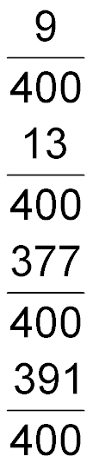
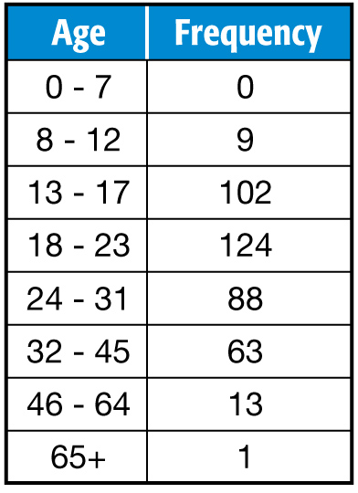
5-Minute Check 1
WEB SITES A Web site asked for the ages of people who accessed the site. Find the experimental probability of randomly selecting each person older than 12 but younger than 46.
A.
B.
C.
D.

Slide 4

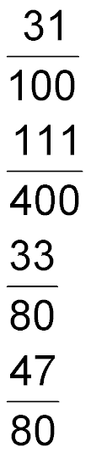
5-Minute Check 2
WEB SITES A Web site asked for the ages of people who accessed the site. Find the experimental probability of randomly selecting each person over 23 years old.
A.
B.
C.
D.

Slide 5

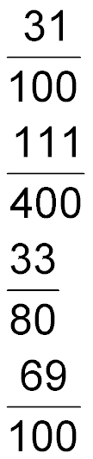
5-Minute Check 3
WEB SITES A Web site asked for the ages of people who accessed the site. Find the experimental probability of randomly selecting each person not between 18 and 23 years old.
A.
B.
C.
D.

Slide 6

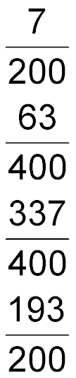
5-Minute Check 4
WEB SITES A Web site asked for the ages of people who accessed the site. Find the experimental probability of randomly selecting each person 45 years old or younger.
A.
B.
C.
D.

Slide 7

5-Minute Check 5
SPEAKERS Dale examines the wiring of floor speakers. He expects to find defects in 1 out of every 40 speakers. Design a simulation that can be used to estimate the probability that the next speaker he examines has a defect.
A. Roll a die 40 times.
B. Flip a coin 40 times.
C. Use a random number generator.
D. Draw a card from a standard deck of cards.

Slide 8

CCSS
Mathematical Practices
8 Look for and express regularity in repeated reasoning.
Common Core State Standards © Copyright 2010. National Governors Association Center for Best Practices and Council of Chief State School Officers. All rights reserved.

Slide 9


Then/Now
You used the Fundamental Counting Principle.
Use permutations.
Use combinations.

Slide 10

Vocabulary
permutation
factorial
combination

Slide 11
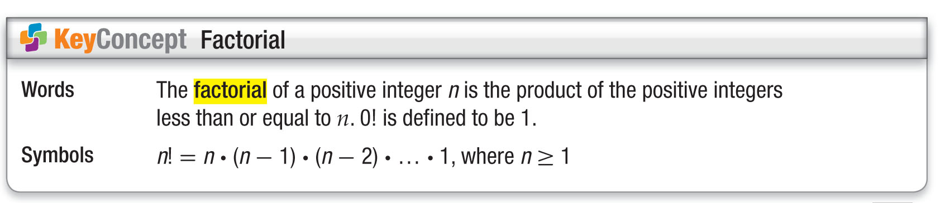
Concept

Slide 12
Example 1
Permutations Using Factorials
CODES Shaquille has a 4-digit pass code to access his e-mail account. The code is made up of the even digits 2, 4, 6, and 8. Each digit can be used only once. How many different pass codes could Shaquille have?
Number of ways to arrange the pass codes:
4 ● 3 ● 2 ● 1 or 24
Answer: There are 24 different pass codes Shaquille could have.

Slide 13


Example 1
Jaime, Shana, Otis, Abigail, and Ernesto are lining up to take a picture on the beach. How many different ways can they line up next to each other?
A. 100
B. 240
C. 60
D. 120

Slide 14
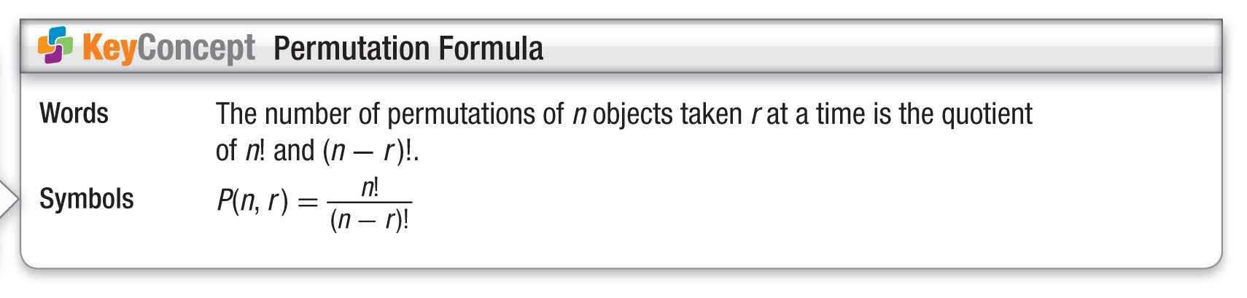
Concept

Slide 15
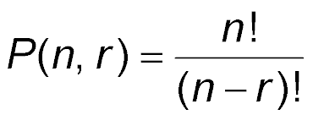
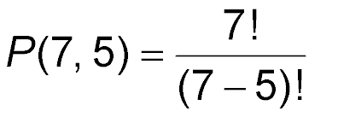
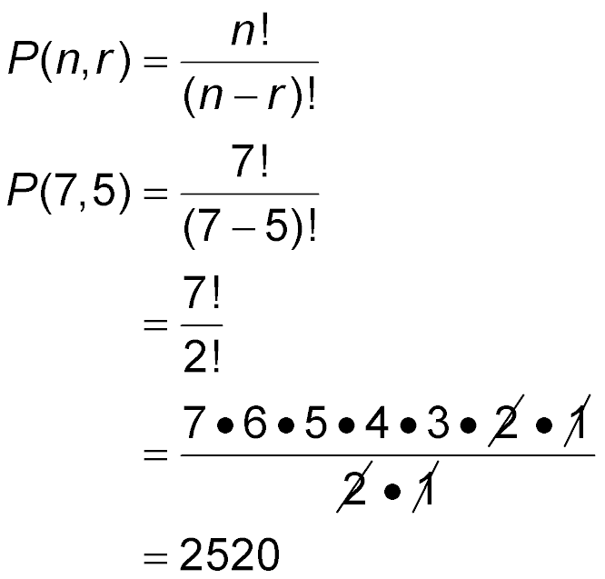
Example 2
Use the Permutation Formula
CODES A word processing program requires a user to enter a 5-digit registration code made up of the digits 1, 2, 3, 4, 5, 6, and 7. No digit can be used more than once. How many different registration codes are possible?
Definition of permutation
n = 7 and r = 5
Simplify.

Slide 16
Example 2
Use the Permutation Formula
Divide by common factors.
Simplify.
Answer: There are 2520 possible registrations codes with the digits 1, 2, 3, 4, 5, 6, and 7.

Slide 17
Example 2
The addresses of the houses on Bridget’s street each have four digits and no digit is used more than once. If each address is made up from the digits 0–9, how many different addresses are possible?
A. 24
B. 210
C. 5040
D. 151,200

Slide 18
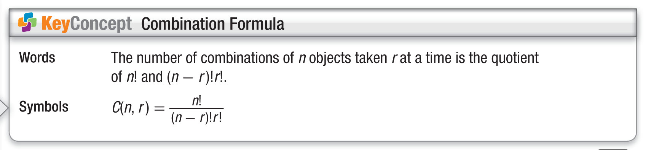
Concept

Slide 19
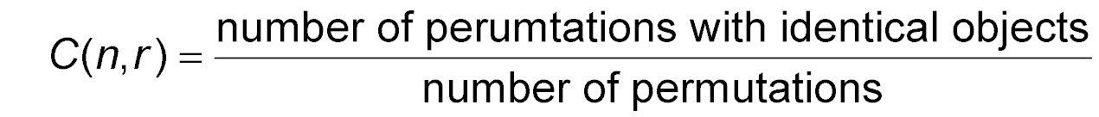
Example 3
Use the Combination Formula
SCHOOL A group of 4 seniors, 5 juniors, and
7 sophomores have volunteered to be on a fundraising committee. Mr. Davidson needs to choose 12 students out of the group. How many ways can the 12 students be chosen?
Since the order in which the students are chosen does not matter, we need to find the number of combinations of 12 students selected from a group of 16.

Slide 20
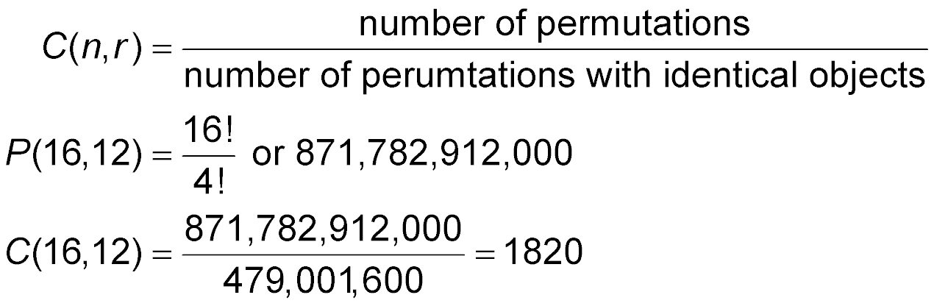
Example 3
Use the Combination Formula
First, find the number of permutations.
Because we are choosing 12, there 12! = 479,001,600 permutations with identical objects.
or 1820
Answer: There are 1820 ways to choose 12 students.

Slide 21
Example 3
SUITCASES Jacinda is packing for her vacation to the mountains. With all her heavy snow gear, she only has room left for 4 more outfits to wear. If she has 7 different outfits laid out on the bed, how many ways can the 4 outfits be chosen?
A. 35
B. 840
C. 148
D. 46

Slide 22
Example 4
Identifying Permutations and Combinations
Identify each situation as a permutation or a combination.
A. During a fire drill, a teacher checks the students in her row to see if everyone is present.
Answer: The order that the students are in does not matter, so it is a combination.

Slide 23
Example 4
Identifying Permutations and Combinations
Identify each situation as a permutation or a combination.
B. In preparing for a competition, a tennis coach lists his players in order of ability.
Answer: Order does matter, so it is a permutation.

Slide 24
Example 4
A teacher assigns selects the order of five students who are giving presentations today. Identify the situation as a permutation or a combination.
A. permutation
B. combination

Slide 25
Example 5
Probability with Permutations and Combinations
TABLE TENNIS Sixteen people signed up for a table tennis tournament. If players are put into groups of 4 and the draw is determined randomly, what is the probability that Heather, Erin, Michele, and Patrick are put into the same group?
Step 1
Find the total number of outcomes.
Since we do not care about specific positions, this is a combination. Find the number of combinations of 16 people taken 4 at a time.

Slide 26
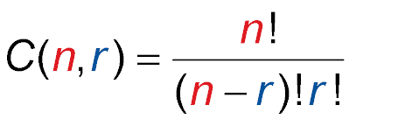
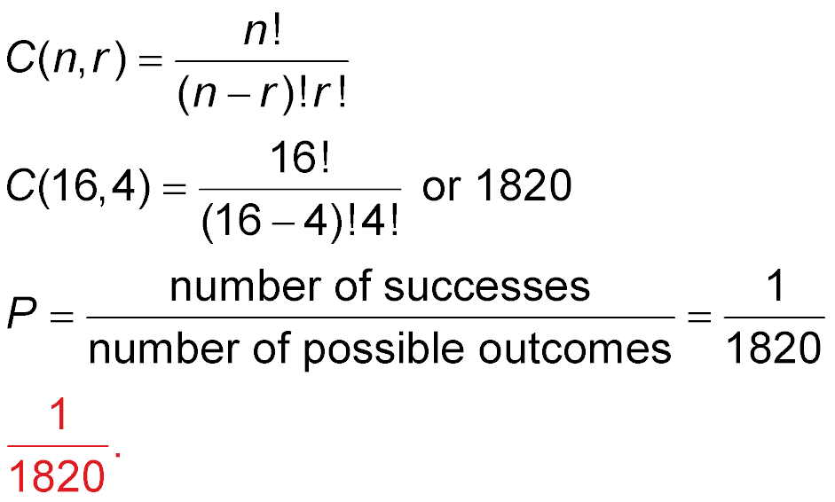
Example 5
Probability with Permutations and Combinations
Combination Formula
n = 16 and r = 4
There are 1820 possible outcomes.
Step 2
Find the successes.
Of the 1820 combinations, only one has Heather, Erin, Michele, and Patrick in the same group.

Slide 27
Example 5
Probability with Permutations and Combinations
Step 3
Find the probability.
Probability Formula
Answer: The probability that Heather, Erin, Michele, and Patrick are put into the same group is

Slide 28
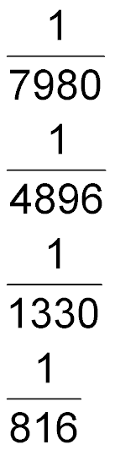
Example 5
VOLUNTEERING Twenty-one volunteers signed up for to work on improving a home. If the volunteers are randomly placed into groups of 3, what is the probability that Samantha, Julie, and Kate are put into the same group?
A.
B.
C.
D.

Slide 29
End of the Lesson

