Slide 1


Splash Screen

Slide 2
Lesson Menu
Five-Minute Check (over Lesson 12–6)
CCSS
Then/Now
Key Concept: Probability of Independent Events
Example 1: Real-World Example: Independent Events
Key Concept: Probability of Dependent Events
Example 2: Real-World Example: Dependent Events
Key Concept: Mutually Exclusive Events
Example 3: Real-World Example: Mutually Exclusive Events
Key Concept: Events that are Not Mutually Exclusive
Example 4: Real-World Example: Events that are Not Mutually Exclusive

Slide 3

5-Minute Check 1
You can vote for 3 of the 5 candidates running for the city council. How many ways can you vote?
A. 10
B. 8
C. 6
D. 5

Slide 4

5-Minute Check 2
North High School has 3 different awards that are given to graduating seniors. If there are 214 seniors, in how many ways can the awards be given if a person cannot win more than one?
A. 560,700
B. 7,560,400
C. 9,663,384
D. 11,960,840

Slide 5

5-Minute Check 3
Evaluate ₉P₄.
A. 12,960
B. 3024
C. 760
D. 126

Slide 6

5-Minute Check 4
Gina needs to pick 9 songs from a list of 12 songs to play during her radio show. How many ways can she include 9 songs in her show in any order?
A. 60
B. 120
C. 180
D. 220

Slide 7

5-Minute Check 5
From a 10-member basketball team, a coach needs to pick 5 starters. His lineup must include one of the two centers. How many starting lineups can the coach make?
A. 240
B. 180
C. 140
D. 80

Slide 8

5-Minute Check 6
Twelve students have been selected for the debate team. How many different seven-student teams can be chosen?
A. 792
B. 588
C. 1008
D. 5040

Slide 9

CCSS
Mathematical Practices
5 Use appropriate tools strategically.
Common Core State Standards © Copyright 2010. National Governors Association Center for Best Practices and Council of Chief State School Officers. All rights reserved.

Slide 10


Then/Now
You calculated simple probability.
Find probabilities of independent and dependent events.
Find probabilities of mutually exclusive events.

Slide 11
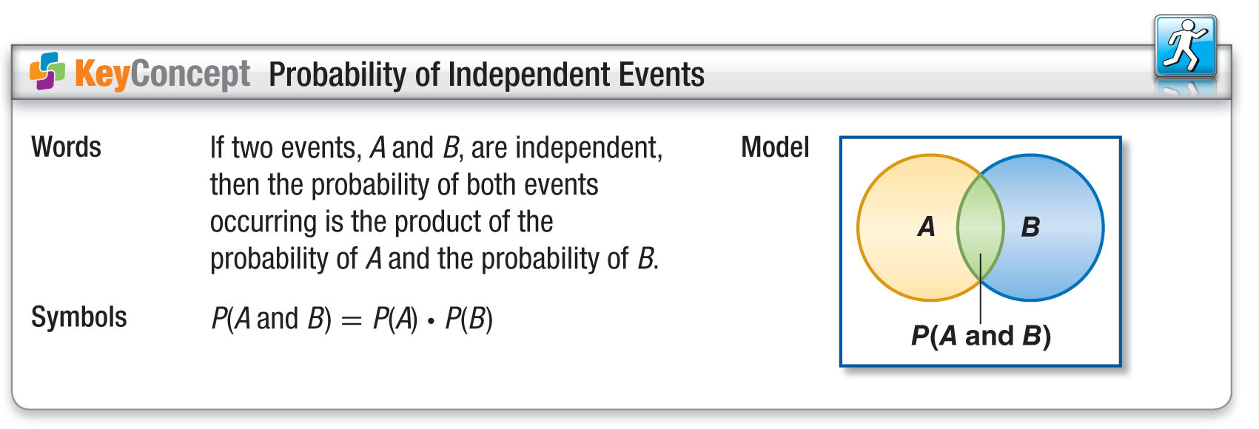
Concept

Slide 12
Example 1
Independent Events
TRAVEL Rae is flying from Birmingham to Chicago
on a flight with a 90% on-time record. On the same day, the chances of rain in Denver are predicted to be 50%. What is the probability that Rae’s flight will be on time and that it will rain in Denver?

Slide 13
Example 1
Independent Events
P(A and B) = P(A)●P(B)
Probability of independent events
P(on time and rain) = P(on time) ● P(rain)
= 0.9 ● 0.5
90% = 0.9 and
50% = 0.5
= 0.45
Multiply.
Answer: The probability that Rae’s flight will be on
time and that it will rain in Denver is 45%.

Slide 14


Example 1
Two cities, Fairfield and Madison, lie on different faults. There is a 60% chance that Fairfield will experience an earthquake by the year 2020 and a
40% chance that Madison will experience an earthquake by 2020. Find the probability that both cities will experience an earthquake by 2020.
A. 60%
B. 40%
C. 24%
D. 100%

Slide 15
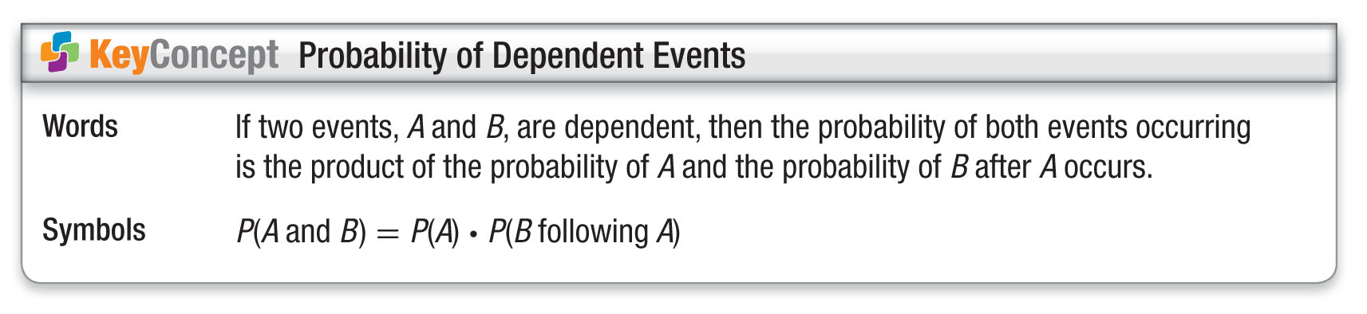
Concept

Slide 16
Example 2
Dependent Events
A. GAMES At the school carnival, winners in the ring-toss game are randomly given a prize from a bag that contains 4 sunglasses, 6 hairbrushes, and 5 key chains. Three prizes are randomly drawn from the bag and not replaced. Find P(sunglasses, hairbrush, key chain).
The selection of the first prize affects the selection of the next prize since there is one less prize from which to choose. So, the events are dependent.

Slide 17
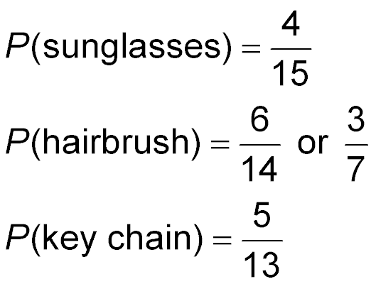
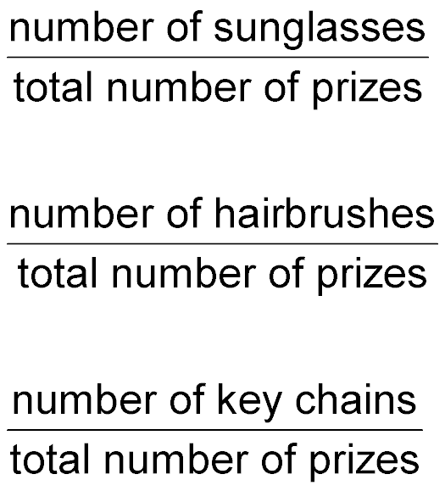
Example 2
Dependent Events
First prize:
Second prize:
Third prize:

Slide 18
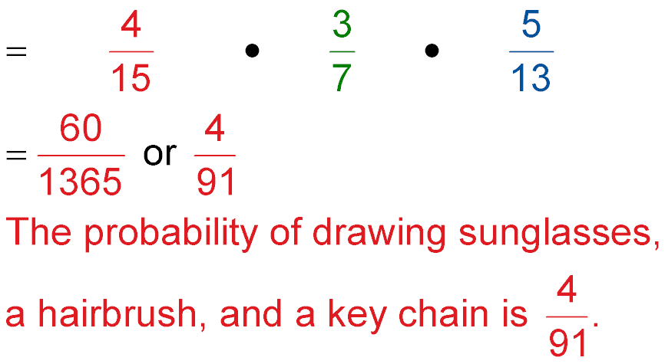
Example 2
Dependent Events
P(sunglasses, hairbrush, key chain) = P(sunglasses)●P(hairbrush)●P(key chain)
Substitution
Multiply.
Answer:
or about 4.4%.

Slide 19
Example 2
Dependent Events
B. GAMES At the school carnival, winners in the ring-toss game are randomly given a prize from a bag that contains 4 sunglasses, 6 hairbrushes, and 5 key chains. Three prizes are randomly drawn from the bag and not replaced. Find P(hairbrush, hairbrush, not a hairbrush).
After two hairbrushes are selected, there are 13 prizes left. Since both of the prizes are hairbrushes, there are still 9 prizes that are not hairbrushes.

Slide 20
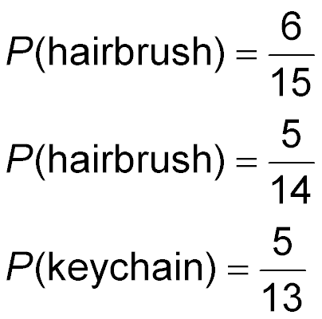

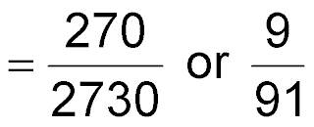
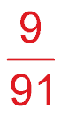
Example 2
Dependent Events
P(hairbrush, hairbrush, not a hairbrush)
= P(hairbrush) ● P(hairbrush) ● P(not a hairbrush)
=
●
●
Answer: The probability is or about 9.9%.

Slide 21
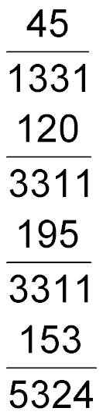
Example 2
A. A gumball machine contains 16 red gumballs, 10 blue gumballs, and 18 green gumballs. Once a gumball is removed from the machine, it is not replaced. Find each probability if the gumballs are removed in the order indicated.
P(red, green, blue)
A.
B.
C.
D.

Slide 22
Example 2
B. A gumball machine contains 16 red gumballs, 10 blue gumballs, and 18 green gumballs. Once a gumball is removed from the machine, it is not replaced. Find each probability if the gumballs are removed in the order indicated.
P(green, blue, not red)
A.
B.
C.
D.

Slide 23
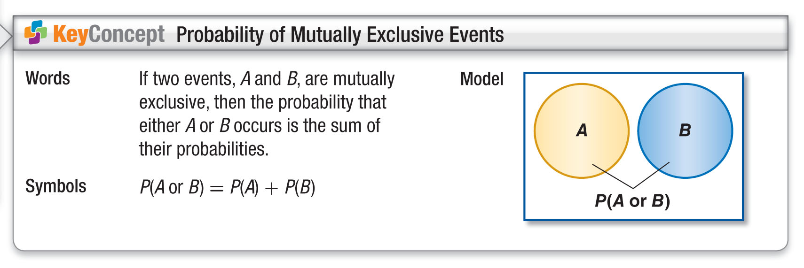
Concept

Slide 24
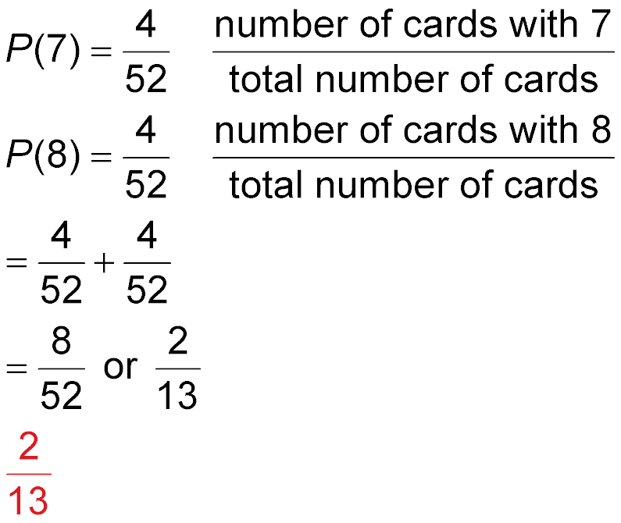
Example 3
Mutually Exclusive Events
A. A card is being drawn from a standard deck. Find the probability of P(7 or 8).
Since a card cannot show a 7 and an 8 at the same time, these events are mutually exclusive.
←
←
←
←

Slide 25

Example 3
Mutually Exclusive Events
P(7 or 8) = P(7) + P(8) Probability of mutually exclusive events.
Substitution
Add.
Answer: The probability of drawing a 7 or 8 is or about 15.4%.

Slide 26
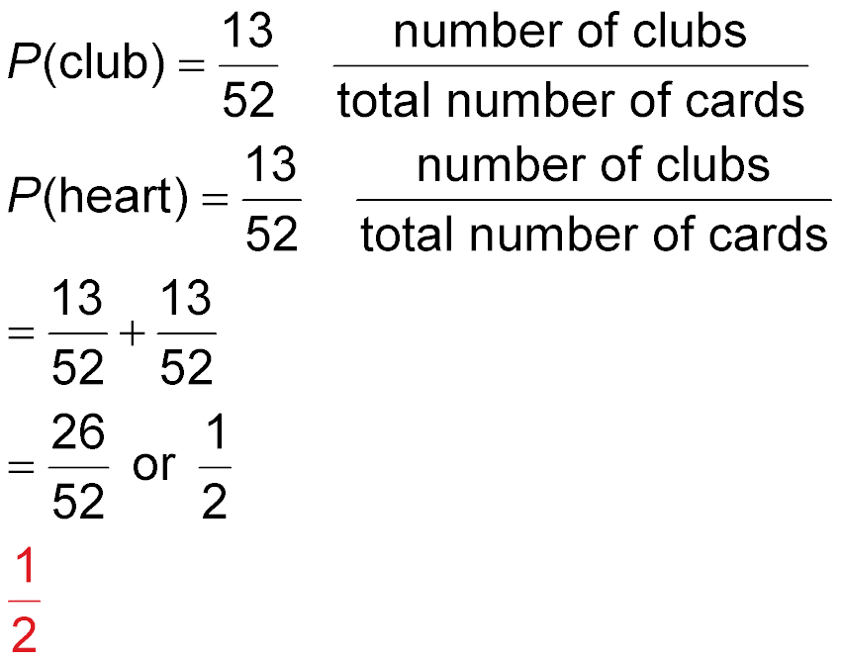
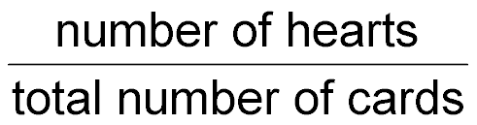
Example 3
Mutually Exclusive Events
B. A card is being drawn from a standard deck. Find the probability of P(neither club nor heart).
You can find the probability of drawing a club or a heart and then subtract this from 1.
←
←
←
←

Slide 27
Example 3
Mutually Exclusive Events
P(club or heart) = P(club) + P(heart) Probability of mutually exclusive events.
Substitution
Add.
Answer: The probability of not drawing a club or a heart is 1 – = or 50%.

Slide 28

Example 3
A. The French Club has 16 seniors, 12 juniors,
15 sophomores, and 21 freshmen as members.
What is the probability that a member chosen at random is a junior or a senior?
A.
B. 1
C.
D. 0

Slide 29
Example 3
B. The French Club has 16 seniors, 12 juniors,
15 sophomores, and 21 freshmen as members.
What is the probability that a member chosen at random is not a senior?
A.
B.
C.
D.

Slide 30
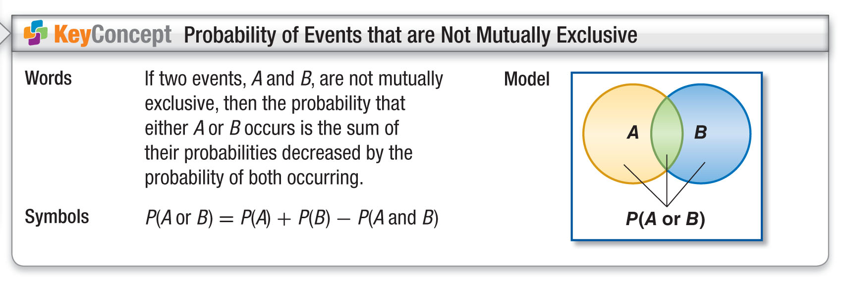
Concept

Slide 31
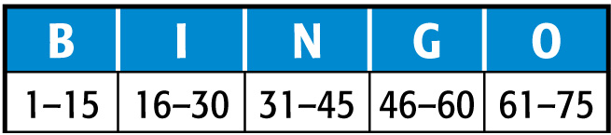
Example 4
Events that are Not Mutually Exclusive
GAMES In the game of bingo, balls or tiles are numbered 1 through 75. These numbers correspond to columns on a bingo card, as shown in the table. A number is selected at random. What is the probability that it is a multiple of 5 or is in the N column?

Slide 32
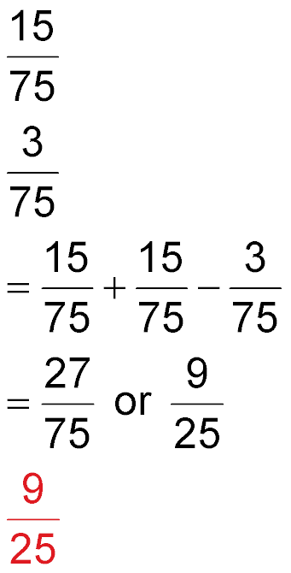
Example 4
Events that are Not Mutually Exclusive
Since a tile can be a multiple of 5 and in the N column, the events are not mutually exclusive.
P(multiple of 5) P(N column) P(multiple of 5 and N column) =
=
=
P(multiple of 5 or N column) = P(multiple of 5) +
P(N column) – P(multiple of 5 and N column)

Slide 33

Example 4
Events that are Not Mutually Exclusive
Substitution
Simplify.
Answer: The probability is or 36%.

Slide 34

Example 4
In Mrs. Kline’s class, 7 boys have brown eyes and
5 boys have blue eyes. Out of the girls, 6 have brown eyes and 8 have blue eyes. If a student is chosen at random from the class, what is the probability that the student will be a boy or have brown eyes?
A.
B.
C.
D.

Slide 35
End of the Lesson

