Slide 1


Splash Screen

Slide 2
Lesson Menu
Five-Minute Check (over Lesson 12–7)
CCSS
Then/Now
New Vocabulary
Example 1: Random Variables
Key Concept: Properties of Probability Distributions
Example 2: Probability Distribution
Key Concept: Expected Value of a Discrete Random Variable
Example 3: Real-World Example: Expected Value

Slide 3


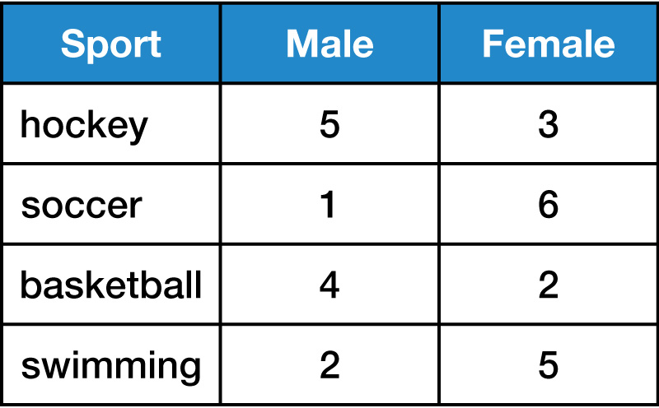
5-Minute Check 1
Using the table, find the probability that a girl who plays hockey will be chosen as the Athlete of the Year award.
A.
B.
C.
D.

Slide 4


5-Minute Check 2
Using the table, find the probability of choosing a boy or a soccer player as Athlete of the Year.
A.
B.
C.
D.

Slide 5


5-Minute Check 3
Using the table, find the probability of choosing a swimmer or hockey player as Athlete of the Year.
A.
B.
C.
D.

Slide 6


5-Minute Check 4
A bag contains 21 marbles. Six of these are red. Two students each draw a marble from the bag without looking. What is the probability they will both draw a red marble?
A.
B.
C.
D.

Slide 7

CCSS
Mathematical Practices
4 Model with mathematics.
Common Core State Standards © Copyright 2010. National Governors Association Center for Best Practices and Council of Chief State School Officers. All rights reserved.

Slide 8


Then/Now
You found probabilities of events.
Find probabilities by using random variables.
Find the expected value of a probability distribution.

Slide 9

Vocabulary
random variable
discrete random variable
probability distribution
probability graph
expected value

Slide 10
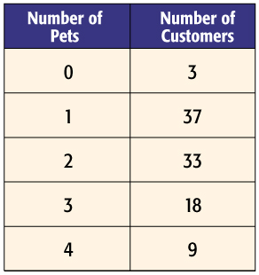
Example 1
Random Variables
A. The owner of a pet store asked customers how many pets they owned. The results of this survey are shown in the table. Find the probability that a randomly chosen customer has 2 pets.
Let X represent the number of pets a customer owns. There is only one outcome in which a customer owns 2 pets, and there are 100 customers.

Slide 11
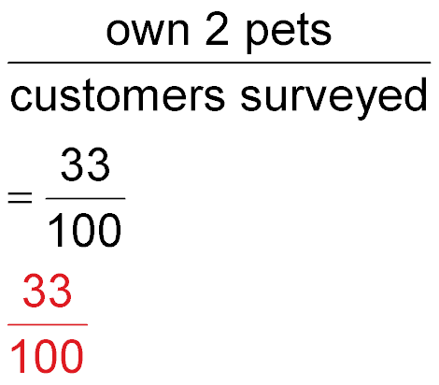
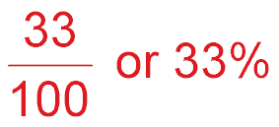
Example 1
Random Variables
P(X = 3) = P(X = n) is the probability of X occurring n times.
Answer: The probability is .

Slide 12
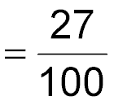
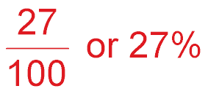
Example 1
Random Variables
B. The owner of a pet store asked customers how many pets they owned. The results of this survey are shown in the table. Find the probability that a randomly chosen customer has at least 3 pets.
There are 18 + 9 or 27 customers
who own at least 3 pets.
P(X ≥ 3)
Answer: The probability is .

Slide 13


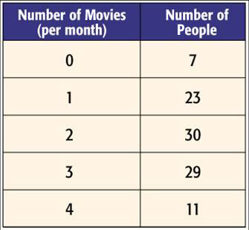
Example 1
A. A survey was conducted concerning the number of movies people watch at the theater per month. The results of this survey are shown in the table. Find the probability that a randomly chosen person watches at most
1 movie per month.
A. 30% B. 40%
C. 50% D. 60%

Slide 14
Example 1
B. A survey was conducted concerning the number of movies people watch at the theater per month. The results of this survey are shown in the table. Find the probability that a randomly chosen person watches 0 or 4 movies per month.
A. 0 % B. 10%
C. 18% D. 100%

Slide 15
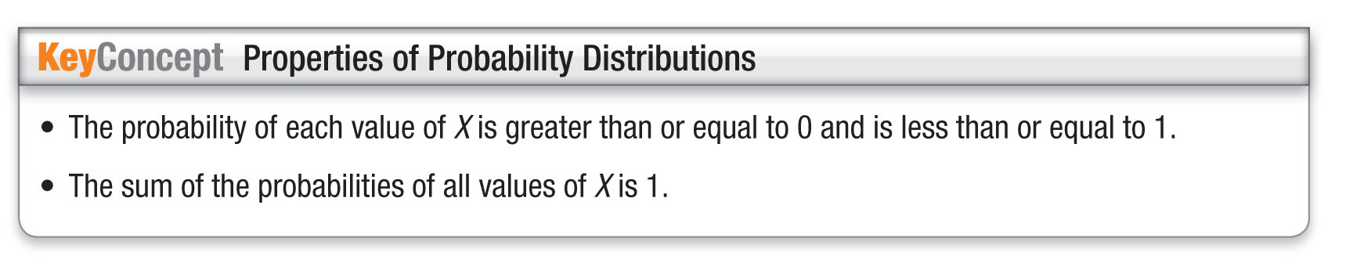
Concept

Slide 16
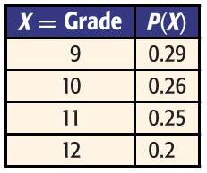
Example 2
Probability Distribution
A. POPULATION The table shows the probability distribution of the number of students in each grade at Sunnybrook High School. Show that the distribution is valid.
Answer: For each value of X, the probability is greater than or equal to 0 and less than or equal to 1. Also, 0.29 + 0.26 + 0.25 + 0.2 = 1, so the sum of the probabilities is 1.

Slide 17
Example 2
Probability Distribution
B. POPULATION The table shows the probability distribution of the number of students in each grade at Sunnybrook High School. If a student is chosen at random, what is the probability that he or she is in grade 11 or 12?
Recall that the probability of a compound event is the sum of the probabilities of each individual event.
The probability of a student being in grade 11 or
grade 12 is the sum of the probability of grade 11 and the probability of grade 12.

Slide 18
Example 2
Probability Distribution
P(X ≥ 11) = P(X = 11) + P(X = 12) Sum of individual probabilities
= 0.25 + 0.2 or 0.45 P(X = 11) = 0.25,
P(X = 12) = 0.2
Answer: The probability of a student being in grade 11 or grade 12 is 0.45.

Slide 19
Example 2
Probability Distribution
C. POPULATION The table shows the probability distribution of the number of students in each grade at Sunnybrook High School. Make a probability graph of the data.
Use the data from the probability distribution table to draw a bar graph.
Draw and label the vertical and horizontal axes. Remember to use equal intervals on each axis. Include a title.

Slide 20
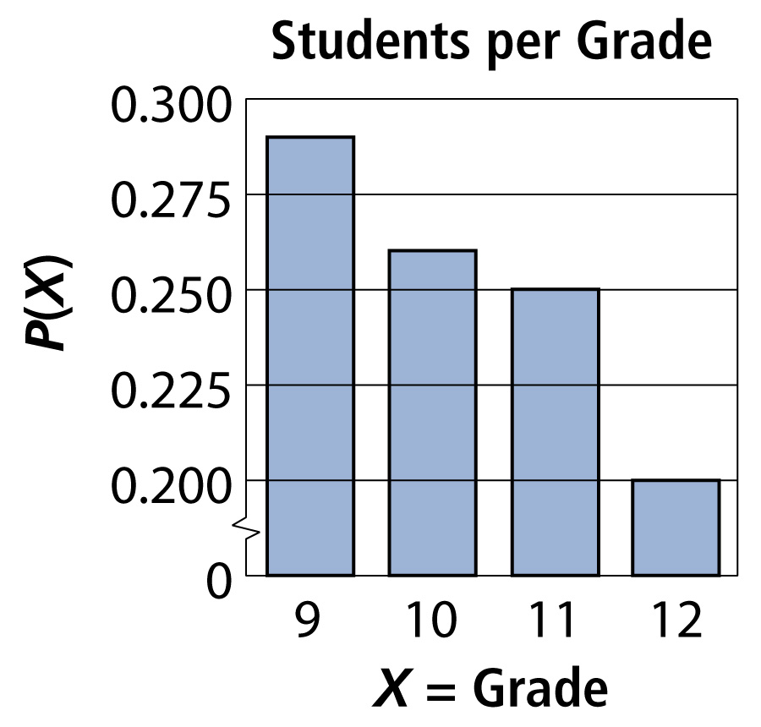
Example 2
Probability Distribution
Answer:

Slide 21
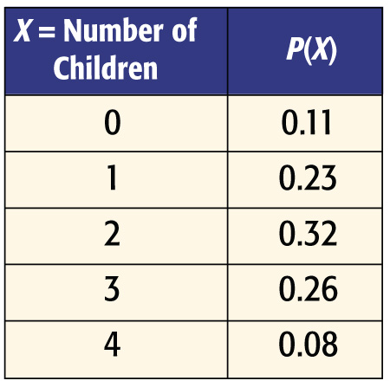
Example 2
A. The table shows the probability distribution of the number of children per family in the city of Maplewood. Is the distribution valid?
A. yes
B. no

Slide 22
Example 2
B. The table shows the probability distribution of the number of children per family in the city of Maplewood. If a family was chosen at random, what is the probability that they have at least 2 children?
A. 0.11 B. 0.23
C. 0.66 D. 0.08

Slide 23
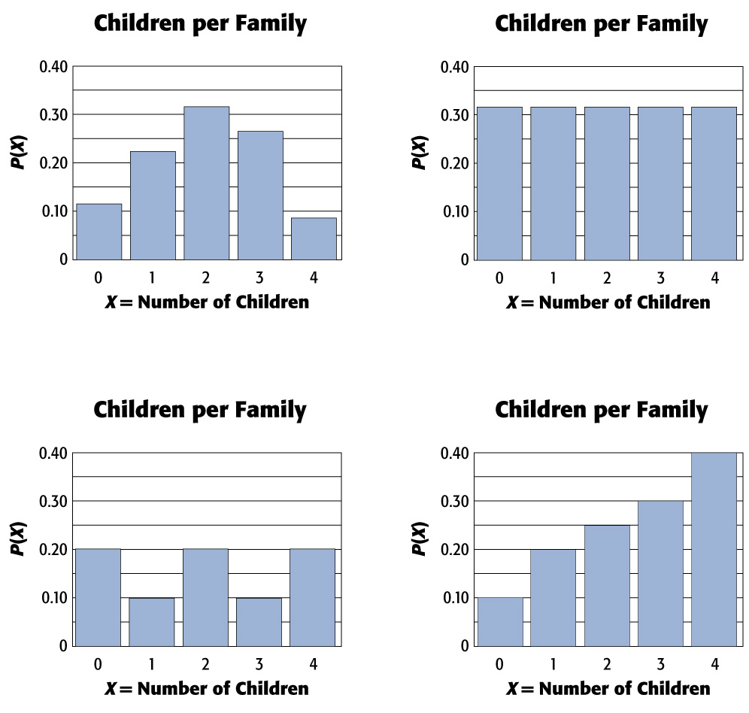
Example 2
C. Make a probability graph of the data.
A. B.
C. D.

Slide 24
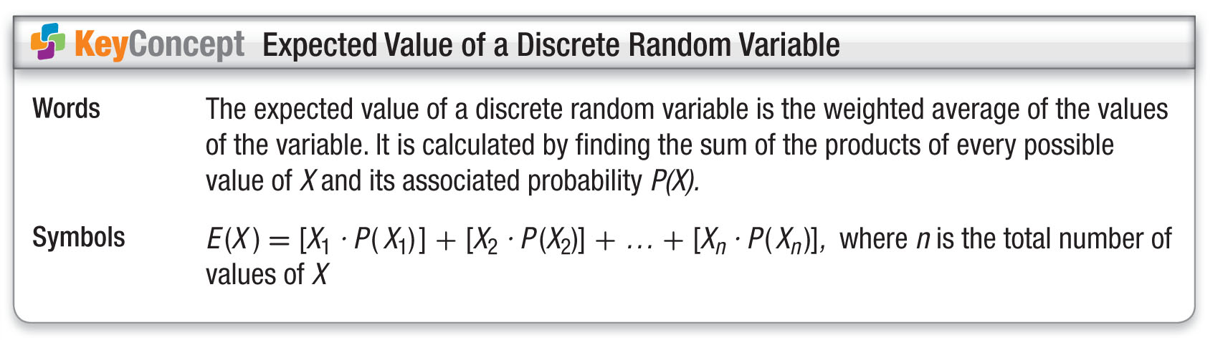
Concept

Slide 25
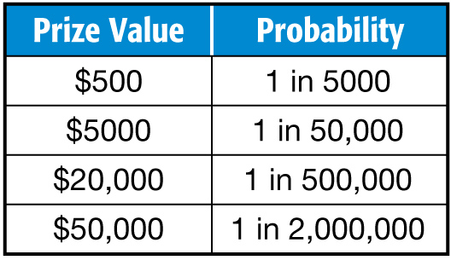
Example 3
Expected Value
Nikki paid $5 for an entry into a contest with the following prize values.
A. Create a probability distribution.
Find the probability associated with each prize.
Note that the probability of winning $0 is found by subtracting the probability of winning something from 1.

Slide 26
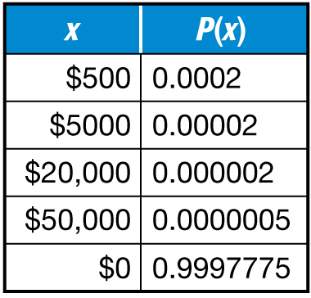
Example 3
Expected Value
Answer:

Slide 27
Example 3
Expected Value
Nikki paid $5 for an entry into a contest with the following prize values.
B. Calculate the expected value.
E(X) = [X₁ ● P(X₁)] + [X₂ ● P(X₂)] + … + [X_{n} ● P(X_{n})]
= 500(0.0002) + 5000(0.00002) + 20,000(0.000002)
+ 50,000(0.0000005) + 0(0.999…)
= 0.1 + 0.1 + 0.04 + 0.025 + 0 or 0.265
Answer: The expected value is 0.265 or about $0.27.

Slide 28
Example 3
Expected Value
Nikki paid $5 for an entry into a contest with the following prize values.
C. Interpret your results.
Answer: The expected value of 0.265 means the following: One entry can be expected to win about $0.27 once the purchase is made. Assuming that the expected number of entries is sold, the maker of the contest makers can expect to spend about $0.27 per entry. Therefore, with a cost of $5, they expect to earn about $4.73 per entry.

Slide 29
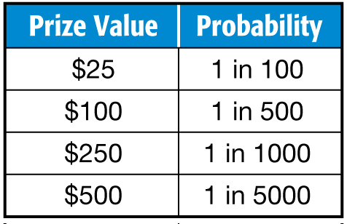
Example 3
Angie paid $1 for an entry into a contest with the following prize values. Calculate the expected value and interpret the results.
A. $0.80; The contest makers expect to lose $0.20 per entry.
B. $0.80; The contest makers expect to earn $0.80 per entry.
C. $0.80; The contest makers expect to earn $0.20 per entry.
D. $0.80; The contest makers expect to lose $0.80 per entry.

Slide 30
End of the Lesson

