Slide 1


Splash Screen

Slide 2
Lesson Menu
Five-Minute Check (over Chapter 1)
CCSS
Then/Now
New Vocabulary
Example 1: Translate Sentences into Equations
Example 2: Real-World Example: Use the Four-Step Problem-Solving Plan
Example 3: Write a Formula
Example 4: Translate Equations into Sentences
Example 5: Write a Problem

Slide 3

5-Minute Check 1
Choose the correct algebraic expression for the verbal expression twice the sum of a number and 7.
A. 2 + 7
B. 2 + n + 7
C. 2(n + 7)
D. 2 ● n ● 7

Slide 4


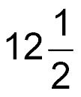
5-Minute Check 2
Evaluate y² + (xz + y) when x = 0.4, y = 3, z = .
A. 15
B.
C. 11.25
D. 9

Slide 5
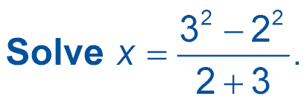

5-Minute Check 3
A. 5
B. 2
C. 1
D. 0

Slide 6

5-Minute Check 4
Rewrite (5b – 6)2 + 3b in simplest form.
A. 13b – 12
B. 8b – 4
C. 7b + 4
D. 2b – 4

Slide 7

5-Minute Check 5
Find a counterexample for the conditional statement.
If you square a number, the result will be greater than or equal to the original number.
A. 0 < n < 1
B. n = 0
C. n = 1
D. 100 < n

Slide 8

5-Minute Check 5
Which is a true statement?
A. The square root of any whole number is a whole number.
B. The absolute value of any nonzero rational number is positive.
C. All functions are relations, so all relations are functions.
D. All linear equations have only one solution.

Slide 9

CCSS
Content Standards
A.CED.1 Create equations and inequalities in one variable and use them to solve problems.
Mathematical Practices
2 Reason abstractly and quantitatively.
Common Core State Standards © Copyright 2010. National Governors Association Center for Best Practices and Council of Chief State School Officers. All rights reserved.

Slide 10


Then/Now
You evaluated and simplified algebraic
expressions.
Translate sentences into equations.
Translate equations into sentences.

Slide 11

Vocabulary
formula

Slide 12

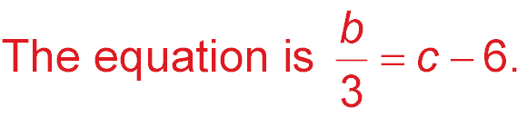
Example 1
Translate Sentences into Equations
A. Translate this sentence into an equation.
A number b divided by three is equal to six less than c.
b divided by three is equal to six less than c.
= c – 6
Answer:

Slide 13
Example 1
Translate Sentences into Equations
B. Translate this sentence into an equation.
Fifteen more than z times six is y times two minus eleven.
Fifteen more than z times six is y times two minus eleven.
15 + z × 6 = y × 2 – 11
Answer: The equation is 15 + 6z = 2y – 11.

Slide 14


Example 1
A. Translate this sentence into an equation.
A number c multiplied by six is equal to two more than d.
A. 6c = d + 2
B. 2c = d + 6
C. c = d + 2
D. c = 6(d + 2)

Slide 15
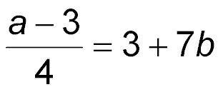
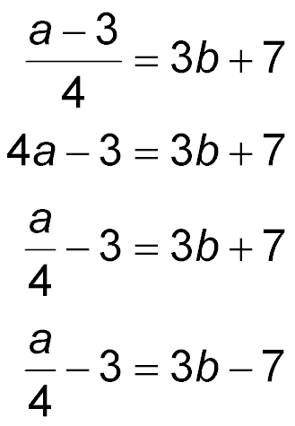
Example 1
B. Translate this sentence into an equation.
Three less than a number a divided by four is seven more than 3 times b.
A.
B.
C.
D.

Slide 16
Example 2
Use the Four-Step
Problem-Solving Plan
JELLY BEANS A jelly bean manufacturer produces 1,250,000 jelly beans per hour. How many hours does it take them to produce 10,000,000 jelly beans?
Understand You know that 1,250,000 jelly beans
are produced each hour. You want to
know how many hours it will take to
produce 10,000,000 jelly beans.
Plan Write an equation to represent the
situation. Let h represent the number
of hours needed to produce the jelly
beans.

Slide 17
Example 2
Use the Four-Step
Problem-Solving Plan
1,250,000 times hours equals 10,000,000.
1,2500,000 × h = 10,000,000
Solve 1,250,000h = 10,000,000
Find h mentally by asking, “What number times 125 equals 1000?”
h = 8
Answer: It will take 8 hours to produce
10,000,000 jellybeans.
Check If 1,250,000 jelly beans are produced in one hour, then 1,250,000 x 8 or 10,000,000 jelly beans are produced in 8 hours. The answer makes sense.

Slide 18
Example 2
A person at the KeyTronic World Invitational
Type-Off typed 148 words per minute. How many minutes would it take to type 3552 words?
A. 148 minutes
B. 30 minutes
C. 3552 minutes
D. 24 minutes

Slide 19
Example 3
Write a Formula
GEOMETRY Translate the sentence into a formula. The perimeter of a square equals four times the length of a side.
Words Perimeter equals four times the length of a side.
Variables Let P = perimeter and s = length of a side.
Perimeter equals four times the length
of a side.
Formula P = 4s
Answer: The formula is P = 4s.

Slide 20
Example 3
Translate the sentence into a formula.
The area of a circle equals the product of π and the square of the radius r.
A. A = π + r²
B. A = πr²
C. A = 2πr
D. A = 2r + π

Slide 21
Example 4
Translate Equations into Sentences
A. Translate the equation into a verbal sentence.
12 – 2x = –5
12 – 2x = –5
Twelve minus two times x equals negative five.
Answer: Twelve minus two times x equals negative five.

Slide 22
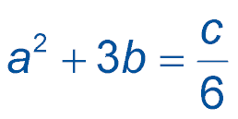

Example 4
Translate Equations into Sentences
B. Translate the equation into a verbal sentence.
a² + 3b =
a squared plus three times b equals c divided by 6.
Answer: a squared plus three times b equals c divided by six.

Slide 23
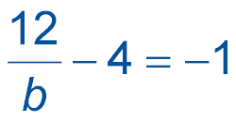
Example 4
A. Translate the equation into a verbal sentence.
A. Twelve minus four divided by b is negative one.
B. Twelve less than four divided by b equals negative one.
C. Four minus twelve divided by b equals negative one.
D. Twelve divided by b minus four equals negative one.

Slide 24
Example 4
B. Translate the equation into a verbal sentence.
5a = b² + 1
A. Five plus a equals b squared plus one.
B. Five times a equals twice b plus one.
C. Five times a equals b squared plus one.
D. The quotient of five and a equals b squared plus one.

Slide 25
Example 5
Write a Problem
Write a problem based on the given information.
f = cost of fries f + 1.50 = cost of burger
4(f + 1.50) – f = 8.25
Answer: The cost of a burger is $1.50 more than the cost of fries. Four times the cost of a burger minus the cost of fries equals $8.25. How much do fries cost?

Slide 26
Example 5
Write a problem based on the given information.
h = Tiana's height in inches
h – 3 = Consuelo's height in inches
3h(h – 3) = 8262
A. Consuelo is 3 inches shorter than Tiana. The product of Consuelo’s height and three times Tiana’s is 8262. How tall is Tiana?
B. Consuelo is 3 inches taller than Tiana. The product of Consuelo's height and three times Tiana's is 8262. How tall is Tiana?
C. Consuelo is 3 inches shorter than Tiana. The sum of Consuelo's height and three times Tiana's is 8262. How tall is Tiana?
D. Tiana is 3 inches shorter than Consuelo. The product of Consuelo's height and three times Tiana's is 8262. How tall is Tiana?

Slide 27
End of the Lesson

