Slide 1


Splash Screen

Slide 2
Lesson Menu
Five-Minute Check (over Lesson 2–1)
CCSS
Then/Now
New Vocabulary
Key Concept: Addition Property of Equality
Example 1: Solve by Adding
Key Concept: Subtraction Property of Equality
Example 2: Solve by Subtracting
Key Concept: Multiplication and Division Property of Equality
Example 3: Solve by Multiplying and Dividing
Example 4: Real-World Example: Solve by Multiplying

Slide 3

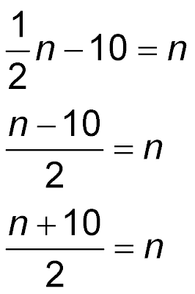
5-Minute Check 1
Translate the sentence into an equation.
Half a number minus ten equals the number.
A.
B. n – 10 = n
C.
D.

Slide 4

5-Minute Check 2
Translate the sentence into an equation.
The sum of c and twice d is the same as 20.
A. c + 2 + d = 20
B. c – 2d = 20
C. c + 2d = 20
D. 2cd = 20

Slide 5

5-Minute Check 3
Translate the equation, 10(a – b) = b + 3, into a verbal sentence.
A. Ten times the difference of
a and b is b times 3.
B. Ten times the difference of
a and b equals b plus 3.
C. Ten more than a minus b is
3 more than b.
D. Ten times a plus b is 3 times b.

Slide 6

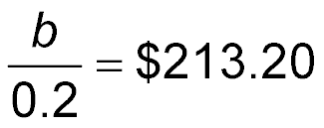
5-Minute Check 4
The sale price of a bike after being discounted 20% is $213.20. Which equation can you use to find the original cost of the bike b?
A. b – 0.2b = $213.20
B. b + 0.2b = $213.20
C.
D. 0.2b = $213.20

Slide 7

5-Minute Check 5
Rachel bought some clothes for $32 from last week’s paycheck. She saved $58 after her purchase. Write an equation to represent how much money Rachel had before her purchase.
A. t = 58 – 32
B. 58 – t = 32
C. t + 58 + 32 = 0
D. t – 32 = 58

Slide 8

CCSS
Content Standards
A.REI.1 Explain each step in solving a simple equation as following from the equality of numbers asserted at the previous step, starting from the assumption that the original equation has a solution. Construct a viable argument to justify a solution method.
A.REI.3 Solve linear equations and inequalities in one variable, including equations with coefficients represented by letters.
Mathematical Practices
6 Attend to precision.
Common Core State Standards © Copyright 2010. National Governors Association Center for Best Practices and Council of Chief State School Officers. All rights reserved.

Slide 9


Then/Now
You translated sentences into equations.
Solve equations by using addition and subtraction.
Solve equations by using multiplication and division.

Slide 10

Vocabulary
solve an equation
equivalent equations

Slide 11
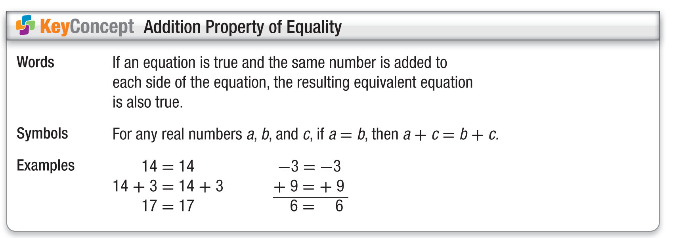
Concept 1

Slide 12
Example 1
Solve by Adding
Solve h – 12 = –27. Then check your solution.
h – 12 = –27 Original equation
h – 12 + 12 = –27 + 12 Add 12 to each side.
h = –15 Simplify.
Answer: h = –15

Slide 13
Example 1
Solve by Adding
To check that –15 is the solution, substitute –15 for h in the original equation.
h – 12 = –27 Original equation
?
–15 – 12 = –27 Replace h with –15.
✓
–27 = –27 Simplify.

Slide 14


Example 1
Solve a – 24 = 16. Then check your solution.
A. 40
B. –8
C. 8
D. –40

Slide 15
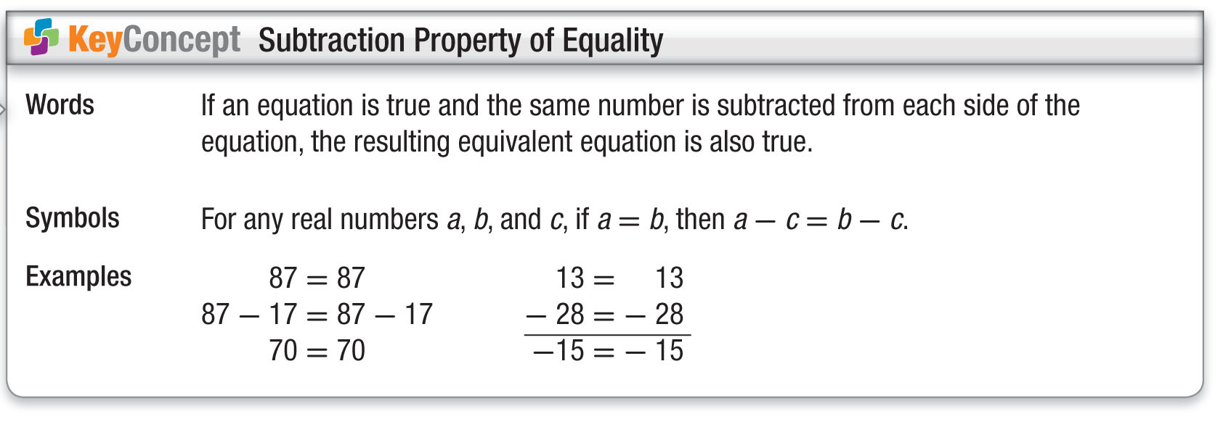
Concept 2

Slide 16
Example 2
Solve by Subtracting
Solve c + 102 = 36. Then check your solution.
c + 102 = 36 Original equation
c + 102 – 102 = 36 – 102 Subtract 102 from each side.
Answer: c = –66
To check that –66 is the solution, substitute –66 for c in the original equation.
c + 102 = 36 Original equation
–66 + 102 = 36 Replace c with –66.
✓
36 = 36 Simplify.

Slide 17
Example 2
Solve 129 + k = –42. Then check your solution.
A. 87
B. –171
C. 171
D. –87

Slide 18
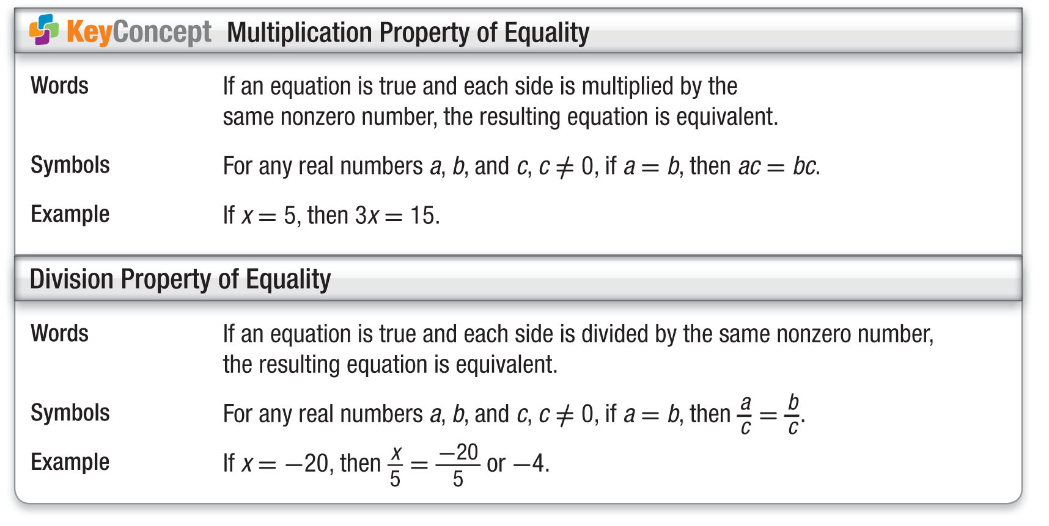
Concept 3

Slide 19

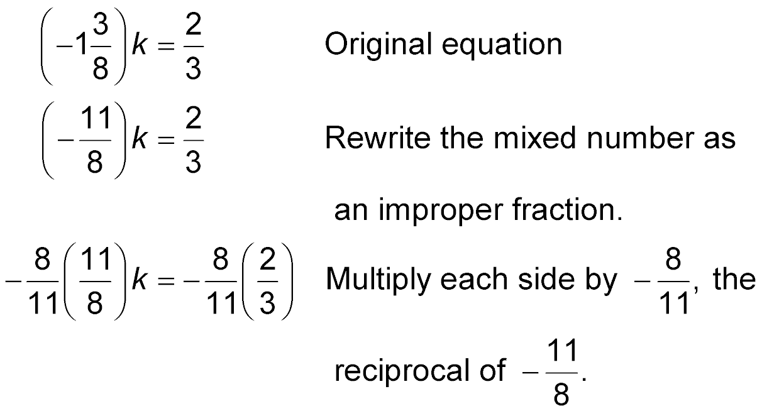
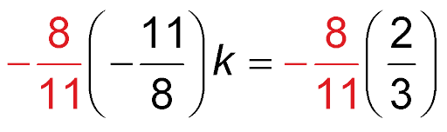
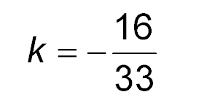
Example 3
Solve by Multiplying and Dividing
A.
Rewrite the mixed number as an improper fraction.

Slide 20
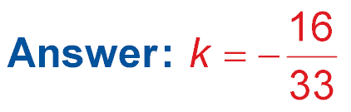
Example 3
Solve by Multiplying and Dividing

Slide 21
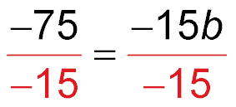
Example 3
Solve by Multiplying and Dividing
B. Solve –75 = –15b.
–75 = –15b Original equation
Divide each side by –15.
5 = b Check the result.
Answer: 5 = b

Slide 22

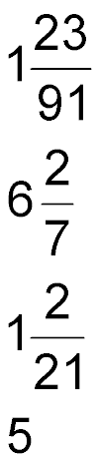
Example 3
A.
A.
B.
C.
D. 5

Slide 23
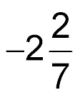
Example 3
B. Solve 32 = –14c.
A. –3
B. 46
C. 18
D.

Slide 24

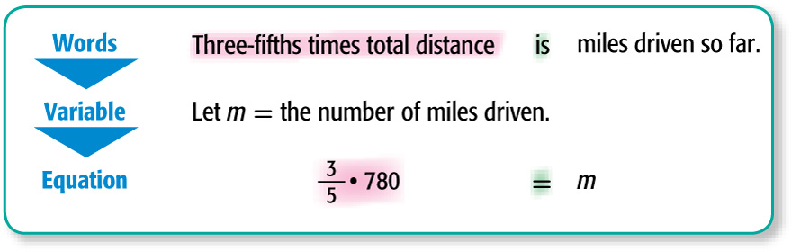
Example 4
Solve by Multiplying
TRAVEL Ricardo is driving 780 miles to Memphis. He drove about of the distance on the first day. About how many miles did Ricardo drive?

Slide 25
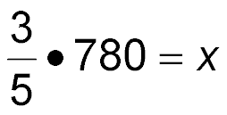
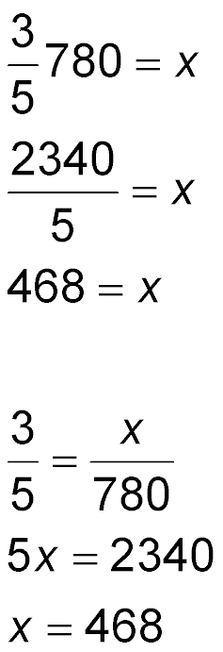
Example 4
Solve by Multiplying
Original equation
Multiply.
Simplify.
Answer: Ricardo drove about 468 miles on the first day.

Slide 26
Example 4
Water flows through a hose at a rate of 5 gallons per minute. How many hours will it take to fill a 2400-gallon swimming pool?
A. 4 h
B. 6 h
C. 8 h
D. 16 h

Slide 27
End of the Lesson

