Slide 1


Splash Screen

Slide 2
Lesson Menu
Five-Minute Check (over Lesson 2–2)
CCSS
Then/Now
New Vocabulary
Example 1: Solve Multi-Step Equations
Example 2: Real-World Example: Write and Solve a
Multi-Step Equation
Concept Summary: Consecutive Integers
Example 3: Solve a Consecutive Integer Problem

Slide 3

5-Minute Check 1
Solve z – 11 = 15.
A. 4
B. 6
C. 26
D. 28

Slide 4

5-Minute Check 2
Solve 2.4 + w = –1.9.
A. –4.3
B. –0.5
C. 0.5
D. 4.3

Slide 5

5-Minute Check 3
Solve 28 = x – (–5).
A. 34
B. 32
C. 25
D. 23

Slide 6

5-Minute Check 4
Write an equation for a number decreased by –4 is equal to 15. Then solve the equation.
A. n ÷ (–4) = 15; n = –60
B. n – (–4) = 15; n = 11
C. n – 4 = 15; n = 19
D. n – (–4) = 15; n = 19

Slide 7

5-Minute Check 5
A farmer planted 35 more acres of corn this year than last year. If he planted 200 acres of corn this year, how many acres did he plant last year?
A. 220 acres
B. 205 acres
C. 184 acres
D. 165 acres

Slide 8

5-Minute Check 5
A plane travels at 380 miles per hour. How many hours does it take for this plane to travel 2090 miles, if it maintains the same speed?
A. 5.5 hours
B. 6 hours
C. 6.5 hours
D. 7 hours

Slide 9

CCSS
Content Standards
A.REI.1 Explain each step in solving a simple equation as following from the equality of numbers asserted at the previous step, starting from the assumption that the original equation has a solution. Construct a viable argument to justify a solution method.
A.REI.3 Solve linear equations and inequalities in one variable, including equations with coefficients represented by letters.
Mathematical Practices
8 Look for and express regularity in repeated reasoning.
Common Core State Standards © Copyright 2010. National Governors Association Center for Best Practices and Council of Chief State School Officers. All rights reserved.

Slide 10


Then/Now
You solved single-step equations.
Solve equations involving more than one operation.
Solve equations involving consecutive integers.

Slide 11

Vocabulary
multi-step equation
consecutive integers
number theory

Slide 12
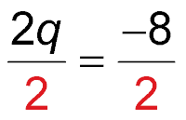
Example 1
Solve Multi-Step Equations
A. Solve 2q + 11 = 3. Check your solution.
2q + 11 = 3 Original equation
2q + 11 – 11 = 3 – 11 Subtract 11 from each side.
2q = –8 Simplify.
Divide each side by 2.
q = –4 Simplify.
Answer: q = –4
To check, substitute –4 for q in the original equation.

Slide 13
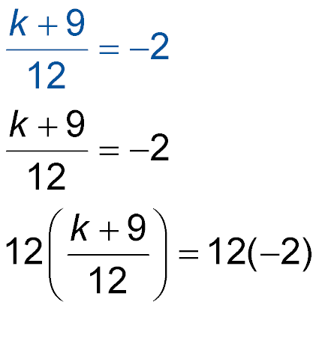
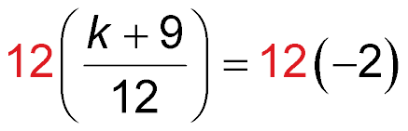
Example 1
Solve Multi-Step Equations
B. Solve . Check your solution.
Original equation
Multiply each side by 12.
k + 9 = –24
Simplify.
k + 9 – 9 = –24 – 9
Subtract 9 from each side.

Slide 14
Example 1
Solve Multi-Step Equations
k = –33
Simplify.
Answer: k = –33
To check, substitute –33 for k in the original equation.

Slide 15


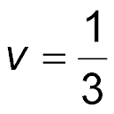
Example 1
A. Solve 6v + 7 = –5. Check your solution.
A. v = –2
B. v = –6
C. v = 2
D.

Slide 16
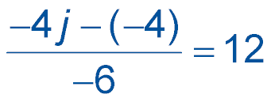
Example 1
B. Solve . Check your solution.
A. j = 17
B. j = –17
C. j = 19
D. j = –19

Slide 17
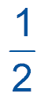
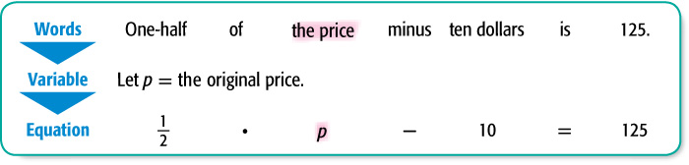
Example 2
Write and Solve a Multi-Step Equation
SHOPPING Susan had a $10 coupon for the purchase
of any item. She bought a coat that was its original
price. After using the coupon, Susan paid $125 for the coat before taxes. What was the original price of the coat? Write an equation for the problem. Then solve the equation.

Slide 18
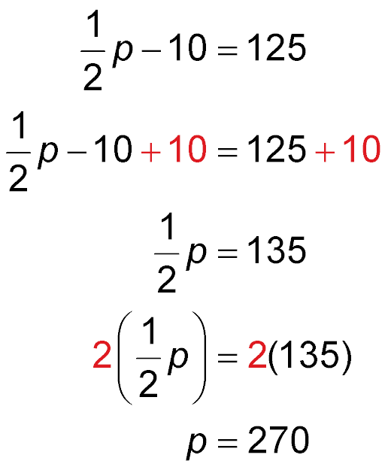
Example 2
Write and Solve a Multi-Step Equation
Original equation
Add 10 to each side.
Simplify.
Multiply each side by 2.
p = 270 Simplify.
Answer: The original price of the coat was $270.

Slide 19
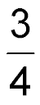
Example 2
Three-fourths of the difference of a number and 7 is negative fifteen. What is the number?
A. –13
B. –15
C.
D. 7

Slide 20
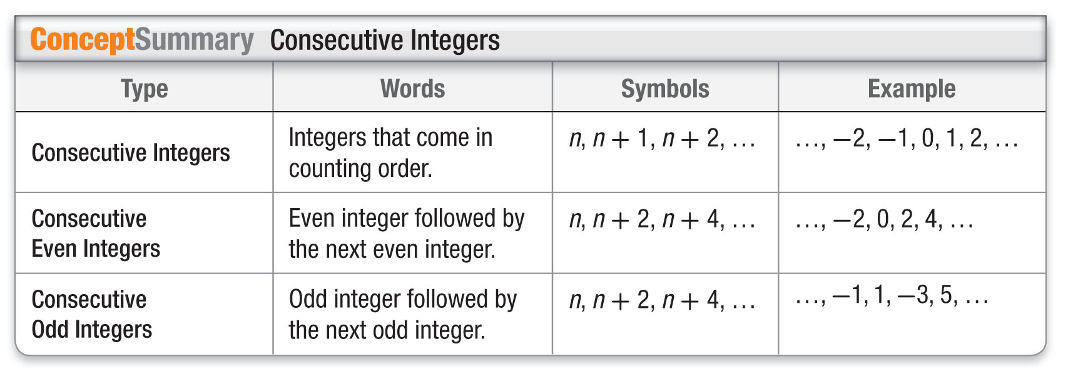
Concept

Slide 21
Example 3
Solve a Consecutive Integer Problem
NUMBER THEORY Write an equation for the problem below. Then solve the equation and answer the problem.
Find three consecutive odd integers whose sum is 57.
Let n = the least odd integer.
Let n + 2 = the next greater odd integer.
Let n + 4 = the greatest of the three odd integers.
The sum of three consecutive odd integers is 57.
n + (n + 2) + (n + 4) = 57

Slide 22
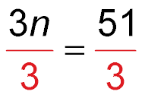
Example 3
Solve a Consecutive Integer Problem
n + (n + 2) + (n + 4) = 57 Original equation
3n + 6 = 57 Simplify.
3n + 6 – 6 = 57 – 6 Subtract 6 from each side.
3n = 51 Simplify.
Divide each side by 3.
n = 17 Simplify.
n + 2 = 17 + 2 or 19
n + 4 = 17 + 4 or 21
Answer: The consecutive odd integers are 17, 19,
and 21.

Slide 23
Example 3
Find three consecutive even integers whose sum
is 84.
A. 28, 30, 32
B. 26, 28, 30
C. 20, 20, 24
D. 40, 20, 24

Slide 24
End of the Lesson

