Slide 1


Splash Screen

Slide 2
Lesson Menu
Five-Minute Check (over Lesson 2–3)
CCSSS
Then/Now
New Vocabulary
Example 1: Solve an Equation with Variables on Each Side
Example 2: Solve an Equation with Grouping Symbols
Example 3: Find Special Solutions
Concept Summary: Steps for Solving Equations
Example 4: Standardized Test Example

Slide 3

5-Minute Check 1
Solve –56 = 7y.
A. 8
B. 6
C. –8
D. –9

Slide 4
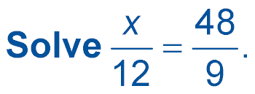

5-Minute Check 2
A. 82
B. 64
C. 58
D. 51

Slide 5

5-Minute Check 3
Solve 5w = –27.5.
A. 32.5
B. 5.5
C. –5.5
D. –22.5

Slide 6


5-Minute Check 4
Write an equation for negative three times a number is negative thirty. Then solve the equation.
A. –3n = –30; 10
B. –3n = 30; –10
C. –3 = –30n;
D. –3 + n = –30; –27

Slide 7

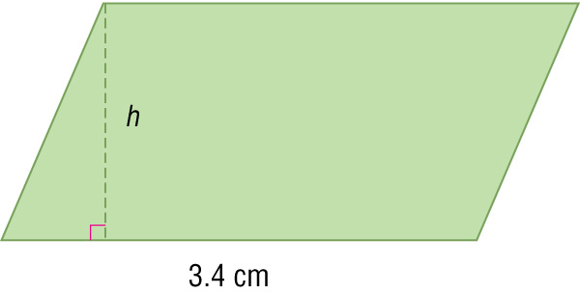
5-Minute Check 5
What is the height of the parallelogram if the area is 7.82 square centimeters?
A. 5.3 cm
B. 3.2 cm
C. 3.1 cm
D. 2.3 cm

Slide 8

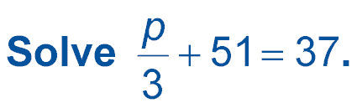
5-Minute Check 5
–
A. p = –14
B. p = 14
C. p = –42
D. p = 42

Slide 9

CCSS
Content Standards
A.REI.1 Explain each step in solving a simple equation as following from the equality of numbers asserted at the previous step, starting from the assumption that the original equation has a solution. Construct a viable argument to justify a solution method.
A.REI.3 Solve linear equations and inequalities in one variable, including equations with coefficients represented by letters.
Mathematical Practices
1 Make sense of problems and persevere in solving them.
5 Use appropriate tools strategically.
Common Core State Standards © Copyright 2010. National Governors Association Center for Best Practices and Council of Chief State School Officers. All rights reserved.

Slide 10


Then/Now
You solved multi-step equations.
Solve equations with the variable on each side.
Solve equations involving grouping symbols.

Slide 11

Vocabulary
identity

Slide 12
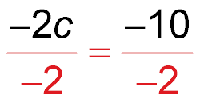
Example 1
Solve an Equation with Variables on Each Side
Solve 8 + 5c = 7c – 2. Check your solution.
8 + 5c = 7c – 2 Original equation
– 7c = – 7c Subtract 7c from each side.
8 – 2c = –2 Simplify.
– 8 = – 8 Subtract 8 from each side.
–2c = –10 Simplify.
Divide each side by –2.
Answer: c = 5 Simplify.
To check your answer, substitute 5
for c in the original equation.

Slide 13




Example 1
Solve 9f – 6 = 3f + 7.
A.
B.
C.
D. 2

Slide 14

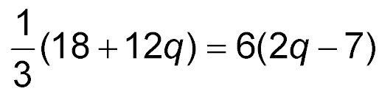
Example 2
Solve an Equation with Grouping Symbols
Original equation
6 + 4q = 12q – 42 Distributive Property
6 + 4q – 12q = 12q – 42 – 12q Subtract 12q from each side.
6 – 8q = –42 Simplify.
6 – 8q – 6 = –42 – 6 Subtract 6 from each side.
–8q = –48 Simplify.

Slide 15
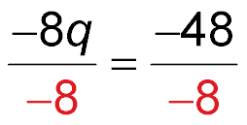
Example 2
Solve an Equation with Grouping Symbols
Divide each side by –8.
q = 6 Simplify.
Answer: q = 6
To check, substitute 6 for q in the original equation.

Slide 16
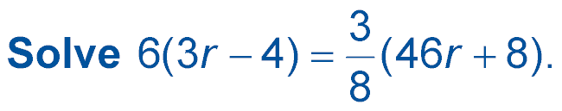
Example 2
A. 38
B. 28
C. 10
D. 36

Slide 17
Example 3
Find Special Solutions
A. Solve 8(5c – 2) = 10(32 + 4c).
8(5c – 2) = 10(32 + 4c) Original equation
40c – 16 = 320 + 40c Distributive Property
40c – 16 – 40c = 320 + 40c – 40c Subtract 40c from each side.
–16 = 320 This statement is false.
Answer: Since –16 = 320 is a false statement, this equation has no solution.

Slide 18
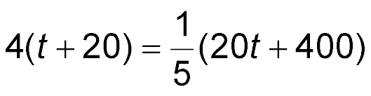
Example 3
Find Special Solutions
B. Solve .
Original equation
4t + 80 = 4t + 80 Distributive Property
Answer: Since the expression on each side of the
equation is the same, this equation is an identity. The statement 4t + 80 = 4t + 80 is true for all values of t.

Slide 19
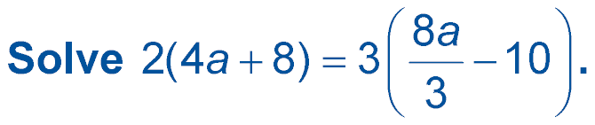
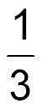
Example 3
A.
A.
B. 2
C. true for all values of a
D. no solution

Slide 20
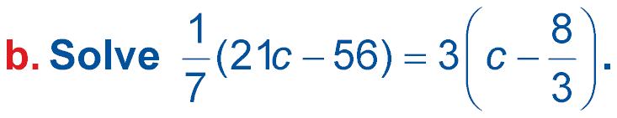
Example 3
B.
A.
B. 0
C. true for all values of c
D. no solution

Slide 21
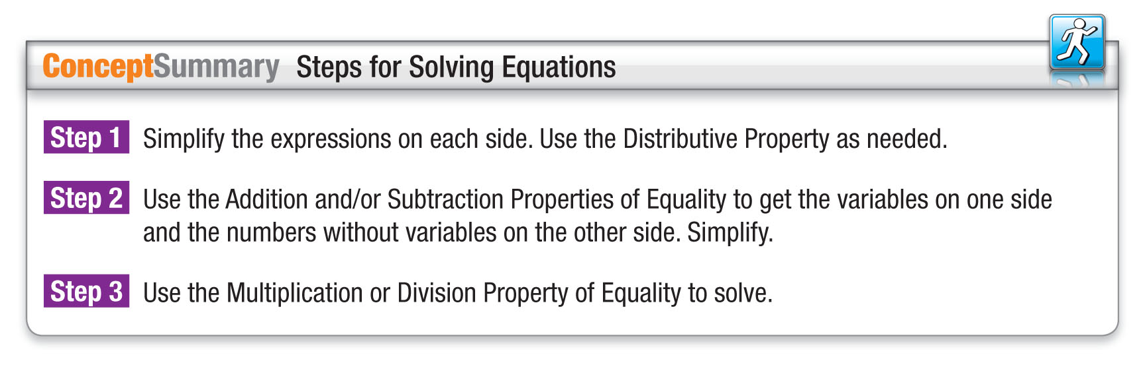
Concept

Slide 22
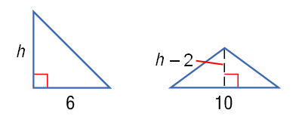
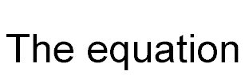
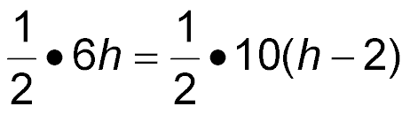
Example 4
Find the value of h so that the figures have the same area.
A 1 B 3 C 4 D 5
Read the Test Item
represents this situation.
Solve the Test Item
You can solve the equation or substitute each value into the equation and see if it makes the equation true. We
will solve by substitution.

Slide 23
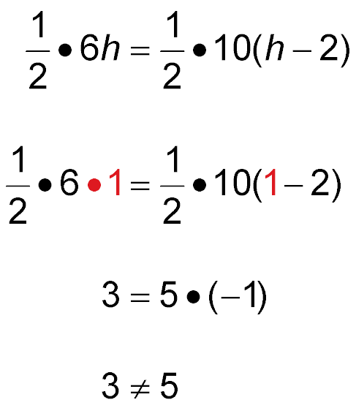
Example 4
A: Substitute 1 for h.

Slide 24
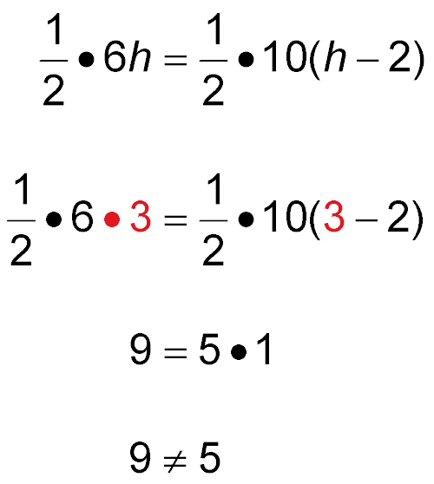
Example 4
B: Substitute 3 for h.

Slide 25
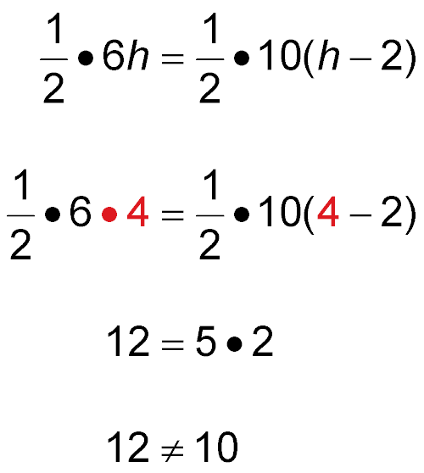
Example 4
C: Substitute 4 for h.

Slide 26
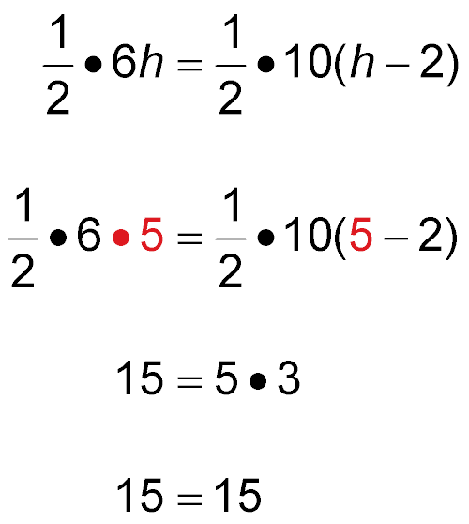
Example 4
D: Substitute 5 for H.
✓
Answer: Since the value 5 makes the statement true, the answer is D.

Slide 27
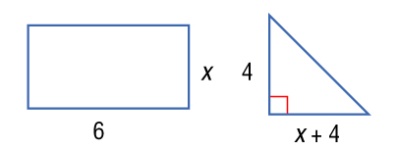
Example 4
Find the value of x so that the figures have the same area.
A. 1
B. 2
C. 3
D. 4

Slide 28
End of the Lesson

