Slide 1


Splash Screen

Slide 2
Lesson Menu
Five-Minute Check (over Lesson 2–4)
CCSS
Then/Now
Example 1: Expressions with Absolute Value
Key Concept: Absolute Value Equations
Example 2: Solve Absolute Value Equations
Example 3: Real-World Example: Solve an Absolute Value Equation
Example 4: Write an Absolute Value Equation

Slide 3

5-Minute Check 1
Solve 8y + 3 = 5y + 15.
A. –4
B. –1
C. 4
D. 13

Slide 4


5-Minute Check 2
Solve 4(x + 3) – 14 = 7(x – 1).
A. 15
B. 2
C.
D.

Slide 5

5-Minute Check 3
Solve 2.8w – 3 = 5w – 0.8.
A. –1
B. 0
C. 1
D. 2.2

Slide 6

5-Minute Check 4
Solve 5(x + 3) + 2 = 5x + 17.
A. 50
B. 25
C. 2
D. all numbers

Slide 7

5-Minute Check 5
An even integer divided by 10 is the same as the next consecutive even integer divided by 5. What are the two integers?
A. 2, 4
B. 4, 6
C. –4, –2
D. –6, –4

Slide 8

5-Minute Check 5
Solve 12w + 4(6 – w) = 2w + 60.
A. w = 6
B. w = –6
C. w = 7
D. w = –7

Slide 9

CCSS
Content Standards
A.REI.1 Explain each step in solving a simple equation as following from the equality of numbers asserted at the previous step, starting from the assumption that the original equation has a solution. Construct a viable argument to justify a solution method.
A.REI.3 Solve linear equations and inequalities in one variable, including equations with coefficients represented by letters.
Mathematical Practices
3 Construct viable arguments and critique the reasoning of others.
7 Look for and make use of structure.
Common Core State Standards © Copyright 2010. National Governors Association Center for Best Practices and Council of Chief State School Officers. All rights reserved.

Slide 10


Then/Now
You solved equations with the variable on each side.
Evaluate absolute value expressions.
Solve absolute value equations.

Slide 11
Example 1
Expressions with Absolute Value
Evaluate |a – 7| + 15 if a = 5.
|a – 7| + 15 = |5 – 7| + 15 Replace a with 5.
= |–2| + 15 5 – 7 = –2
= 2 + 15 |–2| = 2
= 17 Simplify.
Answer: 17

Slide 12


Example 1
Evaluate |17 – b| + 23 if b = 6.
A. 17
B. 24
C. 34
D. 46

Slide 13
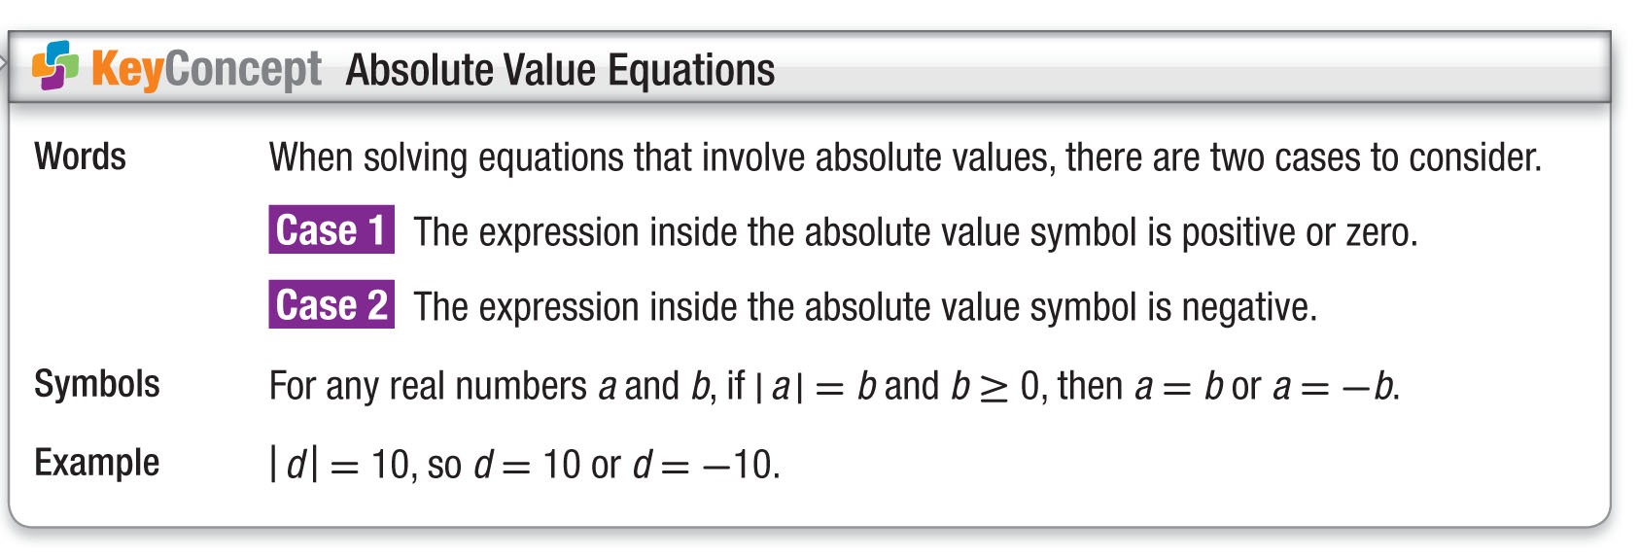
Concept

Slide 14
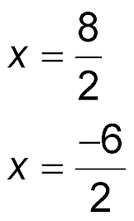
Example 2
Solve Absolute Value Equations
A. Solve |2x – 1| = 7. Then graph the solution set.
|2x – 1| = 7 Original equation
Case 1 Case 2
2x – 1 = 7 2x – 1 = –7
2x – 1 + 1 = 7 + 1 Add 1 to each side. 2x – 1 + 1 = –7 + 1
2x = 8 Simplify. 2x = –6
Divide each side by 2.
x = 4 Simplify. x = –3

Slide 15
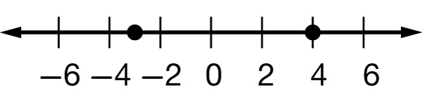
Example 2
Solve Absolute Value Equations
Answer: {–3, 4}

Slide 16
Example 2
Solve Absolute Value Equations
B. Solve |p + 6| = –5. Then graph the solution set.
|p + 6| = –5 means the distance between p and 6 is –5. Since distance cannot be negative, the solution is the empty set Ø.
Answer: Ø

Slide 17
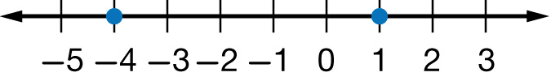
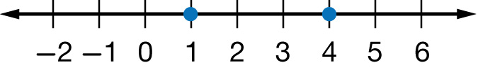
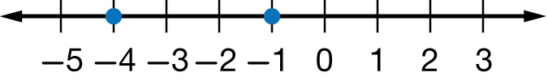
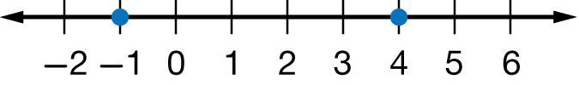
Example 2
A. Solve |2x + 3| = 5. Graph the solution set.
A. {1, –4}
B. {1, 4}
C. {–1, –4}
D. {–1, 4}

Slide 18

Example 2
B. Solve |x – 3| = –5.
A. {8, –2}
B. {–8, 2}
C. {8, 2}
D.

Slide 19
Example 3
Solve an Absolute Value Equation
WEATHER The average January temperature in a northern Canadian city is 1°F. The actual January temperature for that city may be about 5°F warmer or colder. Write and solve an equation to find the maximum and minimum temperatures.
Method 1 Graphing
|t – 1| = 5 means that the distance between t and 1 is
5 units. To find t on the number line, start at 1 and move 5 units in either direction.

Slide 20
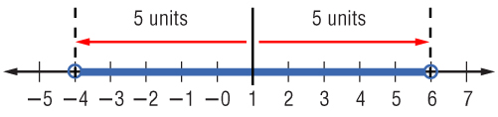
Example 3
Solve an Absolute Value Equation
The distance from 1 to 6 is
5 units.
The distance from 1 to –4 is
5 units.
The solution set is {–4, 6}.

Slide 21
Example 3
Solve an Absolute Value Equation
Method 2 Compound Sentence
Write |t – 1| = 5 as t – 1 = 5 or t – 1 = –5.
Case 1
Case 2
t – 1 = 5
t – 1 = –5
t – 1 + 1 = 5 + 1 Add 1 to
each side.
t – 1 + 1 = –5 + 1
t = 6 Simplify.
t = –4
Answer: The solution set is {–4, 6}. The maximum and minimum temperatures are –4°F and 6°F.

Slide 22
Example 3
WEATHER The average temperature for Columbus on Tuesday was 45ºF. The actual temperature for anytime during the day may have actually varied from the average temperature by 15ºF. Solve to find the maximum and minimum temperatures.
A. {–60, 60}
B. {0, 60}
C. {–45, 45}
D. {30, 60}

Slide 23

Example 4
Write an Absolute Value Equation
Write an equation involving absolute value for the graph.
Find the point that is the same distance from –4 as the distance from 6. The midpoint between –4 and 6 is 1.

Slide 24
Example 4
Write an Absolute Value Equation
The distance from 1 to –4 is 5 units.
The distance from 1 to 6 is 5 units.
So, an equation is |y – 1| = 5.
Answer: |y – 1| = 5

Slide 25

Example 4
Write an equation involving the absolute value for the graph.
A. |x – 2| = 4
B. |x + 2| = 4
C. |x – 4| = 2
D. |x + 4| = 2

Slide 26
End of the Lesson

