Slide 1


Splash Screen

Slide 2
Lesson Menu
Five-Minute Check (over Lesson 2–5)
CCSS
Then/Now
New Vocabulary
Example 1: Determine Whether Ratios Are Equivalent
Key Concept: Means-Extremes Property of Proportion
Example 2: Cross Products
Example 3: Solve a Proportion
Example 4: Real-World Example: Rate of Growth
Example 5: Real-World Example: Scale and Scale Models

Slide 3

5-Minute Check 1
Express the statement using an equation involving absolute value. Do not solve. The fastest and slowest recorded speeds of a speedometer varied 3 miles per hour from the actual speed of 25 miles per hour.
A. s – 25 = 3
B. |s – 25| = 3
C. s = 3 < 25
D. s – 3 < 25

Slide 4

5-Minute Check 2
Solve |p + 3| = 5. Graph the solution set.
A. {–8, 2}
B. {–2, 2}
C. {–2, 8}
D. {2, 10}

Slide 5

5-Minute Check 3
Solve | j – 2| = 4. Graph the solution set.
A. {2, 6}
B. {–2, 6}
C. {2, –2}
D. {–6, 8}

Slide 6

5-Minute Check 4
Solve |2k + 1| = 7. Graph the solution set.
A. {5, 3}
B. {4, 3}
C. {–4, –3}
D. {–4, 3}

Slide 7

5-Minute Check 5
A refrigerator is guaranteed to maintain a temperature no more than 2.4°F from the set temperature. If the refrigerator is set at 40°F, what are the least and greatest temperatures covered by the guarantee?
A. {34.8°F, 40.4°F}
B. {36.8°F, 42.1°F}
C. {37.6°F, 42.4°F}
D. {38.7°F, 43.6°F}

Slide 8

5-Minute Check 6
Solve |x + 8| = 13.
A. x = 5, 21
B. x = –5, 21
C. x = 5, –21
D. x = –5, –21

Slide 9

CCSS
Content Standards
A.REI.1 Explain each step in solving a simple equation as following from the equality of numbers asserted at the previous step, starting from the assumption that the original equation has a solution. Construct a viable argument to justify a solution method.
A.REI.3 Solve linear equations and inequalities in one variable, including equations with coefficients represented by letters.
Mathematical Practices
6 Attend to precision.
Common Core State Standards © Copyright 2010. National Governors Association Center for Best Practices and Council of Chief State School Officers. All rights reserved.

Slide 10


Then/Now
You evaluated percents by using a proportion.
Compare ratios.
Solve proportions.

Slide 11

Vocabulary
ratio
proportion
means
extremes
rate
unit rate
scale
scale model

Slide 12
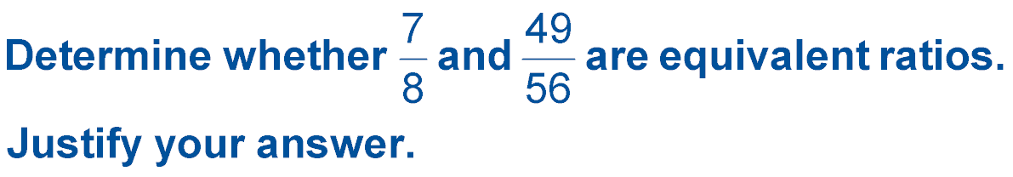

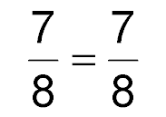
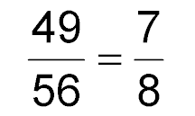

Example 1
Determine Whether Ratios Are Equivalent
÷1
÷7
÷1
÷7
Answer: Yes; when expressed in simplest form, the ratios are equivalent.

Slide 13



Example 1
A. They are not equivalent ratios.
B. They are equivalent ratios.
C. cannot be determined

Slide 14
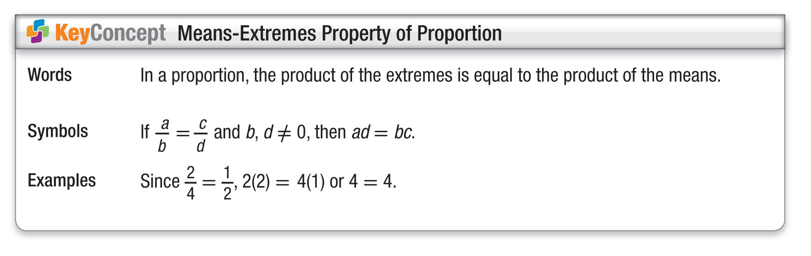
Concept

Slide 15
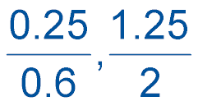
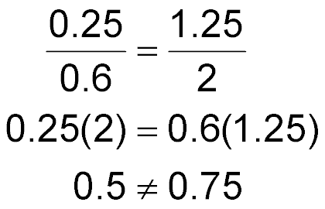

Example 2
Cross Products
A. Use cross products to determine whether the pair
of ratios below forms a proportion.
?
Original proportion
?
Find the cross products.
Simplify.
Answer: The cross products are not equal, so the ratios do not form a proportion.

Slide 16
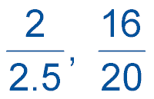
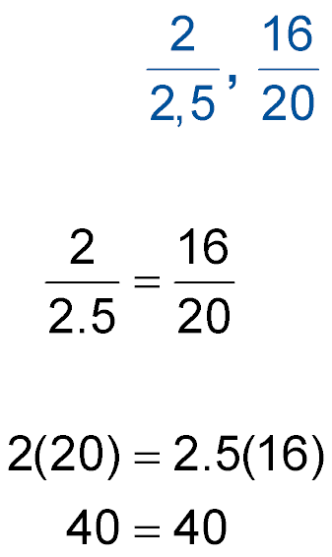

Example 2
Cross Products
B. Use cross products to determine whether the pair of ratios below forms a proportion.
?
Original proportion
?
Find the cross products.
Simplify.
Answer: The cross products are equal, so the ratios form a proportion.

Slide 17
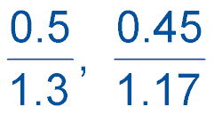
Example 2A
A. Use cross products to determine whether the pair of ratios below forms a proportion.
A. The ratios do form a proportion.
B. The ratios do not form a proportion.
C. cannot be determined

Slide 18
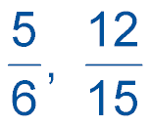
Example 2B
B. Use cross products to determine whether the pair of ratios below forms a proportion.
A. The ratios do form a proportion.
B. The ratios do not form a proportion.
C. cannot be determined

Slide 19
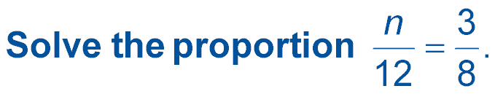
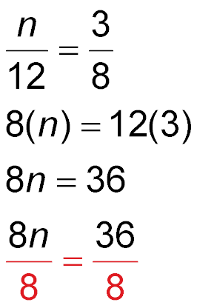
Example 3
Solve a Proportion
A.
Original proportion
Find the cross products.
Simplify.
Divide each side by 8.
Answer: n = 4.5 Simplify.

Slide 20
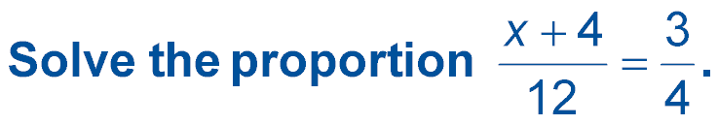
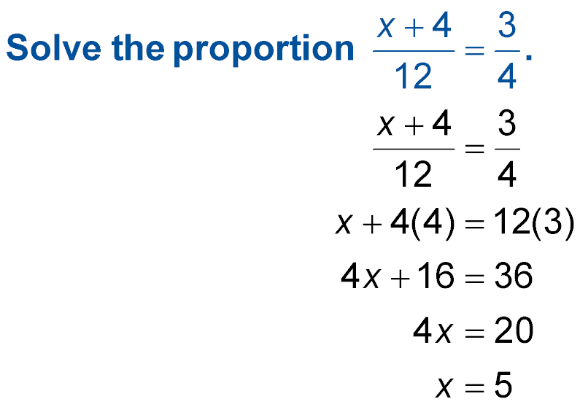

Example 3
Solve a Proportion
B.
Original proportion
Find the cross products.
Simplify.
Subtract 16 from each side.
Answer: x = 5 Divide each side by 4.

Slide 21

Example 3A
A.
A. 10
B. 63
C. 6.3
D. 70

Slide 22
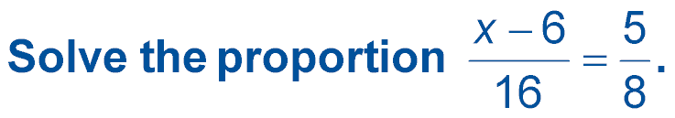
Example 3B
B.
A. 6
B. 10
C. –10
D. 16

Slide 23
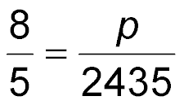
Example 4
Rate of Growth
BICYCLING The ratio of a gear on a bicycle is 8:5. This means that for every eight turns of the pedals, the wheel turns five times. Suppose the bicycle wheel turns about 2435 times during a trip. How many times would you have to crank the pedals during the trip?
Understand Let p represent the number pedal turns.
Plan Write a proportion for the problem and solve.
pedal turns
pedal turns
wheel turns
wheel turns

Slide 24
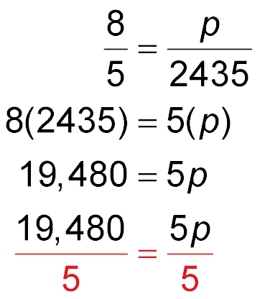
Example 4
Rate of Growth
Solve Original proportion
Find the cross products.
Simplify.
Divide each side by 5.
3896 = p Simplify.

Slide 25
Example 4
Rate of Growth
Answer: You will need to crank the pedals 3896 times.
Check Compare the ratios.
8 ÷ 5 = 1.6
3896 ÷ 2435 = 1.6
The answer is correct.

Slide 26
Example 4
BICYCLING Trent goes on 30-mile bike ride every Saturday. He rides the distance in 4 hours. At this rate, how far can he ride in 6 hours?
A. 7.5 mi
B. 20 mi
C. 40 mi
D. 45 mi

Slide 27

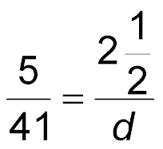
Example 5
Scale and Scale Models
MAPS In a road atlas, the scale for the map of Connecticut is 5 inches = 41 miles. What is the
distance in miles represented by 2 inches on the map?
Let d represent the actual distance.
Connecticut:
scale
scale
actual
actual

Slide 28
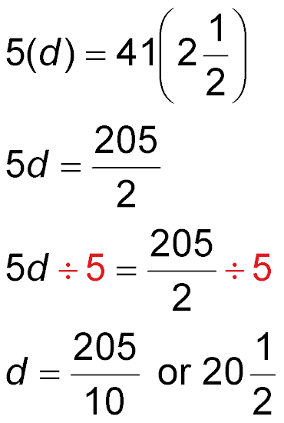
Example 5
Scale and Scale Models
Original proportion
Find the cross products.
Simplify.
Divide each side by 5.
Simplify.

Slide 29
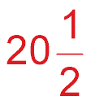
Example 5
Scale and Scale Models
Answer: The actual distance is miles.

Slide 30
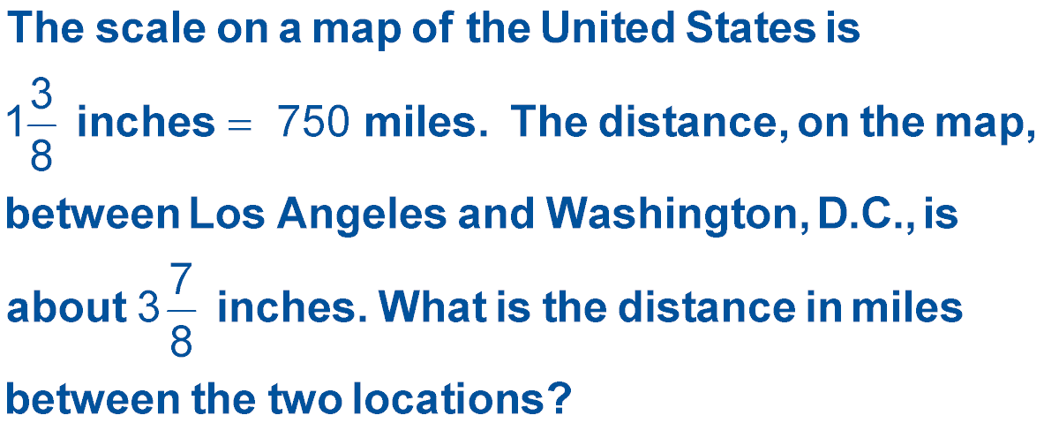
Example 5
A. about 750 miles
B. about 1500 miles
C. about 2000 miles
D. about 2114 miles

Slide 31
End of the Lesson

