Slide 1


Splash Screen

Slide 2
Lesson Menu
Five-Minute Check (over Lesson 2–6)
CCSS
Then/Now
New Vocabulary
Example 1: Percent of Change
Example 2: Real-World Example: Percent of Change
Example 3: Sales Tax
Example 4: Discounts

Slide 3
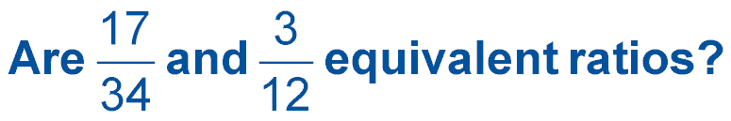

5-Minute Check 1
A. yes
B. no

Slide 4
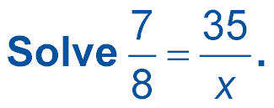

5-Minute Check 2
A. 38
B. 40
C. 42
D. 50

Slide 5
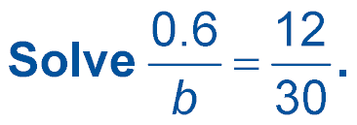

5-Minute Check 3
A. 4
B. 2
C. 1.5
D. 1.2

Slide 6
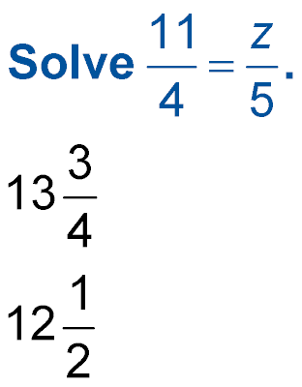

5-Minute Check 4
A. 15
B.
C. 13
D.

Slide 7

5-Minute Check 5
A bottling machine can fill 210 bottles every
5 minutes. How many bottles can it fill in 1 hour?
A. 12,600
B. 6300
C. 3425
D. 2520

Slide 8
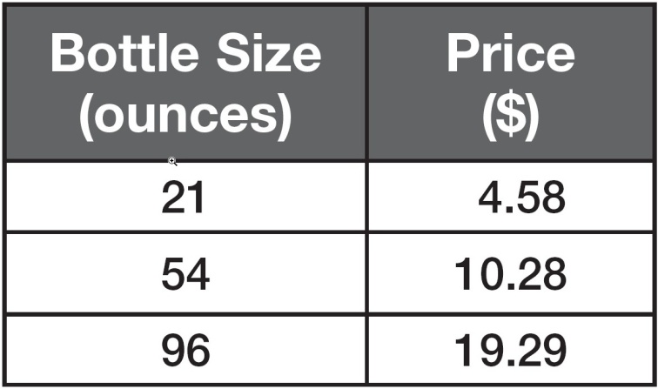

5-Minute Check 6
The table shows the prices of three different sizes of detergent. Which size has the lowest price per ounce?
A. 21-ounce bottle
B. 54-ounce bottle
C. 96-ounce bottle
D. All three bottles have the same price per ounce.

Slide 9

CCSS
Content Standards
N.Q.1 Use units as a way to understand problems and to guide the solution of multistep problems; choose and interpret units consistently in formulas; choose and interpret the scale and the origin in graphs and data displays.
A.REI.3 Solve linear equations and inequalities in one variable, including equations with coefficients represented by letters.
Mathematical Practices
8 Look for and express regularity in repeated reasoning.
Common Core State Standards © Copyright 2010. National Governors Association Center for Best Practices and Council of Chief State School Officers. All rights reserved.

Slide 10


Then/Now
You solved proportions.
Find the percent of change.
Solve problems involving percent of change.

Slide 11

Vocabulary
percent of change
percent of increase
percent of decrease

Slide 12
Example 1A
Percent of Change
A. Determine whether the percent of change is a percent of increase or a percent of decrease. Then find the percent of change.
original: 32
new: 40
Find the amount of change. Since the new amount is greater than the original, the percent of change is a percent of increase.
40 – 32 = 8

Slide 13
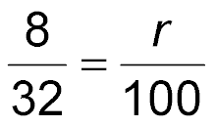
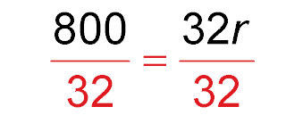
Example 1A
Percent of Change
Find the percent using the original number, 32, as the base.
change
percent of change
original amount
100 percent
8(100) = 32(r) Find the cross products.
800 = 32r Simplify.
Divide each side by 32.
25 = r Simplify.
Answer: The percent of increase is 25%.

Slide 14
Example 1B
Percent of Change
B. Determine whether the percent of change is a percent of increase or a percent of decrease. Then find the percent of change.
original: 20
new: 4
Find the amount of change. Since the new amount is less than the original, the percent of change is a percent of decrease.
20 – 4 = 16

Slide 15
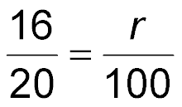
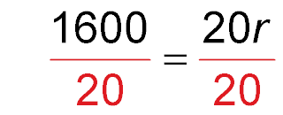
Example 1B
Percent of Change
Find the percent using the original number, 20, as the base.
change
percent of change
original amount
100 percent
16(100) = 20(r) Find the cross products.
1600 = 20r Simplify.
Divide each side by 20.
80 = r Simplify.
Answer: The percent of decrease is 80%.

Slide 16


Example 1A
A. Determine whether the percent of change is a percent of increase or a percent of decrease. Then find the percent of change.
original: 20
new: 18
A. increase of 10%
B. decrease of 10%
C. increase of 90%
D. decrease of 90%

Slide 17
Example 1B
B. Determine whether the percent of change is a percent of increase or a percent of decrease. Then find the percent of change.
original: 12
new: 48
A. increase of 300%
B. decrease of 300%
C. increase of 25%
D. decrease of 25%

Slide 18
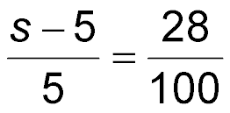
Example 2
Percent of Change
SALES The price a used-book store pays to buy a book is $5. The store sells the book for 28% above the price that it pays for the book. What is the selling price of the book?
Let s = the selling price of the book. Since 28% is the percent of increase, the amount the used-book store pays to buy a book is less than the selling price. Therefore, s – 5 represents the amount of change.
change
percent of change
book store cost
100 percent

Slide 19
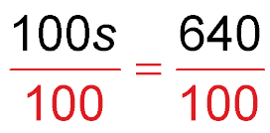
Example 2
Percent of Change
(s – 5)(100) = 5(28) Find the cross products.
100s – 500 = 140 Distributive Property
100s – 500 + 500 = 140 + 500 Add 500 to each side.
100s = 640 Simplify.
Divide each side by 100.
s = 6.4 Simplify.
Answer: The selling price of the $5 book is $6.40.

Slide 20
Example 2
At one store the price of a pair of jeans is $26.00. At another store the same pair of jeans has a price that is 22% higher. What is the price of jeans at the second store?
A. $38.00
B. $31.72
C. $25.00
D. $27.72

Slide 21
Example 3
Sales Tax
SALES TAX A meal for two at a restaurant costs $32.75. If the sales tax is 5%, what is the total price of the meal?
Step 1 Find the tax.
The tax is 5% of the price of the meal.
5% of $32.75 = 0.05 × 32.75 5% = 0.05
= 1.6375 Use a calculator.

Slide 22
Example 3
Sales Tax
Step 2 Find the cost with tax.
Round $1.6375 to $1.64. Add this amount to the
original price.
$32.75 + $1.64 = $34.39
Answer: The total price of the meal is $34.39.

Slide 23
Example 3
A portable CD player costs $69.99. If the sales tax is 6.75%, what is the total price of the CD player?
A. $64.27
B. $100.00
C. $76.74
D. $74.71

Slide 24
Example 4
Discounts
DISCOUNT A dog toy is on sale for 20% off the original price. If the original price of the toy is $3.80, what is the discounted price?
Step 1 Find the discount.
The discount is 20% of the original price.
20% of $3.80 = 0.20 × 3.80 20% = 0.20
= 0.76 Use a calculator.

Slide 25
Example 4
Discounts
Step 2 Find the cost after discount.
Subtract $0.76 from the original price.
$3.80 – $0.76 = $3.04
Answer: The discounted price of the dog toy is $3.04.

Slide 26
Example 4
A baseball cap is on sale for 15% off the original price. If the original price of the cap is $19.99, what is the discounted price?
A. $9.99
B. $4.99
C. $16.99
D. $34.99

Slide 27
End of the Lesson

