Slide 1


Splash Screen

Slide 2
Lesson Menu
Five-Minute Check (over Lesson 2–7)
CCSS
Then/Now
New Vocabulary
Example 1: Solve for a Specific Variable
Example 2: Solve for a Specific Variable
Example 3: Real-World Example: Use Literal Equations
Example 4: Use Dimensional Analysis

Slide 3

5-Minute Check 1
State whether the percent of change is a percent of increase or a percent of decrease. Then find the percent of change. Round to the nearest whole percent.
original: 84
new: 96
A. increase; 22%
B. increase; 14%
C. decrease; 14%
D. decrease; 22%

Slide 4

5-Minute Check 2
State whether the percent of change is a percent of increase or a percent of decrease. Then find the percent of change. Round to the nearest whole percent.
original: 47
new: 18
A. increase; 5%
B. decrease; 50%
C. decrease; 58%
D. decrease; 62%

Slide 5

5-Minute Check 3
What is the discounted price of a tent with a price of $89 and a discount of 15%?
A. $78.60
B. $75.65
C. $74.00
D. $67.53

Slide 6

5-Minute Check 4
What is the final price of a pair of hiking boots with a price of $78, a discount of 10%, and a tax of 6%?
A. $62.44
B. $68.00
C. $74.41
D. $76.32

Slide 7

5-Minute Check 5
On July 1, a stock sold for $46 per share, and on August 1, it sold for $48.30 per share. What was the percent of change in the price of the stock?
A. 5% increase
B. 7% increase
C. 12% increase
D. 5% decrease

Slide 8

5-Minute Check 6
Olivia’s cell phone bill last month was $125. This month her bill is $85. What is the percent of change?
A. 32% decrease
B. 36% increase
C. 39% decrease
D. 40% increase

Slide 9

CCSS
Content Standards
A.CED.4 Rearrange formulas to highlight a quantity of interest, using the same reasoning as in solving equations.
A.REI.3 Solve linear equations and inequalities in one variable, including equations with coefficients represented by letters.
Mathematical Practices
6 Attend to precision.
Common Core State Standards © Copyright 2010. National Governors Association Center for Best Practices and Council of Chief State School Officers. All rights reserved.

Slide 10


Then/Now
You solved equations with variables on each side.
Solve equations for given variables.
Use formulas to solve real-world problems.

Slide 11

Vocabulary
literal equation
dimensional analysis
unit analysis

Slide 12
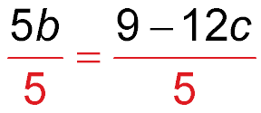
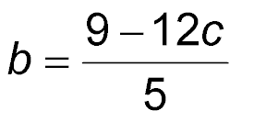
Example 1
Solve for a Specific Variable
Solve 5b + 12c = 9 for b.
5b + 12c = 9 Original equation
5b + 12c – 12c = 9 – 12c Subtract 12c from each side.
5b = 9 – 12c Simplify.
Divide each side by 5.
Simplify.

Slide 13
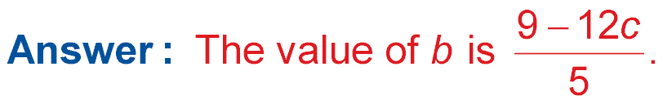
Example 1
Solve for a Specific Variable

Slide 14


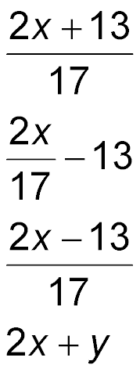

Example 1
Solve 2x – 17y = 13 for y.
A.
B.
C.
D. y = 2x + 4

Slide 15
Example 2
Solve for a Specific Variable
Solve 7x – 2z = 4 – xy for x.
7x – 2z = 4 – xy Original equation
7x – 2z + xy = 4 – xy + xy Add xy to each side.
7x – 2z + xy = 4 Simplify.
7x – 2z + xy +2z = 4 + 2z Add 2z to each side.
7x + xy = 4 + 2z Simplify.
x(7 + y) = 4 + 2z Use the Distributive Property.

Slide 16
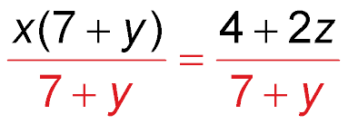
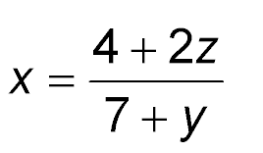
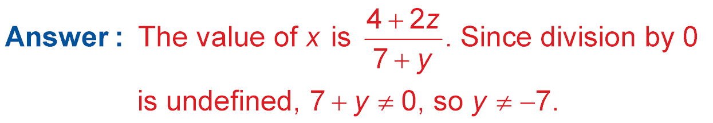
Example 2
Solve for a Specific Variable
Divide each side by 7 + y.
Simplify.

Slide 17
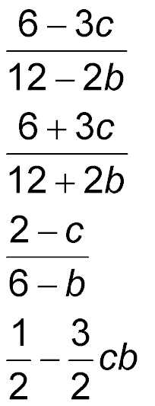

Example 2
Solve 12a + 3c = 2ab + 6 for a.
A.
B.
C.
D.
; b ≠ 6
; b ≠ –6
; b ≠ 6

Slide 18
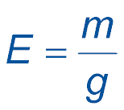
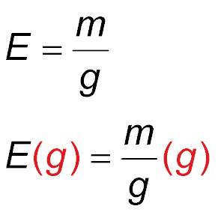
Example 3A
Use Literal Equations
A. FUEL ECONOMY A car’s fuel economy E (miles
per gallon) is given by the formula , where
m is the number of miles driven and g is the number
of gallons of fuel used. Solve the formula for m.
Formula for fuel economy
Multiply each side by g.
Answer: Eg = m or m = Eg

Slide 19
Example 3B
Use Literal Equations
B. FUEL ECONOMY If Quanah’s car has an average fuel consumption of 30 miles per gallon and she used 9.5 gallons, how far did she drive?
Eg = m Formula for miles driven
30(9.5) = m E = 30 mpg and g = 9.5 gallons
285 = m Multiply.
Answer: She drove 285 miles.

Slide 20
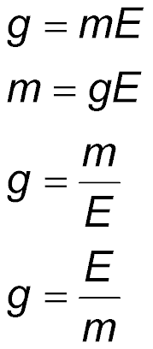
Example 3A
A. FUEL ECONOMY A car’s fuel economy E (miles
per gallon) is given by the formula , where
m is the number of miles driven and g is the number
of gallons of fuel used. Solve the formula for g.
A. g = mE B. m = gE
C. D.

Slide 21
Example 3B
B. If Quanah drove 1477 miles and her pickup has an average fuel consumption of 19 miles per gallon, about how many gallons of fuel did she use?
A. 19 gallons
B. 1477 gallons
C. 77.74 gallons
D. 80 gallons

Slide 22
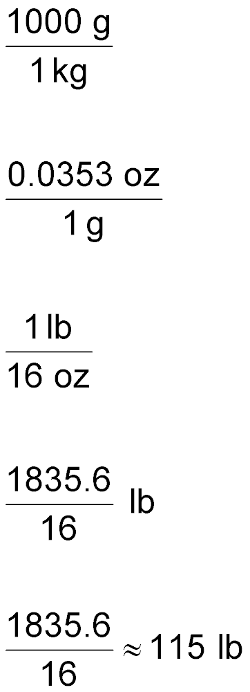
Example 4
Use Dimensional Analysis
CHIMPANZEES The average weight of the chimpanzees at a zoo is 52 kilograms. If
1 gram ≈ 0.0353 ounce, use dimensional analysis to find the average weight of a chimpanzee in pounds. (Hint: 1 lb = 16 oz)
weight of
chimpanzee
kilograms
to grams
grams to
ounces
ounces
to pounds
52 kg × × ×

Slide 23
Example 4
Use Dimensional Analysis
Notice how the units cancel, leaving the unit to which you are converting.
52 kg × × × =
Answer: The average weight of a chimpanzee is about 115 pounds.

Slide 24
Example 4
CHARITY Janet is walking 20 laps of a track in a relay to raise money for cancer research. If each lap is 350 meters, how many miles will Janet walk? (Hint: 1 meter ≈ 1.094 yards and 1 mile = 1760 yards)
A. about 4.35 mi
B. about 7 mi
C. about 7.7 mi
D. about 8 mi

Slide 25
End of the Lesson

