Slide 1


Splash Screen

Slide 2
Lesson Menu
Five-Minute Check (over Chapter 2)
CCSS
Then/Now
New Vocabulary
Key Concept: Standard Form of a Linear Equation
Example 1: Identify Linear Equations
Example 2: Standardized Test Example
Example 3: Real-World Example: Find Intercepts
Example 4: Graph by Using Intercepts
Example 5: Graph by Making a Table

Slide 3

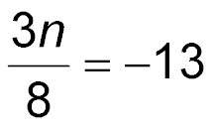
5-Minute Check 1
Translate three times a number decreased by eight is negative thirteen into an equation.
A. 3(n – 8) = 13
B.
C. 3n – 5 = 1
D. 3n – 8 = –13

Slide 4

5-Minute Check 2
Solve –24 + b = –13.
A. 37
B. 11
C. –11
D. –37

Slide 5
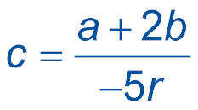

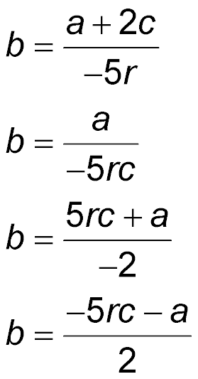
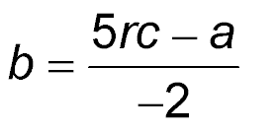
5-Minute Check 3
Solve for b.
A.
B.
C.
D.

Slide 6

5-Minute Check 4
A stamp collector bought a rare stamp for $16, and sold it a year later for $20.50. Find the percent of change.
A. 4.5% increase
B. 12% increase
C. 18% increase
D. 28% increase

Slide 7

5-Minute Check 5
A teacher’s first-period math class has 16 students and her second period math class has 24 students. If the first-period class averaged a score of 93 on a quiz and the second-period class averaged 81, what is the weighted average of the two classes quiz scores?
A. 89%
B. 87%
C. 86.5%
D. 85.8%

Slide 8

CCSS
Content Standards
F.IF.4 For a function that models a relationship between two quantities, interpret key features of graphs and tables in terms of the quantities, and sketch graphs showing key features given a verbal description of the relationship.
F.IF.7a Graph linear and quadratic functions and show intercepts, maxima, and minima.
Mathematical Practices
8 Look for and express regularity in repeated reasoning.
Common Core State Standards © Copyright 2010. National Governors Association Center for Best Practices and Council of Chief State School Officers. All rights reserved.

Slide 9


Then/Now
You represented relationships among quantities using equations.
Identify linear equations, intercepts, and zeros.
Graph linear equations.

Slide 10

Vocabulary
linear equation
standard form
constant
x-intercept
y-intercept

Slide 11
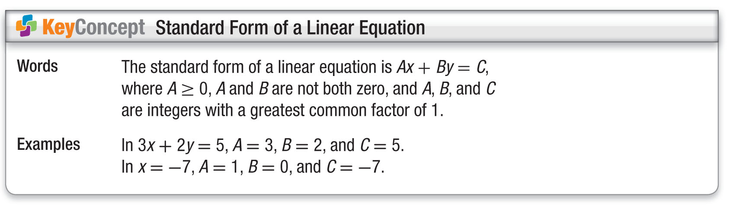
Concept

Slide 12
Example 1 A
Identify Linear Equations
A. Determine whether 5x + 3y = z + 2 is a linear equation. Write the equation in standard form.
First, rewrite the equation so that the variables are on the same side of the equation.
5x + 3y = z + 2 Original equation
5x + 3y – z = z + 2 – z Subtract z from each side.
5x + 3y – z = 2 Simplify.
Since 5x + 3y – z has three variables, it cannot be written in the form Ax + By = C.
Answer: This is not a linear equation.

Slide 13
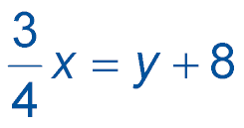
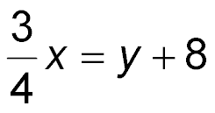
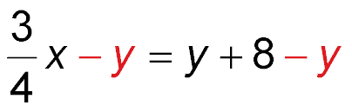
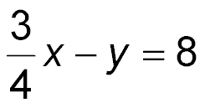
Example 1 B
Identify Linear Equations
B. Determine whether is a linear equation.
Write the equation in standard form.
Rewrite the equation so that both variables are on the same side of the equation.
Original equation
Subtract y from each side.
Simplify.

Slide 14
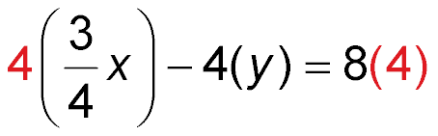
Example 1 B
Identify Linear Equations
To write the equation with integer coefficients, multiply each term by 4.
Original equation
Multiply each side of the equation by 4.
3x – 4y = 32 Simplify.
The equation is now in standard form, where A = 3,
B = –4, and C = 32.
Answer: This is a linear equation.

Slide 15


Example 1 CYP A
A. Determine whether y = 4x – 5 is a linear equation. Write the equation in standard form.
linear equation; y = 4x – 5
not a linear equation
linear equation; 4x – y = 5
linear equation; 4x + y = 5

Slide 16
Example 1 CYP B
B. Determine whether 8y –xy = 7 is a linear equation. Write the equation in standard form.
not a linear equation
linear equation; 8y – xy = 7
linear equation; 8y = 7 + xy
linear equation; 8y – 7 = xy

Slide 17
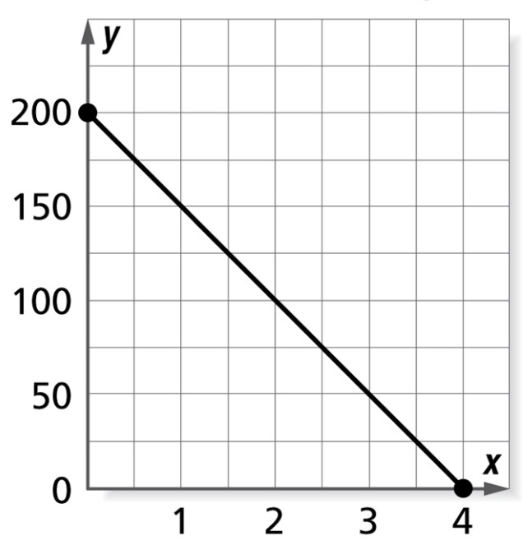
Example 2 A
Find the x- and y-intercepts of the segment graphed.
A x-intercept is 200; y-intercept is 4
B x-intercept is 4; y-intercept is 200
C x-intercept is 2; y-intercept is 100
D x-intercept is 4; y-intercept is 0
Read the Test Item
We need to determine the x- and y-intercepts of the line in the graph.

Slide 18
Example 2 A
Solve the Test Item
Step 1 Find the x-intercept. Look for the point where the line crosses the
x-axis.
The line crosses at
(4, 0). The x-intercept is 4 because it is the
x-coordinate of the point where the line crosses the x-axis.

Slide 19
Example 2 A
Solve the Test Item
Step 2 Find the y-intercept. Look for the point where the line crosses the
y-axis.
The line crosses at
(0, 200). The y-intercept is 200 because it is the
y-coordinate of the point where the line crosses the y-axis.
Answer: The correct answer is B.

Slide 20
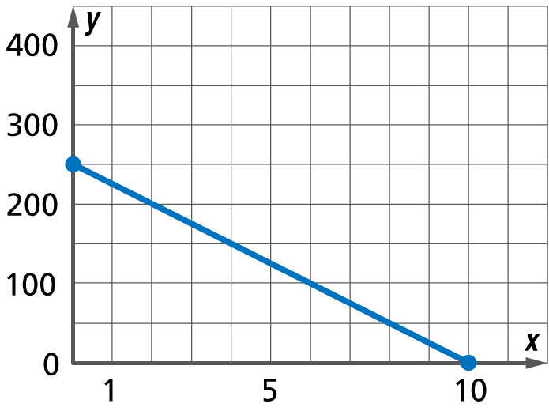
Example 2 CYP A
Find the x- and y-intercepts of the graphed segment.
A. x-intercept is 10;
y-intercept is 250
B. x-intercept is 10;
y-intercept is 10
C. x-intercept is 250;
y-intercept is 10
D. x-intercept is 5;
y-intercept is 10

Slide 21
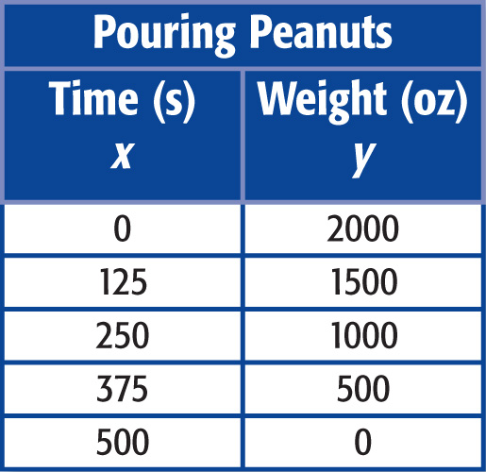
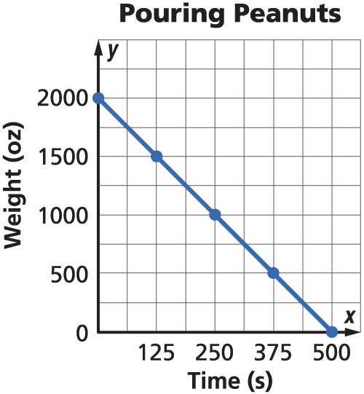
Example 3 A
Find Intercepts
ANALYZE TABLES A box of peanuts is poured into bags at the rate of
4 ounces per second. The table shows the function relating to the weight of the peanuts in the box and the time in seconds the peanuts have been pouring out of the box.
A. Determine the x- and y-intercepts of the graph of the function.
Answer: x-intercept = 500;
y-intercept = 2000

Slide 22
Example 3 B
Find Intercepts
B. Describe what the intercepts in the previous problem mean.
Answer: The x-intercept 500 means that after
500 seconds, there are 0 ounces of peanuts left in the box. The y-intercept of 2000 means that at time 0, or before any peanuts were poured, there were 2000 ounces of peanuts in the box.

Slide 23
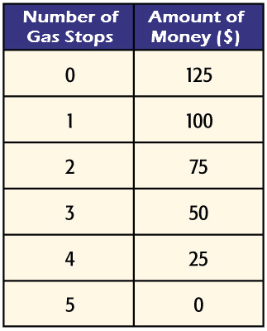
Example 3 CYP A
ANALYZE TABLES Jules has a gas card for a local gas station. The table shows the function relating the amount of money on the card and the number of times he has stopped to purchase gas.
A. Determine the x- and y-intercepts of the graph of the function.
x-intercept is 5; y-intercept is 125
x-intercept is 5; y-intercept is 5
x-intercept is 125; y-intercept is 5
x-intercept is 5; y-intercept is 10

Slide 24
Example 3 CYP B
B. Describe what the y-intercept of 125 means in the previous problem.
It represents the time when there is no money left on the card.
It represents the number of food stops.
At time 0, or before any food stops, there was $125 on the card.
This cannot be determined.

Slide 25
Example 4
Graph by Using Intercepts
Graph 4x – y = 4 using the x-intercept and the
y-intercept.
To find the x-intercept, let y = 0.
4x – y = 4 Original equation
4x – 0 = 4 Replace y with 0.
4x = 4 Simplify.
x = 1 Divide each side by 4.
To find the y-intercept, let x = 0.
4x – y = 4 Original equation
4(0) – y = 4 Replace x with 0.
–y = 4 Simplify.
y = –4 Divide each side by –1.

Slide 26
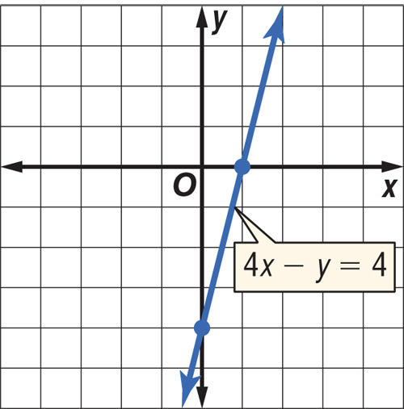
Example 4
Graph by Using Intercepts
The x-intercept is 1, so the graph intersects the x-axis at (1, 0). The y-intercept is –4, so the graph intersects the
y-axis at (0, –4). Plot these points. Then draw a line that connects them.
Answer:

Slide 27
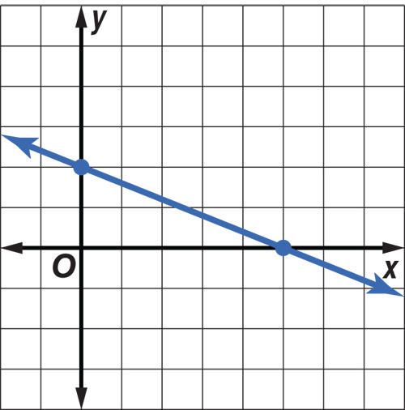
Example 4 CYP
Is this the correct graph for 2x + 5y = 10?
yes
no

Slide 28
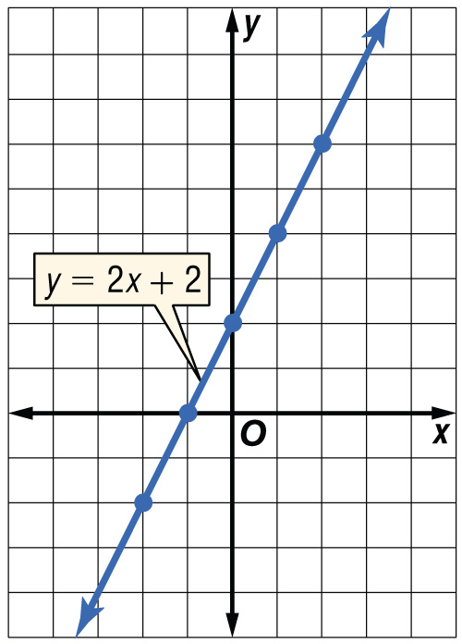
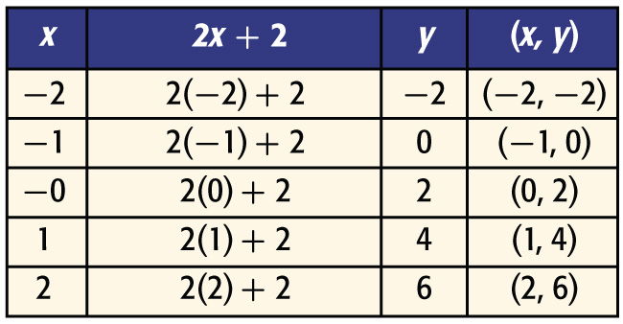
Example 5
Graph by Making a Table
Graph y = 2x + 2.
The domain is all real numbers, so there are infinite solutions. Select values from the domain and make a table. Then graph the ordered pairs. Draw a line through the points.
Answer:

Slide 29
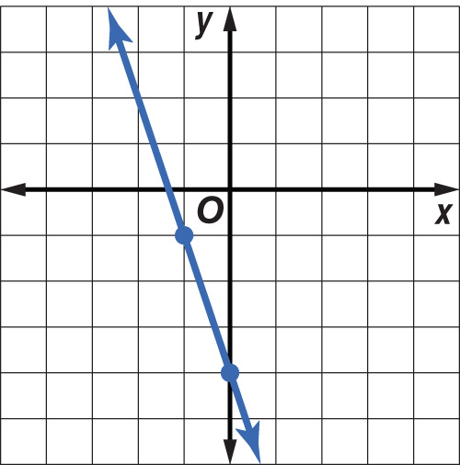
Example 5 CYP
Is this the correct graph for y = 3x – 4?
yes
no

Slide 30
End of the Lesson

