Slide 1


Splash Screen

Slide 2
Lesson Menu
Five-Minute Check (over Lesson 3–1)
CCSS
Then/Now
New Vocabulary
Key Concept: Linear Function
Example 1: Solve an Equation with One Root
Example 2: Solve an Equation with No Solution
Example 3: Real-World Example: Estimate by Graphing

Slide 3

5-Minute Check 1
Determine whether y = –2x – 9 is a linear equation. If it is, write the equation in standard form.
A. linear; y = 2x – 9
B. linear; 2x + y = –9
C. linear; 2x + y + 9 = 0
D. not linear

Slide 4

5-Minute Check 2
Determine whether 3x – xy + 7 = 0 is a linear equation. If it is, write the equation in standard form.
A. linear; y = –3x – 7
B. linear; y = –3x + 7
C. linear; 3x – xy = –7
D. not linear

Slide 5

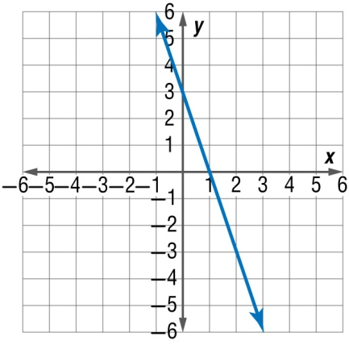
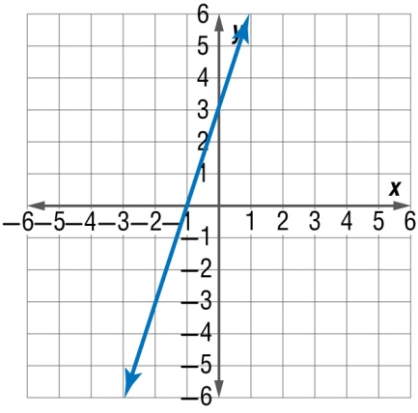
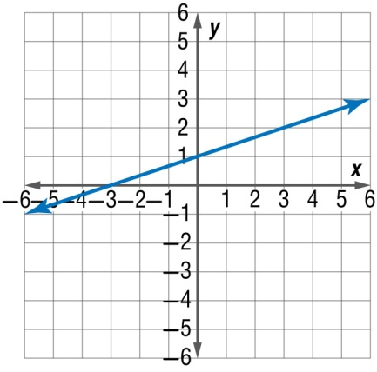
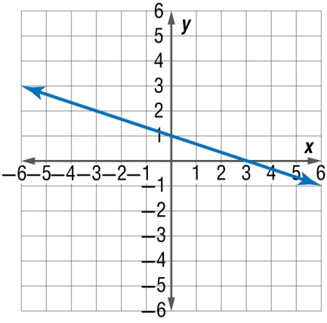
5-Minute Check 3
Graph y = –3x + 3.
A. B.
C. D.

Slide 6

5-Minute Check 4
Jake’s Windows uses the equation c = 5w + 15.25 to calculate the total charge c based on the number of windows w that are washed. What will be the charge for washing 15 windows?
A. $75.00
B. $85.25
C. $87.50
D. $90.25

Slide 7

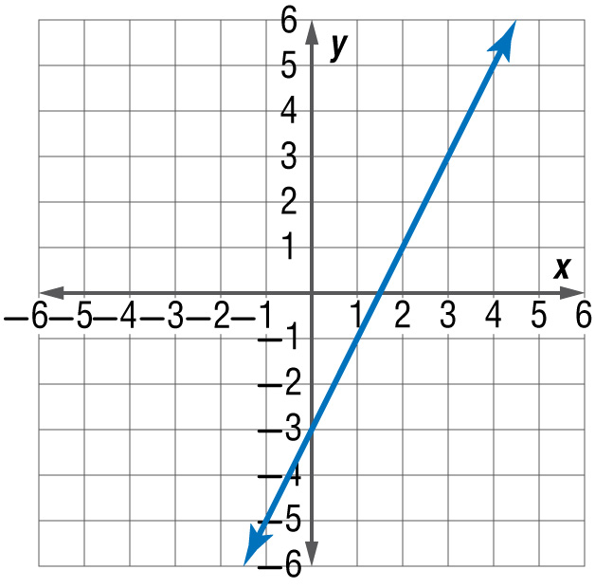
5-Minute Check 5
Which linear equation is represented by this graph?
A. y = x – 3
B. y = 2x + 1
C. y = x + 3
D. y = 2x – 3

Slide 8

CCSS
Content Standards
A.REI.10 Understand that the graph of an equation in two variables is the set of all its solutions plotted in the coordinate plane, often forming a curve (which could be a line).
F.IF.7a Graph linear and quadratic functions and show intercepts, maxima, and minima.
Mathematical Practices
4 Model with mathematics.
Common Core State Standards © Copyright 2010. National Governors Association Center for Best Practices and Council of Chief State School Officers. All rights reserved.

Slide 9


Then/Now
You graphed linear equations by using tables
and finding roots, zeros, and intercepts.
Solve linear equations by graphing.
Estimate solutions to a linear equation by graphing.

Slide 10

Vocabulary
linear function
parent function
family of graphs
root
zeros

Slide 11
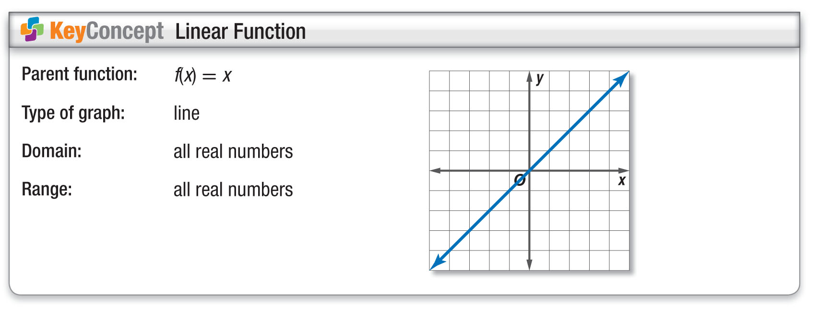
Concept

Slide 12
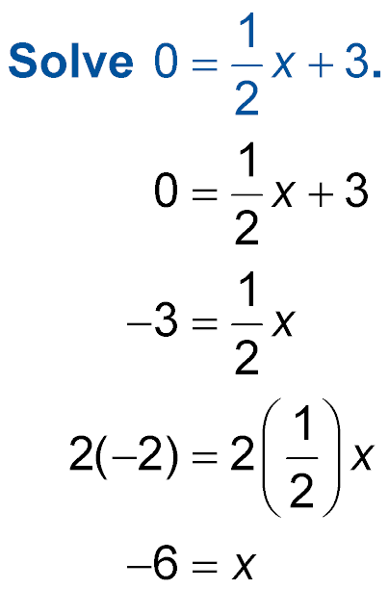
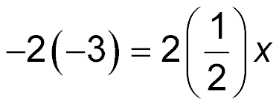
Example 1 A
Solve an Equation with One Root
A.
Method 1 Solve algebraically.
Original equation
Subtract 3 from each side.
Multiply each side by 2.
Simplify.
Answer: The solution is –6.

Slide 13
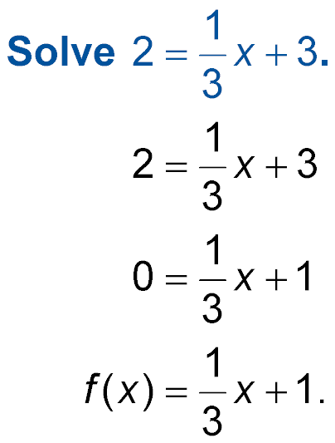
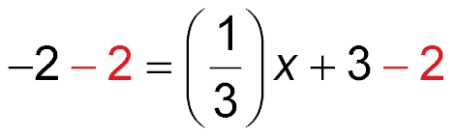
Example 1 B
Solve an Equation with One Root
B.
Method 2 Solve by graphing.
Find the related function. Set the equation equal to 0.
Original equation
Subtract 2 from each side.
Simplify.

Slide 14
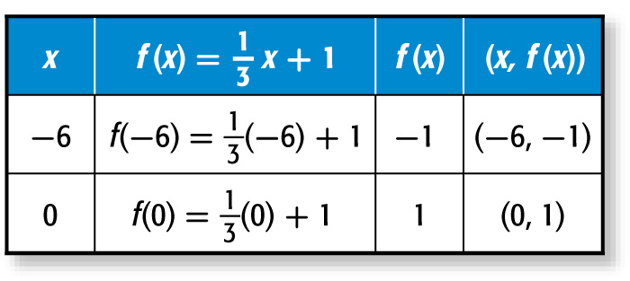
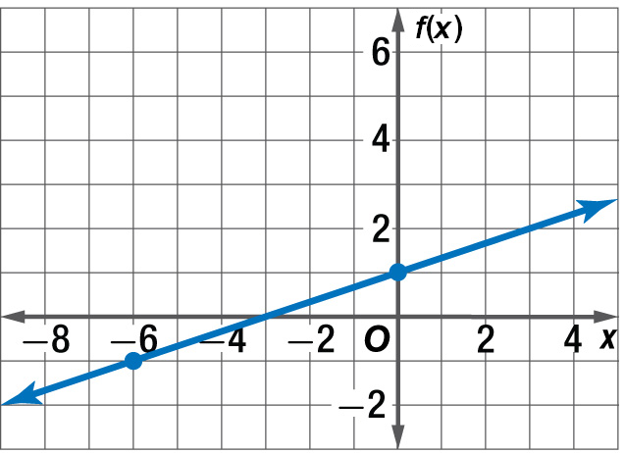
Example 1 B
Solve an Equation with One Root
The related function is To graph the function, make a table.
The graph intersects the x-axis at –3.
Answer: So, the solution is –3.

Slide 15



Example 1 CYPA
A. x = –4
B. x = –9
C. x = 4
D. x = 9

Slide 16

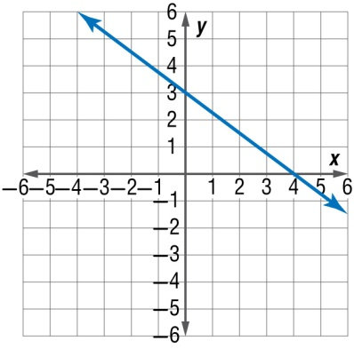
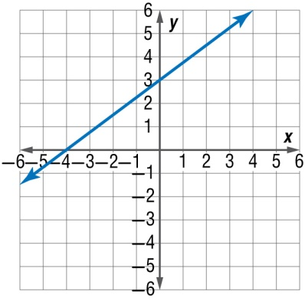
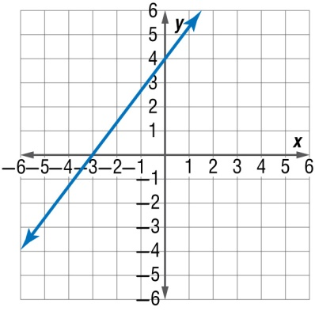
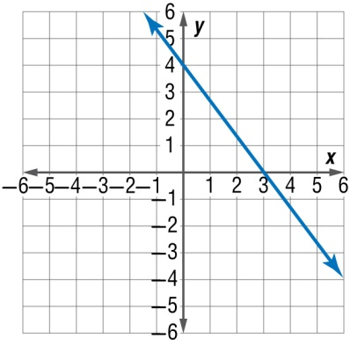
Example 1 CYP B
A. x = 4; B. x = –4;
C. x = –3; D. x = 3;

Slide 17
Example 2 A
Solve an Equation with No Solution
A. Solve 2x + 5 = 2x + 3.
Method 1 Solve algebraically.
2x + 5 = 2x + 3 Original equation
2x + 2 = 2x Subtract 3 from each side.
2 = 0 Subtract 2x from each side.
The related function is f(x) = 2. The root of the linear equation is the value of x when f(x) = 0.
Answer: Since f(x) is always equal to 2, this function has no solution.

Slide 18
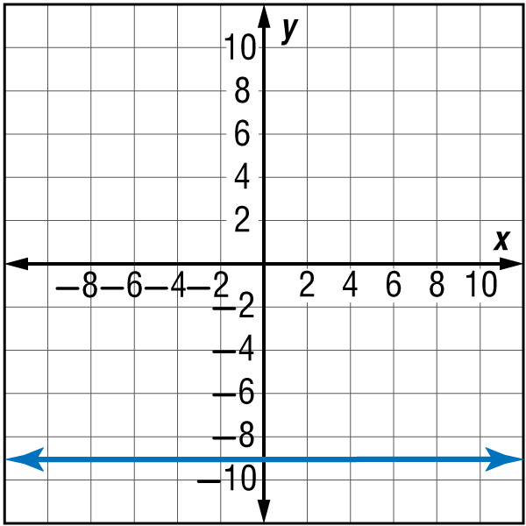
Example 2
Solve an Equation with No Solution
B. Solve 5x – 7 = 5x + 2.
Method 2 Solve graphically.
5x – 7 = 5x + 2 Original equation
5x – 9 = 5x Subtract 2 from each side.
–9 = 0 Subtract 5x from each side.
Graph the related function, which is f(x) = –9. The graph of the line does not intersect the x-axis.
Answer: Therefore, there is no
solution.

Slide 19
Example 2 CYP A
A. Solve –3x + 6 = 7 – 3x algebraically.
A. x = 0
B. x = 1
C. x = –1
D. no solution

Slide 20
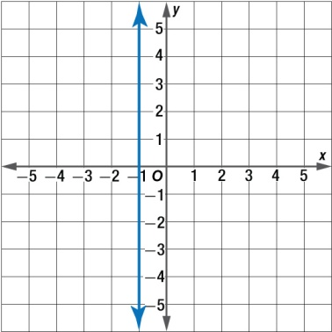
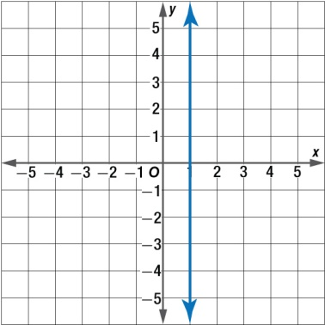
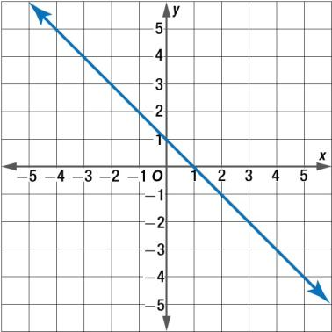
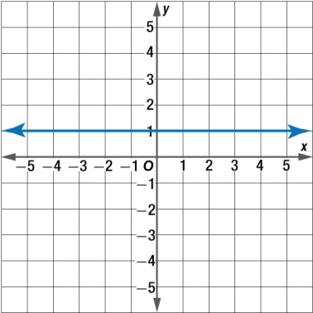
Example 2 CYP B
B. Solve 4 – 6x = –6x + 3 by graphing.
A. x = –1 B. x = 1
C. x = 1 D. no solution

Slide 21
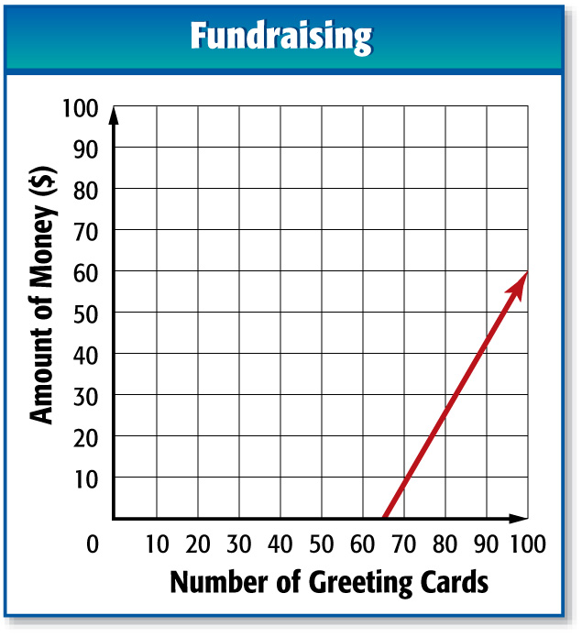
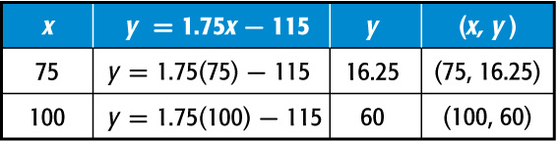
Example 3
Estimate by Graphing
FUNDRAISING Kendra’s class is selling greeting cards to raise money for new soccer equipment. They paid $115 for the cards, and they are selling each card for $1.75. The function y = 1.75x – 115 represents their profit y for selling
x greeting cards. Find the zero of this function. Describe what this value means in this context.
Make a table of values.
The graph appears to intersect the x-axis at about 65. Next, solve algebraically to check.

Slide 22
Example 3
Estimate by Graphing
y = 1.75x – 115 Original equation
0 = 1.75x – 115 Replace y with 0.
115 = 1.75x Add 115 to each side.
65.71 ≈ x Divide each side by 1.75.
Answer: The zero of this function is about 65.71. Since part of a greeting card cannot be sold, they must sell 66 greeting cards to make a profit.

Slide 23

Example 3
TRAVEL On a trip to his friend’s house, Raphael’s average speed was 45 miles per hour. The distance that Raphael is from his friend’s house at a certain moment in the trip can be represented by d = 150 – 45t, where d represents the distance in miles and t is the time in hours. Find the zero of this function. Describe what this value means in this context.
A. 3; Raphael will arrive at his friend’s house
in 3 hours.
Raphael will arrive at his friend’s house in
3 hours 20 minutes.
C. Raphael will arrive at his friend’s house in
3 hours 30 minutes.
D. 4; Raphael will arrive at his friend’s house in 4 hours.
A
B
C
D

Slide 24
End of the Lesson

