Slide 1


Splash Screen

Slide 2
Lesson Menu
Five-Minute Check (over Lesson 3–2)
CCSS
Then/Now
New Vocabulary
Key Concept: Rate of Change
Example 1: Real-World Example: Find Rate of Change
Example 2: Real-World Example: Variable Rate of Change
Example 3: Constant Rates of Change
Key Concept: Slope
Example 4: Positive, Negative, and Zero Slope
Example 5: Undefined Slope
Concept Summary: Slope
Example 6: Find Coordinates Given the Slope

Slide 3

5-Minute Check 1
Solve 2x – 5 = 25.
A. 5
B. 6
C. 10
D. 15

Slide 4

5-Minute Check 2
Solve 5x – 6 = 3x – 8.
A. –1
B. 0
C. 1
D. 2

Slide 5

5-Minute Check 3
Solve 6x + 3 = 6x – 2.
A. 1
B. 0
C. –1
D. no solution

Slide 6

5-Minute Check 4
Solve 9 – 4x = 1 – 4x.
A. 1
B. 0
C. –1
D. no solution

Slide 7

5-Minute Check 5
The equation P = 3000 – 22.5n represents the amount of profit P a catering company earns depending on the number of guests n. After how many guests will the catering company make no profit?
A. 264
B. 222
C. 153
D. 134

Slide 8

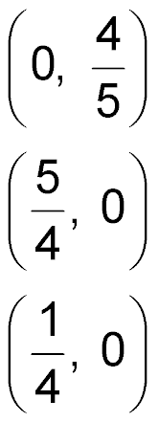
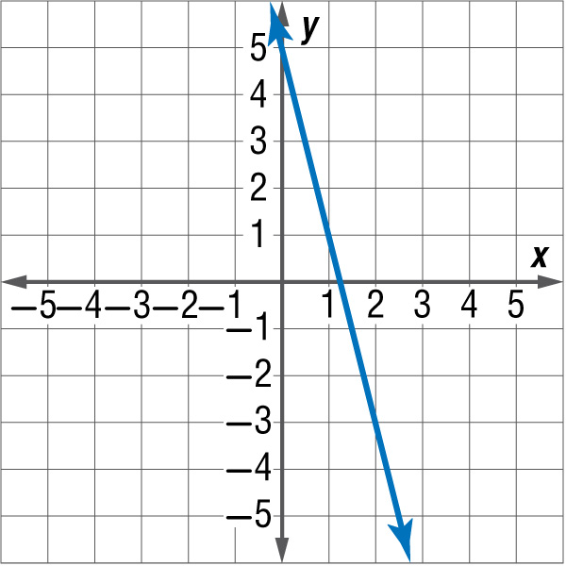
5-Minute Check 6
Graph y = –4x + 5. Where does the graph cross the x-axis?
A. (0, 5)
B.
C.
D.

Slide 9

CCSS
Content Standards
F.IF.6 Calculate and interpret the average rate of change of a function (presented symbolically or as a table) over a specified interval. Estimate the rate of change from a graph.
F.LE.1a Prove that linear functions grow by equal differences over equal intervals, and that exponential functions grow by equal factors over equal intervals.
Mathematical Practices
2 Reason abstractly and quantitatively.
Common Core State Standards © Copyright 2010. National Governors Association Center for Best Practices and Council of Chief State School Officers. All rights reserved.

Slide 10


Then/Now
You graphed ordered pairs in the coordinate plane.
Use rate of change to solve problems.
Find the slope of a line.

Slide 11

Vocabulary
rate of change
slope

Slide 12
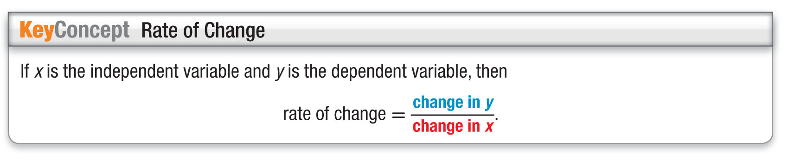
Concept

Slide 13
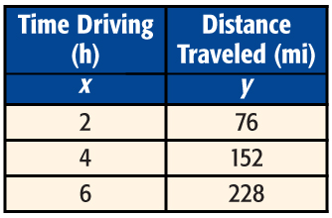
Example 1
Find Rate of Change
DRIVING TIME Use the table to find the rate of change. Explain the meaning of the rate of change.
Each time x increases by 2 hours, y increases by 76 miles.

Slide 14
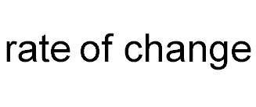
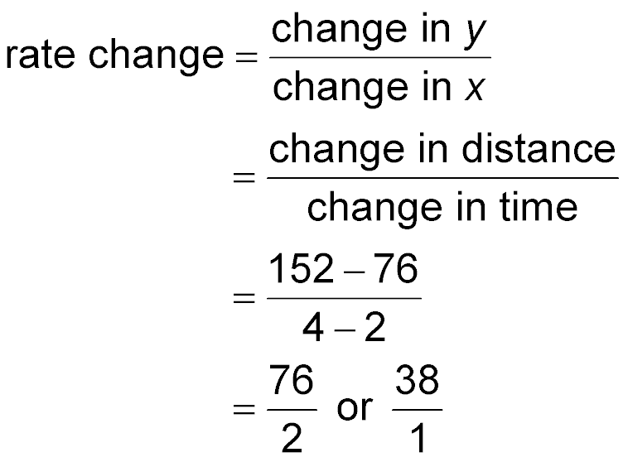
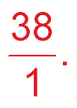
Example 1
Find Rate of Change
Answer: The rate of change is This means the car is traveling at a rate of 38 miles per hour.

Slide 15


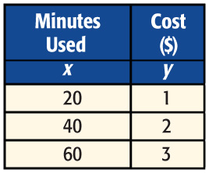
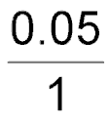



Example 1
CELL PHONE The table shows how the cost changes with the number of minutes used. Use the table to find the rate of change. Explain the meaning of the rate of change.
A. Rate of change is . This means that it costs $0.05 per minute to use the cell phone.
B. Rate of change is . This means that it costs
$5 per minute to use the cell phone.
C. Rate of change is . This means that it costs $0.50 per minute to use the cell phone.
D. Rate of change is . This means that it costs $0.20 per minute to use the cell phone.

Slide 16
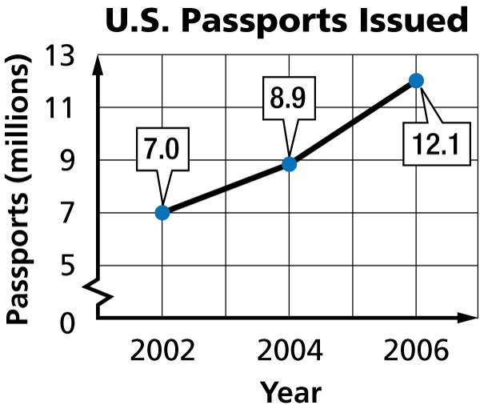
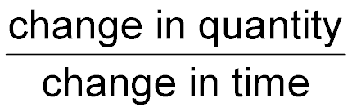
Example 2 A
Variable Rate of Change
A. TRAVEL The graph to the right shows the number of U.S. passports issued in 2002, 2004, and 2006. Find the rates of change for 2002–2004 and 2004–2006.
millions of passports
years

Slide 17
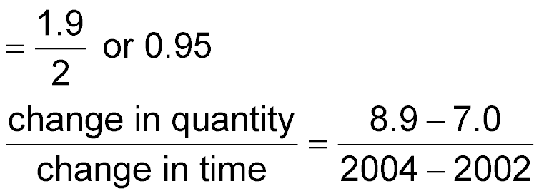
Example 2 A
Variable Rate of Change
2002–2004:
Substitute.
Simplify.
Answer: The number of passports issued increased
by 1.9 million in a 2-year period for a rate of change of 950,000 per year.

Slide 18
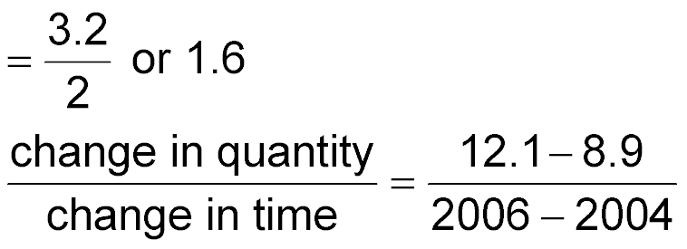
Example 2 A
Variable Rate of Change
2004–2006:
Substitute.
Simplify.
Answer: Over this 2-year period, the number of U.S. passports issued increased by 3.2 million for
a rate of change of 1,600,000 per year.

Slide 19
Example 2 B
Variable Rate of Change
B. Explain the meaning of the rate of change in each case.
Answer: For 2002–2004, there was an average annual increase of 950,000 in passports issued. Between 2004 and 2006, there was an average yearly increase of 1,600,000 passports issued.

Slide 20
Example 2 C
Variable Rate of Change
C. How are the different rates of change shown on the graph?
Answer: There is a greater vertical change for
2004–2006 than for 2002–2004. Therefore, the section of the graph for 2004–2006 is steeper.

Slide 21
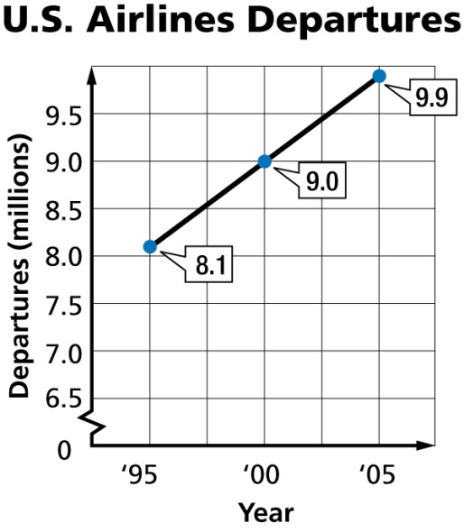
Example 2 CYP A
A. Airlines The graph shows the number of airplane departures in the United States in recent years. Find the rates of change for 1995–2000 and 2000–2005.
A. 1,200,000 per year;
900,000 per year
B. 8,100,000 per year;
9,000,000 per year
900,000 per year;
900,000 per year
180,000 per year;
180,000 per year

Slide 22
Example 2 CYP B
B. Explain the meaning of the slope in each case.
A. For 1995–2000, the number of airplane departures increased by about 900,000 flights each year. For 2000–2005, the number of airplane departures increased by about 180,000 flights each year.
B. The rate of change was the same for 1995–2000 and 2000–2005.
C. The number airplane departures decreased by about 180,000 for 1995–2000 and 180,000 for 2000–2005.
D. For 1995–2000 and 2000–2005, the number of airplane departures was the same.

Slide 23
Example 2 CYP C
C. How are the different rates of change shown on the graph?
A. There is a greater vertical change for 1995–2000 than for 2000–2005. Therefore, the section of the graph for 1995–2000 has a steeper slope.
B. They have different y-values.
C. The vertical change for 1995–2000 is negative, and for 2000–2005 it is positive.
D. The vertical change is the same for both periods, so the slopes are the same.

Slide 24
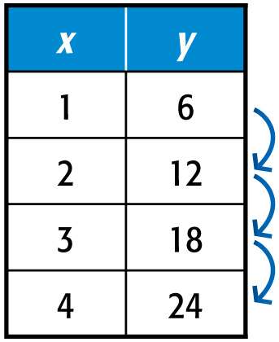
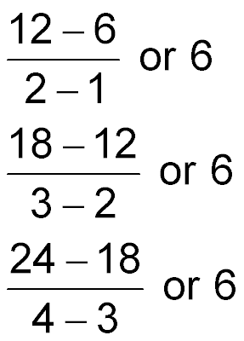
Example 3 A
Constant Rate of Change
A. Determine whether the function is linear. Explain.
Answer: The rate of change is constant. Thus, the function is linear.

Slide 25
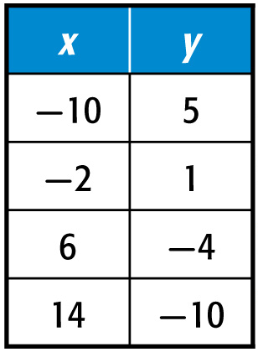
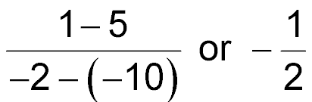
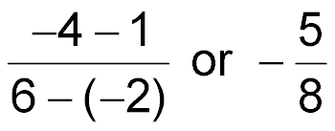
Example 3 B
Constant Rate of Change
B. Determine whether the function is linear. Explain.
Answer: The rate of change is not constant. Thus, the function is not linear.

Slide 26
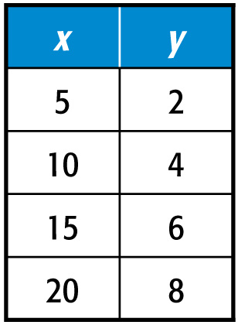
Example 3 CYP A
A. Determine whether the function is linear. Explain.
A. Yes, the rate of change is constant.
B. No, the rate of change is constant.
C. Yes, the rate of change is not constant.
D. No, the rate of change is not constant.

Slide 27
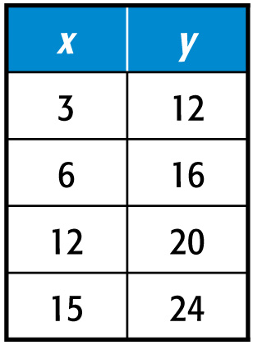
Example 3 CYP B
B. Determine whether the function is linear. Explain.
A. Yes, the rate of change is constant.
B. No, the rate of change is constant.
C. Yes, the rate of change is not constant.
D. No, the rate of change is not constant.

Slide 28
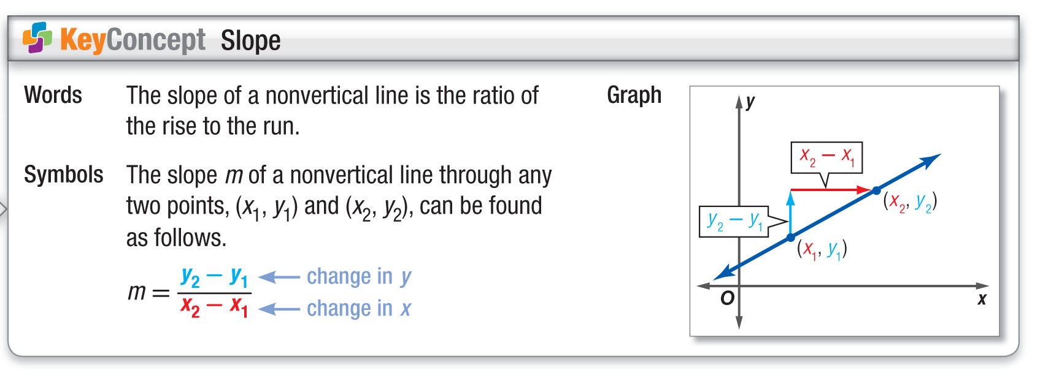
Concept

Slide 29
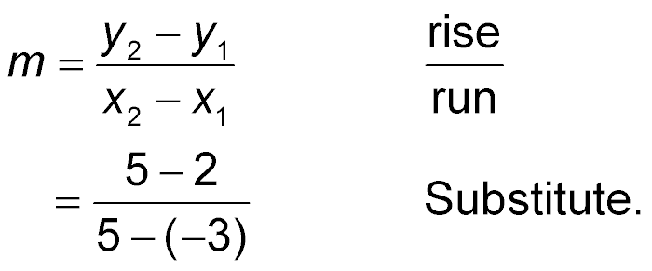
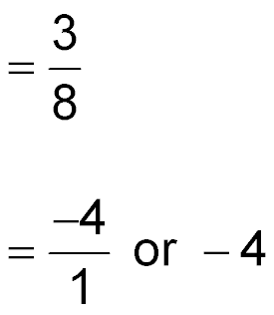
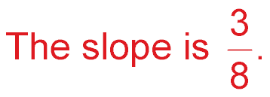
Example 4 A
Positive, Negative, and Zero Slope
A. Find the slope of the line that passes through
(–3, 2) and (5, 5).
Let (–3, 2) = (x₁, y₁) and (5, 5) = (x₂, y₂).
Substitute.
Simplify.
Answer:

Slide 30
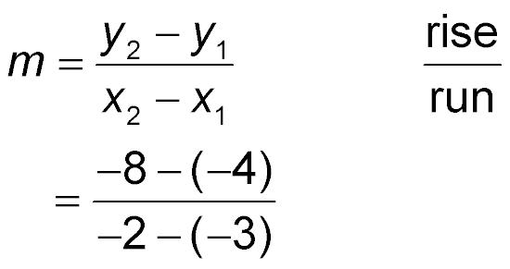
Example 4 B
Positive, Negative, and Zero Slope
B. Find the slope of the line that passes through
(–3, –4) and (–2, –8).
Let (–3, –4) = (x₁, y₁) and (–2, –8) = (x₂, y₂).
Substitute.
Simplify.
Answer: The slope is –4.

Slide 31
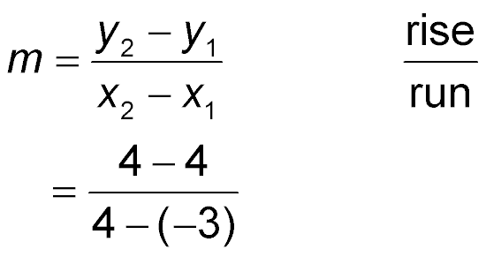
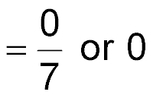
Example 4 C
Positive, Negative, and Zero Slope
C. Find the slope of the line that passes through
(–3, 4) and (4, 4).
Let (–3, 4) = (x₁, y₁) and (4, 4) = (x₂, y₂).
Substitute.
Simplify.
Answer: The slope is 0.

Slide 32

Example 4 CYP A
A. Find the slope of the line that passes through
(4, 5) and (7, 6).
A. 3
B.
C.
D. –3

Slide 33

Example 4 CYP B
B. Find the slope of the line that passes through
(–3, –5) and (–2, –7).
A. 2
B. –2
C.
D.

Slide 34
Example 4 CYP C
C. Find the slope of the line that passes through
(–3, –1) and (5, –1).
A. undefined
B. 8
C. 2
D. 0

Slide 35
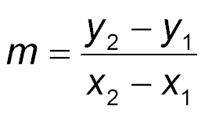
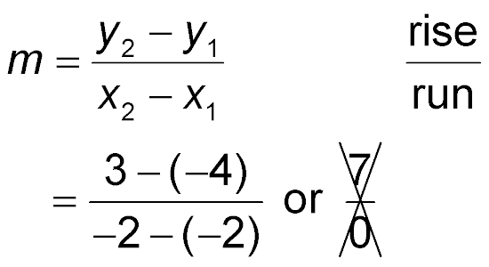
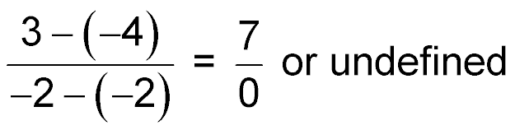
Example 5
Undefined Slope
Find the slope of the line that passes through
(–2, –4) and (–2, 3).
Let (–2, –4) = (x₁, y₁) and (–2, 3) = (x₂, y₂).
Substitution
Answer: Since division by zero is undefined, the slope is undefined.

Slide 36
Example 5
Find the slope of the line that passes through
(5, –1) and (5, –3).
A. undefined
B. 0
C. 4
D. 2

Slide 37
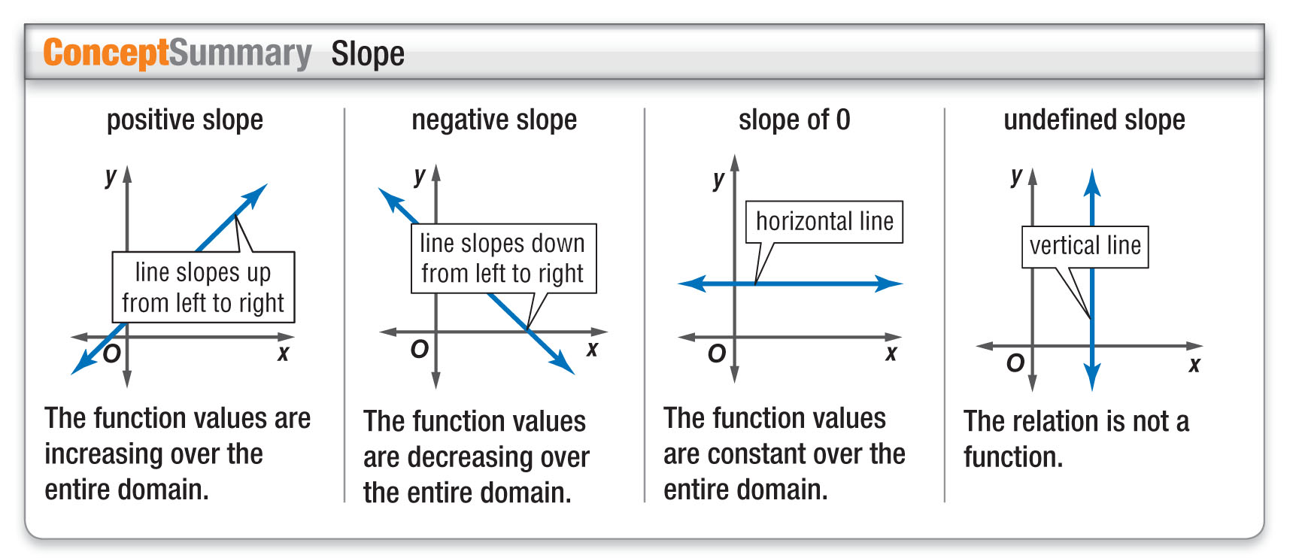
Concept

Slide 38
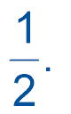
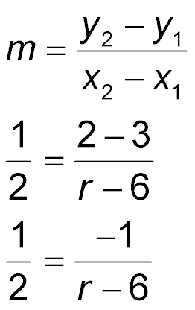
Example 6
Find Coordinates Given the Slope
Find the value of r so that the line through (6, 3)
and (r, 2) has a slope of
Slope formula
Substitute.
Subtract.

Slide 39
Example 6
Find Coordinates Given the Slope
2(–1) = 1(r – 6)
Find the cross products.
–2 = r – 6
Simplify.
–2 + 6 = r – 6 + 6
Add 6 to each side.
4 = r Simplify.
Answer: r = 4

Slide 40
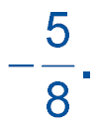

Example 6 CYP
Find the value of p so that the line through (p, 4) and (3, –1) has a slope of
A. 5
B.
C. –5
D. 11

Slide 41
End of the Lesson

