Slide 1


Splash Screen

Slide 2
Lesson Menu
Five-Minute Check (over Lesson 3–3)
CCSS
Then/Now
New Vocabulary
Example 1: Slope and Constant of Variation
Example 2: Graph a Direct Variation
Concept Summary: Direct Variation Graphs
Example 3: Write and Solve a Direct Variation Equation
Example 4: Real-World Example: Estimate Using Direct Variation

Slide 3


5-Minute Check 1
Find the slope of the line that passes through the points (3, 5) and (7, 12).
A.
B.
C.
D.

Slide 4


5-Minute Check 2
Find the slope of the line that passes through the points (–2, 4) and (5, 4).
A. 0
B.
C.
D. undefined

Slide 5

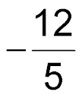
5-Minute Check 3
Find the slope of the line that passes through the points (–3, 6) and (2, –6).
A. 0
B. –1
C.
D. undefined

Slide 6


5-Minute Check 4
Find the slope of the line that passes through the points (7, –2) and (7, 13).
A. 0
B. 11
C.
D. undefined

Slide 7

5-Minute Check 5
In 2005, there were 12,458 fish in Hound’s Tooth Lake. After years of drought, there were only
968 fish in 2010. What is the rate of change in the population of fish for 2005–2010?
A. 3072 fish/year
B. –1976 fish/year
C. –2298 fish/year
D. –3072 fish/year

Slide 8

5-Minute Check 6
The fee for a banquet hall is $525 for a group of
25 people and $1475 for a group of 75 people. Included in the fee is a standard set-up charge. What is the fee per person?
A. $16
B. $18
C. $19
D. $20

Slide 9

CCSS
Content Standards
A.REI.10 Understand that the graph of an equation in two variables is the set of all its solutions plotted in the coordinate plane, often forming a curve (which could be a line).
F.IF.7a Graph linear and quadratic functions and show intercepts, maxima, and minima.
Mathematical Practices
1 Make sense of problems and persevere in solving them.
6 Attend to precision.
Common Core State Standards © Copyright 2010. National Governors Association Center for Best Practices and Council of Chief State School Officers. All rights reserved.

Slide 10


Then/Now
You found rates of change of linear functions.
Write and graph direct variation equations.
Solve problems involving direct variation.

Slide 11

Vocabulary
direct variation
constant of variation
constant of proportionality

Slide 12
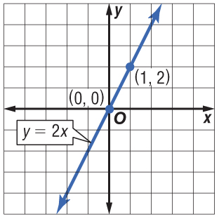
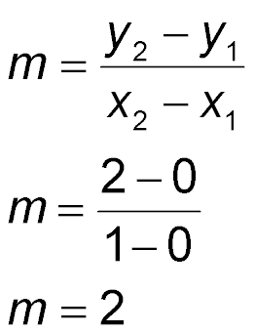
Example 1 A
Slope and Constant of Variation
A. Name the constant of variation for the equation. Then find the slope of the line that passes through the pair of points.
Slope formula
(x₁, y₁) = (0, 0)
(x₂, y₂) = (1, 2)
Answer: The constant of variation is 2. The slope is 2.
Simplify.

Slide 13
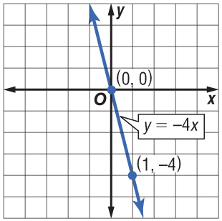
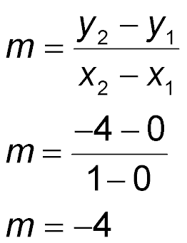
Example 1 B
Slope and Constant of Variation
B. Name the constant of variation for the equation. Then find the slope of the line that passes through the pair of points.
Slope formula
(x₁, y₁) = (0, 0)
(x₂, y₂) = (1, –4)
Answer: The constant of variation is –4. The slope is –4.
Simplify.

Slide 14


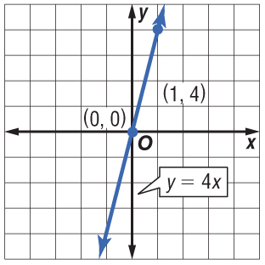
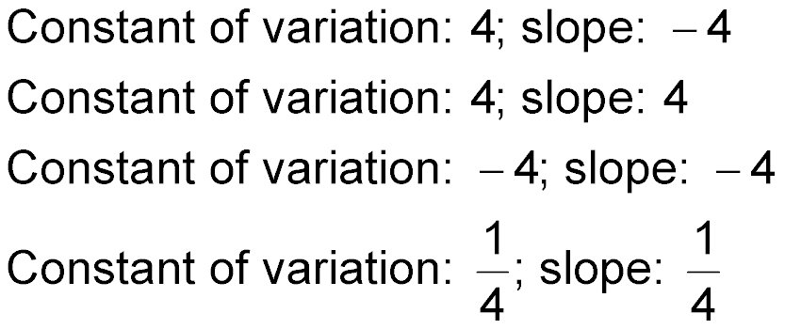
Example 1 CYP A
A. Name the constant of variation for the equation. Then find the slope of the line that passes through the pair of points.
A. constant of variation: 4; slope: –4
B. constant of variation: 4; slope: 4
C. constant of variation: –4; slope: –4
D. constant of variation: slope:

Slide 15
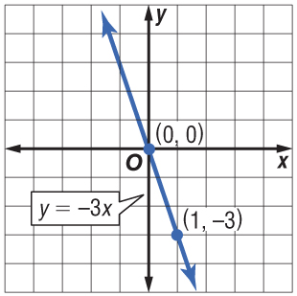
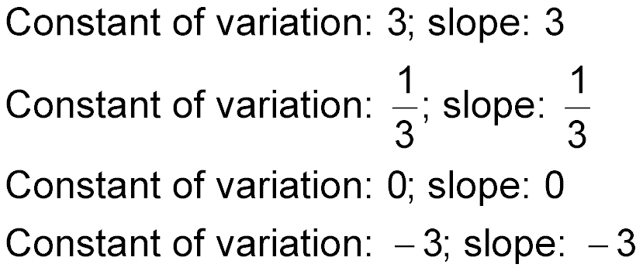
Example 1 CYP B
B. Name the constant of variation for the equation. Then find the slope of the line that passes through the pair of points.
A. constant of variation: 3; slope: 3
B. constant of variation: slope:
C. constant of variation: 0; slope: 0
D. constant of variation: –3; slope: –3

Slide 16
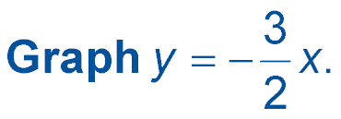
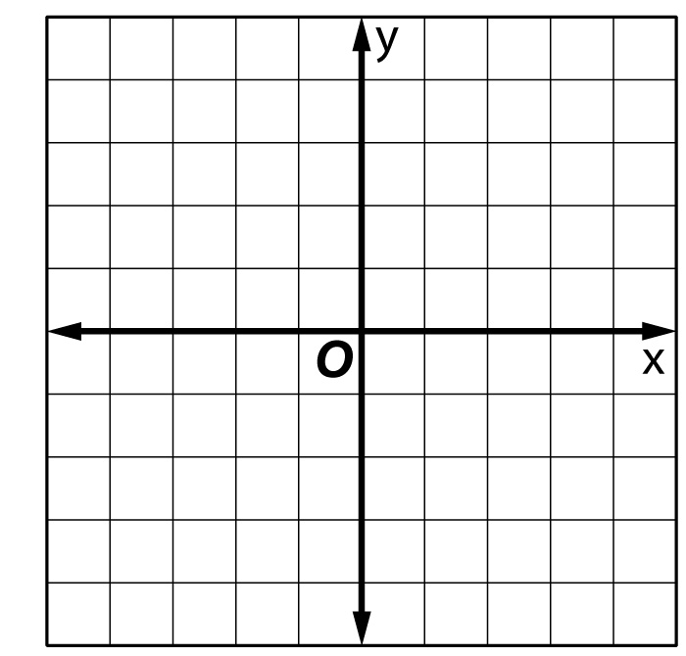

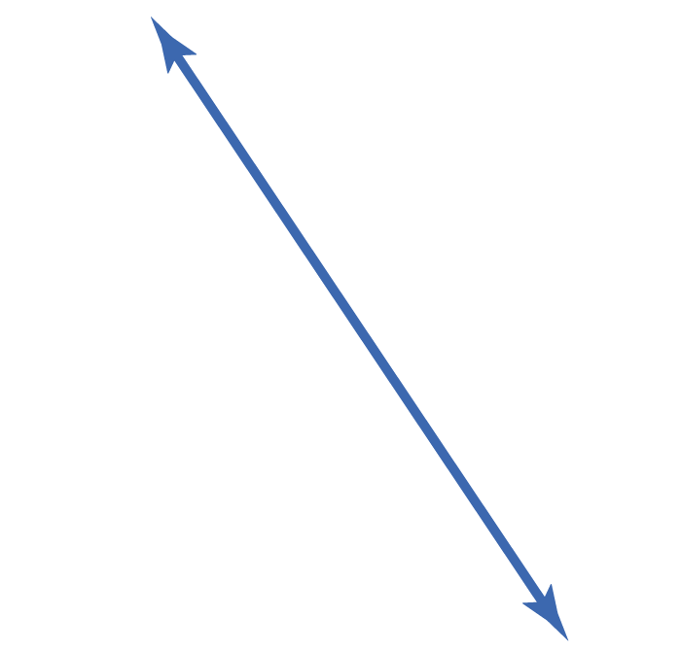
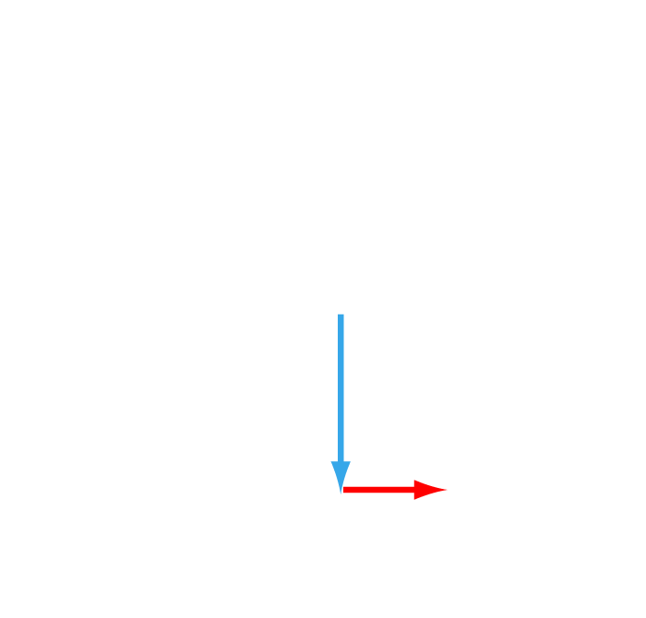
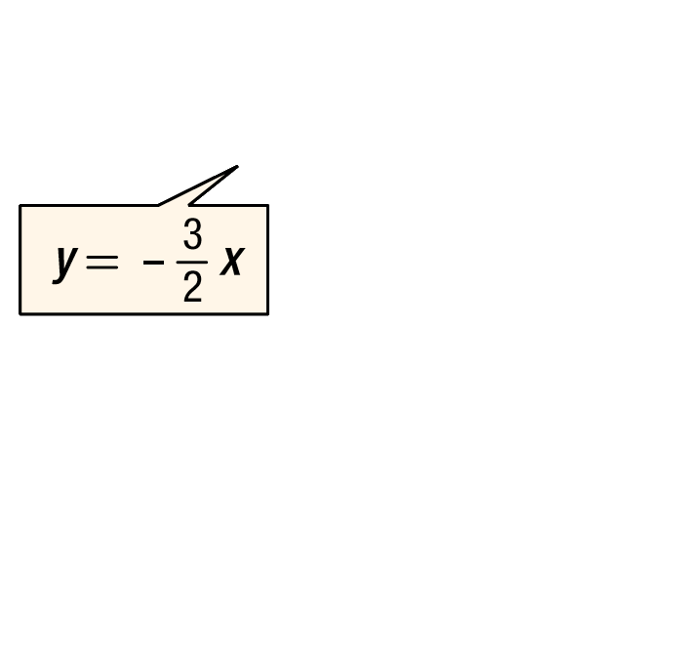
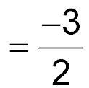
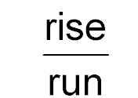
Example 2
Graph a Direct Variation
Answer:
Step 1 Find the slope.
m
Step 2 Graph (0, 0).
Step 3 From the point (0, 0), move down 3 units and right 2 units. Draw a dot.
Step 4 Draw a line connecting the points.

Slide 17
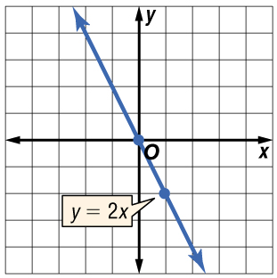
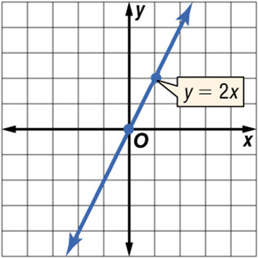
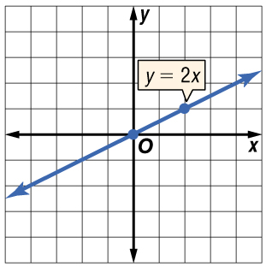
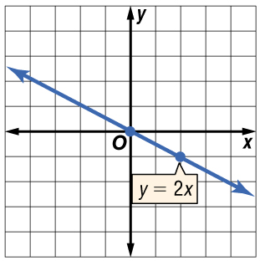
Example 2 CYP
Graph y = 2x.
A. B.
C. D.

Slide 18
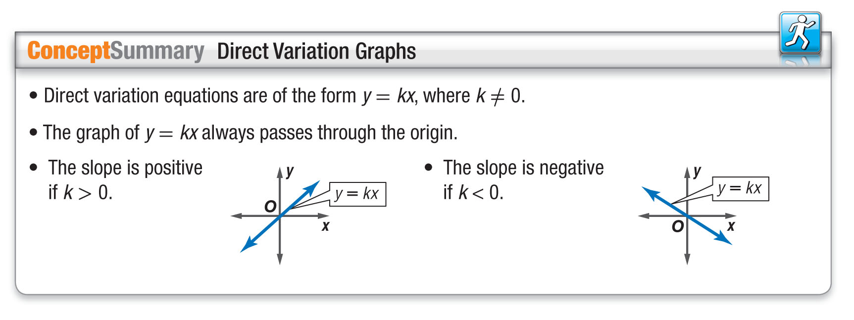
Concept

Slide 19
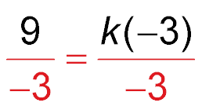
Example 3 A
Write and Solve a Direct Variation Equation
A. Suppose y varies directly as x, and y = 9 when
x = –3. Write a direct variation equation that relates x and y.
Find the value of k.
y = kx Direct variation formula
9 = k(–3) Replace y with 9 and x with –3.
Divide each side by –3.
–3 = k Simplify.

Slide 20
Example 3 A
Write and Solve a Direct Variation Equation
Answer: Therefore, the direct variation equation is
y = –3x.

Slide 21
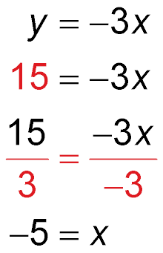
Example 3 B
Write and Solve a Direct Variation Equation
B. Use the direct variation equation to find x when y = 15.
Direct variation equation
Replace y with 15.
Divide each side by –3.
Simplify.
Answer: Therefore, x = –5 when y = 15.

Slide 22
Example 3 CYP A
A. Suppose y varies directly as x, and y = 15 when
x = 5. Write a direct variation equation that relates
x and y.
A. y = 3x
B. y = 15x
C. y = 5x
D. y = 45x

Slide 23
Example 3 CYP B
B. Suppose y varies directly as x, and y = 15 when
x = 5. Use the direct variation equation to find x when
y = –45.
A. –3
B. 9
C. –15
D. –5

Slide 24
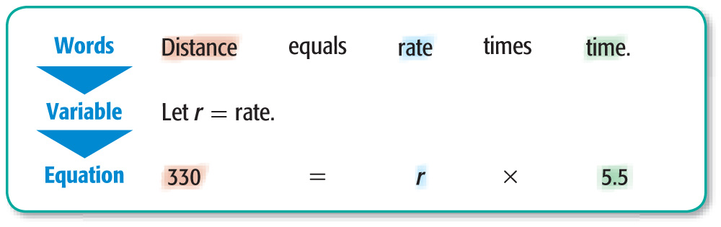
Example 4 A
Estimate Using Direct Variation
A. TRAVEL The Ramirez family is driving
cross-country on vacation. They drive 330 miles in 5.5 hours.
Write a direct variation equation to find the distance driven for any number of hours.

Slide 25
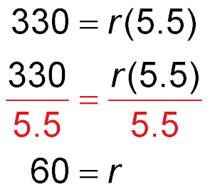
Example 4 A
Estimate Using Direct Variation
Solve for the rate.
Original equation
Divide each side by 5.5.
Simplify.
Answer: Therefore, the direct variation equation is
d = 60t.

Slide 26
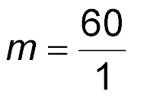
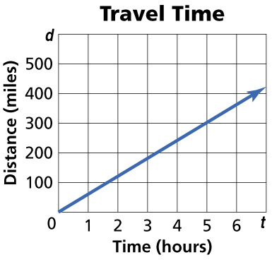
Example 4 B
Estimate Using Direct Variation
B. Graph the equation.
The graph of d = 60t passes through the origin with a slope of 60.
Answer:

Slide 27
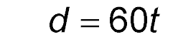
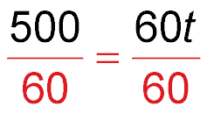
Example 4 C
Estimate Using Direct Variation
C. Estimate how many hours it would take to drive 500 miles.
Original equation
500 = 60t
Replace d with 500.
Divide each side by 60.
8.33 ≈ t
Simplify.
Answer: At this rate, it will take about 8.3 hours to drive 500 miles.

Slide 28
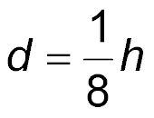
Example 4 CYP A
A. Dustin ran a 26-mile marathon in 3.25 hours. Write a direct variation equation to find the distance run for any number of hours.
A. d = h
B. d = 8h
C. d = 8
D.

Slide 29
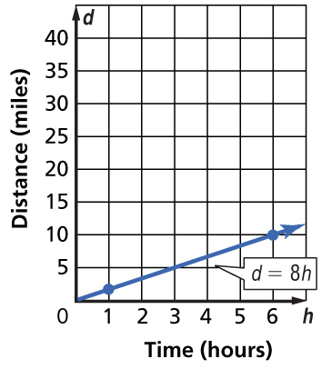
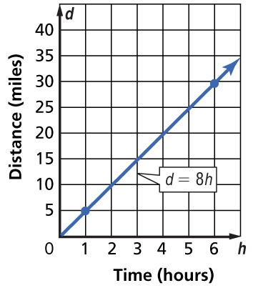
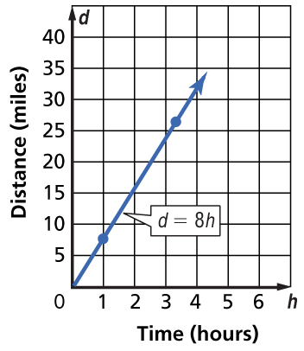
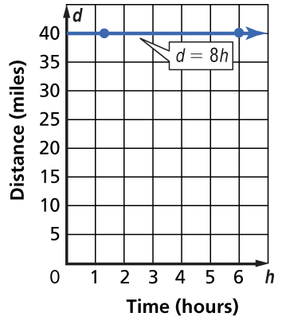
Example 4 CYP B
B. Dustin ran a 26-mile marathon in 3.25 hours. Graph the equation.
A. B.
C. D.

Slide 30
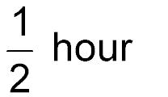
Example 4 CYP C
C. Estimate how many hours it would take to jog
16 miles.
A. 1 hour
B.
C. 16 hours
D. 2 hours

Slide 31
End of the Lesson

