Slide 1


Splash Screen

Slide 2
Lesson Menu
Five-Minute Check (over Lesson 3–4)
CCSS
Then/Now
New Vocabulary
Key Concept: Arithmetic Sequence
Example 1: Identify Arithmetic Sequences
Example 2: Find the Next Term
Key Concept: nth Term of an Arithmetic Sequence
Example 3: Find the nth Term
Example 4: Real-World Example: Arithmetic Sequences as Functions

Slide 3


5-Minute Check 1
What is the constant of variation for the equation of the line that passes through (2, –3) and (8, –12)?
A.
B.
C.
D.

Slide 4

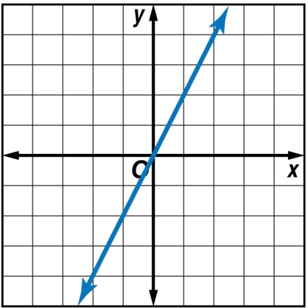
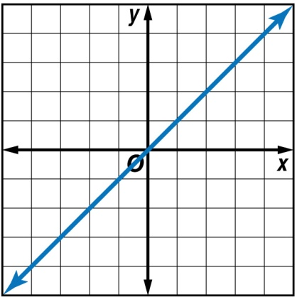
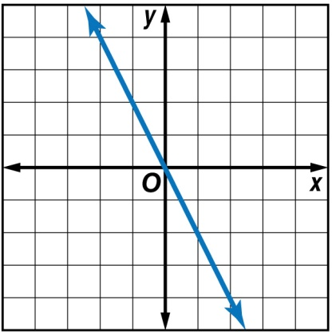
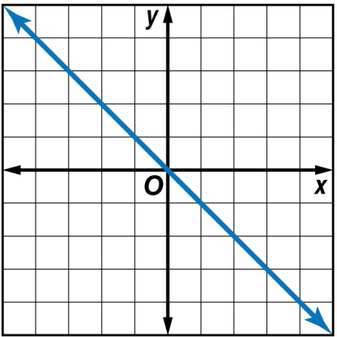
5-Minute Check 2
Which graph represents y = –2x?
A. B.
C. D.

Slide 5

5-Minute Check 3
Suppose y varies directly with x. If y = 32 when
x = 8, find x when y = 64.
A. 6
B. 8
C. 24
D. 16

Slide 6

5-Minute Check 4
Suppose y varies directly with x. If y = –24 when
x = –3, find y when x = –2.
A. 16
B. –16
C. 6
D. 12

Slide 7

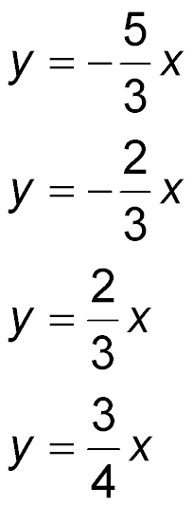
5-Minute Check 5
Which direct variation equation includes the point (–9, 15)?
A.
B.
C.
D.

Slide 8

CCSS
Content Standards
F.BF.2 Write arithmetic and geometric sequences both recursively and with an explicit formula, use them to model situations, and translate between the two forms.
F.LE.2 Construct linear and exponential functions, including arithmetic and geometric sequences, given a graph, a description of a relationship, or two input-output pairs (include reading these from a table).
Mathematical Practices
8 Look for and express regularity in repeated reasoning.
Common Core State Standards © Copyright 2010. National Governors Association Center for Best Practices and Council of Chief State School Officers. All rights reserved.

Slide 9


Then/Now
You identified linear functions.
Recognize arithmetic sequences.
Relate arithmetic sequences to linear functions.

Slide 10

Vocabulary
sequence
terms of the sequence
arithmetic sequence
common difference
recursive formula

Slide 11
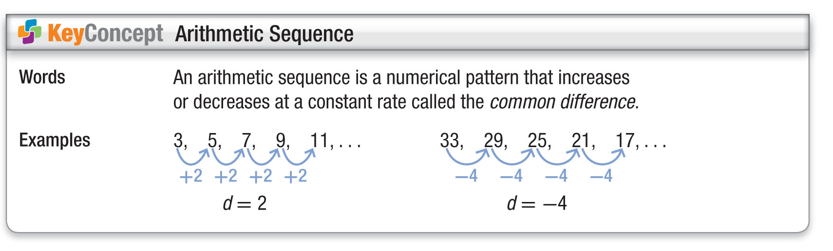
Concept

Slide 12
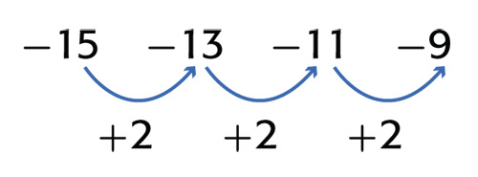
Example 1
Identify Arithmetic Sequences
A. Determine whether –15, –13, –11, –9, ... is an arithmetic sequence. Explain.
Answer: This is an arithmetic sequence because the difference between terms is constant.

Slide 13
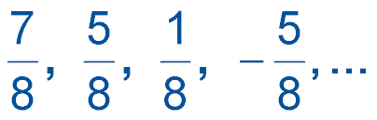
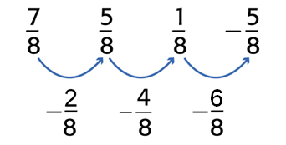
Example 1
Identify Arithmetic Sequences
B. Determine whether is an arithmetic sequence. Explain.
Answer: This is not an arithmetic sequence because the difference between terms is not constant.

Slide 14


Example 1 CYP A
A. Determine whether 2, 4, 8, 10, 12, … is an arithmetic sequence.
cannot be determined
This is not an arithmetic sequence because the difference between terms is not constant.
This is an arithmetic sequence because the difference between terms is constant.

Slide 15
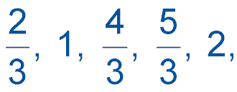
Example 1 CYP B
B. Determine whether … is an arithmetic sequence.
cannot be determined
This is not an arithmetic sequence because the difference between terms is not constant.
This is an arithmetic sequence because the difference between terms is constant.

Slide 16
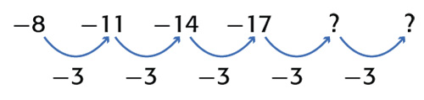
Example 2
Find the Next Term
Find the next three terms of the arithmetic sequence
–8, –11, –14, –17, ….
Find the common difference by subtracting successive terms.
The common difference is –3.

Slide 17
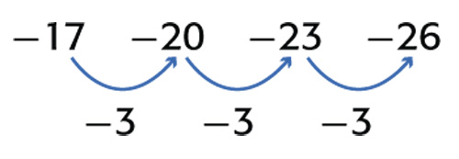
Example 2
Find the Next Term
Subtract 3 from the last term of the sequence to get the next term in the sequence. Continue subtracting 3 until the next three terms are found.
Answer: The next three terms are –20, –23, and –26.

Slide 18
Example 2 CYP
Find the next three terms of the arithmetic sequence 58, 63, 68, 73, ….
A. 78, 83, 88
B. 76, 79, 82
C. 73, 78, 83
D. 83, 88, 93

Slide 19
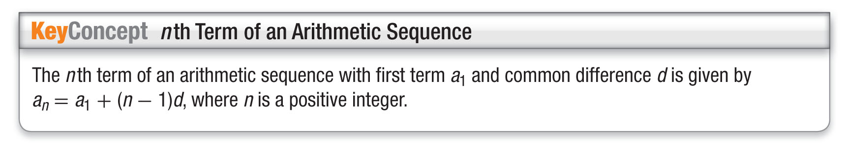
Concept

Slide 20
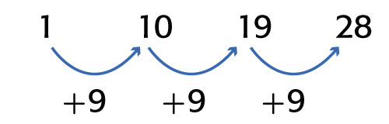
Example 3
Find the nth Term
A. Write an equation for the nth term of the arithmetic sequence 1, 10, 19, 28, … .
Step 1 Find the common difference.
In this sequence, the first term, a₁, is 1. Find the common difference.
The common difference is 9.

Slide 21
Example 3
Find the nth Term
Step 2 Write an equation.
a_{n} = a₁ + (n – 1)d Formula for the nth term
a_{n} = 1 + (n – 1)(9) a₁ = 1, d = 9
a_{n} = 1 + 9n – 9 Distributive Property
a_{n} = 9n – 8 Simplify.

Slide 22
Example 3
Find the nth Term
Check For n = 1, 9(1) – 8 = 1.
For n = 2, 9(2) – 8 = 10.
For n = 3, 9(3) – 8 = 19, and so on.
Answer: a_{n} = 9n – 8

Slide 23
Example 3
Find the nth Term
B. Find the 12th term in the sequence.
Replace n with 12 in the equation written in part A.
a_{n} = 9n – 8 Formula for the nth term
a₁₂ = 9(12) – 8 Replace n with 12.
a₁₂ = 100 Simplify.
Answer: a₁₂ = 100

Slide 24
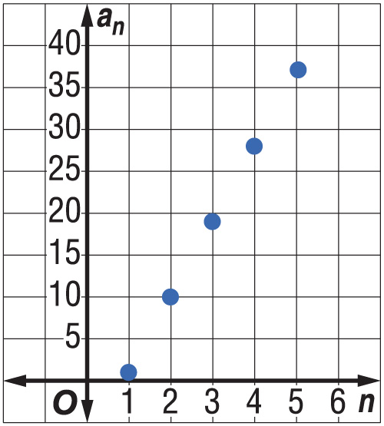
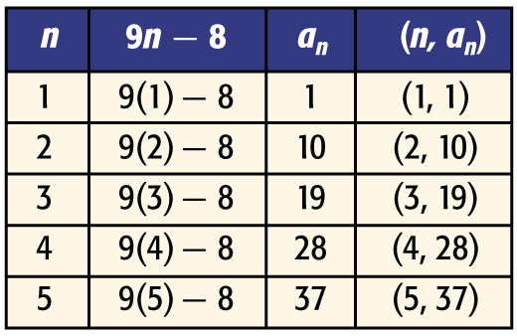
Example 3
Find the nth Term
C. Graph the first five terms of the sequence.
Answer:
The points fall on a line. The graph of an arithmetic sequence is linear.

Slide 25
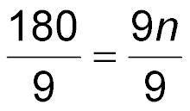
Example 3
Find the nth Term
D. Which term of the sequence is 172?
In the formula for the nth term, substitute 172 for a_{n}.
a_{n} = 9n – 8 Formula for the nth term
172 = 9n – 8 Replace a_{n} with 172.
172 + 8 = 9n – 8 + 8 Add 8 to each side.
180 = 9n Simplify.
Divide each side by 9.

Slide 26
Example 3
Find the nth Term
20 = n Simplify.
Answer: 20th term

Slide 27
Example 3 CYP A
MONEY The arithmetic sequence 2, 7, 12, 17, 22, … represents the total number of pencils Claire has in her collection after she goes to her school store each week.
A. Write an equation for the nth term of the sequence.
a_{n} = 2n + 7
a_{n} = 5n + 2
a_{n} = 2n + 5
a_{n} = 5n – 3

Slide 28
Example 3 CYP B
MONEY The arithmetic sequence 2, 7, 12, 17, 22, … represents the total number of pencils Claire has in her collection after she goes to her school store each week.
B. Find the 12th term in the sequence.
12
57
52
62

Slide 29
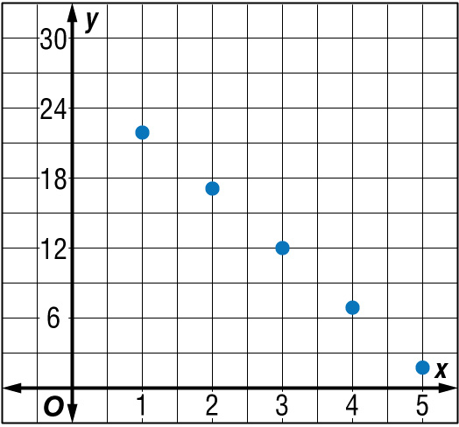
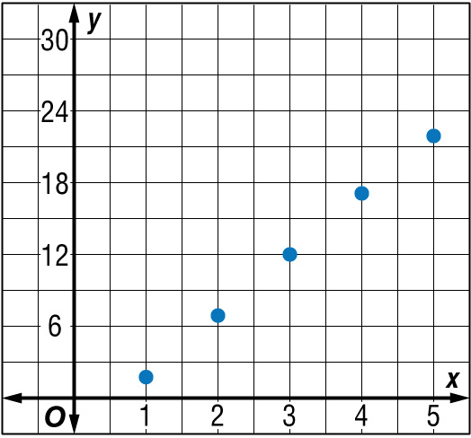
Example 3 CYP C
MONEY The arithmetic sequence 2, 7, 12, 17, 22, … represents the total number of pencils Claire has in her collection after she goes to her school store each week.
C. Which graph shows the first five terms of the sequence?
A. B.

Slide 30
Example 3 CYP C
MONEY The arithmetic sequence 2, 7, 12, 17, 22, … represents the total number of pencils Claire has in her collection after she goes to her school store each week.
D. Which term of the sequence is 97?
10th
15th
20th
24th

Slide 31

Example 4 A
Arithmetic Sequences as Functions
NEWSPAPERS The arithmetic sequence 12, 23, 34, 45, ... represents the total number of ounces that a bag weighs after each additional newspaper is added.
A. Write a function to represent this sequence.
12 23 34 45
+11
+11
+11
The common difference is 11.

Slide 32
Example 4 A
Arithmetic Sequences as Functions
a_{n} = a₁ + (n – 1)d Formula for the nth term
= 12 + (n – 1)11 a₁ = 12 and d = 11
= 12 + 11n – 11 Distributive Property
= 11n + 1 Simplify.
Answer: The function is a_{n} = 11n + 1.

Slide 33
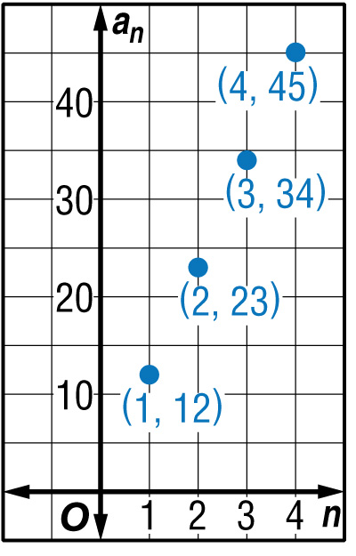
Example 4 b
Arithmetic Sequences as Functions
NEWSPAPERS The arithmetic sequence 12, 23, 34, 45, ... represents the total number of ounces that a bag weighs after each additional newspaper is added.
B. Graph the function a_{n} = 11n + 1
and determine the domain.
The rate of change of the function
is 11. Make a graph and plot the points.
Answer: The domain of the function is the number of newspapers added to the bag {0, 1, 2, 3, 4, …}.

Slide 34
Example 4
SHIPPING The arithmetic sequence 22, 40, 58, 76, … represents the total number of ounces that a box weighs after each additional bottle of salad dressing is added.
A. Write a function to represent this sequence.
a_{n} = 18n – 4
a_{n} = 18n + 4
a_{n} = 4n + 18
a_{n} = 14n + 4

Slide 35
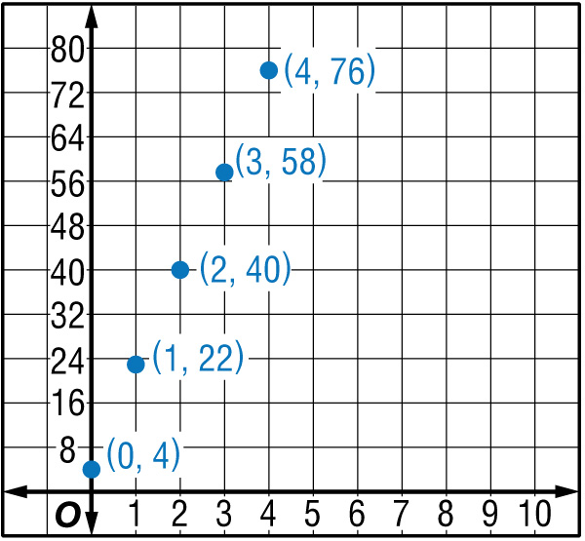
Example 4 CYP B
SHIPPING The arithmetic sequence 22, 40, 58, 76, … represents the total number of ounces that a box weight after each additional bottle of salad dressing is added.
B. Graph the function a_{n} = 18n + 4 and determine the domain of the sequence.
D = {0, 1, 2, 3, 4 , …}
D = {0, 1, 3, 6, 8, …}
D = {22, 40, 58, 76, …}
D = {4, 22, 40, 58, 76, …}

Slide 36
End of the Lesson

