Slide 1


Splash Screen

Slide 2
Lesson Menu
Five-Minute Check (over Lesson 3–5)
CCSS
Then/Now
Key Concept: Proportional Relationship
Example 1: Real-World Example: Proportional Relationships
Example 2: Nonproportional Relationships

Slide 3

5-Minute Check 1
Determine whether the sequence –21, –17, –12,
–6, 1, … is an arithmetic sequence. If it is, state the common difference.
A. Yes, the common difference is 4.
B. Yes, the common difference is n + 1.
C. Yes, the common difference is –4.
D. No, there is no common difference.

Slide 4

5-Minute Check 2
Determine whether the sequence 1.1, 2.2, 3.3,
4.4, … is an arithmetic sequence. If it is, state the common difference.
A. Yes, the common difference is 1.
B. Yes, the common difference is 1.1.
C. No, there is no common difference.
D. Yes, the common difference is 0.1.

Slide 5

5-Minute Check 3
Find the next three terms of the arithmetic sequence 3.5, 2, 0.5, –1.0, ... .
A. –1.5, –2, –2.5
B. –2.5, –4.0, –5.5
C. –2, –3.5, –4
D. –1.5, –3, –4.5

Slide 6

5-Minute Check 4
Find the nth term of the sequence described by
a₁ = –2, d = 4, n = 7.
A. 8
B. 12
C. 22
D. 25

Slide 7

5-Minute Check 5
Which equation represents the nth term of the sequence 19, 17, 15, 13, … ?
A. a_{n} = –2n + 21
B. a_{n} = 2(n – 10) – 2
C. a_{n} = 19 – (n + 1)
D. a_{n} = 10n –2

Slide 8

5-Minute Check 5
What are the fourth, seventh, and tenth terms of the sequence A(n) = 7 + (n – 1)(–3)?
A. 16, 25, 34
B. –2, –11, –20
C. 15, 24, 33
D. –1, –10, –19

Slide 9

CCSS
Content Standards
F.LE.1b Recognize situations in which one quantity changes at a constant rate per unit interval relative to another.
F.LE.2 Construct linear and exponential functions, including arithmetic and geometric sequences, given a graph, a description of a relationship, or two input-output pairs (include reading these from a table).
Mathematical Practices
1 Make sense of problems and persevere in solving them.
7 Look for and make use of structure.
Common Core State Standards © Copyright 2010. National Governors Association Center for Best Practices and Council of Chief State School Officers. All rights reserved.

Slide 10


Then/Now
You recognized arithmetic sequences and related them to linear functions.
Write an equation for a proportional relationship.
Write a relationship for a nonproportional relationship.

Slide 11
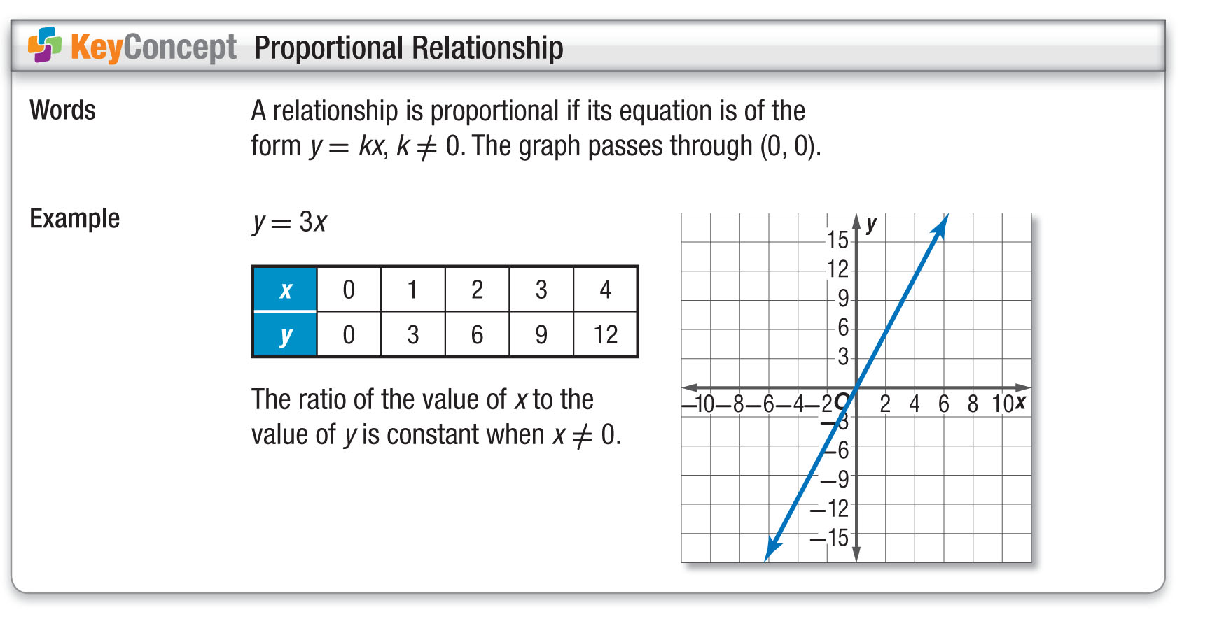
Concept

Slide 12
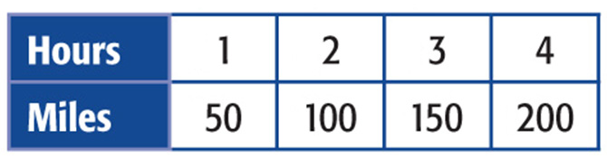
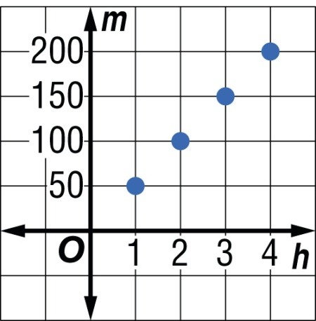
Example 1 A
Proportional Relationships
A. ENERGY The table shows the number of miles driven for each hour of driving.
Graph the data. What can you deduce from the pattern about the relationship between the number of hours of driving h and the numbers of miles
driven m?
Answer: There is a linear relationship between hours of driving and the number of miles driven.

Slide 13
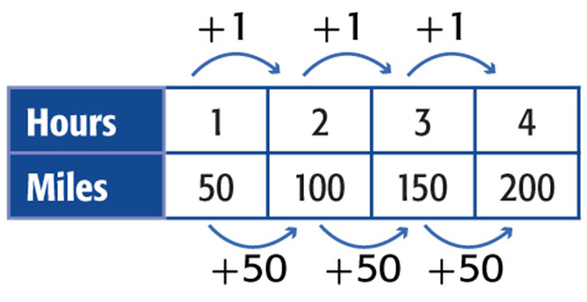
Example 1 B
Proportional Relationships
B. Write an equation to describe this relationship.
Look at the relationship between the domain and the range to find a pattern that can be described as
an equation.

Slide 14
Example 1 B
Proportional Relationships
Since this is a linear relationship, the ratio of the range values to the domain values is constant. The difference of the values for h is 1, and the difference of the values for m is 50. This suggests that m = 50h. Check to see if this equation is correct by substituting values of h into the equation.

Slide 15

Example 1 B
Proportional Relationships
Check If h = 1, then m = 50(1) or 50.
If h = 2, then m = 50(2) or 100.
If h = 3, then m = 50(3) or 150.
If h = 4, then m = 50(4) or 200.
The equation is correct.
Answer: m = 50h

Slide 16
Example 1 B
Proportional Relationships
C. Use this equation to predict the number of miles driven in 8 hours of driving.
m = 50h Original equation
m = 50(8) Replace h with 8.
m = 400 Simplify.
Answer: 400 miles

Slide 17


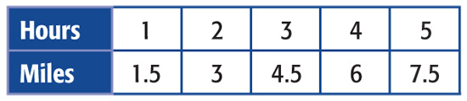
Example 1 CYP A
A. Graph the data in the table. What conclusion can you make about the relationship between the number of miles walked and the time spent walking?
There is a linear relationship between the number of miles walked and time spent walking.
There is a nonlinear relationship between the number of miles walked and time spent walking.
There is not enough information in the table to determine a relationship.
There is an inverse relationship between miles walked and time spent walking.

Slide 18
Example 1 CYP B
B. Write an equation to describe the relationship between hours and miles walked.
A. m = 3h
B. m = 2h
C. m = 1.5h
D. m = 1h

Slide 19
Example 1 CYP C
C. Use the equation from part B to predict the number of miles driven in 8 hours.
A. 12 miles
B. 12.5 miles
C. 14 miles
D. 16 miles

Slide 20
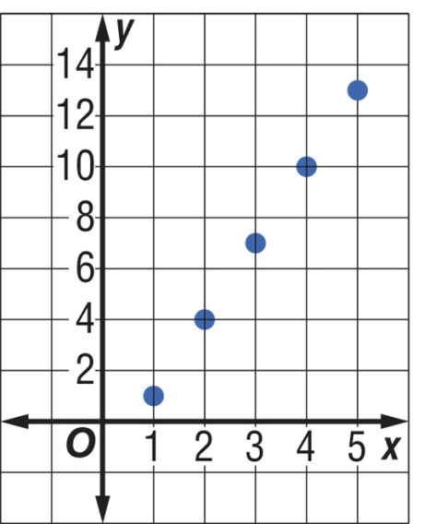
Example 2
Nonproportional Relationships
Write an equation in function notation for the graph.
Understand You are asked to write an equation of the relation that is graphed in function notation.
Plan Find the difference between the
x-values and the difference between the y-values.

Slide 21
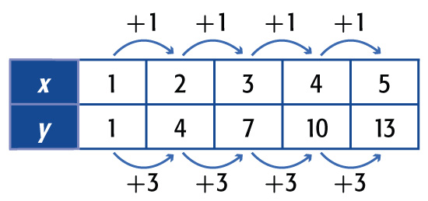
Example 2
Nonproportional Relationships
Solve Select points from the graph and place them in a table
The difference in the x-values is 1, and the difference in the y-values is 3. The difference in y-values is three times the difference of the x-values. This suggests that y = 3x. Check this equation.

Slide 22
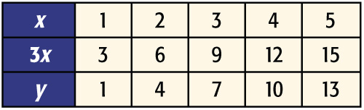
Example 2
Nonproportional Relationships
If x = 1, then y = 3(1) or 3. But the y-value for
x = 1 is 1. This is a difference of –2. Try some other values in the domain to see if the same difference occurs.
y is always 2 less than 3x.

Slide 23
Example 2
Nonproportional Relationships
This pattern suggests that 2 should be subtracted from one side of the equation in order to correctly describe the relation. Check y = 3x – 2.
If x = 2, then y = 3(2) – 2 or 4.
If x = 3, then y = 3(3) – 2 or 7.
Answer: y = 3x – 2 correctly describes this relation. Since the relation is also a function, we can write the equation in function notation as f(x) = 3x – 2.
Check Compare the ordered pairs from the table to the graph. The points correspond.
✓

Slide 24
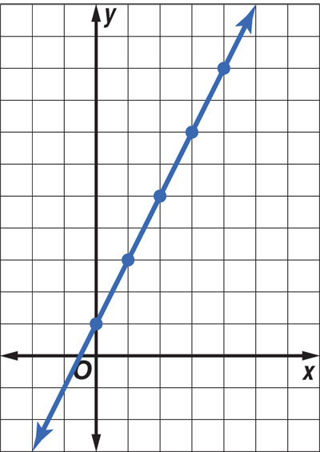
Example 2 CYP
Write an equation in function notation for the relation that is graphed.
A. f(x) = x + 2
B. f(x) = 2x
C. f(x) = 2x + 2
D. f(x) = 2x + 1

Slide 25
End of the Lesson

