Slide 1


Splash Screen

Slide 2
Lesson Menu
Five-Minute Check (over Chapter 3)
CCSS
Then/Now
New Vocabulary
Key Concept: Slope-Intercept Form
Example 1: Write and Graph an Equation
Example 2: Graph Linear Equations
Example 3: Graph Linear Equations
Example 4: Standardized Test Example
Example 5: Real-World Example: Write and Graph a Linear Solution

Slide 3


5-Minute Check 1
What is the slope of the line that passes through
(–4, 8) and (5, 2)?
A.
B.
C.
D.

Slide 4

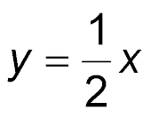
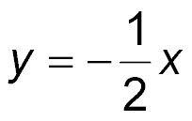
5-Minute Check 2
Suppose y varies directly as x and y = –5 when
x = 10. Which is a direct variation equation that relates x and y?
A. y = 2x
B.
C. y = –2x
D.

Slide 5

5-Minute Check 3
Find the next two terms in the arithmetic sequence –7, –4, –1, 2, ….
A. 4, 7
B. 1, 4
C. 5, 8
D. 3, 6

Slide 6
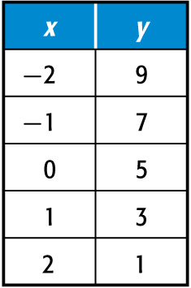

5-Minute Check 4
Is the function represented by the table linear? Explain.
A. Yes, both the x-values and the y-values change at a constant rate.
B. Yes, the x-values increase by 1 and the y-values decrease by 1.
C. No, the x-values and the
y-values do not change at a constant rate.
D. No, only the x-values increase at a constant rate.

Slide 7

5-Minute Check 5
Out of 400 citizens randomly surveyed, 258 stated they supported building a dog park. If the survey was unbiased, how many of the city’s 5800 citizens can be expected not to support the dog park?
A. 2059
B. 4000
C. 3741
D. 2580

Slide 8

CCSS
Content Standards
F.IF.7a Graph linear and quadratic functions and show intercepts, maxima, and minima.
S.ID.7 Interpret the slope (rate of change) and the intercept (constant term) of a linear model in the context of the data.
Mathematical Practices
2 Reason abstractly and quantitatively.
8 Look for and express regularity in repeated reasoning.
Common Core State Standards © Copyright 2010. National Governors Association Center for Best Practices and Council of Chief State School Officers. All rights reserved.

Slide 9


Then/Now
You found rates of change and slopes.
Write and graph linear equations in
slope-intercept from.
Model real-world data with equations in slope-intercept form.

Slide 10

Vocabulary
slope-intercept form

Slide 11
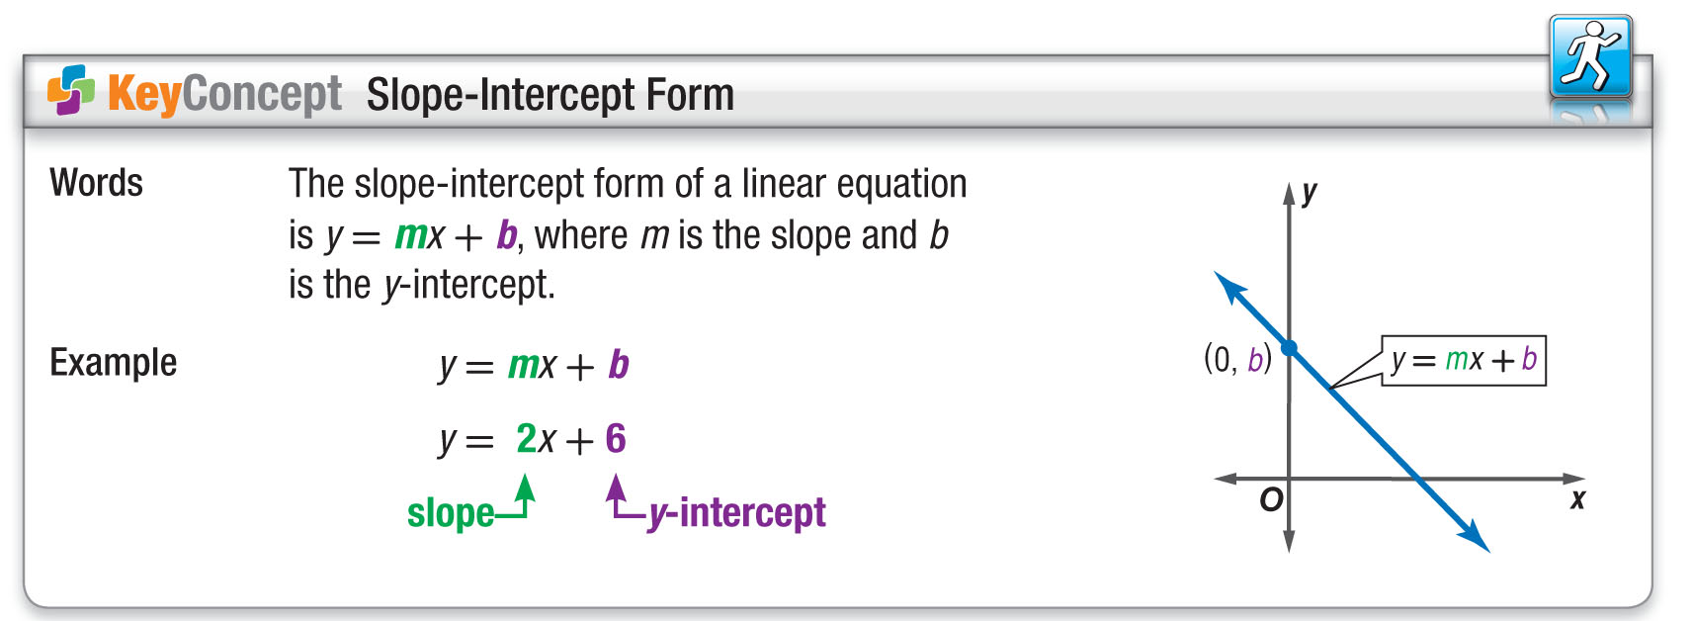
Concept

Slide 12
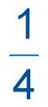
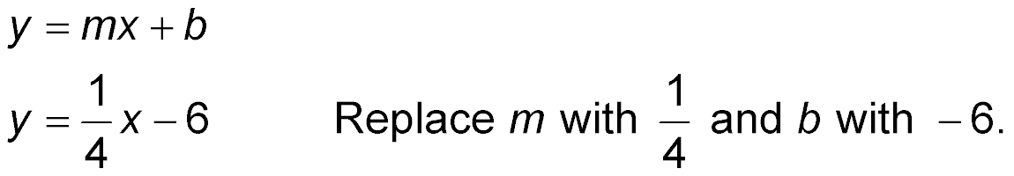
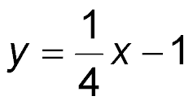
Example 1
Write and Graph an Equation
Write an equation in slope-intercept form of the line with a slope of and a y-intercept of –1. Then graph the equation.
Slope-intercept form

Slide 13
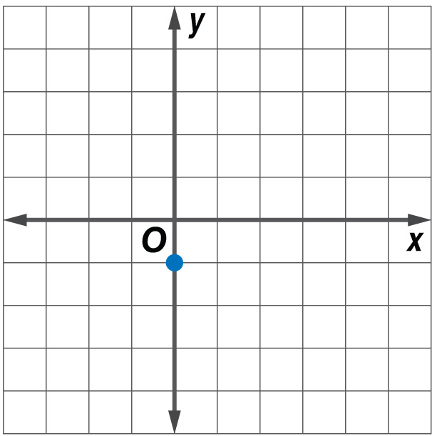
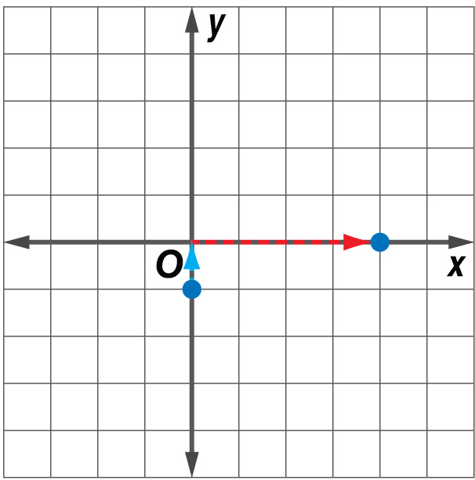
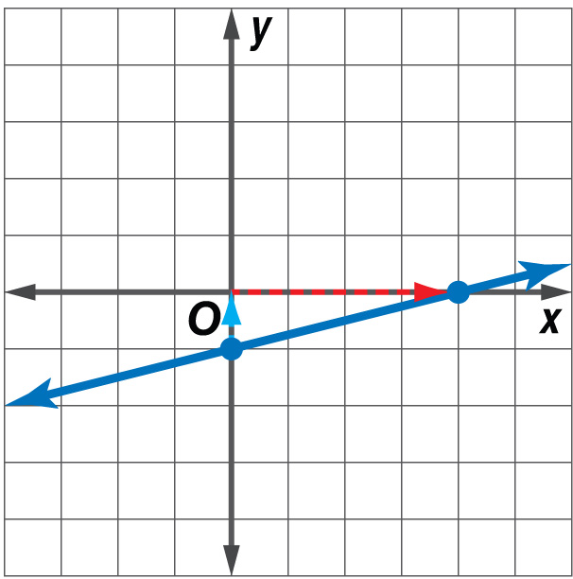
Example 1
Write and Graph an Equation
Now graph the equation .
Step 1 Plot the y-intercept (0, –1).
Step 2 The slope is .
From (0, –1), move up
1 unit and right 4 units.
Plot the point.
Answer:
Step 3 Draw a line through
the points.

Slide 14


Example 1
Write an equation in slope-intercept form of the line whose slope is 4 and whose y-intercept is 3.
A. y = 3x + 4
B. y = 4x + 3
C. y = 4x
D. y = 4

Slide 15
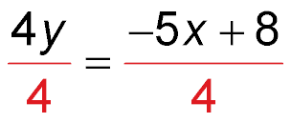
Example 2
Graph Linear Equations
Graph 5x + 4y = 8.
Solve for y to write the equation in slope-intercept form.
5x + 4y = 8
Original equation
5x + 4y – 5x = 8 – 5x
Subtract 5x from each side.
4y = 8 – 5x
Simplify.
4y = –5x + 8
8 – 5x = 8 + (–5x) or –5x + 8
Divide each side by 4.

Slide 16
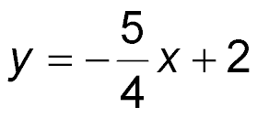
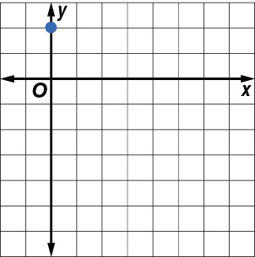
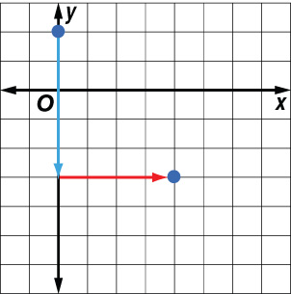
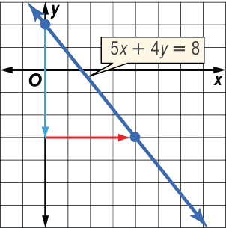

Example 2
Graph Linear Equations
Slope-intercept form
Answer:
Now graph the equation.
Step 1 Plot the y-intercept (0, 2).
Step 2 The slope is
From (0, 2), move down
5 units and right 4 units. Draw a dot.
Step 3 Draw a line connecting the
points.

Slide 17
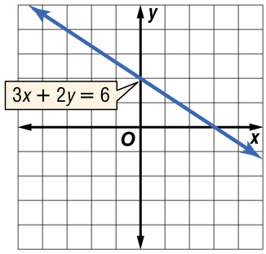
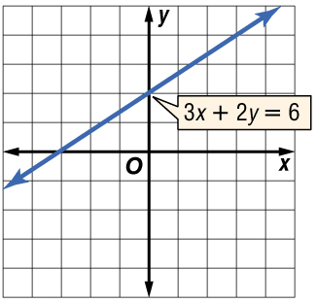
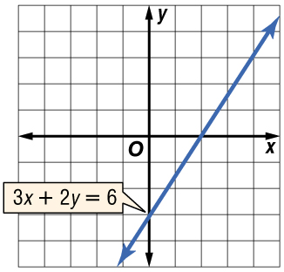
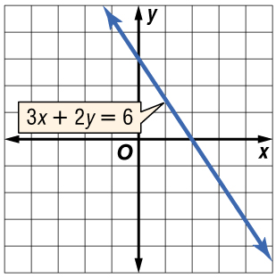
Example 2
Graph 3x + 2y = 6.
A. B.
C. D.

Slide 18
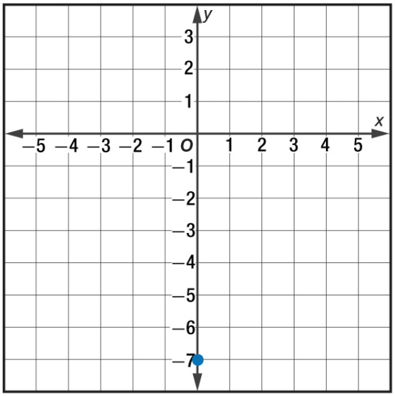
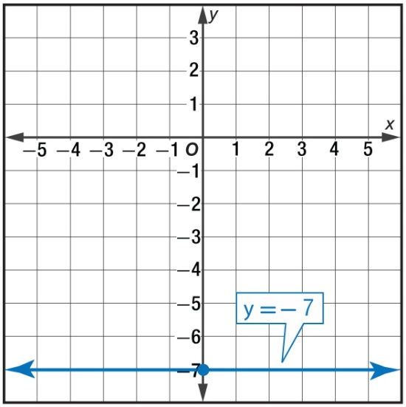
Example 3
Graph Linear Equations
Graph y = –7.
Step 1 Plot the y-intercept (0, −7).
Step 2 The slope is 0. Draw a line through the points with the y-coordinate −7.
Answer:

Slide 19
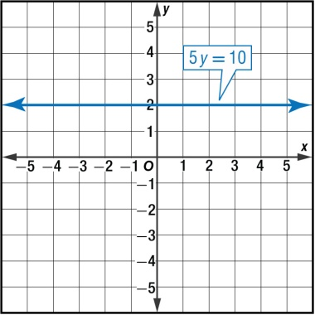
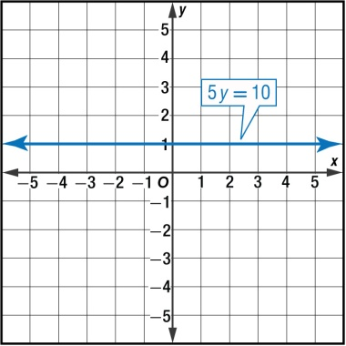
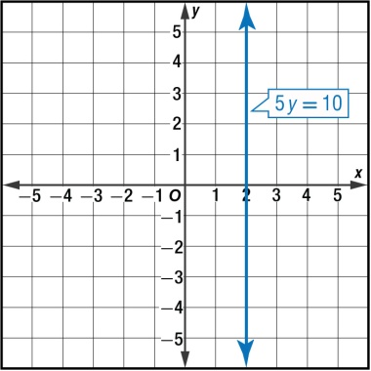
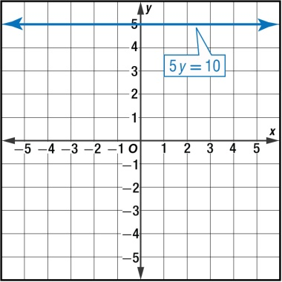
Example 3
Graph 5y = 10.
A. B.
C. D.

Slide 20
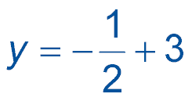
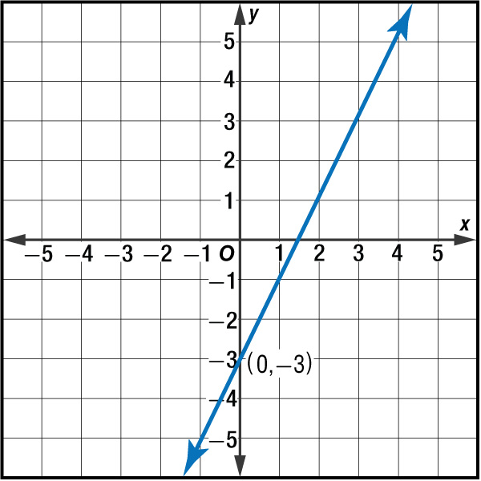
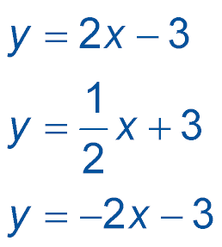
Example 4
Which of the following is an equation in
slope-intercept form for the line shown in the graph?
A.
B.
C.
D.

Slide 21
Example 4
Read the Test Item
You need to find the slope and y-intercept of the line to write the equation.
Solve the Test Item
Step 1 The line crosses
the y-axis at
(0, –3), so the
y-intercept is –3.
The answer is either B or D.

Slide 22
Example 4
Step 2 To get from (0, –3)
to (1, –1), go up
2 units and 1 unit to
the right. The slope
is 2.
Step 3 Write the equation.
y = mx + b
y = 2x – 3
Answer: The answer is B.

Slide 23
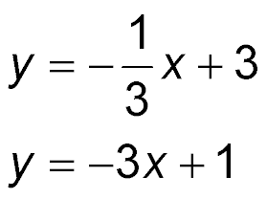
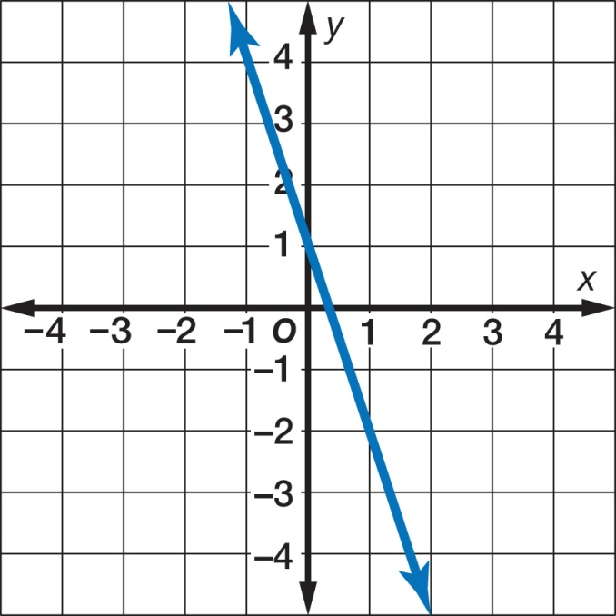
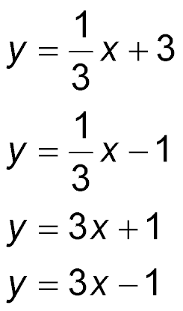
Example 4
Which of the following is an equation in slope-intercept form for the line shown in the graph?
A.
B.
C.
D.

Slide 24
Example 5
Write and Graph a Linear Equation
HEALTH The ideal maximum heart rate for a
25-year-old exercising to burn fat is 117 beats per minute. For every 5 years older than 25, that ideal rate drops 3 beats per minute.
A. Write a linear equation to find the ideal maximum heart rate for anyone over 25 who is exercising to burn fat.

Slide 25
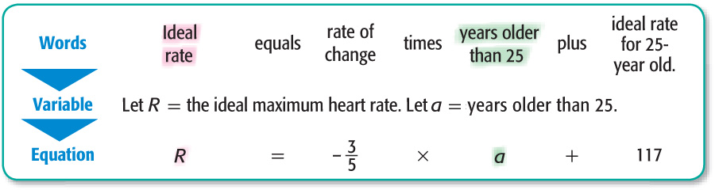
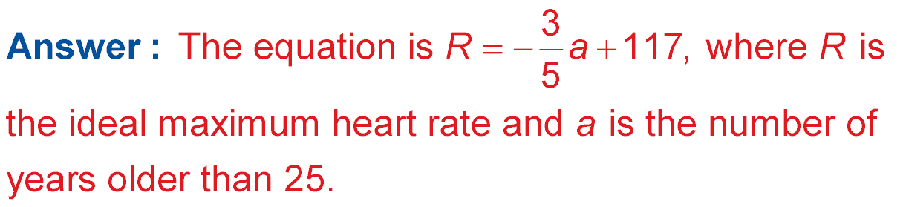
Example 5
Write and Graph a Linear Equation

Slide 26
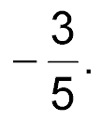
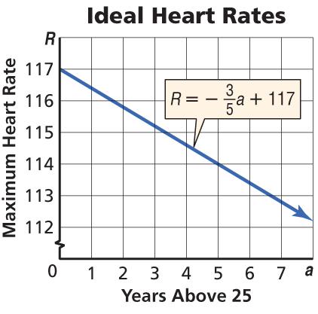
Example 5
Write and Graph a Linear Equation
B. Graph the equation.
The graph passes through (0, 117) with a slope of
Answer:

Slide 27
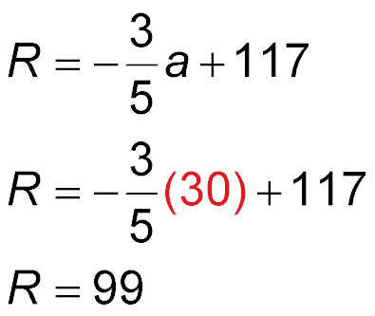
Example 5
Write and Graph a Linear Equation
C. Find the ideal maximum heart rate for a
55-year-old person exercising to burn fat.
The age 55 is 30 years older than 25. So, a = 30.
Ideal heart rate equation
Replace a with 30.
Simplify.
Answer: The ideal maximum heart rate for a 55-year-old person is 99 beats per minute.

Slide 28
Example 5
A. The amount of money spent on Christmas gifts has increased by an average of $150,000
($0.15 million) per year since 1986. Consumers spent $3 million in 1986. Write a linear equation to find the average amount D spent for any year n since 1986.
A. D = 0.15n
B. D = 0.15n + 3
C. D = 3n
D. D = 3n + 0.15

Slide 29
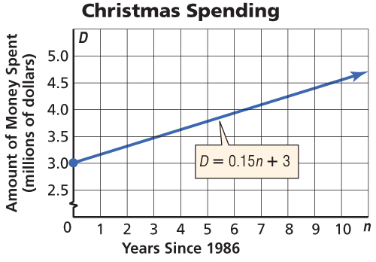
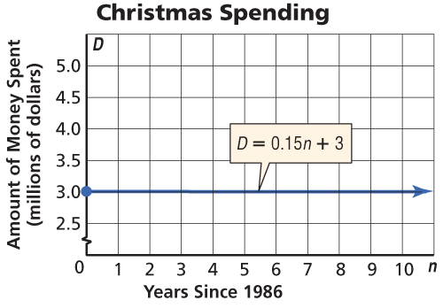
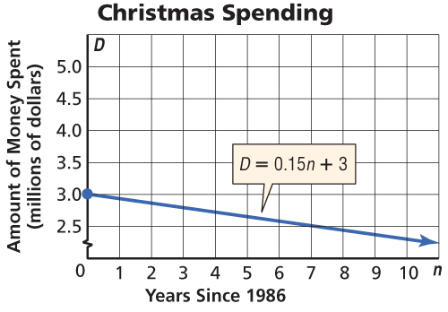
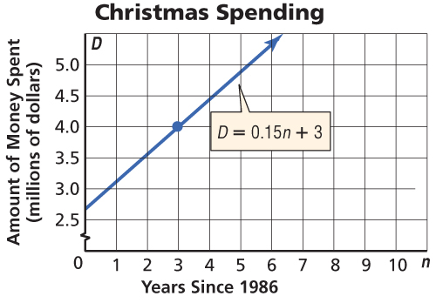
Example 5
B. The amount of money spent on Christmas gifts has increased by an average of $150,000 ($0.15 million) per year since 1986. Consumers spent $3 million in 1986. Graph the equation.
A. B.
C. D.

Slide 30
Example 5
C. The amount of money spent on Christmas gifts has increased by an average of $150,000
($0.15 million) per year since 1986. Consumers spent $3 million in 1986. Find the amount spent by consumers in 1999.
A. $5 million
B. $3 million
C. $4.95 million
D. $3.5 million

Slide 31
End of the Lesson

